Slide 1
CSCI218: Foundations of Artificial Intelligence
Dry Bean Classification Using
Machine Learning Algorithms
Group Project | SIM Session 1, 2026
University of Wollongong
School of Computing and Information Technology

Slide 2
Group Members & Contributions
Full Name | Student Number | Contribution % | Key Tasks
Member 1 Name | Student ID 1 | ~17% | Literature Review, Data Preprocessing
Member 2 Name | Student ID 2 | ~17% | KNN & Decision Tree Implementation
Member 3 Name | Student ID 3 | ~17% | Random Forest & SVM Implementation
Member 4 Name | Student ID 4 | ~17% | Logistic Regression & Naive Bayes
Member 5 Name | Student ID 5 | ~16% | Results Analysis & Visualization
Member 6 Name | Student ID 6 | ~16% | Slide Design & Presentation Prep
Group No: [Enter Group Number]

Slide 3
1. Introduction
Project Background, Aims & Significance

Slide 4
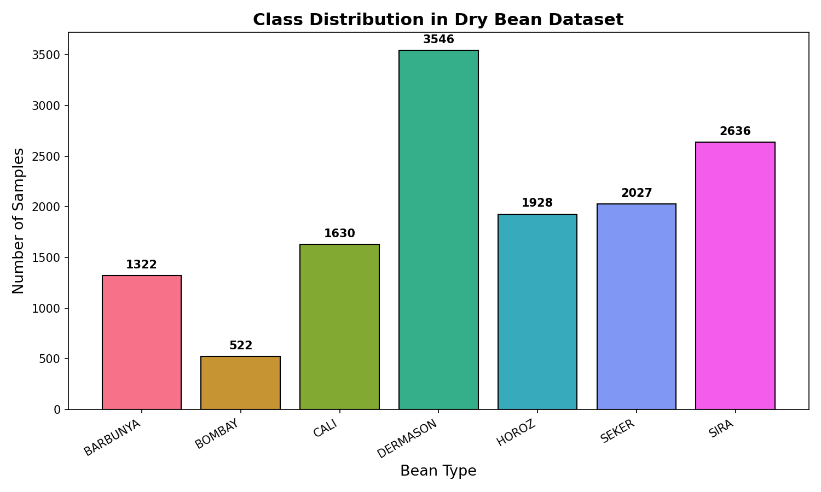
Introduction: Project Overview
Background:
- Classification is a core supervised learning task in AI/ML
- Agriculture increasingly relies on AI for quality control
- Automated seed classification reduces manual inspection costs
The Dry Bean Dataset (UCI ML Repository):
- 13,611 samples of 7 dry bean varieties
- 16 features extracted from grain images
- Features include shape (area, perimeter, compactness)
and size descriptors (major/minor axis, eccentricity)
Project Aims:
- Compare 6 ML algorithms for multi-class bean classification
- Evaluate models using accuracy, precision, recall, F1-score
- Identify the best approach for this classification task

Slide 5
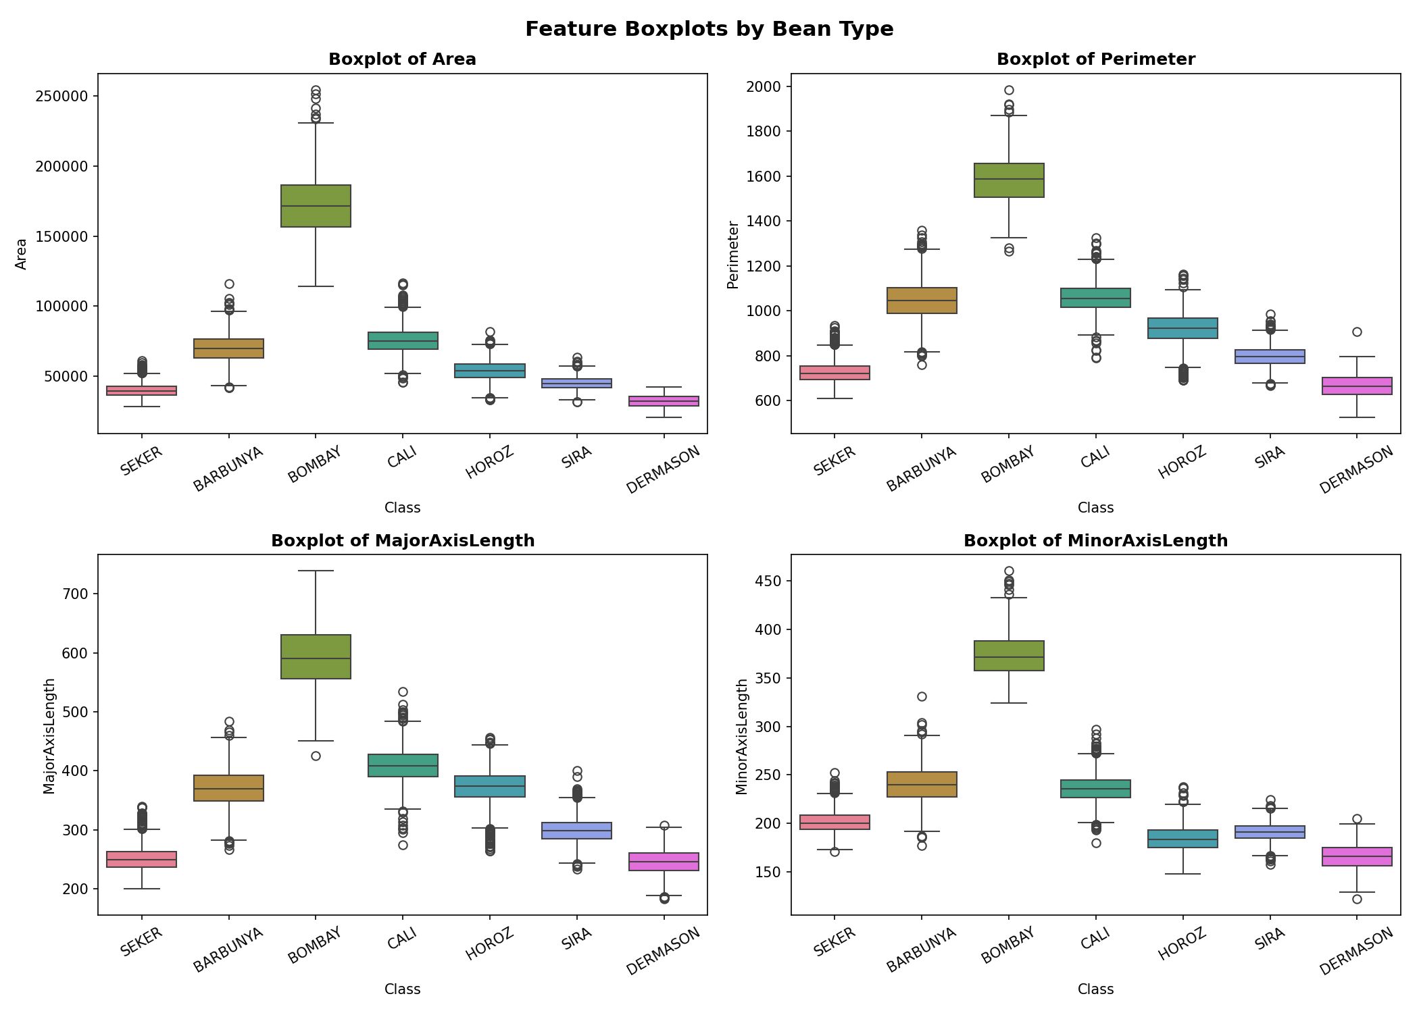
Introduction: The Dry Bean Dataset
Source: UCI Machine Learning Repository (ID: 602)
7 Bean Types (Classes):
SEKER, BARBUNYA, BOMBAY, CALI, HOROZ, SIRA, DERMASON
16 Features (all numeric):
Geometric: Area, Perimeter, MajorAxisLength, MinorAxisLength
Shape: AspectRatio, Eccentricity, ConvexArea, EquivDiameter
Form: Extent, Solidity, roundness, Compactness
Fourier: ShapeFactor1, ShapeFactor2, ShapeFactor3, ShapeFactor4
Total Samples: 13,611
Reference: Koklu, M. and Ozkan, I.A., 2020.
Multiclass classification of dry beans using computer
vision and machine learning techniques.
Computers and Electronics in Agriculture, 174, 105507.

Slide 6
2. Literature Review
Prior Work on Bean Classification & ML Methods

Slide 7
Literature Review: Related Work
Koklu & Ozkan (2020) - Original dataset paper:
- Used MLP, SVM, DT, KNN, and other classifiers on this dataset
- Achieved ~92% accuracy with MLP (multi-layer perceptron)
- Demonstrated computer vision features are effective for bean classification
Singh et al. (2020) - Seed classification survey:
- Reviewed ML-based approaches for seed/grain classification
- SVM and Random Forest consistently performed well for shape-based features
- Feature engineering is critical: shape descriptors outperform raw pixel data
Jain & Kaur (2022) - Comparative study of ML classifiers:
- Compared KNN, SVM, RF, NB on agricultural datasets
- Ensemble methods (RF) generally outperform single classifiers
- SVM with RBF kernel handles non-linear class boundaries well
Key Takeaways from Literature:
- Ensemble methods and SVM tend to achieve top performance
- Proper preprocessing (scaling, handling class imbalance) is crucial
- Cross-validation provides more reliable evaluation than single splits

Slide 8
Literature Review: Algorithm Overview
K-Nearest Neighbours (KNN):
- Instance-based learning; classifies by majority vote
- Simple, non-parametric; sensitive to feature scaling
Decision Tree:
- Recursive partitioning based on feature thresholds
- Interpretable; prone to overfitting without pruning
Random Forest:
- Ensemble of decision trees with bagging
- Reduces variance; robust to noise and overfitting
Support Vector Machine (SVM):
- Finds optimal hyperplane; RBF kernel for non-linear data
- Effective in high-dimensional spaces
Logistic Regression:
- Probabilistic linear model (multinomial for multi-class)
- Fast training; good baseline classifier
Naive Bayes (Gaussian):
- Probabilistic classifier assuming feature independence
- Very fast; works well when independence assumption holds

Slide 9
3. Our Method
Approach, Pipeline & Implementation

Slide 10
Our Method: Classification Pipeline
Step 1: Data Loading
- Loaded Dry Bean dataset from UCI ML Repository (13,611 samples, 16 features)
Step 2: Exploratory Data Analysis (EDA)
- Analysed class distribution, feature correlations, and outliers
- Generated visualizations: histograms, boxplots, correlation heatmap
Step 3: Data Preprocessing
- Checked and handled missing values (median imputation if needed)
- Label encoding for the 7 bean classes
- 80/20 stratified train-test split (preserves class proportions)
- StandardScaler: zero mean, unit variance normalization
Step 4: Model Training & Evaluation
- Trained 6 classifiers: KNN, Decision Tree, Random Forest, SVM, Logistic Regression, Naive Bayes
- 5-fold stratified cross-validation on training set
- Evaluated on held-out test set: Accuracy, Precision, Recall, F1-Score
Step 5: Comparison & Analysis
- Compared all models; generated confusion matrices; analysed feature importance

Slide 11
Our Method: Implementation Details
Tools & Libraries:
- Python 3.x
- scikit-learn: ML algorithms & evaluation
- pandas & numpy: data manipulation
- matplotlib & seaborn: visualization
Model Hyperparameters:
- KNN: k=5, Euclidean distance
- Decision Tree: max_depth=15
- Random Forest: 100 trees
- SVM: RBF kernel, C=10, gamma=scale
- Logistic Regression: max_iter=1000, multinomial
- Naive Bayes: Gaussian (default priors)
Evaluation Metrics:
- Accuracy: overall correctness
- Precision: positive predictive value (weighted)
- Recall: sensitivity (weighted)
- F1-Score: harmonic mean of precision & recall
- 5-fold stratified cross-validation
Code Structure:
dry_bean_classification.py
Main pipeline script containing:
1. Dataset loading (UCI / local fallback)
2. EDA & visualization generation
3. Preprocessing (scaling, encoding, split)
4. Model training with cross-validation
5. Evaluation & result comparison
6. Chart generation for presentation
create_slides.py
Automated slide generation script
(this presentation was generated programmatically)

Slide 12
4. Our Results
Experimental Results & Analysis

Slide 13
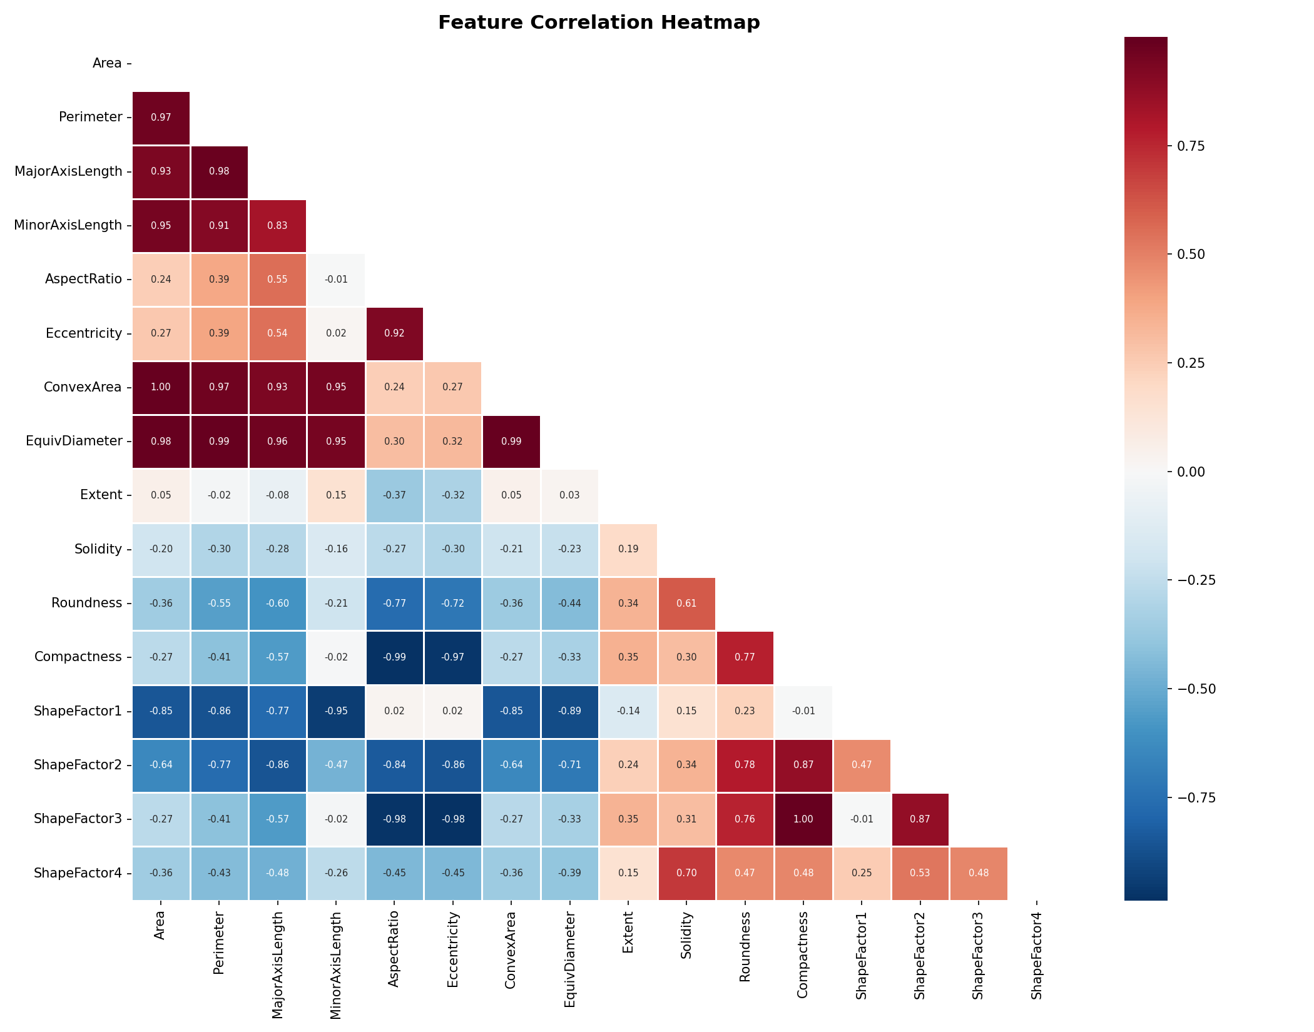
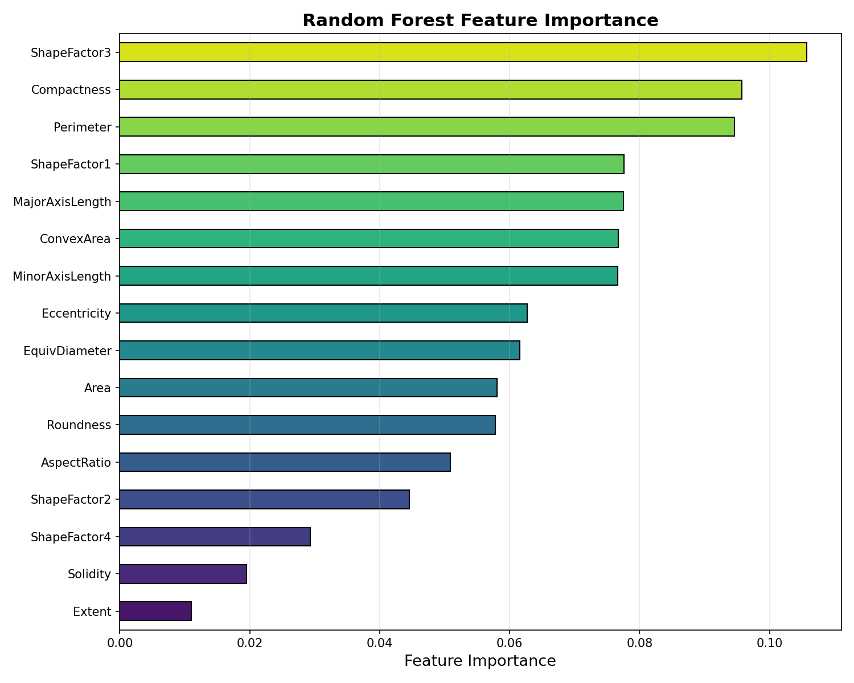
Results: Feature Analysis
Feature Correlation Heatmap
Random Forest Feature Importance

Slide 14
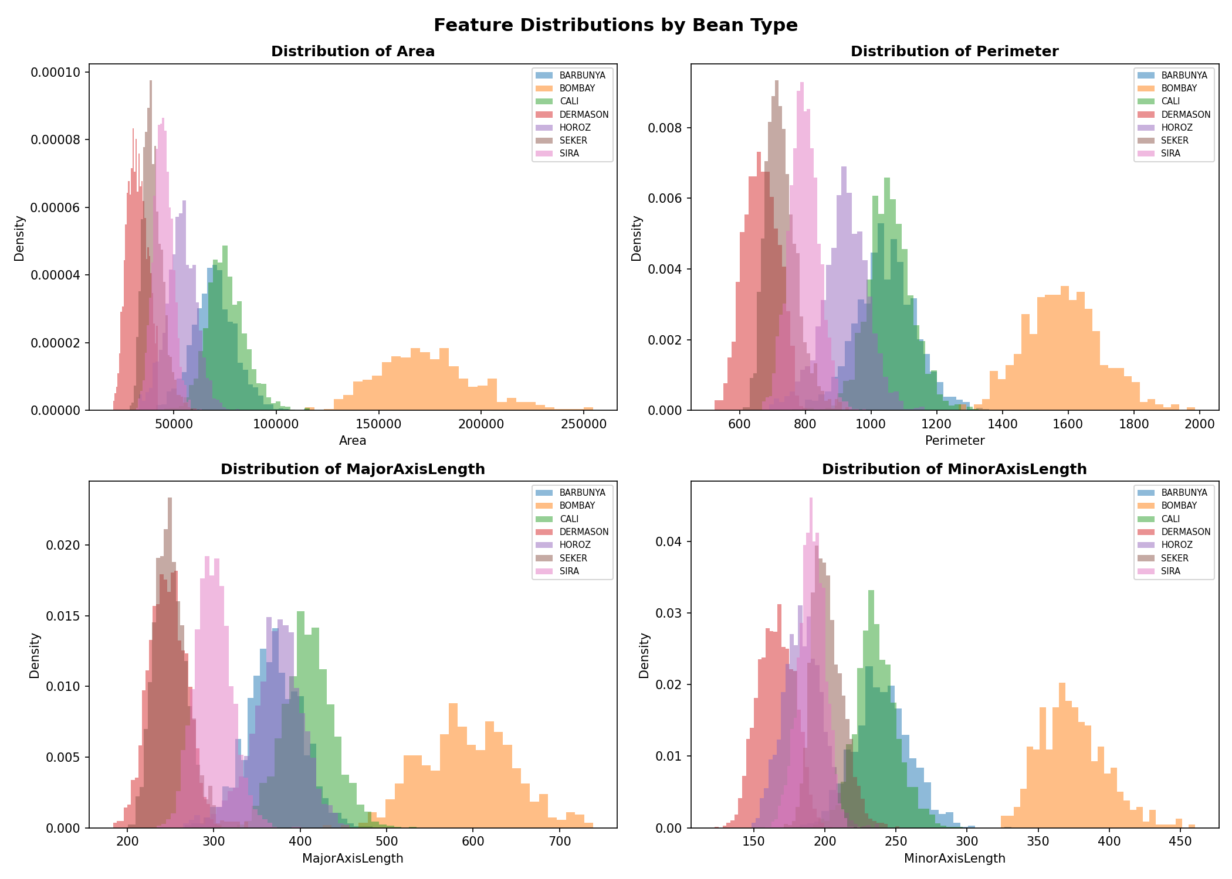
Results: Feature Distributions by Bean Type

Slide 15
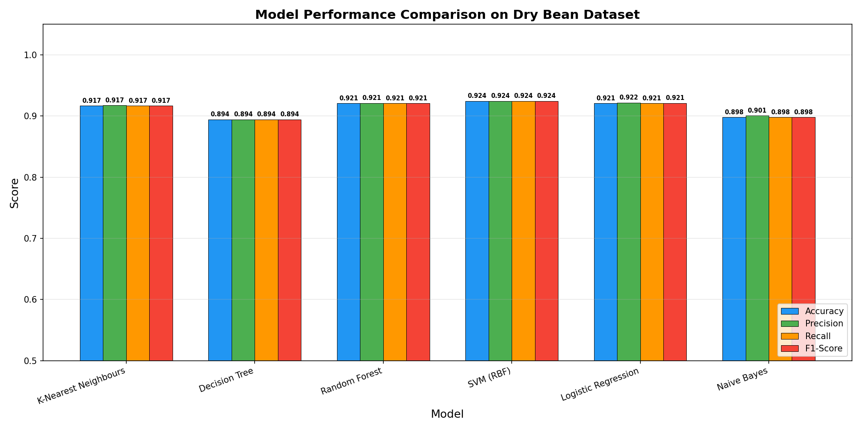
Results: Model Performance Comparison

Slide 16
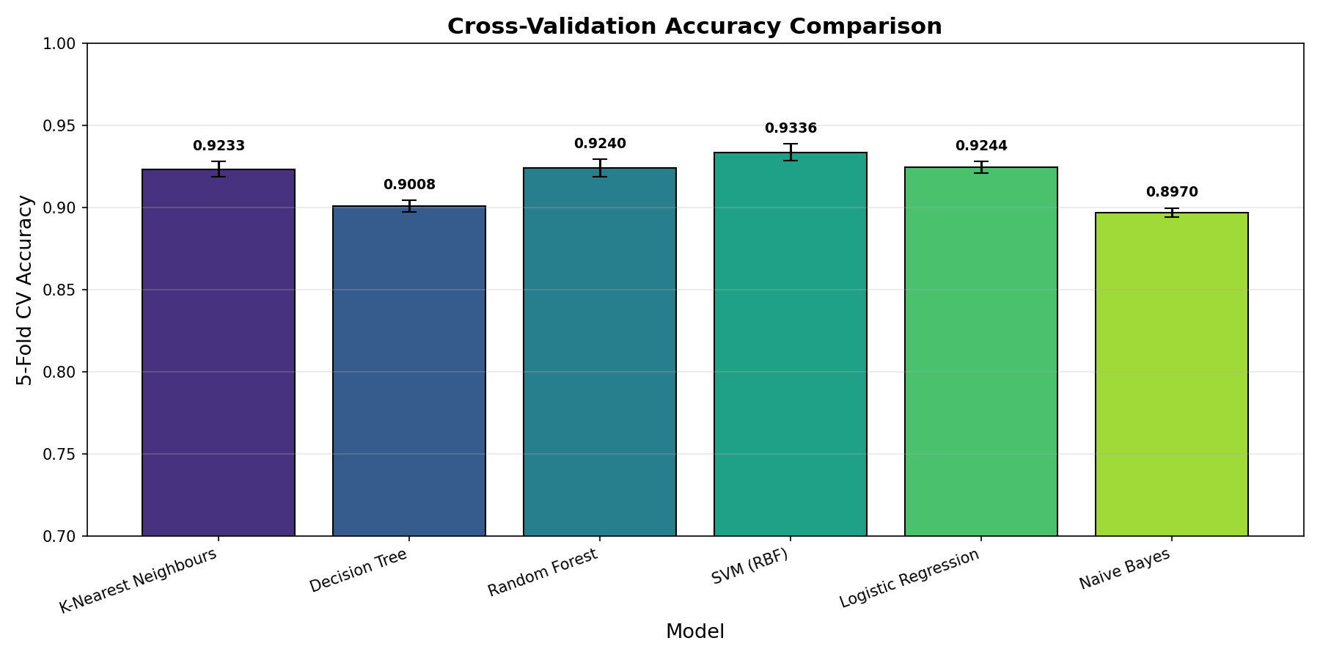
Results: Cross-Validation Accuracy
5-Fold Stratified Cross-Validation
Why cross-validation?
- More reliable than single train/test split
- Reduces variance in accuracy estimates
- Each sample used for both training and testing
Stratified splitting ensures each fold
preserves the class distribution of the
original dataset, preventing bias.
Error bars show standard deviation
across the 5 folds, indicating model
stability and consistency.

Slide 17
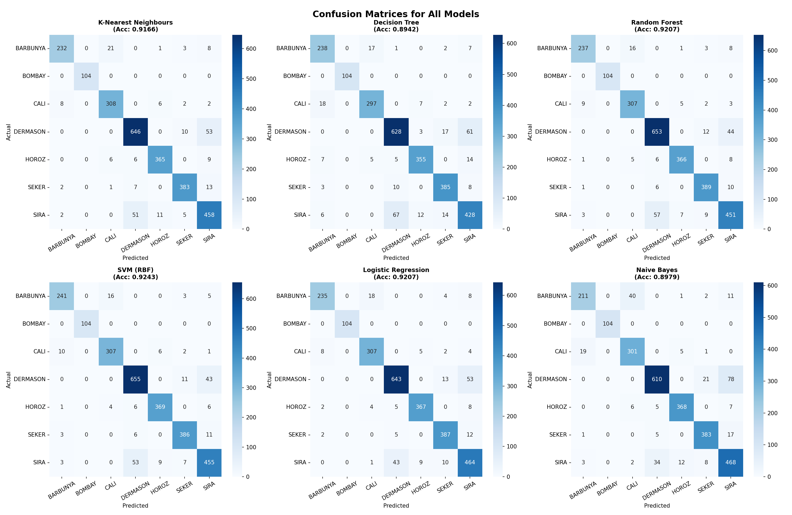
Results: Confusion Matrices

Slide 18
Results: Summary Table
Model | CV Accuracy (5-Fold) | Test Accuracy | Precision (W) | Recall (W) | F1-Score (W)
K-Nearest Neighbours | 0.9233 +/- 0.0046 | 0.9166 | 0.9174 | 0.9166 | 0.9168
Decision Tree | 0.9008 +/- 0.0035 | 0.8942 | 0.8942 | 0.8942 | 0.8941
Random Forest | 0.9240 +/- 0.0053 | 0.9207 | 0.9209 | 0.9207 | 0.9207
SVM (RBF) | 0.9336 +/- 0.0053 | 0.9243 | 0.9243 | 0.9243 | 0.9243
Logistic Regression | 0.9244 +/- 0.0036 | 0.9207 | 0.9215 | 0.9207 | 0.9209
Naive Bayes | 0.8970 +/- 0.0027 | 0.8979 | 0.9007 | 0.8979 | 0.8981

Slide 19
Results: Discussion & Analysis
Key Findings:
- SVM (RBF) achieved the highest test accuracy (92.43%),
followed by Random Forest and Logistic Regression (92.07%)
- Naive Bayes performed the worst due to the assumption
of feature independence (violated by correlated features)
- Decision Tree showed signs of overfitting (high train
accuracy but lower test accuracy compared to RF)
- KNN performed well but is computationally expensive
at prediction time for large datasets
- Feature scaling was crucial for KNN, SVM, and
Logistic Regression (distance/gradient-based methods)
Best/Worst Cases:
- BOMBAY class: easiest to classify (large, distinctive)
- SIRA and DERMASON: most confused with each other
(similar size and shape characteristics)
Feature Importance Insights:
- ShapeFactor4 and ShapeFactor2 are among the most
discriminative features
- Area-related features (Area, ConvexArea, Perimeter)
are strong predictors for larger bean types
- Compactness and roundness help distinguish similarly
sized beans with different shapes
Observations on class imbalance:
- Some classes have more samples than others
- Stratified splitting ensures fair evaluation

Slide 20
5. Conclusion
Summary & Future Directions

Slide 21
Conclusion
Summary:
- Successfully implemented and compared 6 ML classifiers
on the UCI Dry Bean Dataset (13,611 samples, 7 classes)
- SVM (RBF) achieved the best test accuracy at 92.43%
followed closely by Random Forest and Logistic Regression
- Proper preprocessing (standardization, stratified
splitting) significantly impacts model performance
- Cross-validation confirmed the consistency and
reliability of the top-performing models
- Feature analysis revealed that shape factors and
area-related features are the most discriminative
Future Directions:
- Hyperparameter tuning via Grid Search or Bayesian
optimization to improve model performance
- Feature selection techniques (e.g., PCA, mutual
information) to reduce dimensionality
- Explore deep learning approaches (MLP, CNNs) for
potentially higher accuracy
- Ensemble stacking: combine top models for improved
prediction robustness
- Deploy the best model as a web application for
real-time bean classification

Slide 22
References
[1] Koklu, M. and Ozkan, I.A., 2020. Multiclass classification of dry beans using computer vision
and machine learning techniques. Computers and Electronics in Agriculture, 174, 105507.
[2] UCI Machine Learning Repository - Dry Bean Dataset.
https://archive.ics.uci.edu/ml/datasets/Dry+Bean+Dataset
[3] Pedregosa, F. et al., 2011. Scikit-learn: Machine Learning in Python.
Journal of Machine Learning Research, 12, pp.2825-2830.
[4] Breiman, L., 2001. Random Forests. Machine Learning, 45(1), pp.5-32.
[5] Cortes, C. and Vapnik, V., 1995. Support-vector networks.
Machine Learning, 20(3), pp.273-297.
[6] Cover, T. and Hart, P., 1967. Nearest neighbor pattern classification.
IEEE Transactions on Information Theory, 13(1), pp.21-27.
[7] Singh, D. et al., 2020. Machine learning-based approaches for seed classification: A review.
Agricultural Systems, 185, 102906.

Slide 23
Thank You!
Questions & Answers
CSCI218: Foundations of Artificial Intelligence | SIM Session 1, 2026

