Slide 1
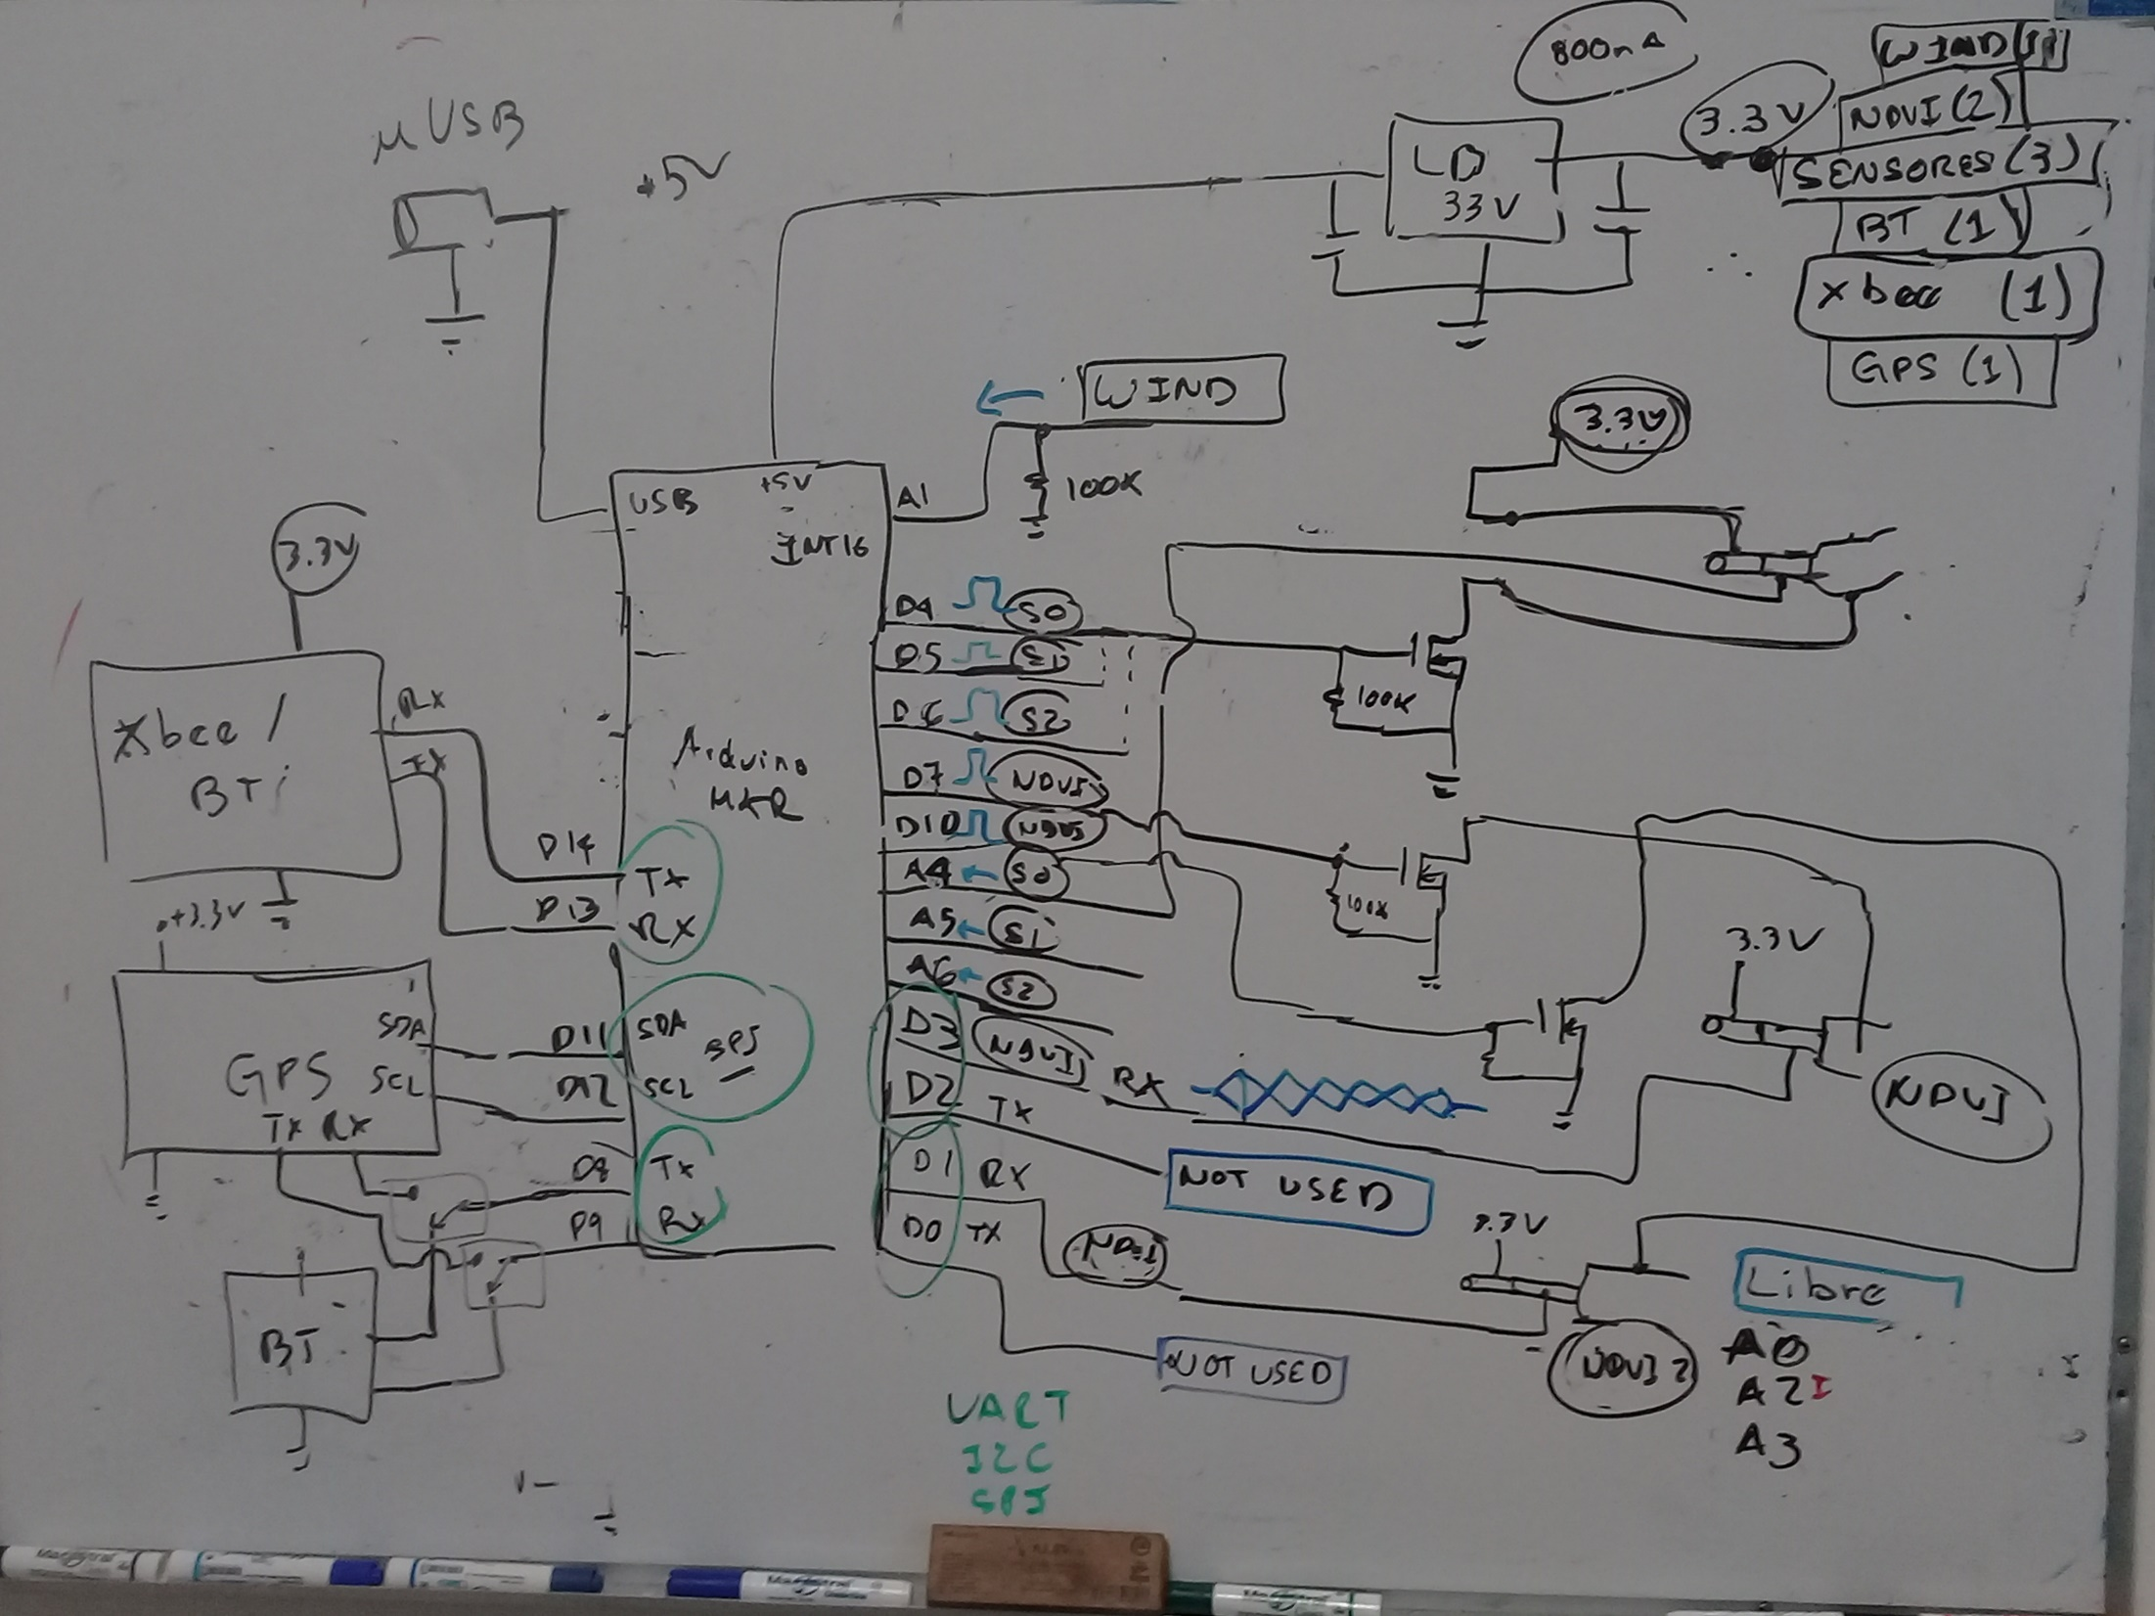
Bluetooth
GPS
Xbee

