Slide 1

MuscleHub
Data Analysis Capstone Project
Fabien Clauss
2019-11-17

Slide 2
Example Table of Contents
A title slide
A description of what happened in this A/B test
A summary of your dataset and any information you think would be helpful background
The results of the three hypothesis tests that you ran, including an explanation of the type of test that you used and why it was appropriate
A summary of the qualitative data
A recommendation for MuscleHub

Slide 3
1. A/B test

Slide 4
1.1 Test description
The current Process to buy a membership at MuscleHub follows these 3 steps:
Take a fitness test with a personal trainer
Fill out an application for the gym
Send in their payment for their first month’s membership
We set up an A/B test to test the influence of the fitness test on the purchase of a membership.
Visitors were randomly assigned to one of two groups:
Group A was asked to take a fitness test with a personal trainer
Group B skipped the fitness test and proceeded directly to the application
The hypothesis is that visitors assigned to Group B will be more likely to purchase a membership.

Slide 5
2. Data Sets

Slide 6
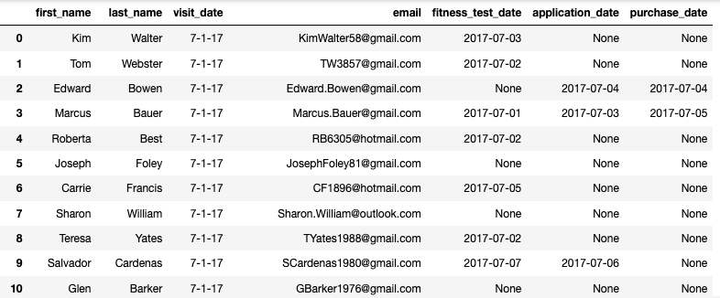
2.1 Data sets (1/2)
The datasets we used are the following:
Visits.csv, where all the visits of potential customer are recorded
Fitness_tests.csv, with the record of all fitness tests
Applications.csv, with all the applications filled bz potential customers
Purchases.csv, contains information about customers who purchased a membership
After looking at the 4 files, we combine them into one DataFrame. (see below)
from IPython.display import display, HTML
df = sql_query('''
SELECT visits.first_name,
visits.last_name,
visits.visit_date,
visits.email,
test.fitness_test_date,
app.application_date,
pay.purchase_date
FROM visits
LEFT JOIN fitness_tests AS 'test'
ON test.email = visits.email
AND test.first_name = visits.first_name
AND test.last_name = visits.last_name
LEFT JOIN applications AS 'app'
ON app.email = visits.email
AND app.first_name = visits.first_name
AND app.last_name = visits.last_name
LEFT JOIN purchases AS 'pay'
ON pay.email = visits.email
AND pay.first_name = visits.first_name
AND pay.last_name = visits.last_name
WHERE visits.visit_date >= '7-1-17'
''')
display(HTML(df.to_html()))

Slide 7
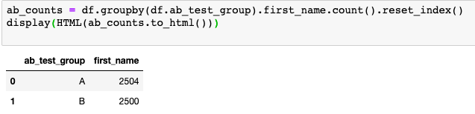
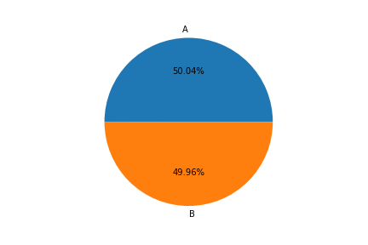
2.2 Datasets (2/2)
The table and graphic below shows that both group of our study are equally represented so that it doesn't introduce any bias.

Slide 8
3. Analysis & Results

Slide 9

3.1 Analysis
We analysed the 3 steps of our funnel - fitness test (group A only), application, purchase of membership - using the following method:
Adding a new column with a boolean-like value for the step in the funnel we are analysing
Counting the number of cases for each value in each group
Pivoting the table
Calculating the total for each group
Calculating the percentages
Finally calculating the statistical significance of our results

Slide 10

3.2 Who picks up an application?
We first looked at the applications. After the methodology described previously we found the following results:
We notice that people from group B turned in more applications. This was expected since for this group the application is the first step whereas in the group A, they first have to complete a fitness step.
We calculated the statistical significance which resulted in p = 0.00096 showing that the difference is very significant.

Slide 11

3.2 Who purchased a membership? (1/2)
We then looked at the people who turned in an application and subsequently purchased a membership. The results are as followed:
We notice that people from group A turning in an application where slightly more likely to purchase an membership.
A possible explanation is that they already had to complete the fitness test which might eliminate the less committed potential customer.
We calculated the statistical significance which resulted in p = 0.43 showing that the difference is not significant.

Slide 12

3.2 Who purchased a membership? (1/2)
When looking at all the potential customer who purchased a membership. The results are as followed:
Now people from group B seem more likely to purchase an membership..
The statistical significance of p = 0.0147 indicates a quite significant difference.
These results seem to confirm our hypothesis that when potential customer do not pass a fitness test at the start of the application process, they are more likely to purchase a membership.

Slide 13
4. Recommendations

Slide 14
4.1 Recommendations
Since the fitness test seem to discourage some potential customer from turning in an application and purchasing a membership, 3 solutions should be evaluated:
Suppress the fitness test. This radical solution presents some drawbacks and risks and should therefore be studied very carefully before implementation
Making the fitness test optional. A carefully designed test could simulate the effect of this change.
Putting the fitness test after the application. This has the advantage, that we would not really change our process, only prevent potential customers to feel overwhelmed with a fitness test right away. This solution could be tested easily with an A/B test.

