Slide 1
Strings
Sarah Khoja

Slide 2
Strings:
Imagine, literally, a string (or grouping/sequence) of case sensitive characters
Not only letters!
Numbers, symbol, etc.
What can we do with strings?
Print to screen
Compare with:
==, <, >, etc
Check the lenght using the len() function
s=”Annie are you okay?”
len(s) -> evaluates to 19
You can index into strings!
Using []

Slide 3
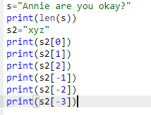

Indexing into Strings:
Using square brackets, get each individual letters/ characters.

Slide 4
Slice:
Slice allows you to grab a chunk of a string.
[start:stop:step]
If you only give [start:stop], then step=1 by default

Slide 5






Slice with the step in use
V

Slide 6
Strings: immutable
You cannot modify individual letters in the string!
Example:
s=”Annie are you okay?” s[0]=”B” #NOT ALLOWED!!!

Slide 7
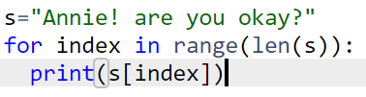
Strings and for loops:

