Slide 1
Serverless .NET with Azure Functions
@fsibot goes Nano-Services

Slide 2

Hello :)
@brandewinder

Slide 3

Agenda
What are Azure Functions?
A real-world example: @fsibot
Frictions: from Cloud to Local

Slide 4
What are Azure Functions?

Slide 5
The buzzword-compliant version
“Azure Functions is a serverless event driven experience that extends the existing Azure App Service platform. These nano-services can scale based on demand and you pay only for the resources you consume.”

Slide 6
Azure Functions are…
Function = Code + Event
Function App = group of Functions
“Serverless”
Pay only for what you use
Based on Azure WebJobs
Recently hit general availability

Slide 7
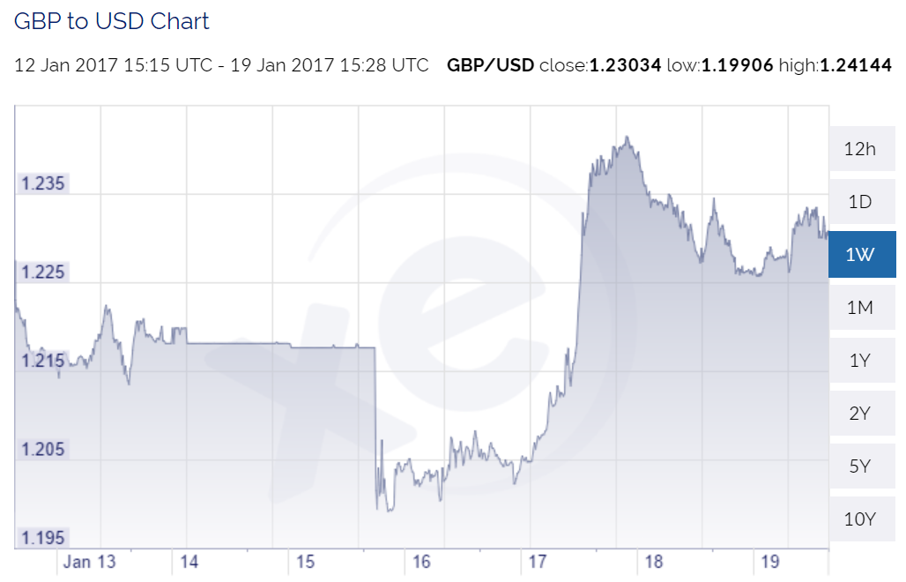

Slide 8
Let’s build a function
Pull the GBP/USD rate every 10 seconds
Send latest cost of a pint on Slack

Slide 9
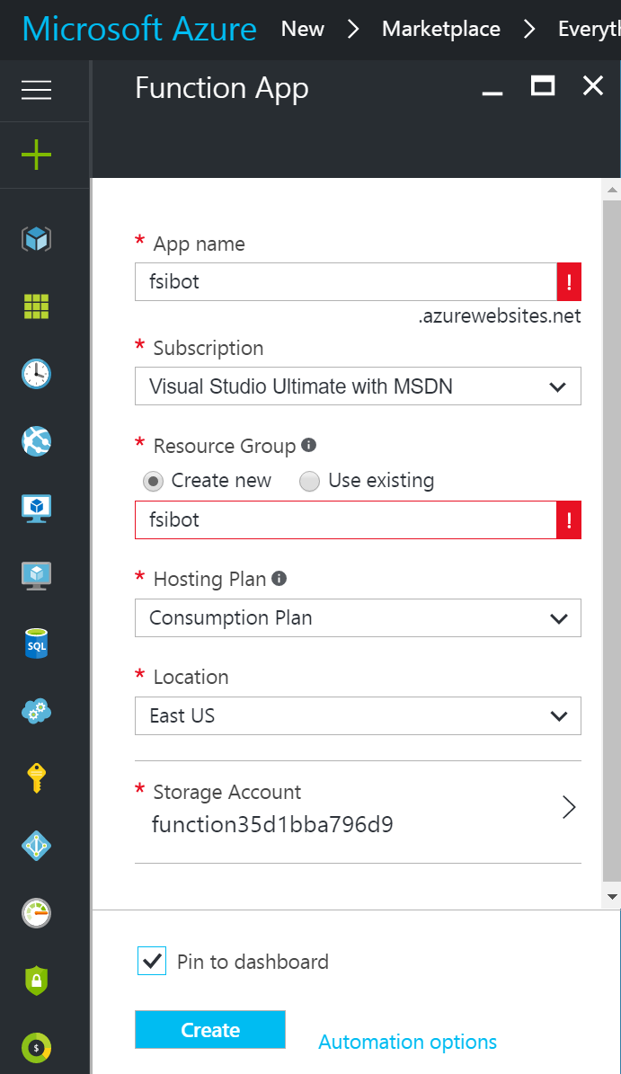

Slide 10
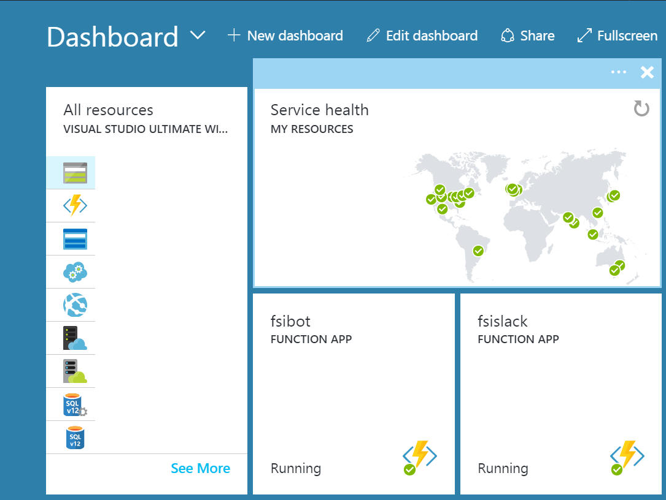

Slide 11
Coding time

Slide 12
Recap: minimal function
Function App = one or more Functions
Function = code + event
Code = script using your favorite language
Event = binding defined in function.json
Azure Storage account

Slide 13
Recap (2)
“in” and “out” bindings
Dependencies using project.json
… Kudu, FTP and more also available
Consumption plan handles scaling
Automatically deployed on code change

Slide 14
“Real-World” Example: @fsibot

Slide 15
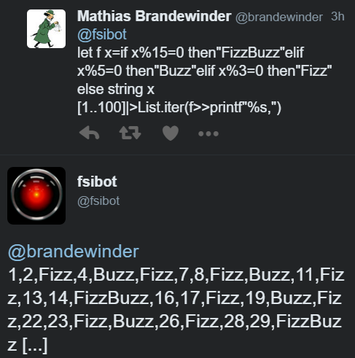
@fsibot

Slide 16
Whiteboard

Slide 17













Whiteboard

Slide 18
Release 1
Codename “I am so naïve”
1 F# service using TopShelf
Hosted in cheapest Azure VM ($12/month)
(Mini) Monolith

Slide 19
Ahem… may I help you?
@fsibot System.Diagnostics.Process.Start("notepad.exe")
@fsibot http://System.IO.Directory .Delete(System.Environment.CurrentDirectory)
@fsibot System.Threading.Thread.CurrentThread.Abort()
@fsibot System.Diagnostics.Process.GetProcesses() |> Array.Parallel.iter (fun p -> p.Kill())

Slide 20
Release 2
Codename “It’s a mean, mean world”
2 F# services using TopShelf
Communicating via Azure Service Bus
Hosted in cheapest Azure VM ($12/month)
(Micro) Services

Slide 21
Release 3
Codename “Nano Service”
3 F# Azure Functions
… Profit!
Repo: …/mathias-brandewinder/fsibot-serverless

Slide 22








Slide 23
Benefits
From Script to Production
Sketch out domain in scripts
Sketch out architecture
Focus on Code/Domain, not Plumbing
Need a queue? Just name it
Hassle-free deployment

Slide 24
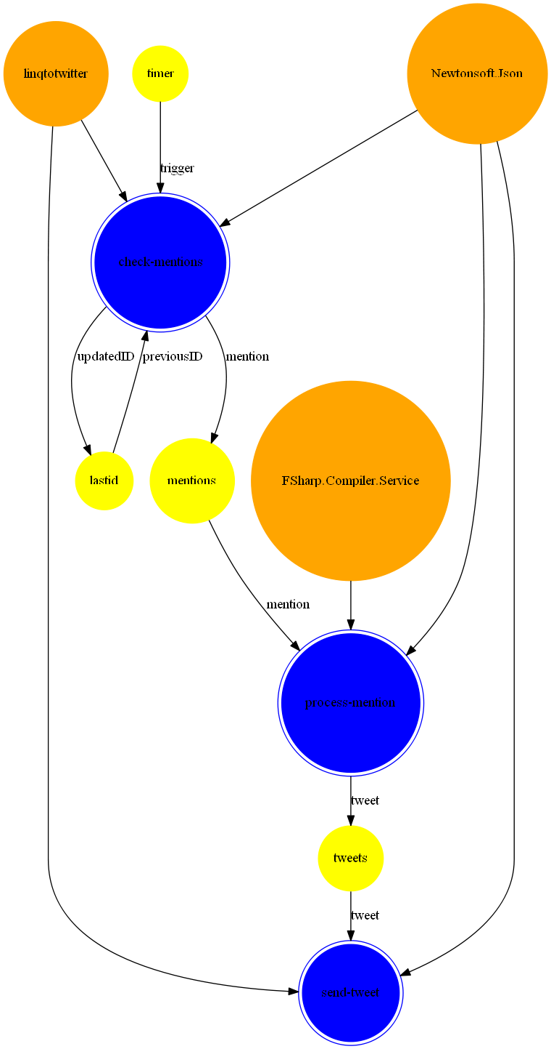
Explicit, declarative architecture

Slide 25
@fsibot on fsharp.org

Slide 26
Benefits: $$$
Azure Functions consumption plan is billed based on resource consumption and executions.
Consumption plan pricing includes a monthly free grant of 1 million requests and 400,000 GB-s of resource consumption per month.
Execution time: $0.000016/GB-s
Total executions: $0.20 per Million Executions

Slide 27
Recommendations
Keep your functions fast
Keep your functions lean
Think small
Expect concurrent execution
Use Queues to communicate between functions
Embrace Stateless-ness
Expect the worst

Slide 28
Frictions: from Cloud to Local

Slide 29
So… making code changes directly on a live server is cool again?

Slide 30
Beyond the online editor
Continuous Deployment
[WIP/Pre-release] Functions CLI
Testing?
Azure Storage Explorer

Slide 31
Take-Aways

Slide 32
Verdict: take a look
Super useful in many situations
Functions make it easy to do the right thing
What I wanted the cloud to be
Local story is work in progress
Very responsive team
Most fun I had coding in a while :)

Slide 33


Slide 34
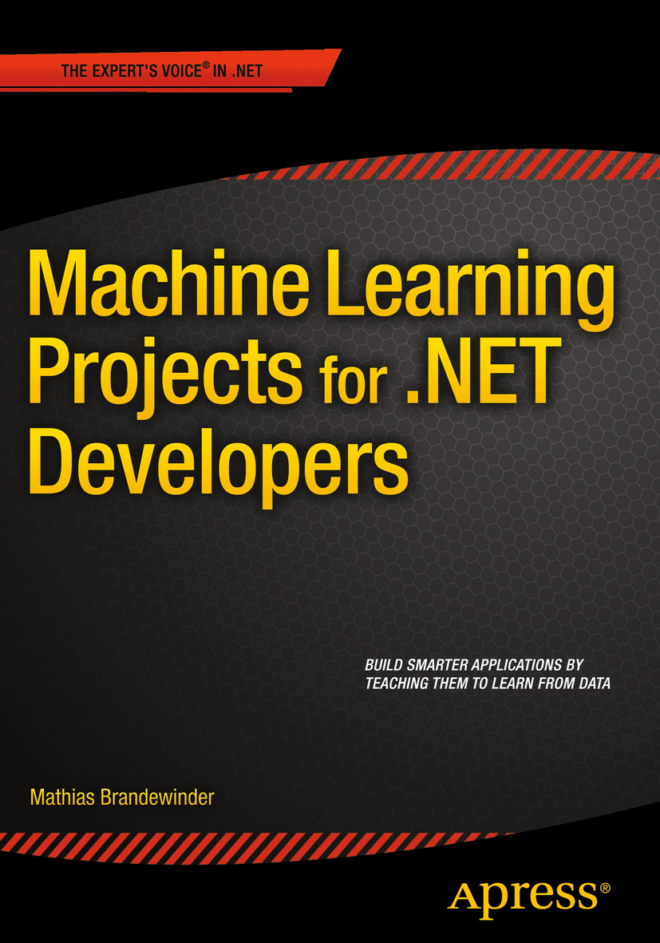
Shameless plug
… I have a book out, and it’s awesome ;)

Slide 35
Thank you :)
@brandewinder
brandewinder.com
Repo: github.com/mathias-brandewinder/fsibot-serverless

