Slide 1
Agile Experiments in Machine Learning

Slide 2

About me
Mathias @brandewinder
F# & Machine Learning
Based in San Francisco
I do have a tiny accent ☺

Slide 3
Why this talk?
Machine learning competition as a team
Team work requires process
Code, but “subtly different”
Statically typed functional with F#

Slide 4
These are unfinished thoughts

Slide 5
Code on GitHub
JamesSDixon/Kaggle.HomeDepot
mathias-brandewinder/Presentations

Slide 6
Plan
The problem
Creating & iterating Models
Pre-processing of Data
Parting thoughts

Slide 7

Kaggle Home Depot

Slide 8
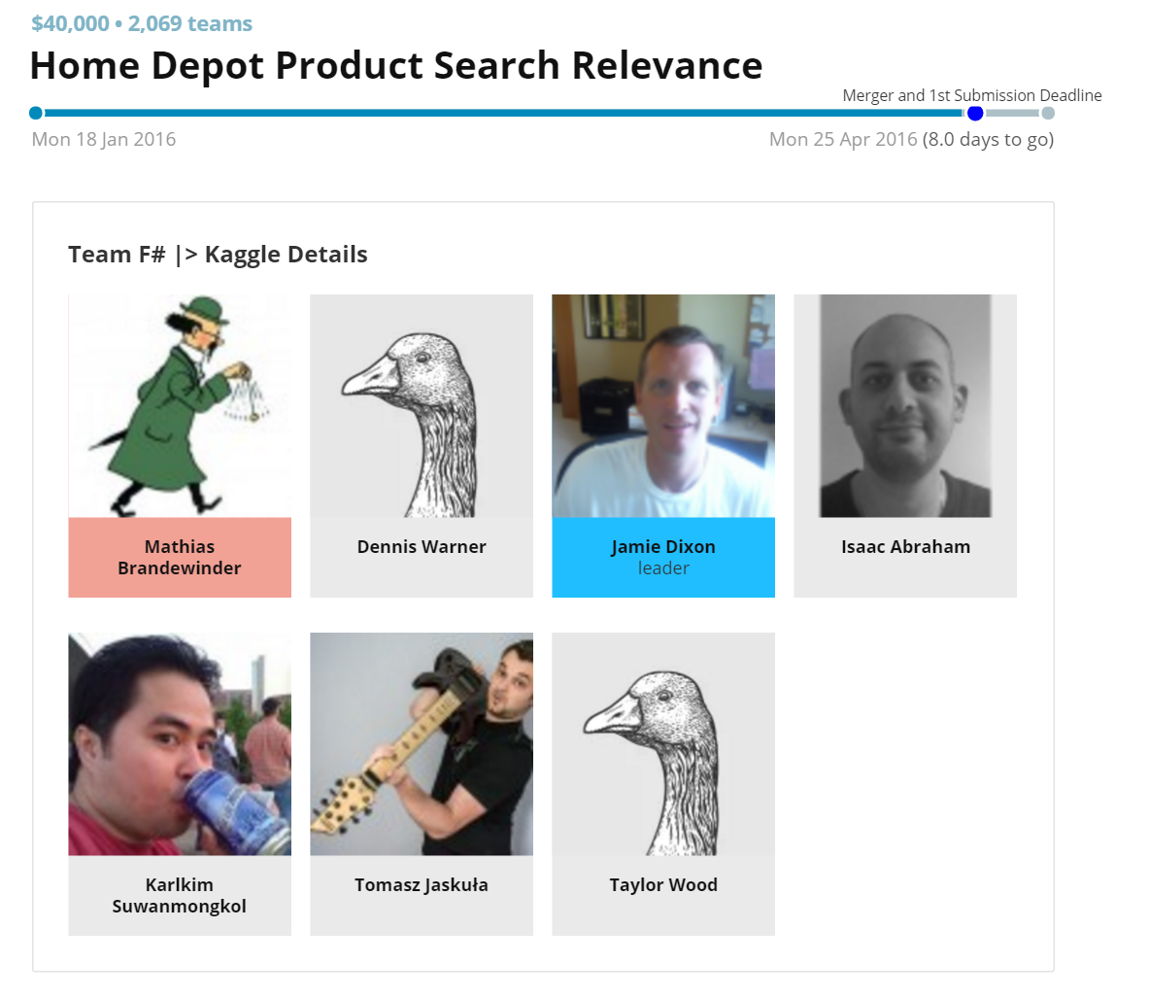
Team & Results
Jamie Dixon (@jamie_Dixon), Taylor Wood (@squeekeeper), & alii
Final ranking: 122nd/2125 (top 6%)

Slide 9
The question
Search
Product
“6 inch damper”
“Battic Door Energy Conservation Products Premium 6 in. Back Draft Damper”
Is this any good?

Slide 10
The data
"Simpson Strong-Tie 12-Gauge Angle","l bracket",2.5
"BEHR Premium Textured DeckOver 1-gal. #SC-141 Tugboat Wood and Concrete Coating","deck over",3
"Delta Vero 1-Handle Shower Only Faucet Trim Kit in Chrome (Valve Not Included)","rain shower head",2.33
"Toro Personal Pace Recycler 22 in. Variable Speed Self-Propelled Gas Lawn Mower with Briggs &amp; Stratton Engine","honda mower",2
"Hampton Bay Caramel Simple Weave Bamboo Rollup Shade - 96 in. W x 72 in. L","hampton bay chestnut pull up shade",2.67
"InSinkErator SinkTop Switch Single Outlet for InSinkErator Disposers","disposer",2.67
"Sunjoy Calais 8 ft. x 5 ft. x 8 ft. Steel Tile Fabric Grill Gazebo","grill gazebo",3
...

Slide 11
The problem
Given a Search, and the Product that was recommended,
Predict how Relevant the recommendation is,
Rated from terrible (1.0) to awesome (3.0).

Slide 12
The competition
70,000 training examples
20,000 search + product to predict
Smallest RMSE* wins
About 3 months
*RMSE ~ average distance between correct and predicted values

Slide 13
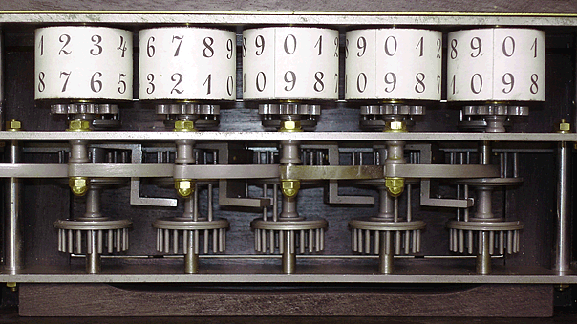
Machine Learning
Experiments in Code

Slide 14
An obvious solution
// domain model
type Observation = {
Search: string
Product: string
}
// prediction function
let predict (obs:Observation) = 2.0

Slide 15
So… Are we done?

Slide 16
Code, but…
Domain is trivial
No obvious tests to write
Correctness is (mostly) unimportant
What are we trying to do here?

Slide 17
We will change the function predict, over and over and over again,
trying to be creative, and come up with a predict function that fits the data better.

Slide 18
Observation
Single feature
Never complete, no binary test
Many experiments
Possibly in parallel
No “correct” model - any model could work. If it performs better, it is better.

Slide 19
Experiments

Slide 20

We care about “something”

Slide 21
What we want
Observation
Model
Prediction

Slide 22
What we really mean
Observation
Model
Prediction
x₁, x₂, x₃
f(x₁, x₂, x₃)
y

Slide 23
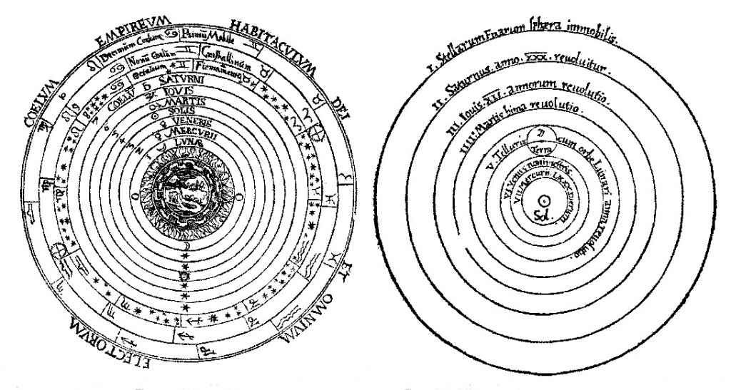
We formulate a model

Slide 24
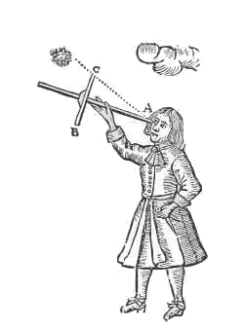
What we have
Observation
Result
Observation
Result
Observation
Result
Observation
Result
Observation
Result
Observation
Result

Slide 25
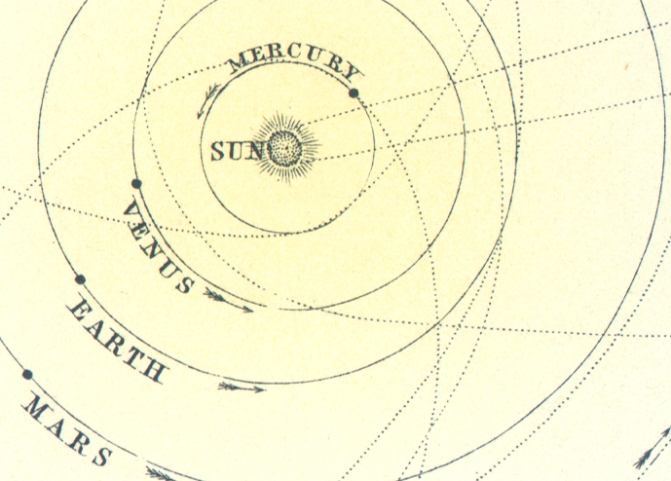
We calibrate the model

Slide 26
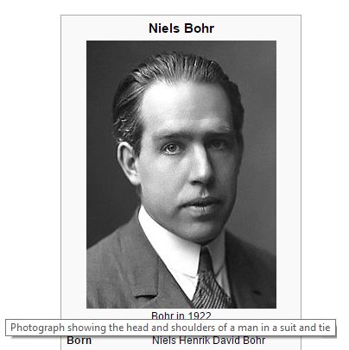
Prediction is very difficult, especially if it’s about the future.

Slide 27
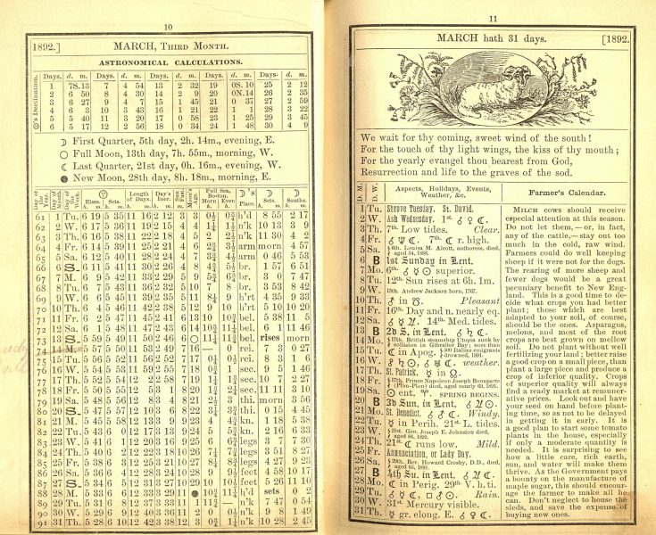
We validate the model
… which becomes the
“current best truth”

Slide 28
Overall process
Formulate model
Calibrate model
Validate model

Slide 29
ML: experiments in code
Formulate model: features
Calibrate model: learn
Validate model

Slide 30
Modelling
Transform Observation into Vector
Ex: Search length, % matching words, …
[17.0; 0.35; 3.5; …]
Learn f, such that f(vector)~Relevance

Slide 31
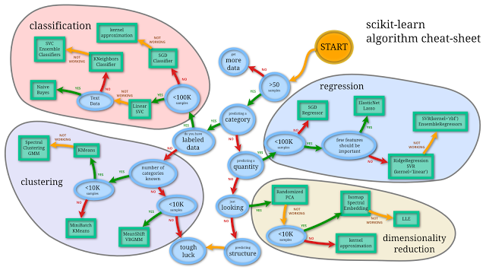
Learning with Algorithms

Slide 32
Validating
Leave some of the data out
Learn on part of the data
Evaluate performance on the rest

Slide 33
Recap
Traditional software: incrementally build solutions by completing discrete features,
Machine Learning: create experiments, hoping to improve a predictor
Traditional process likely inadequate

Slide 34
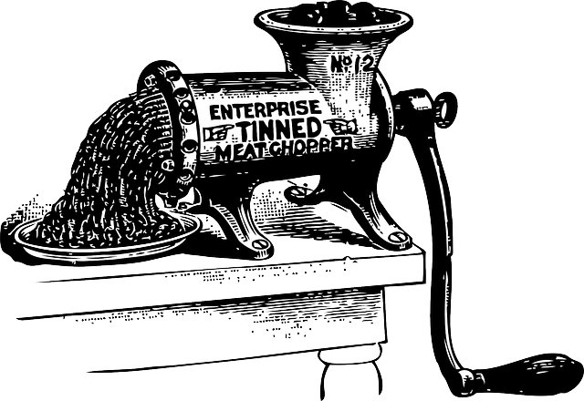
Practice
How the Sausage is Made

Slide 35
How does it look?
// load data
// extract features as vectors
// use some algorithm to learn
// check how good/bad the model does

Slide 36
An example

Slide 37
What are the problems?
Hard to track features
Hard to swap algorithm
Repeat same steps
Code doesn’t reflect what we are after

Slide 38
wasteful
ˈweɪstfʊl,-f(ə)l/
adjective
(of a person, action, or process) using or expending something of value carelessly, extravagantly, or to no purpose.

Slide 39
To avoid waste,
build flexibility where
there is volatility,
and automate repeatable steps.

Slide 40
Strategy
Use types to represent what we are doing
Automate everything that doesn’t change: data loading, algorithm learning, evaluation
Make what changes often (and is valuable) easy to change: creation of features

Slide 41
Core model
type Observation = {
Search: string
Product: string }
type Relevance : float
type Predictor = Observation -> Relevance
type Feature = Observation -> float
type Example = Relevance * Observation
type Model = Feature []
type Learning = Model -> Example [] -> Predictor

Slide 42
“Catalog of Features”
let ``search length`` : Feature =
fun obs -> obs.Search.Length |> float
let ``product title length`` : Feature =
fun obs -> obs.Product.Length |> float
let ``matching words`` : Feature =
fun obs ->
let w1 = obs.Search.Split ' ' |> set
let w2 = obs.Product.Split ' ' |> set
Set.intersect w1 w2 |> Set.count |> float

Slide 43
Experiments
// shared/common data loading code
let model = [|
``search length``
``product title length``
``matching words``
|]
let predictor = RandomForest.regression model training
Let quality = evaluate predictor validation

Slide 44
Data
Shared / Reusable
Feature 1
Algorithm 1
Feature 1
Feature 2
Algorithm 2
Feature 3
Experiment/Model
Feature 3
Algorithm 3
Algorithm 2
…
…
Validation

Slide 45
Example, revisited

Slide 46
Food for thought
Use types for modelling
Model the process, not the entity
Cross-validation replaces tests

Slide 47
Domain modelling?
// Object oriented style
type Observation = {
Search: string
Product: string }
with member this.SearchLength =
this.Search.Length
// Properties as functions
type Observation = {
Search: string
Product: string }
let searchLength (obs:Observation) =
obs.Search.Length
// "object" as a bag of functions
let model = [
fun obs -> searchLength obs
]

Slide 48
Did it work?

Slide 49
Recap
F# Types to model Domain with common “language” across scripts
Separate code elements by role, to enable focusing on high value activity, the creation of features

Slide 50
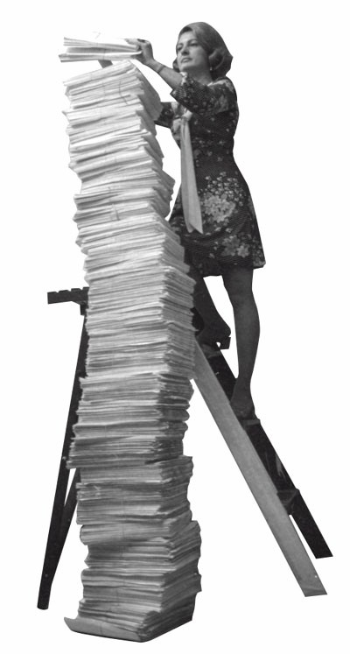
The unbearable heaviness of data

Slide 51
Reproducible research
Anyone must be able to re-compute everything, from scratch
Model is meaningless without the data
Don’t tamper with the source data
Script everything

Slide 52
Analogy: Source Control + Automated Build
If I check out code from source control,
it should work.

Slide 53
One simple main idea:
does the Search query look like the Product?

Slide 54
Dataset normalization
“ductless air conditioners”, “GREE Ultra Efficient 18,000 BTU (1.5Ton) Ductless (Duct Free) Mini Split Air Conditioner with Inverter, Heat, Remote 208-230V”
“6 inch damper”,”Battic Door Energy Conservation Products Premium 6 in. Back Draft Damper”,
“10000 btu windowair conditioner”, “GE 10,000 BTU 115-Volt Electronic Window Air Conditioner with Remote”

Slide 55
Pre-processing pipeline
let normalize (txt:string) =
txt
|> fixPunctuation
|> fixThousands
|> cleanUnits
|> fixMisspellings
|> etc…

Slide 56
Lesson learnt
Pre-processing data matters
Pre-processing is slow
Also, Regex. Plenty of Regex.

Slide 57
Tension
Keep data intact
& regenerate outputs
vs.
Cache intermediate results

Slide 58
There are only two hard problems
in computer science.
Cache invalidation, and
being willing to relocate to San Francisco.

Slide 59
Observations
If re-computing everything is fast – then re-compute everything, every time.
Can you isolate causes of change?

Slide 60
Data
Shared / Reusable
Pre-Processing
Cache
Feature 1
Algorithm 1
Feature 2
Algorithm 2
Feature 1
Feature 3
Algorithm 3
Feature 3
Experiment/Model
…
…
Algorithm 2
Validation

Slide 61
Conclusion

Slide 62
General
Don’t be religious about process
Why do you follow a process?
Identify where you waste energy
Build flexibility around volatility
Automate the repeatable parts

Slide 63
Statically typed functional
Super clean scripts / data pipelines
Types help define clear domain models
Types prevent dumb mistakes

Slide 64
Open questions
Better way to version features?
Experiment is not an entity?
Is pre-processing a feature?
Something missing in overall versioning
Better understanding of data/code dependencies (reuse computation, …)

Slide 65
Thank you ☺
@brandewinder
Come chat if you are interested in the topic!
Repository on GitHub: JamesSDixon/Kaggle.HomeDepot

