Slide 1
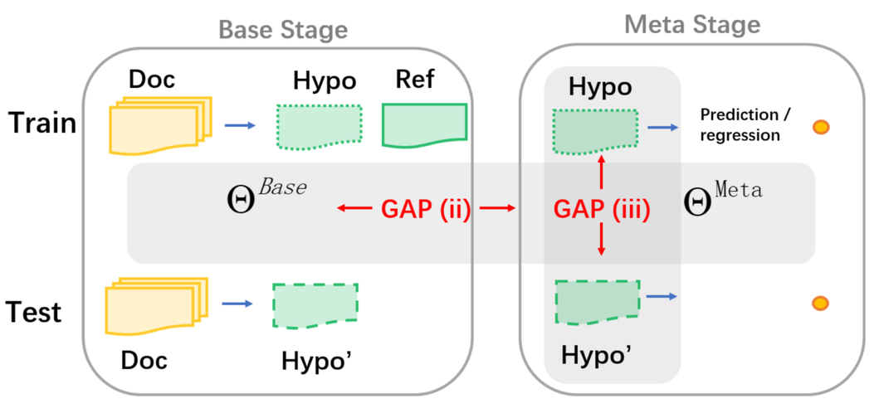

RefSum: Refactoring Neural Summarization
Language Processing and Information Extraction
Felipe Coutinho - 2024
RefSum: Refactoring Neural Summarization (Liu et al., NAACL 2021)

Slide 2
Summarization
Extractive
"Artificial Intelligence (AI) has seen rapid advancements in recent years, revolutionizing industries such as healthcare, finance, and transportation. In healthcare, AI is used to improve diagnostic accuracy and personalize treatments. In finance, it helps detect fraudulent activities and predict market trends. Meanwhile, in transportation, AI powers autonomous vehicles and optimizes traffic management systems. These innovations demonstrate AI's transformative potential across various sectors."
"Artificial Intelligence (AI) has seen rapid advancements, revolutionizing industries such as healthcare, finance, and transportation. AI is used to improve diagnostic accuracy and personalize treatments. These innovations demonstrate AI's transformative potential across various sectors."
Abstractive
"Artificial Intelligence (AI) has seen rapid advancements in recent years, revolutionizing industries such as healthcare, finance, and transportation. In healthcare, AI is used to improve diagnostic accuracy and personalize treatments. In finance, it helps detect fraudulent activities and predict market trends. Meanwhile, in transportation, AI powers autonomous vehicles and optimizes traffic management systems. These innovations demonstrate AI's transformative potential across various sectors."
"AI is rapidly transforming sectors like healthcare, finance, and transportation by enhancing diagnostics, fraud detection, and traffic systems."

Slide 3


Two-stage Learning
Base-Stage
Meta-Stage
🤖
📄
📄
📚
🤖
📄
🤖
📄
📄
🤖
📄
📄

Slide 4
Two-stage Learning
Base-Stage
Meta-Stage
🤖
📄
Gap #1
📄
No parameter sharing, so base and meta models are almost independent
📚
🤖
📄
🤖
📄
📄
🤖
📄
📄

Slide 5
Two-stage Learning
Base-Stage
Meta-Stage
🤖
📄
Gap #2
📄
Training and test data do not come from same distribution
📚
🤖
📄
🤖
📄
📄
🤖
📄
📄

Slide 6
Refactor Text Summarization
Pre-training
Fine tuning
🤖
📄
📄
📚
🤖
📄
🤖
📄
📄
🤖
📄
📄
📚

