Slide 1
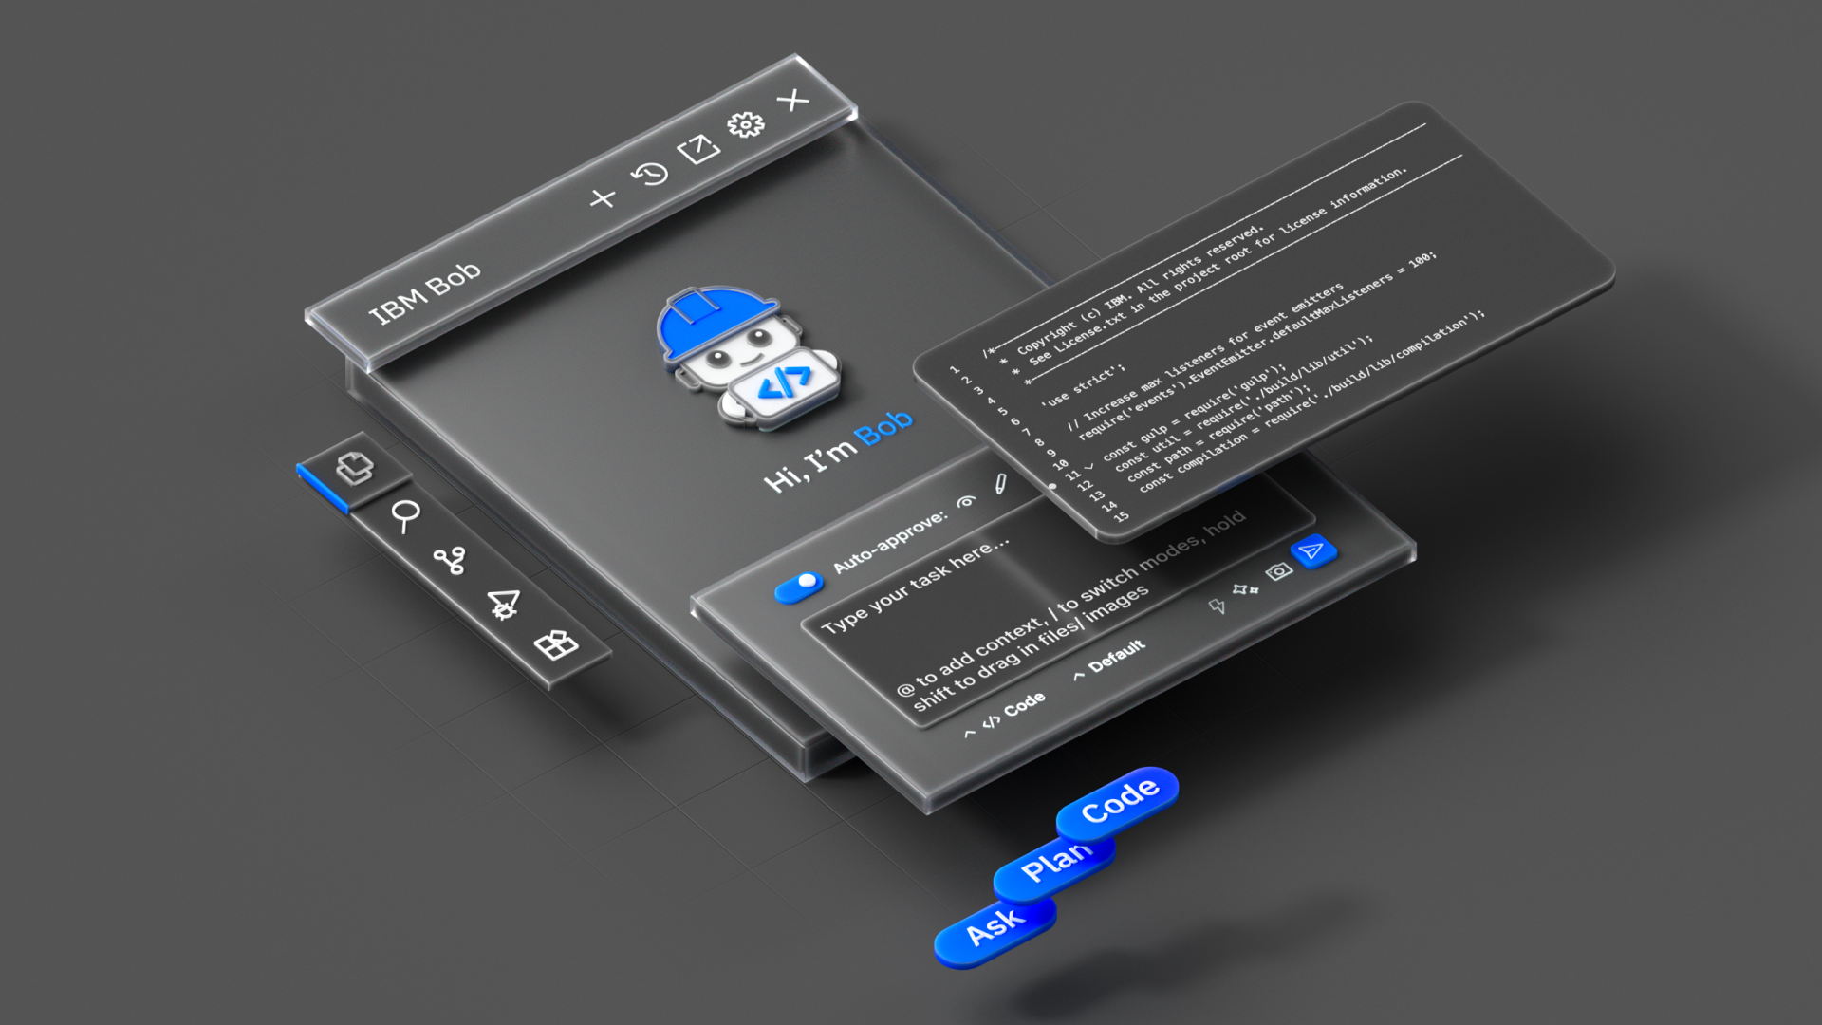

Slide 2
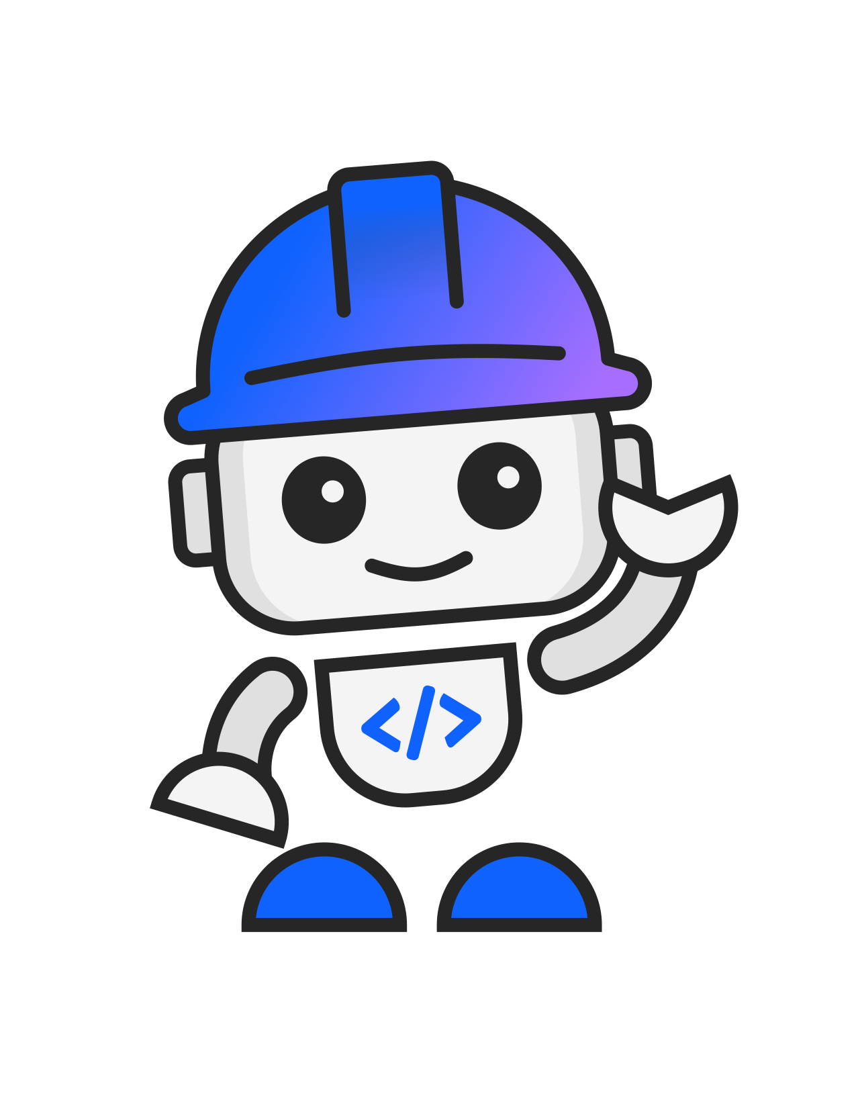
Meet your SDLC partner
IBM Bob
Built for software delivery, not just code generation
Adapts to your intent
Works where you work
Understands the full codebase
Built to understand real codebases, coordinate end-to-end work, and keep developers in control.
Drives end-to-end tasks
Keeps you in control
Notes:
Meet *IBM Bob*, your SDLC partner.
Bob isn’t just here to autocomplete a function and high‑five itself.
It’s built to:
- work where you already work: IDE, terminal & workflow
- understand the whole codebase, not just the file you opened
- drive end‑to‑end tasks
- and keep you in control with clear explanations
In short: Bob optimizes for outcomes, not just output.

Slide 3
Bob-a-thon Overview
Goal | Experience how IBM Bob streamline workflow Understand Bob’s capabilities and enterprise tool integration
Workshop Contents Overview | Bob Solution Quick Overview Hands on lab with canned use case BYOC session with IBM experts
Outcomes | Deeper understanding of IBM Bob capabilities Practical skills in creating workflows Actionable use cases to accelerate workflow Bob Trial for 30 days
Location | On Teams

Slide 4







Our Team
IBM Client Engineering
Reina Sato
Data & AI Specialist
Brandon Mercado
Data & AI Technical Specialist
Varun Sreekumar
Lab Instructor
Bansini Doshi
Facilitator
Tim Rowe
IBM i SME
Dustin Le
Technical Expert
Stacey Dana Cajita
Design Facilitator

Slide 5
Bob-a-thon Agenda
Introduction and Environment Setup (45 minutes) :
  IBM Bob overview
    Bob Capability Overview
    Q&A
  Setup
    Installation/log in verification
Guided Hands-On Session (60 minutes) :
  IBM-led demonstration using pre-built use cases:
Honda Open Workshop (90 minutes) :
  Participants bring their own code, repositories, and development challenges while collaborating with IBM experts to explore how Bob can accelerate your work.
  Honda participants bring: Their own use case, code, challenges and questions
Discovery Workshop (45 minutes) :
  Participants engage in a hands-on workshop to explore how Bob can impact business value.

Slide 6
IBM Bob Engagement: Proof Value in Variety of Engineers
With continuous Bob-a-thon and Bob Office Hour engagement we found following output.
70+
users attended Bob-a-thon
8
Bob-a-thons completed
4
production use cases
3
Bob-a-thon Planned
Feedback from Colin Ingham
# | Team | Pre-canned Use Cases
1 | IVI, IT | Bob
2 | Smart Factory | Bob
3 | GPCS | Bob PPz
4 | Business Application | Bob PPz
5 | Sales Parts and Auto | Bob PPz
6 | Data DBA MF | Bob PPz
7 | Captive Finance Application | Bob PPz
8 | Data Ops | Java Code Modernization
9 | Infrastructure & SRE | Bob for Incident Mng
10 | HNLA | Bob PPi
11 | Maximo | Bob with Maximo
 | Traditional Development | With IBM Bob
Lead time for 1 COBOL Specification | ~3 Days by Senior Engineer (possibly 1-3 weeks) | 4 Minutes
Lead time for 5 COBOL Specification | Minimum 15 days | 1 Hour
Quality | Production Ready | Production Ready (Reviewed by Senior COBOL Engineer)
Method | Manual Coding & Testing | AI-Driven Code Generation
Focus | Developer-Dependent | Specification-Driven
Survey Results
Strong interest in modernization & productivity:
Most participants see value in legacy modernization, code analysis, documentation, and accelerating development work.
Positive overall sentiment:
Most respondents rated IBM Bob positively (4–5/5) and identified meaningful use cases for their teams.
Training and integration are key adoption needs:
Users want more hands-on experience, additional training, and better integration with existing development tools and file formats.
Flexible AI options are important:
Users expressed interest in having the flexibility to choose AI models, workflows, and development environments that best fit their team's needs and preferences.

Slide 7
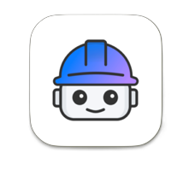
IBM Bob Trial-to-Adoption Journey
Accelerating enterprise AI-assisted software development through guided enablement and hands-on adoption.
Day 1
Bob-a-thon
Week 1 - 4
Trial for 30 days
Week 1-4
Open Office Hour
Feedback Consolidation
Hands-on workshop aligned to targeted use cases to demonstrate how IBM Bob accelerates daily development and operational workflows.
Users receive IBM Bob access on their local machine with free Bobcoins for a 30-day trial.
IBM will host weekly office hours during the first month to support adoption and answer questions.
IBM and Honda will correct feedback and validate value of Bob.
Trial Link
Agenda (3-4hrs):
Steps (5min):
Items:
IBM Bob overview
Guided hands-on
Output review & best practices
Enterprise use case discussion
Sign up from link above
Receive an email
Download from here
Install
Sign in to Bob
Start the journey!
Technical guidance
Prompt engineering tips
Use case expansion discussions
Feedback and optimization support

Slide 8
Software Development Lifecycle with IBM Bob (Example)
SDLC Step | User (Human Role) | IBM Bob (Capabilities) | IBM Bob (Automation Actions) | Integrated Tools
Portfolio / ALM | Define strategy, requirements, initiatives and portfolio | Requirements summarization, Epic/Task generation, prioritization | Draft epics, stories, and acceptance criteria | Jira, ServiceNow
Work Tracking | Review tickets, manage progress | Jira/Incident analysis, task creation, summarization | Summarize tickets, update status, generate tasks | Jira, ServiceNow, GitHub
Security Architecture | Define security architecture | Security concern analysis, map architecture to known security design | Recommend controls, patterns, and security review inputs | Security Scanner, Jira
Threat Modeling | Review threats and approve | Threat scenario generation, attack surface analysis | Generate threat scenarios, identify risks and mitigations | Security Scanner
Source Code | Develop code | Code generation, explanation, refactoring, modernization | Generate code, explain legacy code, convert/modernize | GitHub
Code Review | Review PRs and approve | AI code review, quality analysis, improvement suggestions | Summarize pull requests, Comment on risky code patterns Suggest fixes, Highlight missing tests or documentation | GitHub
Security Controls | Validate security rules & controls | Secure coding suggestions, configuration analysis | Flag insecure coding patterns, Recommend secure alternatives, Draft remediation guidance | Security Scanner, GitHub
Security Scan | Review scan results and decide fixes | Vulnerability analysis, Explain severity, exploitability, and likely impact, Suggest fixes | Explain findings, generate fixes, prepare PRs or tickets | Security Scanner, Jenkins
Build Manager | Monitor build status | Build script generation, CI/CD pipeline assistance | Draft pipeline definitions, Summarize failed build causes, Recommend build-script changes and pipeline optimization | Jenkins, GitHub
Repo Secret Scan | Verify secret leaks and remediate | Secret detection, remediation guidance | Summarize suspected leaks, Generate remediation tasks Draft removal or cleanup PRs, Prepare secret checklists | Security Scanner, GitHub
Automated Testing | Review and approve test results | Unit/API/UI test case generation, Convert user stories into test scenarios | Generate test cases, execute and validate results | Jenkins
Interactive App Testing | Validate UI/Browser behavior | Browser automation, UI test execution | Perform end-to-end tests*, Execute scripted or prompted UI flows, Capture screenshots and logs, Report failures and root causes | Jenkins
Performance Testing | Review performance results | Performance analysis, bottleneck identification | Analyze metrics, identify issues, recommend improvements | Datadog, Jenkins
Penetration Testing | Assess security risks | Attack scenario generation, security analysis support | Draft scenarios and checklists, Summarize vulnerability evidence, Recommend validation workflows, | Security Scanner
Release Approval | Approve release and changes | Risk summarization, impact analysis | Summarize changes, highlight risks, Prepare CAB-facing support material | ServiceNow, Jira
Continuous Logging | Investigate issues, make decisions | Log analysis, root cause identification | Produce incident summaries, Analyze logs, correlate events, identify root cause | Datadog, ServiceNow
Continuous Feedback | Review incidents and improvement actions | Incident summarization, improvement recommendations | Summarize incidents, create actions, track and suggest improvements | Datadog, ServiceNow, Jira
Plan
Develop
Build, Test, Deploy
Monitor
User Role: Takes decisions, reviews and approves
IBM Bob: Automation, analysis and generation
Integrated Tools: Example tools that Bob connect with
*IBM Bob assists, analyzes, orchestrates, and recommends across the SDLC; execution depth depends on tool integration, policy controls, and human approval.

Slide 9


