Slide 1
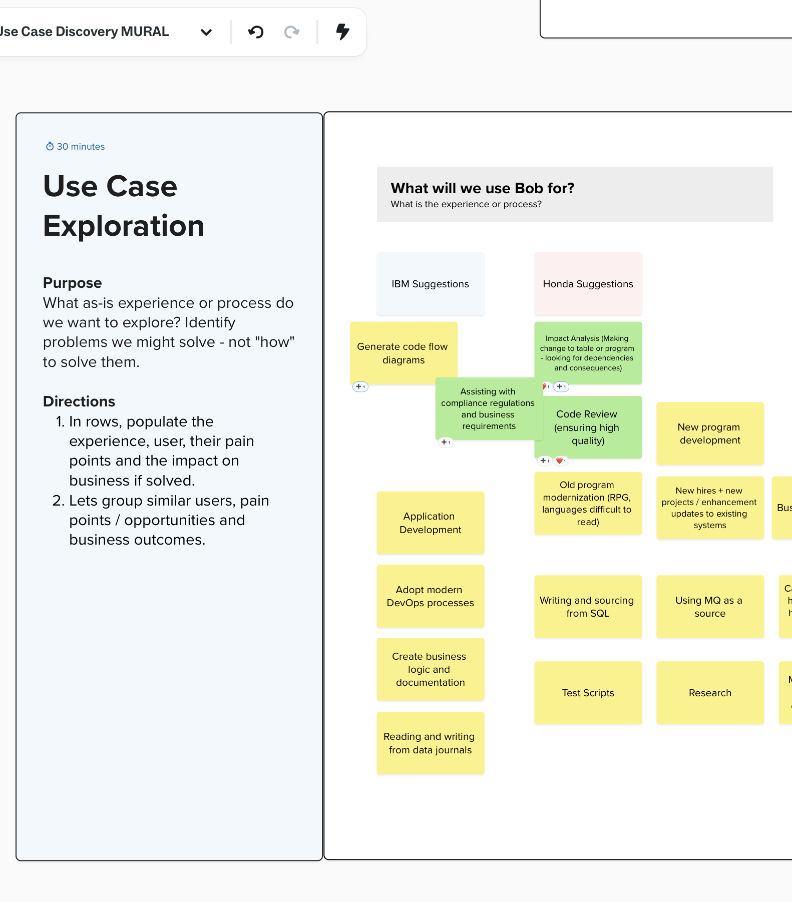
Use Case Discovery
A part of Bobathon w/Premium Package for i
IBM + Honda Logistics
Sept 24, 2026

Slide 2
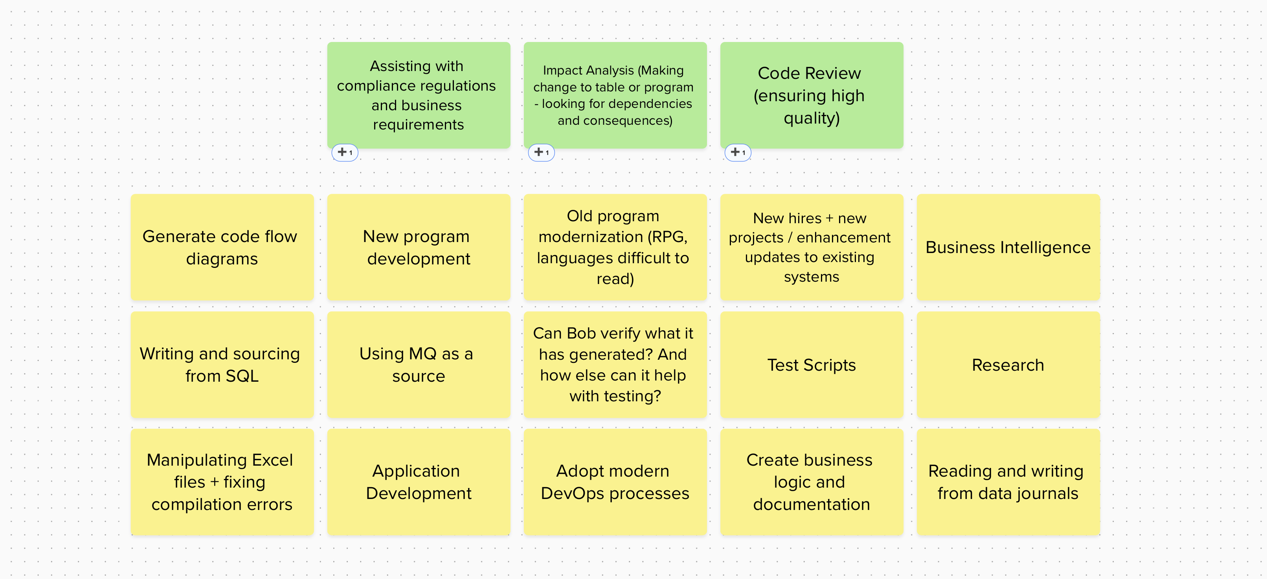
What will we use Bob for?
Biggest Opportunities
Notes:
The top 3 use cases this team wanted to use Bob for is:
Impact Analysis
Code Review
Assisting with compliance regulations and business requirements

Slide 3
3 Biggest Opportunities
Impact Analysis
Code Review
Regulatory Compliance
Looking for dependencies and consequences and making changes to tables and programs.
Ensuring high-quality code.
Assisting with compliance regulations and business requirements.
TIME
Analysis takes 3-4 months and testing takes 4-5 months.
Bob can reduce 8 months of work to 1 month.
Code review takes 2-3 weeks. It can be a challenge.
Bob can help with logic, ensuring nothing is missed.
The multi-step process takes weeks + has manual tracking.
Bob can help with technical and design requirements.
RESOURCES
Devs work on multiple projects at the same time.
2-3 programmers spend 2-3 weeks on a typical project.
Within a year, there are 4 major projects, 32-40 minor projects or enhancements, and 400 tickets raised. 3-4 leads are leading projects.
Devs work on multiple projects at the same time, spending ~3 weeks per project.
Projects are currently tracked in excel + Microsoft projects.
INCONVENIENCE
Testing takes a long time
Balancing time for major projects is a challenge.
Creating documentation requires a lot of different sources and information.

