Slide 1
Minesweeper
Frank Corso & Daniel Farquhar

Slide 2
Background
Since the launch of Windows 10, Minesweeper has been unavailable by default on Windows PCs.
we intend to recreate a stand-alone version of the game for modern Windows operating systems.

Slide 3
System specifications
Development Language: C#
Used primarily due to .NET being created to work with Windows
Deployed as a stand-alone .exe file
No installation required
Should be able to run from any Windows 10 computer without any problem
May work with older Operating Systems, but there is no guarantee
Able to run on relatively low power machines

Slide 4
Basic gameplay loop
Game Start:
Select difficulty from one of three: Beginner, Intermediate, Expert
Changing this during gameplay will reset the game
A board is then generated using a pseudo-random generation algorithm
Main Gameplay:
If the user left-clicks on any square, which then reveals what is under it
An empty square then opens up all other adjacent empty squares
A square containing a number indicating the number of mines nearby, simply opens up
Clicking on a mine, reveals the location of all other mines and ends the game

Slide 5
Basic gameplay loop
Main Gameplay:
If the user right-clicks on any square, it places a flag on it, which then marks it at a suspected mine
The game is won when all the mines in the game are successfully identified with a flag
If the user clicks on the reset button at any time during gameplay, the game is reset.

Slide 6
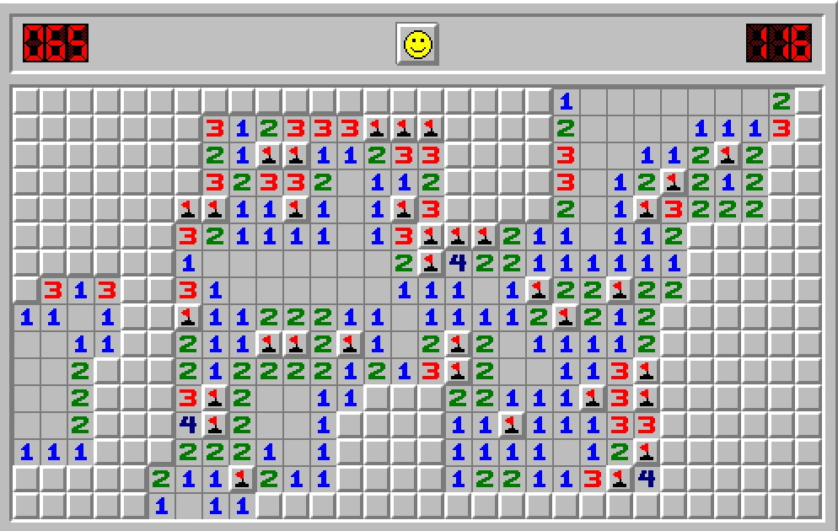
Basic UI Layout

Slide 7
Non-functional requirements
Explosion effects are need to be synced
All threads get equal execution time
Uses a system of board “patterns” to generate the boards faster
Should take no more than 0.5s in the absolute worst case to create the board

Slide 8
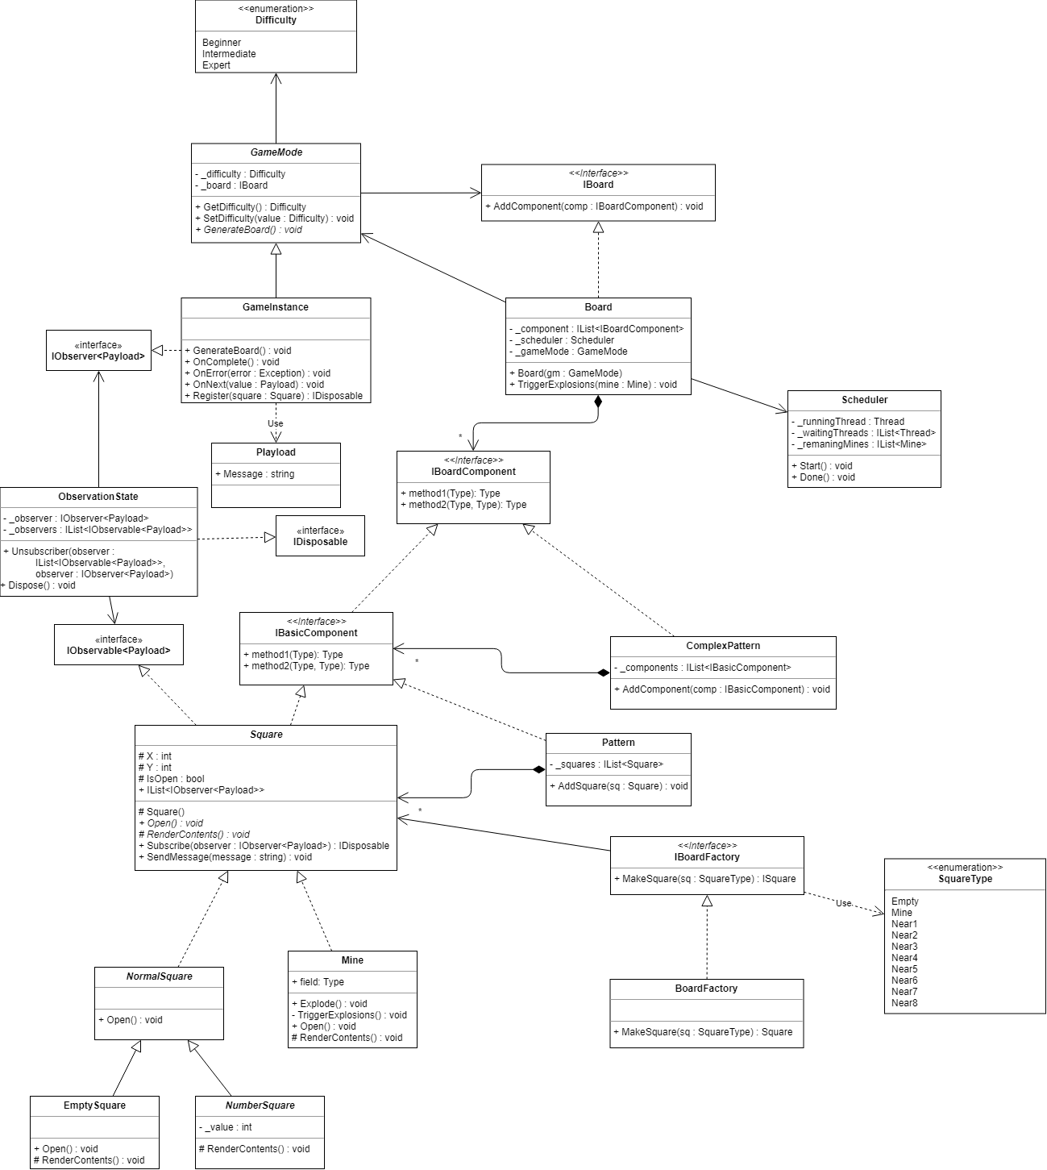
Overall system design
The following patterns are being utilized in this system:
Factory
Composite
Dynamic Linkage
Observer
Scheduler

Slide 9
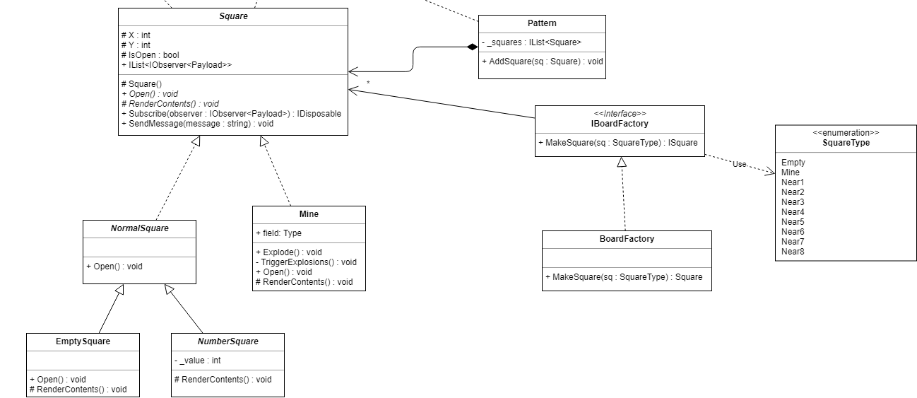
Factory Pattern
Used to determine which type of square to create based on the random generation algorithm’s result. The system also has to parse the mine locations in order to place the numbers
This facilitates the creation of the squares and may allow for new types of square in the future
For example and empty square that has an image underneath it

Slide 10
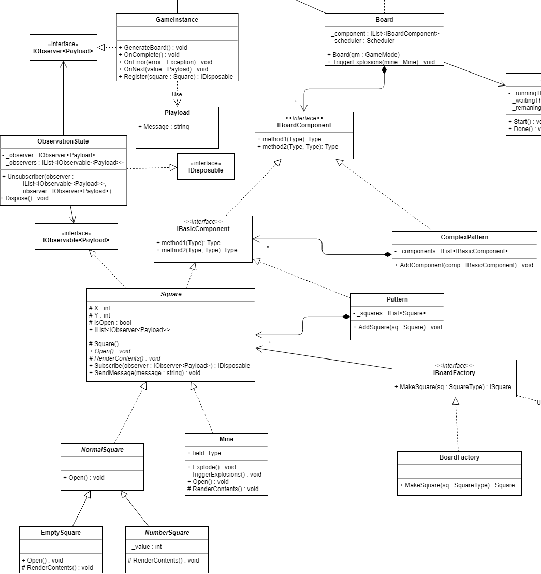
Composite
There are not only multiple types of square, but also various types of components that are composed of each other, which is used in order to utilize the pattern systems the generation algorithm uses

Slide 11
Dynamic Linkage
The game board uses a generation program to make the board, which in turn uses the game board to parse the size of the board as well as other user settings, based on the difficulty mode.
The way the game works, the Board and GameMode need to have access to each other, which this pattern provides

Slide 12
Observer
The game uses the GameInstance class an an observer to watch the squares as they are all opened up and flagged
The observer class is used to trigger the cascade explosion effect once it observes a mine being clicked on
It also is used to parse the victory state for the player

Slide 13
Scheduler
Used to regulate the explosion effect
When a mine explodes, all the adjacent mines are placed into a queue and then set off in parallel after a short delay
This process is then repeated until all mines have been set off

Slide 14
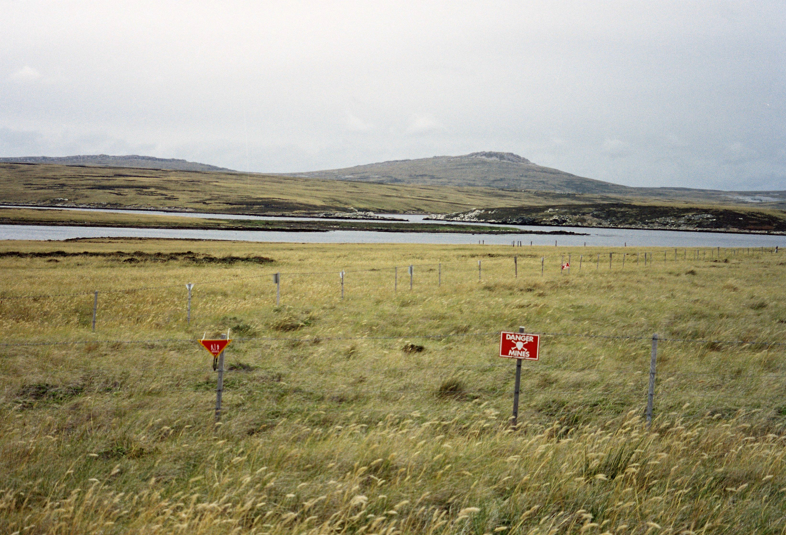
Questions!

