Slide 1

Service Discovery Pattern Designer
JOSÉ DANILO SÁNCHEZ TORRES Mee. Eng

Slide 2








About Me
Technical Manager (GLOBANT)
Systems Engineer (POLIGRAN)
master's degree in education ( UPN)
Student master’s degree in IT management (UCC)

Slide 3
Diary
Contextualization
Microservices?
Service Discovery Pattern Design
Study case: Java - Docker

Slide 4
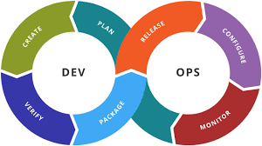
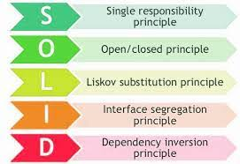
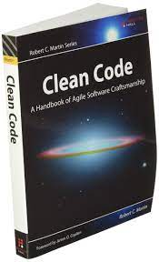



1. Contextualization

Slide 5


1. Contextualization - question 1
¿What is more important: architecture or functionality of any application?

Slide 6
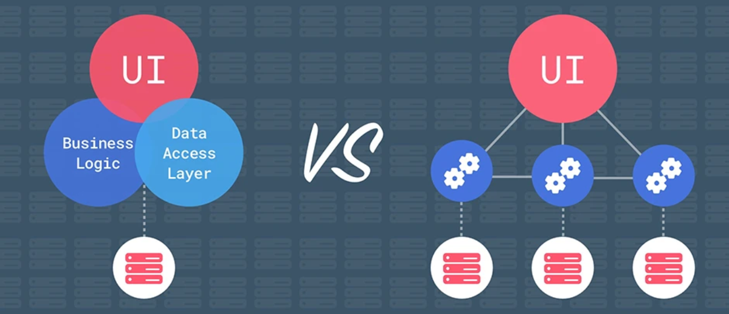
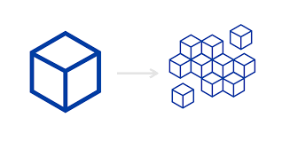
2. Microservices?

Slide 7
2.1. Microservices - question 1
¿What is better an monolithic architecture or a microservices architecture?

Slide 8





2.2. Microservices - question 2
¿What programming language can I use for implementing a microservices architecture?

Slide 9
2.3 Microservice - Definition
A microservice is an independently deployable and developable, small, modular service that addresses a specific and unique business process or problem, and communicates via a lightweight event-based, asynchronous, message-based architecture

Slide 10
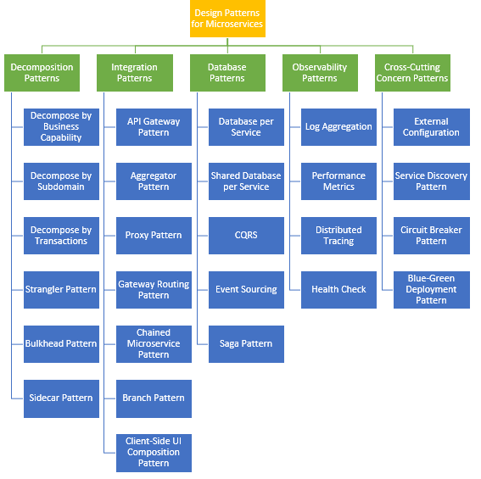
2.4 Microservices Patterns

Slide 11
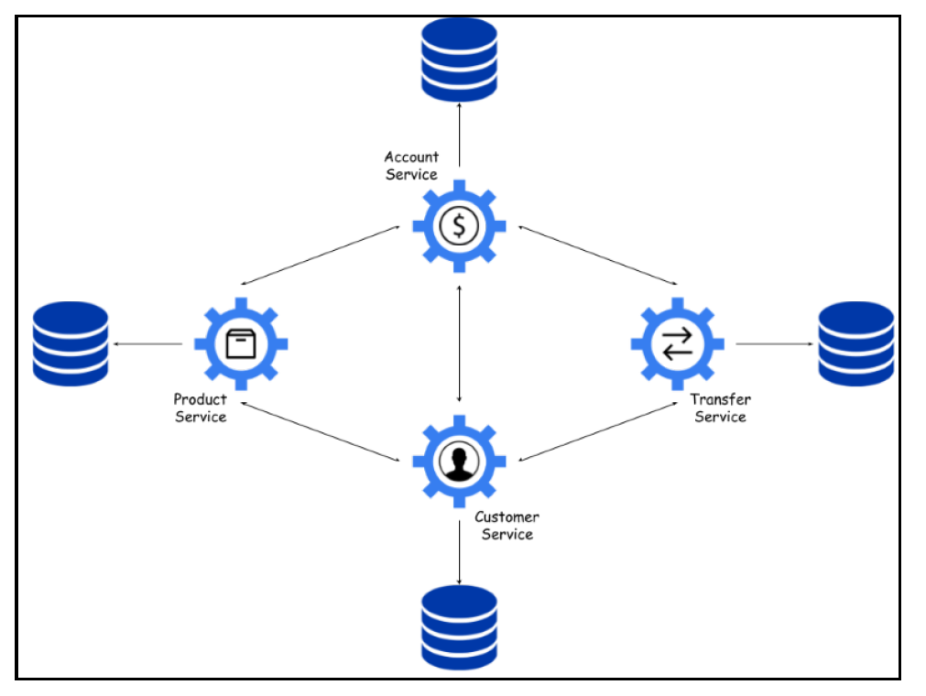
3. Service Discovery Pattern Designer
.

Slide 12
3.1 Service Discovery Pattern Designer - Features
Permits realize an automatic detection of each microservices.
Each service is registered itself in one central place that is accessible by all other services.
The registration key should be the unique name of a service
Each service gets a full list of the services registered on the particular discovery server

Slide 13
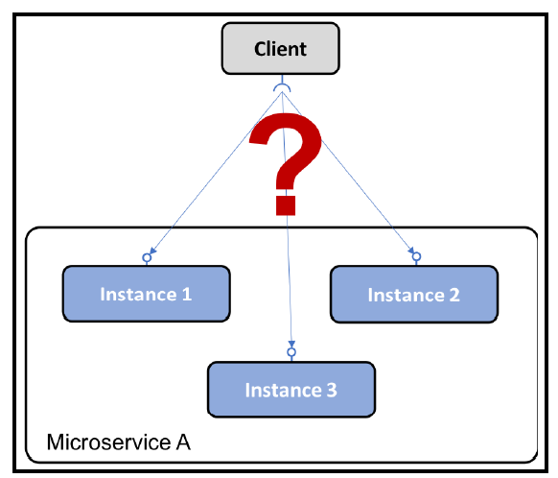
3.2 Service Discovery Pattern - problem
Microservices instances are typically assigned dynamically allocated IP addresses when they start up(using containers). This makes it difficult for a client to make a request to a microservice(Rest API over HTTP)
How can clients find microservices and their instances?

Slide 14
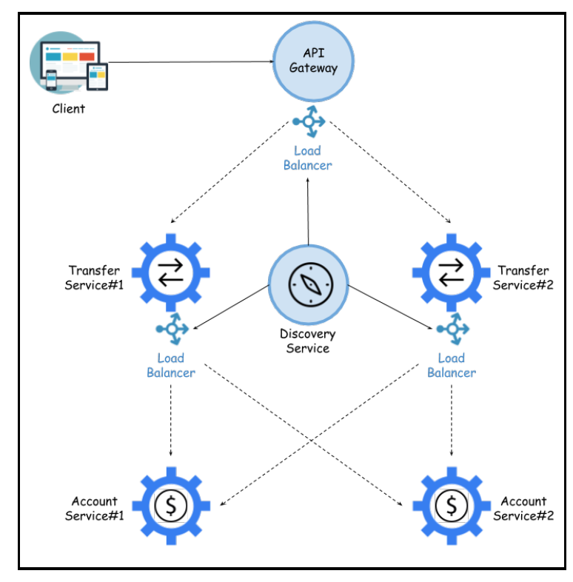
3.3 Service Discovery Pattern - solution
In this case, Add new component named "service discovery" service to the system, which keeps track off
currently available microservices and the IP addresses of its instances

Slide 15
3.4 Service Discovery Pattern - solution requirements
Some solution requirements are the followings:
Automatically register/unregister microservices and their instances as they come and go
The client must be able to make a request(routed) to a logical endpoint for the microservice.
Requests to a microservice must be load-balanced over the available instances
We must be able to detect instances that are not currently healthy, that is, requests will not be routed to them.

Slide 16
3.5 Service Discovery Pattern - solution requirements - final
.

Slide 17
3.6 Service Discovery Pattern - implementations notes:
This design pattern can be implemented using two strategies:
Client-side routing: the client uses a library that communicates with the service discovery service to find out the proper instances to send the requests to.
Server-side routing: the infrastructure of the service discovery service also exposes a reverse proxy thal all requests are sent to. The reverse proxy forwards the requests to a proper microservice instance on behalf of the cliente

Slide 18
3.7 Frameworks and software components - Service Discovery
 | JAVA | JAVASCRIPT
Application Framework | Spring - Quarkus | NodeJS
Build tool | Maven - Gradle | Grunt
Unit-testing Framework | JUnit - Mockito | Jest
API Gateway | Spring Cloud
Service Discovery | Spring Cloud Eureka - Consul | npm service discovery
Client-side load balancing | Spring Cloud Netfilx-Ribbon | NGINX - ExpressJS

Slide 19
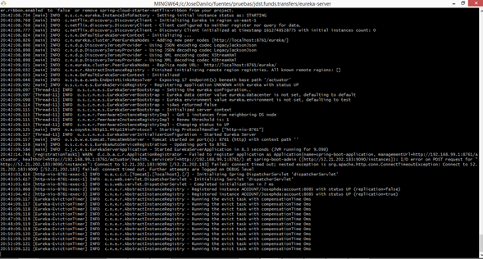
4. Study case: java - Docker - Service Discovery

Slide 20
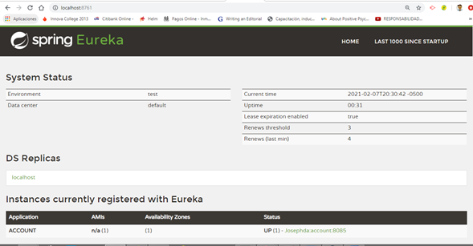
4.1 Study case: java - Docker - Service Discovery (2)

Slide 21
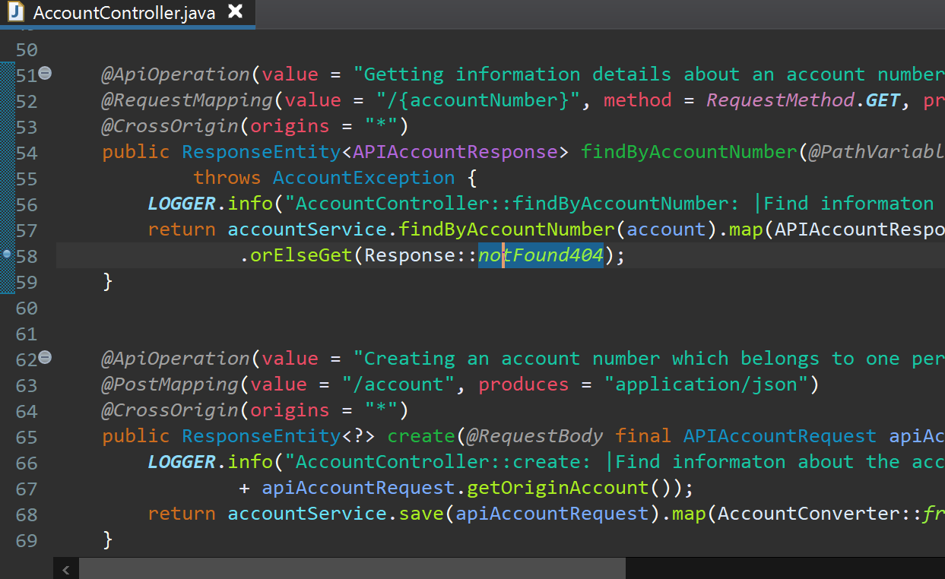
4.2 Study case: java - Docker - Service Discovery (3)

Slide 22
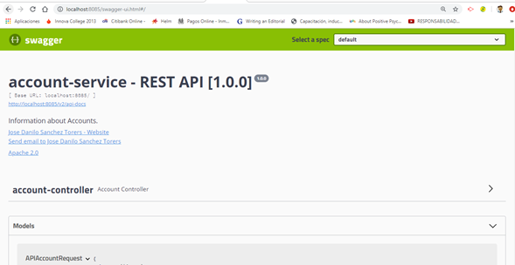
4.3 Study case: java - Docker - Swagger

Slide 23


