Slide 1




EcoreTools-Next: Executable DSL made (more) accessible

Slide 2
About us
Fabien Coulon
Research Engineer
at team DiverSE,
Université Rennes 1
Cédric Brun
CTO
at Obeo,
Nantes

Slide 3

Executable DSL
Interpreter
Compiler
Model Transformation
Static Model Analysis
Etc ...

Slide 4
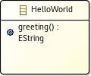
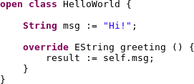
ALE : Action Language for EMF
Complement an Ecore metamodel
  with Runtime Data
  by implementing EOperation

Slide 5

What is ALE ?
Ale is a type of beer brewed using a warm fermentation method, resulting in a sweet, full-bodied and fruity taste.
  Wikipedia

Slide 6
What is ALE ?
Action Language for EMF
Integrated to EcoreTools
  Interpreted Language

Slide 7
What is ALE ?
Action Language for EMF
Integrated to EcoreTools
  Define behavior
  over metamodel
  Interpreted Language
open class FSM {
def void foo() {
State currentState := … ;
if (currentState.oclIsKindOf(Initial)) {
Initial state := currentState; //valid statement
}
}
}

Slide 8
What is ALE ?
Action Language for EMF
Integrated to EcoreTools
  Define behavior
  over metamodel
  Interpreted Language
  Static typing
open class FSM {
def void foo() {
State currentState := … ;
if (currentState.oclIsKindOf(Initial)) {
Initial state := currentState; //valid statement
}
}
}

Slide 9
What is ALE ?
Action Language for EMF
Integrated to EcoreTools
  Define behavior
  over metamodel
  Interpreted Language
  Static typing
  Type inference
open class FSM {
def void foo() {
State currentState := … ;
if (currentState.oclIsKindOf(Initial)) {
Initial state := currentState; //valid statement
}
}
}

Slide 10

Design Ecore
metamodel
is easy
Thanks EcoreTools !

Slide 11
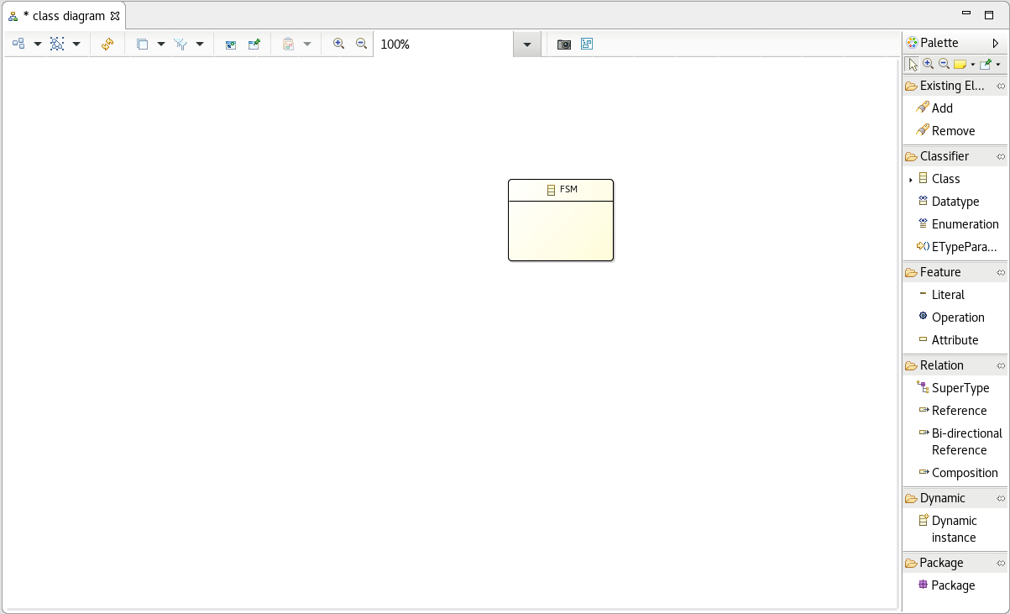
MiniFSM

Slide 12
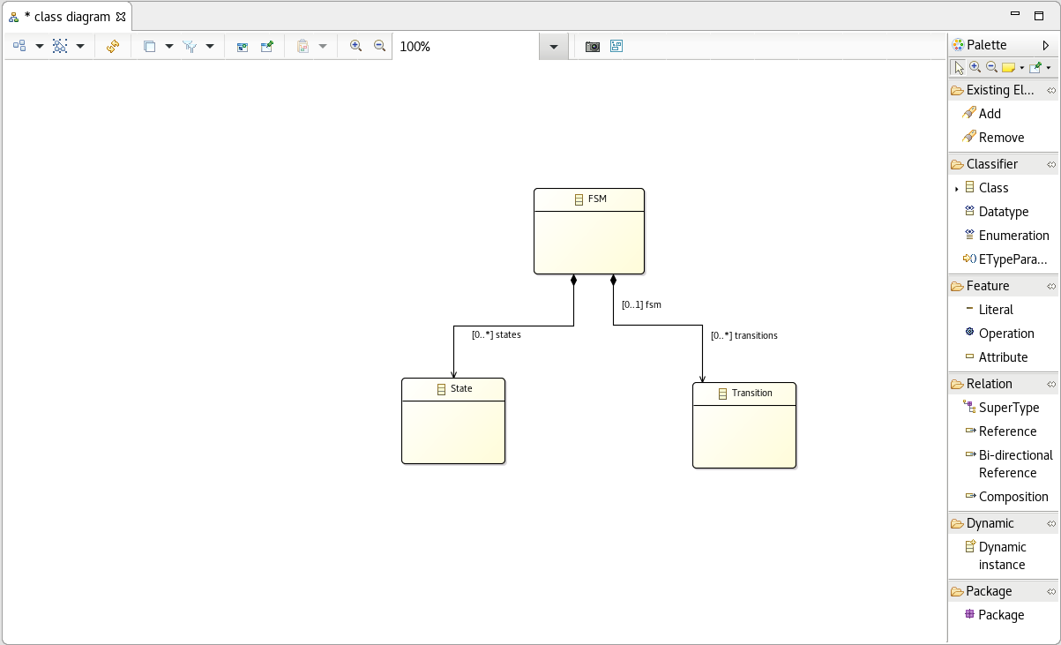
MiniFSM

Slide 13
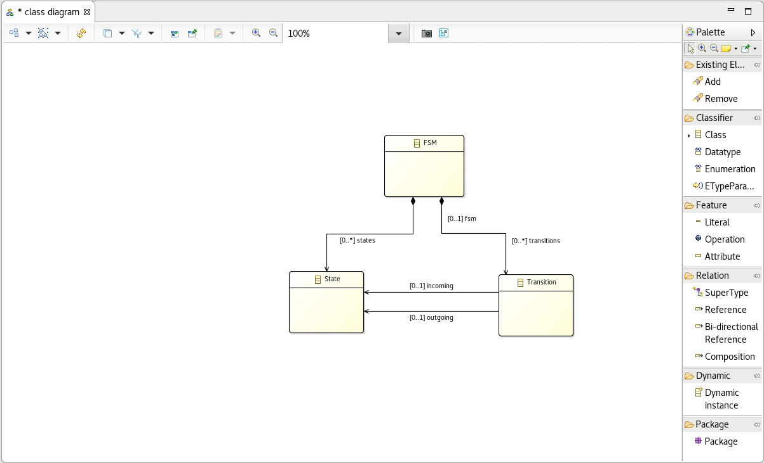
MiniFSM

Slide 14
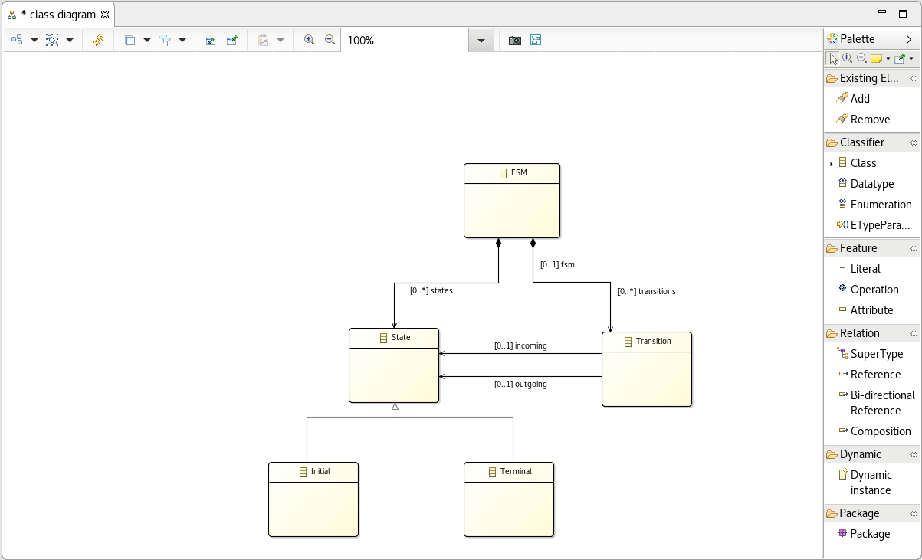
MiniFSM

Slide 15
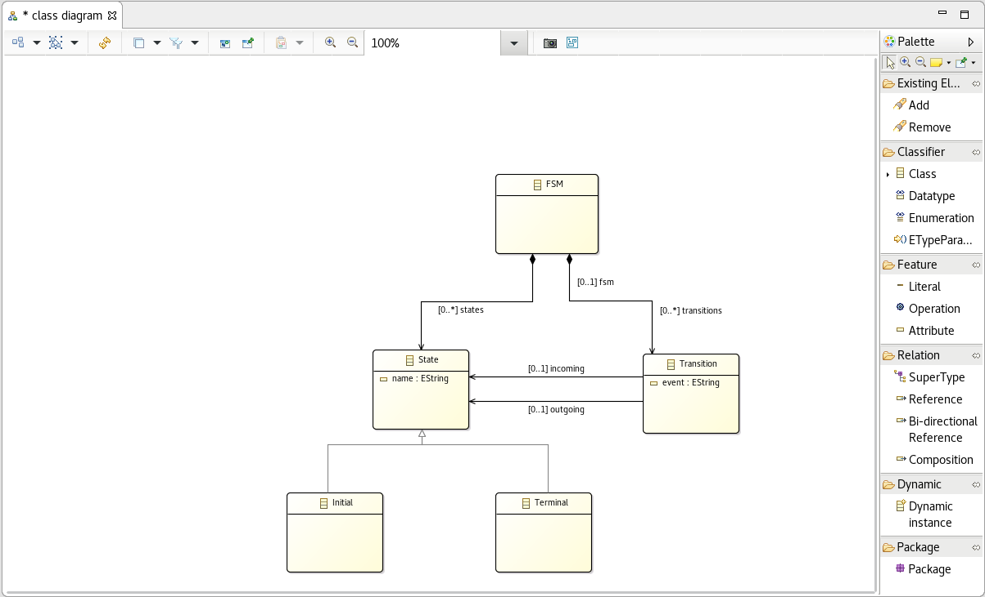
MiniFSM

Slide 16
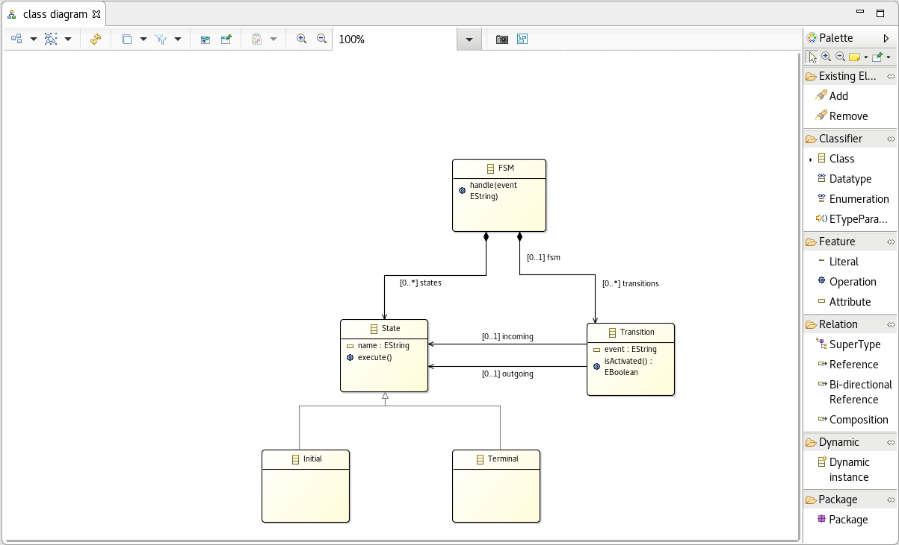
MiniFSM

Slide 17

Write implementation
is not that easy
Modify generated code
Configure the code generation
Use delegation mechanism
Use the generated Switch
Use other tools
Generate code and then:

Slide 18
Write implementation
is not that easy
Modify generated code
Configure the code generation
Use delegation mechanism
Use the generated Switch
Use other tools
Generate code and then:
You have to master the compilation chain

Slide 19
  Code generation step
Can’t design .ecore & test implementation in parallel

Slide 20

  Code generation step
Can’t design .ecore & test implementation in parallel
Run another Eclipse

Slide 21
  Code generation step
Can’t design .ecore & test implementation in parallel
Run another Eclipse
… 20 times a day

Slide 22

Quick Design-Run cycle with ALE
Interpreted behavior
  Just run it !
No code Generation needed
No plugin deployment needed

Slide 23

Demo#1
Implement an EOperation
Run an xDSL

Slide 24
ALE overview
Open Class
Action Language

Slide 25
Ecore
Separate concerns
  Abstract syntax
  Semantic (Runtime data & Behavior)
Open Class
Notes:
Ecore is structural

Slide 26
Demo#2
Re-open FSM EClass
Add currentState feature

Slide 27
ALE overview
Open Class
Action Language

Slide 28
AQL
Acceleo Query Language
EMF Language by Obeo
  Navigate model
  Query model
Expression
Lambda
Easy extension through services mechanism
Interpreted
  No code generation needed
(x.tokens > 0) or ( x.tokens = -1)
myCollection.select(elem | elem.tokens = -1)
obj.myNewService()

Slide 29
ALE extends AQL
AQL is an expression language
ALE provides side effects

Slide 30

Introducing assignments
self.event := ‘event1’;
self.events += localVar;

Slide 31
More control flow
if(i < 3) {
//Do something
}
else {
//Don't do something
}
for(elem in collection){
elem.log(); //Print
}
ClassA cls := … ;
switch (c : cls) {
ClassA case c.field = 4 : 4
ClassA : 2
default : 0
};

Slide 32
Multi-inheritance
open class B {
def void bar() { }
}
open class A {
def void foo() { }
}
open class C extends A,B{
def void main() {
self.foo();
self.bar();
}
}

Slide 33
Runtime Data
class Message {
unique 0..* Node target;
}
open class Stream {
contains 0..* msgs;
opposite outStream
Node toNode;
}

Slide 34
Type inference
EObject obj := … ;
if (obj.oclIsKindOf(ClassA)) {
ClassA a := obj; //valid assign
}
Notes:
Cast without conditinal is error prone

Slide 35

Demo #3: make executable FSM
in 10 minutes

Slide 36
Summary
Action Language for EMF
Made an Executable FSM from scratch
  By re-openning classes

Slide 37
Future Plans
Maturate to industrial grade
Debugger
Animated execution
  https://www.eclipse.org/sirius/lab.html
Compiler: Open class to Java code

Slide 38
Action Language for EMF
Easy executable DSL
Through EcoreTools
No plugin deployment
It is interpreted

Slide 39

Thank you!

