Slide 1
ANDROID APPLICATION
Traditional vs. HouseFinder
HouseFinder
Traditional
HouseFinder
Speed
Slow
Instant
Bridging the Gap in Real Estate Discovery
Updates
Manual
Real-time
Platform
Desktop
Mobile-first
Core Stack
Kotlin
Type-safe, concise language for Android
Listings
Fragmented
Centralized
Android Jetpack
Lifecycle, Navigation, ViewModel
Hilt
Dependency injection framework
Material Design 3
Modern, accessible UI components
Refs: kotlinlang.org · developer.android.com/jetpack

Slide 2
02
Purpose & Business Strategy
CHALLENGES
AUTHENTICATION FLOW
High barriers for small-scale property providers
Launch App
No secure reservation tracking for owners
Login / Register Screen
Stale listings — no real-time availability updates
No
Validate Credentials
Valid?
BUSINESS RULES
Role-based access
Yes
Provider vs. Seeker dashboards
Check User Role
Credential security
Provider
Seeker
jBCrypt password hashing
Provider
Dashboard
Seeker
Dashboard
Offline support
Room-backed data persistence

Slide 3
03
System Design & Database Schema
ER DIAGRAM
MVVM ARCHITECTURE
USER
UI Layer
UI
PK
id
Fragments · XML Layouts · ConstraintLayout
email
1
passwordHash
VM
ViewModel Layer
userRole
1
ViewModels · StateFlow · LiveData
N
N
LISTING
RESERVATION
RE
Repository
PK
id
N
PK
id
1
ListingRepository · UserRepository
FK
providerId
FK
seekerId
title
FK
listingId
price
status
DB
Data Source (Room)
imageUrl
timestamp
DAOs · Entities · SQLite

Slide 4
04
Data Management & Software Stack
Coil
Room DB
Navigation
Lifecycle-aware async image loading
Offline-first local data persistence
Type-safe fragment transitions
coil-kt.github.io/coil
developer.android.com/room
Jetpack Navigation Component
SEQUENCE DIAGRAM — Listing Load Flow
ListingListFragment
ListingViewModel
ListingRepository
Room (DAO)
collectLatest { }
getListings(filter)
dao.getAll()
Flow<List<Listing>>
emit(listings)
UiState.Success(data)
Requirements: Android SDK 26+ · 4 GB RAM

Slide 5
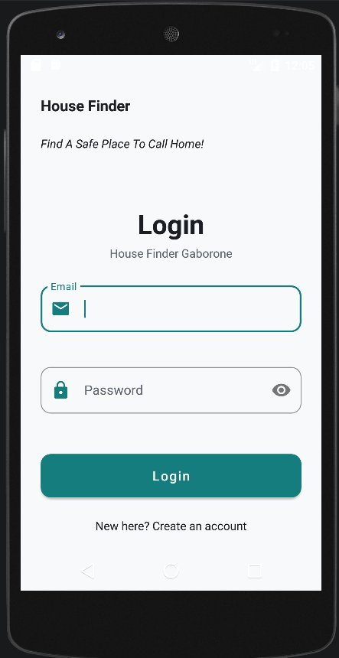
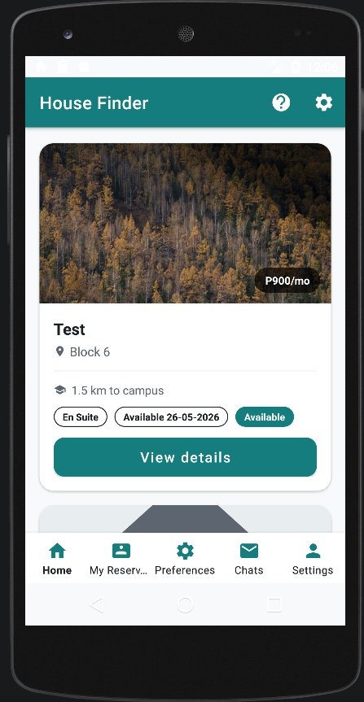
05
UI Implementation
UI FEATURES
ConstraintLayout
Flat view hierarchy for optimised rendering
Material Chips
Real-time filter chips — price, type, distance
Material Design 3
Consistent teal palette, accessible typography
Navigation Component
Type-safe fragment transitions, back stack
Coil Image Loading
Async, lifecycle-aware property photo display
fragment_login.xml
fragment_listing_list.xml

