Slide 1
Observational Studies
Effect of Antidiabetic Agent Choice on Cardiovascular Morbidity and Mortality in Type 2 Diabetes Mellitus
Kate Gelperin, M.D., M.P.H.
FDA CDER Office of Surveillance and Epidemiology
Division of Drug Risk Evaluation (DDRE)

Slide 2
Background
AUG 2006 submission from GSK
    Pooled AVANDIA clinical trials
    Observational study from Ingenix
DDRE review completed FEB 2007
    Regulatory recommendations based on information at that time
Two new observational studies from GSK not yet fully reviewed by FDA

Slide 3
Overview – Observational Studies in Type 2 Diabetes Mellitus (T2DM)
Methodologic challenges in studying cardiovascular outcomes in T2DM
Published population-based studies of cardiovascular outcomes in T2DM
    From Saskatchewan and Tayside
FDA review of Ingenix study
    Included in background package
Two new observational studies from GSK
    Received in June / July 2007
    Preliminary FDA review will be presented
    Not in FDA background package

Slide 4
Observational Studies in T2DM – Methodologic Challenges
Can these observational studies provide sufficiently robust evidence to refute the safety signal identified in the meta-analysis of randomized controlled trials with rosiglitazone?

Slide 5
Observational Studies in T2DM – Methodologic Challenges
OUTCOME – missing ascertainment of out of hospital cardiovascular deaths
EXPOSURE misclassification
Unmeasured CONFOUNDING and other sources of potential bias

Slide 6
Published Observational Studies of Cardiovascular Morbidity and Mortality in Patients with T2DM
Johnson et al. “Reduced cardiovascular morbidity and mortality associated with metformin use in subjects with T2DM”
  Saskatchewan Health Services Databases
  Diabetic Medicine; 22:497-502, 2005
Evans et al. “Risk of mortality and adverse cardiovascular outcomes in T2DM: a comparison of patients treated with sulfonylureas and metformin”
  Tayside Medicines Monitoring Unit (MEMO)
  Diabetologia 49: 930-936, 2006

Slide 7
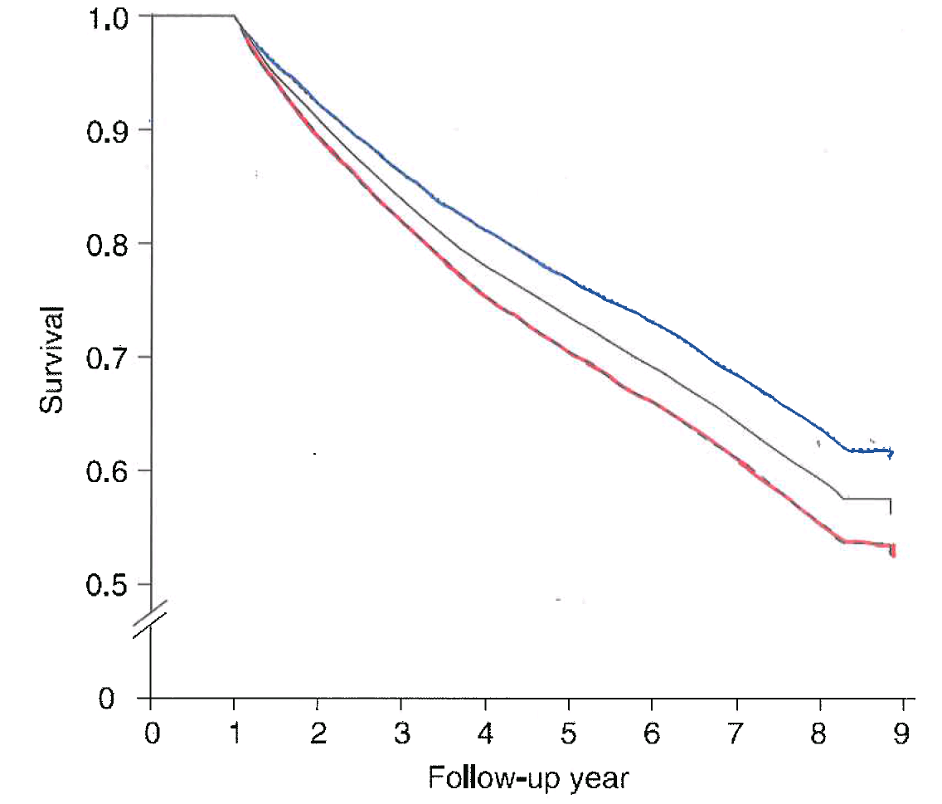
Time to First Non-fatal Cardiovascular Hospitalization or Death (Johnson 2005)
MET monotherapy
SU monotherapy
Combination SU and MET
Johnson et al, Diabetic Medicine; 22:497-502, 2005

Slide 8
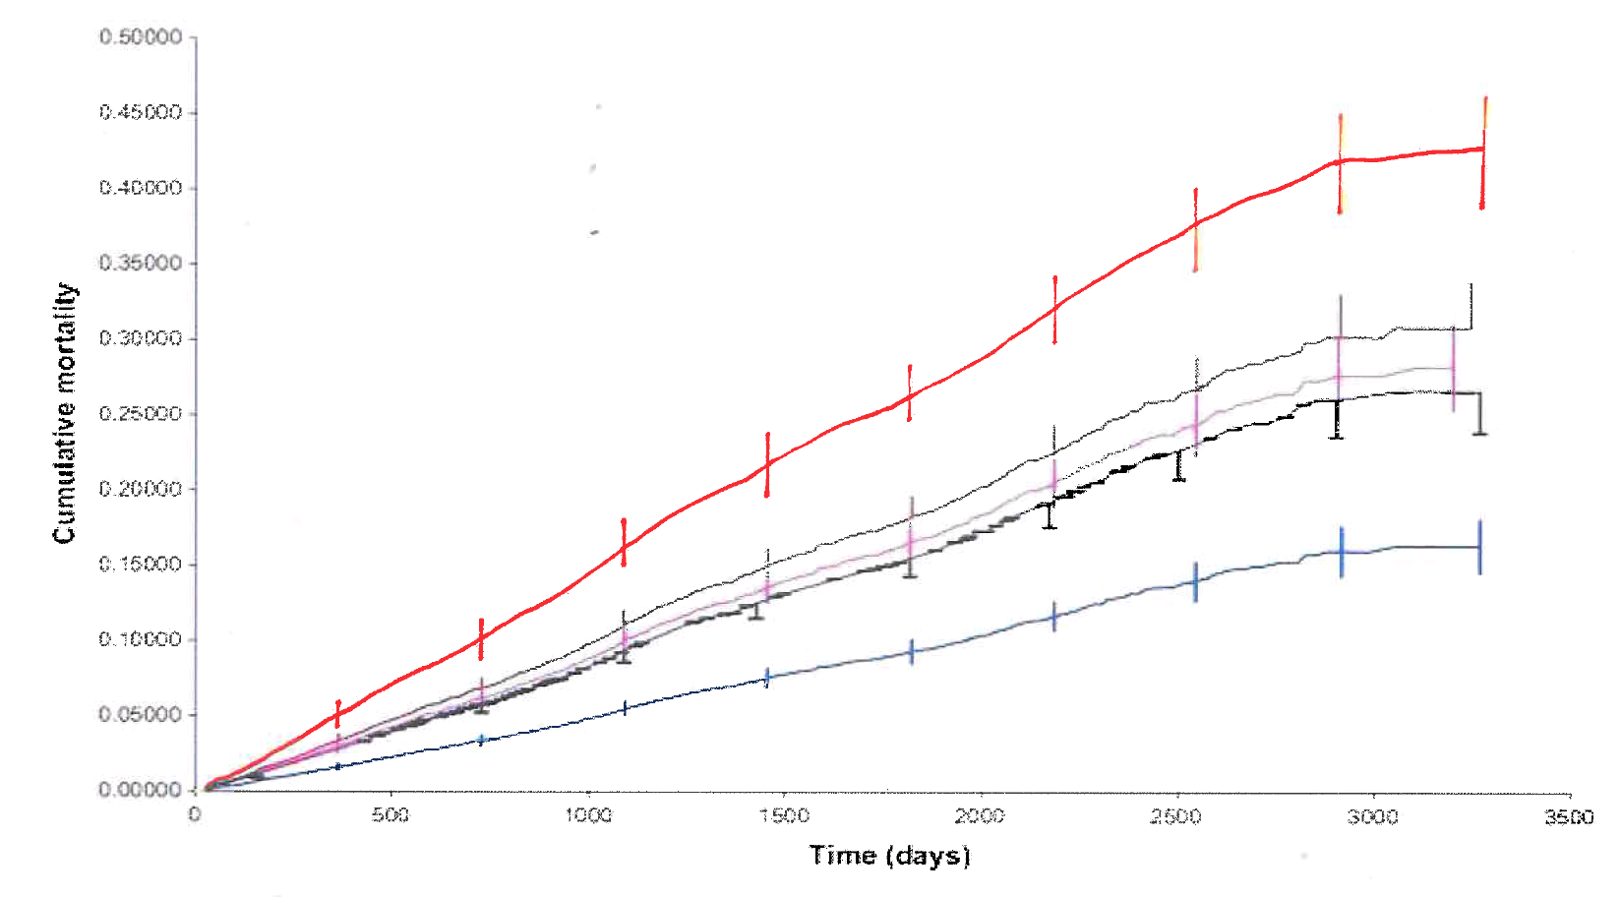
Cumulative Cardiovascular Mortality Rates (Evans 2006)
SU Monotherapy
MET Monotherapy
Adjusted risk ratio (95%CI) 1.70 (1.18-2.45)
SU monotherapy
Combination SU and MET
MET monotherapy
Evans et al, Diabetologia 49: 930-936, 2006

Slide 9
GSK Observational Study #1–
Coronary Heart Disease Outcomes in Patients Receiving Antidiabetic Agents
Balanced Cohort Study
Enrollees of United Healthcare health plans
Drug initiators from JUL 2000 through DEC 2004
Matched cohorts using multivariate balancing procedure (propensity score matching) to match comparable initiators for each study group
New cases of myocardial infarction or coronary revascularization were identified up to JUN 2005

Slide 10
Coronary Heart Disease Outcomes in Patients Receiving Antidiabetic Agents
Outcomes identified in claims data:
  Hospitalized fatal or nonfatal myocardial infarction (primary discharge diagnosis code ICD9 410.xx )
  Coronary revascularization (based on procedure codes)
Outcome does not include out-of-hospital cardiovascular deaths

Slide 11
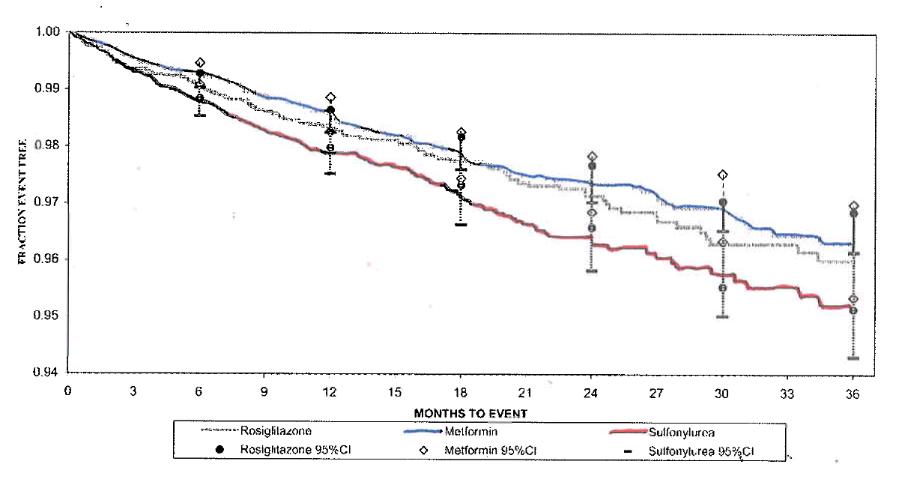
Composite Outcome in the Monotherapy Group
(Fraction Event Free)
MET monotherapy
Rosiglitazone monotherapy
SU monotherapy
Adapted from Figure 3a Ingenix Study Report HM2006/00497/00

Slide 12
GSK Observational Study #2 –
Coronary Heart Disease Outcomes in Patients Receiving Antidiabetic Agents in the Pharmetrics Database
New users of specific antidiabetic therapies
Pharmetrics aggregate of 80 US health plans
Drug initiators from JUN 2000 through Mar 2007
Pairwise comparisons stratified on pair-specific propensity scores
New cases of myocardial infarction or coronary revascularization were identified from hospital insurance claims data

Slide 13
Study Limitations - General
Study populations from both Ingenix and PharMetrics databases have relatively fewer patients ≥65 years of age compared to overall population of diabetics
Limited generalizability to older (≥65 years of age) population

Slide 14
Major Limitation - Outcome
Outcome definition was not inclusive enough to capture the same events as the clinical trials

Slide 15
Proportion of Cardiovascular (CV) Deaths from AVANDIA RCTs Unlikely to be Ascertained in Claims Data
Cardiovascular Deaths | RSG N = 8604 | Comparator N = 5633
Total | 16 | 6
Out-of-hospital | 10 (63%) | 3 (50%)

Slide 16
Proportion of Myocardial Ischemia SAEs from AVANDIA RCTs Unlikely to be Ascertained in Claims Data
Myocardial Ischemia SAEs | RSG N = 8604 | Comparator N = 5633
Total | 86 | 40
Out-of-hospital | 9 (10.5%) | 3 (7.5%)

Slide 17
Study Limitations - Exposure
Definition of new user
    Based on six month look back – long enough?
    Depletion of susceptibles can lead to apparent dilution of risk in all exposure groups
Exposure ascertainment
    No documentation of actual compliance with prescribed therapy – poor adherence?
    Switching among study cohorts - common in study #1, likely also in study #2
    Leads to misclassification bias

Slide 18
Study Limitations - Confounders
Unmeasured confounding
Definition and capture of events
    Is six months long enough to capture information on confounders in claims data?
    Completeness of the list of confounders (e.g. smoking, aspirin)?

Slide 19
GSK Observational Study #3 –
An Assessment of the Effect of Thiazolidinedione Exposure on the Risk of Myocardial Infarction in T2DM Patients
Nested case-control study compares patients on TZD therapies to a reference group of patients on non-TZD therapies
Integrated Healthcare Information Services (IHCIS) database for the years 1997 to 2006
Flawed Study Design and Analysis
    Reference group includes insulin patients who may have had more cardiovascular comorbidities
    Unknown mix of therapies in exposure groups
    No demonstration of adequate adjustment for baseline risk factors

Slide 20
Observational Studies Comparing Rosiglitazone and Pioglitazone
Pharmetrics study:
  Adjusted HR (95%CI) for RSG vs. PIO:
    MI = 0.783 (0.519-1.180)
    MI+CR = 0.966 (0.777-1.201)
Takeda study * (in press):
  Adjusted HR (95%CI) for PIO vs. RSG:
    MI = 0.78 (0.63-0.96)
    MI+CR = 0.85 (0.75-0.98)
* Has not been reviewed by FDA

Slide 21
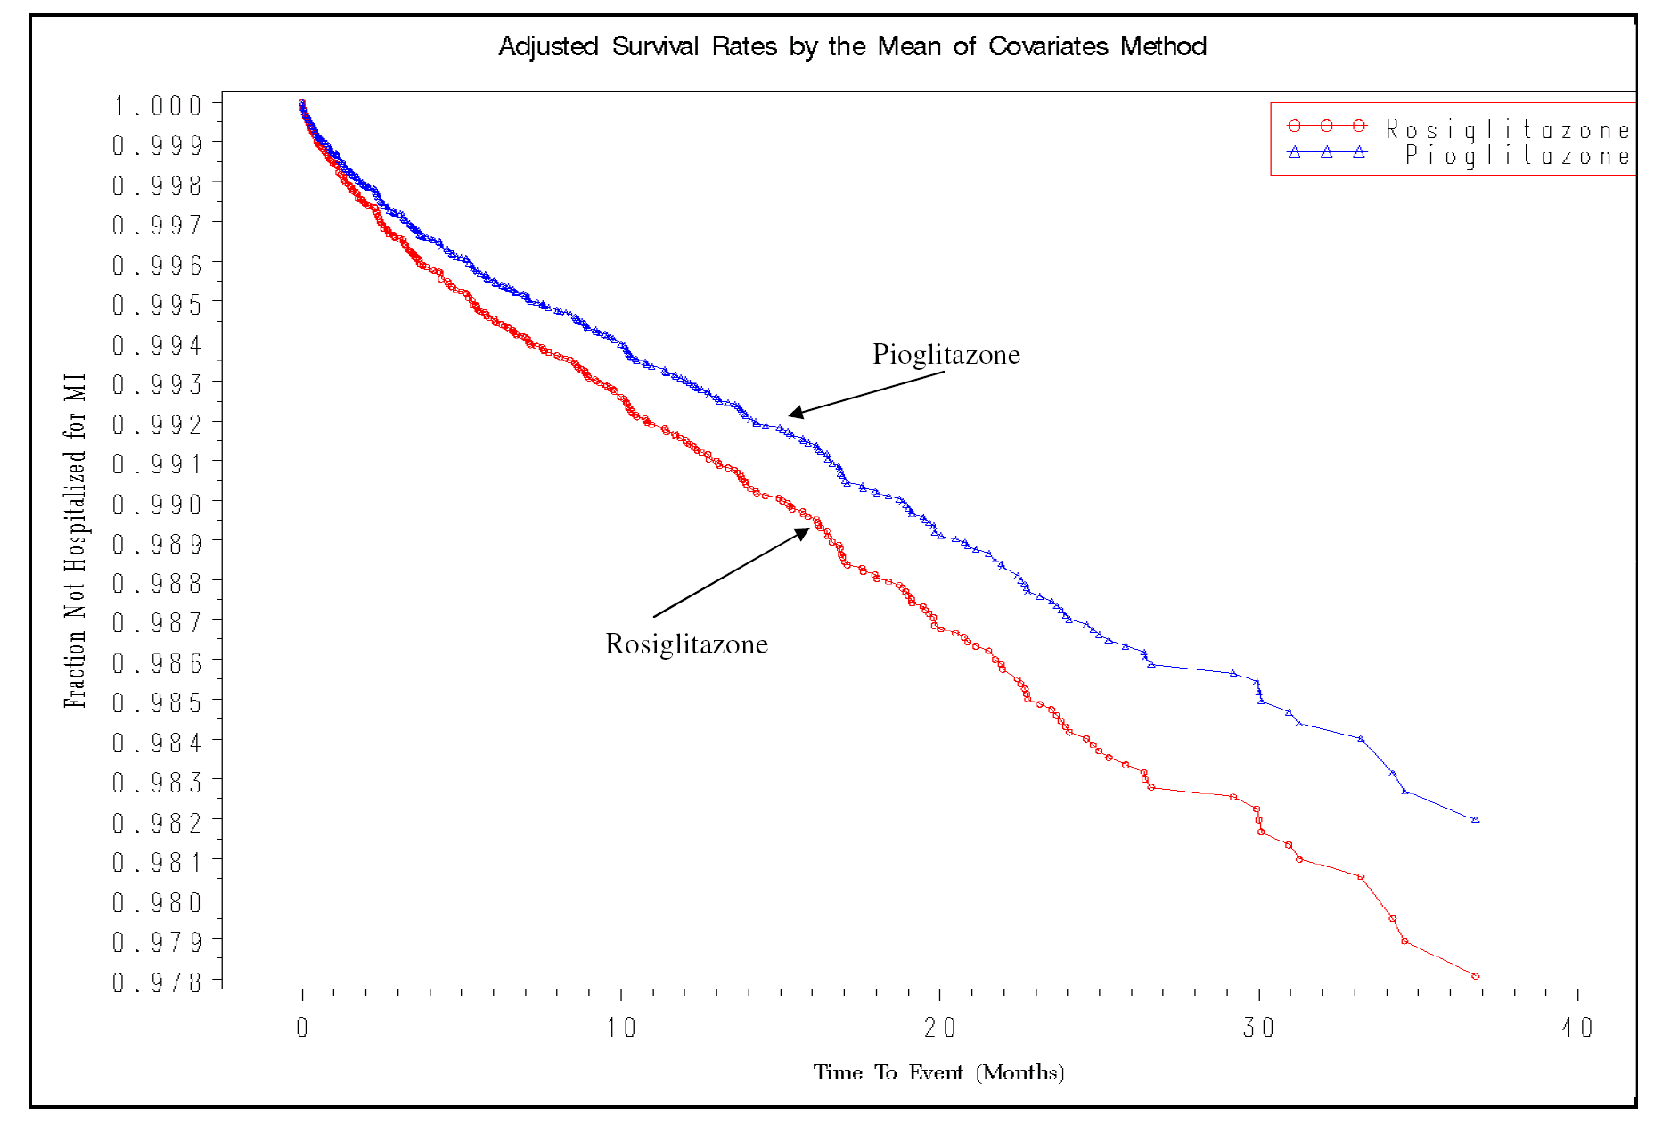
A Comparison of Pioglitazone and Rosiglitazone for Hospitalization for MI in T2DM, Takeda study, in press
HR 0.78 (0.63-0.96)

Slide 22
Summary
Definition of OUTCOME inadequate
    Out-of-hospital cardiovascular deaths seen in adjudicated pooled data from RCTs
    Important “blind spot” in claims data relied on by GSK
EXPOSURE mapping issues
    Potential exposure-related misclassification
Questions remain of unmeasured CONFOUNDING due to incomplete ascertainment of baseline risk factors

Slide 23
Conclusion
Available observational studies do not refute the signal for myocardial ischemia identified in the meta-analysis of randomized controlled trials with rosiglitazone

Slide 24
Acknowledgements
Colleagues in DMEP and Office of Biostatistics
OSE/OB AVANDIA Observational Studies Analysis Team:
    Allen Brinker
    Tarek Hammad
    Yu-Te Wu
    Charles Cooper
    Mark Levenson
    Mark Avigan
    George Rochester
    David Graham
    Gerald DalPan

