Slide 1
Assessment of the cardiovascular risks and health benefits of rosiglitazone
David J. Graham, MD, MPH
Office of Surveillance and Epidemiology
Food and Drug Administration
July 30, 2007

Slide 2
The questions of greatest importance to OSE
1° Does RSG increase the risk of CV events, most importantly, cardiac death, AMI, and stroke?
2° Does CV risk with RSG differ from that of PIO?
3° Does CV risk with RSG differ from that of other oral anti-diabetic agents (e.g., Met, SU)?
If answer to any question is “yes”
  Do the documented health benefits of RSG justify its cardiovascular risks?

Slide 3
Randomized clinical trials data and the OSE question they help to address
Study | Comparison group | Of relevance to Question #
ADOPT | Active | 3?
BARI 2D | Active | 3?
DREAM | PBO | 1,2
GLAI | PIO | 2
PIO meta | Mixed | 2
PROactive | PBO | 2
RECORD | Active | 3?
RSG meta | PBO | 1,2

Slide 4
Does rosiglitazone use increase the risk of cardiac death, AMI and stroke?
RSG meta-analysis
DREAM

Slide 5
Overview of RSG meta-analysis and DREAM
RSG meta-analysis
  1° outcome: total and “serious” Ischemic Heart Disease
  Mean duration DM 5 yrs
  PBO add-on control accounted for 86% of RSG exposure-time; mean f/u ~6 mos
  Post hoc adjudication of routinely reported events
DREAM
  Pre-diabetics; PBO-controlled; f/u ~4.5 years
  Adjudicated CV outcomes

Slide 6
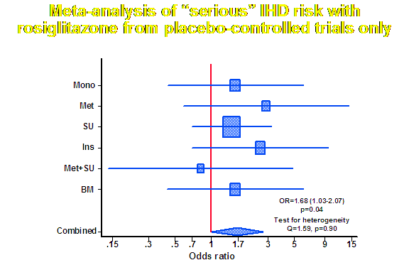

Slide 7
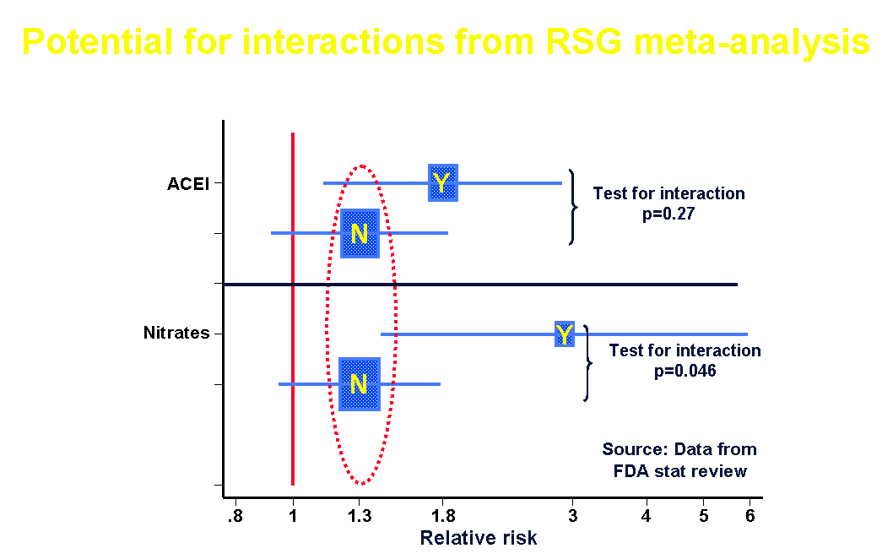

Slide 8
CV outcomes from DREAM by treatment arm
 | RSG + ACEI | ACEI only | RSG only | PBO only
N | 1310 | 1313 | 1325 | 1321
CV composite (%) | 3.4 | 1.8 | 2.4 | 2.4
AMI (%) | 0.8 | 0.2 | 0.4 | 0.5
CHF (%) | 0.8 | 0.1 | 0.2 | 0.1
Notes:
There are aspects of DREAM that remain confusing and contradictory. The view of our Office is that there is clearly something going on in DREAM with respect to the occurrence of AMI and CHF, but we can’t fully explain it.
An interaction between ACEIs and RSG is a possible explanation but there are inconsistencies in the data that suggest the real possibility of other explanations.
It’s well-established that RSG increases CHF risk, so why did DREAM find this risk in the RSG-ACEI arm but not find it in the RSG-only group (point to RSG-only column)?
And if DREAM missed the CHF risk in the RSG-only group, could it also have missed the AMI risk as well? This differential identification of CHF risk is a serious concern for which we have no good answer, except that there may have been differences between the RSG groups that were not addressed by randomization.
Another unanticipated and unexplained contradiction within DREAM involves the seeming interaction between ACEIs and RSG for both CHF and AMI. ACEIs are well-recognized an effective treatment that reduces CHF risk, and there is no pharmacologic reason to explain why RSG should interact in such a manner with ACEIs for either AMIs of CHF.
The absence of a CHF-effect in the RSG-only arm and the surprising and unexpected increase in CHF risk among patients treated with RSG + ACEI lead us to question whether other explanations are more likely.
These include the play of chance, made worse by the low-risk population studied (pre-diabetics) and the small number of events that occurred; or a problem with ascertainment or coding of events, or perhaps some unrecognized difference in the populations randomized to receive ACEI or no ACEI.
These uncertainties lead us to question whether the appearance of an interaction between RSG and ACEIs is real or an artifact.
The conclusion we draw from DREAM is that RSG increased AMI and the CV composite risk. Data from the RSG-meta-analysis do not support a strong interaction. And even if the interaction is real, this is still a very serious liability for RSG because the majority of RSG-treated patients in the US are also taking ACEIs or closely-related ARBs, and those who aren’t probably should be taking them.

Slide 9
Does RSG increase CV risk?
Yes
  FDA meta-analysis shows 20%-68% increased risk with 6-12 months RSG use compared to non-use, especially noticeable in the placebo-controlled analysis
  DREAM shows ~40% increased risk with RSG
    Relatively low-risk population; placebo-controlled
    Uncertainty about what the possible ACEI “interaction” findings mean, but CV risk is increased
    In 2006, 54% of RSG users took concomitant ACEIs or ARBs, and there is evidence to suggest that all patients with T2DM might benefit from their use

Slide 10
Does rosiglitazone increase CV risk
compared to pioglitazone?
PIO meta-analysis
PROactive
GLAI

Slide 11
Pioglitazone meta-analysis of clinical trials
All randomized, double-blind, controlled trials in Takeda’s clinical trials database excluding PROactive
  10,199 PIO patients; 11,247 PIO person-years
Submitted in Oct 2006; FDA review completed Jan 2007; FDA re-analysis not performed
Pre-specified patient-level, time-to-event analysis, stratified by category of study duration
1° outcome: all deaths + nonfatal AMI + nonfatal CVA
  Identified from standard RCT AE reporting process
  Not adjudicated
Notes:
1. Note that in RSG meta-analysis, 86% of exposure time was to PBO

Slide 12
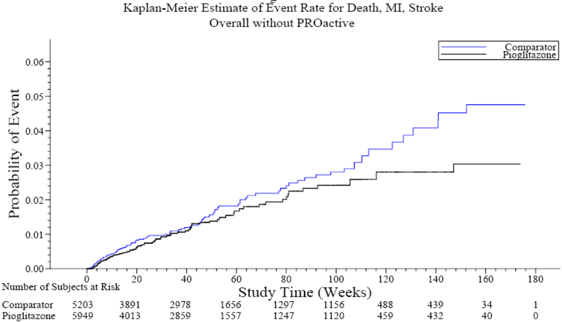
Cardiovascular outcomes from PIO meta-analysis of clinical trials (excludes PROactive)
HR=0.75 (0.55-1.02)
Source: Takeda’s submission

Slide 13
PROspective pioglitAzone Clinical Trial In macroVascular Events (PROactive)
Randomized, double-blind, add-on PBO-controlled
Mean follow-up: 34.5 months
1° outcome:
  All-cause mortality, nonfatal AMI, nonfatal CVA, coronary revascularization, acute coronary syndrome, leg amputation, leg revascularization
HR = 0.90 (0.80-1.02)
2° outcome:
  All-cause mortality, nonfatal AMI, nonfatal CVA
HR = 0.84 (0.72-0.98)

Slide 14
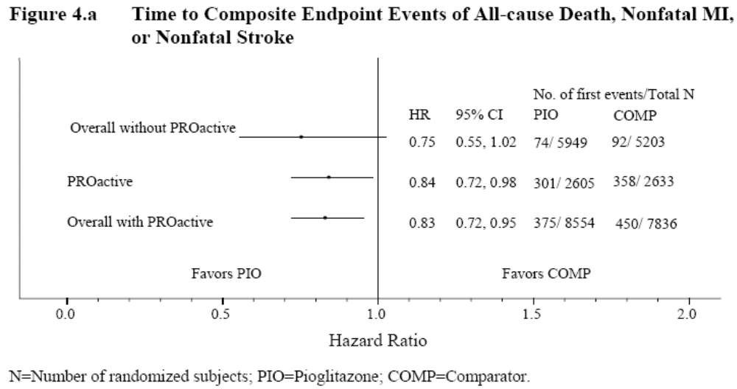
Summary of meta-analysis of pioglitazone clinical trials including PROactive
Source: Takeda’s submission

Slide 15
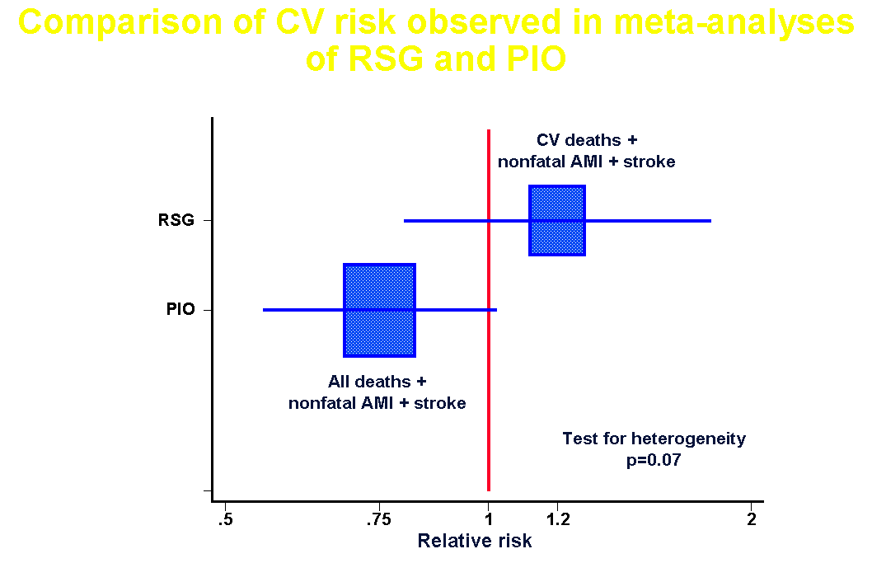

Slide 16
Study H6E-US-GLAI: head-to-head RSG vs. Pio
Study results submitted to FDA Feb 2005 by Takeda
FDA review completed November 2005
Randomized, double-blind; 24 wks
Assessment of lipid effects
CV events collected; not adjudicated
  Case report descriptions very convincing
Balanced with respect to age (56 years), duration of T2DM (4 years), HgbA1c (7.6%); BMI (33)

Slide 17
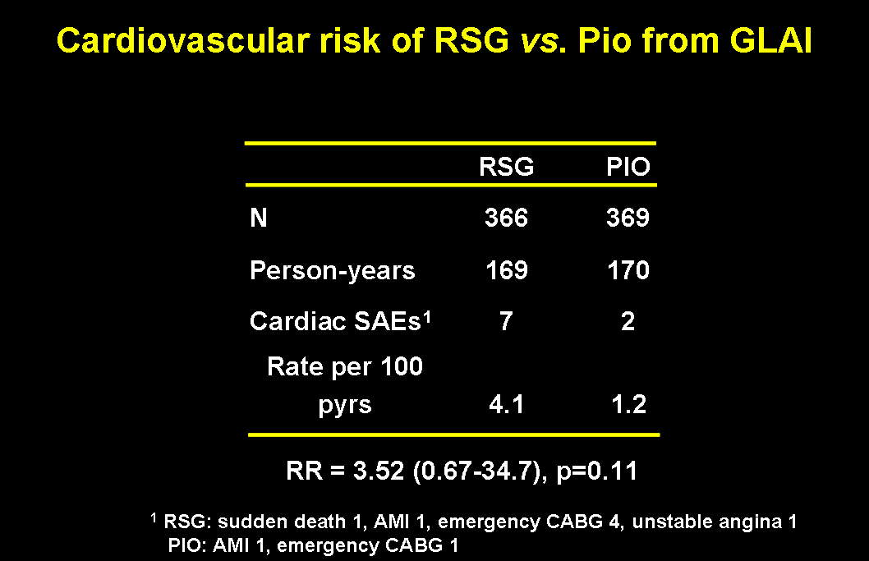

Slide 18
Does CV risk with RSG differ from that with PIO?
Yes
  From DREAM, relatively low-risk population:
    RSG increased risk by ~40% c/w PBO
  From PROactive, high risk population:
    PIO decreased risk by ~15% c/w PBO
  From RSG meta-analysis:
    RSG increased risk of serious IHD by ~40% c/w all comparators & by ~70% c/w PBO
  From PIO meta-analysis:
    PIO decreased risk by ~25% c/w all comparators
  From head-to-head GLAI:
    RSG increased risk 3.5-fold c/w PIO

Slide 19
Does CV risk with rosiglitazone differ from
that of metformin and sulfonylurea
oral anti-diabetic agents?
ADOPT
RECORD
BARI 2D

Slide 20
A Diabetes Outcome Progression Trial (ADOPT)
Recently diagnosed T2DM (mean=1.1 yrs)
All outcomes were efficacy-related
No pre-specified CV outcomes
No CV adjudication; post hoc arbitration of CHF

Slide 21
Pertinent adverse event data from ADOPT
Source: N Engl J Med 2006; 355:2427-43
 | RSG | Met | SU | Met+SU
N | 1456 | 1454 | 1441 | 2895
CV disease (%) | 3.4 | 3.2 | 1.8 | 2.5
AMI (%) | 1.8 | 1.5 | 1.2 | 1.4
CHF (%) | 1.5 | 1.3 | 0.6 | 1.0
CVA (%) | 1.1 | 1.3 | 1.2 | 1.2
PVD (%) | 2.5 | 1.9 | 2.2 | 2.0
Edema (%) | 14.1 | 7.2 | 8.5 | 7.8
Notes:
ADOPT was not designed to assess CV risk and had no established, pre-specified, or audited procedures for capturing CV events such as AMI, stroke, or CHF. This could lead to events being overlooked and not captured, or else miscoded, with the end-result being poor quality adverse event data.
The lack of established procedures can cause problems relating to how events are identified and how they are classified and coded.
For example, RSG is well-known to cause CHF and metformin is not, yet ADOPT failed to distinguish the two drugs for this event. However, a marked difference was noted for “edema”.
Another anomaly to ADOPT is that it may contradict UKPDS, which found a difference between metformin and SU with respect to AMI among overweight patients. Additionally, as shown by Dr. Kate Gelperin earlier, the most carefully performed observational studies of this topic, in which linkage to mortality and cause-of-death data was available, also showed a much lower risk with metformin than SU.
There is also the finding of a statistically significant increase in fracture risk in women on RSG, especially of the long bones of the upper and lower limbs.
Finally, it should be noted that despite very low statistical power that substantially increases the likelihood of a false negative study, the occurrence of fatal and nonfatal AMI was increased in the RSG arm of ADOPT.

Slide 22
Limitations of BARI 2D
BARI 2D not designed to answer questions about specific drugs
Assignment to RSG or metformin not blinded or random
BARI 2D will not meaningfully inform the issue of RSG’s CV risk vís a vís other oral anti-diabetes meds
Markedly low statistical power for drug-specific CV risk questions
The finding of increased risk in RSG + insulin meta-group may have implications for BARI 2D

Slide 23
Rosiglitazone Evaluated for Cardiac Outcomes and Regulation of glycemia in Diabetes (RECORD)
Randomized, non-inferiority, open-label; active-control
Concerns:
  Noninferiority design has intrinsic limitations for safety
    Suboptimal study execution related to AE identification and reporting could mask differences between groups
  Noninferiority margin too large (20%) & rationale not provided
  Open-label (increases bias potential)
  1° endpoint not focused on most important CV outcomes
  Very low to absent statistical power

Slide 24
Statistical power of ADOPT, BARI 2D, and RECORD to exclude a 20% increase in risk of cardiovascular death + AMI + stroke for RSG vs. Met
 | ADOPT | BARI 2D | RECORD
Power to exclude RR=1.2 | <10% | <10% | <10%
None of these studies will provide
meaningful evidence about the comparative
cardiovascular risk of rosiglitazone and metformin

Slide 25
The hidden dangers of low statistical power when dealing with a comparative safety issue
Low power = high “type II” error rate
  Probability of concluding that treatments are similar when they really differ
Consequences of low power
  Falsely concluding that treatments are similar when important differences in risk exist
  Promotes a false sense of security and complacency
  Leads to failure to take appropriate measures to protect patients from unnecessary harm
“Absence of evidence is not evidence of absence”

Slide 26
Does the CV risk of RSG differ from that of metformin or sulfonylurea?
The data provide inadequate and insufficient evidence to conclude that RSG does not increase CV risk compared to metformin or sulfonylureas
Neither RECORD nor BARI 2D will provide meaningful answers to this question

Slide 27
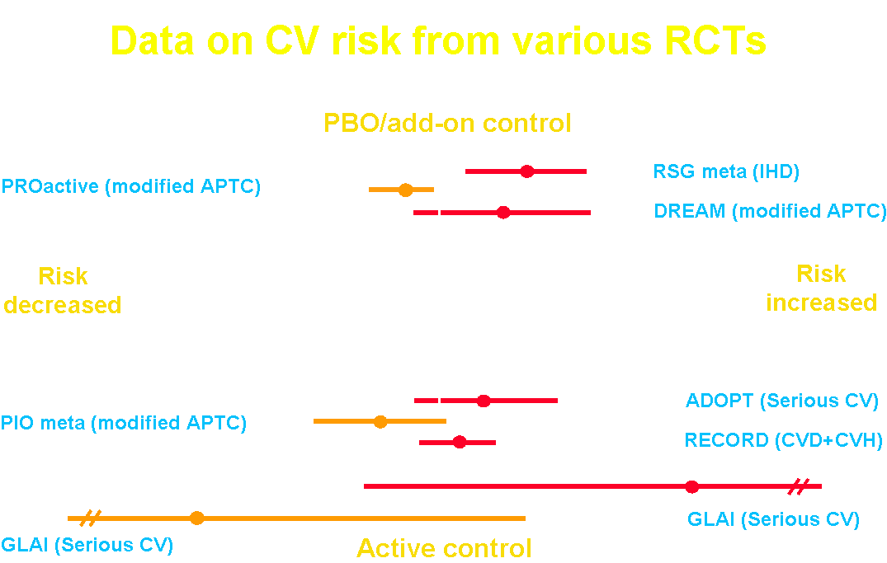

Slide 28
Population impact of
cardiovascular risks and benefits
of rosiglitazone use

Slide 29
Sources of data for estimation of excess cases of cardiovascular deaths and nonfatal AMI (1)
Estimates of the relative risk for CV events obtained from RSG meta-analysis & DREAM
Background rates of CV death + nonfatal AMI, and CV death + nonfatal AMI + nonfatal stroke from published literature
National prescription data used to estimate person-years of RSG use (time at-risk)

Slide 30
Sources of data for estimation of excess cases of cardiovascular deaths and nonfatal AMI (2)
Analysis accounted for variability in level of excess risk while focusing on range of most likely risk
  By using three point estimates of relative risk
    RR=1.2 (“MACE” RSG meta-analysis)
    RR=1.4 (RSG meta-analysis; DREAM)
    RR=1.7 (RSG meta-analysis of PBO-controlled data)
  ± 1 standard deviation (68% confidence intervals)
  By using the inter-quartile range for the background event rates in diabetic patients

Slide 31
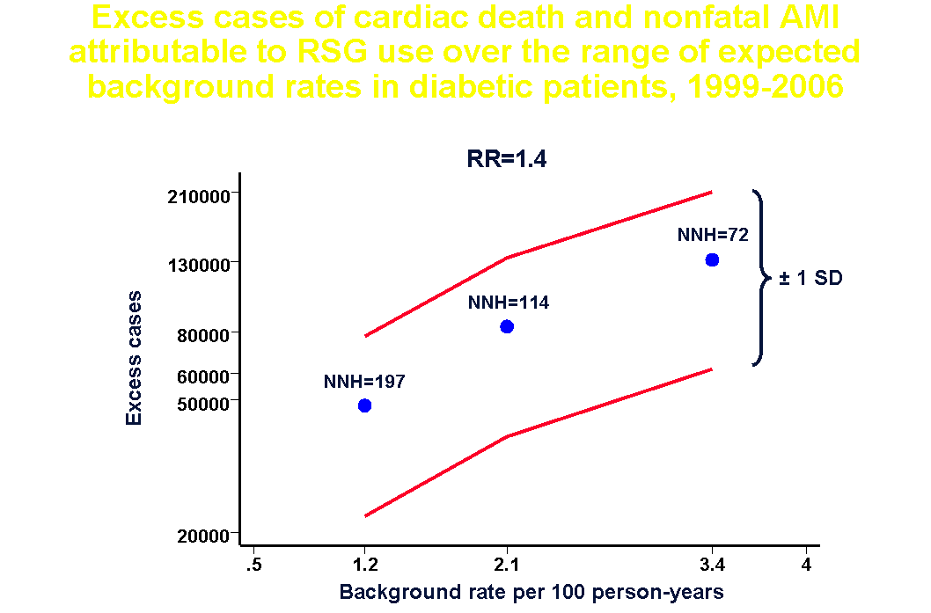

Slide 32
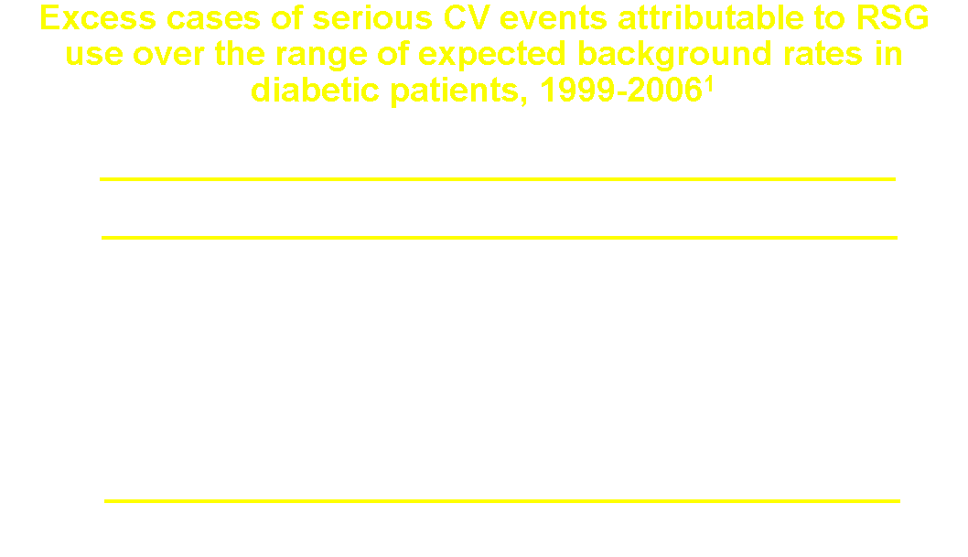

Slide 33
RSG health benefit assessment (1)
What benefits are we interested in?
  How does RSG compare to PIO?
  How does RSG compare to Met or SU?
  Are there benefits unique to RSG?
Two systematic reviews provide insight
  Bolen et al. Ann Intern Med 2007
    Oral anti-diabetes agents
  Bandeira-Echtler et al. Cochrane Collaboration 2007
    Rosiglitazone

Slide 34
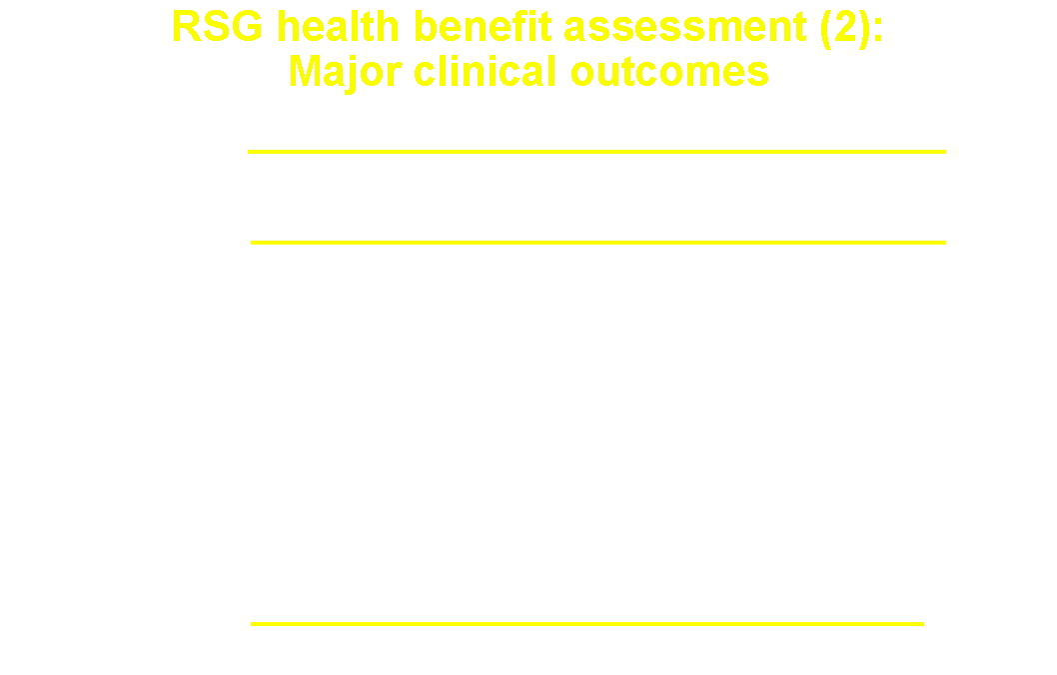

Slide 35
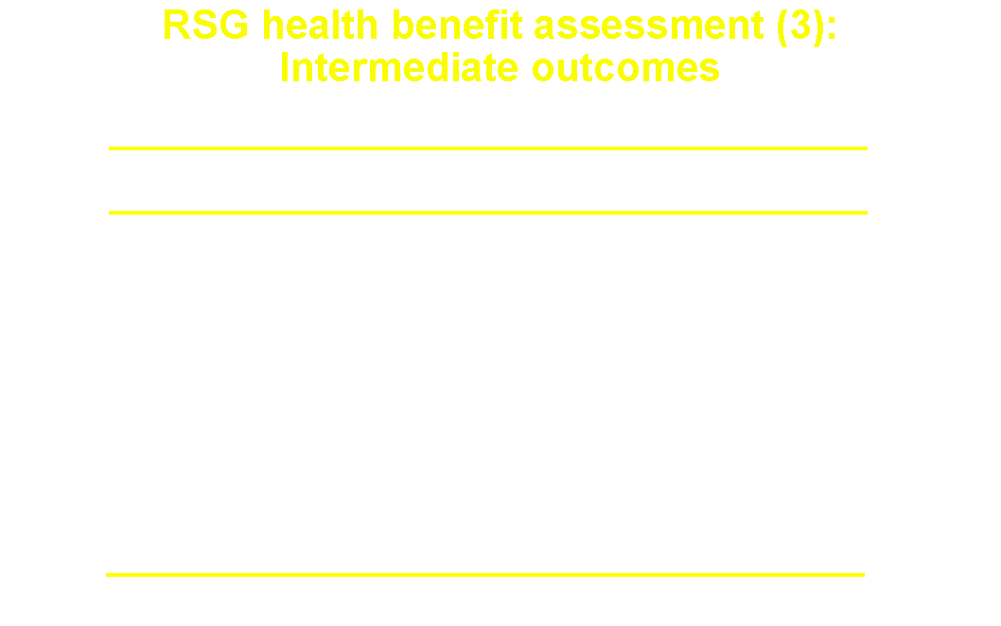

Slide 36
RSG health benefit assessment (4)
No major clinical health benefits have been demonstrated for RSG
  No macrovascular benefits
  No microvascular benefits
RSG confers no clear advantage over other oral anti-diabetes drugs for a variety of intermediate outcomes
RSG confers no unique advantage over PIO and appears to be inferior to PIO with respect to some intermediate outcomes (HDL-C, LDL-C, triglycerides)

Slide 37
Risks, benefits, and degree of certainty (1)
At approval, “definitive proof” of efficacy obtained; health benefit is assumed, not demonstrated or “proven”
  But efficacy measures often don’t translate into long-term benefits
When postmarketing safety concerns arise, reappraisal of “assumed benefit” is necessary; benefit-risk assessment must be made at the population-level
“Actionable” threshold of evidence for serious risk is not “definitive proof”
  Rarely possible due to statistical power (at least 95% power needed to minimize false negative conclusion)
  Unreasonably high threshold, considering obligation to protect public from serious harm

Slide 38
Risks, benefits, and degree of certainty (2)
Despite uncertainty, the analysis must take into account the potential consequences of the risk, as well as the magnitude and certainty of health benefits
Prior measures of efficacy often inadequate to justify serious risk; actual health benefits are essential
For a health benefit to justify a serious risk, it must be clinically important and meaningful, of comparable or greater health-value, and of greater frequency of occurrence than the risk; and there must be definitive evidence to support the benefit.

Slide 39
Decision analysis of RSG risks and benefits
The cost of a wrong decision is not symmetric
  First, absolutely no evidence of major clinical health benefits with RSG
  If RSG increases CV risk, wrong decision will cost thousands of lives
  If RSG doesn’t increase CV risk, wrong decision causes no population harm; other therapies are available
The data on RSG CV risk, though not definitive, strongly suggest the following:
  RSG CV risk is increased (3 studies: RSG meta-analysis, DREAM, GLAI)
  PIO CV risk is not increased, and may be decreased compared to other therapies including RSG (3 studies: PIO meta-analysis, PROactive, GLAI)
  Other studies such as BARI 2D and RECORD will not provide adequate evidence to refute these findings

Slide 40
Conclusions
RSG increases cardiovascular risk compared to its non-use
PIO does not increase cardiovascular risk
RSG has no unique short-term benefits related to glycemic control
RSG has no demonstrated long-term health benefits related to cardiovascular disease, diabetic retinopathy, nephropathy, or neuropathy
Given these conclusions, are there definitively documented population-level health benefits of RSG to justify its continued marketing?
  No
  RSG should be removed from the market
Notes:
RSG increases CV risk compared to its non-use and to PIO
PIO does not increase CV risk and may decrease that risk

Slide 41
Acknowledgments
Rizwan Ahmad, MD
Mark Avigan, MD
Gerald Dal Pan, MD, MHS
Kate Gelperin, MD, MPH
Joy Mele, MS
Todd Sahlroot, PhD
Ellis Unger, MD
FDA library staff

