Slide 1
Positioning DETROL
(Creating a Disease)
Neil Wolf
Group Vice President,
PHARMACIA
Presented to PMRG
October 7, 2002
Notes:
How many have seen
How many have heard of overactive bladder?
How many have overactive bladder???
Overactive Bladder now a lexicon in American culture
-cocktail parties / media / sitcoms / talk shows
Most importantly, routinely discussed between patients and their physicians
Not the case 4 years ago
Pharmacia instrumental in creating new disease
-improving lives of millions around world
Over next 30 minutes, insights
Many dedicated folks
-as team leader, I get privledge
-introduce you to our US Director for Detrol

Slide 2
Detrol Commercial

Slide 3
Positioning DETROL
(Creating a Disease)
Neil Wolf
Group Vice President,
PHARMACIA
Presented to PMRG
October 7, 2002
Notes:
How many have seen
How many have heard of overactive bladder?
How many have overactive bladder???
Overactive Bladder now a lexicon in American culture
-cocktail parties / media / sitcoms / talk shows
Most importantly, routinely discussed between patients and their physicians
Not the case 4 years ago
Pharmacia instrumental in creating new disease
-improving lives of millions around world
Over next 30 minutes, insights
Many dedicated folks
-as team leader, I get privledge
-introduce you to our US Director for Detrol

Slide 4
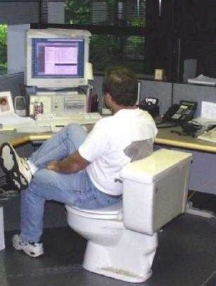
Notes:
Here you see our US Director hard at work in his company issued Detrol office
I know you can’t read his screen…… close up

Slide 5
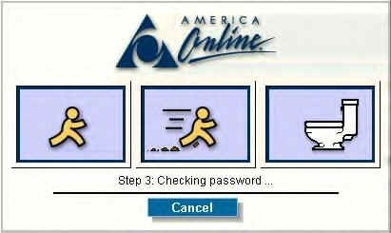
Notes:
This is the screen that our Detrol team sees when they log on each morning
------------------------------------------------------------------------------
Perspective of environment at time
Company called P&U
Historical perspective helps define motivation for
Identifying
Resourcing
Executing
the launch of Detrol

Slide 6
Pharmacia & Upjohn
The Situation in 1995
A Merger without integration
  FarmItalia
  Pharmacia
  Upjohn
A strong “tail”
  Xanax
  Medrol
Successful niche marketer
  Xalatan
  Genotropin
  Camptosar
No major presence in PCP/mass markets.
Notes:
Merged in 1995
Failed merger
No integration
Separate companies, separate locations, and separate priorities
Lack of focus and leadership
Downward spiral in sales and earnings…. And stock price

Slide 7
Pharmacia & Upjohn
The Situation in 1997
New Senior Management
  Fred Hassan, CEO
  Carrie Cox, EVP, Pres. Global Prescription Business
  GLT (Global Leadership Team)
The “New” P&U
  Centralize
  Develop new processes (global)
  Focus on key countries and key brands
  Strengthen “specialty” businesses while growing Primary Care presence (critical mass)
DETROL identified as first, new, global, mass market opportunity

Slide 8
Detrol “Detrusitol” Status
Product Profile
  Muscarinic receptor antagonist
  >70% efficacy
  (= oxybutinin)
  Dry mouth = 23%
  (>70% for oxybutinin)

Slide 9
Detrol “Detrusitol” Status
Product Profile
  Muscarinic receptor antagonist
  >70% efficacy
  (= oxybutinin)
  Dry mouth = 23%
  (>70% for oxybutinin)
Initial Launch Plan
  “Urge incontinence”
  Urologist disease
  Urologist launch only

Slide 10
Market Dynamics
Small, generic market
  $40 million in US
    $29 million in oxybutinin (off patent)

Slide 11
Market Dynamics
Small, generic market
  $40 million in US ($360 million WW)
    $XX million in oxybutinin (off patent)
Prevalence 5 – 15%, skewed toward age 65+
Large, under-diagnosed patient population
  10 - 33 million sufferers in US
Significantly under-treated condition
  <20% treated with pharmacotherapy
    Embarrassment
    “Normal” consequence of aging
    Coping mechanisms
Notes:
Largest competition--- non action
2nd largest competition-- pads

Slide 12
Coping Mechanisms
Toilet Mapping
Defensive Voiding

Slide 13
Objective: Broaden and Own the Understanding of the Market
  Clinical
  Epidemiologic
  Psychometric
  Economic

Slide 14
Objective: Broaden and Own the Understanding of the Market
Clinical
Epidemiologic
Pyschometric
Economic
COMMERCIAL OPPORTUNITY
P&U CREDIBILITY

Slide 15
Converting a Niche Product into a
Mass Market Opportunity
Increase the diagnosis and treatment of urge incontinence
Expand the appropriate patient population
  (beyond urge incontinence)

Slide 16
Converting a Niche Product into a
Mass Market Opportunity
Increase the diagnosis and treatment of urge incontinence
  PCP’s: Pads and/or referral to specialist
  Differential diagnosis required PVR
  (Post Void Residual Examination)

Slide 17
Converting a Niche Product into a
Mass Market Opportunity
PVR
Validated Questionnaire

Slide 18
Converting a Niche Product into a
Mass Market Opportunity
Expand the appropriate patient population
Urge Incontinence
Overactive Bladder

Slide 19
Urge Incontinence Market
US
Urge
Incontinence
12 million
Sufferers

Slide 20
Overactive Bladder
US
Urge
Incontinence
12 million
sufferers
Urgency
21 million sufferers
Frequency
64% of patients suffer from “dry” OAB
OAB is 2.7-fold larger opportunity than urge incontinence

Slide 21
OAB Definitions
Frequency: urination 9 or more times within 24 hours
Urgency: strong, often sudden urge to urinate
Urge incontinence: involuntary contractions of the detrusor muscle that result in the loss of urine

Slide 22
Critical Success Factors
Establish OAB as a serious medical condition with profound negative impact on people’s quality of life… among physicians, consumers, payers and regulatory authorities
Establish Detrol as the therapy of choice for OAB
Educate PCPs (including OBGs) how to screen for, diagnose and treat OAB
Drive potential patients to physician offices by using DTC and PR with symptom recognition

Slide 23
Detrol Message
Why should I care?
Why should I believe?

Slide 24
Detrol Message
Why should I care?
  OAB affects millions of patients
  Significant impact on quality of life
  OAB is a medical condition (not just aging)
  Detrol can help

Slide 25
Detrol Message
Why should I believe?
  >70% efficacy
  <23% dry mouth
  Highly selective for bladder over salivary glands
  Documented improvement in QOL

Slide 26
Detrol
Strategic Imperatives
CONVERSION
Convert
Pharmacological
Therapy
GROWTH
PCPs “own”
OAB
EXPANSION
Patients identify with
symptoms and
seek treatment

Slide 27
Detrol Strategies
Conversion
  Identify and target key prescribers and influencers
  Demonstrate Detrol superiority
  Differentiation through bladder selectivity
  Achieve access by payors

Slide 28
Detrol Strategies
Conversion
  Identify and target key prescribers and influencers
  Demonstrate Detrol superiority
  Differentiation through bladder selectivity
  Achieve access by payors
Growth
  Establish OAB as a legitimate, treatable medical condition that should be treated
  Educate PCPs on diagnosis and treatment of OAB
  Remove barriers to prescribing

Slide 29
Detrol Strategies
Conversion
  Identify and target key prescribers and influencers
  Demonstrate Detrol superiority
  Differentiation through bladder selectivity
  Achieve access by payors
Growth
  Establish OAB as a legitimate, treatable medical condition that should be treated
  Educate PCPs on diagnosis and treatment of OAB
  Remove barriers to prescribing
Expansion
  Provide information on self-identification to OAB sufferers
  Encourage PCPs to screen all appropriate patients
  Establish that OAB is not normal, at any age, and is treatable
  Encourage patients to remain on therapy

Slide 30
Creating OAB
KOL’s
Regulators
Prescribers
OAB
Sufferers
Media
Payors

Slide 31
Creating OAB
KOLs
Advisory boards, consultant meetings
Significant Phase IV activity
ICS definition of OAB changed dramatically and rapidly

Slide 32
Changing the Playing Field
1st International Consultation on Incontinence (ICI); 1998
  Overactive detrusor function is characterized by involuntary detrusor contractions during the filing phase……….
  The unstable detrusor is one that is shown objectively to contract, spontaneously or on provocation, during the filing phase while the patient is attempting to inhibit micturition.
  Note: There has been a move to change the definitions referable to the overactive detrusor and replace it with "the overactive bladder". Sufferers from incontinence better understand this term than either the "overactive detrusor" or the "unstable bladder".

Slide 33
Changing the Playing Field
Overactive Bladder Consensus Conference; July 1999
  "OAB is a medical condition referring to the symptoms of frequency and urgency, with or without urge incontinence, when appearing in the absence of local pathologic or metabolic factors that would account for these symptoms."

Slide 34
Creating OAB
Regulators
Ditropan Indication (1998 PDR):
  Ditropan is indicated for the relief of symptoms of bladder instability associated with voiding in patients with uninhibited neurogenic or reflex neurogenic bladder

Slide 35
Creating OAB
Regulators
Ditropan Indication (1998 PDR):
  Ditropan is indicated for the relief of symptoms of bladder instability associated with voiding in patients with uninhibited neurogenic or reflex neurogenic bladder
Detrol Indication (from PI):
  DETROL Tablets are indicated for the treatment of patients with an overactive bladder with symptoms of urinary frequency, urgency, or urge incontinence.

Slide 36
Creating OAB
Prescribers
Create an environment where PCPs “own” OAB
  Serious medical condition, not just a consequence of aging
  Easy to screen, diagnose and treat

Slide 37
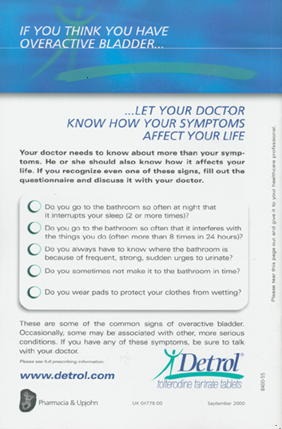

Slide 38
OAB
Screen, Diagnose, Treat
Do you go to the bathroom so often at night that it interrupts your sleep 2 or more times?
Do you go to the bathroom so often that it interferes with the things you do (often more than 8 times in 24 hours)?
Do you always have to know where the bathroom is because of frequent, strong, sudden urges to urinate?
Do you sometimes not make it to the bathroom in time?
Do you wear pads to protect your clothes from wetting?

Slide 39
Creating OAB
Payors
Establish OAB as a serious medical condition, not just a “lifestyle” disorder
  Skin and soft tissue infection
  Falls and fractures
  UTIs
  Significant co-morbidity with depression and sleep disorders
Establish clinical superiority of Detrol over oxybutinin
Greater than 90% of managed lives have unrestricted access to Detrol

Slide 40
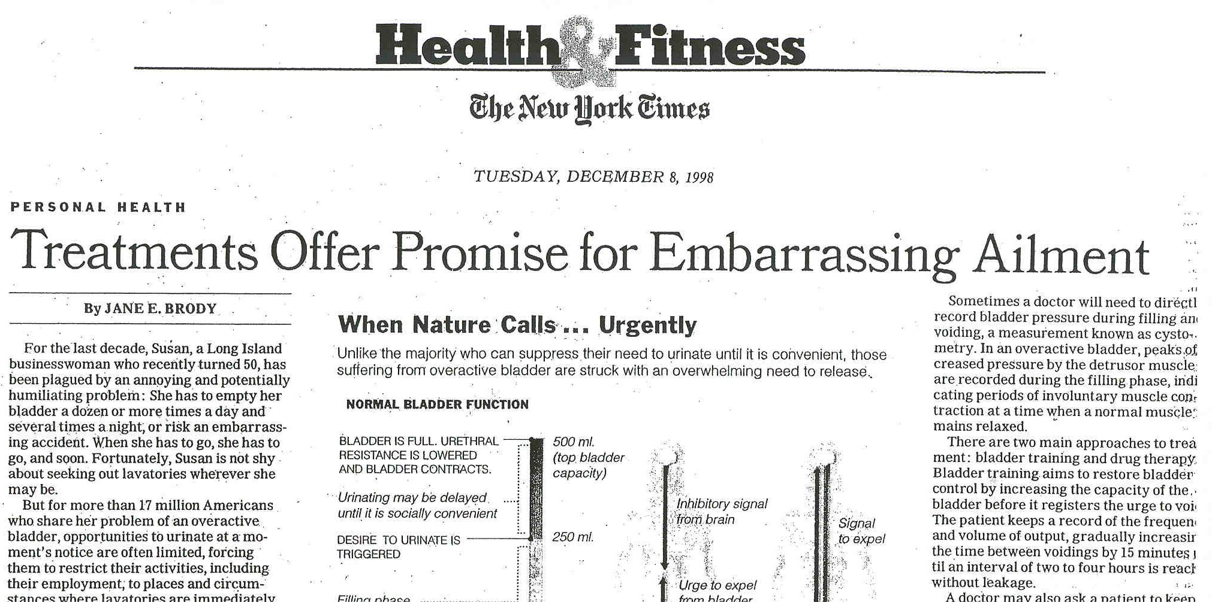
Creating OAB
Media

Slide 41
Launch Sequencing
KOL Development- ’96 to present
Approval- December ’97
OAB pre-launch rep promotion- Jan ‘98
Official launch of Detrol- March ’98
DTC launch- January ‘99

Slide 42
Summary
Differentiation from oxybutinin
Simplify Dx and Tx
Broaden disease definition

Slide 43
Differentiate from oxybutinin
$40 $20M
50% MS Price Premium
(5x)
$100M

Slide 44
Differentiate from oxybutinin
$40 $20M
50% MS Price Premium
(5x)
$100M
Patients Treated
20% -> 50%
$250M Simplify
Dx and Tx

Slide 45
Differentiate from oxybutinin
$40 $20M
50% MS Price Premium
(5x)
$675M
OAB vs UI
(2.7X)
Broaden Disease
Definition
$100M
Patients Treated
20% -> 50%
$250M Simplify
Dx and Tx

Slide 46
Results!
1997
  Mkt NRxs = 1.5M
2001
  Mkt NRxs = 4.6M

Slide 47
Results!
1997
  Mkt NRxs = 1.5M
  Mkt TRx’s = 3.6M
2001
  Mkt NRxs = 4.6M
  Mkt TRx’s =12.7M

Slide 48
Results!
1997
  Mkt NRxs = 1.5M
  Mkt TRx’s = 3.6M
  Mkt $ = $40.2 M
2001
  Mkt NRxs = 4.6M
  Mkt TRx’s =12.7M
  Mkt $ = $806.9M

Slide 49
Results!
1997
  Mkt NRxs = 1.5M
  Mkt TRx’s = 3.6M
  Mkt $ = $40.2 M
  Detrol TRX MS = 0%
2001
  Mkt NRxs = 4.6M
  Mkt TRx’s =12.7M
  Mkt $ = $806.9M
  Detrol TRX MS = 52%

Slide 50
Results!
1997
  Mkt NRxs = 1.5M
  Mkt TRx’s = 3.6M
  Mkt $ = $40.2 M
  Detrol TRX MS = 0%
  Detrol Sales= $0
2001
  Mkt NRxs = 4.6M
  Mkt TRx’s =12.7M
  Mkt $ = $806.9M
  Detrol TRX MS = 52%
  Detrol Sales= $400M

Slide 51
Results!
1997
  Mkt NRxs = 1.5M
  Mkt TRx’s = 3.6M
  Mkt $ = $40.2 M
  Detrol TRX MS = 0%
  Detrol Sales= $0
2001
  Mkt NRxs = 4.6M
  Mkt TRx’s =12.7M
  Mkt $ = $806.9M
  Detrol TRX MS = 52%
  Detrol Sales= $400M
Estimated 2002 >$600M

