Slide 1
Automatic Virtual Metrology (AVM) for Plasma
Reporter:黃一恩

Slide 2
Outline
Introduction
Related work
Methodology
Experiments

Slide 3
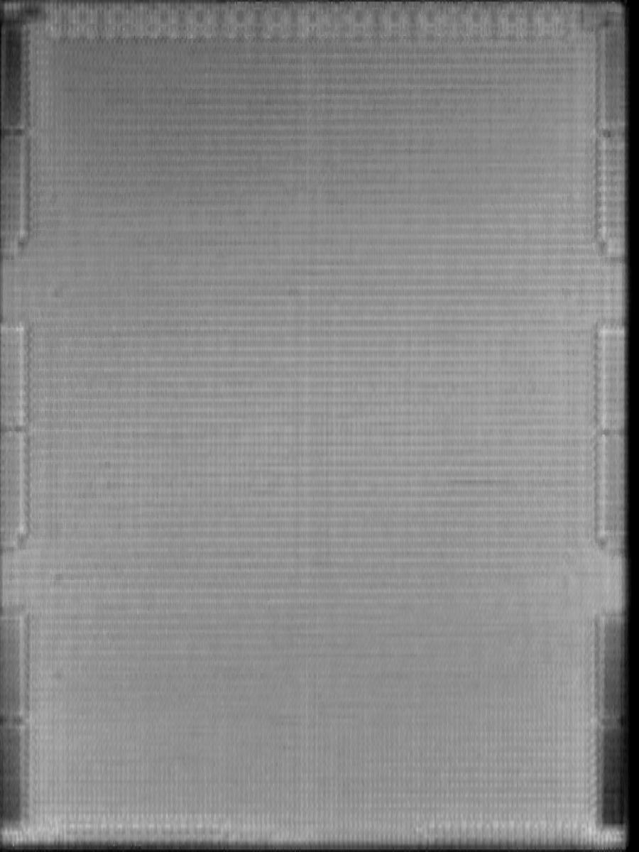
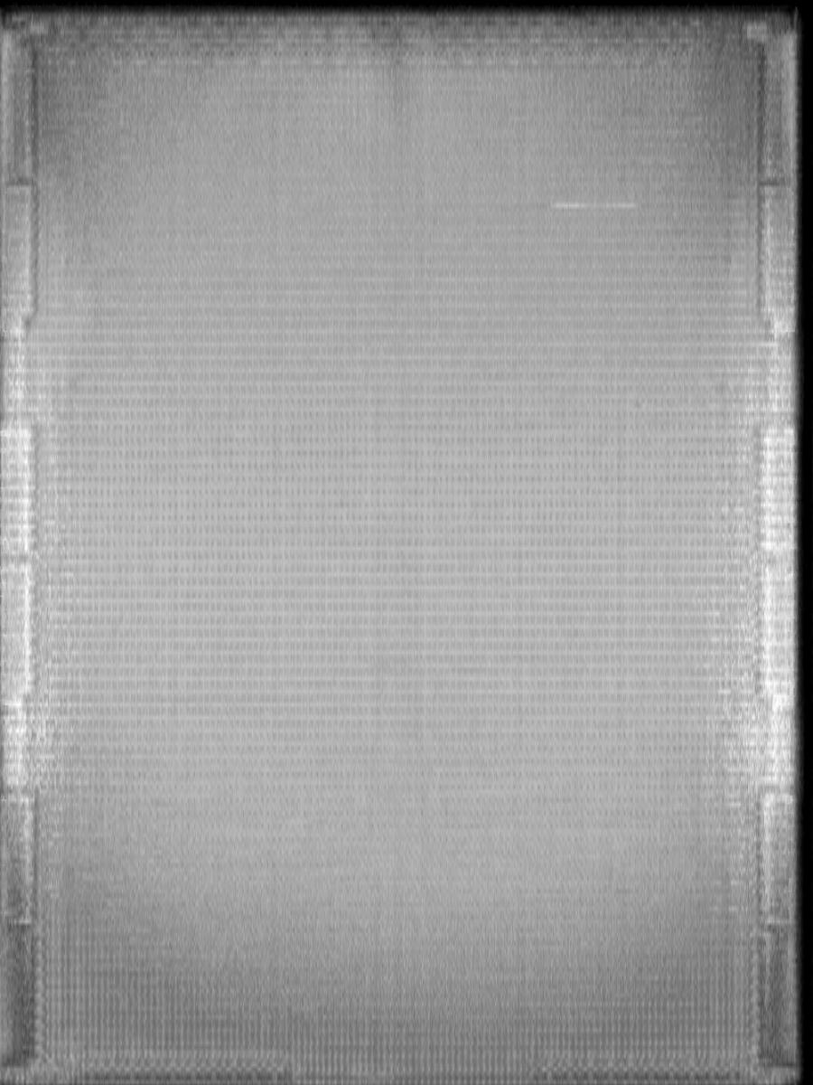
Introduction
SAT image pattern
Pass image Defect image Defect image

Slide 4
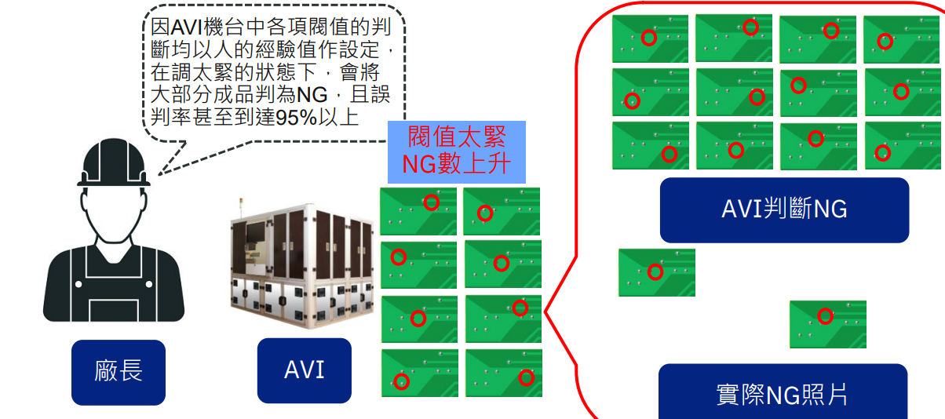
Introduction
Traditional AOI machine high overkill

Slide 5
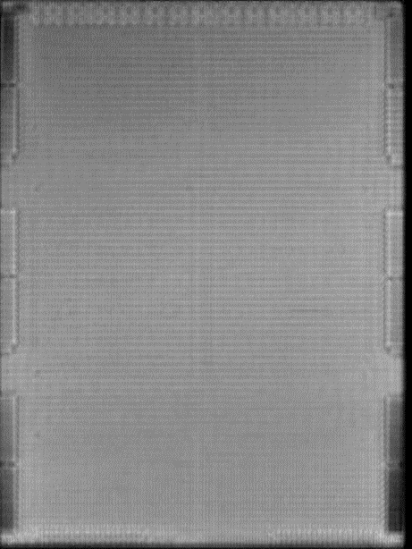
Introduction
Defect image is rare
🞑 It is hard to collect all defect type

Slide 6
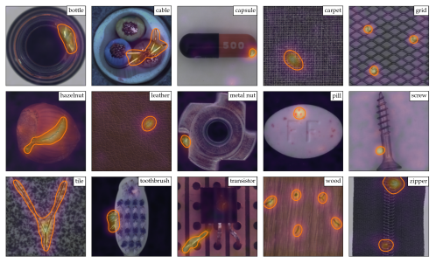
Related work
A Towards Total Recall in Industrial Anomaly Detection
🞑 In this work ,It arises in many industrial scenarios where it is easy to acquire
imagery of normal examples but costly and complicated to specify the expected
defect variations in full
Patchcore in MVTec dataset segmentation result

Slide 7
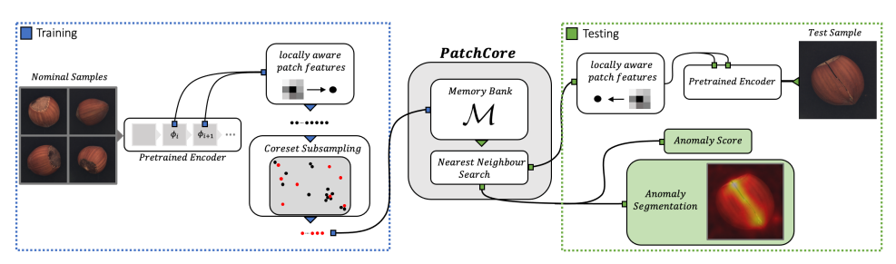
Related work (method)
A Towards Total Recall in Industrial Anomaly Detection
🞑 The PatchCore method consists of several parts that we will describe in sequence
local patch features aggregated into a memory bank a coreset-reduction method
to increase efficiency and finally the full algorithm that arrives at detection and
localization decisions.

Slide 8
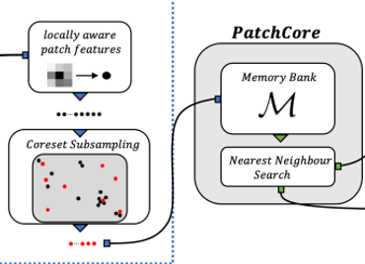
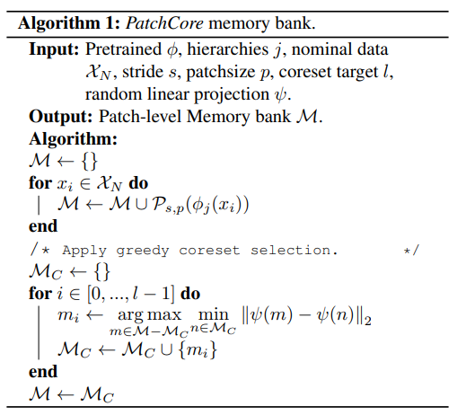
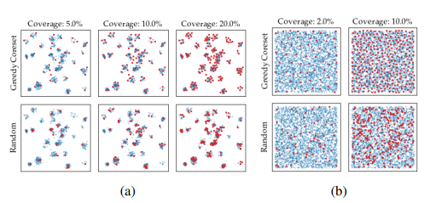
Related work (method)
Greedy coreset selection algorithm

Slide 9
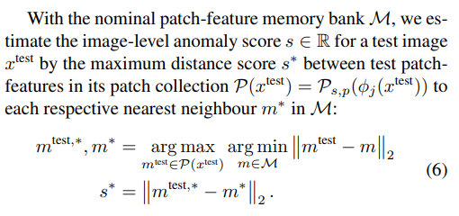
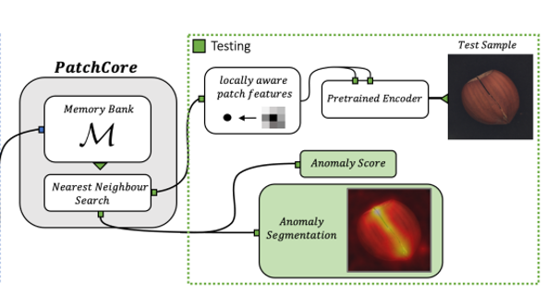
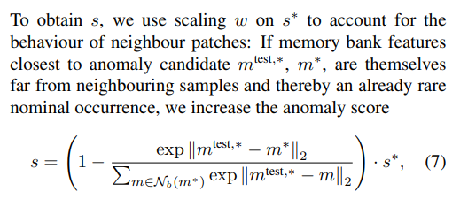
Related work (method)
Inference stage anomaly detection

Slide 10
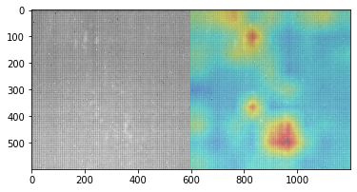
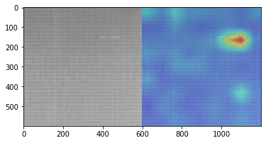
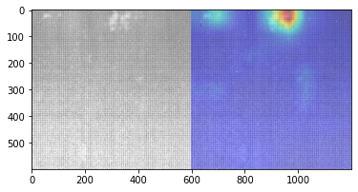
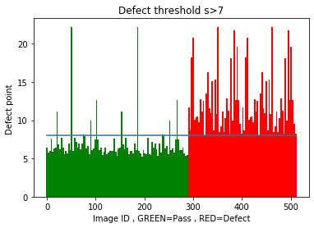
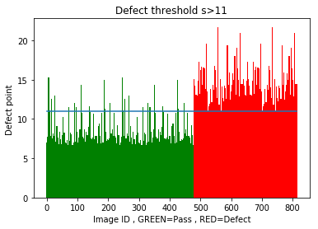
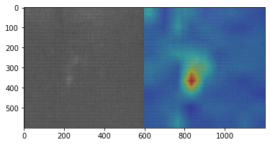
EXPERIMENTS
Product A Product B

Slide 11
