Slide 1
Automatic Virtual Metrology (AVM) for Plasma
Reporter:黃一恩

Slide 2
Outline
Introduction
Related work
Methodology
Experiments

Slide 3
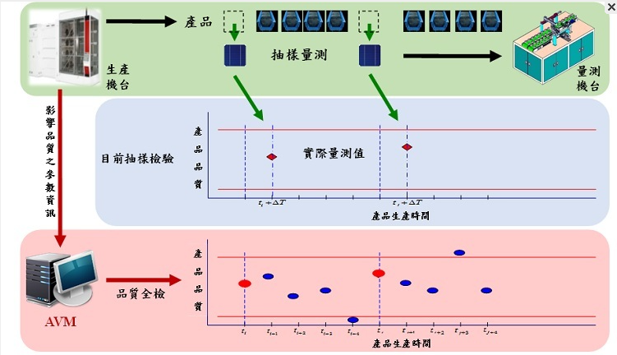
Introduction
Automatic virtual metrology (AVM)
🞑 Automatic Virtual metrology (AVM) can convert sampling inspection with
metrology delay into real-time and online total inspection
🞑 For physical metrology operation in semiconductor manufacturing and the
necessity of reducing physical metrology with AVM for decreasing
manufacturing cost.

Slide 4

Introduction
Plasma ETCH process
🞑 Plasma etch is a semiconductor manufacturing process during which,
material is removed from the surface of semiconducting wafers, typically
made of silicon, using gases in plasma form.
🞑 A host of chemical and electrical complexities make the etch
process notoriously difficult to model and troublesome to control.

Slide 5
Related work
Dynamic Fault Tolerant Migration (DFTM).
🞑 Is a recent method that uses an integer linear programming (ILP)
formulation to analyze workload traffic select the tasks running on the hosts that should be migrated and the target hosts for restoration
The Proactive Coordinated Fault Tolerance (PCFT)
🞑 Method uses Particle Swarm Optimization (PSO) to reduce the overall transmission overhead, network consumption and total execution time for a set of tasks

Slide 6
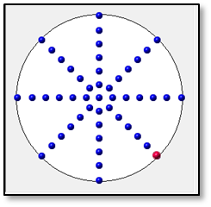
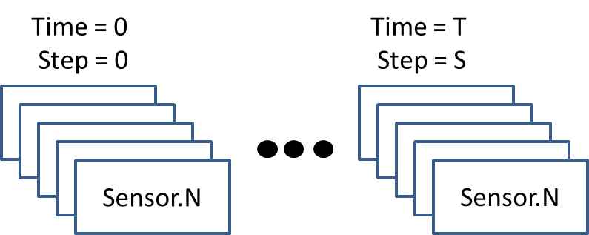
METHODOLOGY
Model predict target
🞑 Our target is wafer’s 49 point Etch rate prediction and alarm detection
through plasma equip collect sensor value (pressure, temperature, gas…)
and use them to train a regression model and alarm detection model
Wafer 49 point location
Plasma equip sensor format

Slide 7
METHODOLOGY
Plasma sensor data format and preprocess
🞑 Plasma equip sensor data is sequential format that shape=(S,T,N)
🞑 Preprocess step 1. Calculate every step sensor (mean,std,max,min)
in T dimension and shape will become (S,N*4)
🞑 Preprocess step 2. Use minimax normalization to normalize sensor
value in S dimension
Time = 0
Step = 0
Time = T
Step = 0
Time = T
Step = S
Sensor.1
Sensor.1
Sensor.1
Sensor.1
Sensor.1
Sensor.1
Sensor.1
Sensor.1
Sensor.1
Sensor.1
Sensor.1
Sensor.1
Sensor.N
Sensor.N
Sensor.N

Slide 8
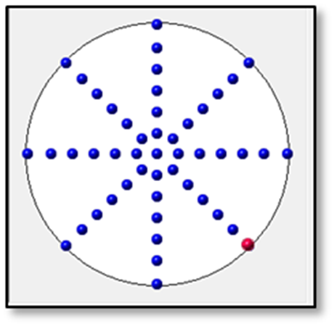
METHODOLOGY
Etch rate data format and preprocess
🞑 Measure equip collect initial thick value and after plasma process
thick value both of shape are (49)
🞑 Preprocess. Calculate all training data thick value mean and std
to do z-score normalization (include testing data)
Wafer 49 point

Slide 9
METHODOLOGY
Etch rate regression model
Output last thick value
Model
prediction
L2 loss
Thick
Thick
model
Repeat step times
After plasma
Thick value
C
Etch rate
model
Optimize model
Update Thick value
Step 1…S
Sensor
Sensor
model

Slide 10
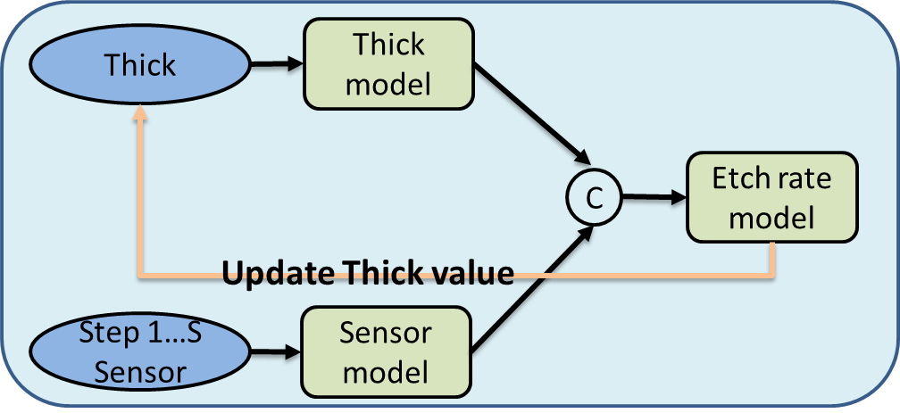
METHODOLOGY
Alarm detection
Repeat step times
Extract every step feature and
calculate all training pass mean feature
Extract from testing data
Sensor.1
Sensor.1
Sensor.1
Sensor.1
Sensor.1
Sensor.1
Sensor.1
Calculate every step cosine
similarity to detect alarm
Sensor.1
Feature N
Feature N

Slide 11
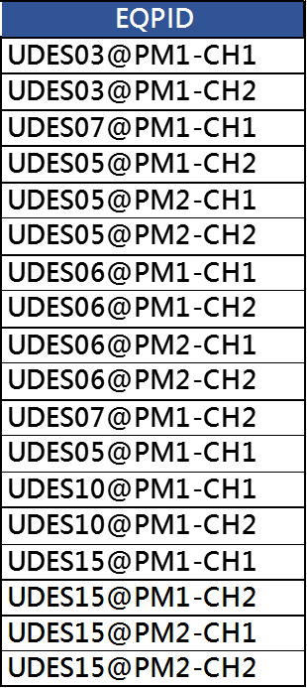
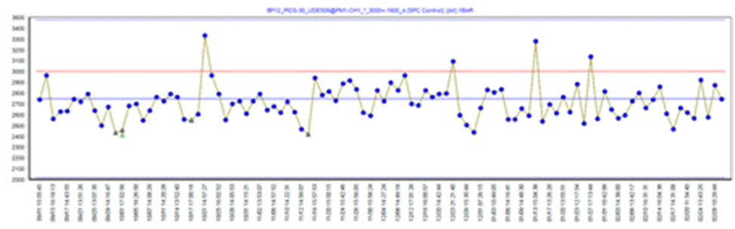

EXPERIMENTS
Training Input: Sensor in-process monitor data
pressure
position
Training Dataset:
Total training data = 2457 (2022/03/01 – 2023/02/28)
Total validation data = 161 (2023/03/01 – 2023/03/31)

Slide 12
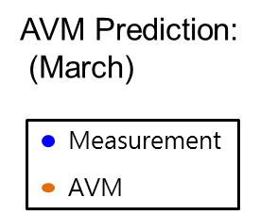
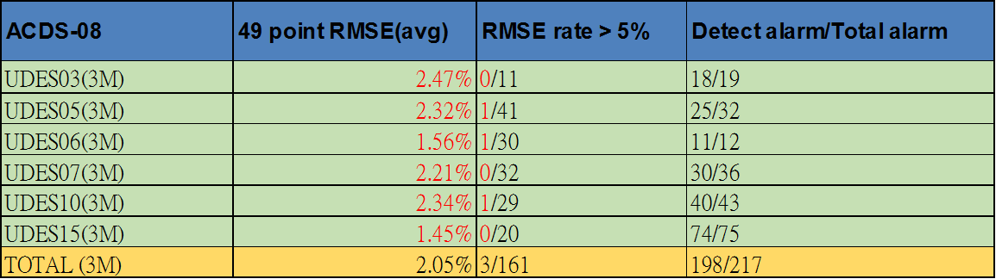


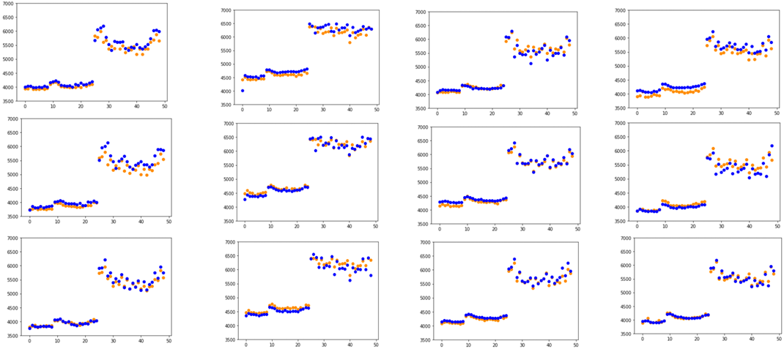
EXPERIMENTS
Recipe 1.

Slide 13
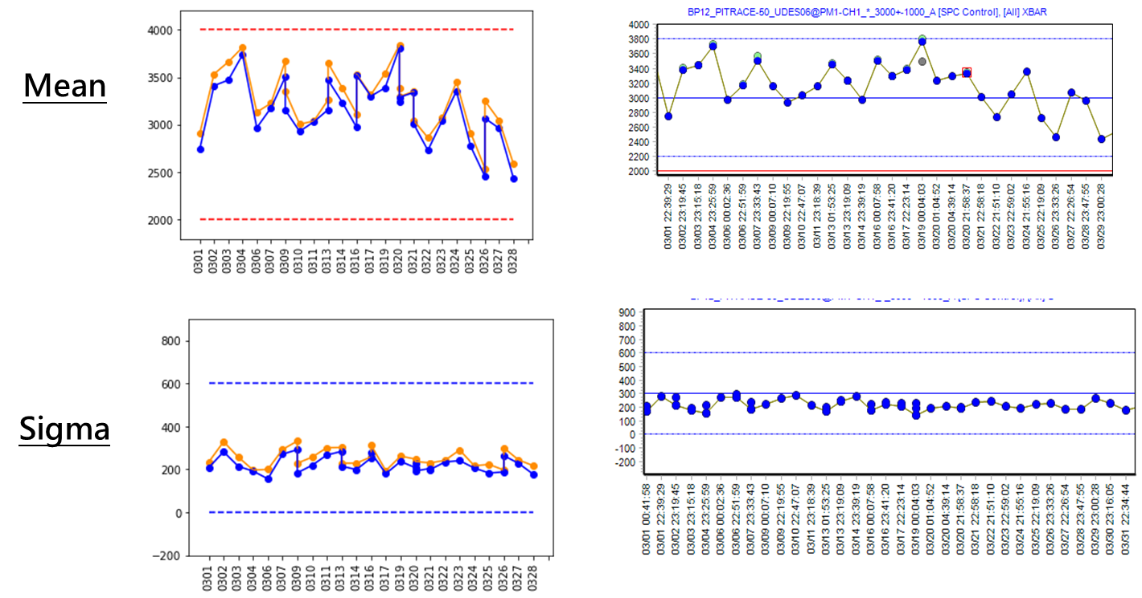
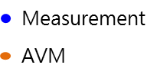
EXPERIMENTS

Slide 14
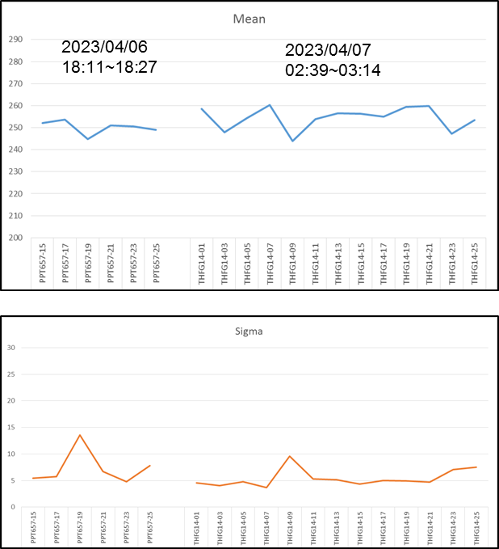
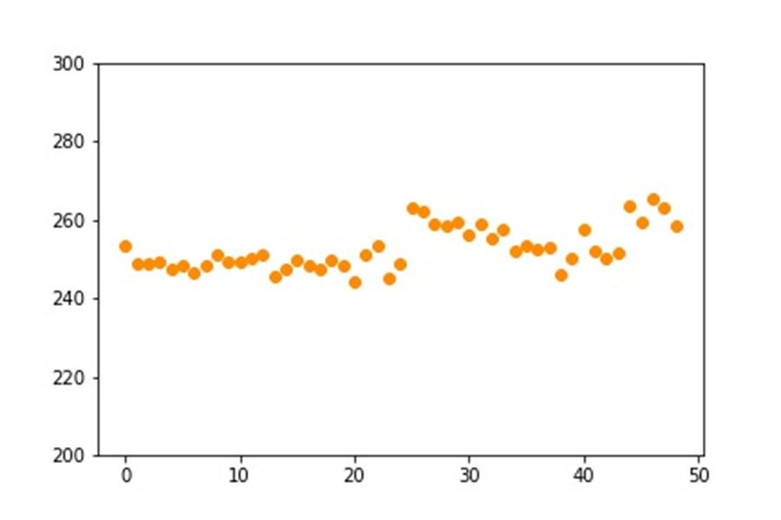
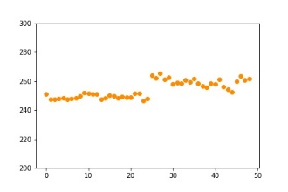
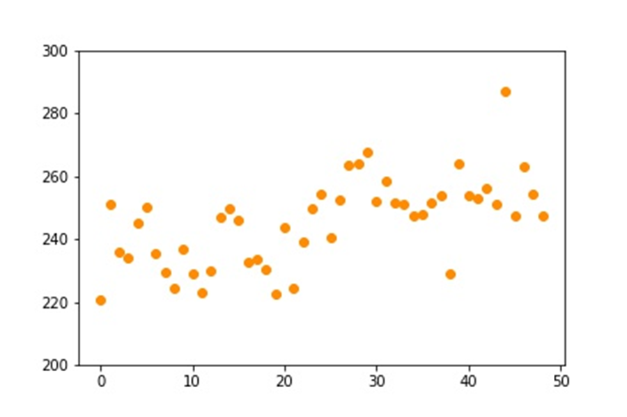
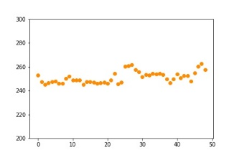
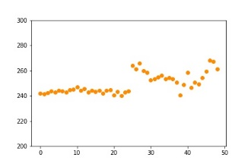
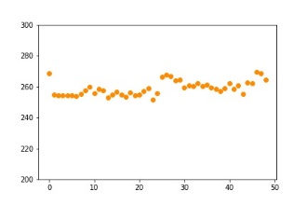
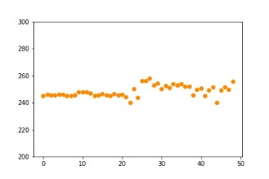
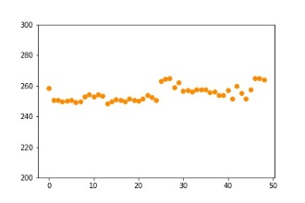
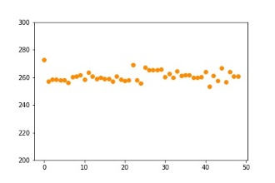
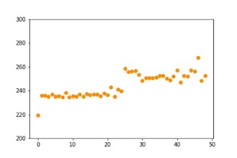
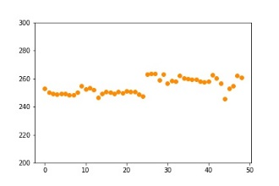
EXPERIMENTS
AVM on Products
Detect alarm

