Slide 1
Outline
Introduction
Related Works
Proposed Scheme
Experiment Results
Conclusions
Notes:
‹#›

Slide 2
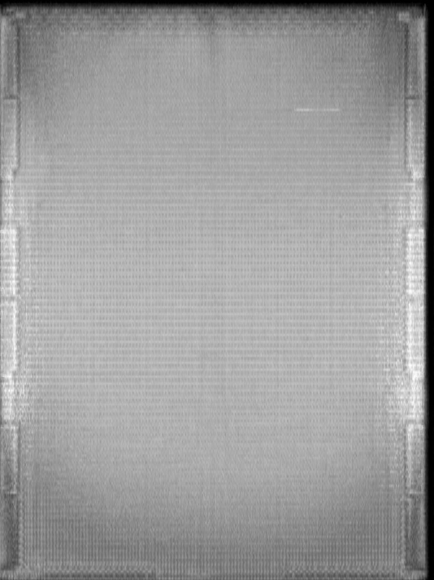
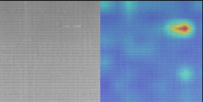
Introduction
We will obtain image from AOI machine and we need to judge this image that is pass or defect
and mark defect location on image
Notes:
‹#›

Slide 3
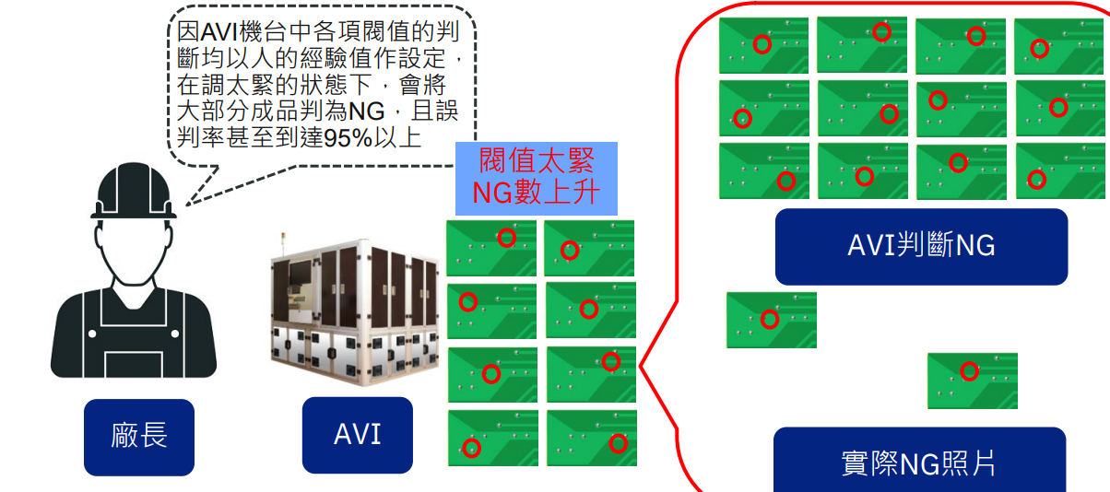
Introduction
In traditional AOI machine that use compare
method so if have tiny difference it will judge
defect that cause high overkill.
Notes:
‹#›

Slide 4
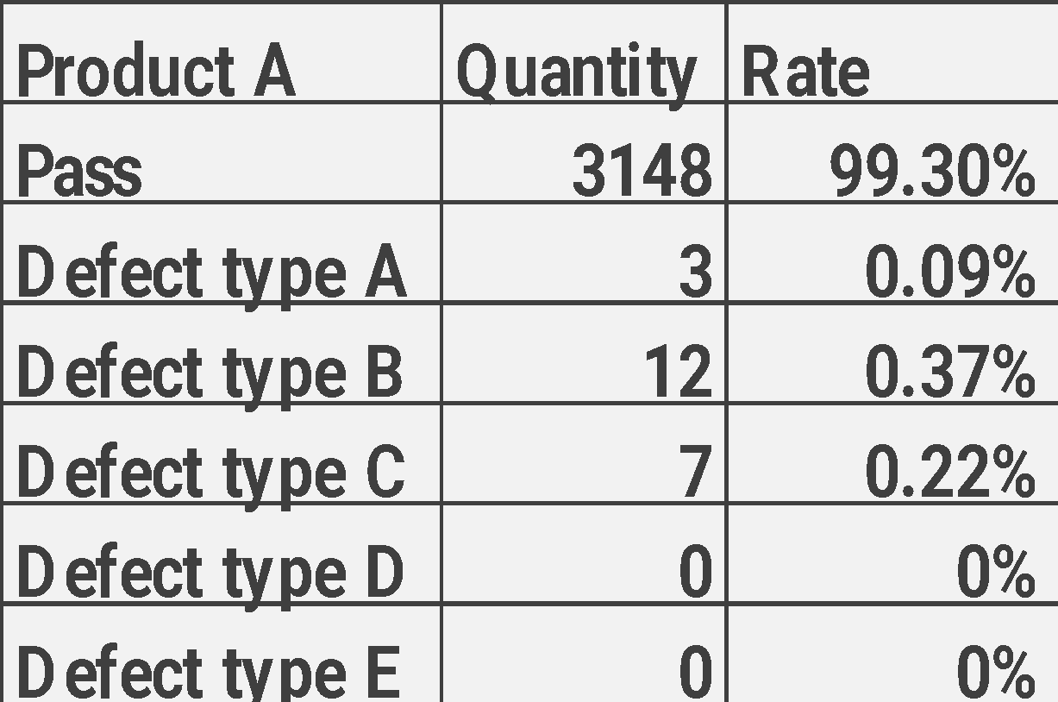
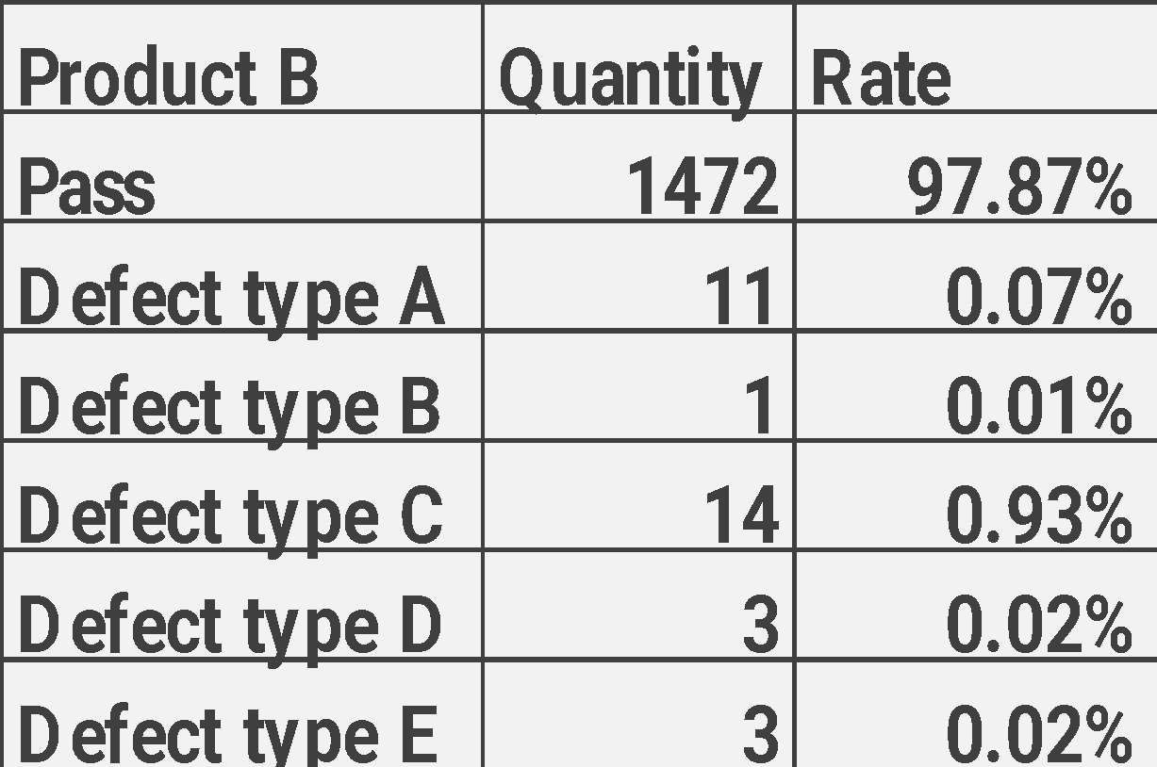
Introduction
It is collect data type distribution in 2023 W45
In our work , we have imbalance data issue in
some product even hard to collect any defect.
Notes:
‹#›

Slide 5
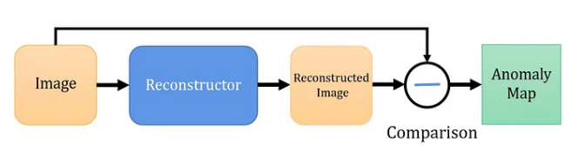
Reconstruction based
Related work
It will compare reconstructor image to original image
if they have difference pattern that is defect
Methods like:
1. IEEE (Memorizing Normality to Detect Anomaly) [2019]
Notes:
‹#›

Slide 6
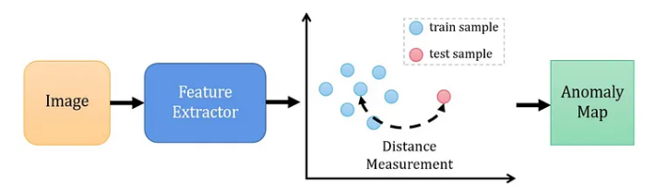
Representation based
Related work
Through calculate test sample to pass feature
distance to judge it is pass or defect
Methods like:
1. CVPR (Towards Total Recall in Industrial
Anomaly Detection) [2022]
Notes:
‹#›

Slide 7
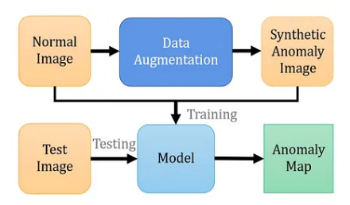
Augmentation based
Related work
Try to use augmentation let normal image become
anomaly data , through model to learn difference
pattern as anomaly
Methods like:
1. Augmented Adversarial Training for Anomaly
Detection[2021]
Notes:
‹#›

Slide 8
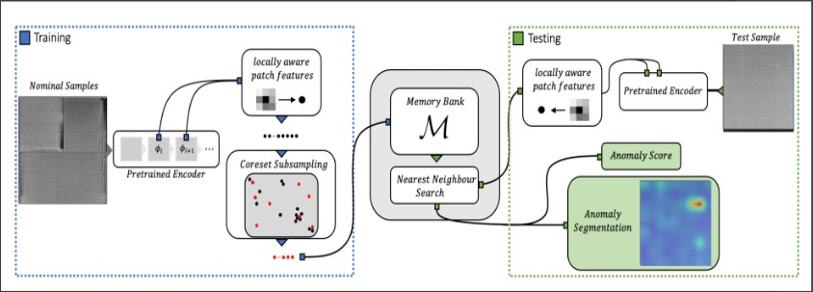
Proposed Scheme
In training stage we will use pretrain model to extract
normal sample feature to memory bank .
In testing stage , we will extract test sample feature to find nearest normal sample in memory bank and
calculate anomaly score
Notes:
‹#›

Slide 9
Greedy coreset selection
Proposed Scheme
If our sampling quantity is large , In testing stage it
will need a lot of time to calculate so we will use
greedy coreset selection to filter normal feature
Notes:
‹#›

Slide 10
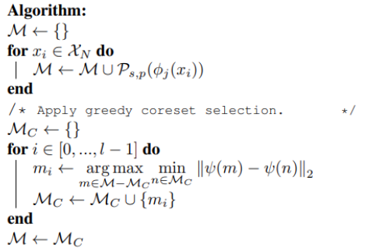
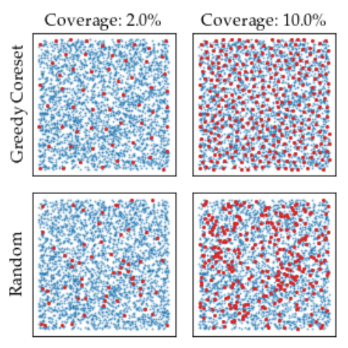
Greedy coreset selection
Proposed Scheme
Define Pretrained φ, hierarchies j, nominal data X , stride s, patchsize p, coreset target l, random linear projection ψ , Memory bank M
Notes:
‹#›

Slide 11
Anomaly score calculation
Proposed Scheme
With the nominal patch-feature memory bank M, we estimate the image-level anomaly score for a test image
Notes:
‹#›

Slide 12
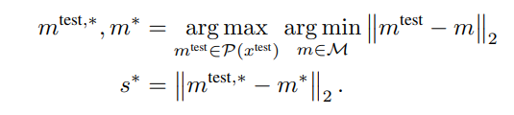

Anomaly score calculation
Proposed Scheme
We estimate the image-level anomaly score s for a test image x^{test} by the maximum distance score s∗ between test patch features in its patch collection
P(x ^{test}) = Ps,p(φj (x^{test})) to each respective nearest neighbour m∗ in M
Notes:
‹#›

Slide 13
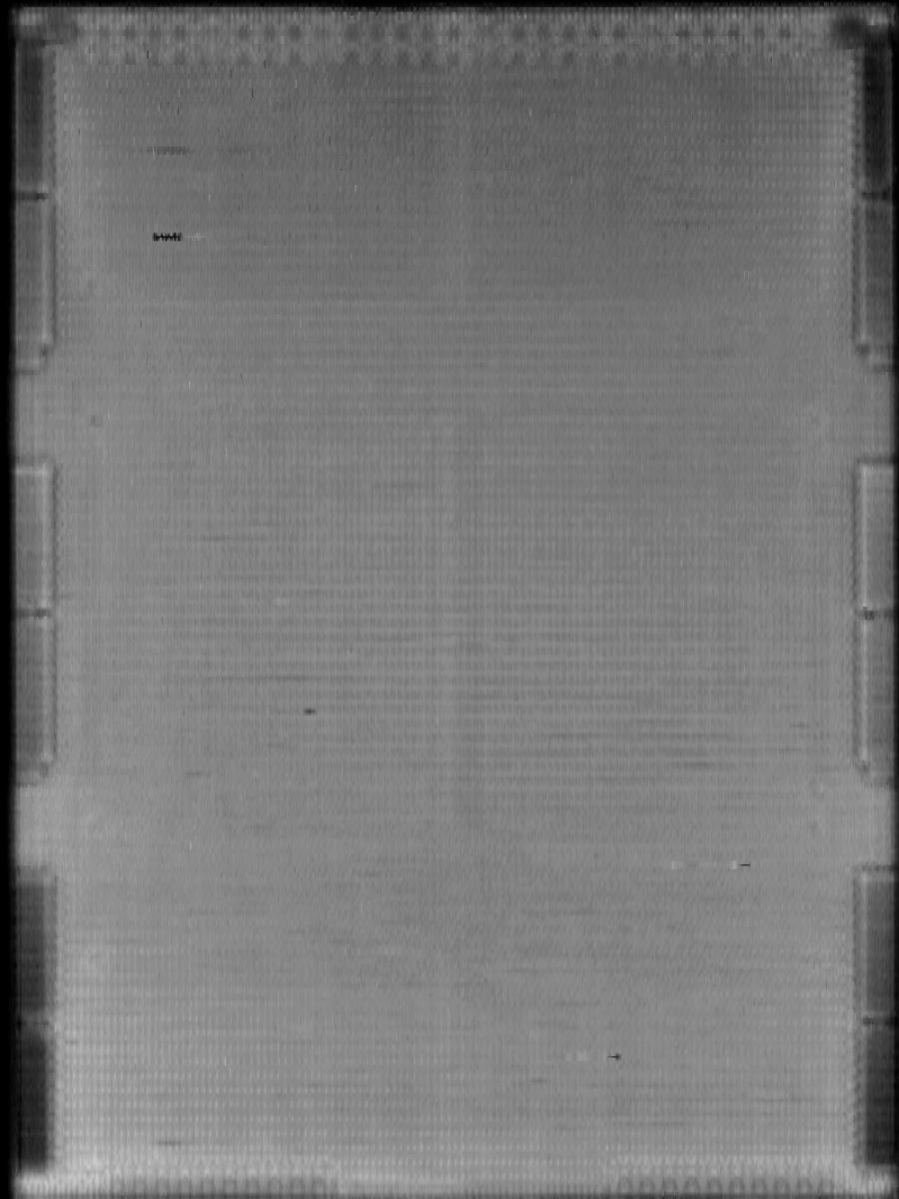
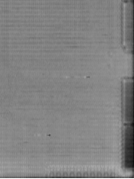
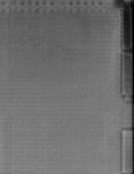
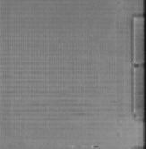
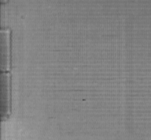
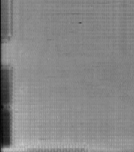
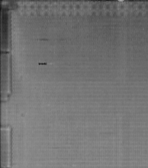
Proposed Scheme
Image Preprocess
Image size = 900x1200
Image size = 224x224
1
2
3
4
Divide to 6 patch(600x600)
And Resize to (224x224)
5
6
Notes:
‹#›

Slide 14


Proposed Scheme
Training stage
Image size = 224x224
Subsampling
Pretrain encoder
(28x28x512)
Adaptive pooling
(7x7x512)
Extract 10% feature
Patchcore
Pretrain model structure : res2net+transformer
Pretrain method : BYOL (self-supervise) Bootstrap your own latent
Pretrain dataset : Our product data (30M)
Parameter num : 12M
Memory
bank
Notes:
‹#›

Slide 15
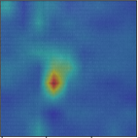
Proposed Scheme
Testing stage
Image size = 224x224
Patchcore
Memory
bank
Pretrain encoder
(28x28x512)
Adaptive pooling
(7x7x512)
Nearest neighbor
Search
Anomaly score
Pretrain model structure : res2net+transformer
Pretrain method : BYOL (self-supervise) Bootstrap your own latent
Pretrain dataset : Our product data (30M)
Parameter num : 12M
Anomaly
segmentation
Notes:
‹#›

Slide 16
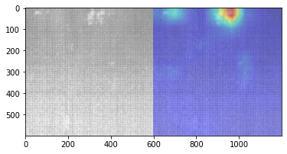
Product A
Experiments results
Notes:
‹#›

Slide 17
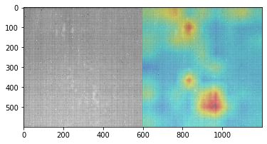
Product A
Experiments results
Notes:
‹#›

Slide 18
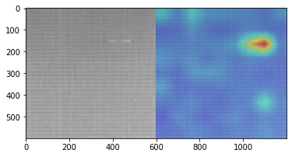
Product A
Experiments results
Notes:
‹#›

Slide 19
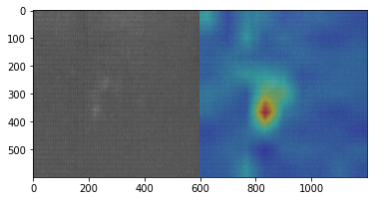
Product B
Experiments results
Notes:
‹#›

Slide 20
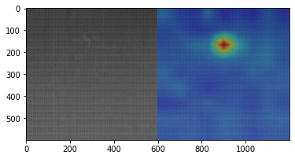
Product B
Experiments results
Notes:
‹#›

Slide 21
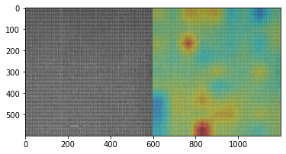
Product B
Experiments results
Notes:
‹#›

Slide 22
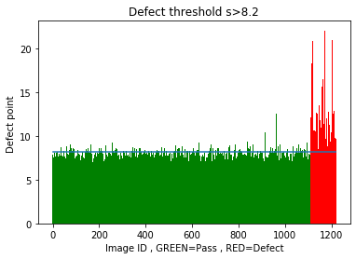
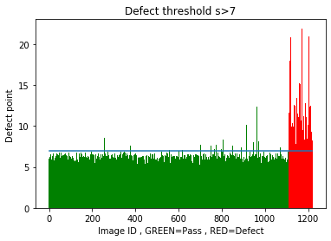
Product A
Experiments results
Data | Training pass | Training defect | Testing pass | Testing defect
Product A | 1000 | 21 | 1143 | 72
Product A | Patchcore 1% | Patchcore 10% | Patchcore 25%
Overkill | 51/1143 | 16/1143 | 15/1143
Underkill | 2/72 | 0/72 | 0/72
Accuracy | 97.22% | 100.00% | 100.00%
Precision | 95.64% | 98.68% | 98.77%
Patchcore 1%
Patchcore 25%
Notes:
‹#›

Slide 23
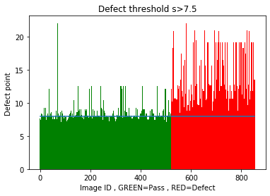
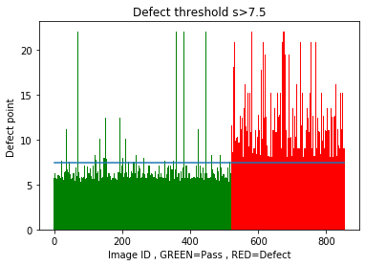
Product B
Experiments results
Data | Training pass | Training defect | Testing pass | Testing defect
Product B | 1000 | 32 | 479 | 337
Product B | Patchcore 1% | Patchcore 10% | Patchcore 25%
Overkill | 62/479 | 32/479 | 12/479
Underkill | 0/337 | 0/337 | 0/337
Accuracy | 100.00% | 100.00% | 100.00%
Precision | 92.37% | 96.06% | 98.52%
Patchcore 1%
Patchcore 25%
Notes:
‹#›

