Slide 1
Automatic Virtual Metrology (AVM) for Plasma
Reporter:黃一恩

Slide 2
Outline
Introduction
Related work
Methodology
Experiments

Slide 3
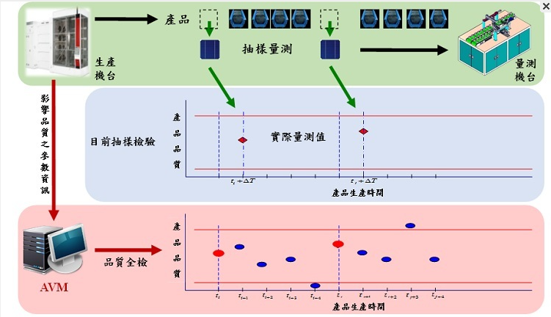
Introduction
Automatic virtual metrology (AVM)
🞑 Automatic Virtual metrology (AVM) can convert sampling inspection with
metrology delay into real-time and online total inspection
🞑 For physical metrology operation in semiconductor manufacturing and the
necessity of reducing physical metrology with AVM for decreasing
manufacturing cost.

Slide 4

Introduction
Plasma ETCH process
🞑 Plasma etch is a semiconductor manufacturing process during which,
material is removed from the surface of semiconducting wafers, typically
made of silicon, using gases in plasma form.
🞑 A host of chemical and electrical complexities make the etch
process notoriously difficult to model and troublesome to control.

Slide 5
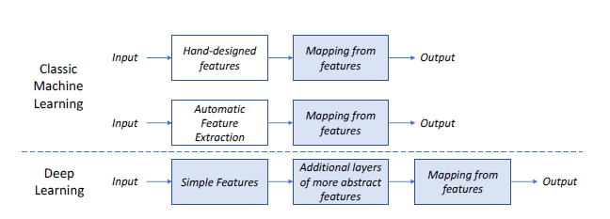
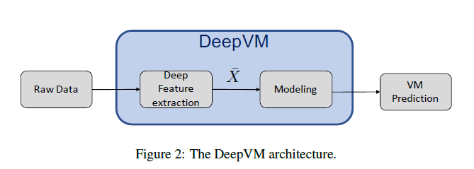
Related work
A Deep Learning-based Approach with Automatic Feature
Extraction for 2D input Data Virtual Metrology (DeepVM).
🞑 DeepVM is an approach to Virtual Metrology that exploits
an automated feature extraction method to replace conventional
machine learning handcraft method

Slide 6
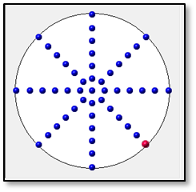
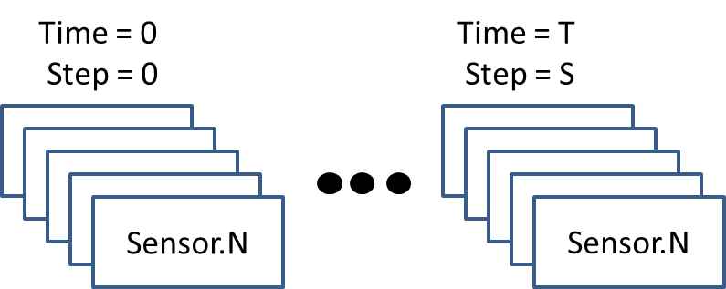
METHODOLOGY
Model predict target
🞑 Our target is wafer’s 49 point Etch rate prediction and alarm detection
through plasma equip collect sensor value (pressure, temperature, gas…)
and use them to train a regression model and alarm detection model
Wafer 49 point location
Plasma equip sensor format

Slide 7
METHODOLOGY
Plasma sensor data format and preprocess
🞑 Plasma equip sensor data is sequential format that shape=(S,T,N)
🞑 Preprocess step 1. Calculate every step sensor (mean,std,max,min)
in T dimension and shape become (S,N*4)
🞑 Preprocess step 2. Use minimax normalization to normalize sensor
value in N dimension
Time = 0
Step = 0
Time = T
Step = 0
Time = T
Step = S
Sensor.1
Sensor.1
Sensor.1
Sensor.1
Sensor.1
Sensor.1
Sensor.1
Sensor.1
Sensor.1
Sensor.1
Sensor.1
Sensor.1
Sensor.N
Sensor.N
Sensor.N

Slide 8
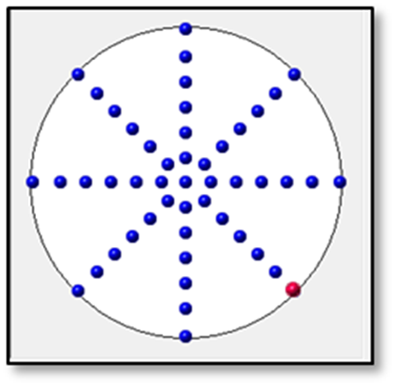
METHODOLOGY
Etch rate data format and preprocess
🞑 Measure equip collect initial thick value and after plasma process
thick value both of shape are (49)
🞑 Preprocess. Calculate all training data thick value mean and std
to do z-score normalization (include testing data)
Wafer 49 point

Slide 9
METHODOLOGY
Etch rate regression model
Output last thick value
Model thick
prediction
L2 loss
Thick
Thick
model
Repeat step times
After plasma
Thick label
C
Etch rate
model
Optimize model
Update Thick value
Step 1…S
Sensor
Sensor
model

Slide 10
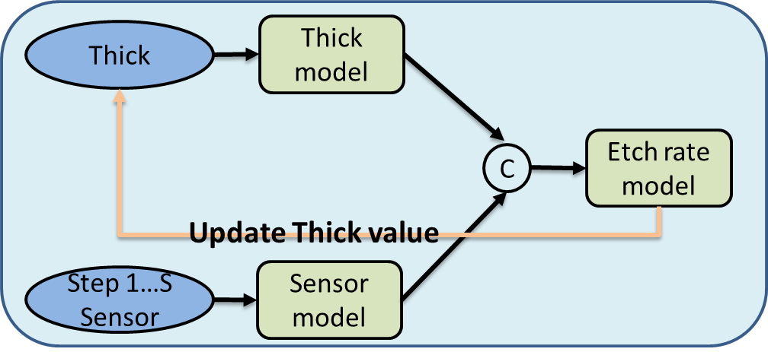
METHODOLOGY
Alarm detection
Repeat step times
Extract every step feature and
calculate all training pass mean feature
Extract from testing data
Sensor.1
Sensor.1
Sensor.1
Sensor.1
Sensor.1
Sensor.1
Sensor.1
Calculate every step cosine
similarity to detect alarm
Sensor.1
Feature N
Feature N

Slide 11
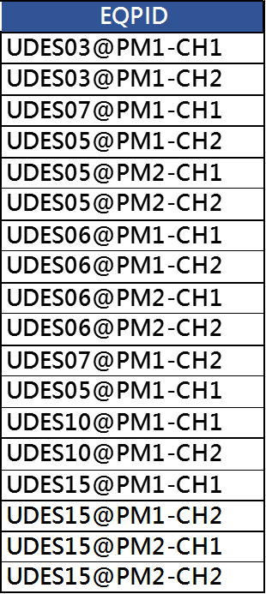
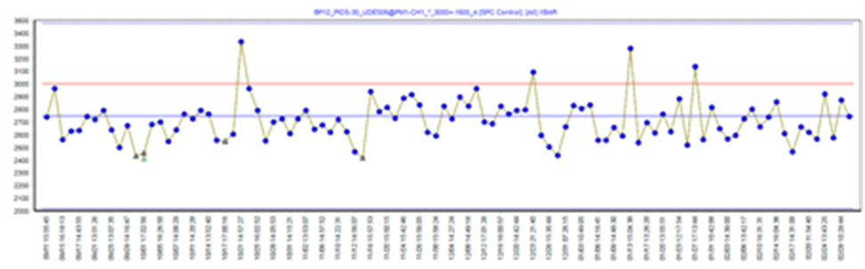

EXPERIMENTS
Training Input: Sensor in-process monitor data
pressure
position
Training Dataset:
Total training data = 12457 (2022/03/01 – 2023/02/28)
Total validation data = 1161 (2023/03/01 – 2023/03/31)

Slide 12
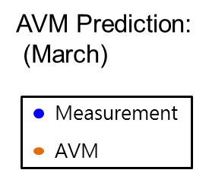


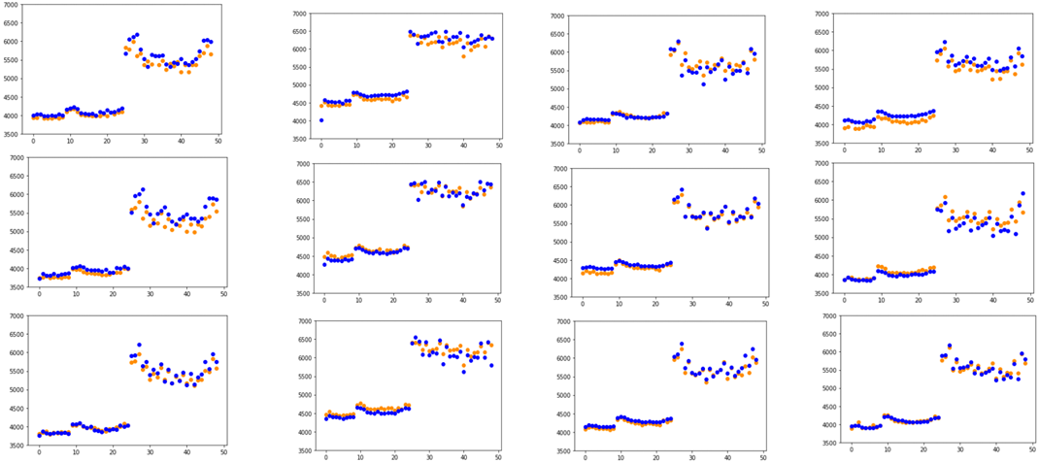
EXPERIMENTS
Recipe 1.

Slide 13
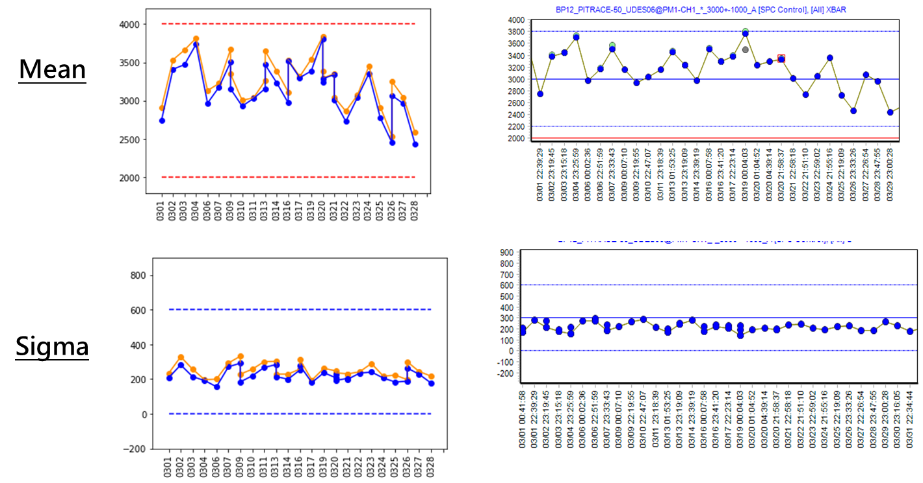
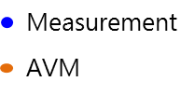
EXPERIMENTS
AVM on Dummy

Slide 14
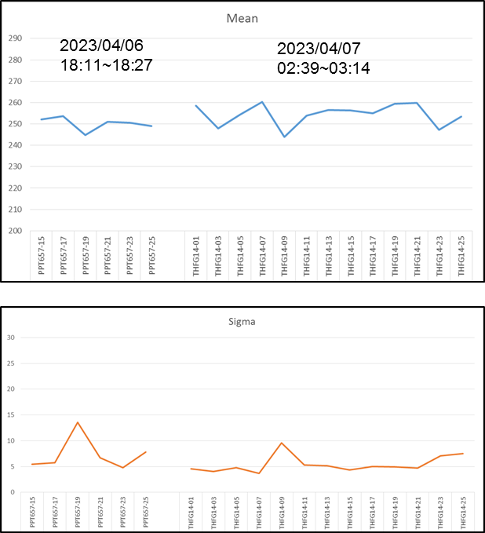
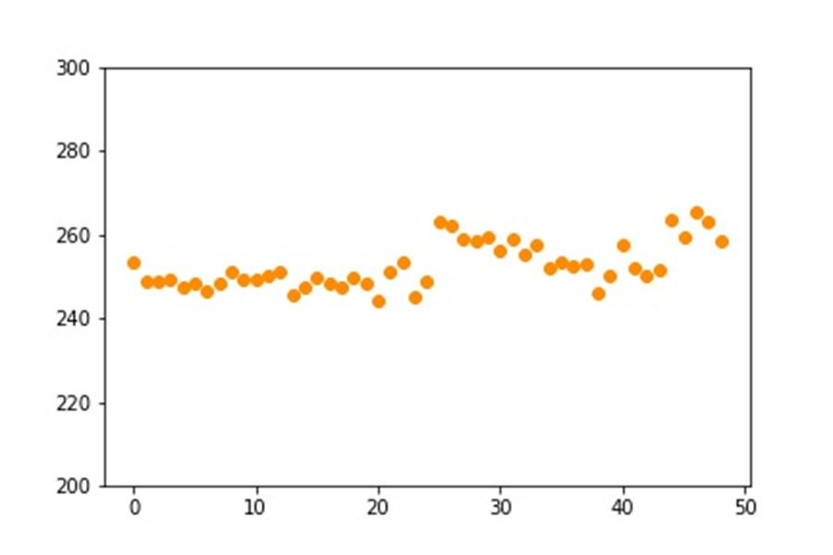
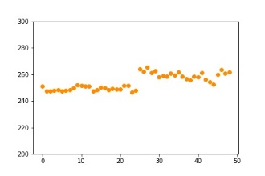
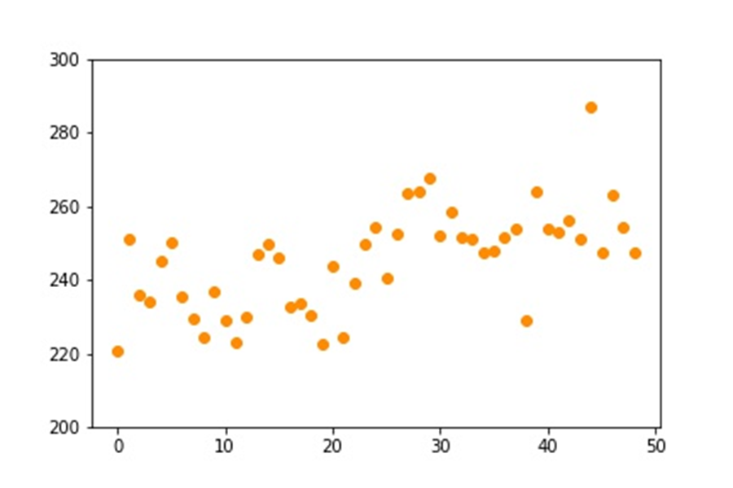
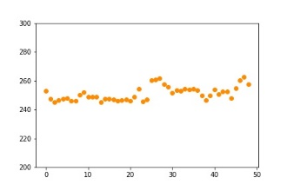
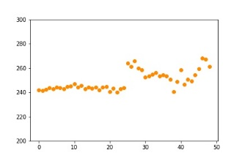
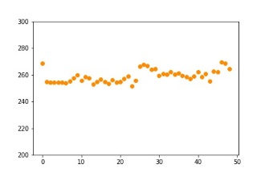
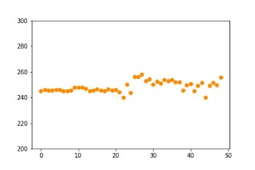
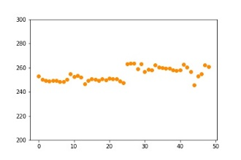
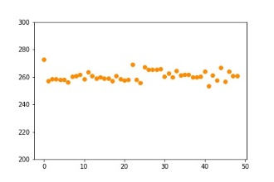
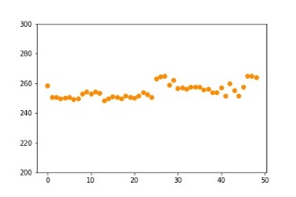
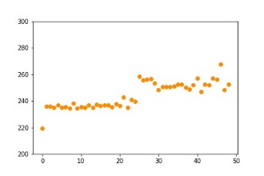
EXPERIMENTS
AVM on Products
Wafer 1
Wafer 2
Wafer 3
Detect alarm
Wafer 4
Wafer 5
Wafer 6
1, 2, 3, 4, 5, 6 , 7, 8 , 9 , 10 , 11 , 12
Wafer 7
Wafer 8
Wafer 9
Wafer 10
Wafer 11
Wafer 12
1, 2, 3, 4, 5, 6 , 7, 8 , 9 , 10 , 11 , 12

