Slide 1
Web程式設計
JQuery
授課教師:陳錫民
Email: hsiminc@fcu.edu.tw

Slide 2
What is jQuery
jQuery is a lightweight, "write less, do more", JavaScript library.
jQuery takes a lot of common tasks and wraps them into methods that you can call with a single line of code.
The purpose of jQuery is to make it much easier to use JavaScript on your website.

Slide 3
What is jQuery
The jQuery library contains the following features:
HTML/DOM manipulation
CSS manipulation
HTML event methods
Effects and animations
AJAX
Utilities

Slide 4
Why jQuery
lots of other JavaScript frameworks out there, but jQuery seems to be the most popular, and also the most extendable.
Many of the biggest companies on the Web use jQuery, such as:
Google
Microsoft
IBM
Netflix

Slide 5
Adding jQuery to Your Web Pages
There are several ways to start using jQuery on your web site.
Download the jQuery library from jQuery.com
Include jQuery from a CDN, like Google

Slide 6
Download from jQuery.com
Downloading jQuery
There are two versions of jQuery available for downloading:
Production version - this is for your live website because it has been minified and compressed
Development version - this is for testing and development (uncompressed and readable code)

Slide 7
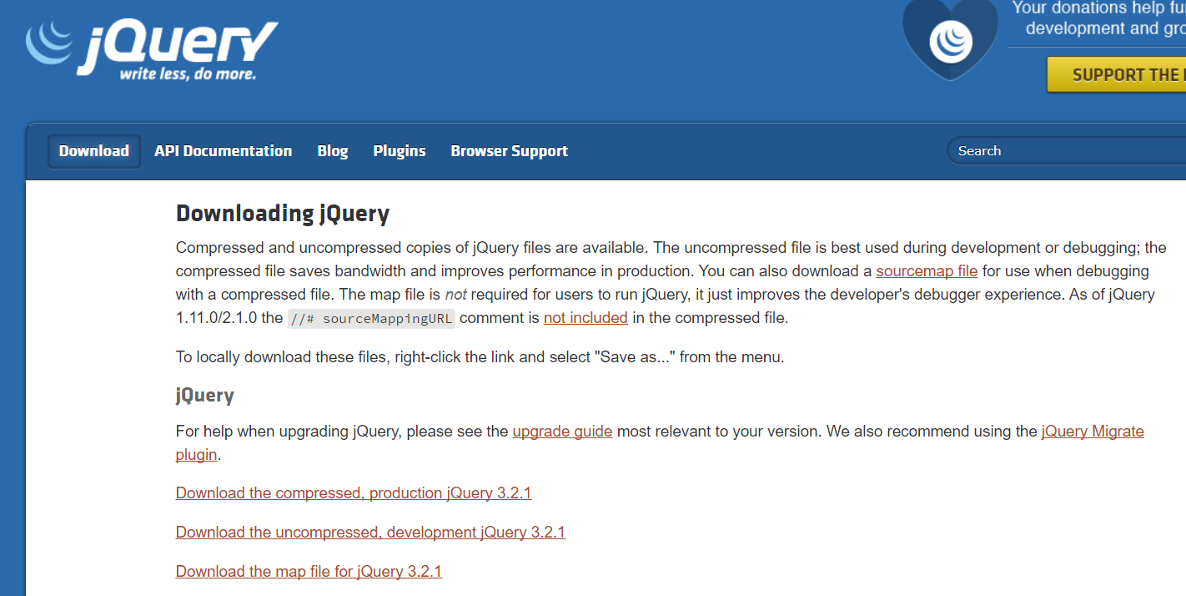
http://jquery.com/download/

Slide 8
Download from jQuery.com
The jQuery library is a single JavaScript file, and you reference it with the HTML <script> tag
notice that the <script> tag should be inside the <head> section

Slide 9
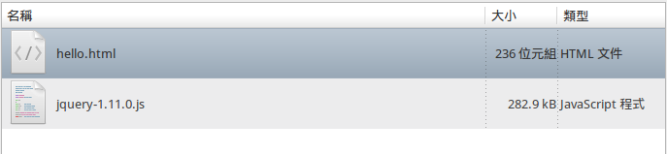
Example
<!DOCTYPE html>
<html>
<head>
<meta charset="utf-8">
<title>範例</title>
<script src="jquery-1.11.0.js"></script>
<script>
$(document).ready(function(){
document.write("Hello World!");
});
</script>
</head>
<body>
</body>
</html>

Slide 10
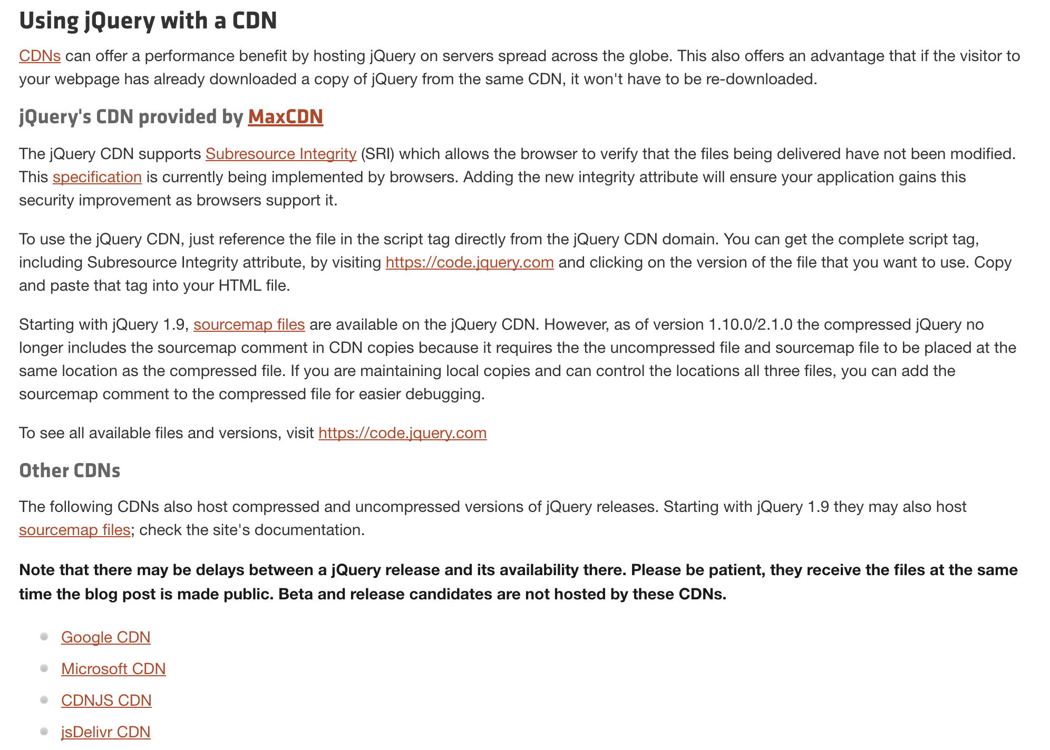
Include jQuery from a CDN

Slide 11
Include jQuery from a CDN
If you don't want to download and host jQuery yourself, you can include it from a CDN (Content Delivery Network).
Both Google and Microsoft host jQuery
<head>
<script src="https://ajax.googleapis.com/ajax/libs/jquery/3.2.1/jquery.min.js"></script>
</head>
<head>
<script src="http://ajax.aspnetcdn.com/ajax/jQuery/jquery-3.2.1.min.js"></script>
</head>

Slide 12
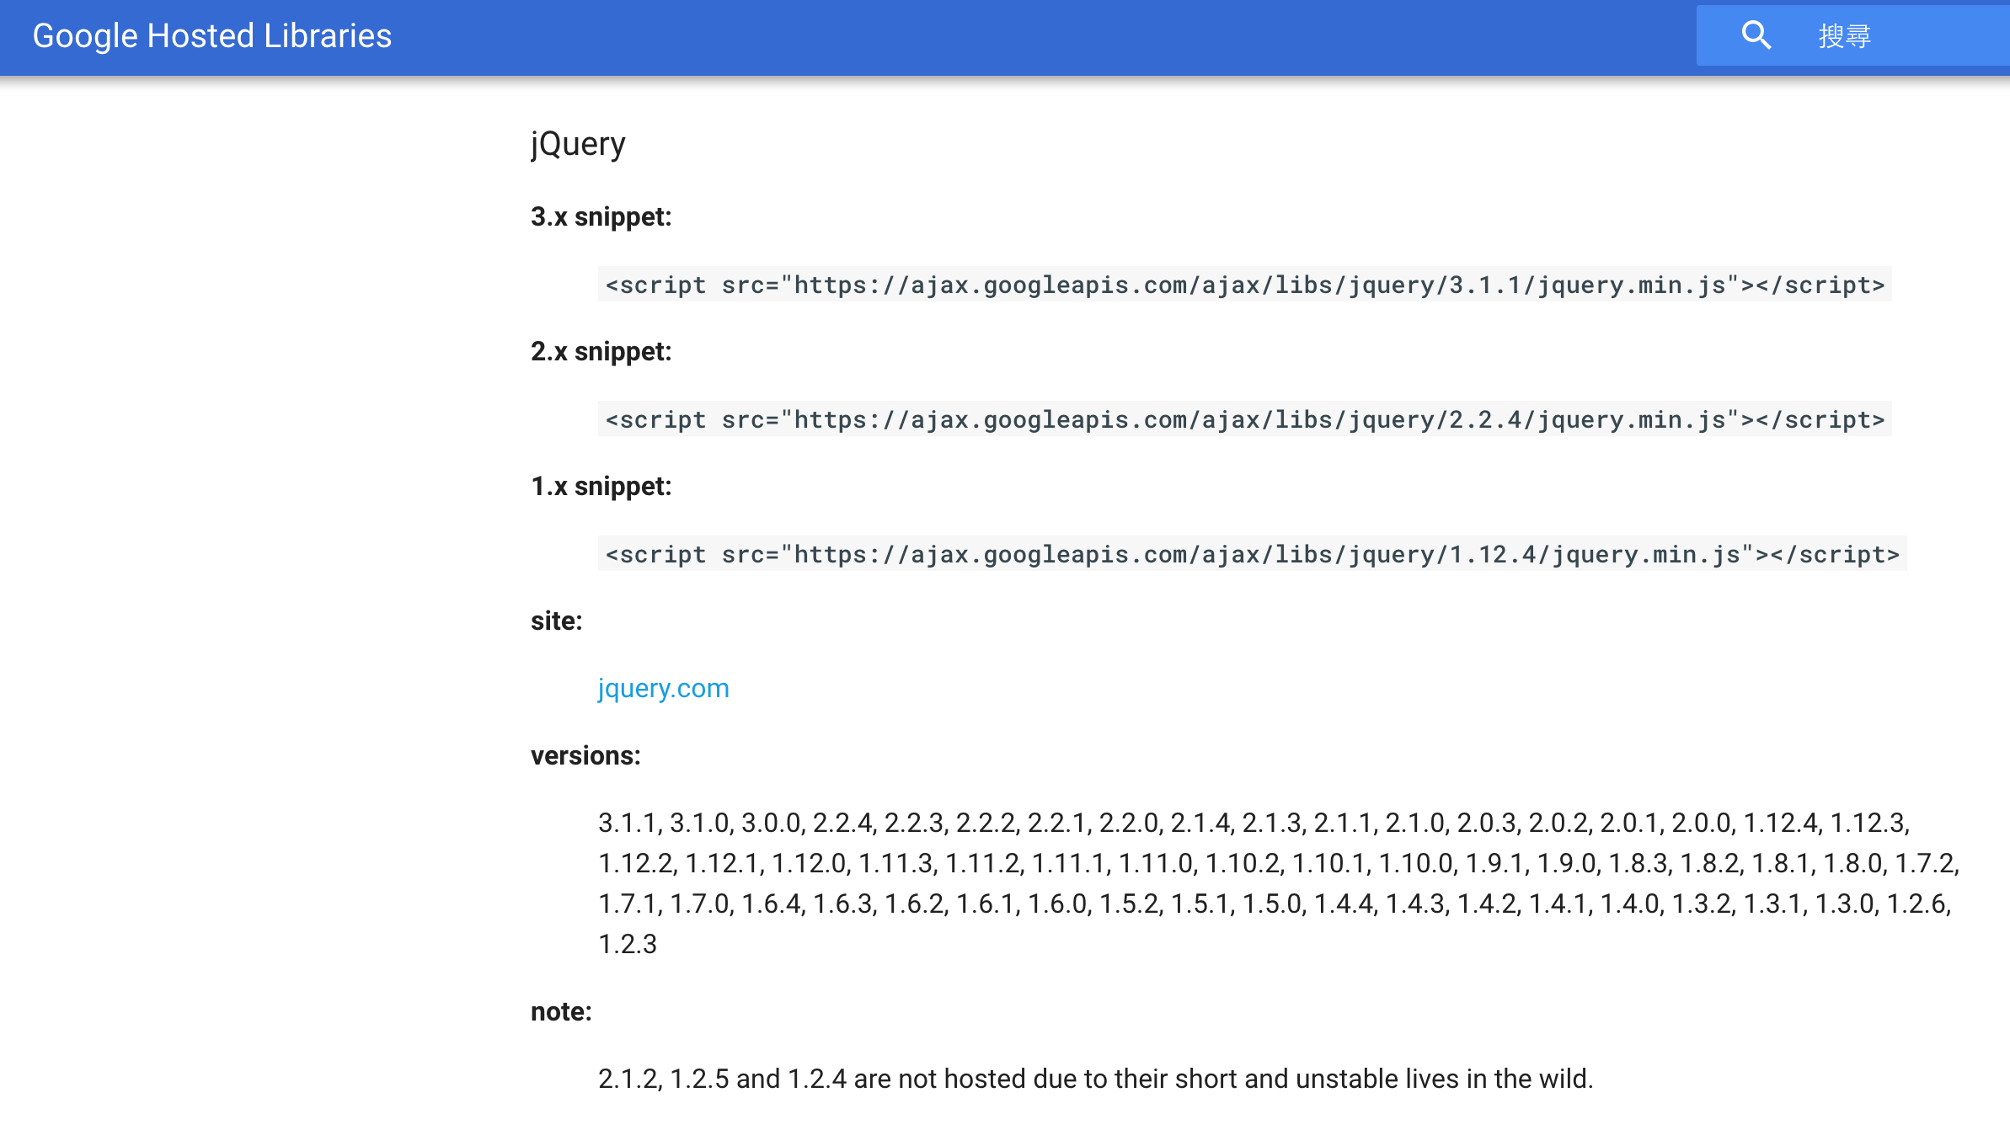
Include jQuery from a CDN

Slide 13
Example
<!DOCTYPE html>
<html>
<head>
<meta charset="utf-8">
<title>範例</title>
<script src="https://ajax.googleapis.com/ajax/libs/jquery/3.2.1/jquery.min.js">
</script>
<script>
$(document).ready(function(){
document.write("Hello World!");
});
</script>
</head>
<body>
</body>
</html>

Slide 14
Include jQuery from a CDN
advantage of using the hosted jQuery from Google or Microsoft
Many users already have downloaded jQuery from Google or Microsoft when visiting another site.
As a result, it will be loaded from cache when they visit your site, which leads to faster loading time.
Also, most CDN's will make sure that once a user requests a file from it, it will be served from the server closest to them, which also leads to faster loading time.

Slide 15
jQuery Syntax
The jQuery syntax is tailor made for selecting HTML elements and performing some action on the element(s).
jQuery uses CSS syntax to select elements.
Basic syntax is: $(selector).action()
A $ sign to define/access jQuery
A (selector) to "query (or find)" HTML elements
A jQuery action() to be performed on the element(s)

Slide 16
jQuery Syntax
Example of $(selector).action()
$(this).hide() - hides the current element.
$("p").hide() - hides all <p> elements.
$(".test").hide() - hides all elements with class="test".
$("#test").hide() - hides the element with id="test".

Slide 17
The Document Ready Event
Notice that all jQuery method are inside a document ready event
Prevent any jQuery code from running before the document is finished loading (is ready).
Here are some examples of actions that can fail if methods are run before the document is fully loaded:
Trying to hide an element that is not created yet.
Trying to get the size of an image that is not loaded yet.

Slide 18
The Document Ready Event
$(document).ready(function(){
// jQuery methods go here...
});
$(function(){
// jQuery methods go here...
});

Slide 19
Exercise 1
Write a HTML document
include jQuery library
After loading document, popup a “Hello World!” alert dialog.

Slide 20
jQuery Selector
jQuery selectors allow you to select and manipulate HTML element(s).
jQuery selectors are used to "find" (or select) HTML elements based on their id, classes, types, attributes, values of attributes and much more.
All selectors in jQuery start with the dollar sign and parentheses: $().

Slide 21
The Element Selector
selects elements based on the element name.
You can select all <p> elements on a page like this:
<!DOCTYPE html>
<html>
<head>
<script src="http://ajax.googleapis.com/ajax/libs/jquery/1.11.0/jquery.min.js">
</script>
<script>
$(document).ready(function(){
$("button").click(function(){
$("p").hide();
});
});
</script>
</head>
<body>
<h2>This is a heading</h2>
<p>This is a paragraph.</p>
<p>This is another paragraph.</p>
<button>Click me</button>
</body>
</html>

Slide 22
The #id Selector
uses the id attribute of an HTML tag to find the specific element.
An id should be unique within a page, so you should use the #id selector when you want to find a single, unique element.
To find an element with a specific id, write a hash (#) character, followed by the id of the HTML element:
<script>
$(document).ready(function(){
$("button").click(function(){
$("#test").hide();
});
});
</script>
</head>
<body>
<h2>This is a heading</h2>
<p>This is a paragraph.</p>
<p id="test">This is another paragraph.</p>
<button>Click me</button>
</body>

Slide 23
The .class Selector
finds elements with a specific class.
To find elements with a specific class, write a period (.) character, followed by the name of the class:
$(document).ready(function(){
$("button").click(function(){
$(".test").hide();
});
});
</script>
</head>
<body>
<h2 class="test">This is a heading</h2>
<p class="test">This is a paragraph.</p>
<p>This is another paragraph.</p>
<button>Click me</button>
</body>

Slide 24
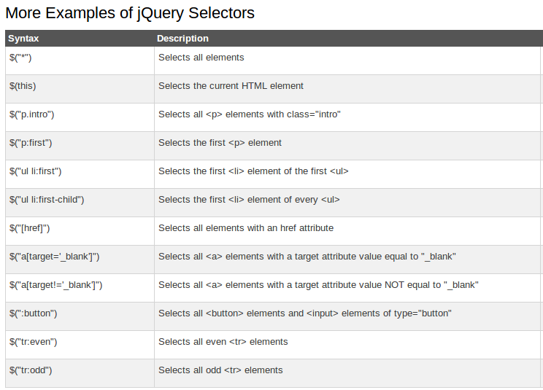
More jQuery Selectors
* http://www.w3schools.com/jquery/jquery_selectors.asp
http://www.w3schools.com/jquery/jquery_ref_selectors.asp

Slide 25
jQuery Event Method
What are Events?
All the different visitor's actions that a web page can respond to are called events.
An event represents the precise moment when something happens.
Examples:
moving a mouse over an element
selecting a radio button
clicking on an element

Slide 26
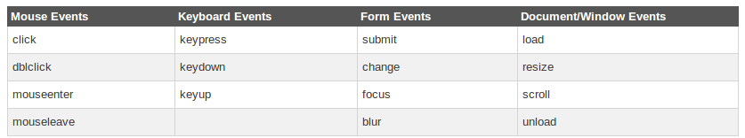
jQuery Event Method
Here are some common DOM events:

Slide 27
jQuery Syntax for Event Method
In jQuery, most DOM events have an equivalent jQuery method.
To assign a click event to all paragraphs on a page, you can do this:
The next step is to define what should happen when the event fires. You must pass a function to the event:
$("p").click();
$("p").click(function(){
// action goes here!!
});

Slide 28
Common Used jQuery Event Methods
$(document).ready()
click()
dblclick()
mouseenter()
mouseleave()
mousedown()
mouseup()
hover()
focus()
blur()
* http://www.w3schools.com/jquery/jquery_events.asp
http://www.w3schools.com/jquery/jquery_ref_events.asp

Slide 29
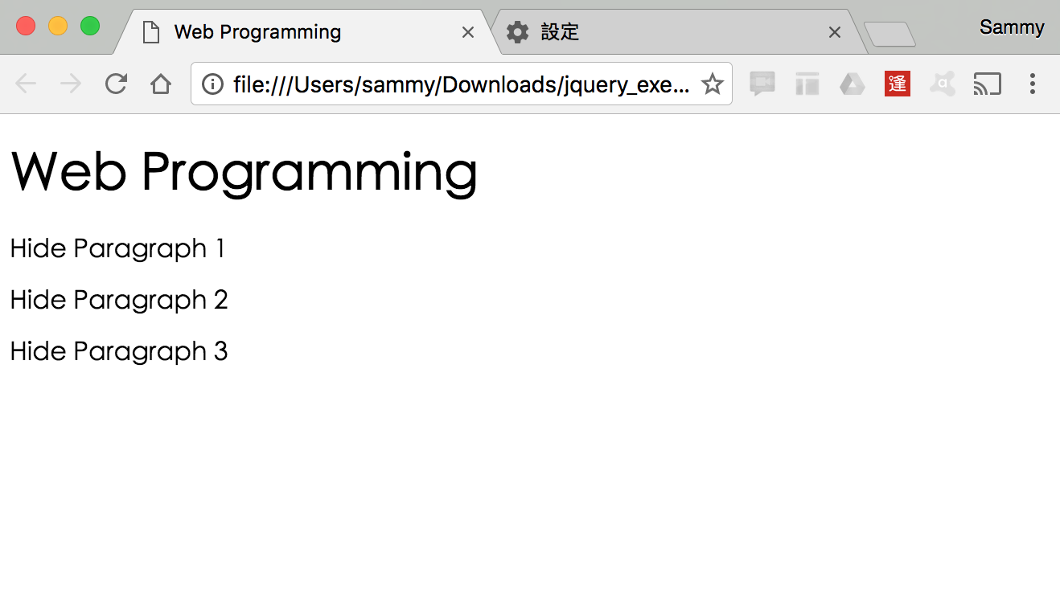
Exercise 2
use p:first to hide first paragraph
use id selector to hide second paragraph
use class selector to hide third paragraph

Slide 30
jQuery Effect
jQuery hide() and show()
With jQuery, you can hide and show HTML elements with the hide() and show() methods:
$("#hide").click(function(){
$("p").hide();
});
$("#show").click(function(){
$("p").show();
});
$("#hide").click(function(){
$("p").hide(100);
});
* http://www.w3schools.com/jquery/jquery_hide_show.asp

Slide 31
jQuery Effect
jQuery toggle()
With jQuery, you can toggle between the hide() and show() methods with the toggle() method.
$("#hide").click(function(){
$("p").toggle();
});
* http://www.w3schools.com/jquery/jquery_hide_show.asp

Slide 32
jQuery Effect: Fade
jQuery fadeIn() Method
The jQuery fadeIn() method is used to fade in a hidden element.
jQuery fadeOut() Method
The jQuery fadeOut() method is used to fade out a visible element.
jQuery fadeToggle() Method
The jQuery fadeToggle() method toggles between the fadeIn() and fadeOut() methods.
jQuery fadeTo() Method
The jQuery fadeTo() method allows fading to a given opacity (value between 0 and 1).
* http://www.w3schools.com/jquery/jquery_fade.asp

Slide 33
jQuery Effect: Sliding
jQuery slideDown() Method
The jQuery slideDown() method is used to slide down an element.
jQuery slideUp() Method
The jQuery slideUp() method is used to slide up an element.
jQuery slideToggle() Method
The jQuery slideToggle() method toggles between the slideDown() and slideUp() methods.
* http://www.w3schools.com/jquery/jquery_slide.asp

Slide 34
jQuery Effect: Animation
The animate() Method
The jQuery animate() method is used to create custom animations.
Syntax
Example
$(selector).animate({params},speed,callback);
$("button").click(function(){
$("div").animate({left:'250px'});
});
* http://www.w3schools.com/jquery/jquery_animate.asp

Slide 35
jQuery Effect: stop
jQuery stop() Method
The jQuery stop() method is used to stop an animation or effect before it is finished.
The stop() method works for all jQuery effect functions, including sliding, fading and custom animations.
Syntax
The optional stopAll parameter specifies whether also the animation queue should be cleared or not. Default is false.
The optional goToEnd parameter specifies whether or not to complete the current animation immediately. Default is false.
$(selector).stop(stopAll,goToEnd);
* http://www.w3schools.com/jquery/jquery_stop.asp

Slide 36
jQuery Callback Function
A callback function is executed after the current effect is 100% finished.
Typical syntax:
Example
$(selector).hide(speed,callback);
$("button").click(function(){
$("p").hide("slow",function(){
alert("The paragraph is now hidden");
});
});
* http://www.w3schools.com/jquery/jquery_callback.asp

Slide 37
jQuery Method Chaining
With jQuery, you can chain together actions/methods.
Chaining allows us to run multiple jQuery methods (on the same element) within a single statement.
Example
$("#p1").css("color","red").slideUp(2000).slideDown(2000);
* http://www.w3schools.com/jquery/jquery_chaining.asp

Slide 38
Exercise 3
Download a picture from Web
Add some animations to the picture

Slide 39
jQuery: Get Content and Attribute
Get Content - text(), html(), and val()
Three simple, but useful, jQuery methods for DOM manipulation are:
text() - Sets or returns the text content of selected elements
html() - Sets or returns the content of selected elements (including HTML markup)
val() - Sets or returns the value of form fields
Get Attributes - attr()
The jQuery attr() method is used to get attribute values.
* http://www.w3schools.com/jquery/jquery_dom_get.asp

Slide 40
jQuery: Set Content
Set Content - text(), html(), and val()
text() - Sets or returns the text content of selected elements
html() - Sets or returns the content of selected elements (including HTML markup)
val() - Sets or returns the value of form fields
A Callback Function for text(), html(), and val()
The callback function has two parameters:
the index of the current element in the list of elements selected and
the original (old) value.
* http://www.w3schools.com/jquery/jquery_dom_set.asp

Slide 41
jQuery: Set Attribute
Set Attribute - attr()
The jQuery attr() method is also used to set/change attribute values.
Example
A Callback Function for attr()
The callback function has two parameters:
the index of the current element in the list of elements selected and
the original (old) attribute value.
$("button").click(function(){
$("#w3s").attr("href","http://www.w3schools.com/jquery");
});
* http://www.w3schools.com/jquery/jquery_dom_set.asp

Slide 42
jQuery: Add Element
Add New HTML Content
Four jQuery methods that are used to add new content:
append() - Inserts content at the end of the selected elements
prepend() - Inserts content at the beginning of the selected elements
after() - Inserts content after the selected elements
before() - Inserts content before the selected elements
* http://www.w3schools.com/jquery/jquery_dom_add.asp

Slide 43
jQuery: Remove Element
Remove Elements/Content
To remove elements and content, there are mainly two jQuery methods:
remove() - Removes the selected element (and its child elements)
empty() - Removes the child elements from the selected element
* http://www.w3schools.com/jquery/jquery_dom_remove.asp

Slide 44
jQuery: Get and Set CSS
jQuery Manipulating CSS
jQuery has several methods for CSS manipulation.
addClass() - Adds one or more classes to the selected elements
removeClass() - Removes one or more classes from the selected elements
toggleClass() - Toggles between adding/removing classes from the selected elements
css() - Sets or returns the style attribute

Slide 45
Example
.important
{
font-weight:bold;
font-size:xx-large;
}
.blue
{
color:blue;
}
jQuery addClass() Method
$("button").click(function(){
$("h1,h2,p").addClass("blue");
$("div").addClass("important");
});
jQuery removeClass() Method
$("button").click(function(){
$("h1,h2,p").removeClass("blue");
});
jQuery toggleClass() Method
$("button").click(function(){
$("h1,h2,p").toggleClass("blue");
});
* http://www.w3schools.com/jquery/jquery_css_classes.asp

Slide 46
jQuery: CSS Method
jQuery css() Method
The css() method sets or returns one or more style properties for the selected elements.
To return the value of a specified CSS property, use the following syntax:
Example
To set a specified CSS property, use the following syntax:
Example
css("propertyname");
$("p").css("background-color");
css("propertyname","value");
$("p").css("background-color","yellow");
* http://www.w3schools.com/jquery/jquery_css.asp

Slide 47
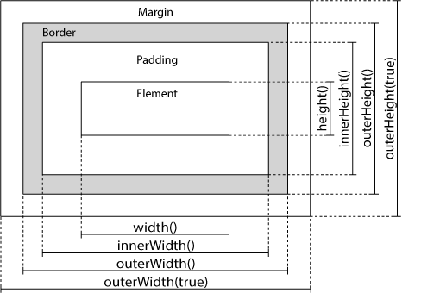
jQuery: Dimensions
jQuery has several important methods for working with dimensions:
width()
height()
innerWidth()
innerHeight()
outerWidth()
outerHeight()
* http://www.w3schools.com/jquery/jquery_dimensions.asp

Slide 48
jQuery Traversing
What is traversing?
used to "find" (or select) HTML elements based on their relation to other elements.
Start with one selection and move through that selection until you reach the elements you desire

Slide 49
<div>
<ul>
<li>
<span> <span>
<li>
<li>
<b>
</li>
</ul>
<div>
<div>
<ul>
<li>
<li>
<span>
<span>
<b>
The <div> element is the parent of <ul>, and an ancestor of everything inside of it
The <ul> element is the parent of both <li> elements, and a child of <div>
The left <li> element is the parent of <span>, child of <ul> and a descendant of <div>
The <span> element is a child of the left <li> and a descendant of <ul> and <div>
The two <li> elements are siblings (they share the same parent)
The right <li> element is the parent of <b>, child of <ul> and a descendant of <div>
The <b> element is a child of the right <li> and a descendant of <ul> and <div>

Slide 50
Traversing Up the DOM Tree
jQuery methods for traversing up the DOM tree
parent()
returns the direct parent element of the selected element.
parents()
returns all ancestor elements of the selected element, all the way up to the document's root element (<html>).
parentsUntil()
returns all ancestor elements between two given arguments
*http://www.w3schools.com/jquery/jquery_traversing_ancestors.asp

Slide 51
Traversing Down the DOM Tree
A descendant is a child, grandchild, great-grandchild, and so on.
Two useful jQuery methods for traversing down the DOM tree are:
children()
returns all direct children of the selected element.
find()
returns descendant elements of the selected element, all the way down to the last descendant.
*http://www.w3schools.com/jquery/jquery_traversing_descendants.asp

Slide 52
jQuery Traversing - Siblings
Siblings share the same parent
siblings()
returns all sibling elements of the selected element.
next()
returns the next sibling element of the selected element
nextAll()
returns all next sibling elements of the selected element
nextUntil()
returns all next sibling elements between two given arguments.
*http://www.w3schools.com/jquery/jquery_traversing_siblings.asp

Slide 53
jQuery Traversing - Filtering
allow you to select a specific element based on its position in a group
first()
returns the first element of the selected elements.
last()
returns the last element of the selected elements.
eq()
returns an element with a specific index number of the selected elements.
filter()
Elements that do not match the criteria are removed from the selection, and those that match will be returned.
not()
returns all elements that do not match the criteria.
*http://www.w3schools.com/jquery/jquery_traversing_filtering.asp

Slide 54
Exercise 4
use first () to hide first paragraph
use eq() to hide second paragraph
use filter() to hide third paragraph

Slide 55
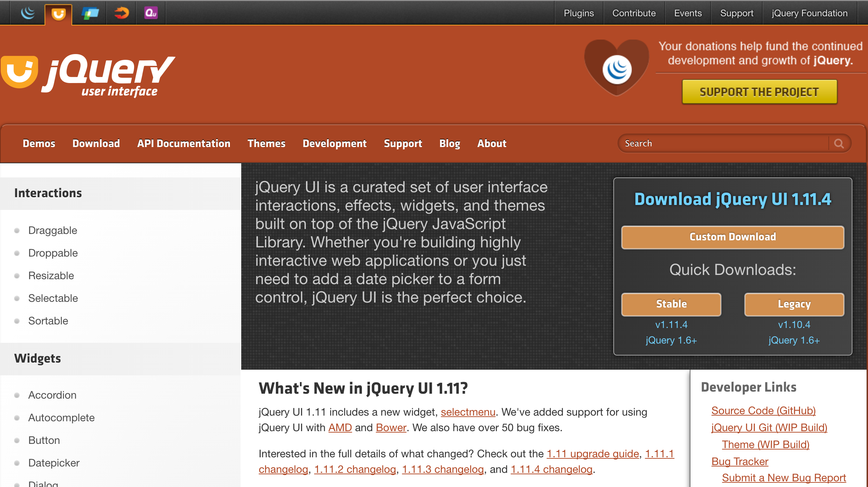
JQuery UI - jqueryui.com

Slide 56
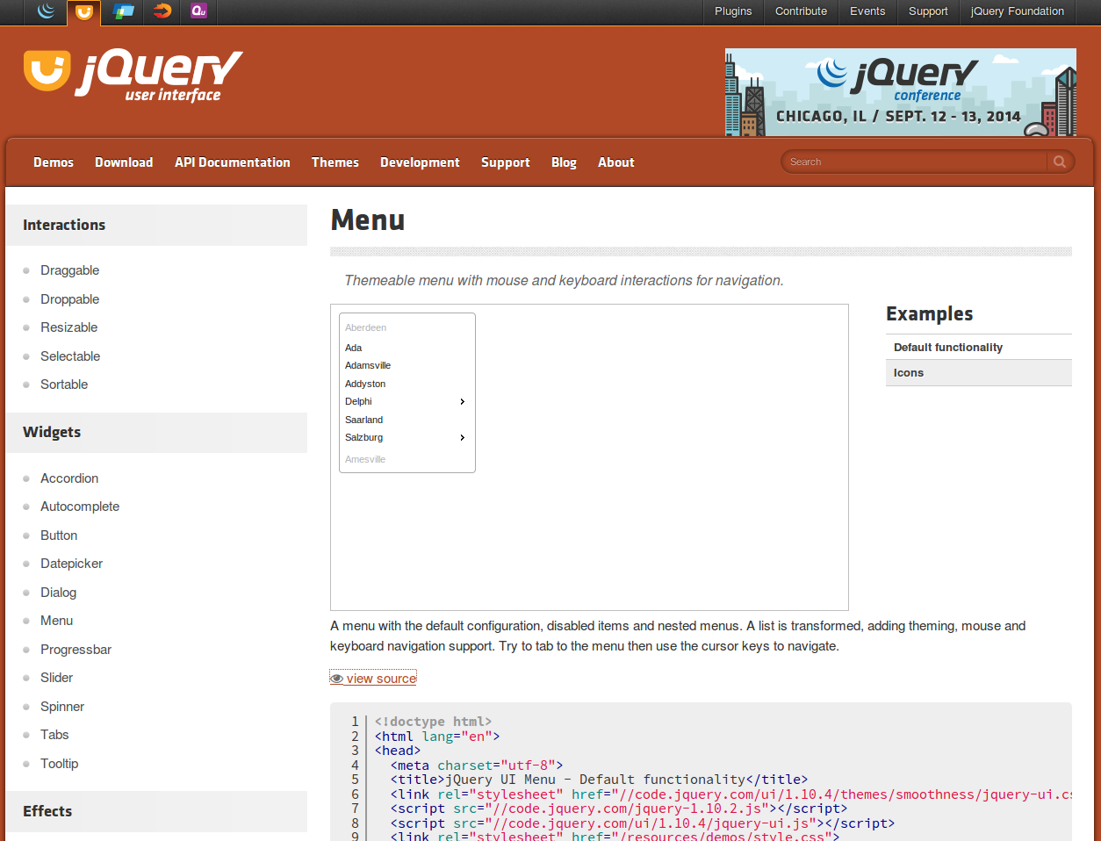
JQuery UI - jqueryui.com

Slide 57
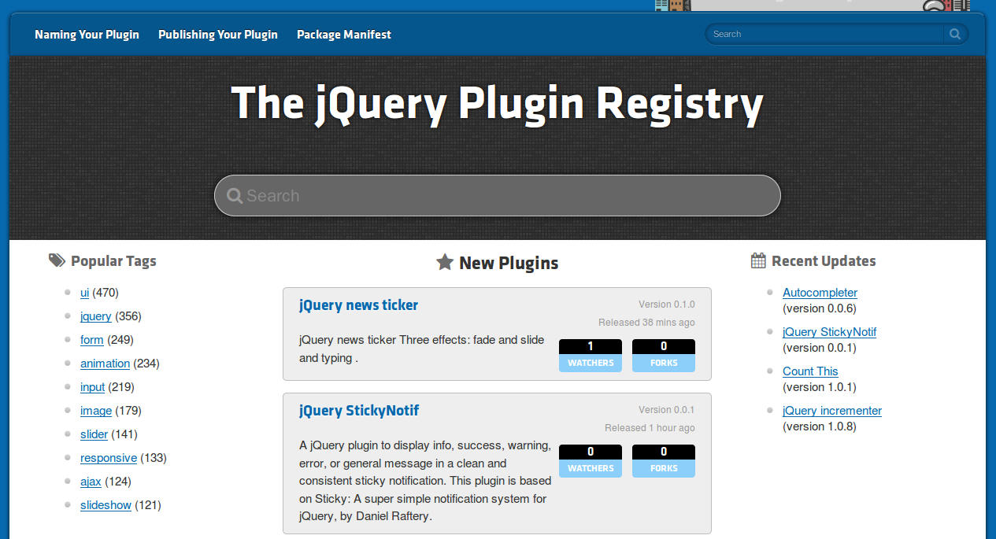
JQuery UI - plugs.jqueryui.com

Slide 58
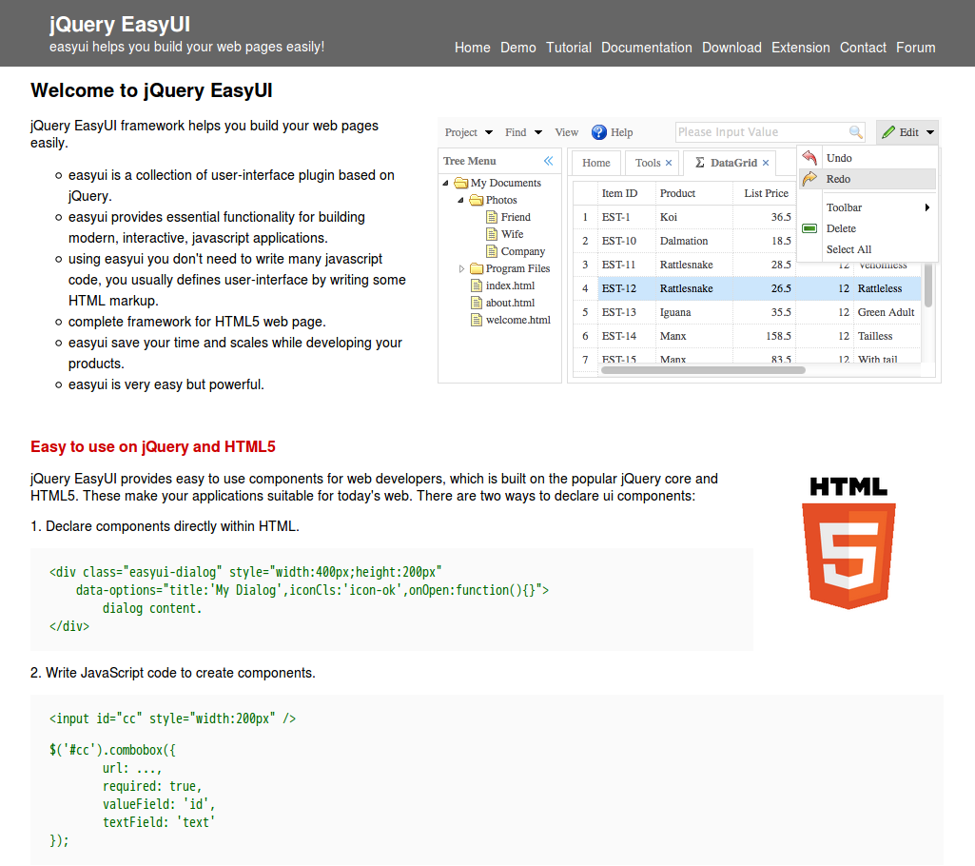
JQuery UI - www.jeasyui.com

Slide 59
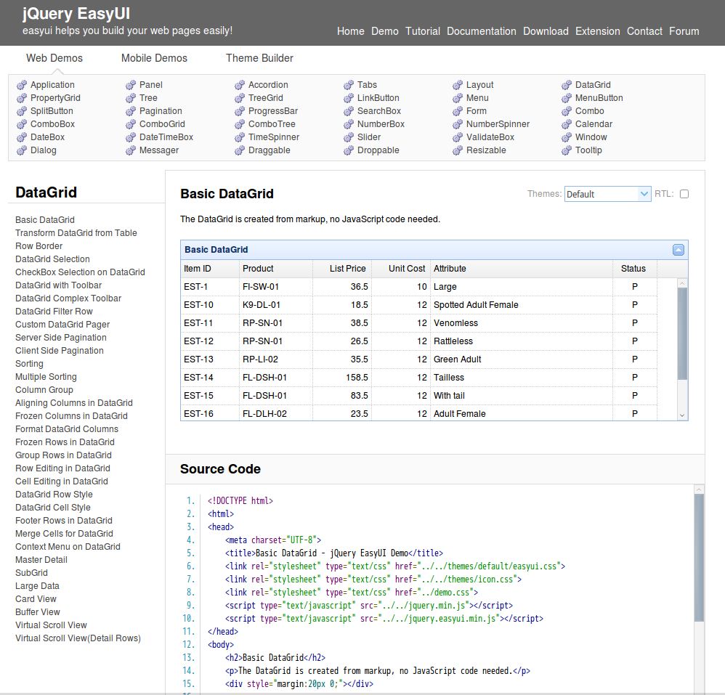
JQuery UI - www.jeasyui.com

