Slide 1
Ch4 Classification
(FOR LATEX)

Slide 2
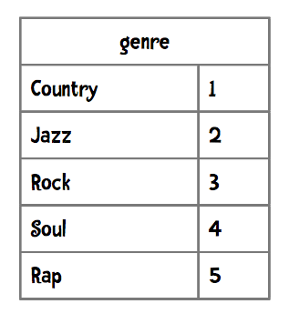
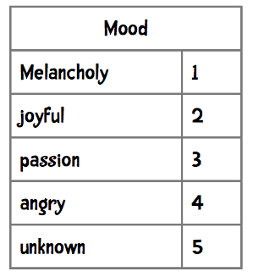
Features of products

Slide 3
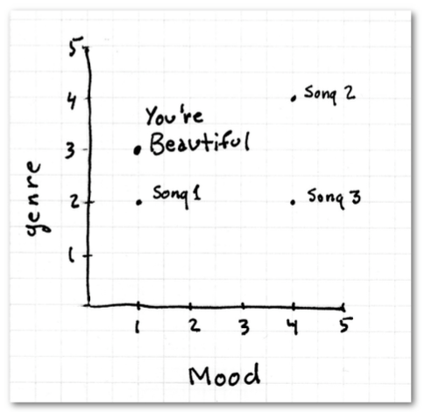
Distance between products
Song1 is closest?!

Slide 4
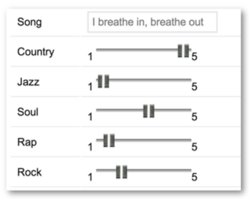
Degree of features
We can easily fix our genre feature by dividing it into 5 separate features—one for country, another for jazz, etc.

Slide 5
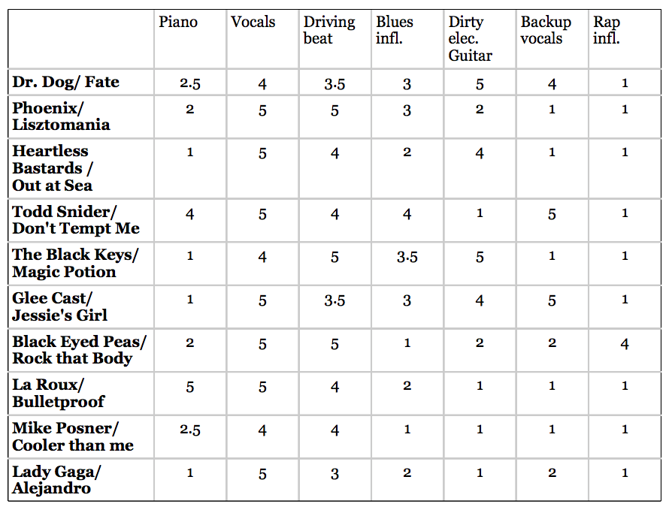
Features

Slide 6
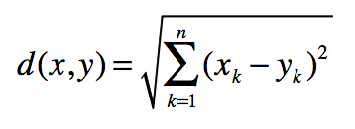
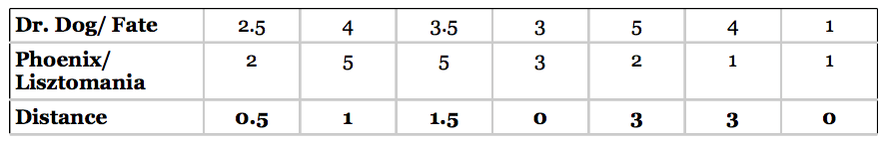
Euclidean distance

Slide 7
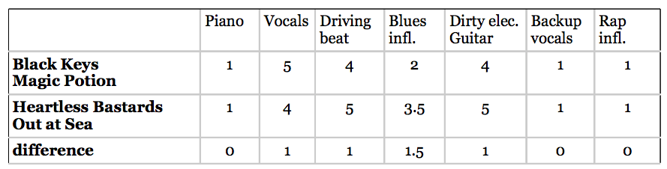
Problems
“We think you would like this tune because it lacks backup vocals. “ -- ?
>>> computeNearestNeighbor("Lady Gaga/Alejandro", music)
[(5, 'Heartless Bastards/Out at Sea'), (5.5, 'Mike Posner'),
(6, 'La Roux/Bulletproof'), (6, 'Phoenix/Lisztomania'), (7.5, "Glee Cast/ Jessie's Girl"),
(8, 'Black Eyed Peas/Rock That Body'), (9, "Todd Snider/Don't Tempt Me"),
(9.5, 'The Black Keys/Magic Potion'), (10.0, 'Dr Dog/Fate')]

Slide 8
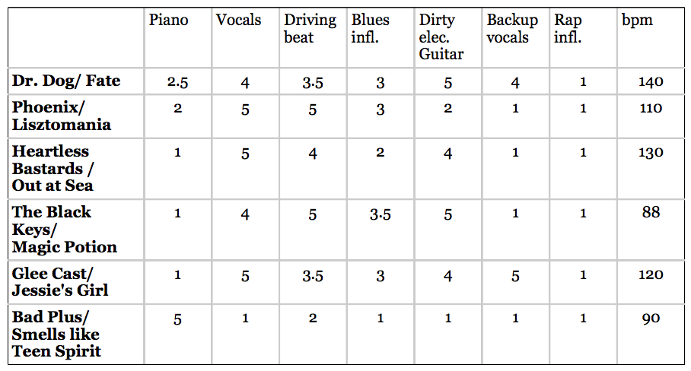
Problem of scale
bpm dominates the calculation.

Slide 9
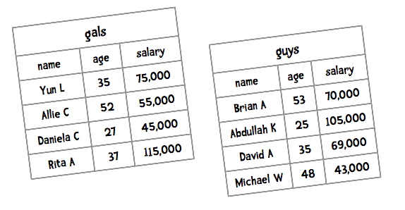
Another example: dating recommendation

Slide 10
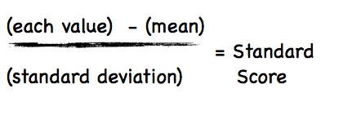
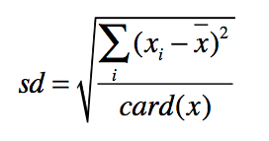

Solution: Normalization
Standard score
The Standard Score for Yun’s salary is
card(x) is the cardinality of x—that is,
how many values there are.

Slide 11
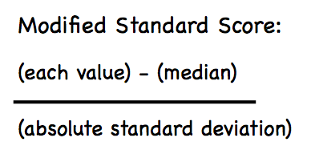
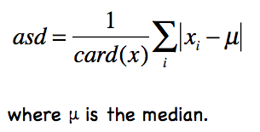
Problem with using Standard Score
It is greatly influenced by outliers
Solution: Modified Standard Score

Slide 12

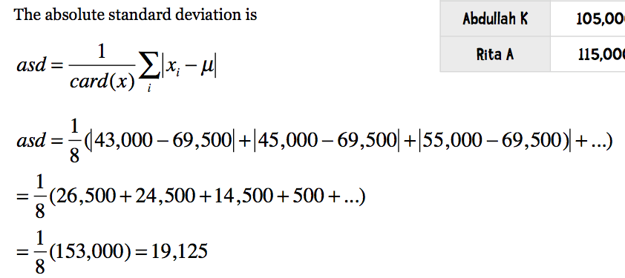
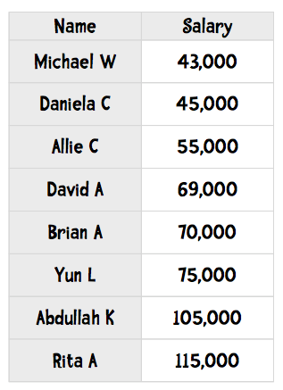
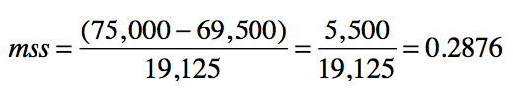
An example
Modified Standard Score for Yun.

Slide 13
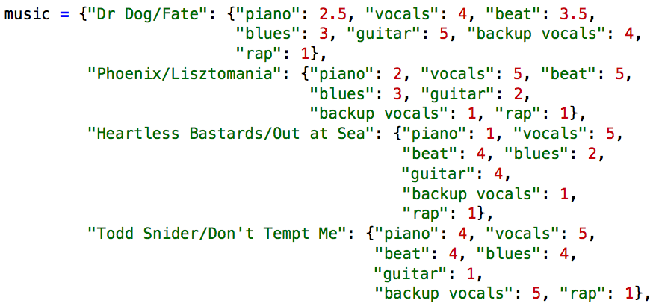
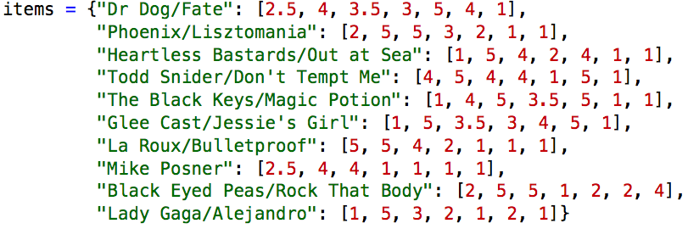
Vectors

Slide 14
In linear algebra, a vector is a quantity that has magnitude and direction. Various well defined operators can be performed on vectors including adding and subtracting vectors and scalar multiplication.
In data mining, a vector is simply a list of numbers that represent the attributes of an object.

Slide 15
Python example
classify
Vector
Like/Dislike
def manhattan(vector1, vector2):
計算兩向量的距離（兩物品的相近程度）
def computeNearestNeighbor(itemName, itemVector, items):
itemName: 物品名稱
itemVector: 描述物品特性的向量
items: 所有物品的集合
def classify(user, itemName, itemVector):
user: 使用者名稱
itemName: 預計預測的物品名稱
itemVector: 該物品的特色向量

Slide 16
Classifier
A classifier is a program that uses an object’s attributes to determine what group or class it belongs to!
”What sport” Example
height, weight ➔ classifier ➔ Sport

Slide 17
Data structure
A dictionary of the form:
{'Asuka Termoto': ('Gymnastics', [54, 66]), 'Brittainey Raven': ('Basketball', [72, 162]), .
A list of lists of the form:
[['Asuka Termoto', 'Gymnastics', 54, 66], ['Brittainey Raven', 'Basketball', 72, 162], ...
A list of tuples of the form:
[('Gymnastics', [54, 66], ['Asuka Termoto']), ('Basketball', [72, 162], ['Brittainey Raven'],...

Slide 18
class Classifier
def __init__(self, filename):
load self.data from file
def getMedian(self, alist):
return median of alist
def getAbsoluteStandardDeviation(self, alist, median):
get absolute standard deviation
def normalizeColumn(self, columnNumber):
given a column number, normalize that column in self.data
def normalizeVector(self, v):
use median and ASD to normalize vector

Slide 19
def manhattan(self, vector1, vector2):
def nearestNeighbor(self, itemVector):
def classify(self, itemVector):
def test(training_filename, test_filename):

