Slide 1
Ch3 Implicit ratings
(FOR LATEX)

Slide 2
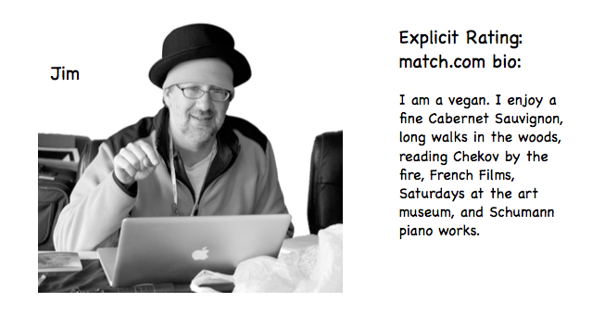
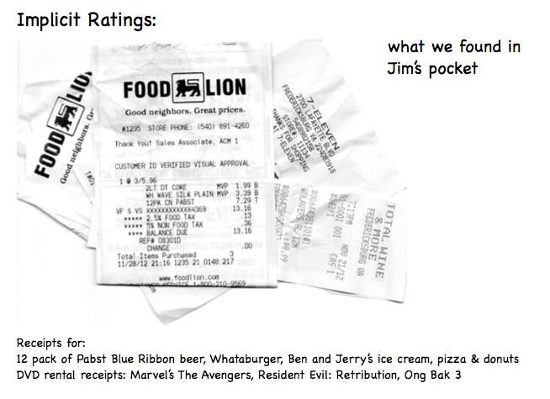
口是心非

Slide 3
Problems with explicit ratings
Problem 1: People are lazy and don't rate items.
Problem 2: People may lie or give only partial information.
Problem 3: People don't update their ratings.

Slide 4
User-based vs. Item-based Filtering
User based
Scalability: the computation increases as the number of users increases
Sparsity: Most recommendation systems have many users and many products but the average user rates a small fraction of the total products
你的朋友都愛看 baby boss, 所以推薦你看
Item based
Compute the similarity between items
Different from use-based filtering
Also called “Model based”
DON’T need to store all ratings
你愛看卡通，所以推薦你看 baby boss

Slide 5
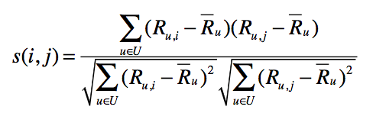
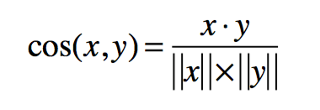
Adjusted Cosine Similarity
Normalize to compensate for this grade inflation

Slide 6
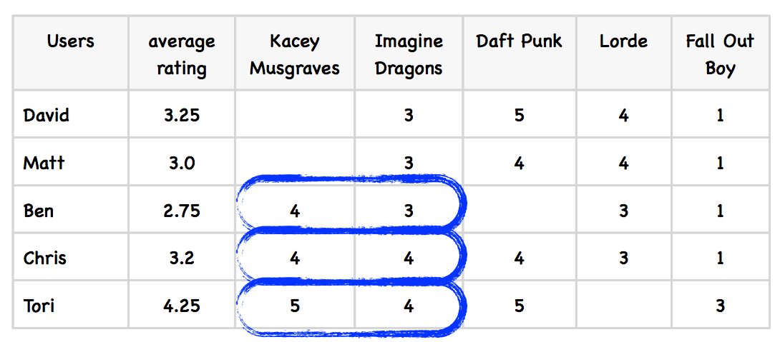
Example

Slide 7
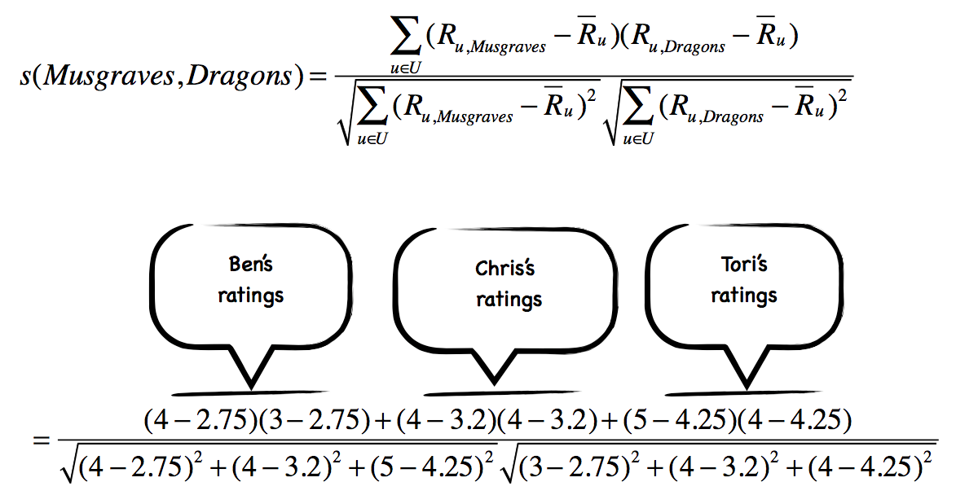

Slide 8
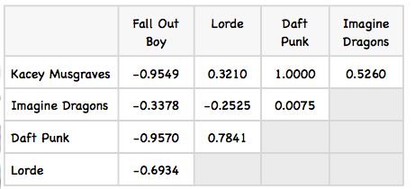
Similarity between items

Slide 9
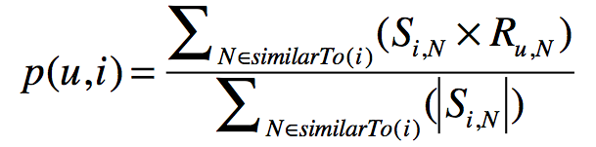
Recommendation
i
?
r₁
s₁
J
r₂
s₂
K
u 對 i 可能的喜好程度
i 和其他事物的相似程度總和

Slide 10
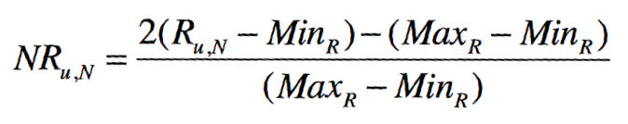
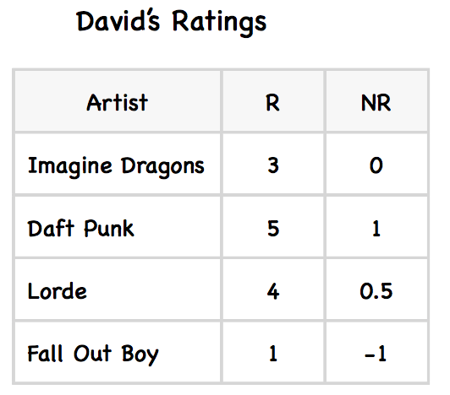
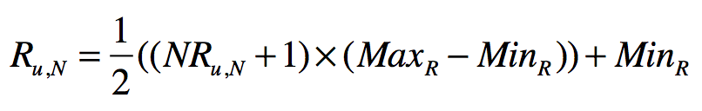
Normalized Rating
(1, 5) => (-1, 1)

Slide 11
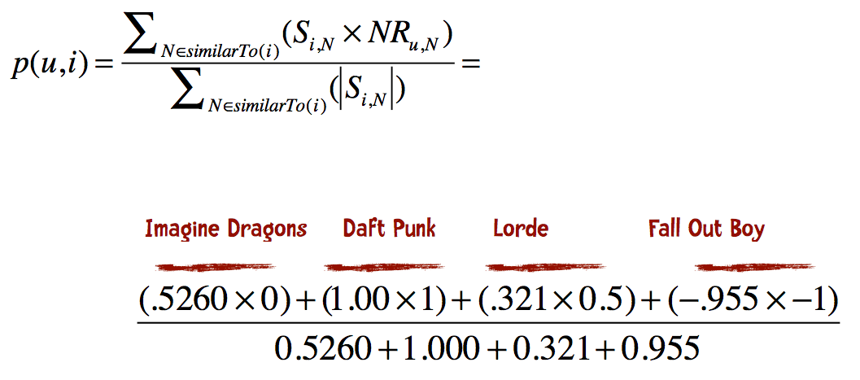
An example

Slide 12
Slope One
“Slope One Predictors for Online Rating-Based Collaborative Filtering”
Daniel Lemire and Anna Machlachlan (http://www.daniel-lemire.com/fr/ abstracts/SDM2005.html)
A simpler approach
Step 1: Computing deviation
Step 2: Making predictions with Weighted Slope One

Slide 13
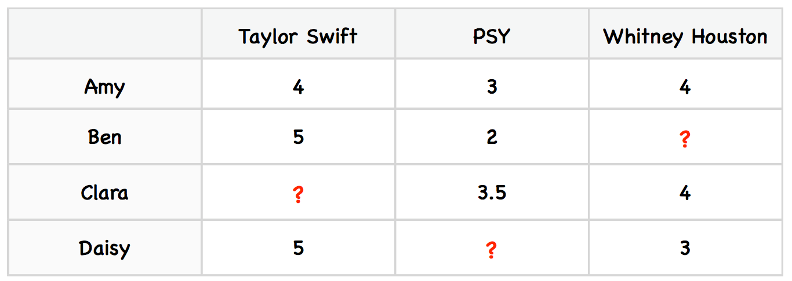
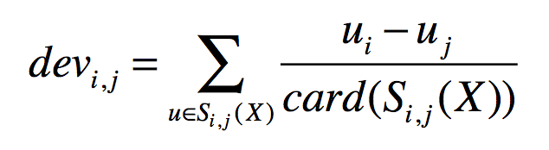
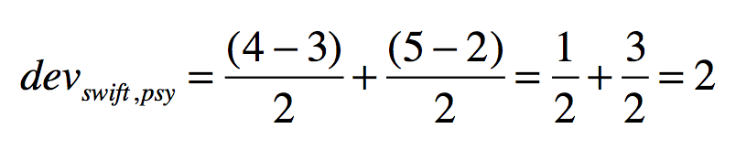
Step 1: Computing deviation
* card(S) is how many elements are in S
* X is the entire set of all ratings
2 個共同評分 swift 與 psy

Slide 14
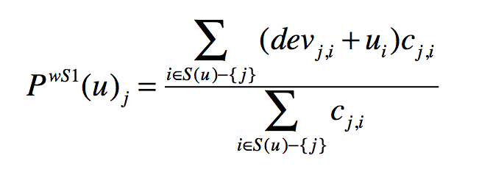

Step 2: Making predictions with Weighted Slope One
weight
u 對 j 可能的喜好程度
(weighted slope one)
除了 j 以外的項目

Slide 15
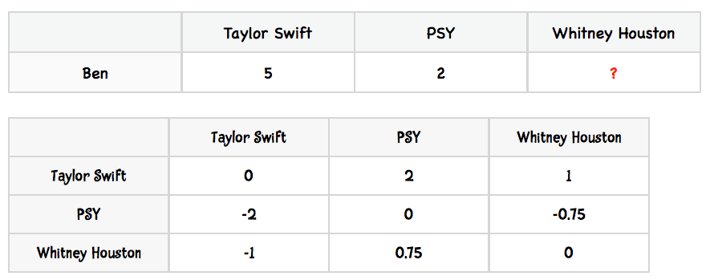
Example
P(Ben)Whitney Houston =
(8 + 5) / (2+2) = 3.375
devj,i.
devj,i + ui then is 4. (5 + -1)
(devj,i +ui)cj,i =4x2=8 (cj,i = 2)
devj,i.
devj,i + ui then is 2.75 (2 + 0.75)
(devj,i +ui)cj,i =2.75x2=5 (cj,i = 2)

