Slide 1

Web程式設計
授課教師:陳錫民
Email: hmchen@mail.fcu.edu.tw

Slide 2
What is CSS?
CSS (Cascading Style Sheets) allows us to apply formatting and styling to the HTML that builds our web pages.
CSS can control many elements of our web pages: colors, fonts, alignment, borders, backgrounds, spacing, margins, and much more.
Difference between with and without CSS
http://www.w3schools.com/css/demo_default.htm

Slide 3

What is CSS?
Separation of structure (HTML) from presentation (CSS)
Relationship between the style formatting and the structure/content is no longer 1:1
multiple style sheets can be applied to the same Web page
Same style sheet can be applied to the multiple Web page

Slide 4
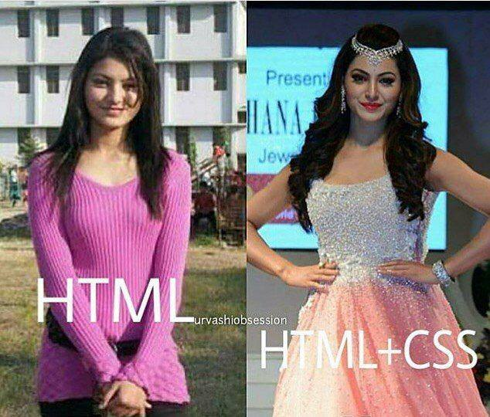
What is CSS?

Slide 5
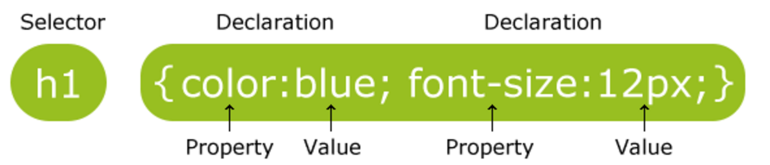
CSS Syntax and Selectors
CSS Syntax
A CSS rule-set consists of a selector and a declaration block:
The selector points to the HTML element you want to style.
The declaration block contains one or more declarations separated by semicolons.
Each declaration includes a CSS property name and a value, separated by a colon.
A CSS declaration always ends with a semicolon, and declaration blocks are surrounded by curly braces.

Slide 6
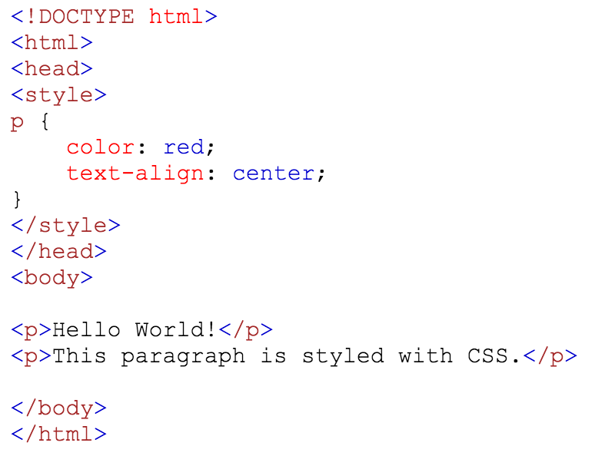

CSS Syntax and Selectors

Slide 7
CSS Selectors
CSS selectors are used to "find" (or select) HTML elements based on their
element name,
id,
class,
attribute,
and more.

Slide 8
CSS Selectors
The element Selector
The element selector selects elements based on the element name.
e.g. You can select all <p> elements on a page like this (in this case, all <p> elements will be center-aligned, with a red text color)
p { text-align: center; color: red; }

Slide 9
CSS Selectors
The id Selector
The id selector uses the id attribute of an HTML element to select a specific element.
The id of an element should be unique within a document, so the id selector is used to select one unique element!
To select an element with a specific id, write a hash (#) character, followed by the id of the element.

Slide 10
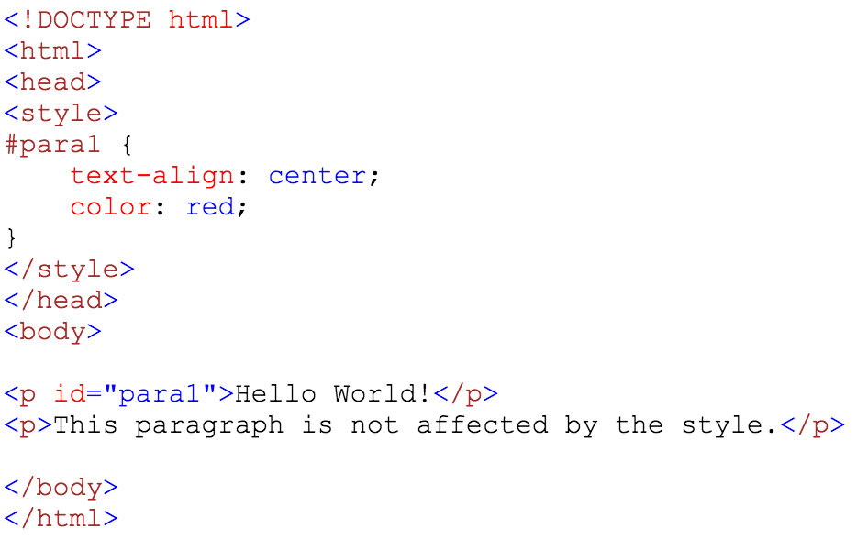

CSS Selectors
The style rule below will be applied to the HTML element with id="para1":

Slide 11
CSS Selectors
The class Selector
The class selector selects elements with a specific class attribute.
To select elements with a specific class, write a period (.) character, followed by the name of the class.

Slide 12
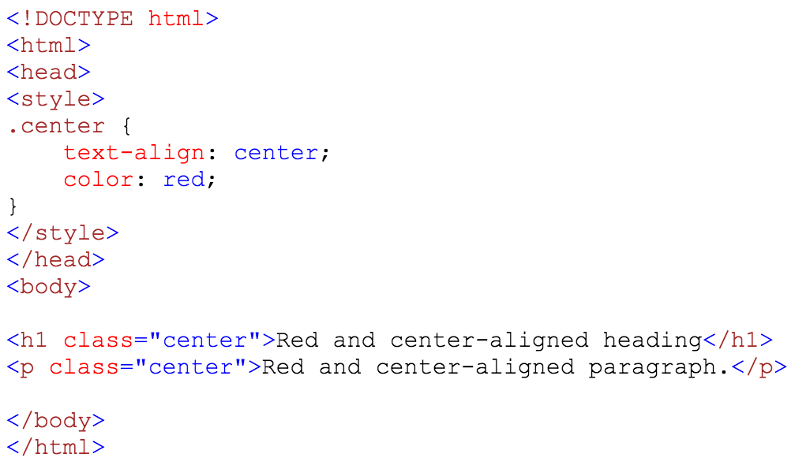

CSS Selectors
In the example below, all HTML elements with class="center" will be red and center-aligned:

Slide 13
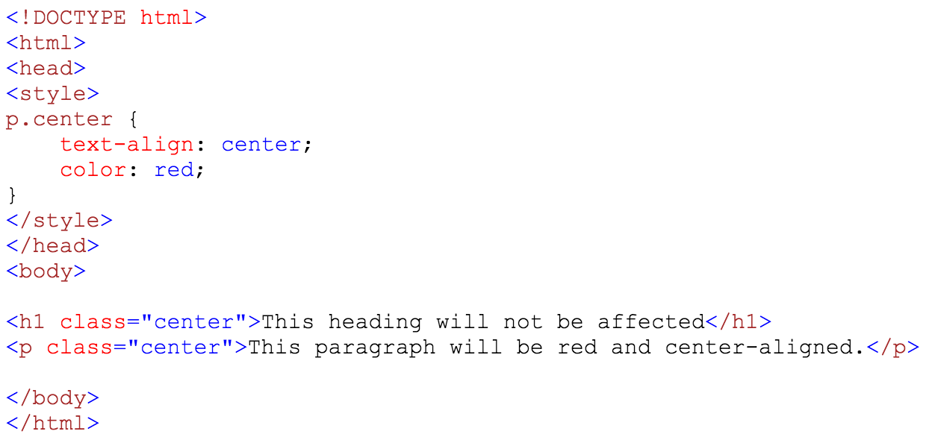

CSS Selectors
You can also specify that only specific HTML elements should be affected by a class.
In the example below, only <p> elements with class="center" will be center-aligned:

Slide 14
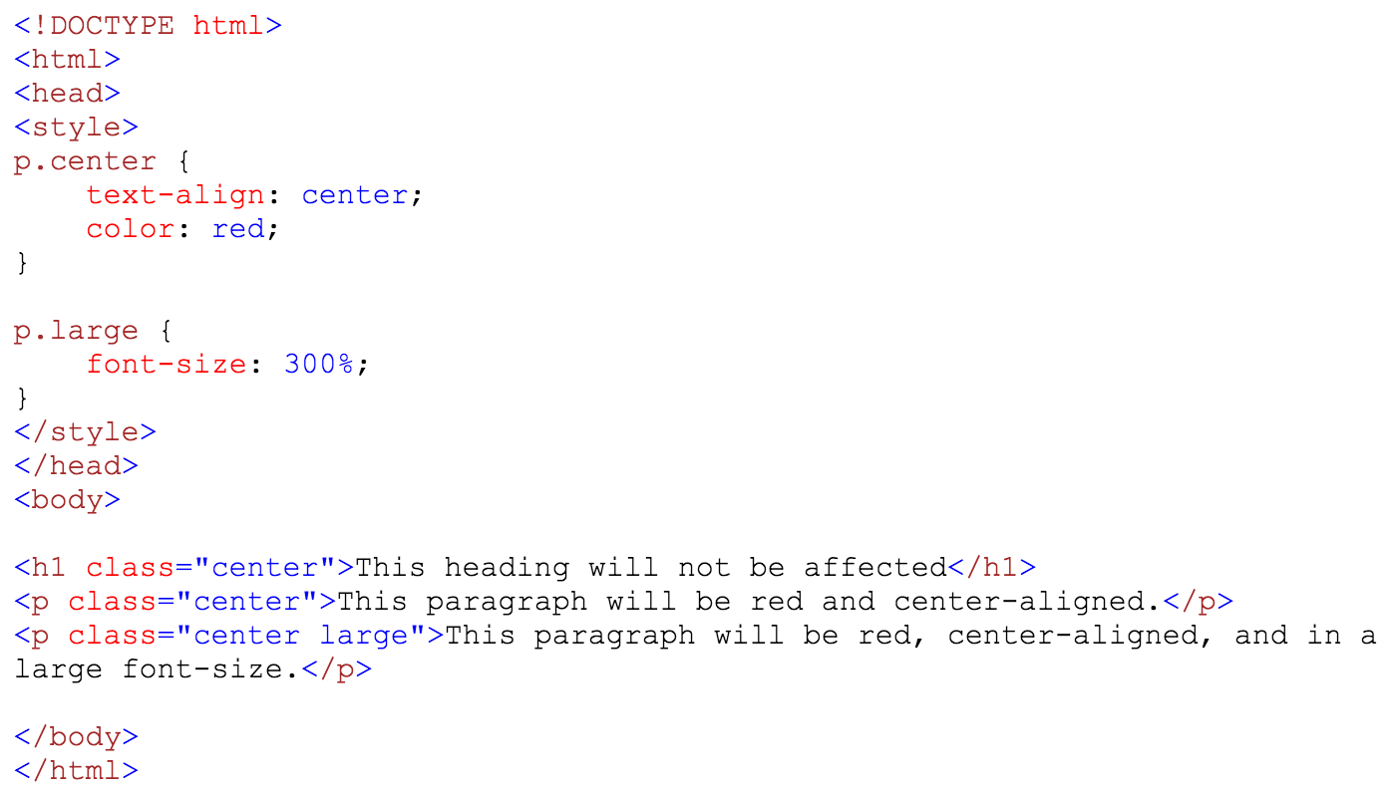
CSS Selectors
HTML elements can also refer to more than one class.
In the example below, the <p> element will be styled according to class="center" and to class="large":

Slide 15
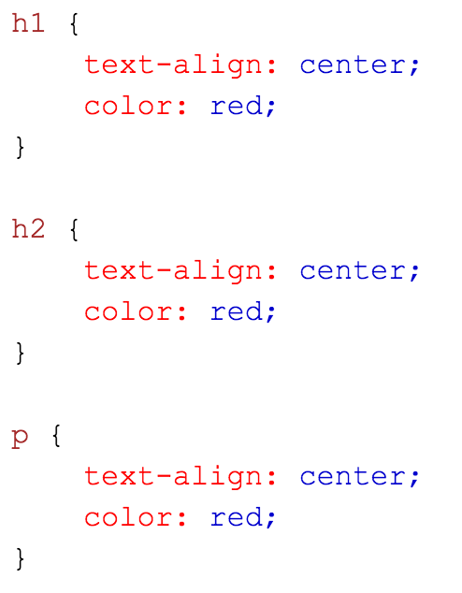
CSS Selectors
Grouping Selectors
If you have elements with the same style definitions, like this:
It will be better to group the selectors, to minimize the code.

Slide 16
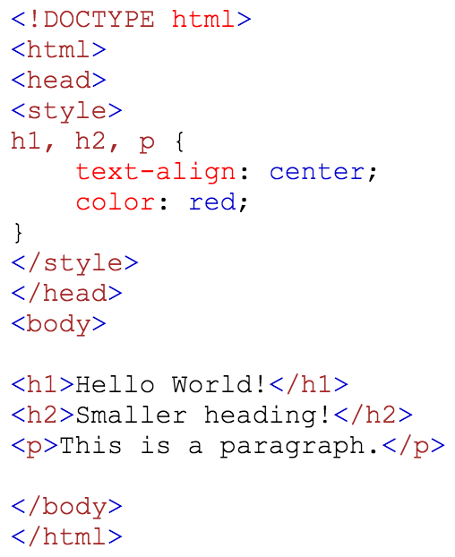

CSS Selectors
To group selectors, separate each selector with a comma.
In the example below we have grouped the selectors from the code above:

Slide 17
Exercise 1
Change the color of all <p> elements to "red".
<!DOCTYPE html>
<html>
<head>
<style></style>
</head>
<body>
<h1>This is a Heading</h1>
<p>This is a paragraph.</p>
<p>This is another paragraph.</p>
</body>
</html>

Slide 18
Exercise 2
Change the color of the element with id="para1", to "red".
<!DOCTYPE html>
<html>
<head>
<style></style>
</head>
<body>
<h1>This is a Heading</h1>
<p id="para1" >This is a paragraph.</p>
<p>This is another paragraph.</p>
</body>
</html>

Slide 19
Exercise 3
Change the color of all elements with the class "colortext", to "red".
<!DOCTYPE html>
<html>
<head>
<style></style>
</head>
<body>
<h1>This is a Heading</h1>
<p>This is a paragraph.</p>
<p class="colortext">This is another paragraph.</p>
<p class="colortext">This is also a paragraph.</p> </body>
</html>

Slide 20
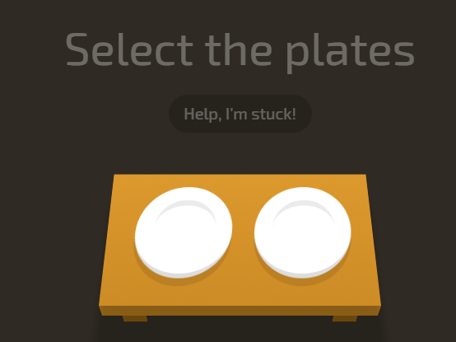
Learn CSS with Game
https://flukeout.github.io/

Slide 21
Exercise 4
Change the color of all <p> and <h1> elements, to "red". Group the selectors to minimize code.
<!DOCTYPE html>
<html>
<head>
<style></style>
</head>
<body>
<h1>This is a heading</h1>
<h2>This is a smaller heading</h2>
<p>This is a paragraph.</p>
<p>This is another paragraph.</p>
</body>
</html>

Slide 22
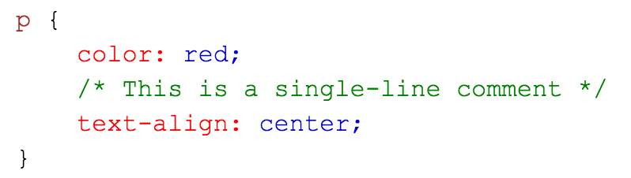
CSS Comments
Comments are used to explain the code, and may help when you edit the source code at a later date.
Comments are ignored by browsers.
A CSS comment starts with /* and ends with */. Comments can also span multiple lines:

Slide 23
Three Ways to Insert CSS
External style sheet
Internal style sheet
Inline style

Slide 24
External Style Sheet
With an external style sheet, you can change the look of an entire website by changing just one file!
Each page must include a reference to the external style sheet file inside the <link> element.
The <link> element goes inside the <head> section:

Slide 25
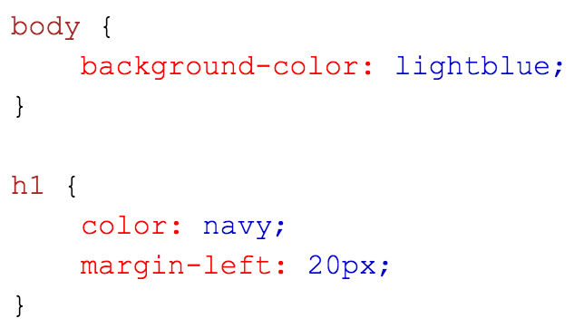
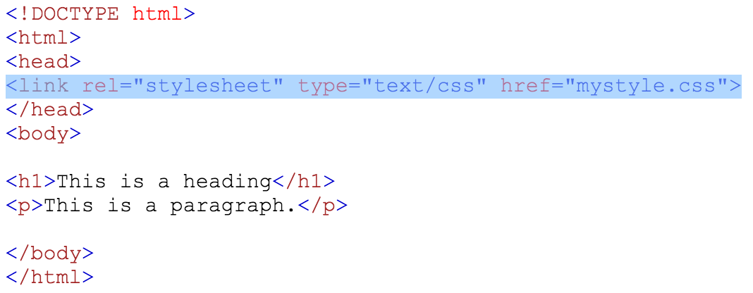

myStyle.css

Slide 26
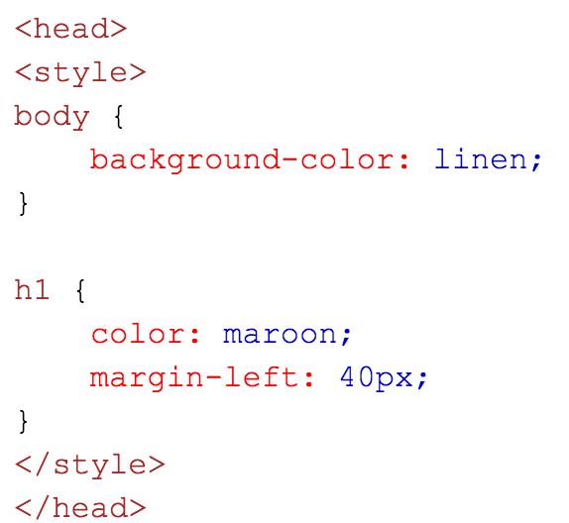
Internal Style Sheet
An internal style sheet may be used if one single page has a unique style.
Internal styles are defined within the <style> element, inside the <head> section of an HTML page:

Slide 27
Inline Styles
An inline style may be used to apply a unique style for a single element.
To use inline styles, add the style attribute to the relevant element.
The style attribute can contain any CSS property.

Slide 28
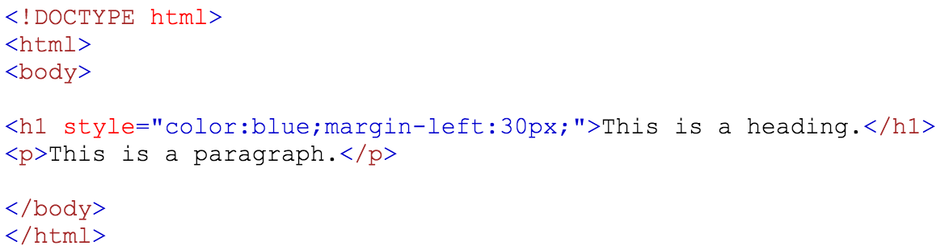

Inline Styles
The example below shows how to change the color and the left margin of a <h1> element:

Slide 29
Multiple Style Sheets
If some properties have been defined for the same selector (element) in different style sheets, the value from the last read style sheet will be used.

Slide 30
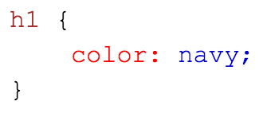
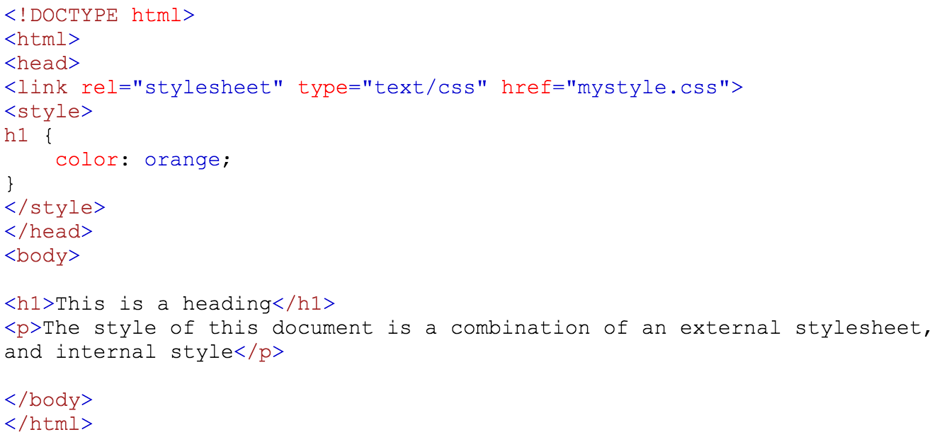
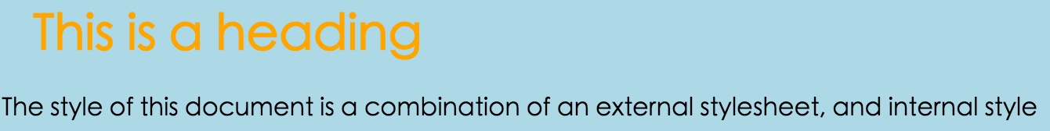
myStyle.css

Slide 31
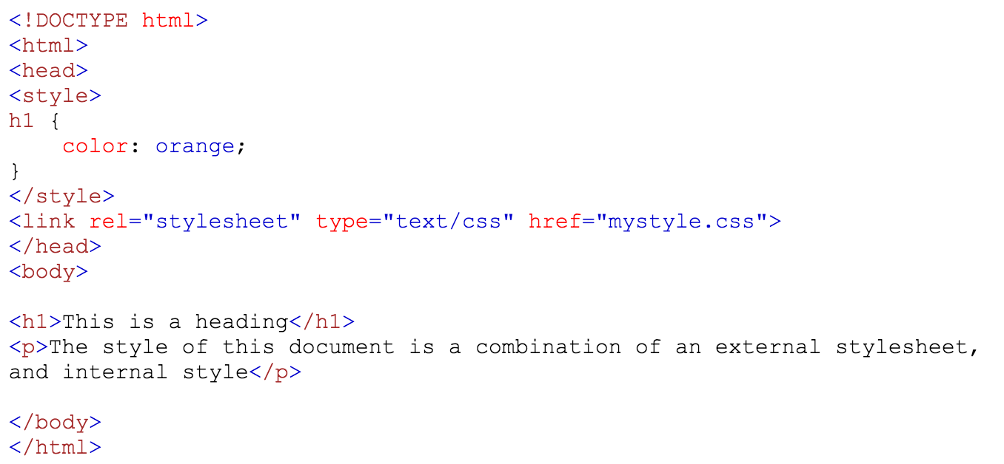
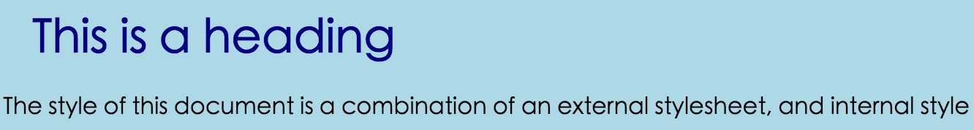
myStyle.css

Slide 32
Cascading Order
What style will be used when there is more than one style specified for an HTML element?
Inline style (inside an HTML element)
External and internal style sheets (in the head section)
Browser default
So, an inline style (inside a specific HTML element) has the highest priority, which means that it will override a style defined inside the <head> tag, or in an external style sheet, or a browser default value.

Slide 33
Style Inheritance
Inheritance
An element that is present within another element (child) inherits all style properties from its “parent” element
However, if such child (or descendant) element has properties that conflict with defined properties of its parent element, conflict is resolved in favors of properties of a child element
Child element properties have greater specificity than ancestor’s properties

Slide 34
Exercise 5~7
Set "background-color: linen" for the page
using an external style sheet
using an internal style sheet
using an inline style
<!DOCTYPE html>
<html>
<head>
</head>
<body>
<h1>This is a Heading</h1>
<p>This is a paragraph.</p>
<p>This is another paragraph.</p>
</body>
</html>

Slide 35
CSS Colors
Colors in CSS are most often specified by:
a valid color name - like "red”
an RGB value - like "rgb(255, 0, 0)”
a HEX value - like "#ff0000”
Ref: http://www.w3schools.com/css/css_colors.asp

Slide 36
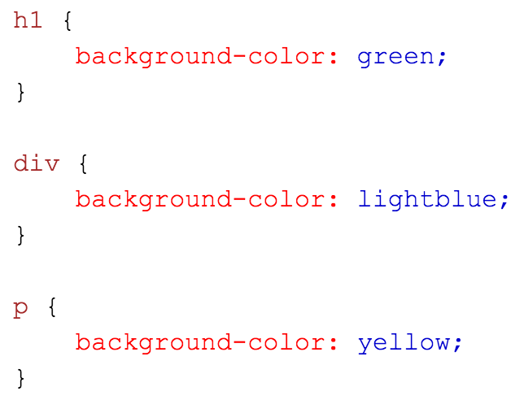
CSS Backgrounds
Background Color
The background-color property specifies the background color of an element.

Slide 37
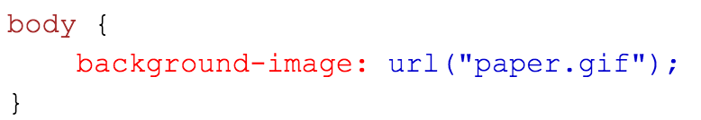
CSS Backgrounds
Background Image
The background-image property specifies an image to use as the background of an element.
By default, the image is repeated so it covers the entire element.
The background image for a page can be set like this:

Slide 38
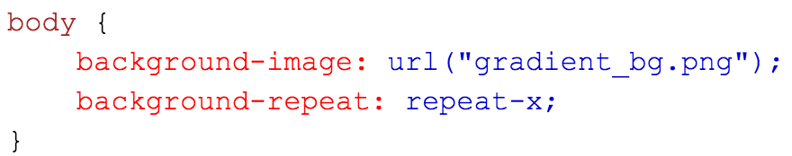
CSS Backgrounds
Background Image
Repeat Horizontally or Vertically
By default, the background-image property repeats an image both horizontally and vertically.
Some images should be repeated only horizontally or vertically, or they will look strange, like this:
Ref: http://www.w3schools.com/css/tryit.asp?filename=trycss_background-image_gradient2

Slide 39
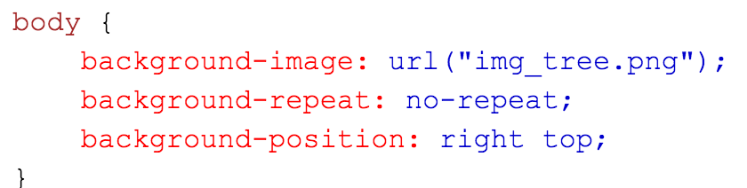
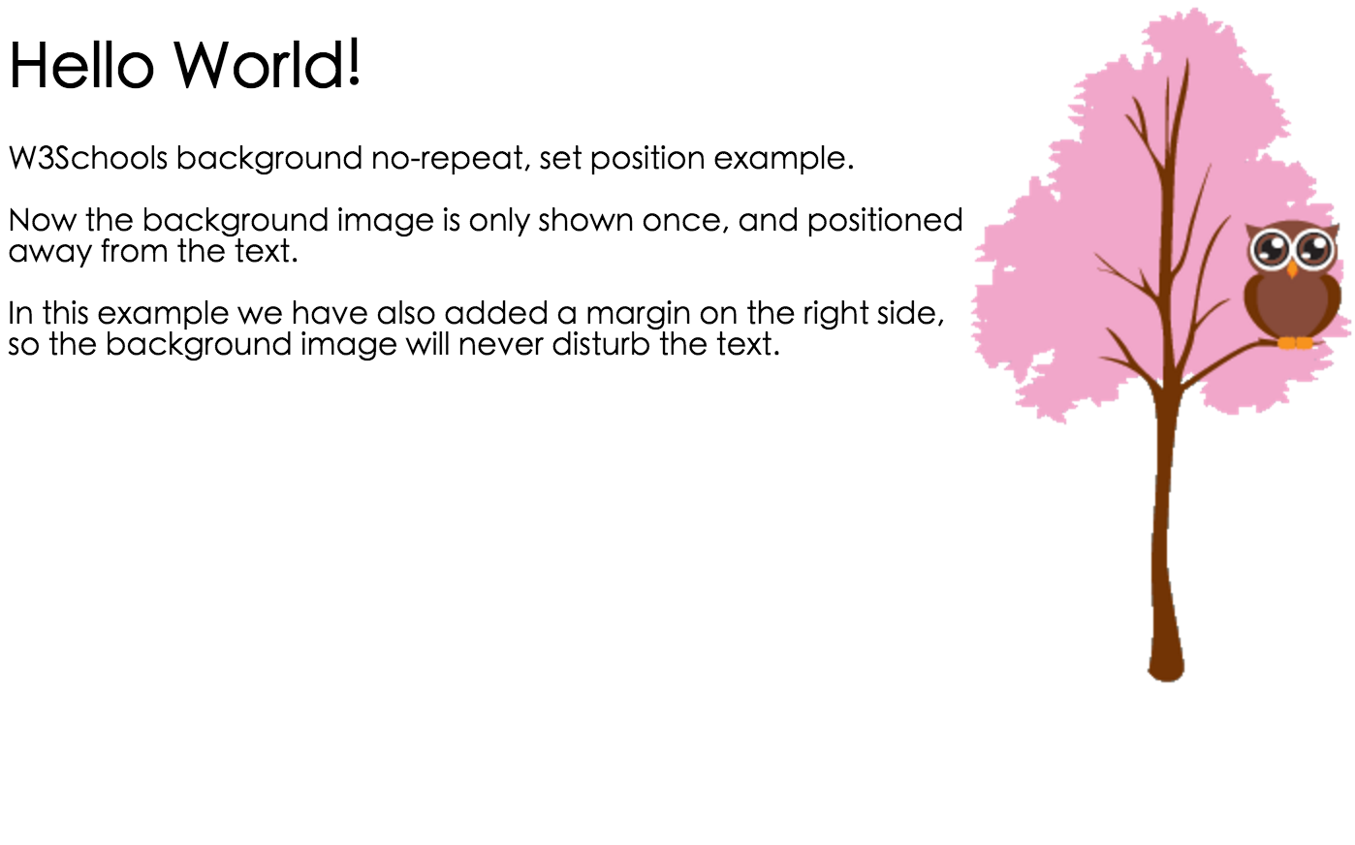
CSS Backgrounds
Background Image - Set position and no-repeat

Slide 40
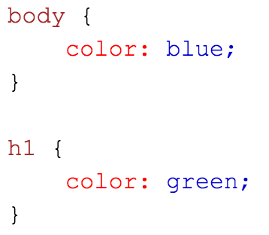
CSS Text
Text Color
The color property is used to set the color of the text.
With CSS, a color is most often specified by:
a color name - like "red”
a HEX value - like "#ff0000”
an RGB value - like "rgb(255,0,0)"

Slide 41
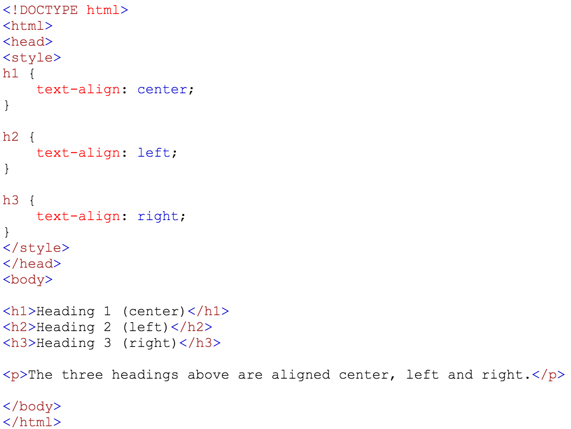
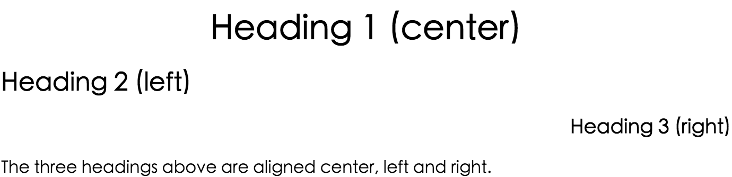
Text Alignment
The text-align property is used to set the horizontal alignment of a text.
A text can be left or right aligned, centered, or justified.

Slide 42
CSS Fonts
The CSS font properties define
the font family,
boldness,
size, and
the style of a text.

Slide 43
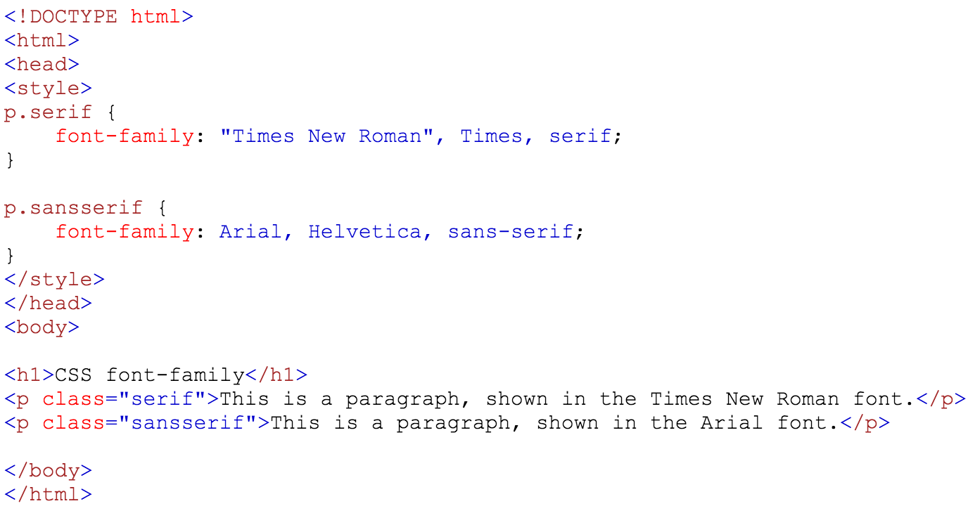
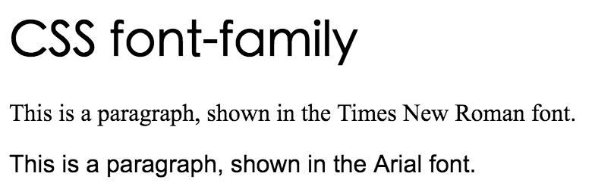
Font Family
The font family of a text is set with the font-family property.
The font-family property should hold several font names as a "fallback" system.
If the browser does not support the first font, it tries the next font, and so on.

Slide 44
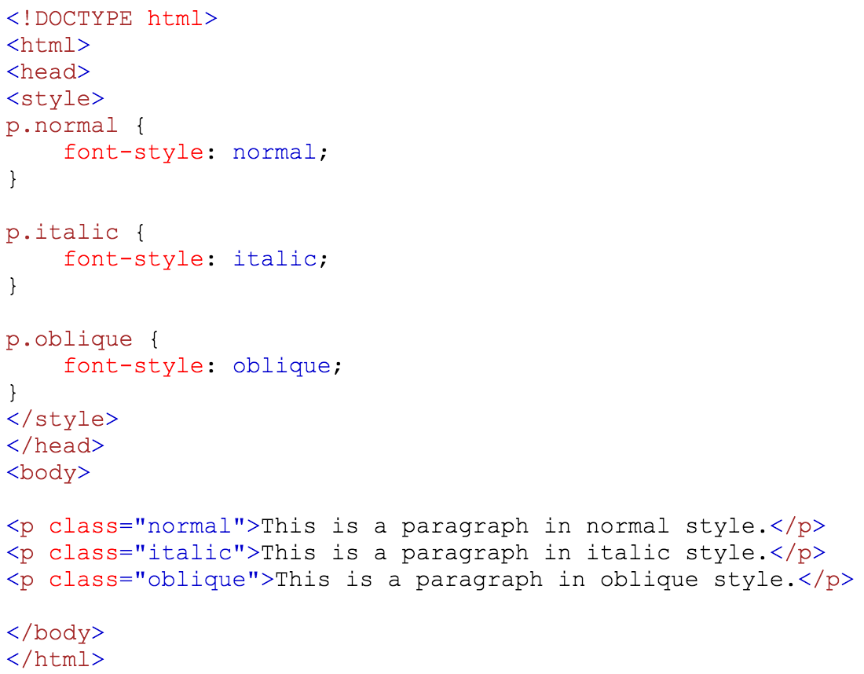
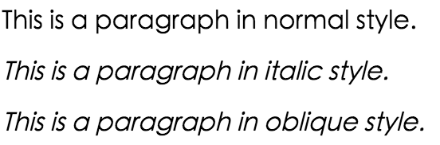
Font Style
The font-style property is mostly used to specify italic text.
This property has three values:
normal - The text is shown normally
italic - The text is shown in italics
oblique - The text is "leaning" (oblique is very similar to italic, but less supported)

Slide 45
CSS Box Model
The CSS Box Model
All HTML elements can be considered as boxes.
In CSS, the term "box model" is used when talking about design and layout.
The CSS box model is essentially a box that wraps around every HTML element. It consists of:
margins,
borders,
padding, and the
actual content.

Slide 46

CSS Box Model
Explanation of the different parts:
Content - The content of the box, where text and images appear
Padding - Clears an area around the content. The padding is transparent
Border - A border that goes around the padding and content
Margin - Clears an area outside the border. The margin is transparent

Slide 47
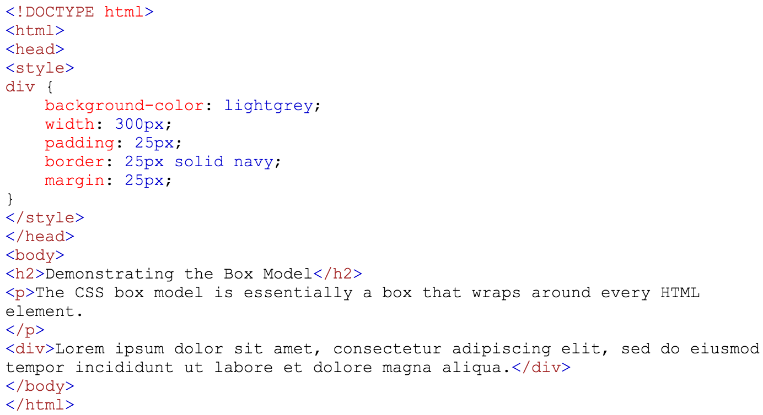
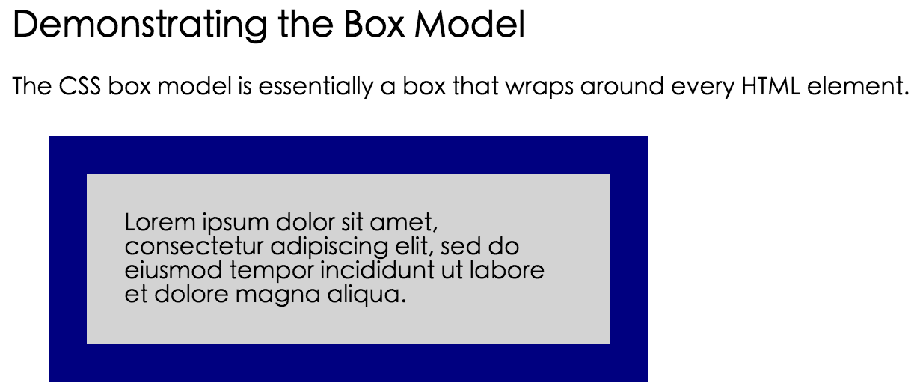

Slide 48
CSS Links
Styling Links
Links can be styled with any CSS property (e.g. color, font-family, background, etc.)
In addition, links can be styled differently depending on what state they are in.
The four links states are:
a:link - a normal, unvisited link
a:visited - a link the user has visited
a:hover - a link when the user mouses over it
a:active - a link the moment it is clicked

Slide 49
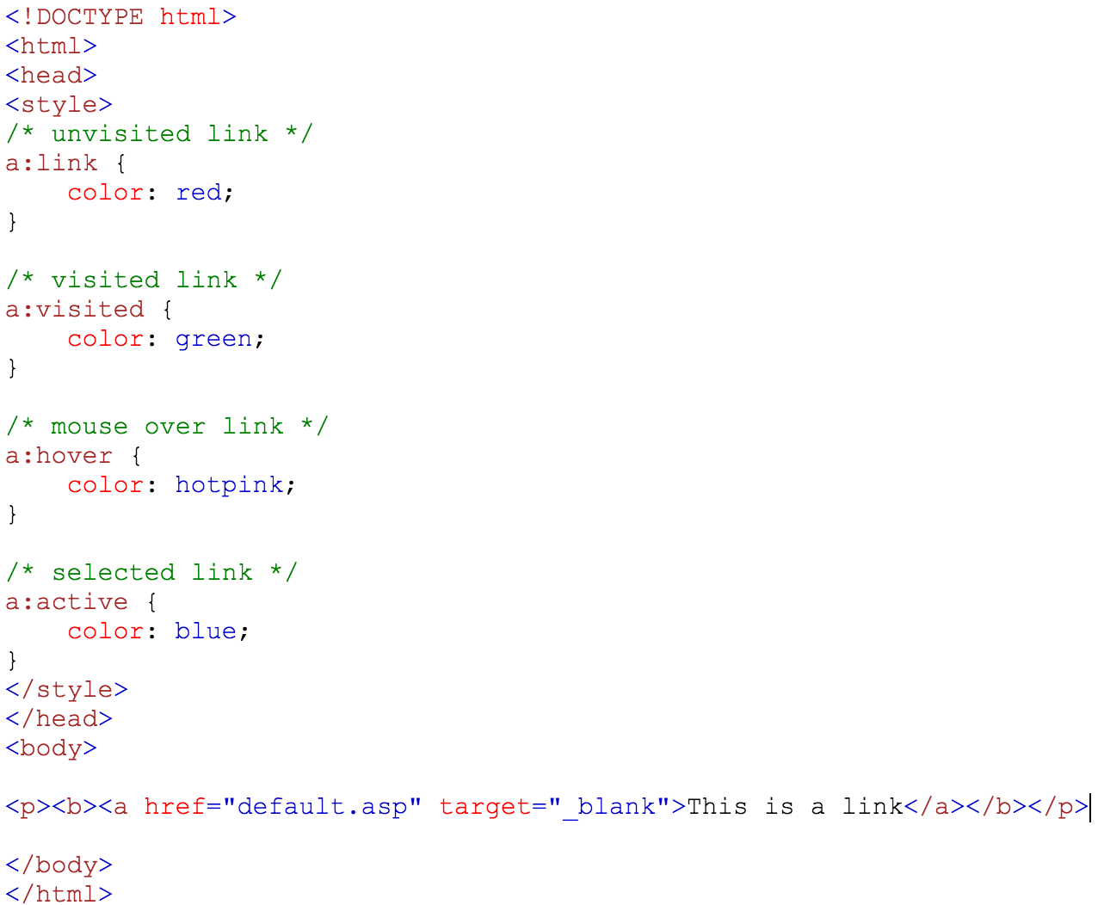

CSS Links
Ref: http://www.w3schools.com/css/tryit.asp?filename=trycss_link

Slide 50
CSS Tables
Table Borders
To specify table borders in CSS, use the border property.
The example below specifies a black border for <table>, <th>, and <td> elements:
Ref http://www.w3schools.com/css/css_table.asp

Slide 51
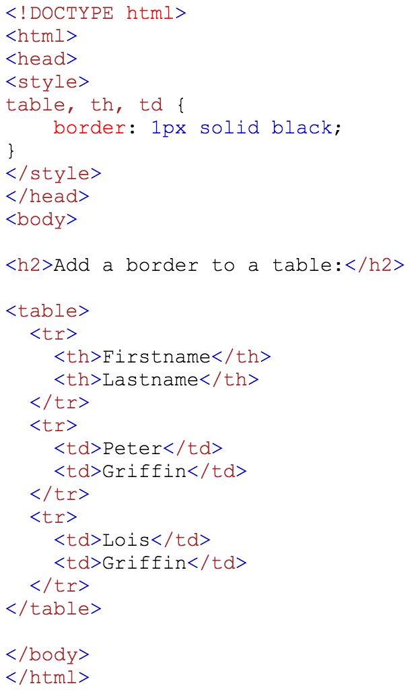
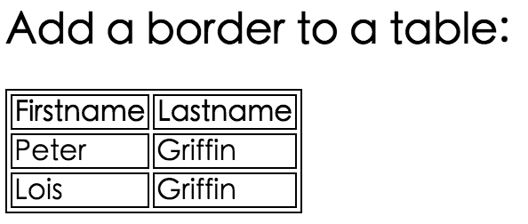

Slide 52
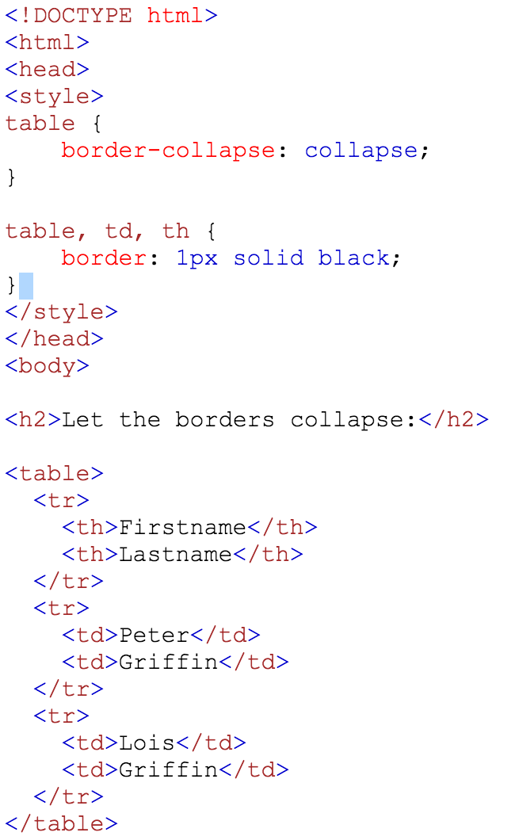
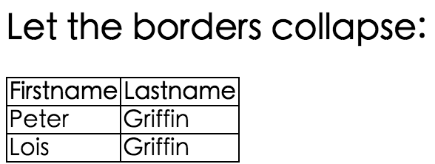
CSS Tables
Collapse Table Borders
The border-collapse property sets whether the table borders should be collapsed into a single border:

Slide 53
Exercise 8
Set the border to "2px solid green" for table, th and td elements.
<!DOCTYPE html>
<html>
<head>
<style></style>
</head>
<body>
<table>
<tr>
<th>Firstname</th> <th>Lastname</th>
</tr>
<tr>
<td>Peter</td> <td>Griffin</td>
</tr>
<tr>
<td>Lois</td>
<td>Griffin</td>
</tr>
</table>
</body>
</html>

