Slide 1
Predicting Earthquakes
By: frank Cusano

Slide 2
Outline
Data/Research - Mapping using Mapbox - Blog hosted on GitHub Pages
Implementation - openMP
Results - output the prediction and overlay on map
Problems encountered
Ways to improve

Slide 3
Research
Minor earthquakes are often a precursor to larger ones “Small earthquakes suggest a certain level of fault line activity and pressure building up, and scientists regularly suggest that we must all prepare for the Big One, since it could occur at any time.” – WiseGeek Article
Earthquakes occur mainly on fault lines
Volcanic activity can cause earthquakes

Slide 4
Gathering Data
Data was taken from https://earthquake.usgs.gov/earthquakes/feed/v1.0/csv.php
Mapped data using Mapbox to get a visual representation of earthquakes

Slide 5
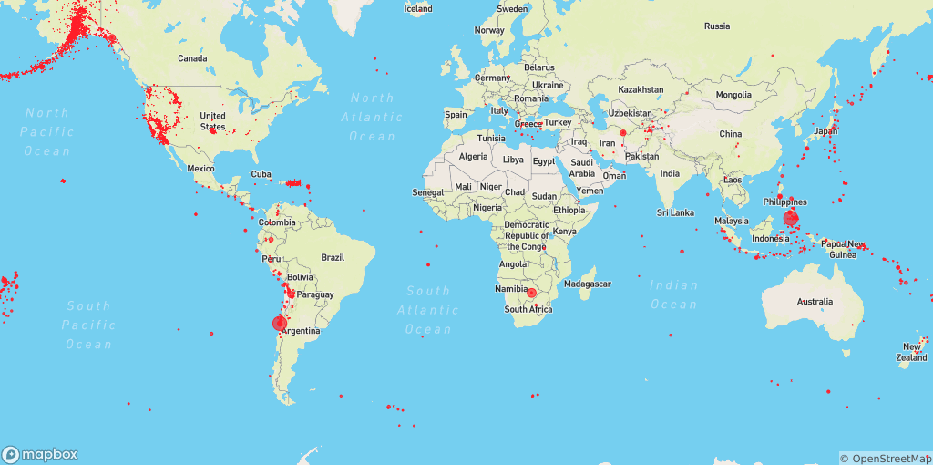
Mapping Raw Earthquake Data

Slide 6
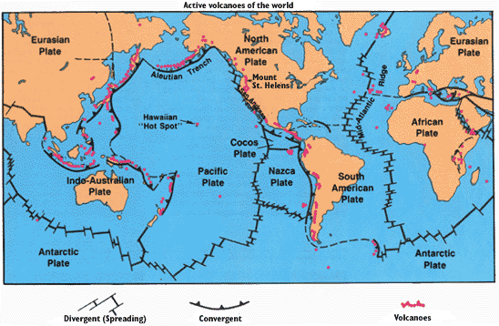
Map of Fault Lines

Slide 7
Implementation
I used openMP on my personal computer which has a 4 core (8 thread) i7 processer. I start by parsing the file and keep track of the important data such as magnitude, location and date. I then sorted the data based on location. From there I recorded how many earthquakes occurred in the past month and how many of those were significant (>5.5). If a significant earthquake occurred then it would be unlikely that another earthquake would occur anytime soon since all of the energy in the ground was released. However, if many small earthquakes occurred then it would suggest that there is energy in the
ground and that a large earthquake would eventually occur. I then averaged out the locations of the small earthquakes and estimated a magnitude based on other large earthquakes in that area. Lastly, I took what my program spit out and I mapped it to get a visual of what my predicted earthquake would look like.

Slide 8
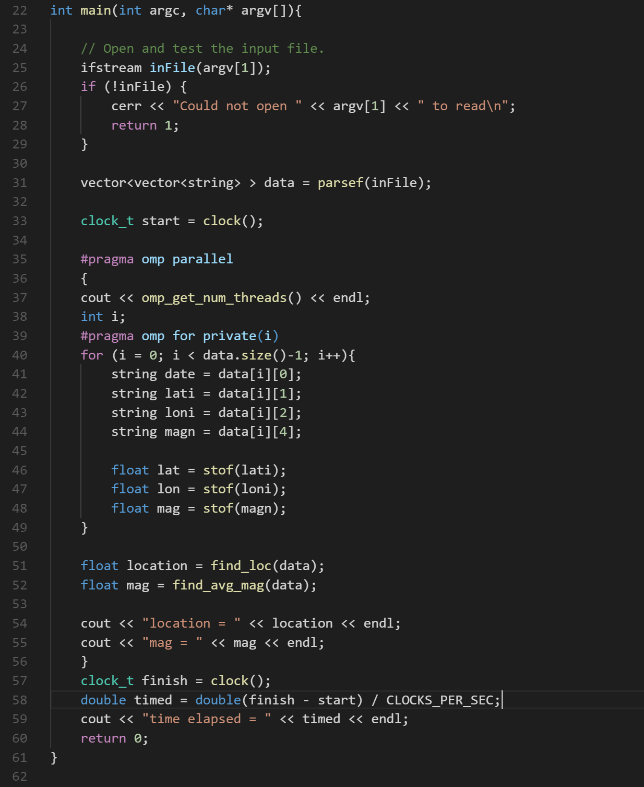
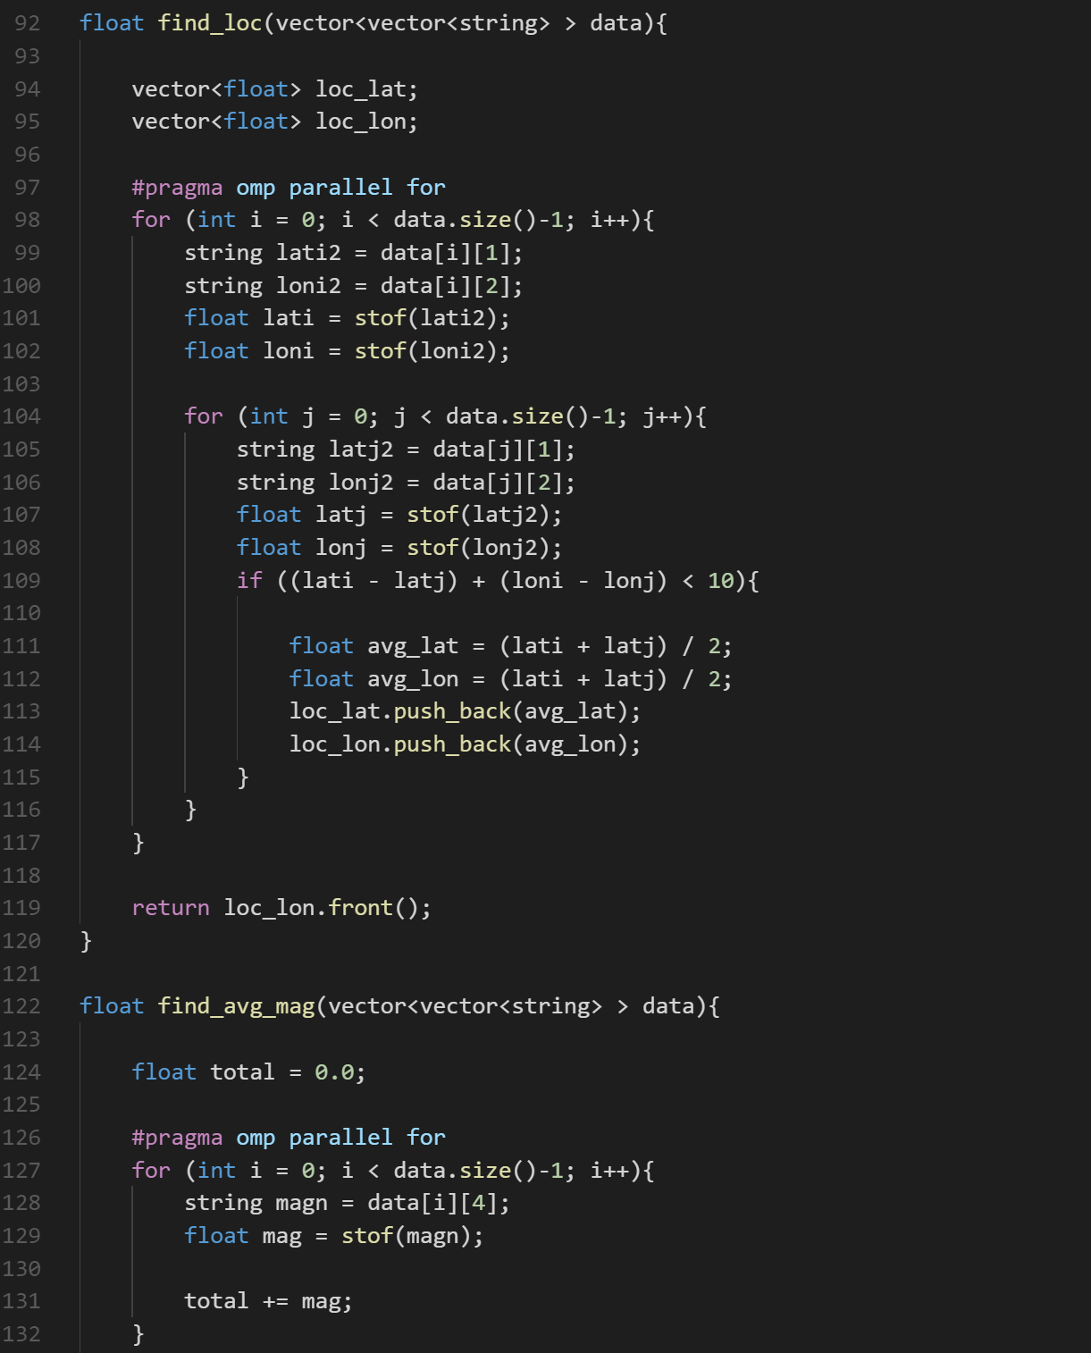
Code

Slide 9
Results
Not Parallel
Parallel
Run time = 0.031 seconds
Prediction lat = 58.851465 lon = -154.285810 mag = 7.2
Run Time = 0.016 seconds
Prediction Data was not accurate

Slide 10
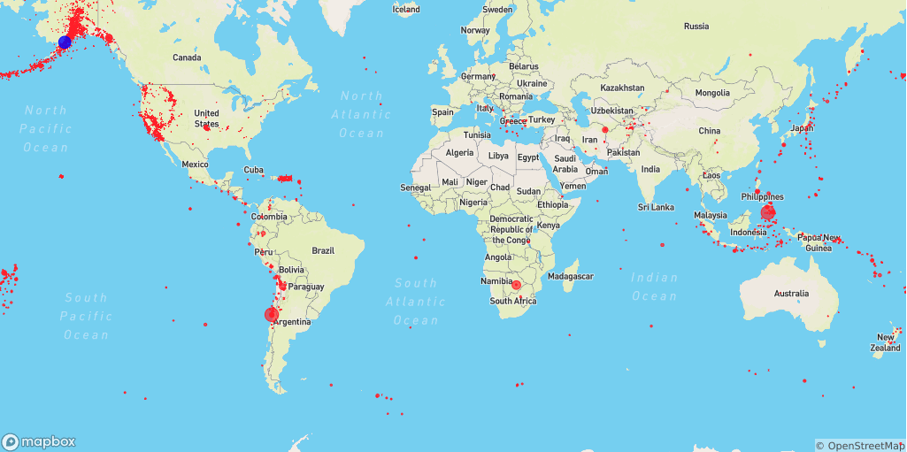
Mapping Results

Slide 11
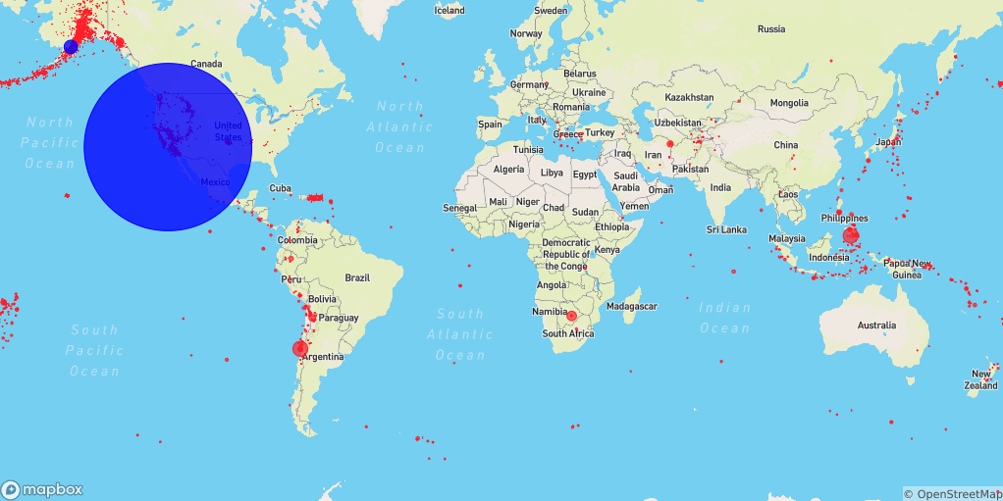
Interesting/Scary thought

Slide 12
Problems Encountered
Large data was not working even though smaller data sets were
Parallel was not giving the same answer
#pragma for loop was causing my program to stop after it finished the for loop
I wanted to also use volcano data but couldn’t find raw data on volcano activity

Slide 13
Ways to Improve
Predict more than just one earthquake
Use Volcano data to help with predictions
Use older earthquake data
Implement this with other natural disasters

Slide 14
Works Cited
https://www.youtube.com/channel/UCvjgXvBlbQiydffZU7m1_aw
http://www.wisegeek.com/is-it-true-that-little-earthquakes-are-precursors-to-big-earthquakes.htm
http://listverse.com/2015/05/25/10-major-natural-disasters-predicted-in-the-near-future/
http://volcano.oregonstate.edu/how-are-volcanoes-and-earthquakes-related

