Slide 1
.

Slide 2
..

Slide 3
…

Slide 4
Riki Fridrich

Slide 5
fczbkk.com

Slide 6
Tree Shaking
Notes:
čo je to tree shaking?

Slide 7

Notes:
ak si myslíte, že tree shaking vyzerá takto, ste na nesprávnej prednáške

Slide 8

Notes:
v skutočnosti tree shaking vyzerá takto

Slide 9

Notes:
klasické knižnice (Jquery)

Slide 10



Slide 11
Notes:
NPM knižnice

Slide 12

Notes:
atomické
pár riadkov

Slide 13
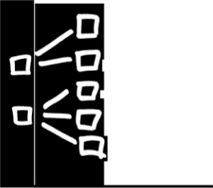

Slide 14
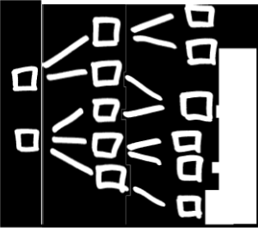

Slide 15
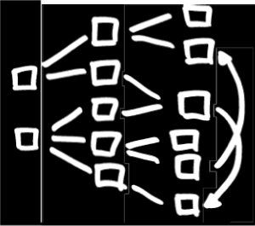

Slide 16

Notes:
stále je to minimálne množstvo kódu, však?

Slide 17

Notes:
každá závislosť je zabalená

Slide 18

Notes:
chceme knižnice postavené z malých častí

Slide 19

Notes:
tak aby sme mohli zbytočné časti vyhodiť

Slide 20

Notes:
čím sa konečne dostávame k tomu, čo je Tree Shaking

Slide 21
Tree Shaking

Slide 22
calculator.js
export function square (n) {
return n * n;
}
export function cube (n) {
return n * n * n;
}

Slide 23
index.js
import {cube} from './calculator.js'
console.log(cube(10));

Slide 24
calculator.js
export function square (n) {
return n * n;
}
export function cube (n) {
return n * n * n;
}

Slide 25
.babelrc
{ "presets": ["latest"] }

Slide 26
webpack.config.js
module.exports = { entry: './src/index.js', output: { filename: 'index.js', path: './lib/' }, module: { rules: [ { test: /\.js$/, loaders: ['babel-loader'] } ] } };

Slide 27
lib/index.js
. . .
}([ function(module, exports, __webpack_require__) { "use strict"; function square(n) { return n * n; } function cube(n) { return n * n * n; } Object.defineProperty(exports, "__esModule", { value: !0 }), exports.square = square, exports.cube = cube; },
. . .

Slide 28
lib/index.js
. . .
}([ function(module, exports, __webpack_require__) { "use strict"; function square(n) { return n * n; } function cube(n) { return n * n * n; } Object.defineProperty(exports, "__esModule", { value: !0 }), exports.square = square, exports.cube = cube; },
. . .

Slide 29
babel export
"use strict";
Object.defineProperty(exports, "__esModule", {value: true});
exports.square = square; exports.cube = cube;
function square(n) {return n * n;} function cube(n) {return n * n * n;}

Slide 30
babel export
"use strict";
Object.defineProperty(exports, "__esModule", {value: true});
exports.square = square; exports.cube = cube;
function square(n) {return n * n;} function cube(n) {return n * n * n;}

Slide 31
.babelrc
{ "presets": ["latest"] }

Slide 32
.babelrc
{ "presets": [ [ "latest", { "es2015": { "modules": false } } ] ] }

Slide 33
babel export (no module)
"use strict";
function square(n) {return n * n;} function cube(n) {return n * n * n;}

Slide 34
webpack.config.js
module.exports = { entry: './src/index.js', output: { filename: 'index.js', path: './lib/' }, module: { rules: [ { test: /\.js$/, loaders: ['babel-loader'] } ] } };

Slide 35
webpack.config.js
var UglifyJsPlugin = require('uglifyjs-webpack-plugin'); module.exports = { . . .
plugins: [ new UglifyJsPlugin({ compress: {dead_code: true} }) ] };

Slide 36
> webpack
Hash: f177e58750d74d4d18e1
Version: webpack 2.2.1
Time: 687ms
Asset Size Chunks Chunk Names
index.js 1.86 kB 0 [emitted] main
[0] ./src/calculator.js 121 bytes {0} [built]
[1] ./src/index.js 63 bytes {0} [built]
WARNING in index.js from UglifyJs
Dropping unused function square [index.js:76,9]

Slide 37
WARNING in index.js from UglifyJs
Dropping unused function square [index.js:76,9]

Slide 38
lib/index.js (no shaking)
. . .
}([ function(module, exports, __webpack_require__) { "use strict"; function square(n) { return n * n; } function cube(n) { return n * n * n; } Object.defineProperty(exports, "__esModule", { value: !0 }), exports.square = square, exports.cube = cube; },
. . .

Slide 39
lib/index.js (tree shaking)
. . .
}([ function(module, __webpack_exports__, __webpack_require__) { "use strict"; function cube(n) { return n * n * n; } __webpack_exports__.a = cube; },
. . .

Slide 40
Notes:
wait, there's more
čo keď náš modul chce konzumovať niekto ďalší?

Slide 41
Notes:
ako exportovať modul?
monoblokom sa nedá triasť
krabičky bez webpacku nepoužijem

Slide 42
Babel
Webpack

Slide 43
Babel
./module/*.js
Webpack
./lib/index.js

Slide 44
package.json
{ . . . "scripts": { "build:classic": "webpack", "build:modern": "babel src -d module" } }

Slide 45
package.json
{ . . . "scripts": { "build:classic": "webpack", "build:modern": "babel src -d module", "build": "npm run build:classic && npm run build:modern" } }

Slide 46
npm run build

Slide 47
package.json
{ . . . "main": "./lib/index.js" }
Notes:
ako rozlíšiť ES5 a ES6 modul?

Slide 48

package.json
{ . . . "main": "./lib/index.js", "module": "./module/index.js", "webpack": "./module/index.js", "jsnext:main": "./module/index.js" }
*.mjs (node)
???
webpack
rollup
Notes:
NodeJS kvôli CommonJS vs import/export chce *.mjs
Michael Jackson

Slide 49
github.com/fczbkk/develcz-2017-tree-shaking

