Slide 1
Heterophily
2024.05

Slide 2
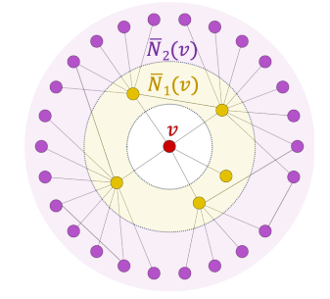






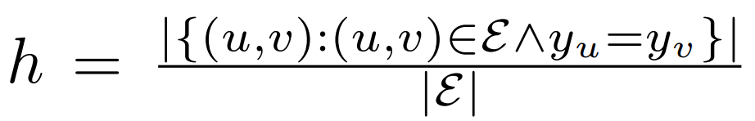
《Beyond Homophily in Graph Neural Networks: Current Limitations and Effective Designs》
 | homophily | heterophily
homogeneous | 单类节点 同类吸引配边 | 单类节点 异类吸引配边(不存在)
heterogeneous | 多类节点 同类吸引配边 | 多类节点 异类吸引配边
‘mixing’ results in similarity across neighbours’ features
combine without ‘mixing’: evolve separately
earlier/later
local/global
high Hz/low Hz
H

Slide 3






《Beyond Homophily in Graph Neural Networks: Current Limitations and Effective Designs》

Slide 4
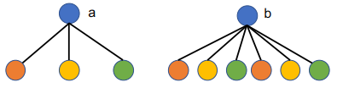

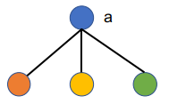
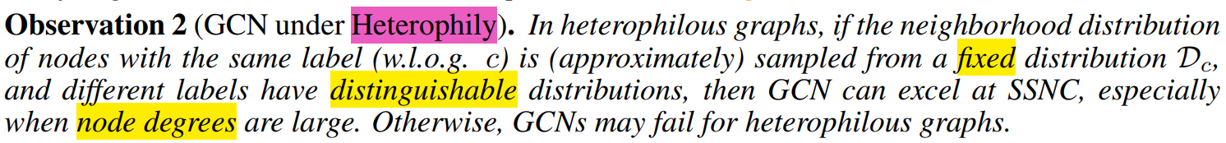
《Is Homophily a Necessity for Graph Neural Networks?》
mean在提取节点的邻居分布，
与homophily和heterophily无关

Slide 5


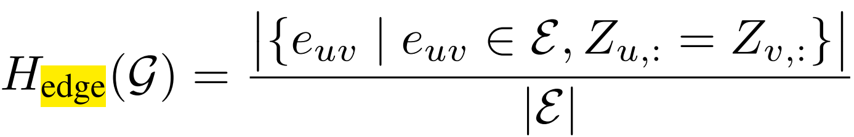



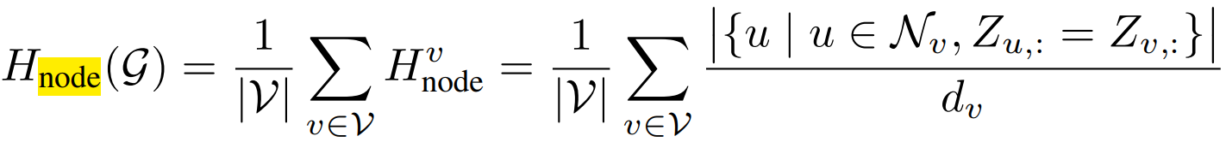

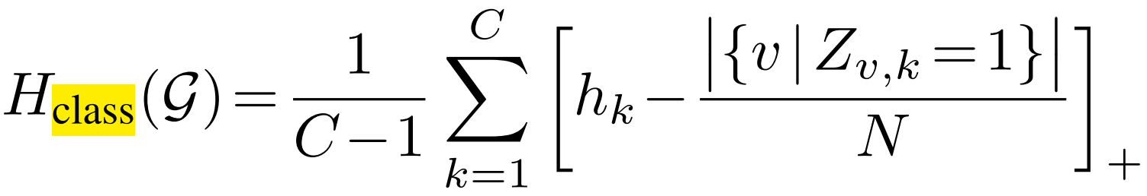




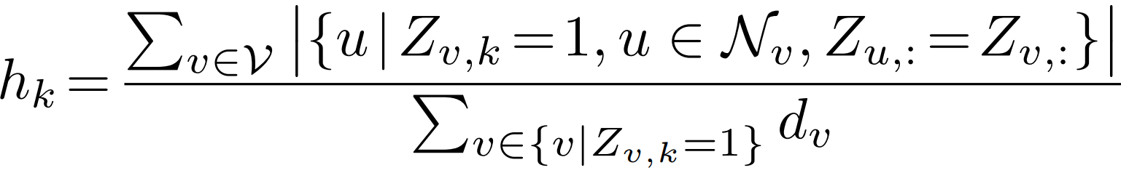


《Revisiting Heterophily For Graph Neural Networks》
?

Slide 6

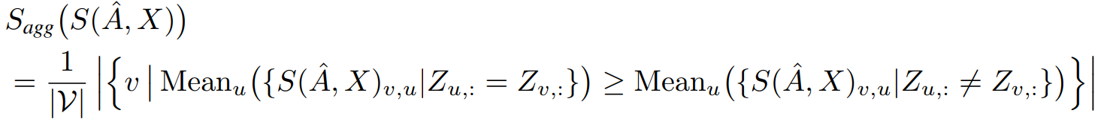





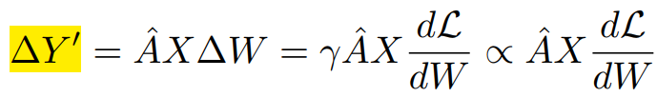

《Revisiting Heterophily For Graph Neural Networks》
N x C

Slide 7
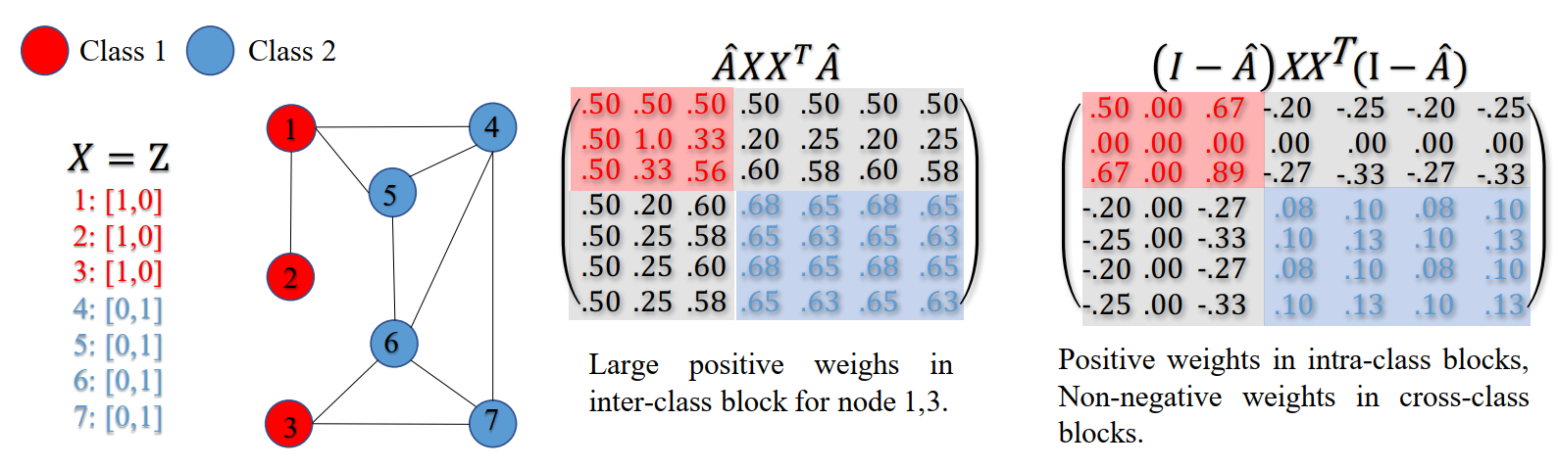
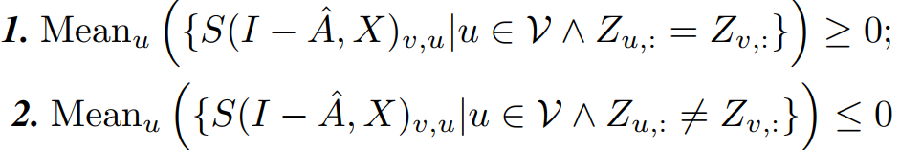






《Revisiting Heterophily For Graph Neural Networks》

Slide 8
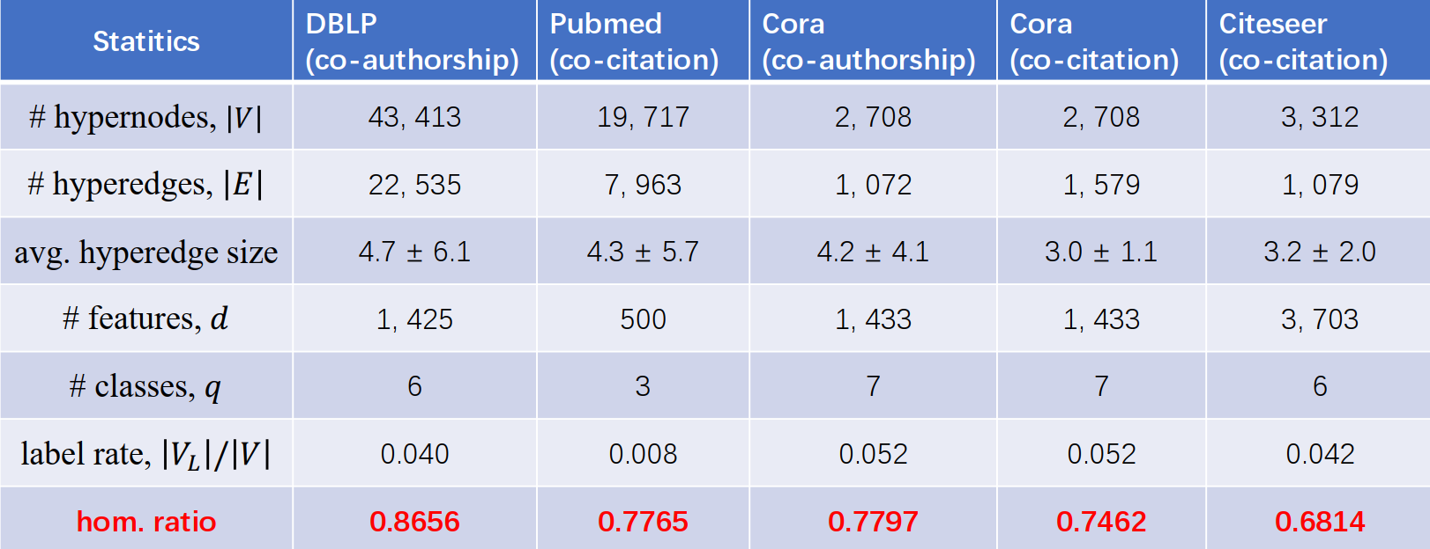
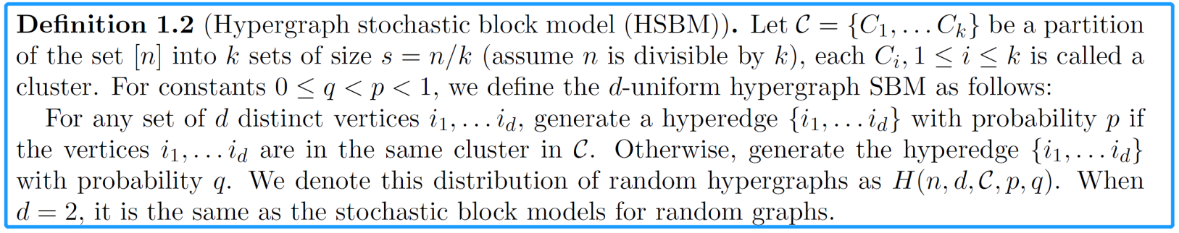
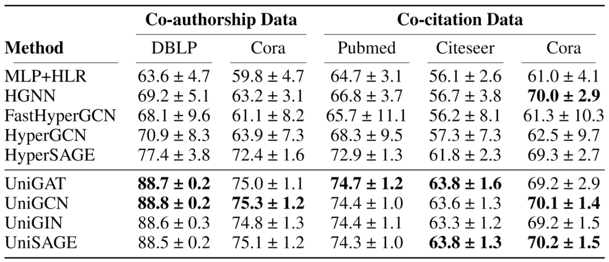
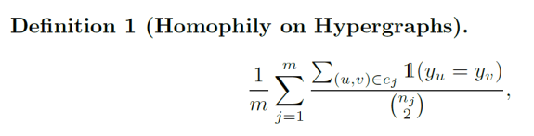
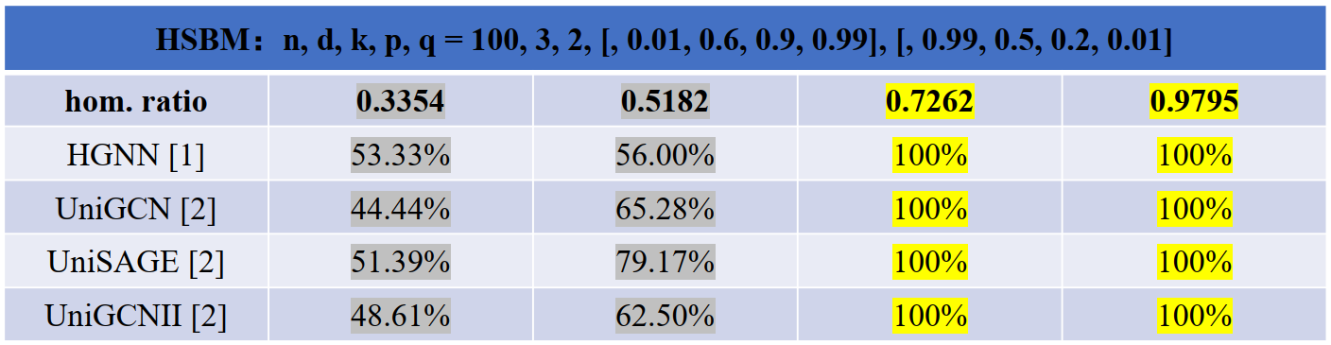
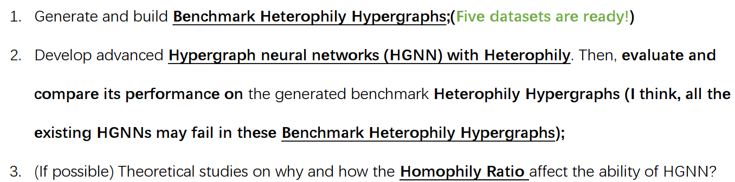
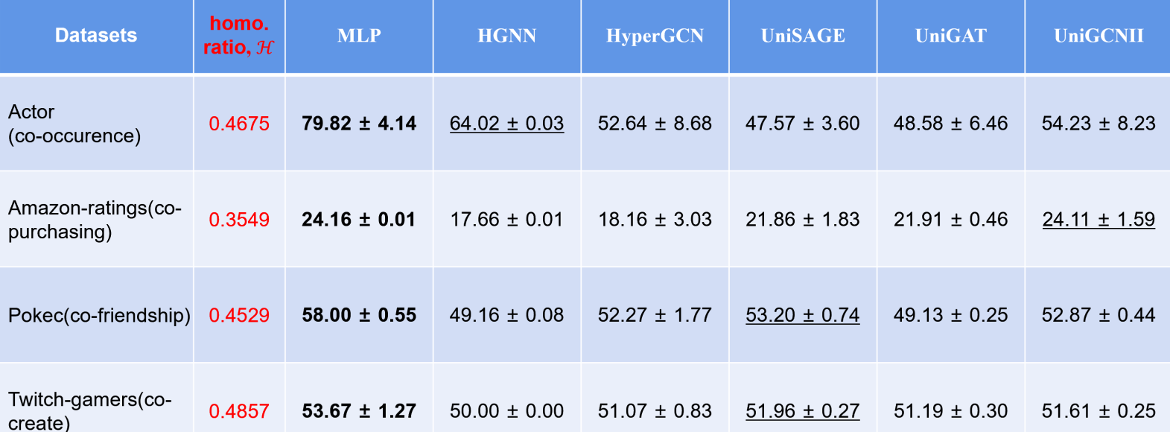
《HGNN with Heterophily》

