Slide 1
时空图神经网络 Spatio-Temporal Graph Neural Networks
2024.04.11

Slide 2
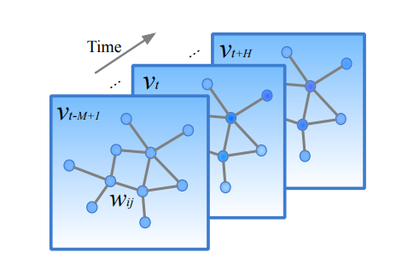
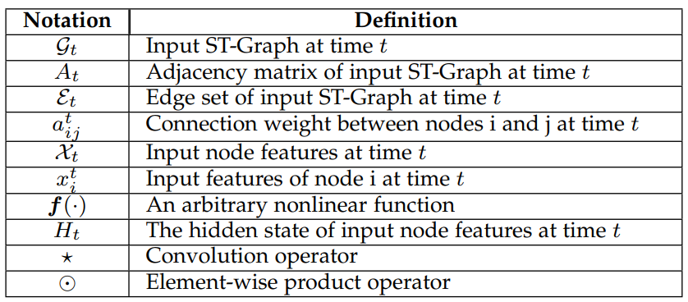


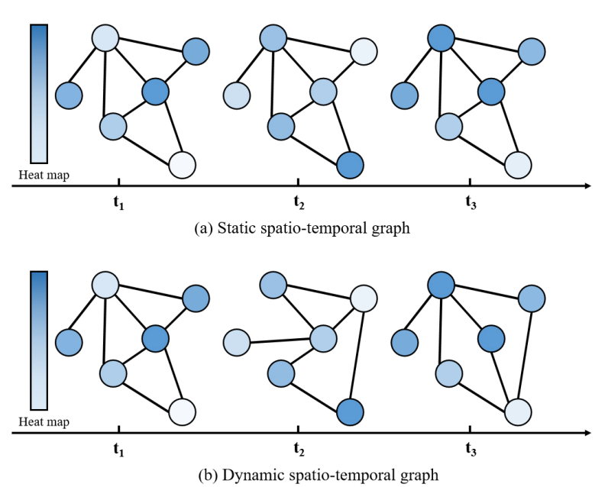



Topology-based graph:
Distance-based graph:
Similarity-based graph:
PCC + DTW
Interaction-based graph:

Slide 3
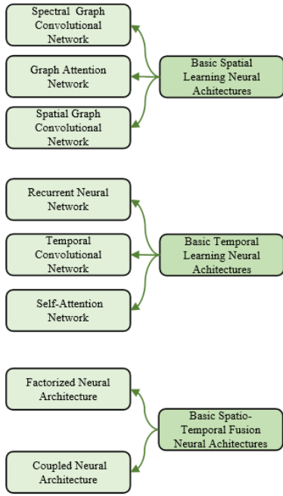
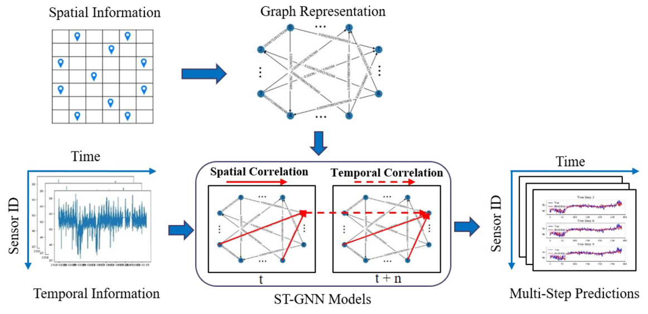
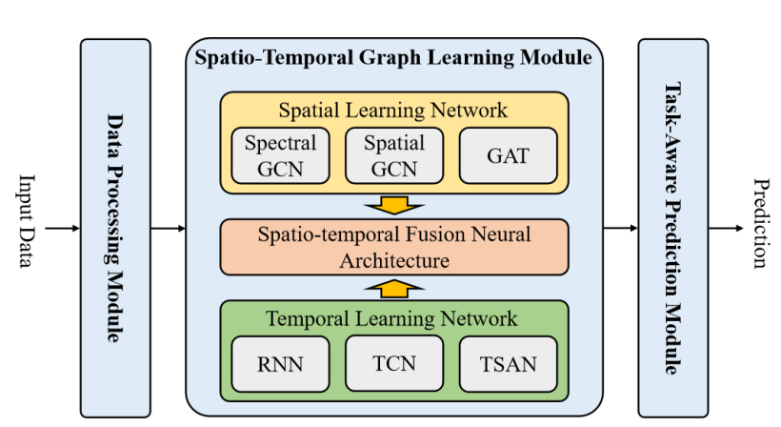

Slide 4
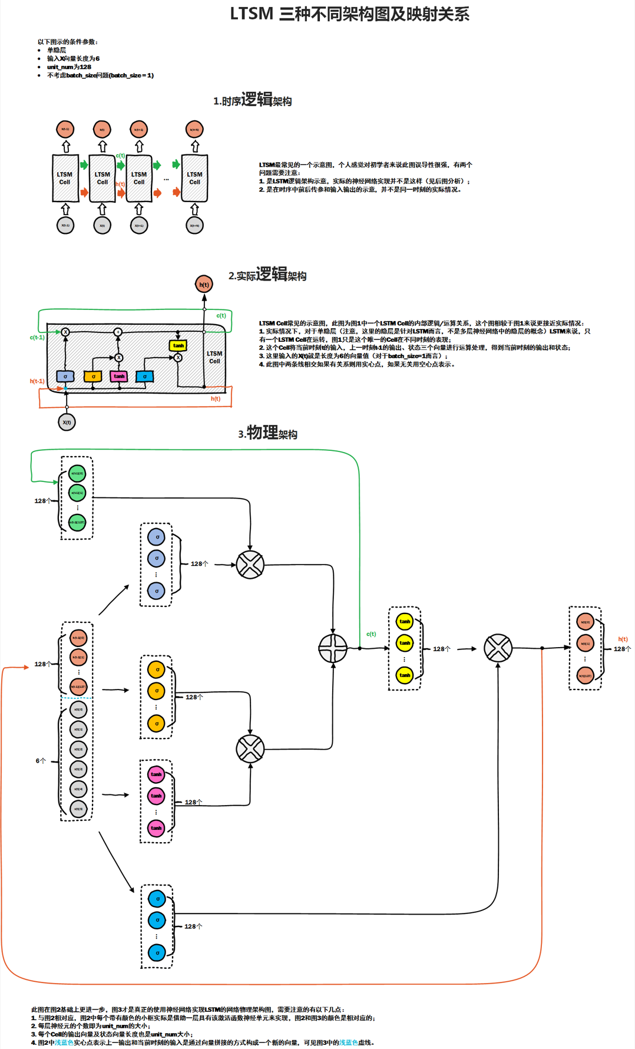
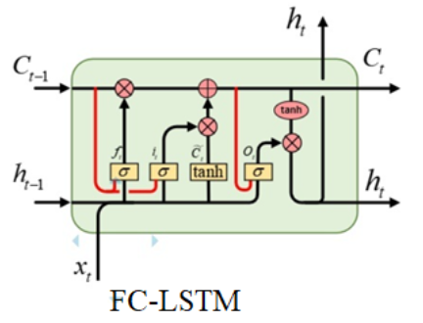
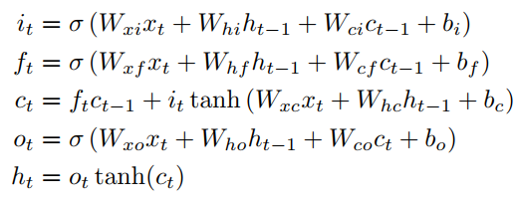
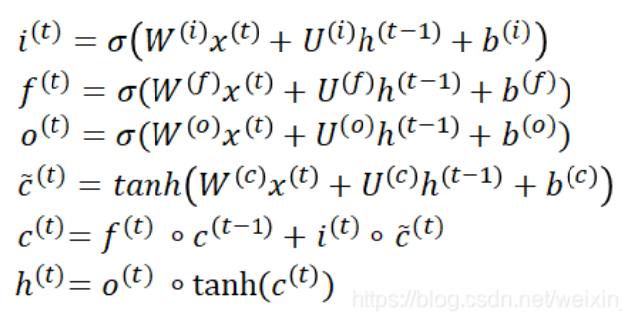


《LONG SHORT-TERM MEMORY 》
LSTM
《Generating Sequences With Recurrent Neural Networks》
FC-LSTM
《Convolutional LSTM Network》
Conv-LSTM

Slide 5
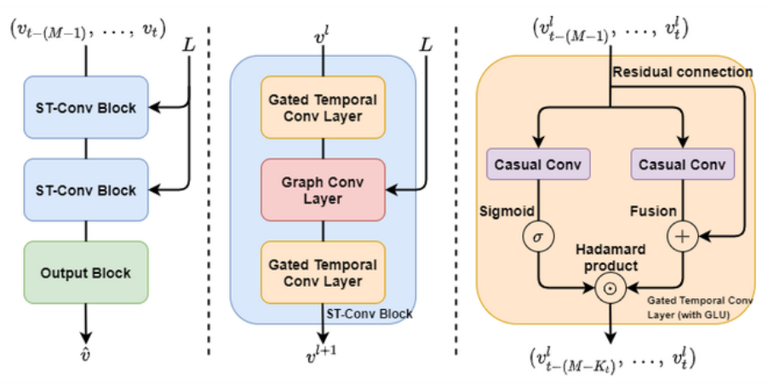


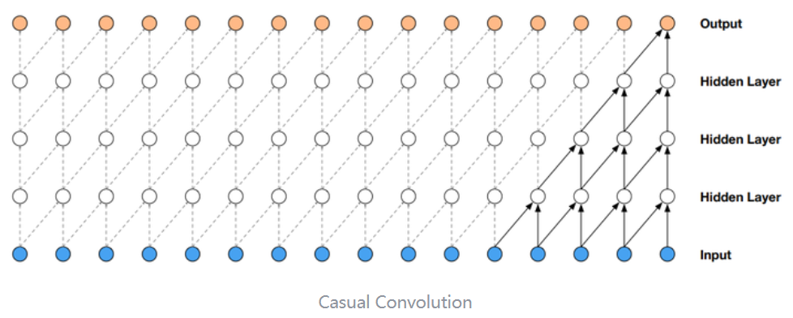




《Spatio-Temporal Graph Convolutional Networks》

Slide 6



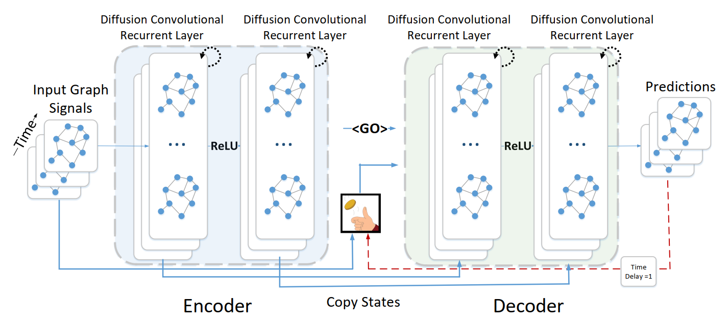




《DCRNN: DIFFUSION CONVOLUTIONAL RECURRENT NEURALNETWORK》
《Sequence to Sequence Learning with Neural Networks》
E有向 + W节点相似度
空间关系建模：
双向扩散
时间关系建模：
DC-GRU
scheduled sampling:
训练时，以概率epsilon将真实样本作为decoder输入；
随着时间推移，epsilon逐渐减小

Slide 7
