Slide 1
课程安排
1. GNN基础
2. 基于random walk的图嵌入算法
3. GCN
4. 研究方向说明
5.语言模型GraphSAGE
6. Attention机制与GAT
7. 实例讲解：HGNN
8. 异质图算法
9. VGAE和graph GAN
10. 实例讲解：DSTG
11. GNN模型的解释性
12. How to write
13. beyondGNN
14. 论文选会以及如何让你的论文更容易发表

Slide 2
Node Embedding

Slide 3


Feature Learning in Graphs
Goal: Efficient task-independent feature learning for machine learning in networks!
node
vec
u
$$f:u→ℝ^{d}$$
$$ℝ^{d}$$

Slide 4
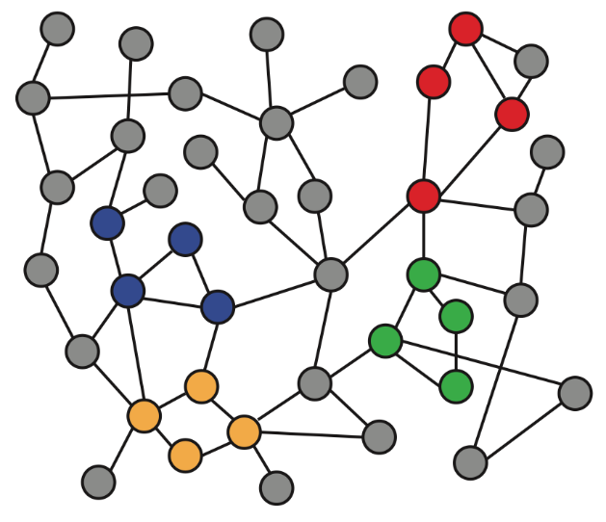
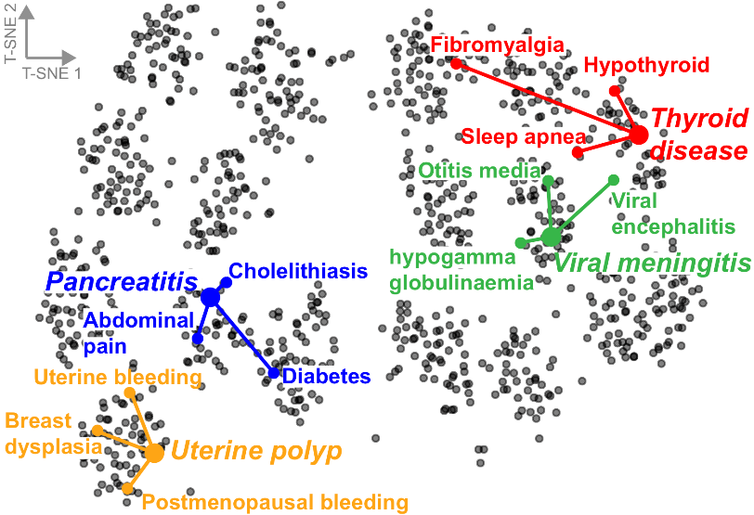
Embedding Nodes
Input
Output
Intuition: Map nodes to d-dimensional embeddings such that similar nodes in the graph are embedded close together

Slide 5
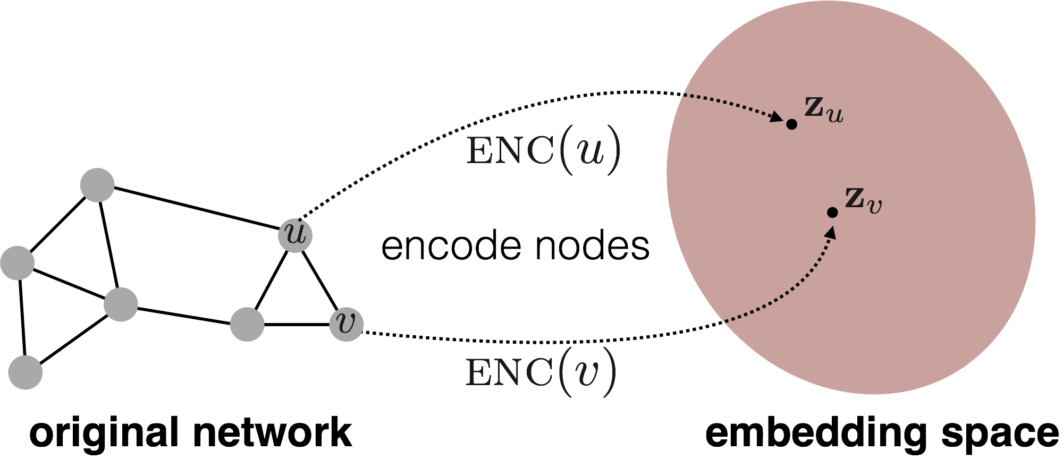
Feature Learning in Graphs
Assume we have a graph G:
V is the vertex set
A is the adjacency matrix (assume binary)
No node features or extra information is used!
Goal: Map nodes so that similarity in the embedding space (e.g., dot product) approximates similarity in the network
d-dimensional
embedding space
Input network

Slide 6
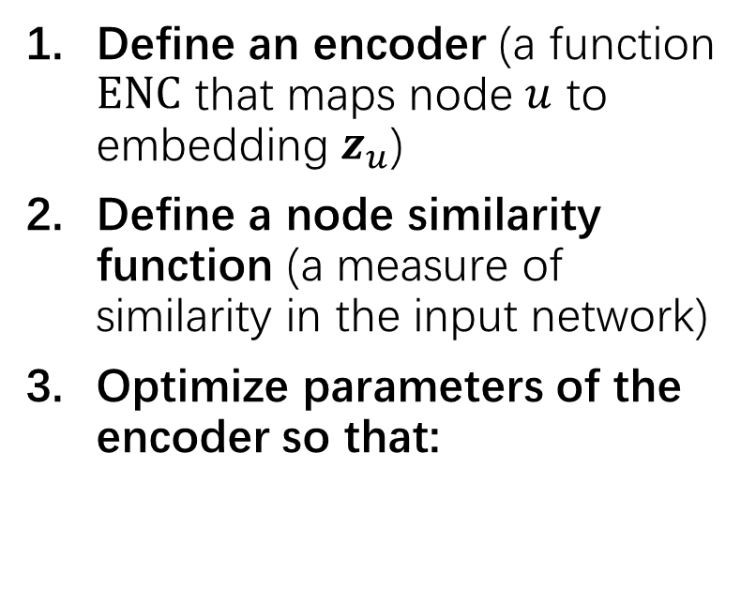
Embedding Nodes
Define an encoder (a function $ENC$ that maps node $u$ to embedding $z_{u}$)
Define a node similarity function (a measure of similarity in the input network)
Optimize parameters of the encoder so that:
Goal:
Need to define!
Input network
d-dimensional
embedding space
Notes:
Note that other distance measures other than dot products could be used (e.g., Euclidean distance), but the dot product is the standard measure of similarity used.

Slide 7
Embedding Nodes
Goal:
Encoder maps a node to a d-dimensional vector:
Similarity function defines how relationships in the input network map to relationships in the embedding space:
d-dimensional embedding
Need to define!
node in the input graph
d-dimensional
embedding space
Similarity of u and v in the network
dot product between node embeddings
Input network
Notes:
Note that other distance measures other than dot products could be used (e.g., Euclidean distance), but the dot product is the standard measure of similarity used.

Slide 8
Embedding Nodes
Goal:
Many methods use similar encoders:
node2vec, DeepWalk, LINE, struc2vec
These methods use different notions of node similarity:
Two nodes have similar embeddings if:
they are connected?
they share many neighbors?
they have similar local network structure?
etc.
Need to define!
Input network
d-dimensional
embedding space
Notes:
Note that other distance measures other than dot products could be used (e.g., Euclidean distance), but the dot product is the standard measure of similarity used.

Slide 9
Adjacency-based Similarity
Similarity function is the edge weight between u and v in the network
Intuition: Dot products between node embeddings approximate edge existence
loss (what we want to minimize)
embedding similarity
(weighted) adjacency matrix for the graph
sum over all node pairs
Notes:
Note that other distance measures other than dot products could be used (e.g., Euclidean distance), but the dot product is the standard measure of similarity used.

Slide 10
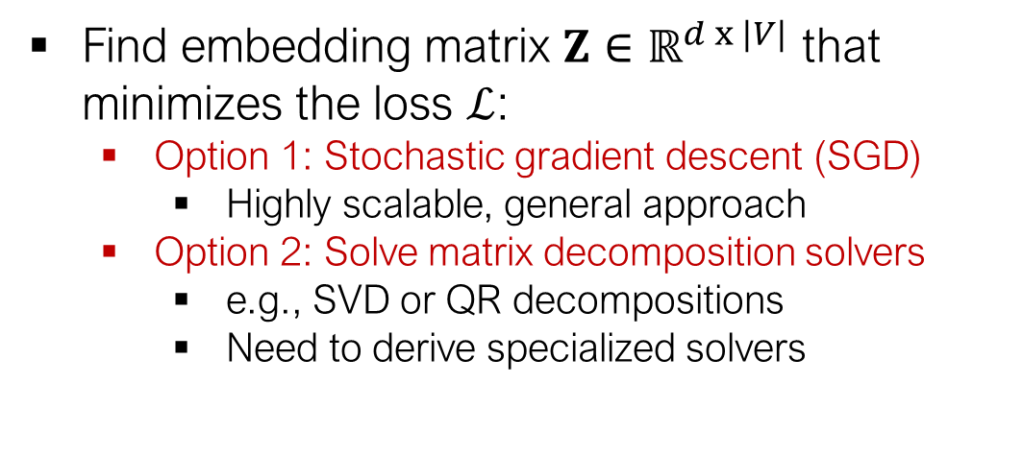
Adjacency-based Similarity
Find embedding matrix $Z∈ℝ^{d x |V|}$ that minimizes the loss $ℒ$:
Option 1: Stochastic gradient descent (SGD)
Highly scalable, general approach
Option 2: Solve matrix decomposition solvers
e.g., SVD or QR decompositions
Need to derive specialized solvers
Notes:
Note that other distance measures other than dot products could be used (e.g., Euclidean distance), but the dot product is the standard measure of similarity used.

Slide 11
Random Walk
Material based on:
Perozzi et al. 2014. DeepWalk: Online Learning of Social Representations. KDD.
Grover et al. 2016. node2vec: Scalable Feature Learning for Networks. KDD.
Ribeiro et al. 2017. struc2vec: Learning Node Representations from Structural Identity. KDD.
Notes:
Note that other distance measures other than dot products could be used (e.g., Euclidean distance), but the dot product is the standard measure of similarity used.

Slide 12
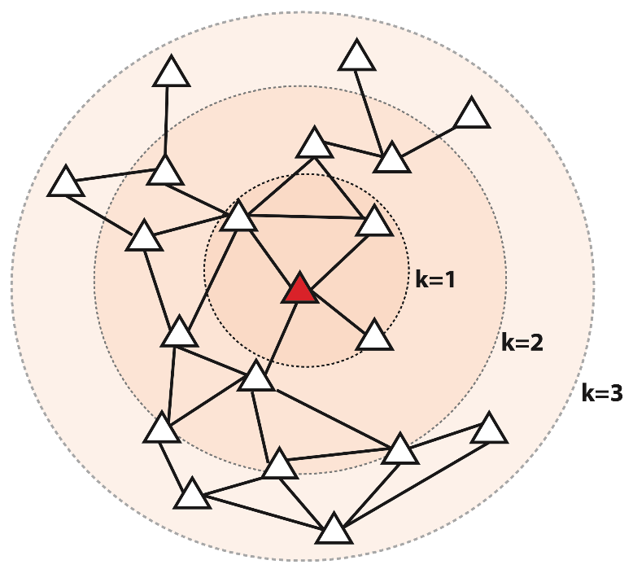
Multi-Hop Similarity
Idea: Define node similarity function based on higher-order neighborhoods
Red: Target node
k=1: 1-hop neighbors
A (i.e., adjacency matrix)
k= 2: 2-hop neighbors
k=3: 3-hop neighbors
How to stochastically define these higher-order neighborhoods?
Notes:
Note that other distance measures other than dot products could be used (e.g., Euclidean distance), but the dot product is the standard measure of similarity used.

Slide 13

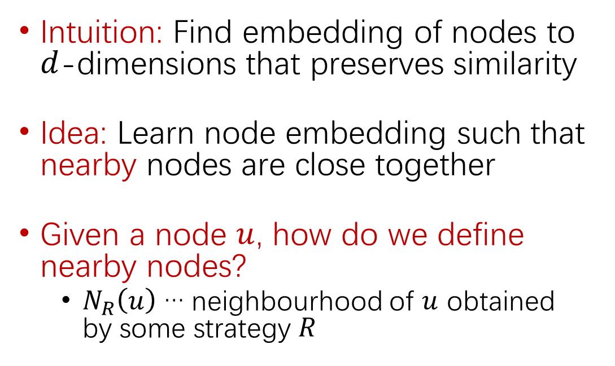
Unsupervised Feature Learning
Intuition: Find embedding of nodes to $d$-dimensions that preserves similarity
Idea: Learn node embedding such that nearby nodes are close together
Given a node $u$, how do we define nearby nodes?
$N_{R}\left(u\right)$ … neighbourhood of $u$ obtained by some strategy $R$
$$u$$
Randomwalk：
节点u开始形成100个路径
每个路径跳3次
Notes:
Note that other distance measures other than dot products could be used (e.g., Euclidean distance), but the dot product is the standard measure of similarity used.

Slide 14
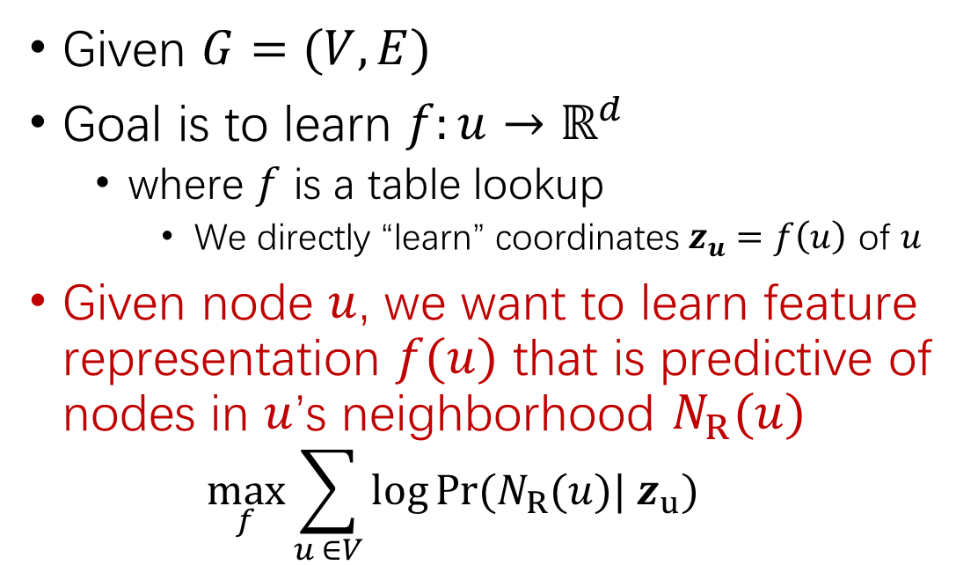
Unsupervised Feature Learning
Given $G=(V,E)$
Goal is to learn $f:u→ℝ^{d}$
where $f$ is a table lookup
We directly “learn” coordinates $z_{u}=f\left(u\right)$ of $u$
Given node $u$, we want to learn feature representation $f(u)$ that is predictive of nodes in $u$’s neighborhood $N_{R}(u)$
$$\max_{f}{\sum_{u ∈V}{\log{Pr(N_{R}(u})| z_{u})}}$$
$$u$$
Notes:
Note that other distance measures other than dot products could be used (e.g., Euclidean distance), but the dot product is the standard measure of similarity used.

Slide 15
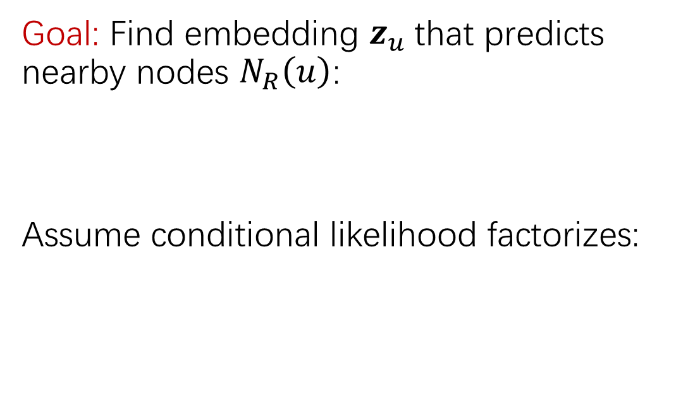
Unsupervised Feature Learning
Goal: Find embedding $z_{u}$that predicts nearby nodes $N_{R}\left(u\right)$:
Assume conditional likelihood factorizes:
$$u$$
Probability that u and v co-occur in a random walk over the network
Random-walk Embeddings
Notes:
Note that other distance measures other than dot products could be used (e.g., Euclidean distance), but the dot product is the standard measure of similarity used.

Slide 16
Random Walk
Simulate many short random walks starting from each node using a strategy R
For each node u, get N_{R}(u) as a sequence of nodes visited by random walks starting at u
For each node u, learn its embedding by predicting which nodes are in N_{R}(u):
$$u$$
Probability that u and v co-occur in a random walk over the network
Random-walk Embeddings
Notes:
Note that other distance measures other than dot products could be used (e.g., Euclidean distance), but the dot product is the standard measure of similarity used.

Slide 17
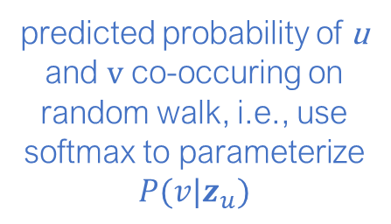
Random Walk
sum over all nodes u
sum over nodes v seen on random walks starting from u
predicted probability of u and v co-occuring on random walk, i.e., use softmax to parameterize $P(v|z_{u})$
$$u$$
Random walk embeddings = $z_{u}$ minimizing L
Notes:
Note that other distance measures other than dot products could be used (e.g., Euclidean distance), but the dot product is the standard measure of similarity used.

Slide 18
Random Walk
But doing this naively is too expensive!
$$u$$
Nested sum over nodes gives O(|V|²) complexity!
The problem is normalization term in the softmax function?
Notes:
Note that other distance measures other than dot products could be used (e.g., Euclidean distance), but the dot product is the standard measure of similarity used.

Slide 19
Random Walk
Solution: Negative sampling (Mikolov et al., 2013)
i.e., instead of normalizing w.r.t. all nodes, just normalize against k random negative samples
$$u$$
random distribution over all nodes
sigmoid function
Notes:
Note that other distance measures other than dot products could be used (e.g., Euclidean distance), but the dot product is the standard measure of similarity used.

Slide 20
Random Walk
Simulate many short random walks starting from each node using a strategy R
For each node u, get N_{R}(u) as a sequence of nodes visited by random walks starting at u
For each node u, learn its embedding by predicting which nodes are in N_{R}(u):
$$u$$
Can efficiently approximate using negative sampling
Notes:
Note that other distance measures other than dot products could be used (e.g., Euclidean distance), but the dot product is the standard measure of similarity used.

Slide 21
Random Walk （针对有权图如何修改）
What strategies can we use to obtain these random walks?
Simplest idea:
Fixed-length, unbiased random walks starting from each node (i.e., DeepWalk from Perozzi et al., 2013)
Can we do better?
Grover et al., 2016; Ribeiro et al., 2017; Abu-El-Haija et al., 2017 and many others
$$u$$
Notes:
Note that other distance measures other than dot products could be used (e.g., Euclidean distance), but the dot product is the standard measure of similarity used.

Slide 22
node2vec: Biased Walks
Idea: Use flexible, biased random walks that can trade off between local and global views of the network (Grover and Leskovec, 2016)
$$u$$
Notes:
Note that other distance measures other than dot products could be used (e.g., Euclidean distance), but the dot product is the standard measure of similarity used.

Slide 23



node2vec: Biased Walks
Two classic strategies to define a neighborhood $N_{R}\left(u\right)$ of a given node $u$:
$$u$$
$$N_{BFS}\left(u\right)=\{ s_{1},s_{2},s_{3}\}$$
Local microscopic view
$$N_{DFS}\left(u\right)=\{ s_{4},s_{5},s_{6}\}$$
Global macroscopic view
Notes:
Note that other distance measures other than dot products could be used (e.g., Euclidean distance), but the dot product is the standard measure of similarity used.

Slide 24

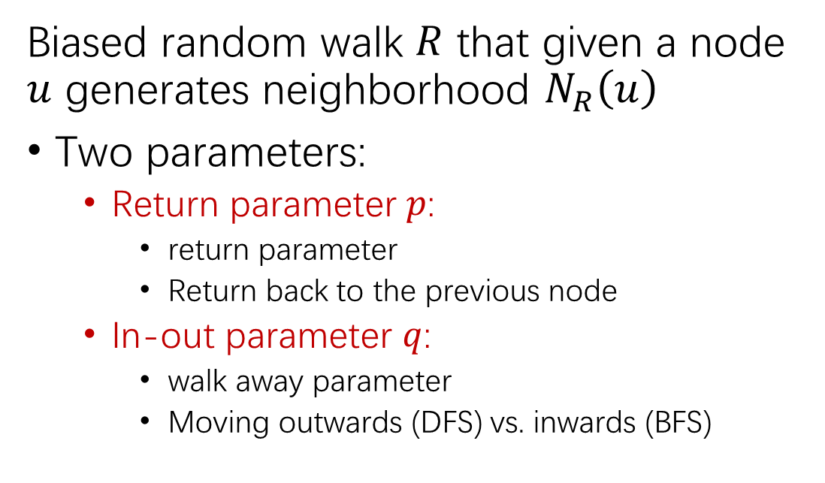



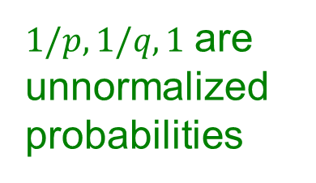


node2vec: Biased Walks
Same distance to $u$
s₂
Biased random walk $R$ that given a node $u$ generates neighborhood $N_{R}\left(u\right)$
Two parameters:
Return parameter $p$:
return parameter
Return back to the previous node
In-out parameter $q$:
walk away parameter
Moving outwards (DFS) vs. inwards (BFS)
s₃
w
Farther from $u$
u
s₁
Closer to $u$
s₂
$$1$$
s₃
w
$$1/q$$
u
s₁
$$1/p$$
$1/p,1/q,1$ are unnormalized probabilities
Notes:
Note that other distance measures other than dot products could be used (e.g., Euclidean distance), but the dot product is the standard measure of similarity used.

Slide 25

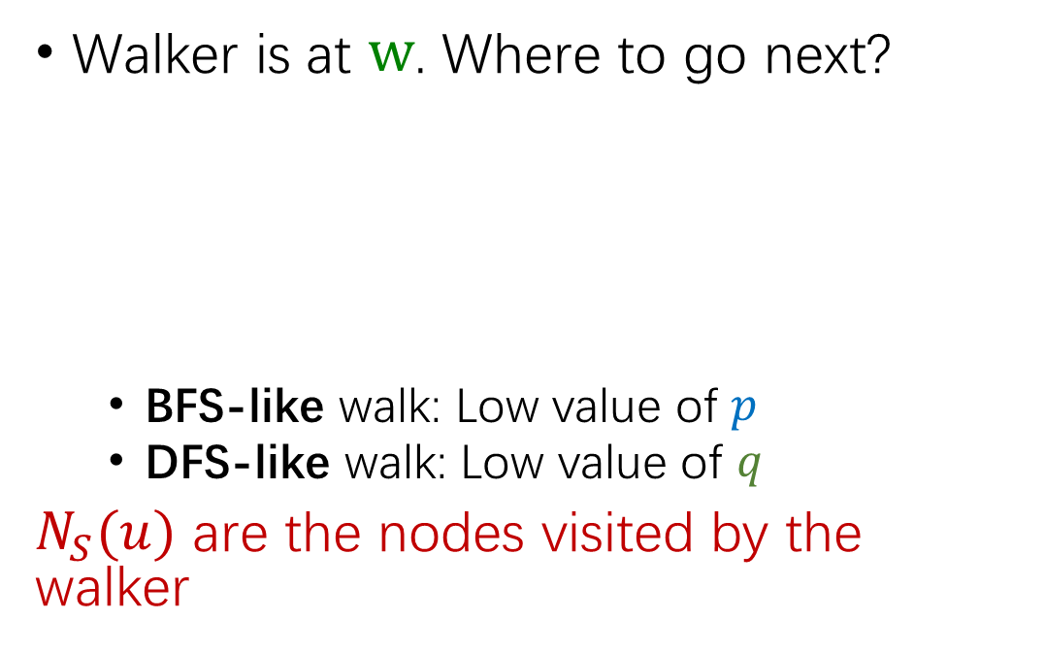


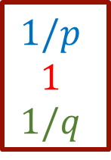

node2vec: Biased Walks
Walker is at $w$. Where to go next?
BFS-like walk: Low value of $p$
DFS-like walk: Low value of $q$
$N_{S}(u)$ are the nodes visited by the walker
s₂
$$1$$
s₃
s₁ s₂ s₃
$$1/p$$
$$1$$
$$1/q$$
w
$w→$
$$1/q$$
u
s₁
$$1/p$$
Unnormalized transition prob.
Notes:
Note that other distance measures other than dot products could be used (e.g., Euclidean distance), but the dot product is the standard measure of similarity used.

Slide 26
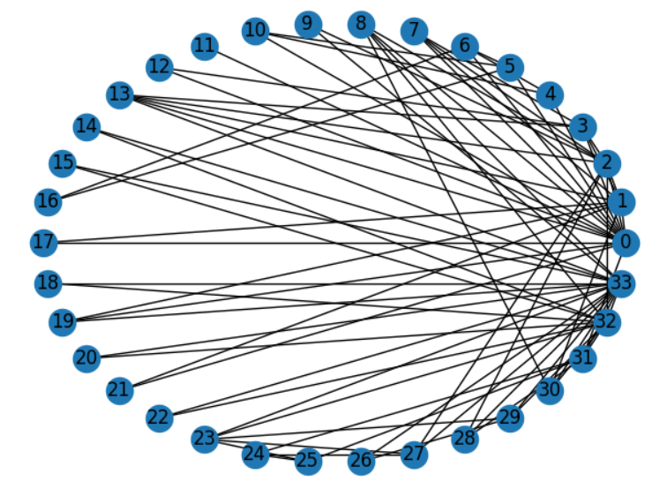
Karate Club
该图描述了一个空手道俱乐部会员的社交关系，以34名会员作为节点，如果两位会员在俱乐部之外仍保持社交关系，则在节点间增加一条边。
每个节点具有一个34维的特征向量，一共有78条边。
在收集数据的过程中，管理人员 John A 和 教练 Mr. Hi（化名）之间产生了冲突，会员们选择了站队，一半会员跟随 Mr. Hi 成立了新俱乐部，剩下一半会员找了新教练或退出了俱乐部。

