Slide 1
AE and VAE

Slide 2
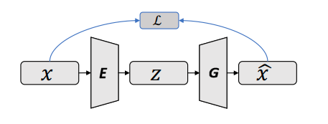
Vanilla Autoencoder
Reconstruct high-dimensional data using a neural network model with a narrow
bottleneck layer
The bottleneck layer captures the compressed latent coding, so the nice by-product
is dimension reduction
The low-dimensional representation can be used as the representation of the data
in various applications, e.g., image retrieval, data compression …

Slide 3
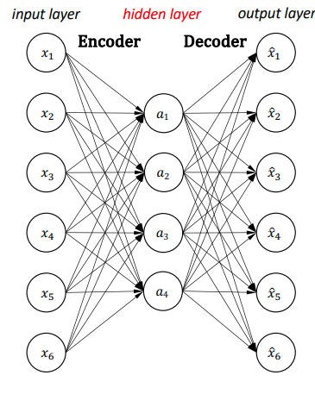

Vanilla Autoencoder
• The hidden units are usually less than the number of inputs
• Dimension reduction --- Representation learning
The distance between two data can be measure by
Mean Squared Error (MSE):

Slide 4
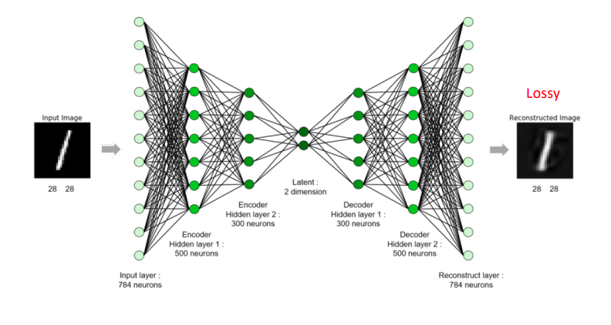
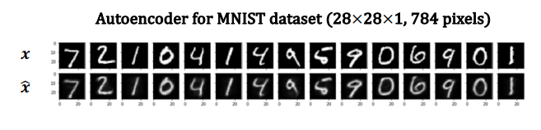
Vanilla Autoencoder

Slide 5
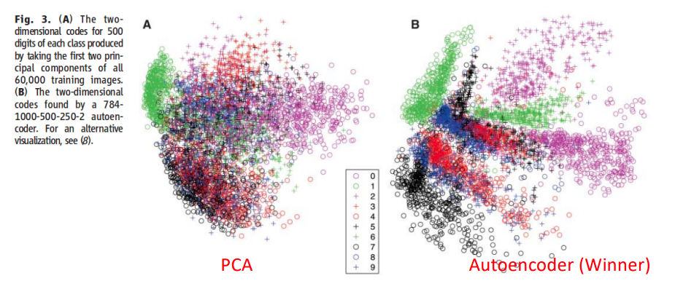
Vanilla Autoencoder VS PCA
t-SNE visualization on MNIST: PCA vs. Autoencoder
Hinton and Salakhutdinov, science, 2016.

Slide 6
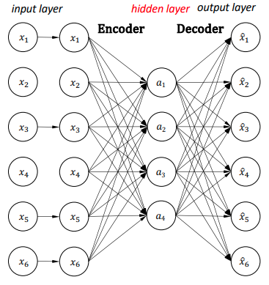
Denoising Autoencoder
Denoising autoencoder was proposed in 2008, 4 years before the dropout paper (Hinton, et al. 2012).
Denoising autoencoder can be seem as applying dropout between the input and the first layer.
Denoising autoencoder can be seem as one type of data augmentation on the input.

Slide 7
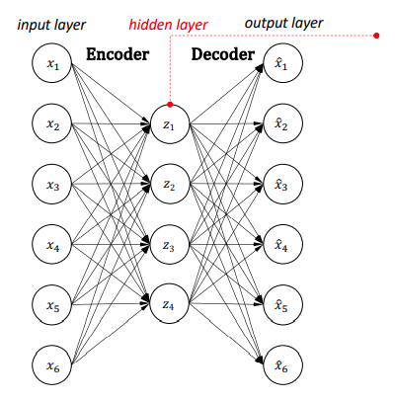
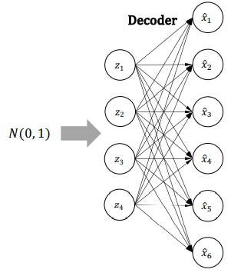
Variational Autoencoder
AE：the compressed latent codes of autoencoders are not prior distributions, autoencoder cannot learn to represent the data distribution.
Can the hidden output be a prior distribution, e.g., Normal distribution?
Decoder maps N(0, 1) to data space

Slide 8
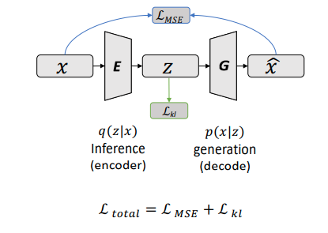
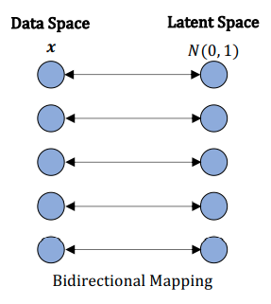
Variational Autoencoder

Slide 9
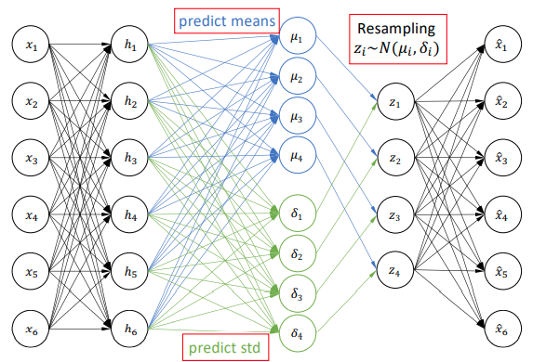
Variational Autoencoder
1. Encode the input
2. Predict means
3. Predict standard derivations
4. Use the predicted means and standard derivations to sample new latent variables individually
5. Reconstruct the input

Slide 10
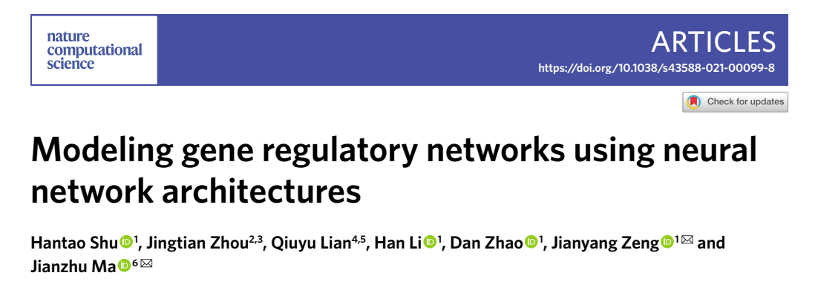
deepSEM

Slide 11
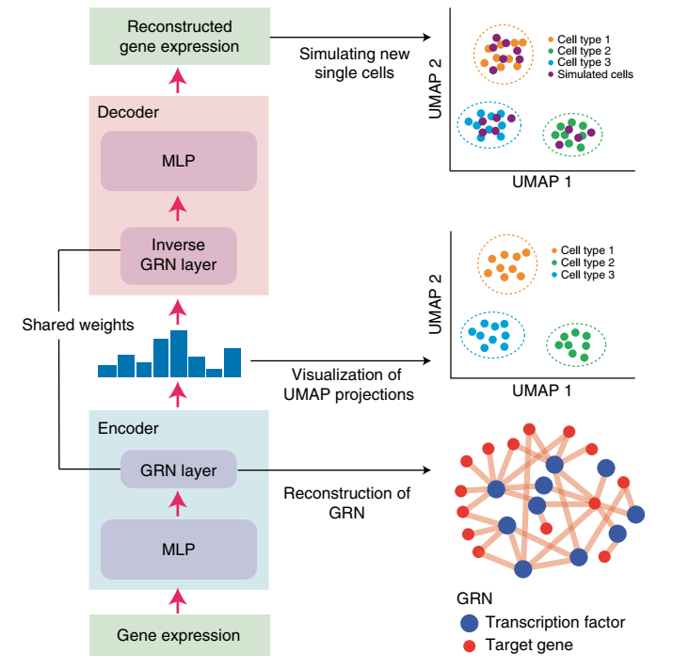
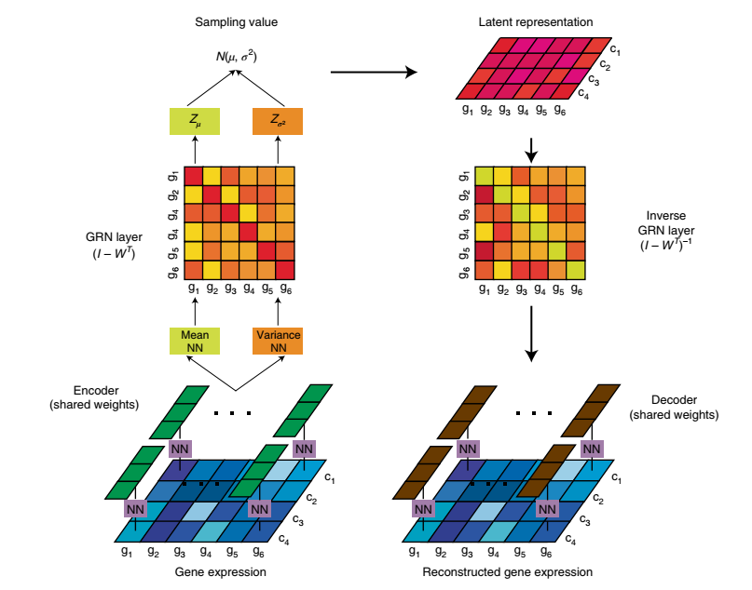
deepSEM

Slide 12
GAE/ VGAE

Slide 13
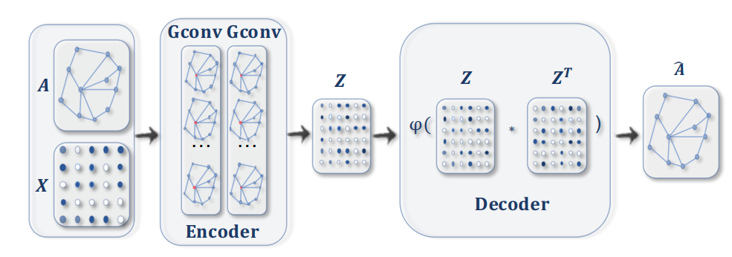






GAE
Similarity reconstruct A
embedding

Slide 14
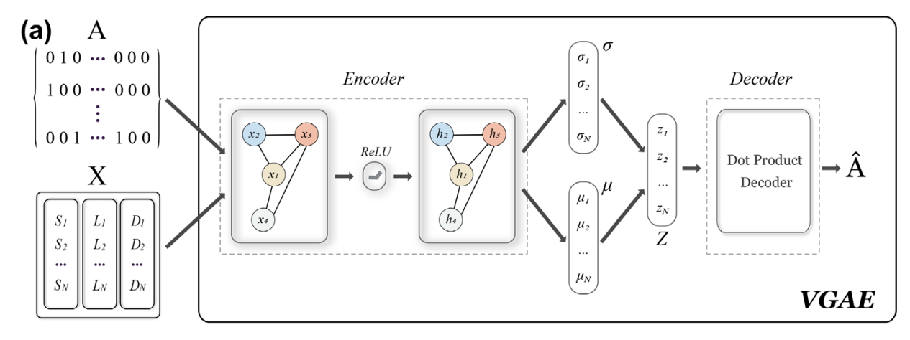
VGAE
DaehanKim/vgae_pytorch: This repository implements variational graph auto encoder by Thomas Kipf. (github.com)

Slide 15
