Slide 1
How to Write a Scientific Paper

Slide 2
Is the paper worth writing?
What’s in the literature?
“So What?”
It’s a lot of work (average 20-30 drafts). Don’t do it unless its worth it.

Slide 3
What do I have to say?
  A single question clearly stated with adequate evidence for the answer.
  Try stating the question and its answer in one simple sentence.

Slide 4
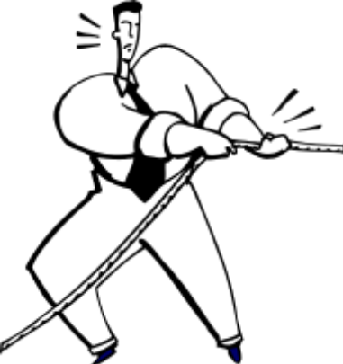
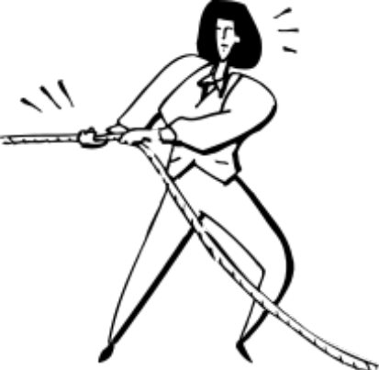
Is it one or more papers?
Putting too much in one
paper makes it diffuse and
less compelling than if its focused
Salami Science?

Slide 5
OK, So you want to/need to write a paper → next questions
What is the right format for the message (original article/review?)
What is the right audience—who cares?
What journal should I choose?

Slide 6
A scientific article as a critical argument
Statement of problem; posing a question
Presentation of evidence
Assessment of the validity of the evidence in the face of ..
  strengths/weaknesses
  other evidence
Conclusions

Slide 7
Literature Search First
What has been done and what can you say that’s new?
Be thorough in your search:---a high sensitivity/low specificity search.

Slide 8
The Title Page: Do it early
Establishes responsibilities in paper writing
Avoids hurt feelings

Slide 9
The Process of Paper Writing
Create an outline first
Plan on multiple drafts:
  Filename with dates
  One filename written over with new draft
Tables/figures early: prompt more analysis
Deadlines for you and coauthors

Slide 10

The Introduction
Draw audience in; be provocative
Target journal specific audience
Identify gaps in knowledge
End with question/hypothesis
Knee Pain, Why?

Slide 11
The Methods Section
Should include subheadings
Write clearly enough to be understood by nontechnical reader and be replicated
Past tense

Slide 12
The Results Section
Organize around tables/figures
Present tabular results selectively in text
Past tense
No interpretation; just the facts!
Tables should stand on their own
90
80
70
60
50
% Fellows with Papers Published
40
30
20
10
0
before
after
talk
talk

Slide 13
The Discussion Section
1st paragraph: answer question/hypothesis
Remainder:
  Evidence pro and con: literature review
  Strengths/limitations of your study
  Implications of findings (be conservative)
  Other findings of your study
Last Paragraph: conclusion

Slide 14
Getting Tense!
PAST and PRESENT
When quoting previously published work, refer to it in present tense (e.g. penicillin treats strep throat)
When describing your own study, refer to work in past tense (e.g. we tested a new antibiotic for strep throat)

Slide 15
The good scientific paper ...
Is focused on a specific question(s).
Covers a broad spectrum of disease or methodologic questions
Less is More.

Slide 16
In a good scientific paper ...
A: Abstract and tables and figures are understandable without reading whole paper.
B. Abstract and tables and figures are understandable only with reading whole paper.

Slide 17
In a good scientific paper ...
A: Writing is in passive voice (e.g. it was found that…).
B. Writing is in active voice (we found that…).
C. Writing mixes active and passive voice.

Slide 18
In a good scientific paper ...
A: A term defined in the methods section is used again and again (a rose, a rose, a rose)
B. Various synonyms for a term are used to prevent reader boredom. (a rose, a flower with a thorny stem, a fragrant flower)
Define a term and use it consistently. Otherwise, you’ll confuse the reader.

Slide 19
In a good scientific paper ...
A: Writing is flowery
B. Writing is concise
Generally, the shorter, the better

Slide 20
Proofread before Submitting
  Are terms used consistently throughout?
  Do numbers in abstract match numbers in text and tables?
  Do citations in text match references?
  Are Syntax and Grammar acceptable

Slide 21
A brief synopsis of writing an abstract
It’s a minipaper:
  Introduction (usually 1-2 sentences)
  Methods (often longest part)
  Results
  Discussion is limited to concluding statement
Like a paper, requires many drafts, most oriented to presenting argument concisely

Slide 22
Getting the Reviews of Your Paper
“The reviewer is always right.” (whether they are or not!)
Don’t respond quickly. Digest reviews.
.

