Slide 1
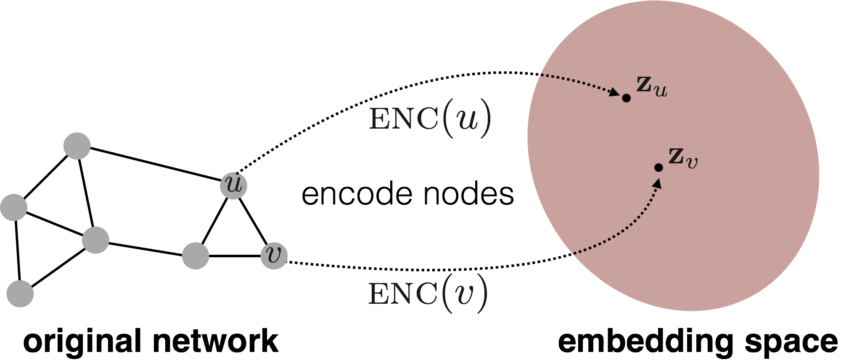
Embedding is not the most important!
The embedding performs poorly when
SNR is too low in dataset.
the relationship is incorrect.
the relationship is redundancy.
d-dimensional
embedding space
Input network
Dataset and relationship is much important!

Slide 2
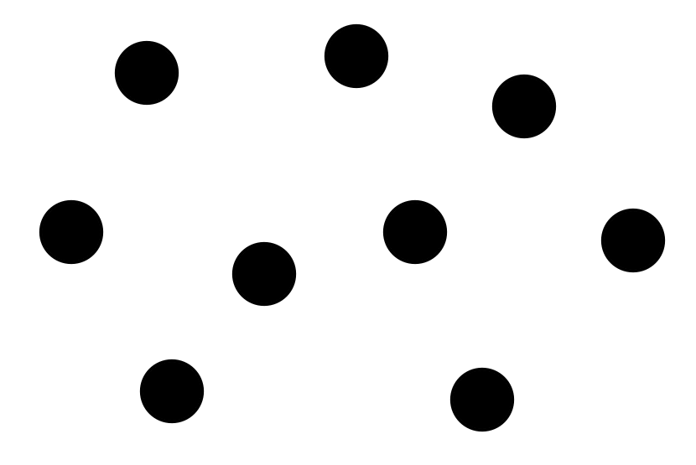
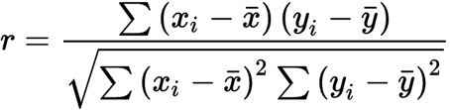
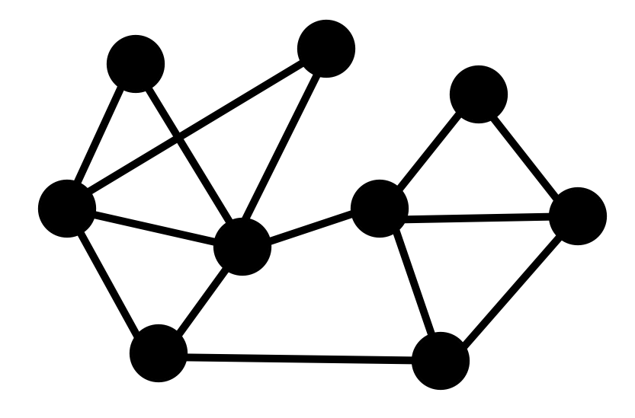
How to build a graph? GNN?
Similarity:
PCC
An important topic!

Slide 3
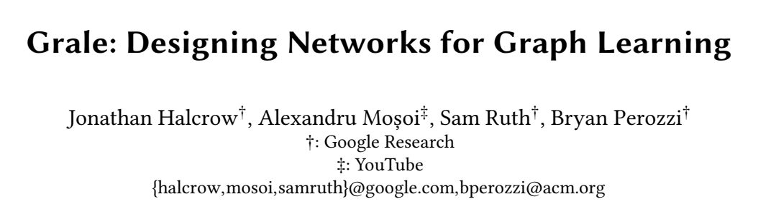
In real world applications, the choice of which edges to use for computation is the first step in any graph learning process.
The choice of edges can drastically affect the performance of downstream semi-supervised learning systems.
Grale: graph design for graphs with billions of nodes
Grale operates by fusing together different measures of (potentially weak) similarity to create a graph which exhibits high task-specific homophily between its nodes.

Slide 4






Notation
consider a general multiclass learning setting
a partially labeled set of points
the first 𝐿 points have class labels
a one-hot vector of dimension 𝐶
Each sub-representation has its own natural distance measure

Slide 5


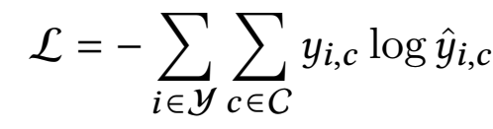
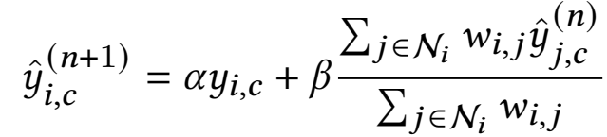
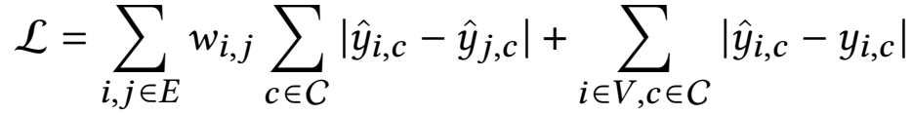
Loss function
a classification problem:
assume a graph 𝐺 = (𝑉 , 𝐸 ):
Potts model type loss function

Slide 6




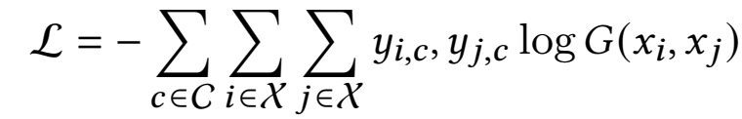
GRALE
Design task specific graphs by reducing the original task to training a classifier on pairs of points

Slide 7
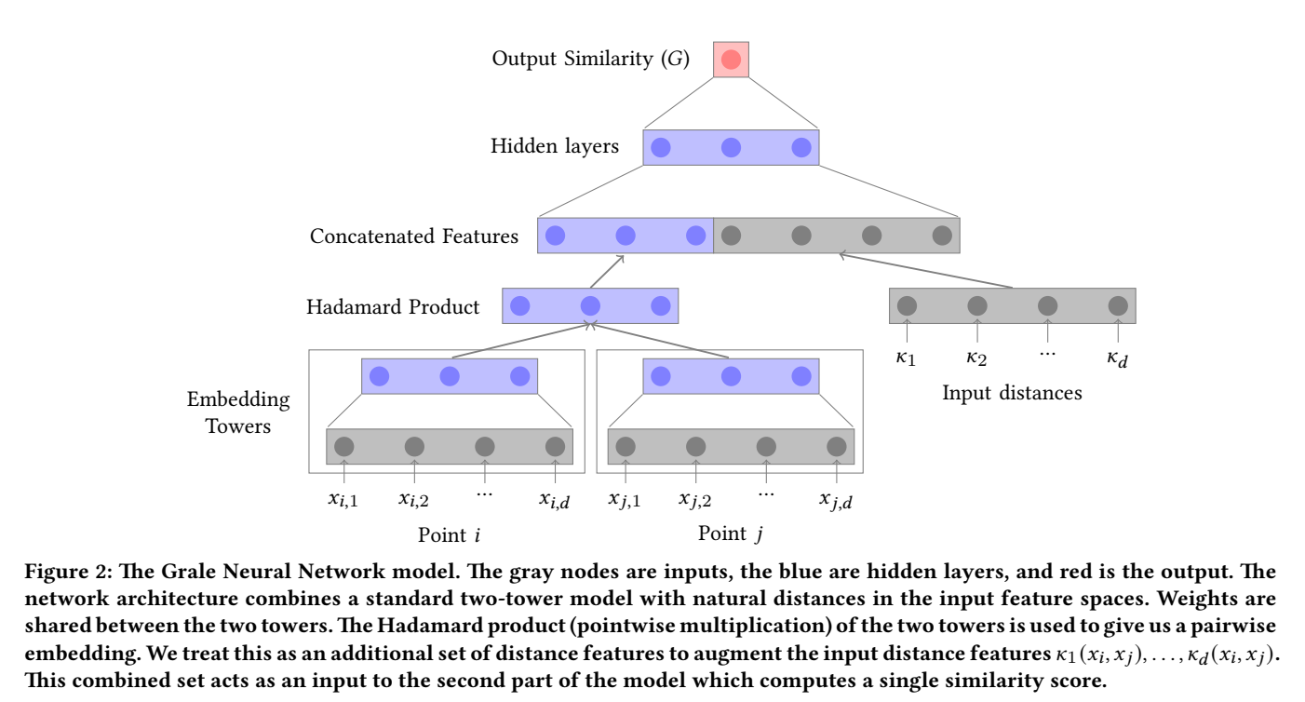
GRALE
一种计算相似性的神经网络

Slide 8
Spurious Correlations
Statistical significance: Standard threshold is 5%, meaning would be observed by chance 1 out of 20 times
But if you look at enough relationships you’ll find “significant” ones by chance
Spurious means there’s no real connection

Slide 9
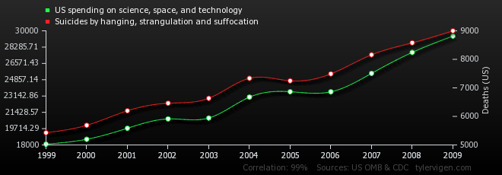
Spurious Correlations
US Spending on Science, Space and Technology Correlates with Suicides by Hanging, Strangulation and Suffocation

Slide 10
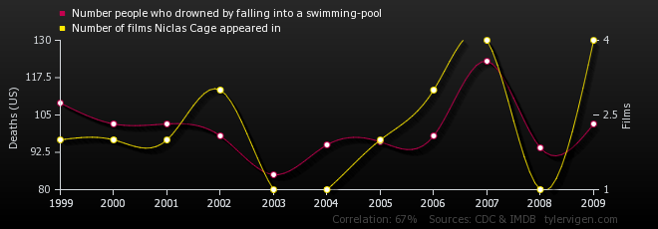
Spurious Correlations
Number of People Who Drowned by Falling into a Swimming Pool Correlates with Number of Nicholas Cage Films

Slide 11
Big Data Analysis Requires Causality
Big data is not randomized
We have to compare treatments when patients and providers choose what they think is best (AB test)
We want to choose treatments and design interventions
Causal inference is crucial
If We Don’t Think About Causality . . .
Our predictions can be fragile
Our interventions can be misguided

Slide 12
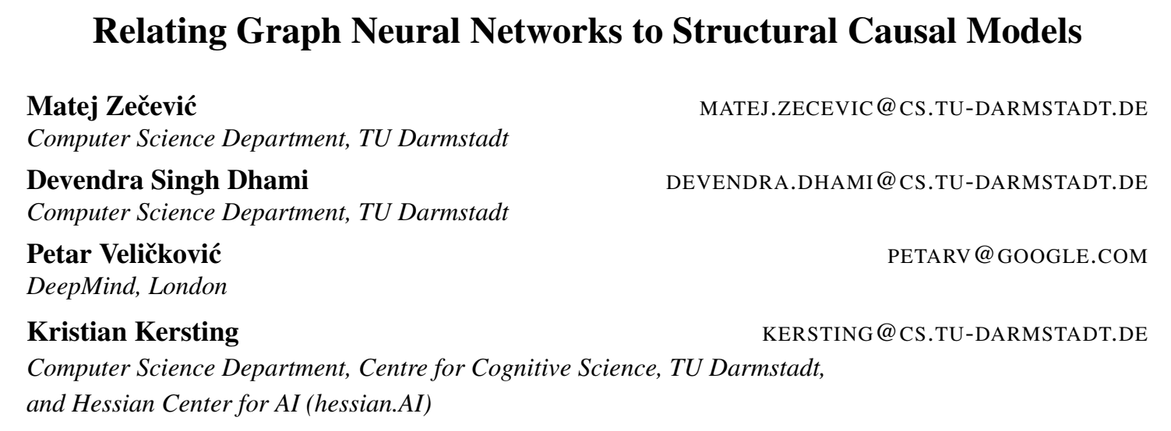
Causal Inference
https://www.youtube.com/watch?v=XC-Bfg3dO0I&ab_channel=ValenceDiscovery
Pearl Causal Hierarchy (PCH) - 馒头and花卷 - 博客园 (cnblogs.com)
https://www.nature.com/articles/s41598-021-87411-8
https://proceedings.mlr.press/v139/lin21d.html
CausalGNN: Causal-Based Graph Neural Networks for Spatio-Temporal Epidemic Forecasting | Proceedings of the AAAI Conference on Artificial Intelligence

Slide 13
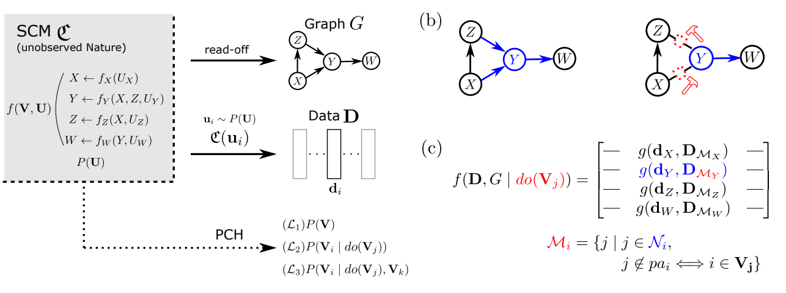
Relating Graph Neural Networks to Structural Causal Models
AB实验的形式化
Judea Pearl提出的“因果阶梯”论（Pearl Causal Hierarchy，PCH）

Slide 14
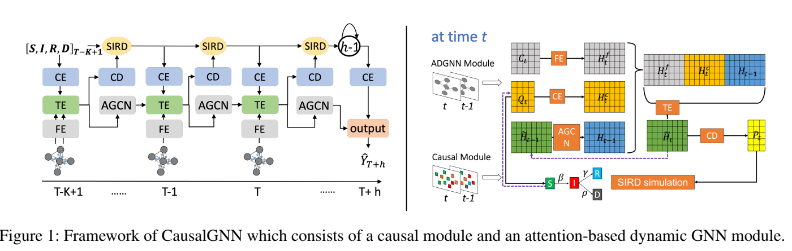
CausalGNN: Causal-Based Graph Neural Networks for Spatio-Temporal Epidemic Forecasting
构建差分方程来考虑因果性
FE：feature encoding
CE：causal encoding
AGCN：dynamic graph encoding
TE：temporal encoding
CD：causal decoding
SIRD：susceptible(S)-infected(I)- recovered(R)-deceased(D)

Slide 15
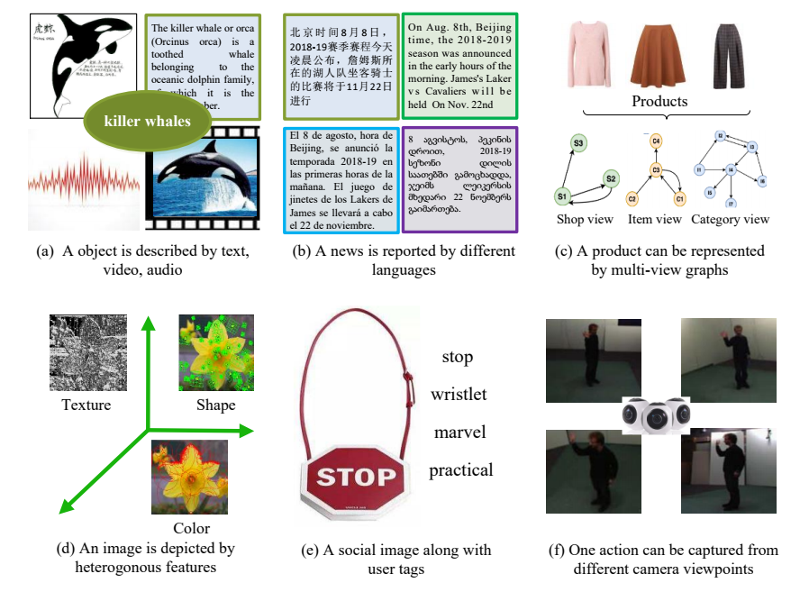
Multi-view data

Slide 16
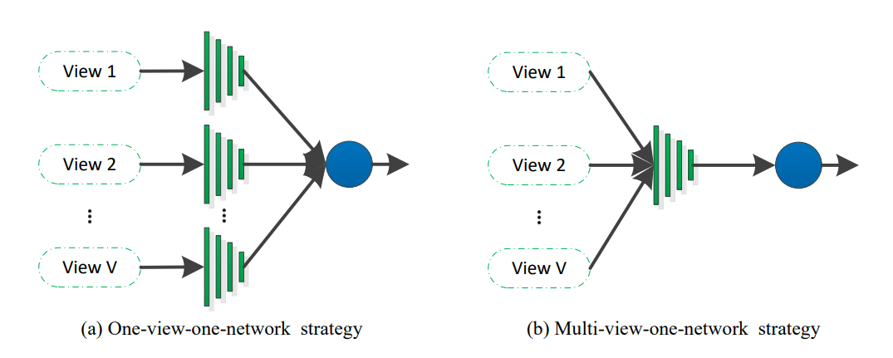
Multi-view learning
Multi-modal?
Deep multi-view learning methods: A review - ScienceDirect

Slide 17
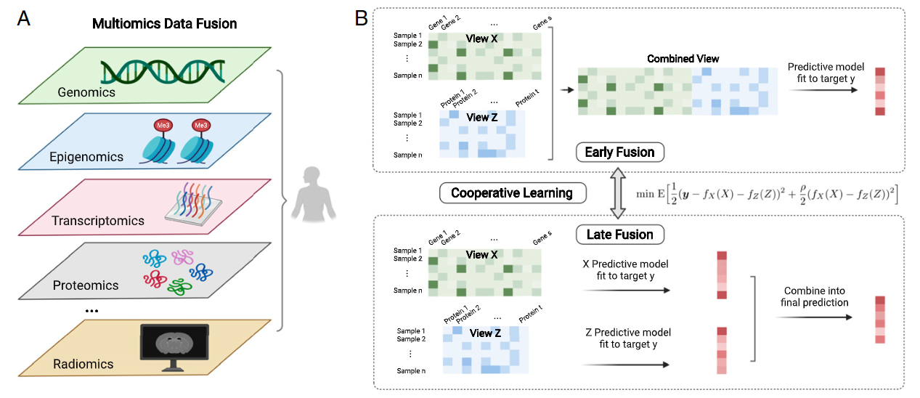
Multi-view learning

Slide 18
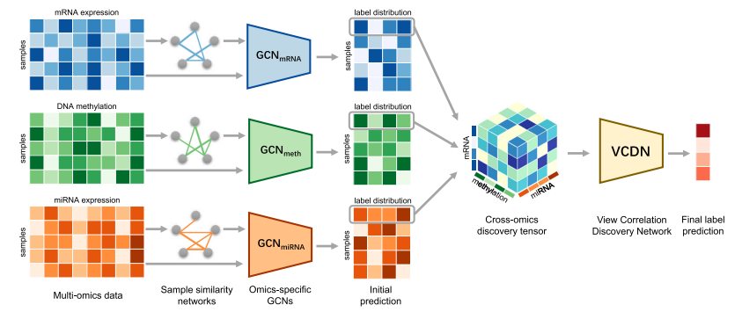
Multi-view learning

Slide 19
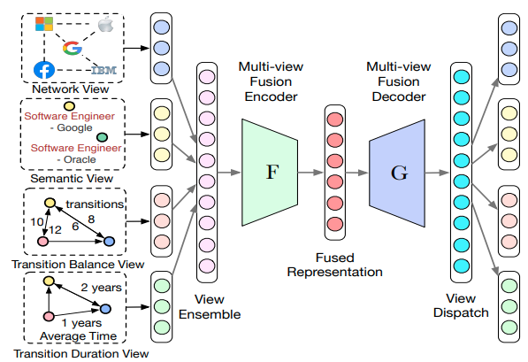
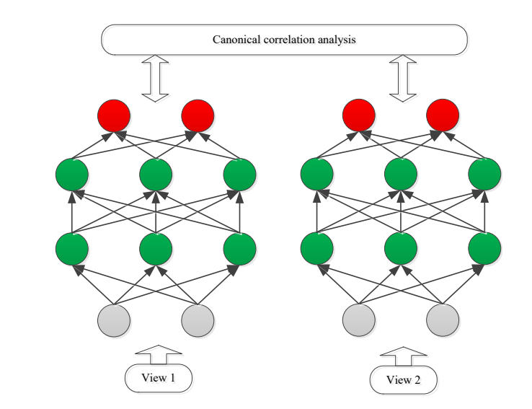
How to fuse multi-view data
Auto-encoder
canonical correlation analysis
Deep multi-view learning methods: A review - ScienceDirect

