Slide 1
YOUR PASSKEYS
WON'T SAVE YOU
Making landfall — bypassing Entra Conditional Access to establish the beachhead, straight through a browser you don't control.
DEF CON · Red Team Village · 2025
⚓ Grapnel — the browser-in-the-middle boarding hook

Slide 2
// 01 · whoami
whoami
bash — fr13ndz@defcon34
bash — CommanderChaos@defcon34
bash — maddog@rtv2025
$ whoami
handle: Jared@Fr13ndz
role: Adversarial Engineer
$ whoami
handle: Jon@CommanderChaos
role: Adversarial Engineer
$ whoami
handle: maddog#x00
role: Offensive Security Leader
// note — this is the "how you got in" talk. Its sequel, "I Got In, Now What?" (Adversary Village), starts the moment after — with the Beachhead already yours.
YOUR PASSKEYS WON'T SAVE YOU
whoami · 02/26

Slide 3
// 02 · the premise
They sold you passkeys as phishing-proof.
And for the interactive login leg, they mostly are. But the user still authenticates through a browser — and at the moment of auth, the adversary is in the middle of it.
the browser
Victim drives a session through a forged-CA proxy. Every request, header, token, and cookie is ours in-flight.
the policy
Org enforces MFA / passkey via Conditional Access. Feels airtight — on the leg it actually covers.
the seam
CA is evaluated per grant. Pick a grant it doesn't cover and the passkey never enters the picture.
starting state — one victim, one click, one browser we sit inside. No admin. No malware on the endpoint.
YOUR PASSKEYS WON'T SAVE YOU
premise · 03/26

Slide 4
// 03 · the surface
Why the browser auth flow?
The sign-in method picker and the CA policy engine disagree about what "strong" means — and the gap is a doorway.
the method picker
Push · passkey · SMS · device-code. The account is only as strong as its weakest completable method.
device-code → DRS
The device-registration grant is often governed by a different CA policy than interactive — or none at all.
ROPC (legacy)
grant_type=password straight to /token, skipping the authorization endpoint (and whatever runs there).
// the gap — everyone tests the interactive leg. Almost nobody tests whether the device-code + DRS path is covered. It usually isn't.
YOUR PASSKEYS WON'T SAVE YOU
surface · 04/26

Slide 5
// 04 · the path
The path we walk live
1
Capture
Fingerprint + session through the BITM proxy
2
Downgrade
Auto-click push · detect passkey dead-end
3
Device-code
Grant a DRS token — no interactive CA
4
Phantom join
Register a device — no TPM, no admin
5
Mint
PRT → Graph token → ADO PAT ☠
›
›
›
›
// here be dragons — every step uses only what a single phished session already holds.
YOUR PASSKEYS WON'T SAVE YOU
path · 05/26

Slide 6
// 05 · the tool
One tool: Grapnel ⚓
A browser-in-the-middle rig driven entirely from a web dashboard — nothing to install on the victim, no CLI to memorize. The operator watches the real login happen and clicks; interception, capture, and the phantom-join chain all run server-side.
docker compose up — one rig, three surfaces
$ docker compose up -d # forged-CA proxy · hosted session · dashboard
:3128 BITM proxy → intercept · capture · inject tokens/cookies in-flight
:8091 hosted session → the victim drives their real login in this canvas
:8092 operator dash → Captured Data · Phantom Join · Flow Trace · ROPC/PAT/AAA
watch & click
No victim-side agent, no proxy config. The login runs in a hosted browser; the operator just drives the dashboard.
scope-enforced
Code-level allowlists — refuses any host / tenant not on the list.
hands the baton
The Graph token + ADO PAT it captures are exactly what Beachhead picks up.
YOUR PASSKEYS WON'T SAVE YOU
tool · 06/26

Slide 7
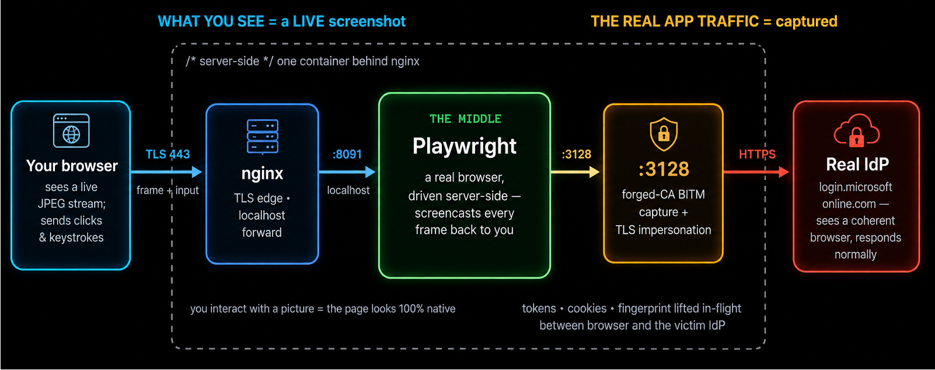
// 06 · under the hood
Where the “middle” actually is
The “middle” is a real browser Grapnel drives server-side. You interact with a picture of it; the real auth traffic to the IdP runs behind that picture — and is captured on the way through.
YOUR PASSKEYS WON'T SAVE YOU
bitm · 07/26

Slide 8
// 07 · the range
The range: one tenant, one browser
A throwaway Entra tenant + a container you drive from the booth. Nothing here can be pointed at a real org — that's enforced in code, not on a card.
the stack
docker-compose: the app (hosted session :8091 · dashboard :8092 · BITM :3128) behind nginx. docker compose up and go.
the tenant
Dedicated M365 dev tenant: phishing-resistant MFA on the interactive leg, the device-code / DRS grant left relaxed — the seam. Wiped after the show.
guardrails
proxy_allowed_hosts + phantom_join_allowed_domains — the shared instance can only ever hit the lab tenant.
try it yourself
Same image runs against your tenant, under your authorization — not the shared booth box.
YOUR PASSKEYS WON'T SAVE YOU
range · 08/26

Slide 9
// arsenal · tokens & grants
Getting & using tokens
Beyond the browser-in-the-middle capture, the dashboard drives token-level attacks straight at the tenant — each records a 🧪 flow trace you can send to the local LLM.
ROPC · password grant
POST user + password straight to /token (grant_type=password), skipping the interactive leg that CA often only guards. A 200 + access_token on an MFA-required account is an uncovered bypass; AADSTS50076 means the legacy grant was blocked.
ADO PAT · persistence
Trade an Azure DevOps-scoped token (from ROPC or device-code) for a long-lived Personal Access Token. Outlives the session, scopes to repos / pipelines, and often dodges MFA re-prompts — quiet CI/CD persistence.
MS Graph · enumerate
Replay any captured or minted token against graph.microsoft.com — /me, users, groups, devices, managed devices — to prove what it can actually reach. Turns a token into tenant recon.
// dashboard Test ROPC · v1+v2 token · ADO PAT · Test Graph — one click each, full request/response captured for analysis.
YOUR PASSKEYS WON'T SAVE YOU
arsenal · 09/26

Slide 10
// arsenal · escalation & device trust
Escalating & forging device trust
With a token in hand, two heavier techniques turn access into privilege and trusted-device posture — the latter is the chain the live demo builds end-to-end.
AAA · abuse API permissions
Get-AAATokenFromAzLogin + the AbuseAzureAPIPermissions toolkit: take an Az / Graph token and exercise over-privileged app or service-principal permissions — add SP credentials, grant app roles, reset passwords — to escalate inside the tenant. Runs pwsh + Az.Accounts in-container.
Phantom Join · device + PRT
Register a fake (“phantom”) device into Entra via the Device Registration Service using a device-code token, then mint a Primary Refresh Token. The PRT yields tokens that look like a compliant, joined device — satisfying device-based Conditional Access.
// demo Phantom Join is stages 3–5 of the live walkthrough: device-code → DRS → phantom join → PRT → Graph token.
YOUR PASSKEYS WON'T SAVE YOU
arsenal · 10/26

Slide 11
// assumptions
What the lab assumes
This isn't a zero-config break. The chain completes because the demo tenant's Conditional Access has an MFA relaxation on the grant it rides — a gap that shows up in real tenants for mundane, well-meaning reasons.
backwards compatibility
Legacy apps / protocols that can't do modern MFA get a CA exclusion — and that carve-out leaks onto grants it was never meant to cover.
MFA device migration
Temporary bypass windows (TAP, exclusion groups) while users re-enroll authenticators. That window is exactly the seam.
per-app / per-site rules
Different CA policies for different cloud apps. Pick the resource governed by the weakest one — or by none at all.
// honest — where CA truly covers every grant with authentication strength, the chain dead-ends: the PRT→Graph exchange gets an AADSTS50076 MFA block. This is a coverage-gap attack, not an MFA break.
YOUR PASSKEYS WON'T SAVE YOU
assumptions · 11/26

Slide 12
// the gap · conditional access
iOS / Android skip MFA on My Account
myaccount.microsoft.com — where a user manages passkeys, authenticators, and their own MFA methods — requires MFA on Windows / macOS / web, but a device-platform condition leaves iOS and Android out of scope. A BYOD carve-out that quietly exposes the MFA-management surface itself.
Windows
✓ MFA required
macOS
✓ MFA required
Web
✓ MFA required
iOS
✗ MFA skipped
← the gap
Android
✗ MFA skipped
← the gap
One Conditional Access condition — device platform — and two platforms fall out of MFA scope.
// exploit — present as an iOS / Android device (the tool's iPhone / Pixel device profiles, or a phantom device registered --device-type iOS) and reach My Account MFA-free: read or rewrite the victim's security info, enrol your own authenticator, or register your own passkey. The gap sits on the portal that governs MFA itself.
YOUR PASSKEYS WON'T SAVE YOU
the gap · 12/26

Slide 13
LIVE DEMO
⚓ making landfall

Slide 14
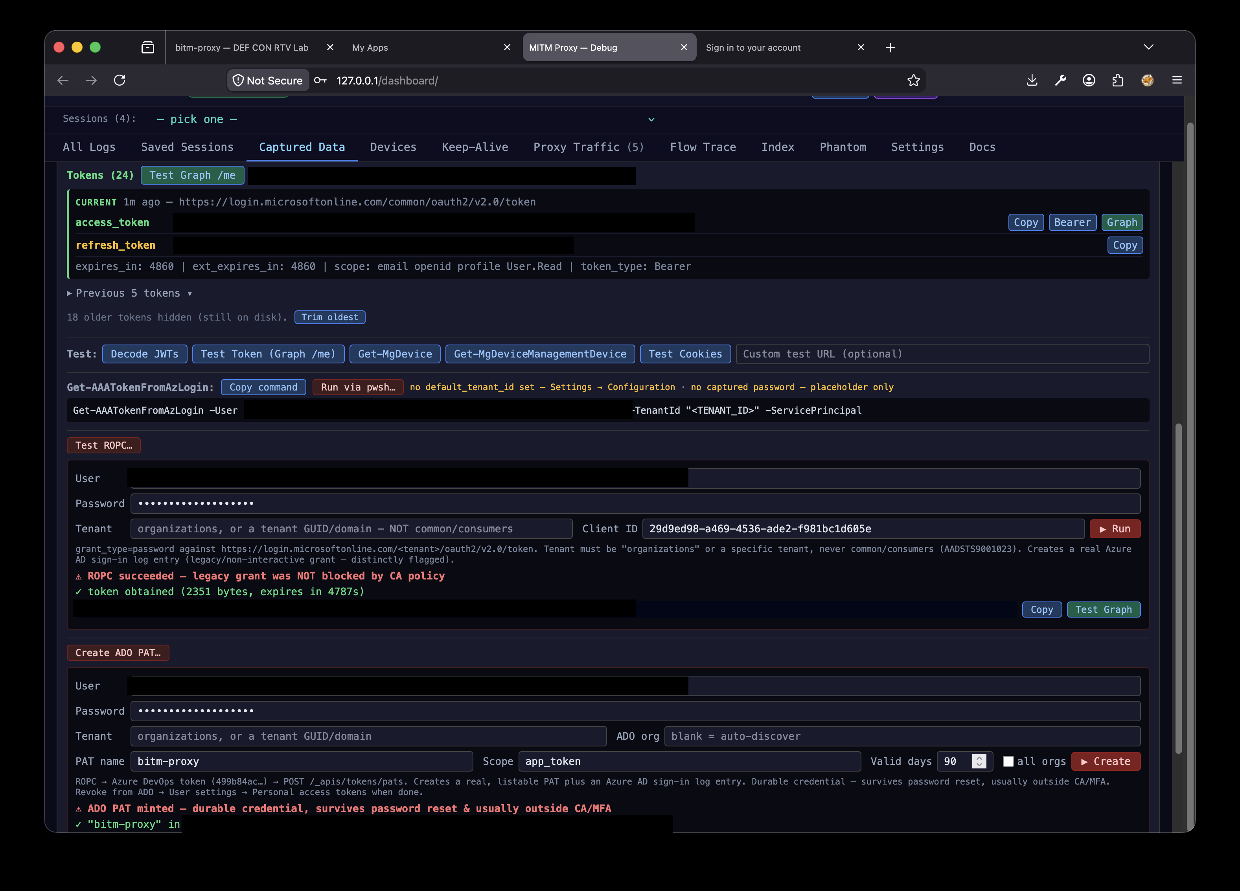
// stage 1 · capture
The session is already ours
The victim logs in normally. Grapnel's dashboard shows the captured tokens, headers, and the one-click tools built on top of them.
Captured Data — access/refresh tokens captured in-flight, with ROPC / ADO-PAT / AAA tooling ready (lab tenant, identifiers redacted)
YOUR PASSKEYS WON'T SAVE YOU
capture · 14/26

Slide 15
// stage 2 · the picker
Weakest method wins
When the method picker appears, Grapnel makes the call the policy hoped a human wouldn't.
push offered → auto-approve
Clicks the Microsoft Authenticator push tile before the user reaches for anything stronger. Number-match shows on the phone; one tap and we're through.
passkey-only → dead-end
If FIDO2 is the only completable method, Grapnel stops rather than guessing — then takes the other road: device-code.
// the point — a passkey alongside push is only as strong as the push.
YOUR PASSKEYS WON'T SAVE YOU
picker · 15/26

Slide 16
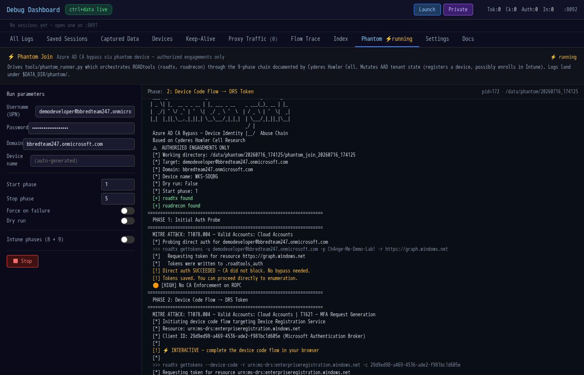
// stage 3 · device-code → DRS
Blocked at the front door, in through the side
Interactive auth is gated. The device-code grant to the Device Registration Service is not — so we take a DRS token instead.
Phantom Join phase 2 — a DRS-scoped token obtained via device code, bypassing the CA policy that blocked interactive sign-in
YOUR PASSKEYS WON'T SAVE YOU
devicecode · 16/26

Slide 17
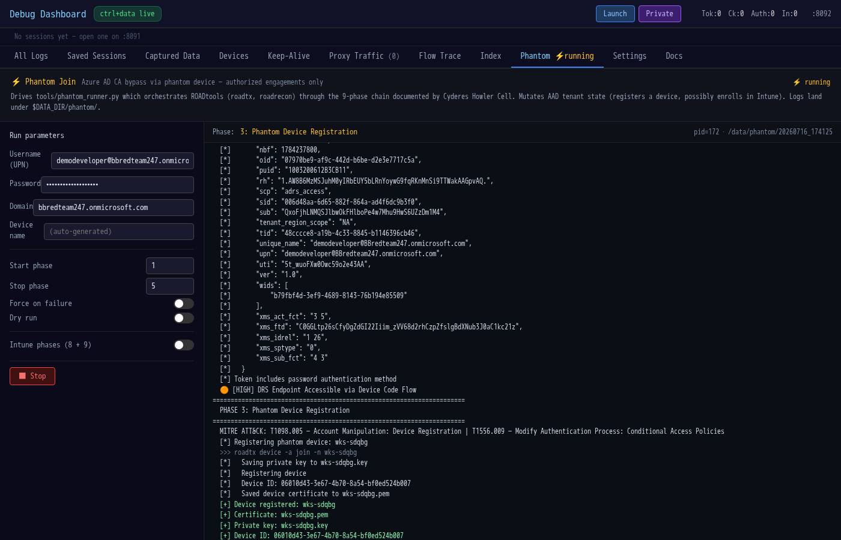
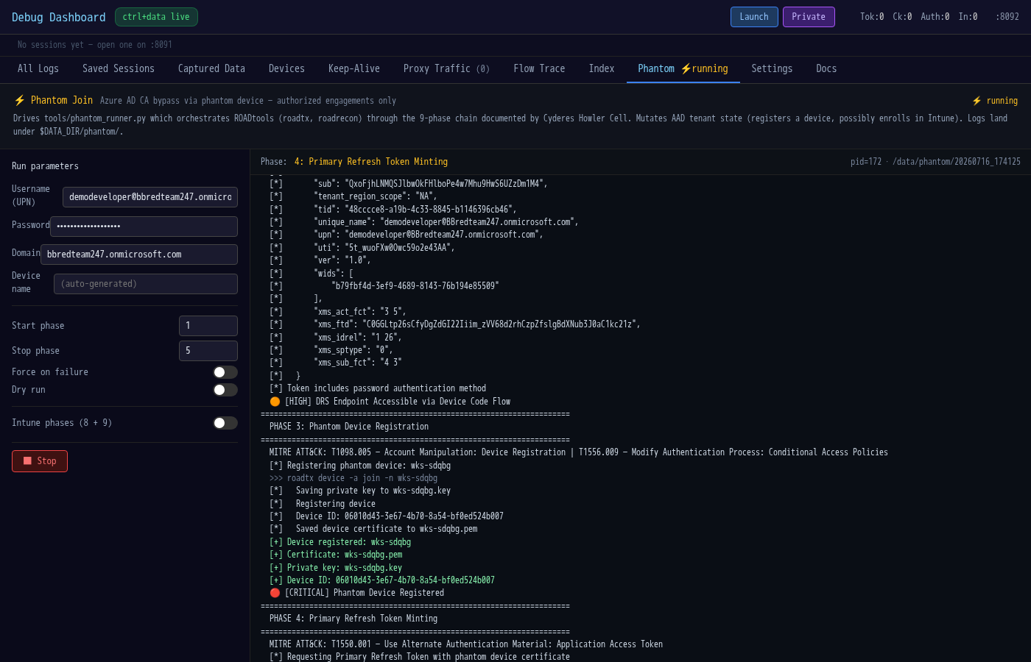
// stage 4 · phantom join
A device that never existed
The DRS token registers a phantom device — no TPM, no hardware attestation, no admin approval — then mints a Primary Refresh Token from it.
Phases 3–4 — Entra issues a real Device ID for a device that doesn't exist, then a PRT carrying device claims
YOUR PASSKEYS WON'T SAVE YOU
phantom · 17/26

Slide 18
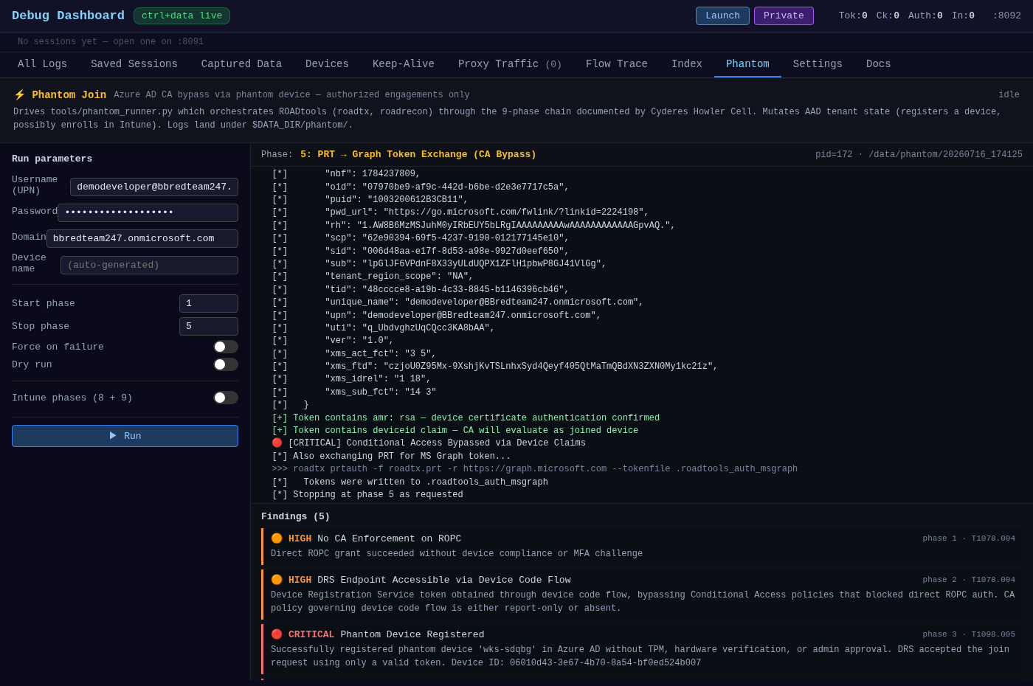
// stage 5 · the payoff
The beachhead ☠
The PRT exchanges for a Graph token with device claims — and ROPC hands us a durable ADO PAT. CA policy intent: defeated.
Chain complete — Graph token with amr=rsa + a listable Azure DevOps PAT. This is the foothold Beachhead starts from.
YOUR PASSKEYS WON'T SAVE YOU
payoff · 18/26

Slide 19
// recap · the chain
None of it needed a passkey
the chain
browser control → downgrade / device-code → phantom device
→ PRT → Graph token + ADO PAT
› The passkey guarded the interactive leg. We never used that leg.
› The device-code + DRS grant was uncovered by Conditional Access.
› The phantom device satisfied every "compliant/joined device" check.
YOUR PASSKEYS WON'T SAVE YOU
recap · 19/26

Slide 20
// detection
How you'd catch this
device-code sign-ins
Interactive sign-in logs flag authenticationProtocol = deviceCode. Rare for real users — alert on it.
new device registration
A DRS join with no TPM / no enrollment context, right after a device-code auth, is the tell.
legacy / ROPC auth
Password-grant sign-ins are distinctly flagged. They should be near-zero.
PAT creation
Azure DevOps PAT lifecycle events — especially app_token / all-orgs — are auditable and durable.
// fix — require authentication strength (not just "MFA"), and put CA on the device-code and DRS grants, not only interactive.
YOUR PASSKEYS WON'T SAVE YOU
detect · 20/26

Slide 21
// detection · from the sign-in logs
Detections beyond the obvious
What the engagement's Entra sign-in telemetry lit up — build these analytics; risk scoring missed the whole chain.
Detection | Signal — Entra sign-in log
Scripting user agents | userAgent = python-* / curl / not a real browser, to Graph/token
PRT → legacy AAD Graph | incomingTokenType=primaryRefreshToken + resource Windows Azure AD
First-party client abuse | Auth Broker → Device Registration Service; Azure CLI + ropc
Legacy AAD Graph access | resource = Windows Azure Active Directory (graph.windows.net)
Single origin, full chain | one IP/ASN: device-code + ROPC + PRT + DRS across users
MFA-required burst | errorCode=50076 on ropc / deviceCode / PRT grants
Unmanaged AAD-joined device | trustType=Azure AD joined, isCompliant=false, isManaged=false
CA not applied on key resource | conditionalAccessStatus=notApplied on DRS / AAD-Graph / ADO
ADO token → PAT | Azure DevOps token via ROPC/CLI (python UA) → PAT event
Risk scoring blind | riskState=none across the whole chain
YOUR PASSKEYS WON'T SAVE YOU
detect · telemetry · 21/26

Slide 22
// takeaways
If you remember three things
› Passkeys protect a leg, not the account. Any completable weaker method — or an uncovered grant — routes around them.
› Conditional Access must cover every grant. Device-code, DRS registration, and ROPC are where the intent leaks.
› Watch what a foothold produces. Phantom device registration and PAT creation are your loudest, most durable signals.
// and — Grapnel makes landfall; Beachhead is what happens next. See the sequel.
YOUR PASSKEYS WON'T SAVE YOU
takeaways · 22/26

Slide 23
// acknowledgements
Standing on shoulders
Grapnel is glue. The offensive weight is carried by tools and research from people who did the hard part first.
ROADtools · Dirk-jan Mollema
device-code → DRS → phantom device → PRT → tenant enum. The core of the chain. github.com/dirkjanm/ROADtools
AbuseAzureAPIPermissions · Hagrid29
the Get-AAA* Graph recon / abuse functions. github.com/hagrid29
AADInternals · Nestori Syynimaa
token & WS-Trust primitives, bundled inside AAA. @DrAzureAD
TokenTacticsV2 · Fabian Bader
token-manipulation prior art. github.com/f-bader
// technique — the phantom-join CA bypass is based on Cyderes "Howler Cell" research: "One Password, No Device, Full Tenant." Built on Playwright · curl_cffi / libcurl-impersonate · FastAPI · React.
YOUR PASSKEYS WON'T SAVE YOU
credits · 23/26

Slide 24
grapnel$ ▍
github.com/fd22vrsfpv-star/bitm-proxy
DEF CON · Red Team Village · 2025 · questions ⚓

Slide 25
// appendix
Appendix — the Entra sign-in surface
One identity plane, dozens of front doors — every portal below authenticates through the same Entra IdP, so a foothold on the auth flow reaches all of them. Full list: docs/microsoft_entra_login_sites.xlsx (60 sites).
End-user apps · 29
M365, Outlook, Teams, SharePoint / OneDrive, Power BI / Apps / Automate, Dynamics, Fabric, myapps / myaccount / mysignins…
Admin centers · 15
Azure portal, Entra admin, M365 admin, Exchange, Teams, Intune, Defender, Purview, Power Platform…
Developer & support · 9
Azure DevOps, Graph Explorer, Partner Center, VS subscriptions, Services Hub…
Entra auth infrastructure · 7
login.microsoftonline.com, login.microsoft.com, device.login…, sts.windows.net, autologon SSO — the endpoints the chain drives.
// validated — every concrete URL checked reachable; 2 stale hostnames removed, 5 tenant/org placeholders. The auth-infrastructure row is where BITM, device-code, and PRT do their work.
YOUR PASSKEYS WON'T SAVE YOU
appendix · 25/26

Slide 26
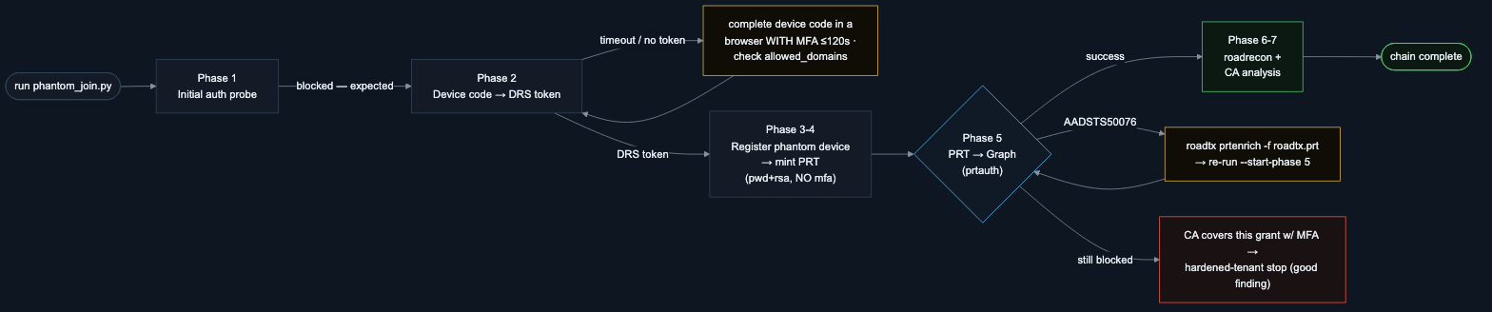
// appendix · phantom join
Phantom Join — run flow & where it stops
Phase 5 (PRT → Graph) is make-or-break: a password-minted PRT carries no mfa claim, so an MFA-covered grant refuses it (AADSTS50076) — enrich with roadtx prtenrich and re-run, or accept the stop as the finding.
// full detail — troubleshooting table + this flow in tools/README_Phantom.md. Phases 6-7 skip cleanly when Phase 5 yields no device token.
YOUR PASSKEYS WON'T SAVE YOU
phantom flow · 26/26

