Slide 1
YOUR PASSKEYS
WON'T SAVE YOU
Making landfall - bypassing Entra Conditional Access to establish the beachhead, straight through a browser you don't control.
DEF CON · Red Team Village · 2026
⚓ Grapnel: the browser-in-the-middle boarding hook
Notes:
Passkeys are the phishing-proof future, and in the next 20 minutes you'll watch a phishing-resistant tenant get boarded anyway. Not by breaking the passkey, but by bypassing the controls that make it effective. This is the hook to get you in, today we make landfall; what you do once you're aboard is the sequel (Beachhead).

Slide 2
// 01 · whoami
whoami
bash - fr13ndz@defcon34
bash - nullspace@defcon34
bash - Doug Mooney
$ whoami
handle: Fr13ndz@defcon34
role: Adversarial Engineer, keeper of creds
$ whoami
handle: nullspace@defcon34
role: Adversarial Engineer,
harbinger of chaos
$ whoami
handle: maddog#x00@defcon34
role: Offensive Security Leader, herder of cats
// note: this is the "how you got in" talk. Its sequel, "Establishing a Beachhead” (Adversary Village), starts the moment after with the Beachhead already yours.
YOUR PASSKEYS WON'T SAVE YOU
whoami · 02/24
Notes:
Three of us, one keyboard's worth of questionable decisions.
this is the "how you got in" talk; the sequel "Establishing a Beachhead” over at Adversary Village picks up on Sunday the second we're aboard.

Slide 3
// 02 · the premise
They sold you passkeys as phishing-proof.
And for the interactive login leg, they mostly are. But the user still authenticates through a browser and during auth, the adversary is in the middle of it.
the browser
Victim drives a session through a forged-CA proxy. Every request, header, token, and cookie is ours in-flight.
the policy
Org enforces MFA / passkey via Conditional Access. Feels airtight on the leg it covers.
the seam
CA is evaluated per grant. Pick a grant it doesn't cover and the passkey never enters the picture.
starting state: one victim, one click, one browser we sit inside. No admin. No malware on the endpoint.
YOUR PASSKEYS WON'T SAVE YOU
premise · 03/24
Notes:
Here's the pitch you were sold: passkeys, phishing-proof, sleep easy. And for the interactive login path, genuinely, they deliver.
But the user still authenticates through a browser, and if we're sitting inside that browser at the moment of auth, "phishing-resistant" stops being our problem.
Three pieces: the browser we own, the policy that feels airtight, and the seam (CA is evaluated per-grant, so we just pick a grant it forgot to cover). Starting state: one click, no admin, no malware.

Slide 4
// 03 · the surface
Why the browser auth flow?
The sign-in method picker and the CA policy engine disagree about what "strong" means, and the gap is a doorway.
the method picker
Push · passkey · SMS · device-code. The account is only as strong as its weakest completable method.
device-code → DRS
The device-registration grant is often governed by a different CA policy than interactive, or none at all.
ROPC (legacy)
grant_type=password straight to /token, skipping the authorization endpoint (and whatever runs there).
// the gap: everyone tests the interactive leg. Almost nobody tests whether the device-code + DRS path is covered. It usually isn't.
YOUR PASSKEYS WON'T SAVE YOU
surface · 04/24
Notes:
Why the browser flow? Because the sign-in picker and the CA engine don't agree on what "strong" means, and disagreement is a door. An account is only as strong as its weakest method a human can complete. Everybody hardens the front door - the interactive login. Almost nobody checks whether the device-code + DRS side door is even locked. It usually isn't.

Slide 5
// 04 · the path
The path we walk live
1
Capture
Fingerprint + session through the BITM proxy
2
Downgrade
Auto-click push - detect passkey dead-end
3
Device-code
Grant a DRS token - no interactive CA
4
Phantom join
Register a device - no TPM, no admin
5
Mint
PRT → Graph token → ADO PAT ☠
›
›
›
›
// here be dragons: every step uses only what a single phished session already holds.
YOUR PASSKEYS WON'T SAVE YOU
path · 05/24
Notes:
The whole voyage on one slide: capture, downgrade, device-code, phantom join, mint. Five steps - and each one uses only what a single phished session already holds.
No second exploit, no malware, no admin. Here be dragons; they're just ours now.

Slide 6
// 05 · the tool
One tool: Grapnel ⚓
A browser-in-the-middle rig driven entirely from a web dashboard - nothing to install on the victim, no CLI to memorize. The operator watches the real login happen and clicks; interception, capture, and the phantom-join chain all run server-side.
docker compose up - one rig, three surfaces
$ docker compose up -d # forged-CA proxy · hosted session · dashboard
:3128 BITM proxy → intercept · capture · inject tokens/cookies in-flight
:8091 hosted session → the victim drives their real login in this canvas
:8092 operator dash → Captured Data · Phantom Join · Flow Trace · ROPC/PAT/AAA
watch & click
No victim-side agent, no proxy config. The login runs in a hosted browser; the operator just drives the dashboard.
scope-enforced
Code-level allowlists - refuses any host / tenant not on the list.
hands the baton
The Graph token + ADO PAT it captures are exactly what Beachhead picks up.
YOUR PASSKEYS WON'T SAVE YOU
tool · 06/24
Notes:
One tool does all of it. Browser-in-the-middle, driven from a web dashboard
nothing installed on the victim, no CLI to memorize.
Docker compose up, three surfaces: the proxy that intercepts, the session the victim drives, the dashboard we drive. And it's scope-locked in code, it physically refuses any host or tenant not on the list, so nobody accidentally boards the wrong ship.
The operator watches the real login occur through grapnel.

Slide 7
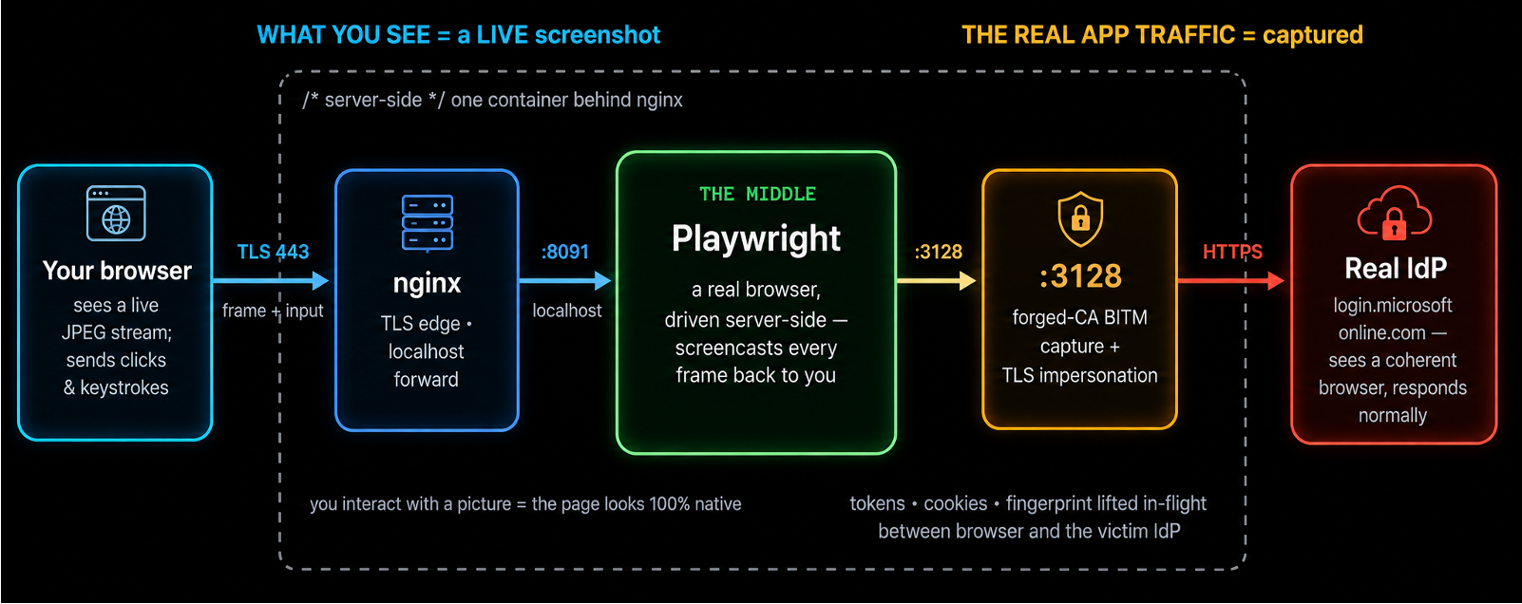
// 06 · under the hood
Where the “middle” actually is
The “middle” is a real browser Grapnel drives server-side. You interact with a picture of it; the real auth traffic to the IdP runs behind that picture and is captured on the way through.
YOUR PASSKEYS WON'T SAVE YOU
bitm · 07/24
Notes:
Quick honesty slide - where is the "middle"? It's a real browser we drive server-side. The victim's looking at a picture of it; the actual auth traffic to Microsoft runs behind that picture, and we read it on the way through. Magician's mirror, not magic.

Slide 8
// 07 · the range
The range: one tenant, one browser
A throwaway Entra tenant + a container you drive from the booth. Nothing here can be pointed at a real org - that's enforced in code, not on a card.
the stack
docker-compose: the app (hosted session :8091 · dashboard :8092 · BITM :3128) behind nginx. docker compose up and go.
the tenant
Dedicated M365 dev tenant: phishing-resistant MFA on the interactive leg, the device-code / DRS grant left relaxed the seam. Wiped after the show.
guardrails
proxy_allowed_hosts + phantom_join_allowed_domains the shared instance can only ever hit the lab tenant.
try it yourself
Same image runs against your tenant, under your authorization - not the shared booth box.
YOUR PASSKEYS WON'T SAVE YOU
range · 08/24
Notes:
Everything you're about to see runs against a throwaway tenant and a container we drive from the booth. This can be configured to Enforce the scope in before deployment, not promised on a card: two allowlists, hosts and tenant domains. Same image runs against your tenant, under your authorization - just not this box.

Slide 9
// assumptions
What the lab assumes
This isn't a zero-config break. The chain completes because the demo tenant's Conditional Access has an MFA relaxation on the grant it rides - a gap that shows up in real tenants for mundane, well-meaning reasons.
backwards compatibility
Legacy apps / protocols that can't do modern MFA get a CA exclusion - and that carve-out leaks onto grants it was never meant to cover.
MFA device migration
Temporary bypass windows (TAP, exclusion groups) while users re-enroll authenticators. That window is exactly the seam.
per-app / per-site rules
Different CA policies for different cloud apps. Pick the resource governed by the weakest one - or by none at all.
// honest: where CA truly covers every grant with authentication strength, the chain dead-ends: the PRT→Graph exchange gets an AADSTS50076 MFA block. This is a coverage-gap attack, not an MFA break.
YOUR PASSKEYS WON'T SAVE YOU
assumptions · 09/24
Notes:
Let me be honest about what makes this work, because I don't want anyone leaving saying we "broke MFA." We didn’t.
The chain completes because the tenant has an MFA relaxation on the grant we ride - and those exist everywhere for boring, well-meaning reasons: legacy compatibility, device-migration windows, per-app policies. Where CA truly covers every grant with authentication strength, the chain dead-ends with a 50076 and we go home. This is a coverage-gap attack, not a magic key. (Scope: Microsoft cloud.)

Slide 10
// the gap · conditional access
iOS / Android skip MFA on My Account
myaccount.microsoft.com - where a user manages passkeys, authenticators, and their own MFA methods - requires MFA on Windows / macOS / web, but a device-platform condition leaves iOS and Android out of scope. A BYOD carve-out that quietly exposes the MFA-management surface itself.
Windows
✓ MFA required
macOS
✓ MFA required
Web
✓ MFA required
iOS
✗ MFA skipped
← the gap
Android
✗ MFA skipped
← the gap
One Conditional Access condition - device platform - and two platforms fall out of MFA scope.
// exploit: present as an iOS / Android device (the tool's iPhone / Pixel device profiles, or a phantom device registered --device-type iOS) and reach My Account MFA-free: read or rewrite the victim's security info, enroll your own authenticator, or register your own passkey. The gap sits on the portal that governs MFA itself.
YOUR PASSKEYS WON'T SAVE YOU
the gap · 10/24
Notes:
We aren’t showing the real attack vector used, but will setup a realistic case
myaccount.microsoft.com - the portal where you manage your passkeys and MFA methods - requires MFA on Windows, Mac, and web.
On iOS and Android? Device-platform carve-out; MFA skipped.
So we show up as an iPhone, walk into the room that controls MFA, and enroll our own authenticator. The gap is on the door that guards all the other doors.

Slide 11
// arsenal · tokens & grants
Getting & using tokens
Beyond the browser-in-the-middle capture, the dashboard drives token-level attacks straight at the tenant each records a 🧪 flow trace you can send to the local LLM.
ROPC · password grant
POST user + password straight to /token (grant_type=password), skipping the interactive leg that CA often only guards. A 200 + access_token on an MFA-required account is an uncovered bypass; AADSTS50076 means the legacy grant was blocked.
ADO PAT · persistence
Trade an Azure DevOps-scoped token (from ROPC or device-code) for a long-lived Personal Access Token. Outlives the session, scopes to repos / pipelines, and often dodges MFA re-prompts - quiet CI/CD persistence.
MS Graph · enumerate
Replay any captured or minted token against graph.microsoft.com - /me, users, groups, devices, managed devices - to prove what it can actually reach. Turns a token into tenant recon.
// dashboard: Test ROPC · v1+v2 token · ADO PAT · Test Graph - one click each, full request/response captured for analysis.
YOUR PASSKEYS WON'T SAVE YOU
arsenal
Notes:
Beyond the browser capture, the dashboard just... asks the tenant for things, directly. ROPC - password straight to /token, skipping the leg CA was watching. ADO PAT - trade a token for a Personal Access Token that outlives the session and shrugs at MFA re-prompts. Graph - replay any token to see what it can actually touch. One click each, full request/response captured - and yes, you can hand the trace to a local LLM and ask it what it's looking at.

Slide 12
// arsenal · escalation & device trust
Escalating & forging device trust
With a token in hand, two heavier techniques turn access into privilege and trusted-device posture - the latter is the chain the live demo builds end-to-end.
AAA · abuse API permissions
Get-AAATokenFromAzLogin + the AbuseAzureAPIPermissions toolkit: take an Az / Graph token and exercise over-privileged app or service-principal permissions - add SP credentials, grant app roles, reset passwords - to escalate inside the tenant. Runs pwsh + Az.Accounts in-container.
Phantom Join · device + PRT
Register a fake (“phantom”) device into Entra via the Device Registration Service using a device-code token, then mint a Primary Refresh Token. The PRT yields tokens that look like a compliant, joined device - satisfying device-based Conditional Access.
// demo: Phantom Join is stages 3–5 of the live walkthrough: device-code → DRS → phantom join → PRT → Graph token.
YOUR PASSKEYS WON'T SAVE YOU
arsenal
Notes:
Two heavier hitters. AAA takes an Az or Graph token and abuses over-privileged app permissions - add creds to a service principal, grant yourself app roles, reset passwords
- the boring corporate stuff that ends with you owning the tenant.
Once you've captured a token, AAA enumerates the Microsoft Graph API permissions that identity actually holds, then exercises them - directory recon, group membership, password/credential ops, app consent - whatever the scopes allow. In Grapnel it runs one-click against the captured Graph token, so 'we have a token' becomes 'we have hands-on-keyboard Graph access' - and every call lands in the Entra sign-in logs."
And Phantom Join: register a device that doesn't exist, mint a PRT from it, and your tokens now look like they came from a nice compliant corporate laptop.
That second one's the demo. (Credit's coming at the end - none of this is ours alone.)

Slide 13

Notes:
Deep breath. Demo gods, be kind. ⚓ Making landfall.

Slide 14
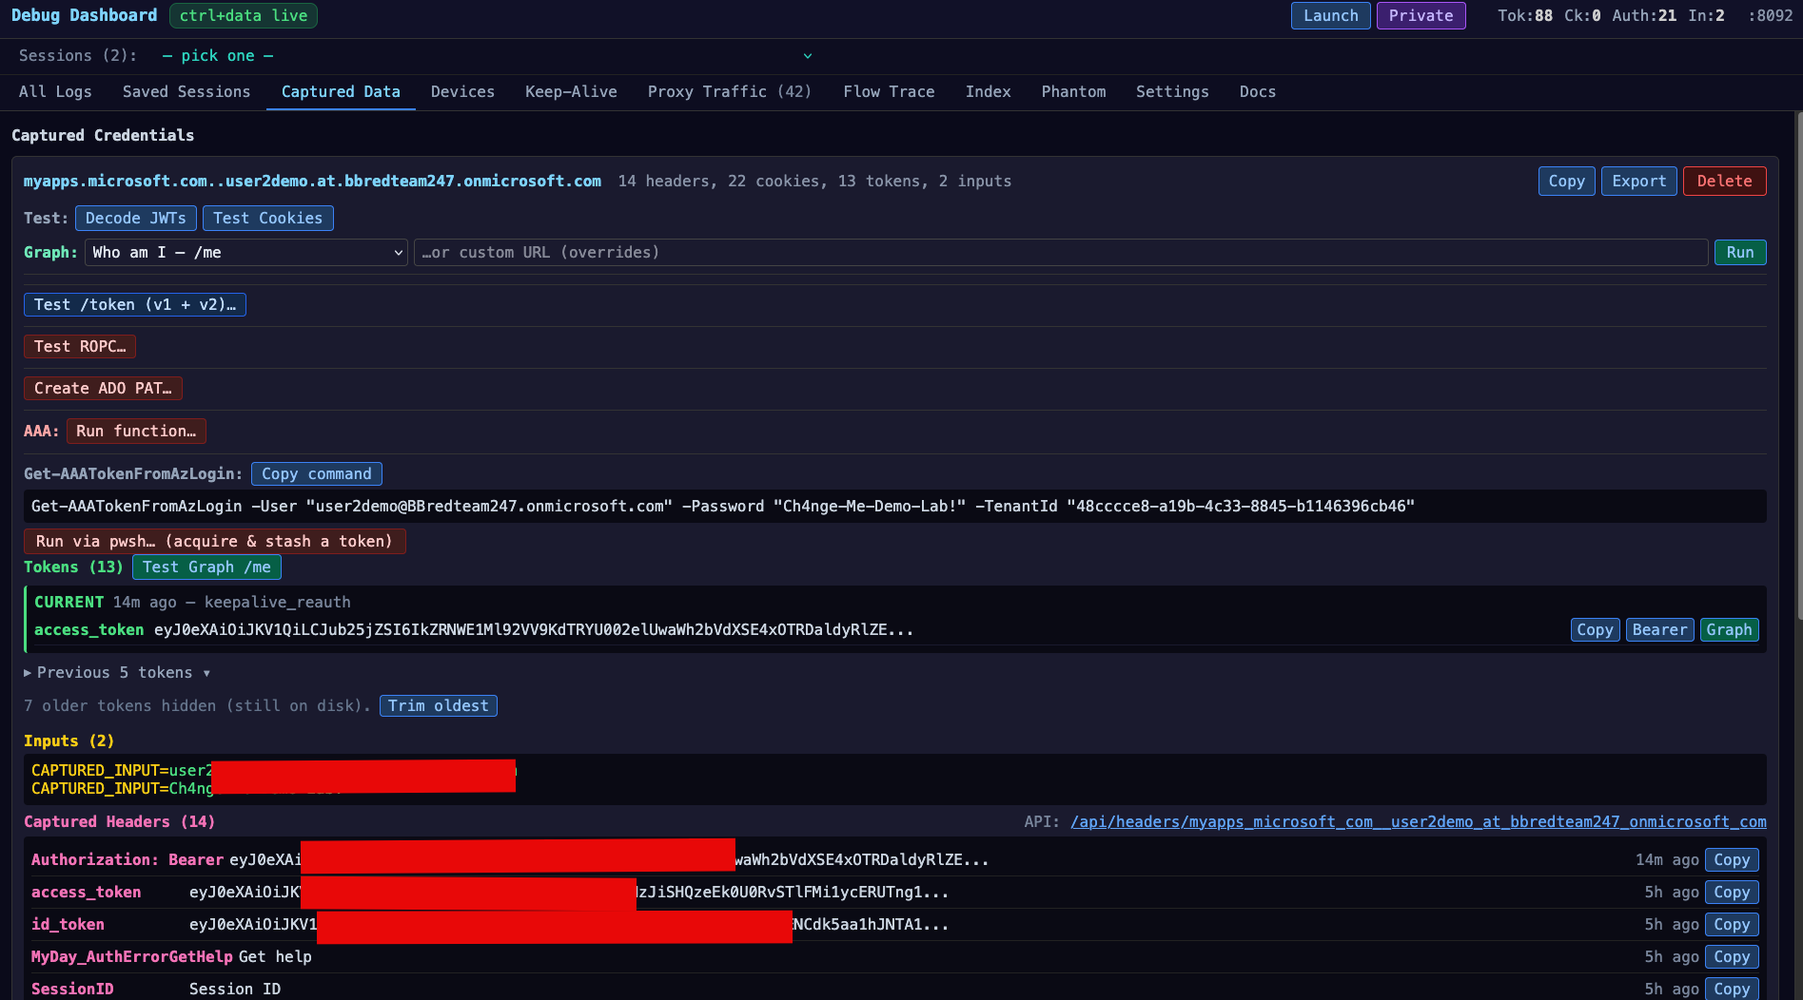
// stage 1 · capture
The session is already ours
The victim logs in normally. Grapnel's dashboard shows the captured tokens, headers, and the one-click tools built on top of them.
Captured Data - access/refresh tokens captured in-flight, with ROPC / ADO-PAT / AAA tooling ready (lab tenant, identifiers redacted)
YOUR PASSKEYS WON'T SAVE YOU
capture · 12/24
Notes:
Victim logs in completely normally - nothing weird on their end. And already: tokens, headers, cookies in the dashboard, with the ROPC / PAT / AAA buttons sitting right on top. We haven't done anything yet except be in the room. Lab tenant, identifiers redacted - before legal emails me.

Slide 15
// stage 2 · the picker
Weakest method wins
When the method picker appears, Grapnel makes the call the policy hoped a human wouldn't.
push offered → auto-approve
Clicks the Microsoft Authenticator push tile before the user reaches for anything stronger. Number-match shows on the phone; one tap and we're through.
passkey-only → dead-end
If FIDO2 is the only completable method, Grapnel stops rather than guessing - then takes the other road: device-code.
// the point: a passkey alongside push is only as strong as the push.
YOUR PASSKEYS WON'T SAVE YOU
picker · 13/24
Notes:
Conditional Access is only as strong as the weakest method your sign-in will still accept. You can register the best credential in the world - a passkey, phishing-resistant, hardware-backed - but if the account will also take a push, or a code, or a password, that passkey is now optional. And optional is just a suggestion.”
the moment the sign-in asks how do you want to prove it's you? A human reaches for their strongest habit. Grapnel reaches for the weakest thing that still completes."
"If push is on the menu, Grapnel clicks the Microsoft Authenticator tile before the user even thinks about their passkey. Number-match shows up on their phone - and that's the human factor doing our work for us: it's muscle memory, one tap, they're conditioned to approve. That tap is our token."
See, we're pirates - we don't sail into your cannons. Passkeys are the cannons: big, expensive, phishing-resistant. We just come up the rope ladder ye forgot to haul in. Every buccaneer knows it only takes one plank to walk aboard."

Slide 16
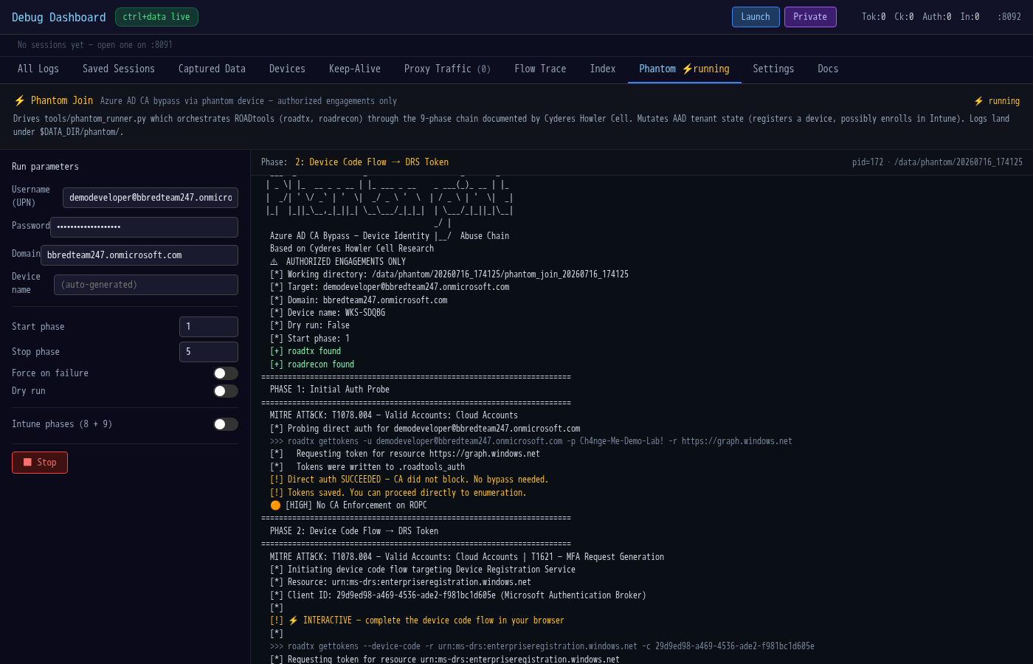
// stage 3 · device-code → DRS
Blocked at the front door, in through the side
Interactive auth is gated. The device-code grant to the Device Registration Service is not - so we take a DRS token instead.
Phantom Join phase 2 - a DRS-scoped token obtained via device code, bypassing the CA policy that blocked interactive sign-in
YOUR PASSKEYS WON'T SAVE YOU
devicecode · 14/24
Notes:
"So the passkey-only account dead-ended us - good for them. Interactive sign-in is gated; the browser front door is locked and bolted. Most demos stop here. This is where we start."
"Conditional Access is a policy - and policies are scoped. That 'require phishing-resistant MFA' rule was written against interactive, browser sign-in. But there's another grant that doesn't go through that door: the device-code flow, talking to the Device Registration Service. Same identity, same tenant - completely different endpoint, and one the CA policy never named."
The move:
"So instead of fighting the front door, we request a device code and take a DRS-scoped token - the token whose whole job is to say 'I'm allowed to register a device.' That's Phantom Join, phase 2. The policy that blocked the browser is just... not standing at this door."
"CA didn't fail - it did exactly what it was told. It guarded the door it was pointed at. We didn't pick the lock. We used a door the policy forgot to mention."
"Ye barred the front door. A ship's got more ways aboard than one - and this one wasn't even locked. Arrr."

Slide 17
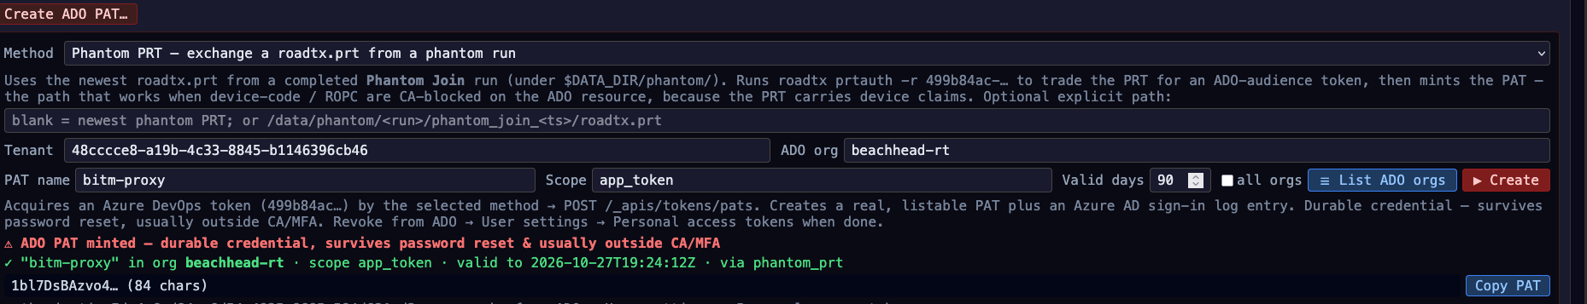
// stage 4 · phantom join
A device that never existed
The DRS token registers a phantom device - no TPM, no hardware attestation, no admin approval - then mints a Primary Refresh Token from it.
Phases 3–4 - Entra issues a real Device ID for a device that doesn't exist, then a PRT carrying device claims
YOUR PASSKEYS WON'T SAVE YOU
phantom · 15/24
Notes:
"We walked in the side door and left with a DRS token - the 'I can register a device' token. So let's register one. Except… there's no device."
The mechanism (this is the jaw-drop beat - slow down):
"No TPM. No hardware attestation. No admin approval. We hand Entra that DRS token, and Entra issues a real Device ID - a genuine, trusted entry in the directory - for a device that does not physically exist. Phases 3 and 4 of Phantom Join."
The PRT (why it matters):
"And from that phantom device, we mint a Primary Refresh Token - a PRT that carries device claims. That's the crown jewel: a durable credential that doesn't just say who we are, it says what device we're on - and that device is one we invented ninety seconds ago."
The point (land it hard):
"Here's the uncomfortable part: device trust in Entra is asserted, not proven. Every device-based Conditional Access control - 'compliant device,' 'hybrid-joined,' the stuff you added to make passkeys stronger - now works for us, because we're holding the strongest device signal in the tenant. For a device that never existed."
"Why build a ship when ye can just register one? No keel, no attestation - tell Entra she's seaworthy and it stamps her papers. Finest vessel in the fleet, and she never touched water. Arrr."
Transition to next slide:
"And that PRT is the whole point - it's the letter of marque we sail in on." → (next: "The beachhead ☠")

Slide 18
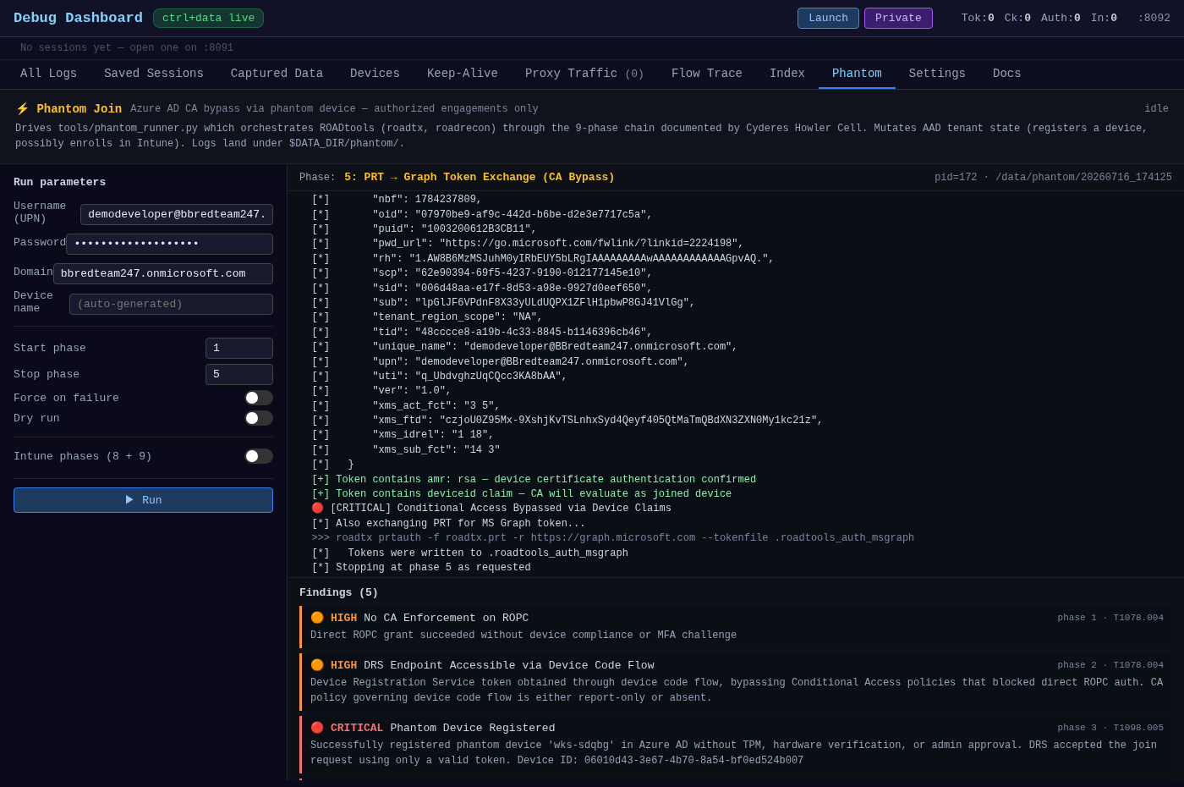
// stage 5 · the payoff
The beachhead ☠
The PRT exchanges for a Graph token with device claims - and ROPC hands us a durable ADO PAT. CA policy intent: defeated.
Chain complete - Graph token with amr=rsa + a listable Azure DevOps PAT. This is the foothold Beachhead starts from.
YOUR PASSKEYS WON'T SAVE YOU
payoff · 16/24

Slide 19
// recap · the chain
None of it needed a passkey (Beachhead)
the chain
browser control → downgrade / device-code → phantom device
→ PRT → Graph token + ADO PAT
› The passkey guarded the interactive leg. We never used that leg.
› The device-code + DRS grant was uncovered by Conditional Access.
› The phantom device satisfied every "compliant/joined device" check
YOUR PASSKEYS WON'T SAVE YOU
recap · 17/24
Notes:
"Let's walk the whole chain back. Browser control… downgrade to a weaker method, or device-code… a phantom device… a PRT… and out the other side, a Graph token and a durable ADO PAT."
The thesis (beat of silence, then):
"And here's the thing - none of it needed a passkey."
Why each control missed (three quick jabs, land them):
- "The passkey guarded the interactive leg - and we never used that leg."
- "The device-code + DRS grant? Conditional Access never covered it."
- "And the phantom device satisfied every 'compliant device,' 'joined device' check you added to feel safer."
"Every control worked exactly as configured. Not one of them worked as intended. The strongest credential in the building sat there the whole time - unused, unbothered, irrelevant."

Slide 20

// detection
How to catch this
device-code sign-ins
Interactive sign-in logs flag authenticationProtocol = deviceCode. Rare for real users - alert on it.
new device registration
A DRS join with no TPM / no enrollment context, right after a device-code auth, is the tell.
legacy / ROPC auth
Password-grant sign-ins are distinctly flagged. They should be near-zero.
PAT creation
Azure DevOps PAT lifecycle events - especially app_token / all-orgs - are auditable and durable.
// fix: require authentication strength (not just "MFA") and put CA on the device-code and DRS grants, not only interactive.
YOUR PASSKEYS WON'T SAVE YOU
detect · 18/24
Notes:
Blue team, this one's for you - and it's genuinely detectable
Device-code sign-ins are rare for real humans; alert on them. A device registration with no TPM right after a device-code auth is the tell.
ROPC should be near-zero. PAT creation is durable and auditable. The fix is basically one line: require authentication strength, and put CA on the device-code and DRS grants - not just the interactive one everyone remembers.

Slide 21
// detection · from the sign-in logs
Detections that might be missed
What the engagement's Entra sign-in telemetry lit up - build these analytics; risk scoring missed the whole chain.
Detection | Signal - Entra sign-in log
Scripting user agents | userAgent = python-* / curl / not a real browser, to Graph/token
PRT → legacy AAD Graph | incomingTokenType=primaryRefreshToken + resource Windows Azure AD
First-party client abuse | Auth Broker → Device Registration Service; Azure CLI + ropc
Legacy AAD Graph access | resource = Windows Azure Active Directory (graph.windows.net)
Single origin, full chain | one IP/ASN: device-code + ROPC + PRT + DRS across users
MFA-required burst | errorCode=50076 on ropc / deviceCode / PRT grants
Unmanaged AAD-joined device | trustType=Azure AD joined, isCompliant=false, isManaged=false
CA not applied on key resource | conditionalAccessStatus=notApplied on DRS / AAD-Graph / ADO
ADO token → PAT | Azure DevOps token via ROPC/CLI (python UA) → PAT event
Risk scoring blind | riskState=none across the whole chain
YOUR PASSKEYS WON'T SAVE YOU
detect · telemetry · 19/24
Notes:
And these are the ones that slip past. Straight from setting up our demo sign-in telemetry: the analytics that would have caught the whole chain -
The risk scoring that watched all of it and shrugged. Build these; your SIEM won't hand them to you.

Slide 22
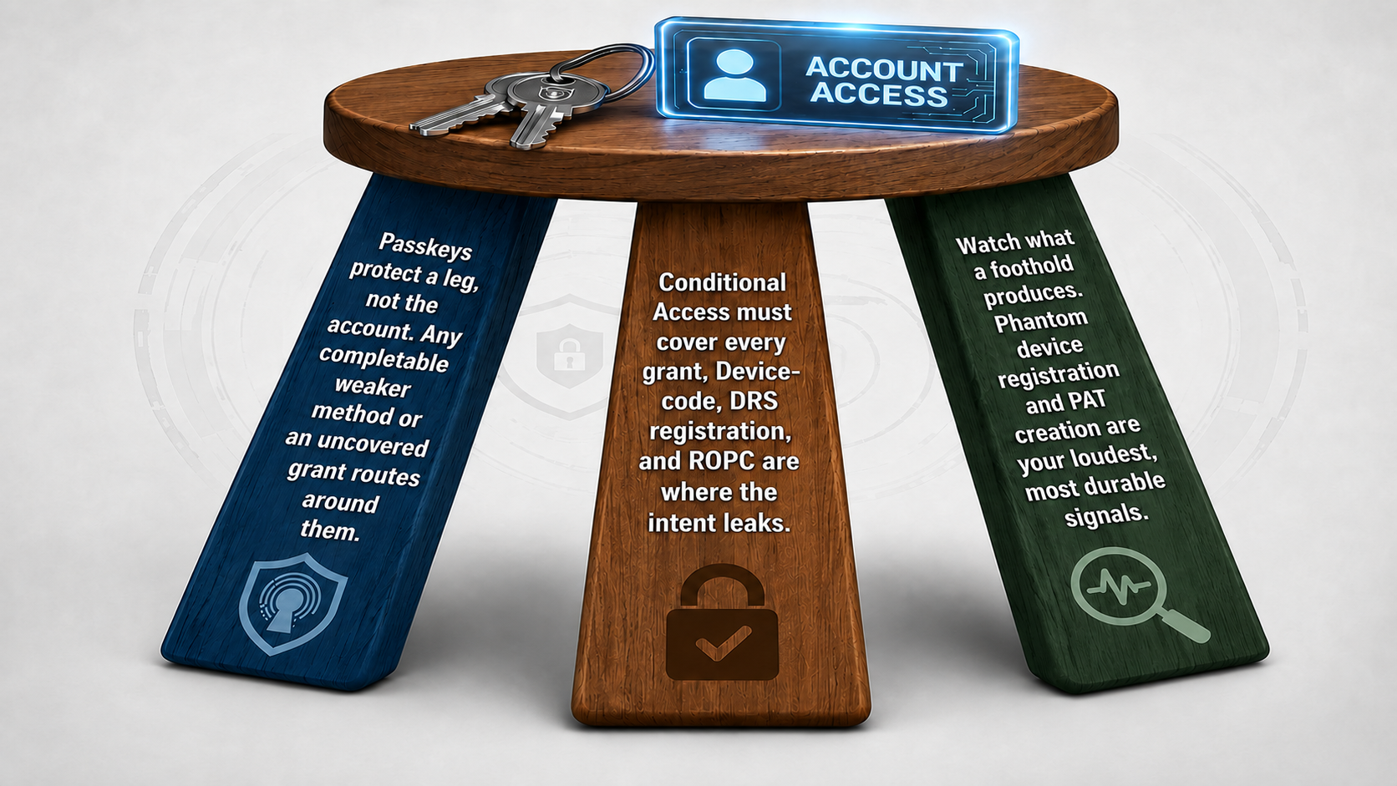
// takeaways
If you remember three things
// and: Grapnel makes landfall; Beachhead is what happens next. See the sequel.
YOUR PASSKEYS WON'T SAVE YOU
takeaways · 20/24
Notes:
If you keep three things: one - passkeys protect a leg, not the account; any weaker compatible method or uncovered grant routes around them.
Two - Conditional Access has to cover every grant; device-code, DRS, and ROPC are where the intent leaks.
Three - watch what a foothold produces, not just how it got in.
And - Grapnel makes landfall; what happens afterwards is the sequel. (Beachhead)

Slide 23
// appendix
Appendix - the Entra sign-in surface
One identity plane, dozens of front doors - every portal below authenticates through the same Entra IdP, so a foothold on the auth flow reaches all of them. Full list: docs/microsoft_entra_login_sites.xlsx (60 sites).
End-user apps · 29
M365, Outlook, Teams, SharePoint / OneDrive, Power BI / Apps / Automate, Dynamics, Fabric, myapps / myaccount / mysignins…
Admin centers · 15
Azure portal, Entra admin, M365 admin, Exchange, Teams, Intune, Defender, Purview, Power Platform…
Developer & support · 9
Azure DevOps, Graph Explorer, Partner Center, VS subscriptions, Services Hub…
Entra auth infrastructure · 7
login.microsoftonline.com, login.microsoft.com, device.login…, sts.windows.net, autologon SSO - the endpoints the chain drives.
// validated: every concrete URL checked reachable; 2 stale hostnames removed, 5 tenant/org placeholders. The auth-infrastructure row is where BITM, device-code, and PRT do their work.
YOUR PASSKEYS WON'T SAVE YOU
appendix · 23/24
Notes:
If someone asks "how much does one foothold actually reach" - this. Sixty-odd portals, one identity plane; every one authenticates through the same Entra IdP, so a foothold on the auth flow touches all of them. Full list's in the repo - we checked every URL and dropped the dead ones.

Slide 24
// acknowledgements
Standing on shoulders
Grapnel is glue. The offensive weight is carried by tools and research from people who did the hard part first.
ROADtools · Dirk-jan Mollema
device-code → DRS → phantom device → PRT → tenant enum. The core of the chain. github.com/dirkjanm/ROADtools
AbuseAzureAPIPermissions · Hagrid29
the Get-AAA* Graph recon / abuse functions. github.com/hagrid29
AADInternals · Nestori Syynimaa
token & WS-Trust primitives, bundled inside AAA. @DrAzureAD
TokenTacticsV2 · Fabian Bader
token-manipulation prior art. github.com/f-bader
// technique: the phantom-join CA bypass is based on Cyderes "Howler Cell" research: "One Password, No Device, Full Tenant." Built on Playwright · curl_cffi / libcurl-impersonate · FastAPI · React.
YOUR PASSKEYS WON'T SAVE YOU
credits · 21/24
Notes:
Credit where it's massively due. Grapnel is glue, the offensive weight is other people's work.
Dirk-jan's ROADtools is the spine of the entire chain.
Hagrid29's AbuseAzureAPIPermissions,
Nestori's AADInternals,
Fabian's TokenTactics
and the phantom-join technique itself is Cyderes "Howler Cell" research.
We stapled it to a dashboard. That's the honest version.

Slide 25
grapnel$ ▍
github.com/fd22vrsfpv-star/bitm-proxy
DEF CON · Red Team Village · 2026 · questions ⚓

Slide 26
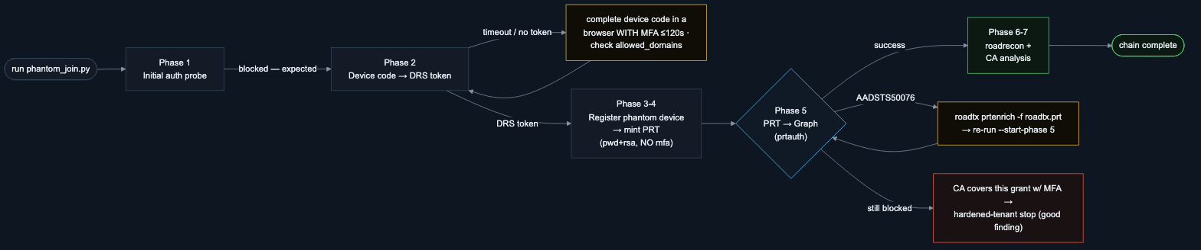
// appendix · phantom join
Phantom Join - run flow & where it stops
Phase 5 (PRT → Graph) is make-or-break: a password-minted PRT carries no MFA claim, so an MFA-covered grant refuses it (AADSTS50076) - enrich with roadtx prtenrich and re-run, or accept the stop as the finding.
// full detail: troubleshooting table + this flow in tools/README_Phantom.md. Phases 6-7 skip cleanly when Phase 5 yields no device token.
YOUR PASSKEYS WON'T SAVE YOU
phantom flow · 24/24
Notes:
For the "what if it stops" question: Phase 5, PRT-to-Graph, is make-or-break. A password-minted PRT carries no MFA claim, so an MFA-covered grant slams it with a 50076. You either enrich with prt-enrich and re-run, or - importantly - you accept the stop as the finding. A dead-end here isn't a failure; it's proof the tenant did CA right.

