Slide 1
What was the question?
What is the word frequencies of 1984, Animal Farm, The constitution and the federalist papers

Slide 2
What was the approach?
Put the books in text files
Count the word frequencies of each book
Plot the word frequencies on a graph

Slide 3
What problems did I encounter?
Making the custom graph for the extra credit in Python was challenging
Getting banned from Guttenberg

Slide 4
What results did I get?
The word frequencies of the constitution and the federalist papers are surprisingly similar
The word frequencies of 1984 and Animal Farm are surprisingly different

Slide 5
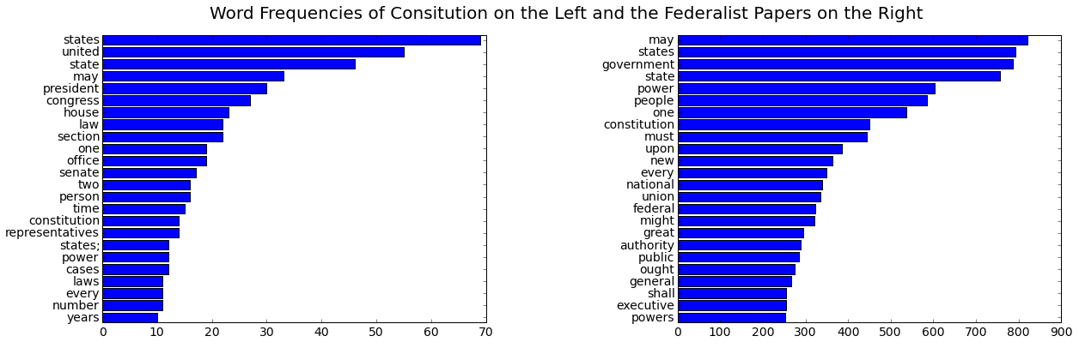
The Constitution and Federalist Papers

Slide 6
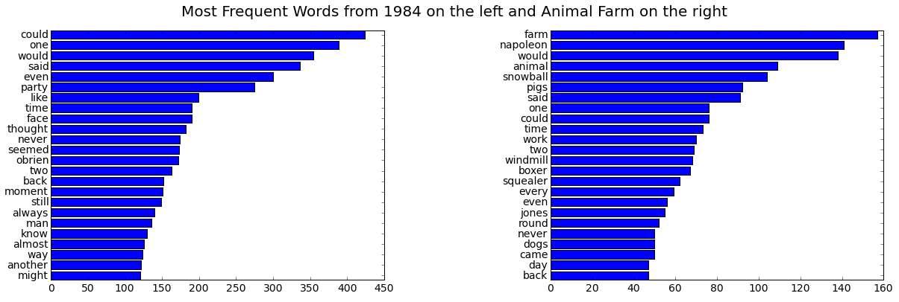
Orwell’s 1984 and Animal Farm

Slide 7
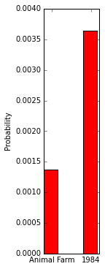
Binomial distribution of the word “Thought” in 1984 and Animal Farm

Slide 8
What New ideas did this generate?
Generating word frequencies for various things can give insight.
For example, generating the word frequencies of politicians can help assess their priorities

