Slide 1
What Make Long Term Contributors in Open Source Community
Zhou Minghui
zhmh@pku.edu.cn
Peking University

Slide 2
Outline
Motivation
Methodology
Constructing Metrics
Building Model
Validation

Slide 3















Long Term and Productive!
Open source universe desire for valuable contributors
Long Term
Productive

Slide 4


However, in Gnome and Mozilla
Over 10 years
More than 70% of contributors are One-Time-Contributors
Only 3.6% in Gnome and 0.9% in Mozilla contributors become
Long Term Contributors:
people who stay at the project for at least three years

Slide 5
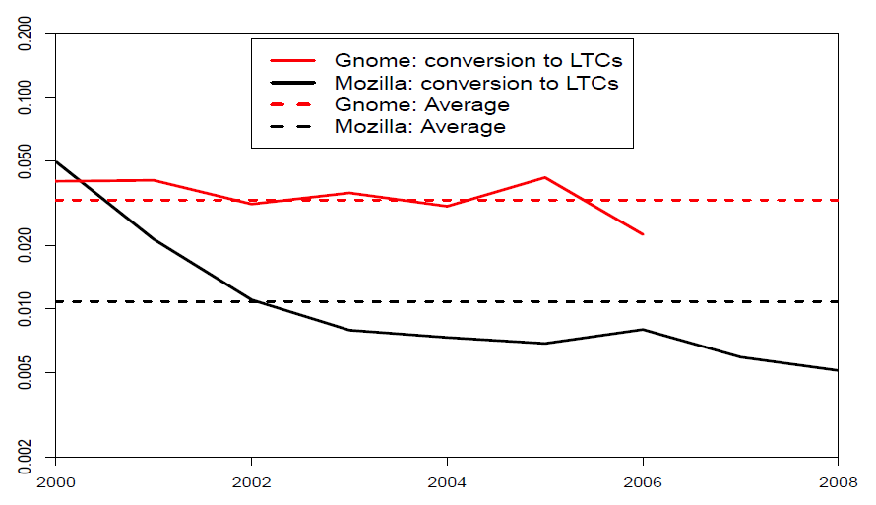
Newcomer to LTC Conversion Drops!

Slide 6
Therefore,
This raised an interesting question:
  What happened to the newcomers of the projects? Can we increase more LTCs?
We study
  Can the initial activities reveal who would stay with a project for a long time?
Practical Benefits
  May help the community to focus its limited resources on the promising newcomers (who are more likely to become LTCs).
  May help determine ways to improve the initial experiences of new contributors and may reveal an explicit path to train and retain new contributors until they become capable of solving complicated tasks effectively and accurately.

Slide 7
Outline
Motivation
Methodology
Constructing Metrics
Building Model
Validation

Slide 8
Workflow of an issue in Bugzilla
Brant@gurganus.name
2002/04/02
Report
bugzilla@iwaruna.com
...
Change Status
bugzilla@iwaruna.com
...
Comment
Mozilla-06@oliverklee.de
…
Change Status
Wolruf@gmail.com
2002/04/02…
Modify OS
myk@mozilla.org
2004/11/22
Modify Product
Activity traces in workflow, are a record of people’s behaviors, and therefore, are likely to reflect people’s characters
The climate of a project is determined by participants’ behavior, and therefore, are likely to be reflected by issue traces
Notes:
134821;-1;brant@gurganus.name;1017687900;reporter;VERIFIED;DUPLICATE
134821;c0;brant@gurganus.name;1017738305;cmt;Brant Gurganus;483
134821;0;wolruf@gmail.com;1017738489;OS;Windows XP;All
134821;1;wolruf@gmail.com;1017738489;Hardware;PC;All
134821;c1;wolruf@gmail.com;1017738489;cmt;Olivier Cahagne;19
134821;c2;brant@gurganus.name;1017740723;cmt;Brant Gurganus;32
134821;2;mozilla-06@oliverklee.de;1017742595;Status;NEW;RESOLVED
134821;3;mozilla-06@oliverklee.de;1017742595;Resolution;---;DUPLICATE
134821;4;mozilla-06@oliverklee.de;1017742595;Summary;ability to resume
downloads;[RFE] ability to resume downloads
134821;c3;mozilla-06@oliverklee.de;1017742595;cmt;Oliver Klee;66
134821;5;bugzilla@iwaruna.com;1029907236;Status;RESOLVED;VERIFIED
134821;c4;bugzilla@iwaruna.com;1029907236;cmt;sairuh (rarely reading
bugmail);137
134821;9999;bugzilla@iwaruna.com;1101122708;qa_contact;VERIFIED;DUPLICATE
134821;6;myk@mozilla.org;1101173108;Product;Browser;Seamonkey
Activity traces in workflow, are a record of people’s behaviors, and therefore, are likely to reflect people’s characters
Each event has an associate date, time, the type of action, and the email/name of the developer performing the action.
Issue traces reflect the climate of the project at any specific time
The climate of a project is determined by participants’ behavior
Issue workflow could measure the social communications between people in projects
Issues are a typical example of the artifact-mediated communication: the person receiving the issue needs to go through the work done by her predecessor in order to contribute herself.

Slide 9
Methodology: data-driven analysis
Based on six snapshots: whole extract of Bugzilla data
Learn what was going on
  Read issues of 40 contributors (20 non-LTCs/20 LTCs)
  Survey 56 (36 non-LTCs and 20 LTCs)
  Extract practices published on project web sites
  Review research literature
Measure discovered factors via activity in Bugzilla
Fit models of future LTCs
Validate
  Predict future LTCs
  Conduct Survey on 240 Mozilla/Gnome participants
Interpret, consider practical implications, future

Slide 10
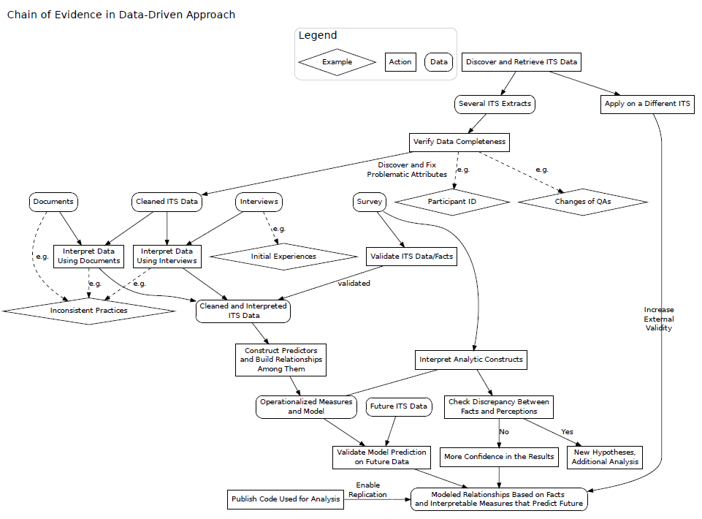

Slide 11
Outline
Motivation
Methodology
Constructing Metrics
Building Model
Validation

Slide 12
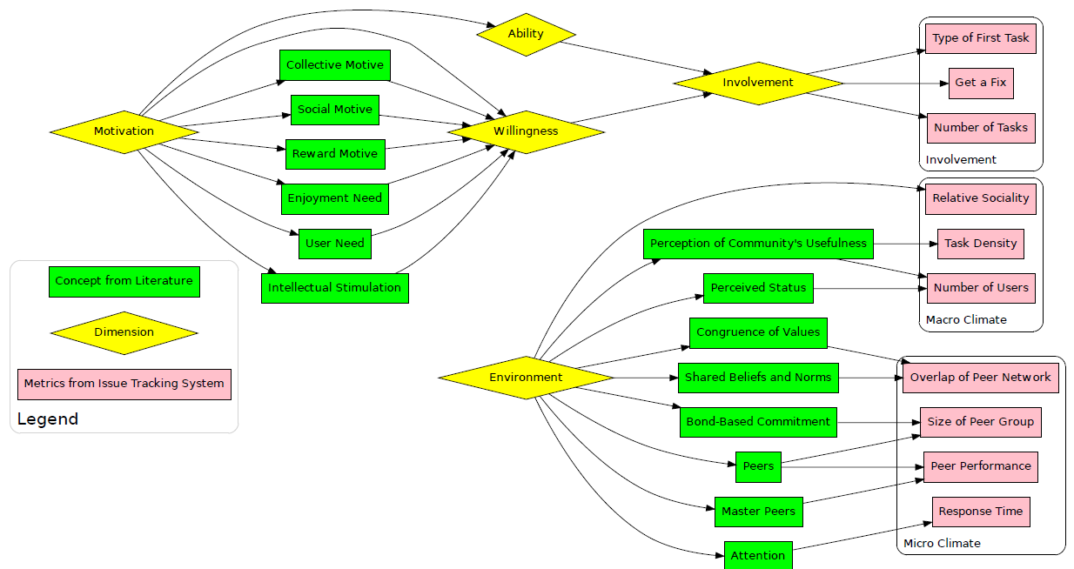
Metrics Derived from Bugzilla

Slide 13
Ability/Willingness distinguishes LTCs
Numbers and types of tasks
  Non-LTC: ”I don’t have enough time/knowledge to resolve issues by myself”, provide minimum information necessary to report, don’t respond to requests for information
  LTC: “Patch to get access attributes for nested class/struct/union”
  LTCs had higher response rate (Fisher’s-test p-value=0.07)
Willing to spend more effort on tasks
  “If I want the bugs to go away, I have to be willing to note the bugs.”
  “If you have faced a bug, you need to spend effort to describe it... to check for duplicates... to create report... to wait until response.”
  “All time you are waiting you must keep an issue in mind.”
  “After [the] initial response there is [a] good possibility that devs can’t or don’t want to reproduce the issue and you must know how to [do] diagnostics and how to prove that issue really exists.”

Slide 14
Environment determines people’s fate
Macro-climate: same for everybody
  Popularity:
  “GNOME is something which you can show to your friends and family members”
Micro-climate: specific to each individual
  Attention, Number of peers, Performance of peers
  “With bugzilla, ... the feedback from the developers shows that they care, and appreciate the effort I made, and actively work to solve the bug in a way that I can see progress.”
  “As I met a lot of nice people at GUADECs who became friends there was also a personal component involved in the motivation.”
  “I learned a lot from this leading open source project while working with other contributors”

Slide 15
Measures of Ability/Willingness and
Environment
Observation I: Ability/Willingness can be measured via
  The volume and the type of tasks
  The effort spent on tasks
Observation II: Environment can be measured via
  Macro-climate (shared among participants)
    Project’s popularity
    Project’s relative sociality
  Micro-climate (unique for each person)
    Number of peers
    Peers’ productivity
    Peers’ social clustering
    The attention received from peers

Slide 16
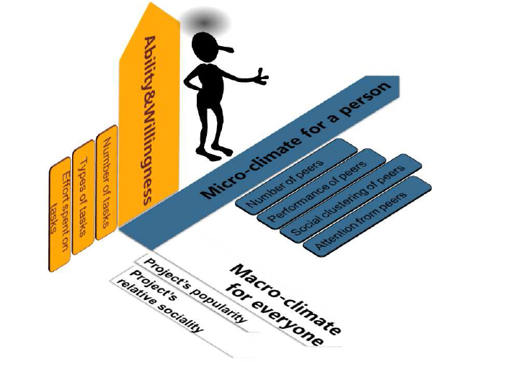
Three Dimensions

Slide 17
Logistic Regression Model for LTCs
isLTC ~ nUsr + RS + GotFix + BtE
+nCmt + nPeer + pShared
+LckAttn + PeerPerf + prj

Slide 18
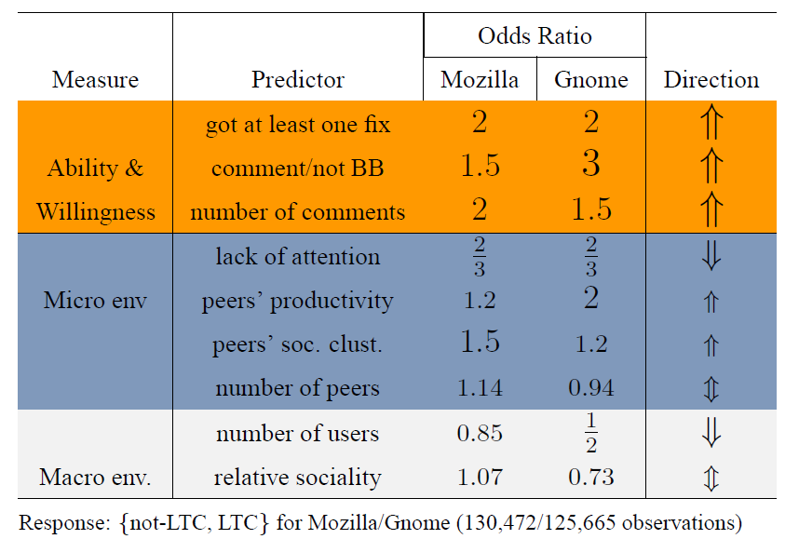
Logistic regression model for LTCs

Slide 19
Who will become an LTC?
Actions in the first month predict LTCs
  Pro-community attitude has the greatest positive effect
    The choice to start by a comment for an existing issue
    Effort spent to improve the quality of issue reporting
  Bad environment deters via
    Macro-climate of high project popularity
    Micro-climate of low attention
  Good environment attracts via
    Micro-climate of peer performance and
    Micro-climate of peer social clustering

Slide 20
Outline
Motivation
Methodology
Constructing Metrics
Building Model
Validation

Slide 21
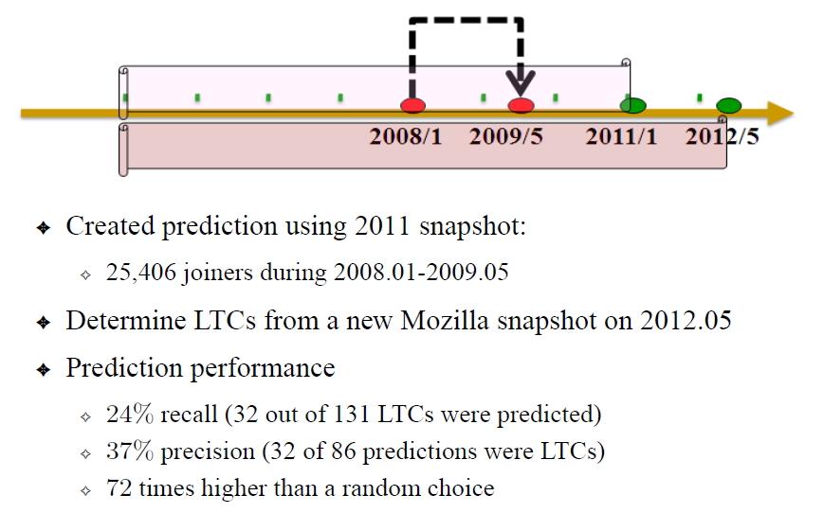
Can we predict future LTCs?
Predict future using a new Moz extract

Slide 22
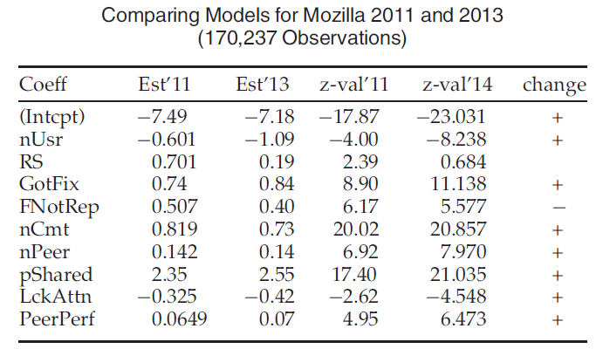
Can we reproduce the model?
Reproduce the model using Mozilla dump

Slide 23
Conduct a survey to validate analytic constructs
Sampled 240 participants
Carefully designed questions
Customized emails for every individual
71 could not be delivered, and 29 responses were usable for our analysis
  One unusable response: “Given that you call GNOME an OSS project, i don’t think I want to participate. GNOME is a free software project.”

Slide 24
Limitations
Three snapshots for Gnome data and three for Mozilla
Sensitivity analysis using various operationalizations
  Full email was not available for post-2008 Gnome
  Person to ID (email) changes over time
Variation in operationalizations
  BugBuddy in Gnome vs start from a bug report in Mozilla
Do measures capture the right concepts: e.g., peer clustering
Should relationships be in the observed direction: e.g. project popularity is bad?
Are Gnome and Mozilla projects representative?

Slide 25
Summary of Contributions
Methodology
  Measure individuals’ attitudes and emotional dispositions from digital traces of their activity
Science
  Models of project success show largest effects brought by soft qualities, such as willingness
Software practice
  Projects: particular attention for new contributors
  Newcomers: deeds matter, not intentions, limit expectations
Future and Reproducibility
  Implications for OSS and commercial development practices and non-software domains
  https://www.passionlab.org/projects/developerfluency.html

Slide 26

People behave differently when joining!
More productive peers
More attention from community
Micro-climate
Starting from attaching a fix
Spending more effort getting a bug fixed
Macro-climate
Product more popular
Willingness
Ability
Taking more tasks

Slide 27
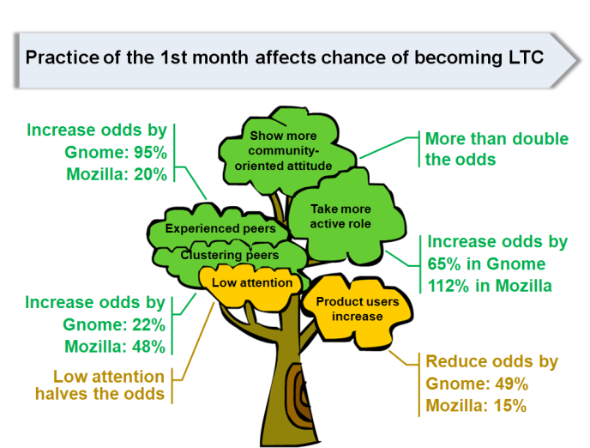
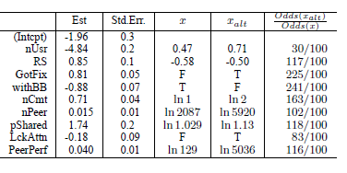
Logistic regression model for LTCs

