Slide 1
Measure of Influence
Kapil Agrawal, Sadika Amreen, ChunyAN TANG

Slide 2
Measure Quality of Comments
nUC = Number of Unique Comments
nTc = Total Number of Comments
nQC = Quality of Comments
For each repository:
nQC = nUC / nTC
A higher ratio indicates:
→ good quality of comments because
→ there are more unique comments
→ comments are updated frequently during commits

Slide 3
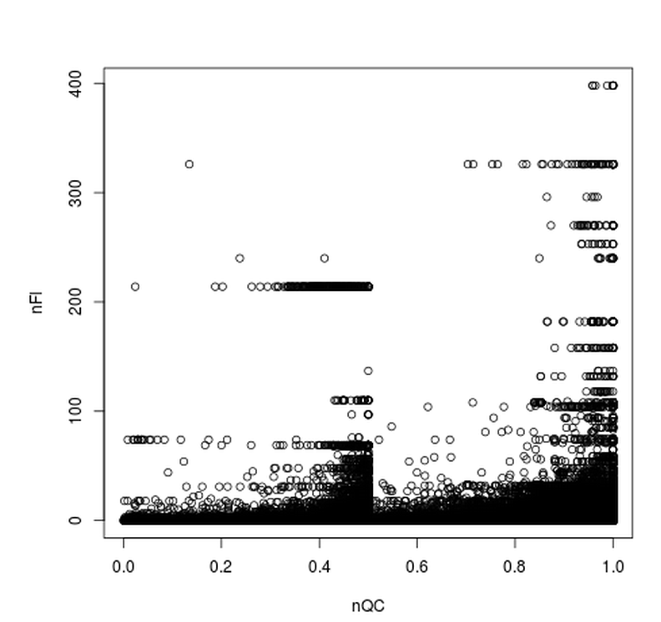
No. of Followers VS Comment Quality

Slide 4
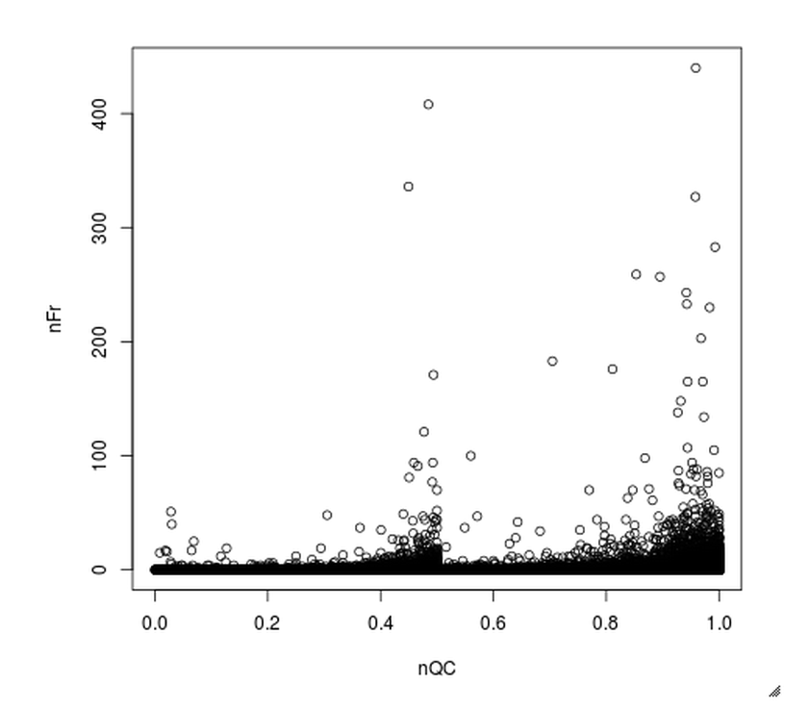
Number of Forks VS Comment Quality
Outlier with max of nFr = 5153 removed

Slide 5
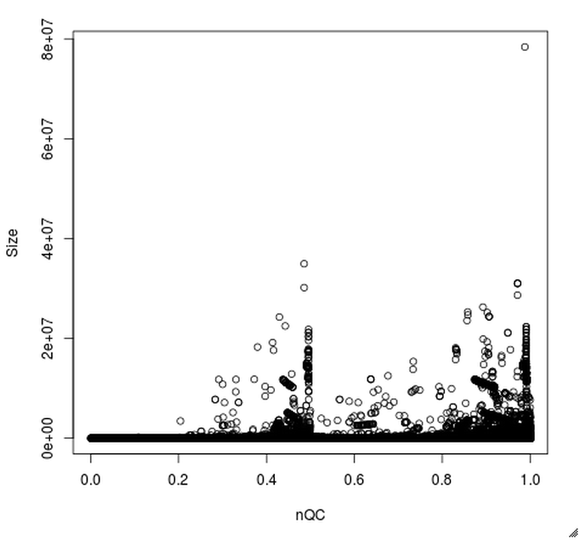
Size VS Comment Quality

Slide 6

Delta VS Comment Quality
Delta defines the number of files changed during a single commit

Slide 7
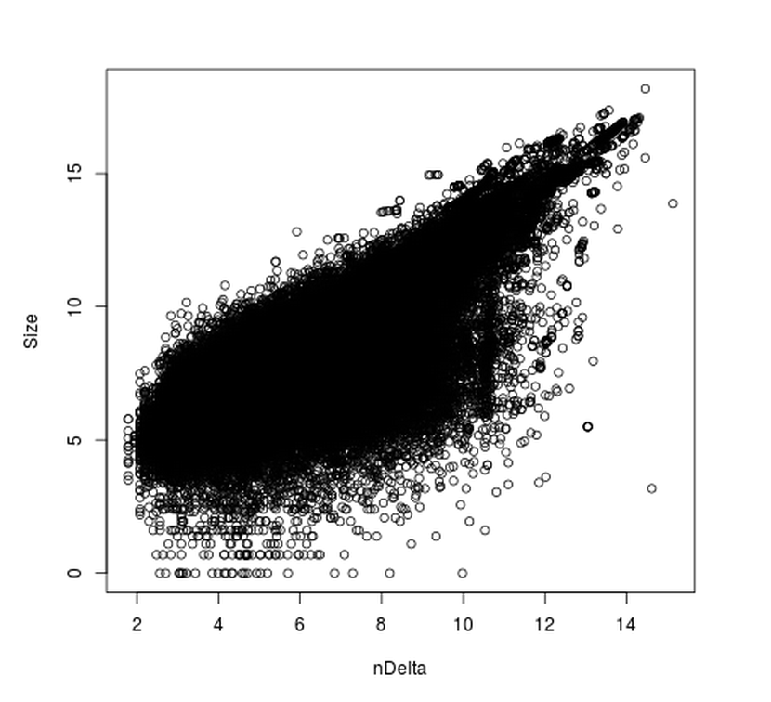
Size VS Delta
Plotted after converting the data to a logarithmic scale
Plot shows strong positive correlation between nDelta and Size
Size defines the size of comments
Delta defines the number of files changed during each commit
Intuitively, we expect to see this correlation since the size of the comments should increase with increasing number of files committed to a repository

Slide 8
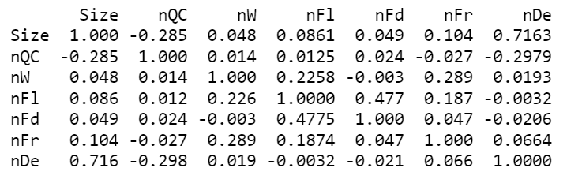
Correlations between measures
Size → Comment size
nQC → Comment Quality
nW → No. of Watchers
nFl → No. of Followers
nFd → No. of Followed
nFr → No. of Forks
nDe → Delta

Slide 9
Interpreting results
The negative correlation between Quality of Comments and Size
→ Quality of Comments tend to fall when the Size of comments is large
The negative correlation between Quality of Comments and Delta
→ Quality of Comments tend to fall when there are more files changed per commit
The strong positive correlation between Size and Delta
→ Combined with the previous results, backs up that both Size and Delta influence Comment Quality

Slide 10
Inference & Discussion
When the size of a comment gets larger, people may be more reluctant to change the comment and may prefer to use the same comment for a new commit
When there are a large number of files changed in a single commit, a single comment is used for that commit

