Slide 1
Analysis of BitBucket Users
Team 3
Mark Carringer, Sam Kavkewitz, DJ Rose

Slide 2
Problem
Perform a competitive analysis of BitBucket
Userbase
Version control system
Programming language
Keywords

Slide 3
Methodology
BitBucket API
Search for all repositories returns a paginated list
Iterate through the pages of the list and keep applicable values
API only returns public repositories, so inference cannot be made about the quantity or characteristics of private repositories.

Slide 4
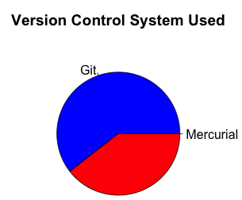
BitBucket Users
Users: 190,310 Repositories: 417,336
Median repos/user: 1

Slide 5
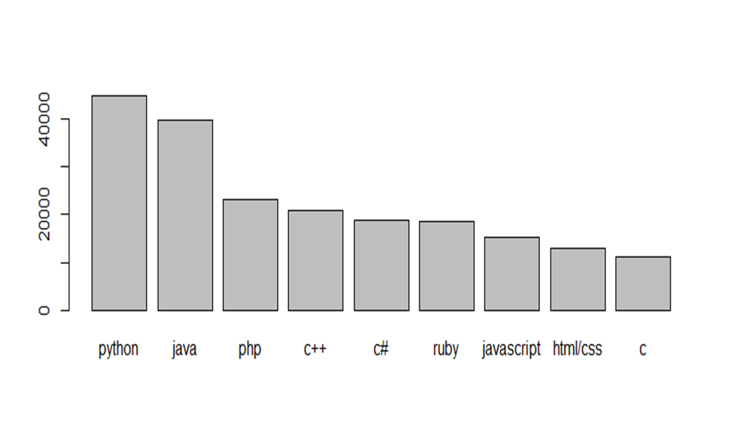
Programming Languages.

Slide 6
Subject Areas

Slide 7
“Google”

Slide 8
Additional Considerations
No access to private repositories
Significant number of missing values for programming language analysis
Language and description as specified by user may not be accurate

