Slide 1
Influence
Chris, Josh, DJ

Slide 2
Measures of Influence
Quality Repos
Any repo with 4 or more forks
Contributions
Repos to which a user has at least one commit

Slide 3
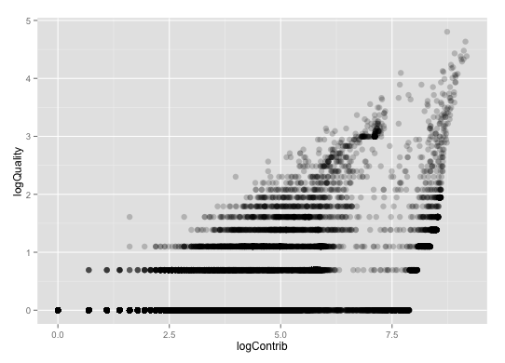
Contributions vs Quality

Slide 4
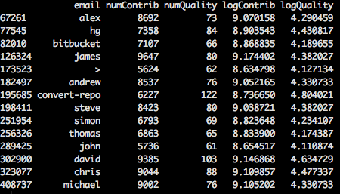
Influential Users

