Slide 1
Final Project: StockSentimentAnalysis
by Reazul Hoque, Miller Moore,
Curtis Wilkerson, and Mitchell Wade

Slide 2
Presentation Overview
Project Plan
Project Execution
Example Slides to Highlight Process
Model Evaluation
Conclusions

Slide 3
Project Plan
Meet remotely using email/GitHub and also scheduled meetings to work in parallel
Use the Git docker and GitHub via the browser for python/R notebooks
Develop web crawler to scrape stock-related tweets from Twitter
Once enough historical tweets obtained, score sentiment per stock per day using nltk
Aggregate past sentiment in different ways (e.g., last day’s score, prior week’s mean score, prior month’s std dev of scores, etc)
Apply a data mining algorithm to assess whether aggregate sentiment predictors can adequately forecast a future price movement (i.e., if(Price_t+h/Price_t) > 1,1,0) )

Slide 4
Project Execution
As a proof-of-concept for reality, built a web-scraper to grab tweets from Twitter's webpage
Obtained permission from StockTwits based on academic research to use all 2014 tweets
Actually used the 2014 StockTwits data provided as a JSON file (~12GB)
Processed JSON file to extract tweets and score sentiment
Only used tweets from largest 50 stocks from the NYSE
Scored each tweet using the nltk sentiment utility as positive= 1, negative=-1, and neutral=0
Aggregated these scores by summing by day, by stock
Output the above as a matrix with dates as rows, stocks as columns, and scores in cells (to csv)
Imported the csv file into R for modeling
Created additional aggregated features of sentiment scores (as explained in the prior slide)
Combined those features with the response variable (as explained in prior slide)
Used a random forest algorithm in classification mode to determine whether sentiment is able to explain forward price predictions
Performance evaluated on successive rolling windows (using ROC curves and chi-square tests on predicted vs actual tables)

Slide 5

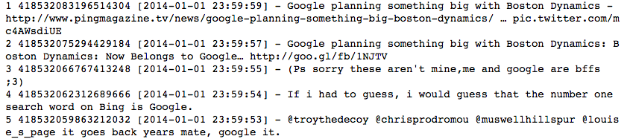
Twitter Scraper

Slide 6
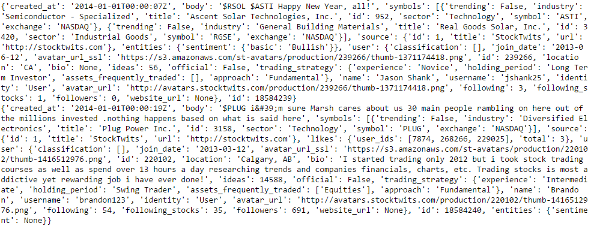
Example: Raw JSON File with Tweets

Slide 7
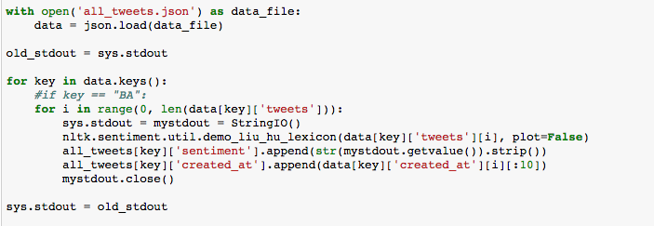
Tweet Processing and Sentiment Scoring Code

Slide 8
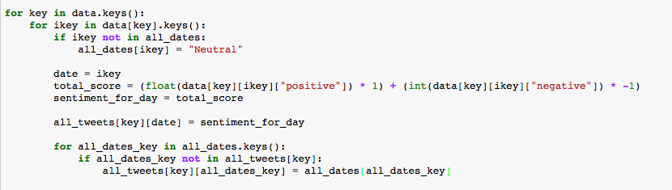
Tweet Processing and Sentiment Scoring Code

Slide 9
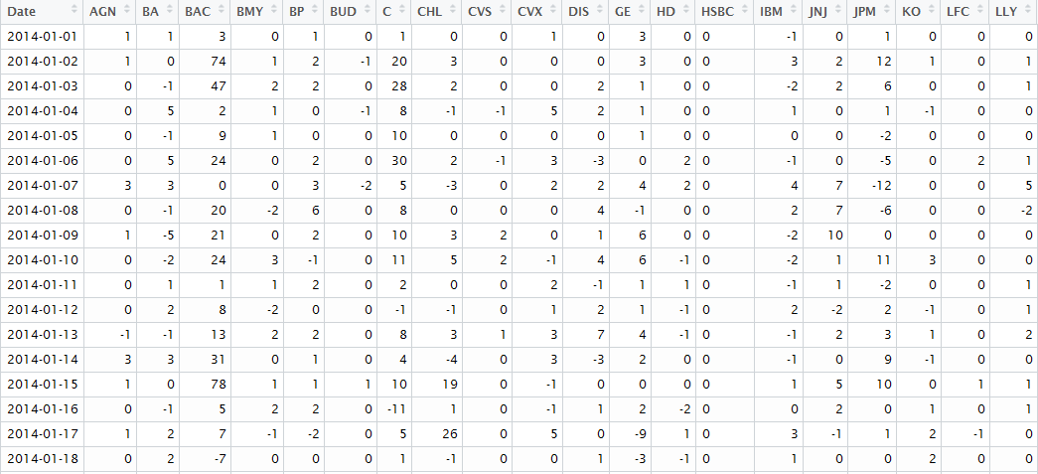
Example: Stock Matrix of Scores (Output from JSON Tweet Processing)

Slide 10
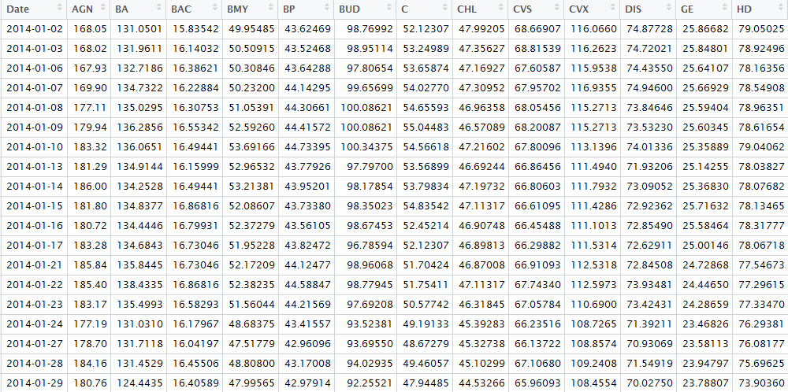
Example: Adjusted Closing Prices by Date

Slide 11
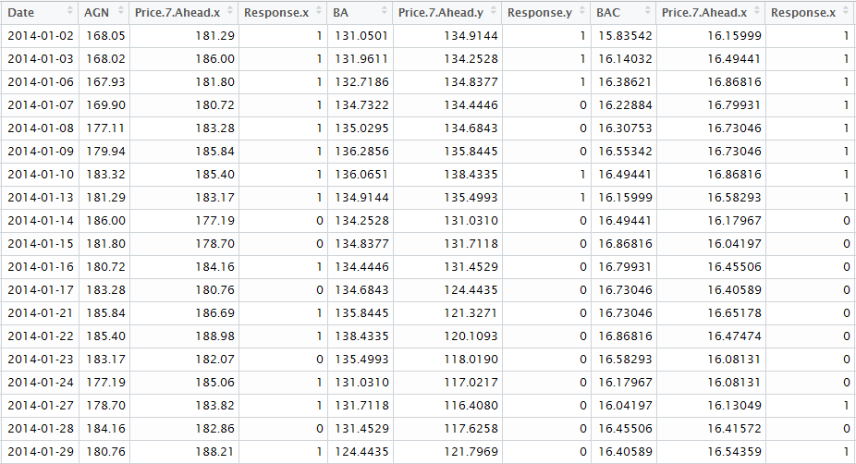
Example: Response Variables

Slide 12
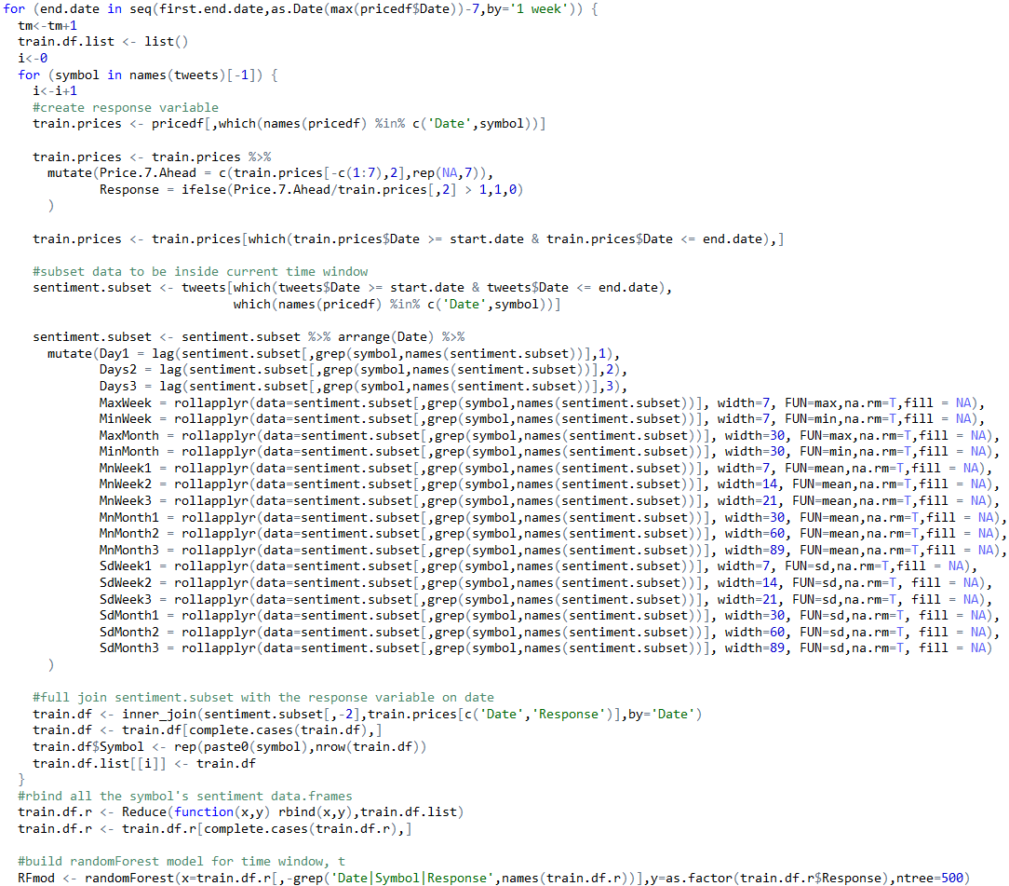
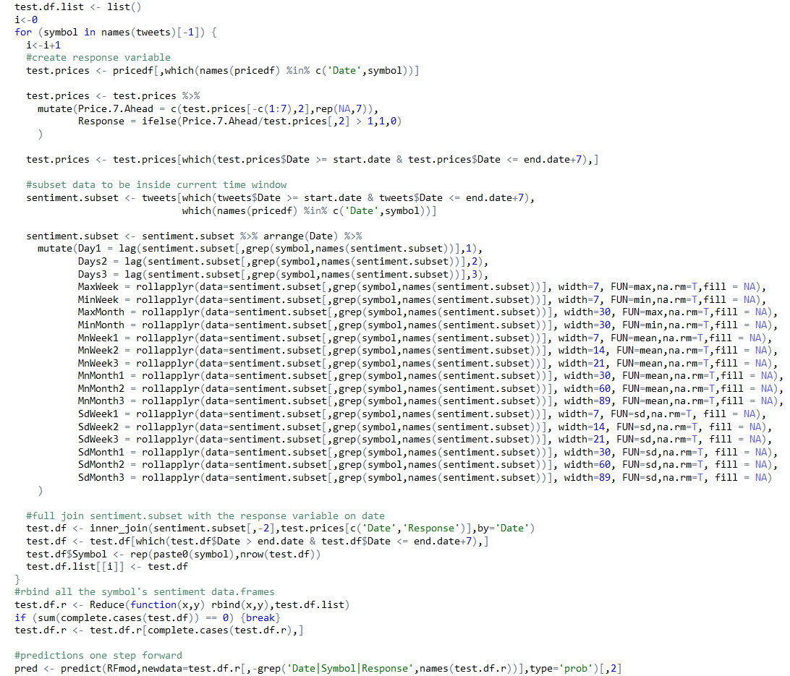
R Code for Training and Testing

Slide 13
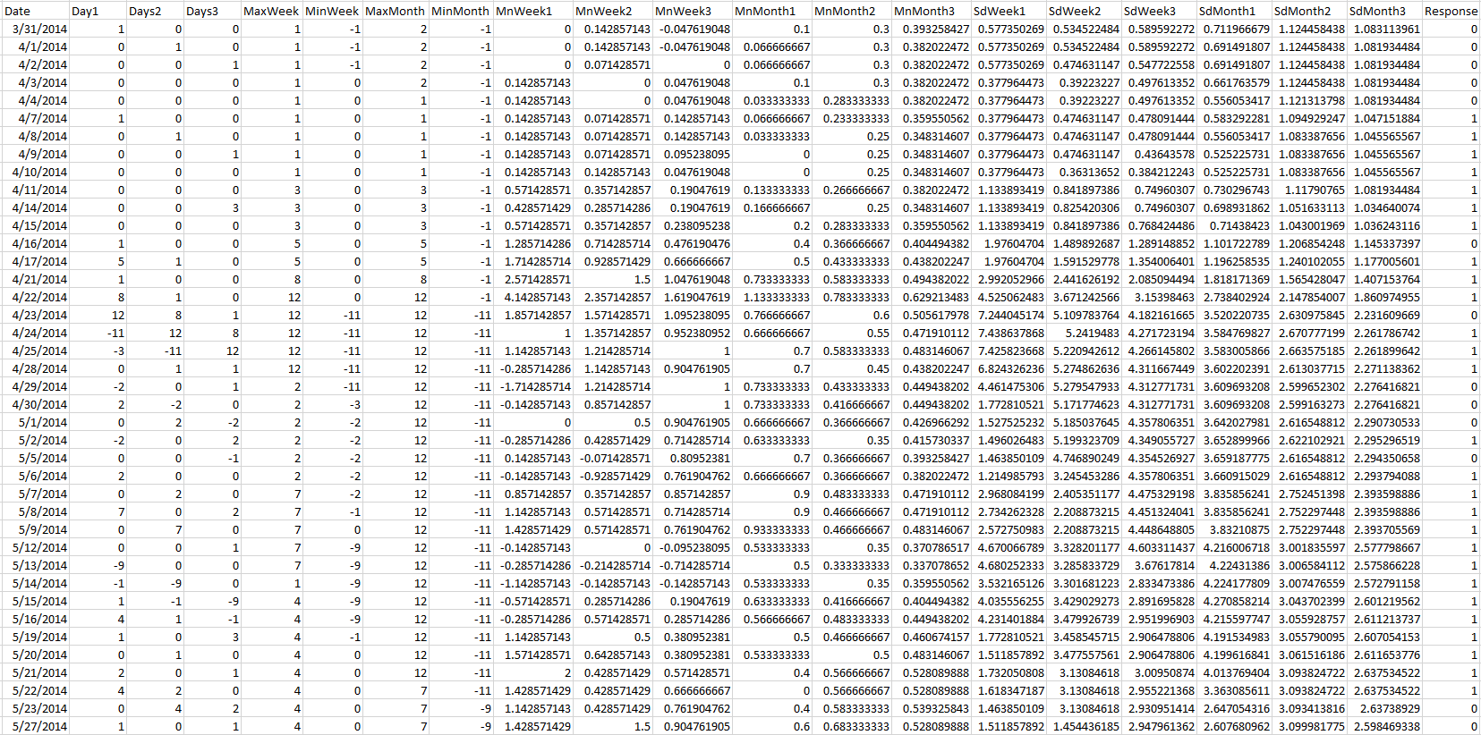
Example: Training Basetable (Variables Only Consist of Aggregations of Prior Sentiment Data)

Slide 14
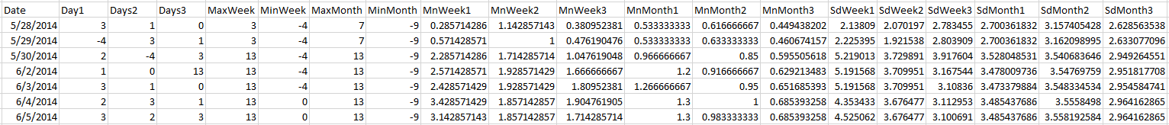



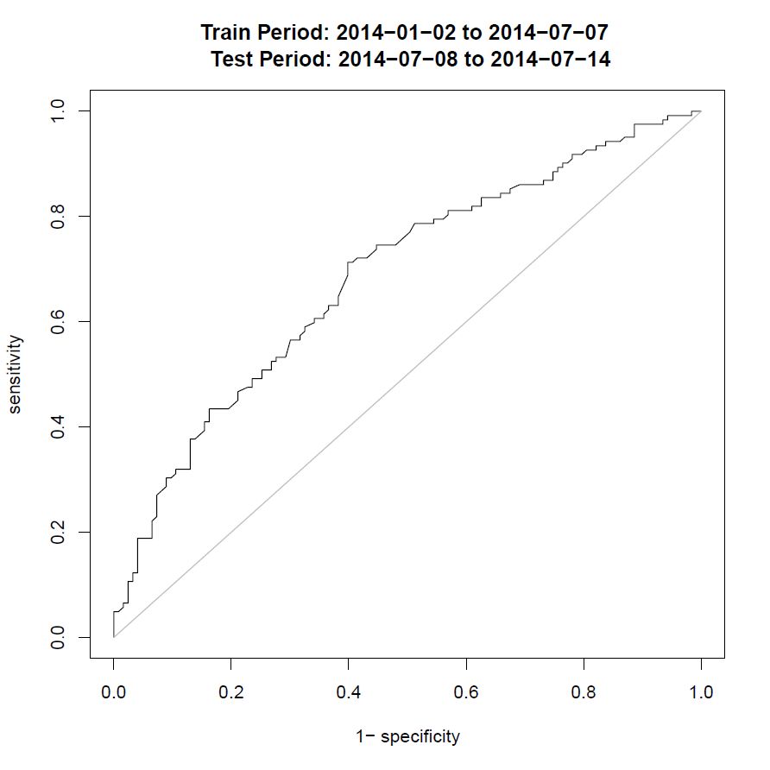
Model Evaluated at Each Rolling Week (includes all symbols)
Pred vs Actual => Confusion Matrix => p-value from chi-square test => ROC area under the curve (AUC)
Repeat training and testing process for each week from 31 Mar to 22 Dec
Store p-values and AUCs for each week

Slide 15
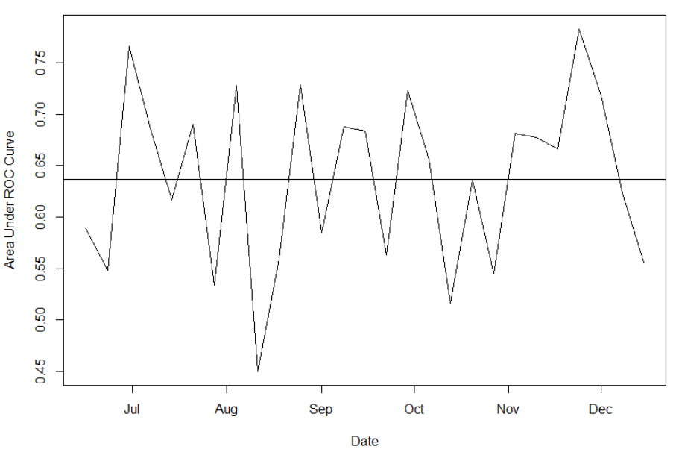
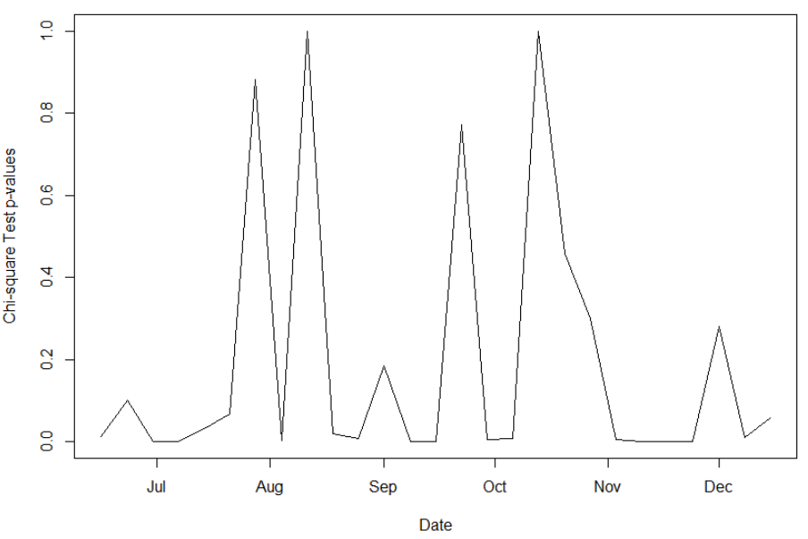
Performance At Each Weekly Test
AUC Values At Each Test Week
Chi-square p-values At Each Week
Except for one week, AUC values exceed 0.5, indicating predictive performance is consistently better than random
Chi-square test of independence significant in most weeks (16/27)

Slide 16
Marginal Effect of Tweet data
Tweet sentiment and activity clearly correlates with prices changes in stock
What additional information does it bring to the table?
Test:
Build model only using stock price data
Build model using price data and tweet data
Assess the differences between the two

Slide 17
Marginal Effect of Tweet Data
Created and tested 19 different stock
Results (t-test of differences in AUC; H_0 differences equal zero):
Two Sample t-test
t = 1.6499, df = 18, p-value = 0.1163
CI: -0.00255220 0.02122588
sample estimate:
mean of x : 0.009336842

Slide 18
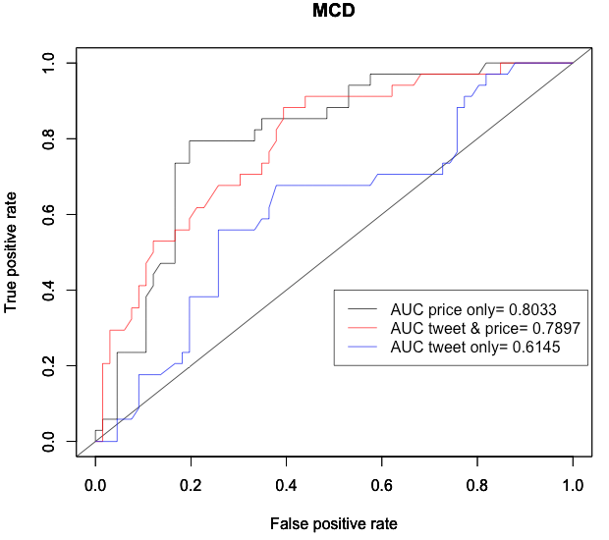
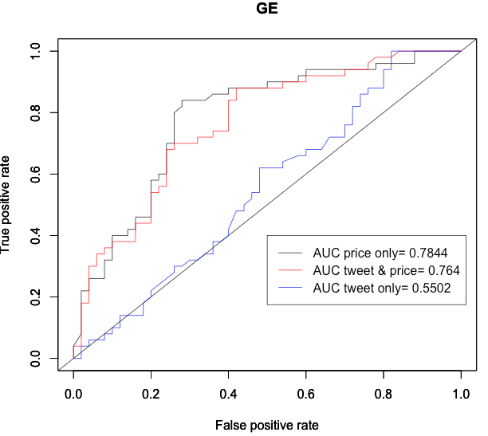
Marginal Effect of Tweet Data – Worst Performing Tweets

Slide 19
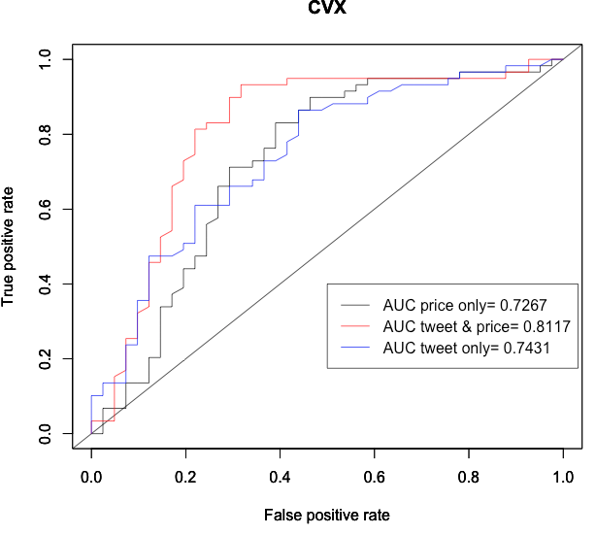
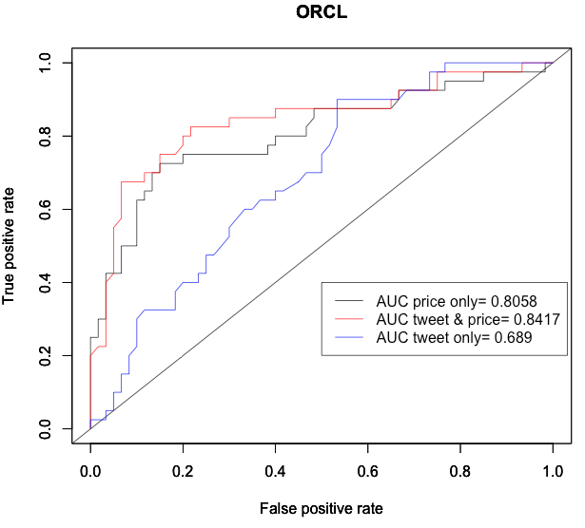
Marginal Effect of Tweet Data- Best Performing Tweets

Slide 20
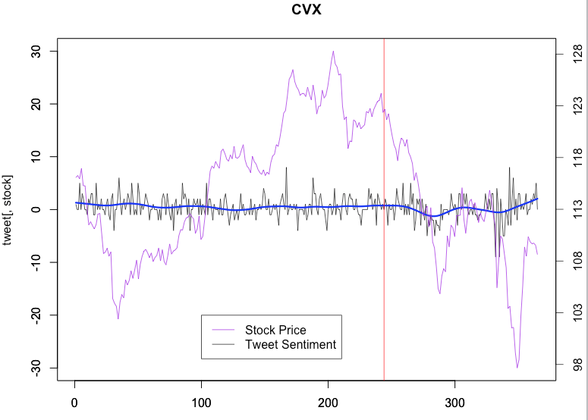
Why are some tweets more informative than others?

Slide 21
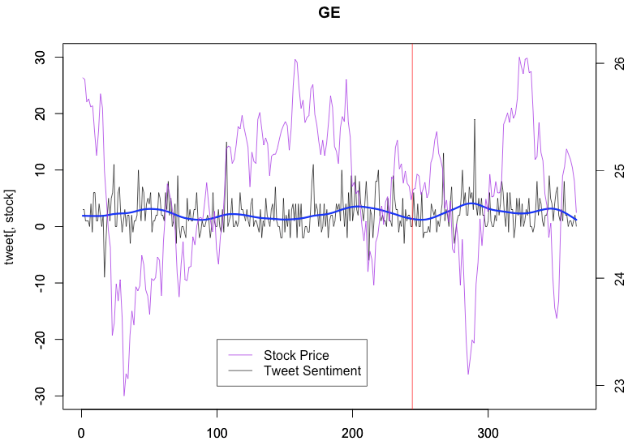
Why are some tweets more informative than others?

Slide 22
Conclusions
AUC values are judged to be more relevant => direct implications to trading performance
Chi-square tests too restrictive => possibly adjust critical level (the mean p-value is 0.19 and could be argued as significant for trading applications)
Either way, in the large majority of weeks for both evaluation metrics, performance appears much better than random
Conclusion: Stock tweet sentiment seems to have an association with future price movement (at least throughout the second half of 2014) !
Marginal improvements from tweet data seem to be stock and time dependent

