Slide 1
Understand Bitcoin
Cody Williams
Harry Hughes
Milan Patel

Slide 2
Concept
P2P system – totally digital!!!!
Decentralized – regulated by majority consensus
Block Chain – distributed DB to track transactions
Transactions signed with Public and Private Keys!

Slide 3
Goal
Our team investigated the official repository for bitcoin(github)
Analyze the repo to see what kinds of results we can gather
Learn where bitcoin currency is being used
Transactions Summary
Size of transactions
Blockchain info analysis

Slide 4
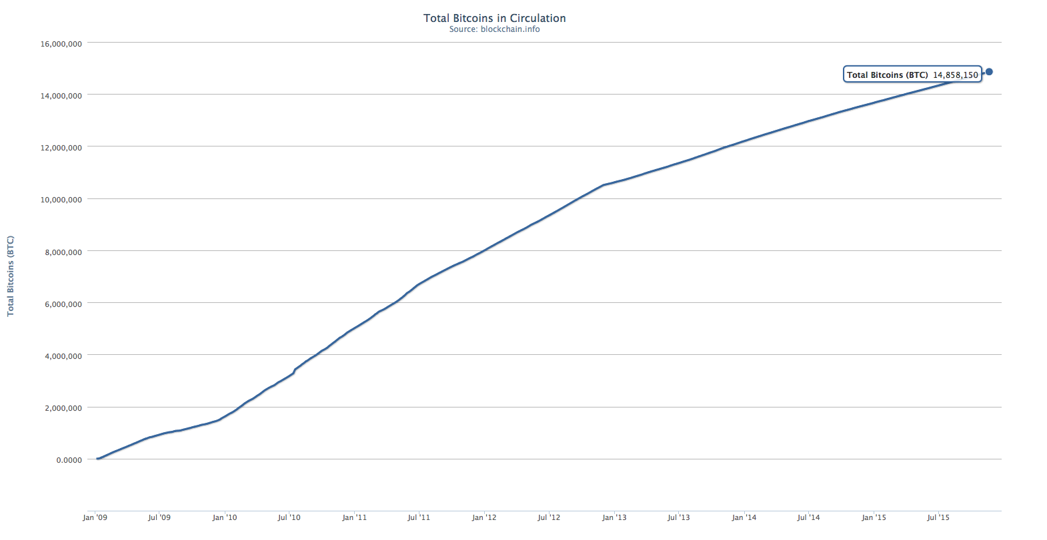
Bitcoin Circulation

Slide 5
Findings
We were able to successful get data on repos for bitcoin
Also gather some basic information about the contributors
We wanted to analyze blockchain but we learned that they made most of the info available anyways.

Slide 6
Issues
Bitcoin provides users good privacy
Disadvantages:
Private transactions use for illegal purposes
Unable to pinpoint where the currency was being used
IP addressed spoofing

Slide 7
Results
File Extension
To gain insight into different programming languages
Verify the results
Top files modified by year
Track development trends

Slide 8
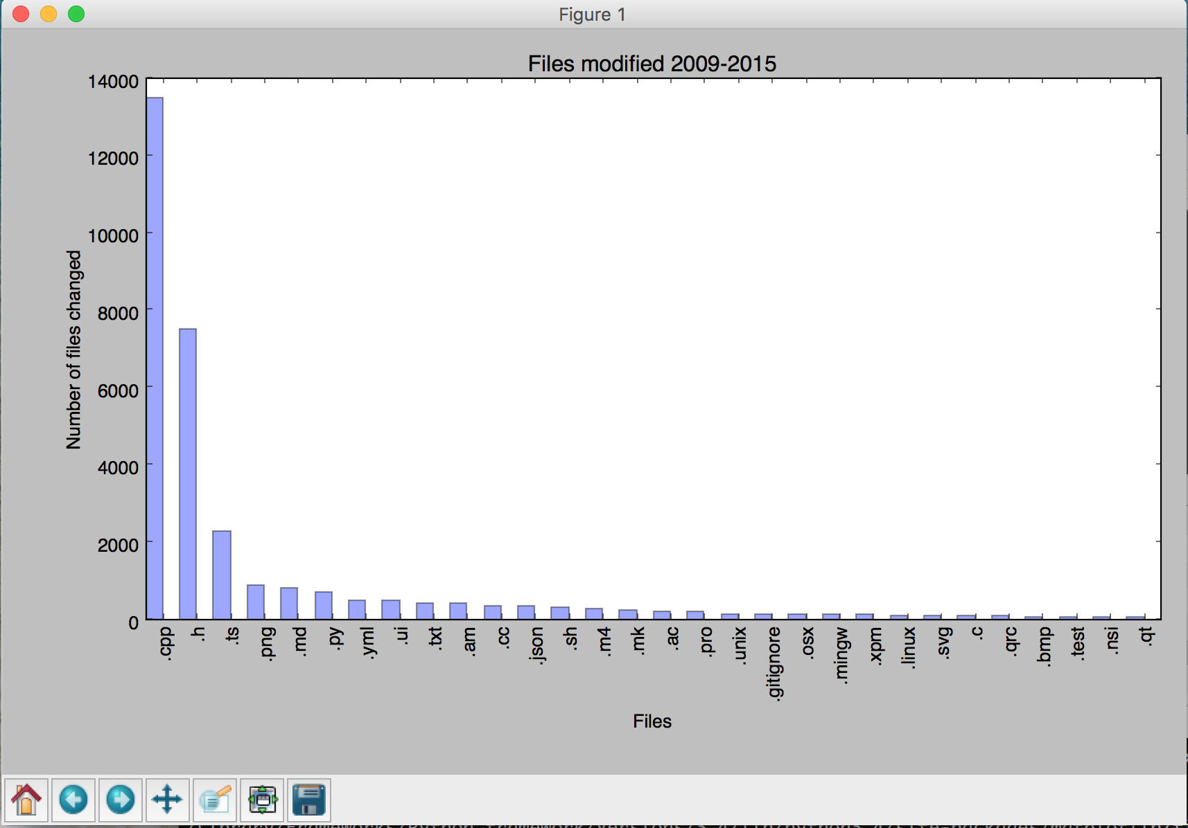
Total Number of Files Modified

Slide 9
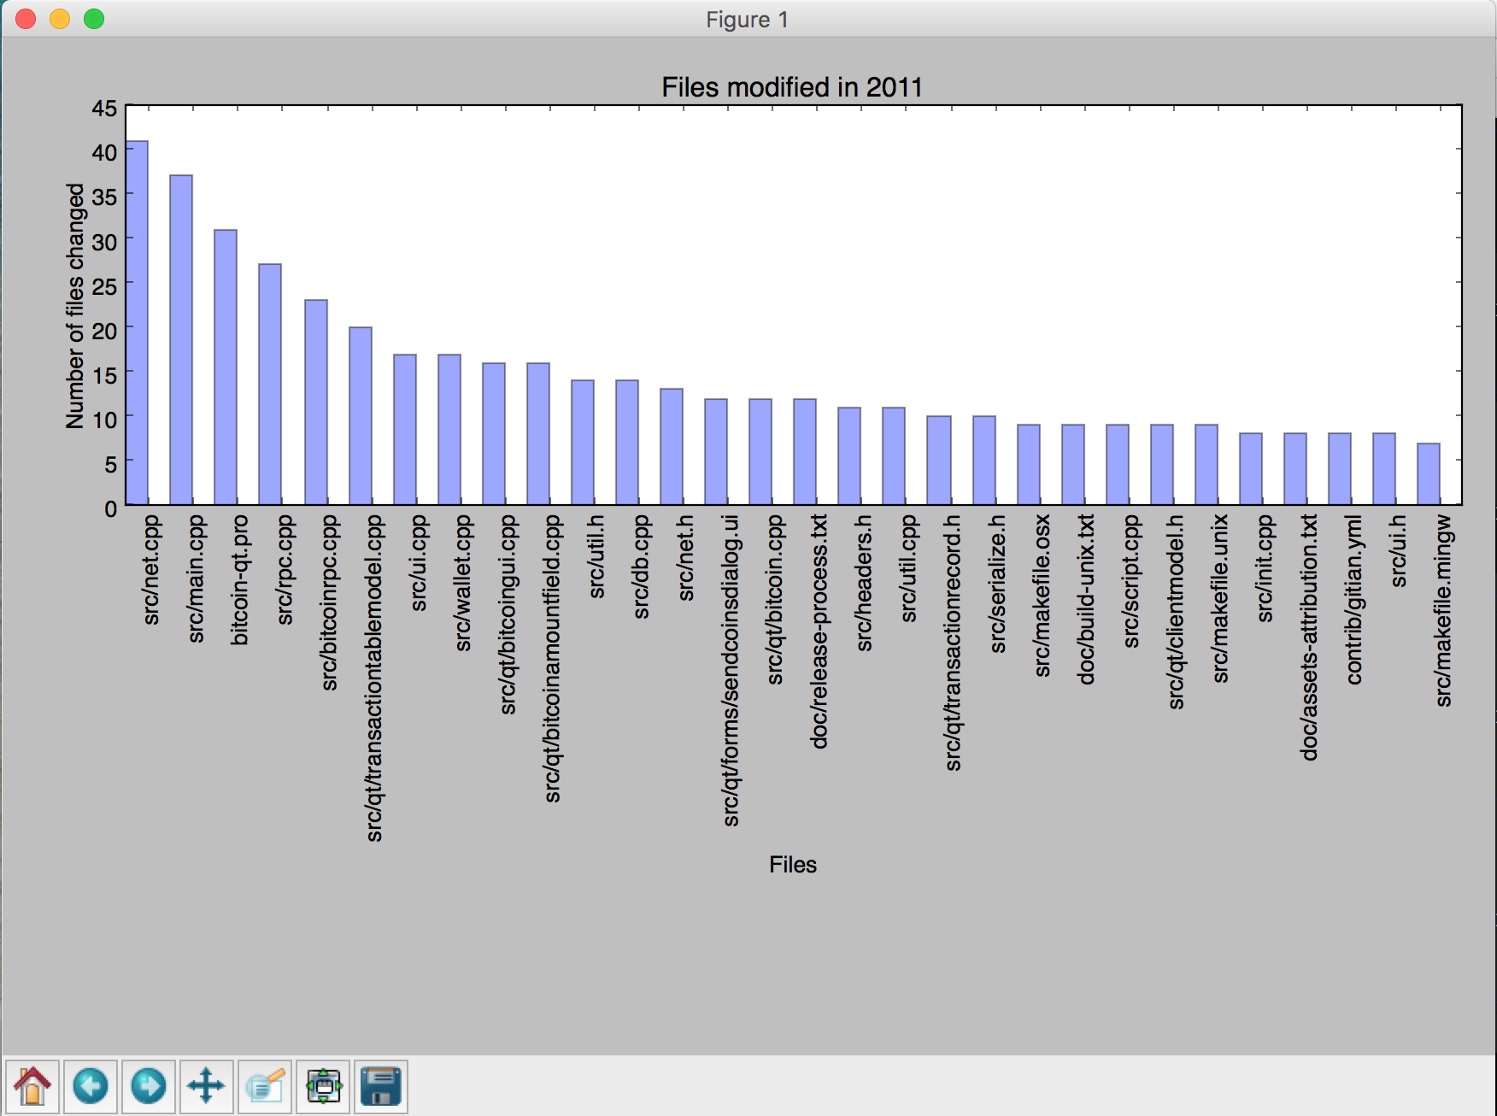

Slide 10
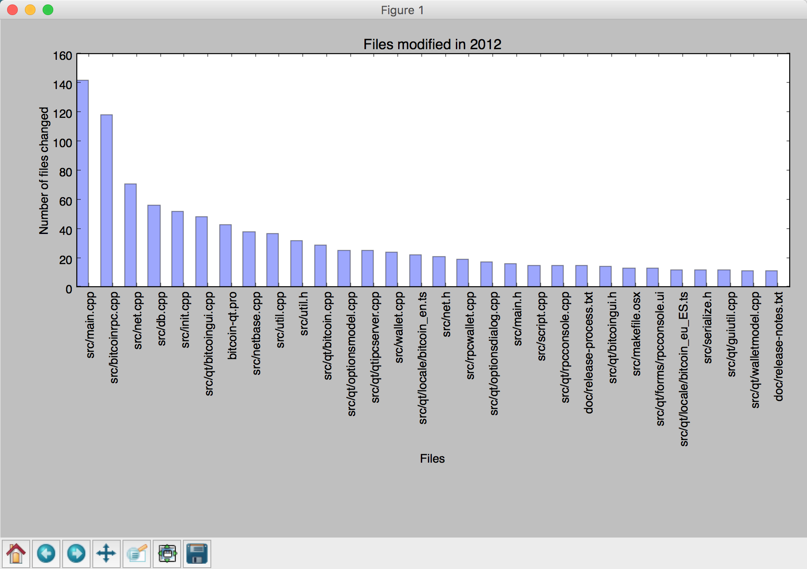

Slide 11
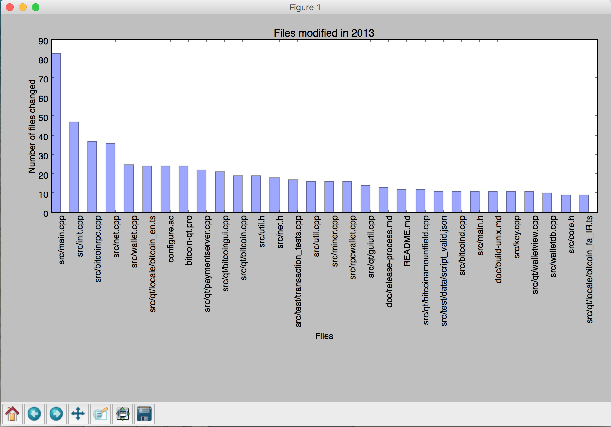

Slide 12
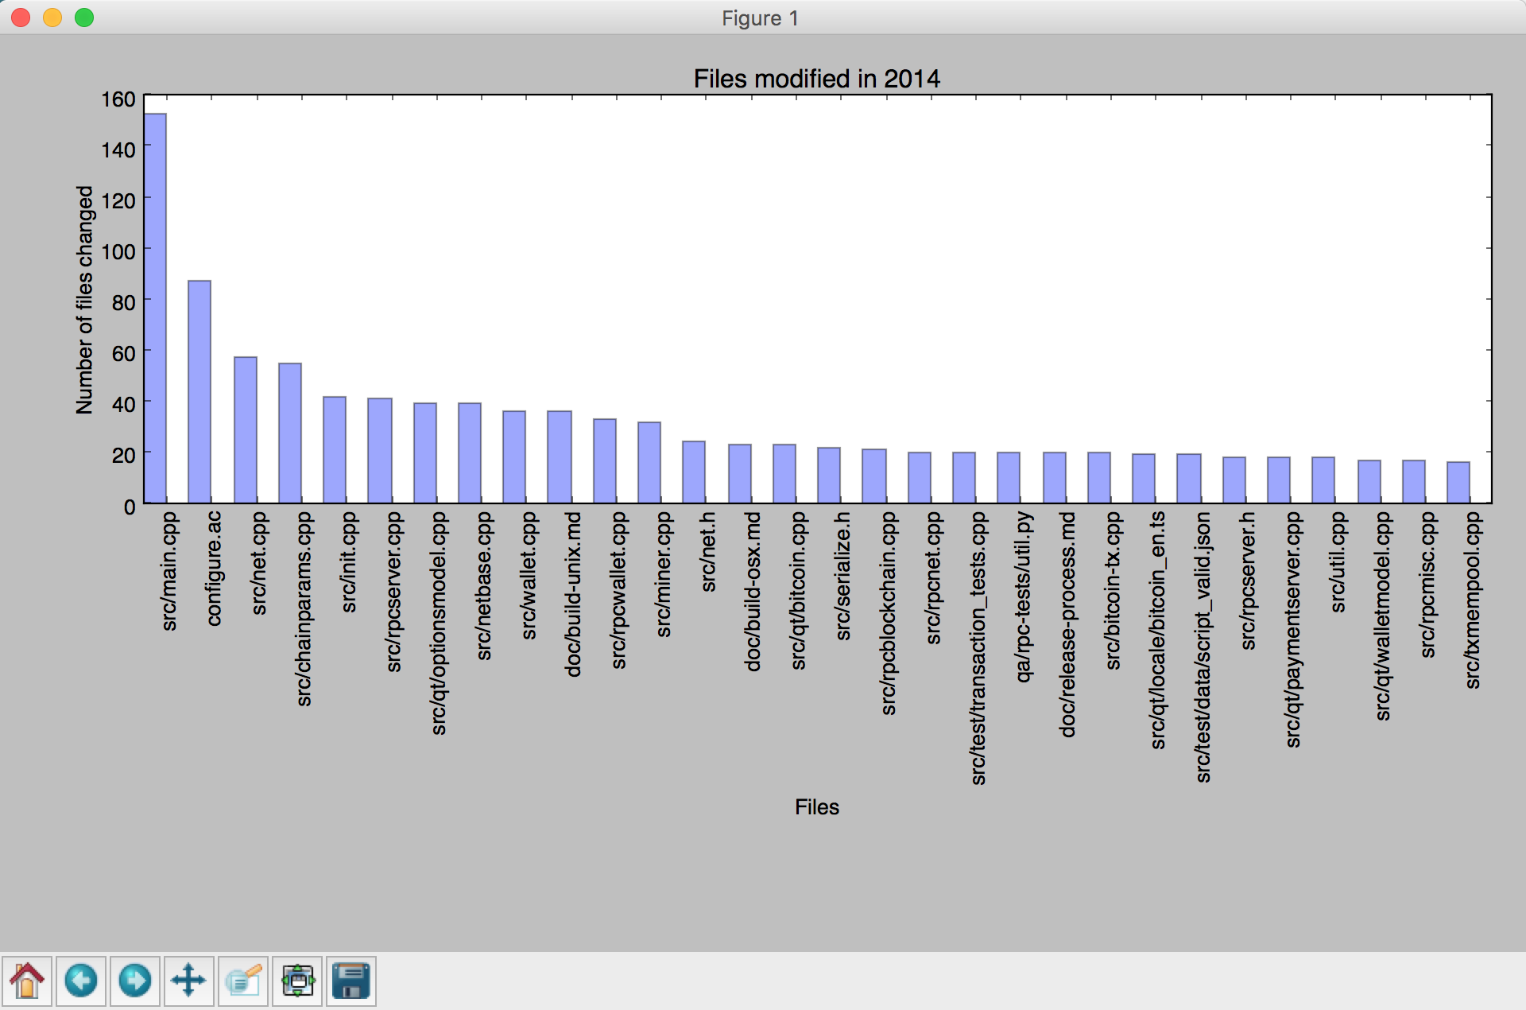

Slide 13
