Slide 1
NFl draft analysis
Based on NFL combine results
CS 545
Jonathan Adams and Julian Swart
12/01/17

Slide 2

Main question
Can we predict a prospective athlete’s draft round based on his performance in the NFL combine?
Yes! We can predict draft round ~4 times better than random for most positions
If so, can we determine which drills an athlete needs to improve his performance?
Yes! Our model allows an athlete to see which drills have the biggest impact on draft rank based on his position

Slide 3
AGenda
Data collection and processing
Exploratory Analysis
Modeling
Results
Future Work
Questions

Slide 4
Data collection
All data collected using Python – Beautifulsoup and exported to CSV files for each website
Data collected from 2004 - 2018
Two CSVs read into R and merged by player name
NFL combine stats: http://nflcombineresults.com/nflcombinedata.php
Draft Rank: http://www.nfl.com/draft/history/fulldraft

Slide 5
Data processing
Multiple labels for similar positions, e.g. (“OLB”, “MLB”,”ILB”) are all linebackers so changed label to “LB”
Subset based on position
Only used complete cases for each position
Had to remove bench press column from WR and QB data because neither position completed the test very often

Slide 6
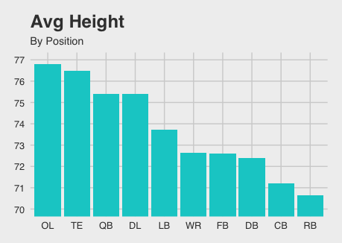
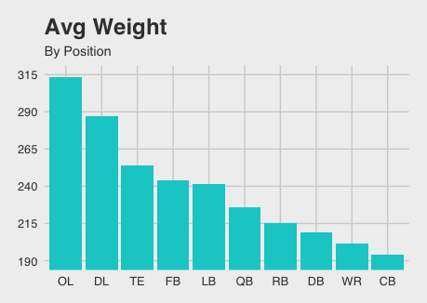
Data by position

Slide 7
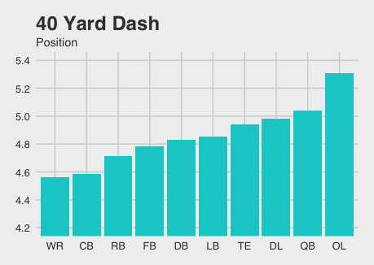
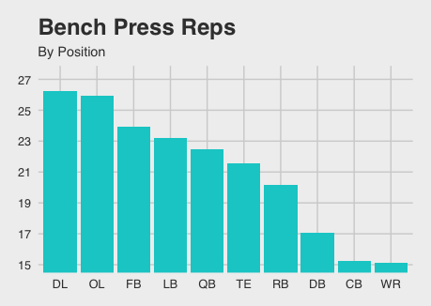
Data by position

Slide 8
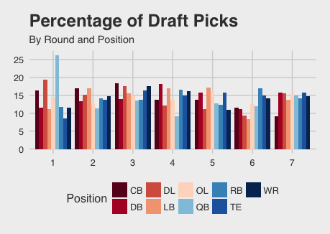
Draft round by position

Slide 9
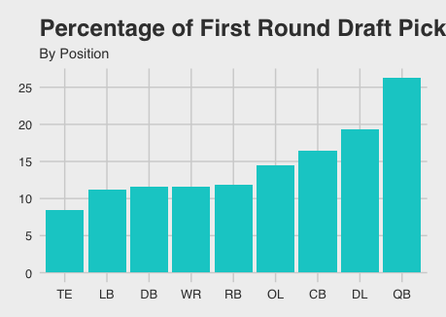
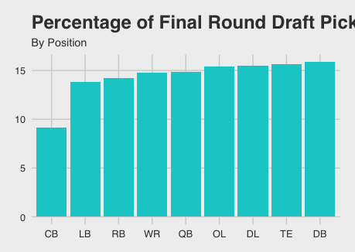
Draft round by position

Slide 10
Modeling
Map numeric draft rank (0 to ~250) to draft round
Not every year has identical numbers drafted per round so may be wrong on a few
Made predictive models for each position
Random Forest, Naïve Bayes, Multinomial, and Support Vector Machine

Slide 11
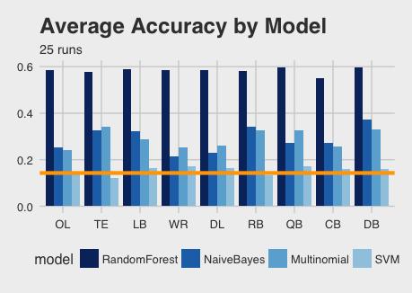
Results
Orange line represents random guess: ~14%

Slide 12
Random forest
Most Important Variable on Average:
OL | TE | LB | WR | DL | RB | QB | CB | DB
Height | Height | 40 yard dash | Weight | 3 cone drill | Broad jump | 3 cone drill | 40 yard dash | 3 cone drill

Slide 13
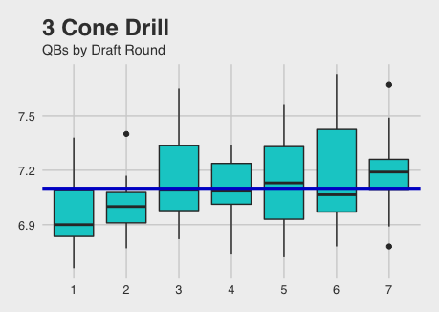
Example of important variable

Slide 14
Future work
Find better data source for college stats to include into the models
Determine best way to handle missing combine test statistics
Correlation between other tests (see appendix)
Look into clustering and relationships between clusters
Model ensembling

Slide 15

questions

Slide 16
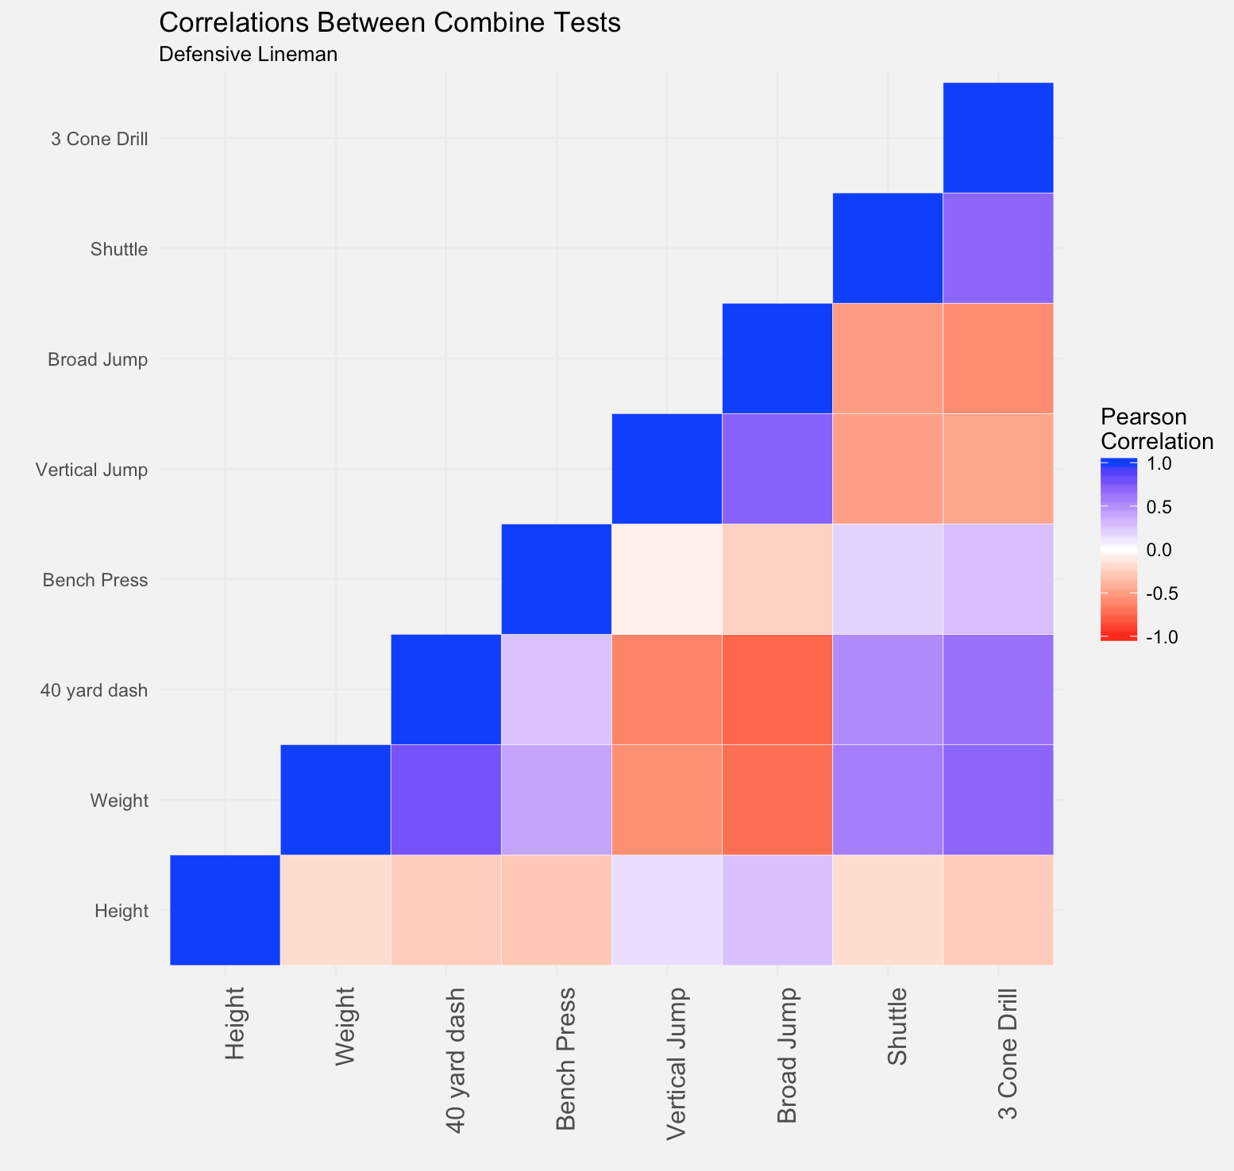
Appendix

Slide 17
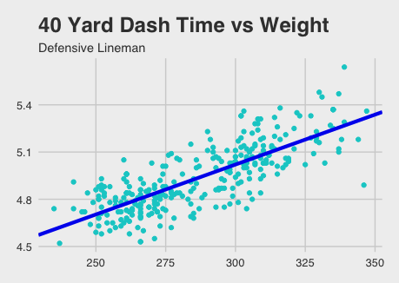
appendix

