Slide 1
Frameworks
Trish Goedecke, Preston Provins, Jerry Duncan

Slide 2
Quick Recap
Choosing a JavaScript frameworks for a new project can be a challenging process.
There seems to be a new handful gaining popularity every year or so
Previous ones don’t seem to lose steam either.
Some of the most popular frameworks:
React.js (maintained by Facebook)
Angular.js (supported by Google)
Ember.js (opinionated best practices)
Backbone.js
jQuery
VueJS
We know you forgot.

Slide 3
Objectives
1) Collect framework related resources
Identify Projects that use the frameworks.
Collect dependencies of the frameworks.
Attain questions and answers of frameworks on StackOverflow.
Retrieve Issues and Responses of each framework.
2) Build a website to display the data that we had collected.
3) Derive predictors on collected data and train a model to make predictions.

Slide 4
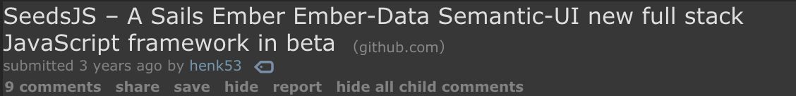
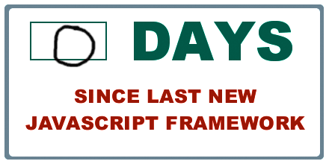
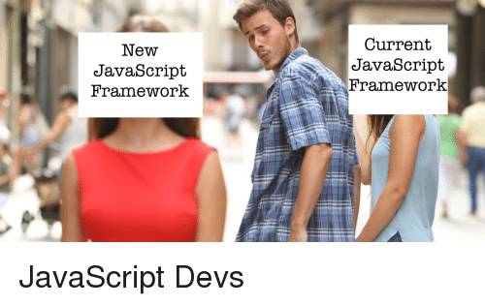
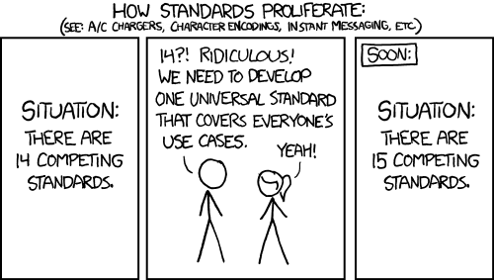
Motivations.

Slide 5
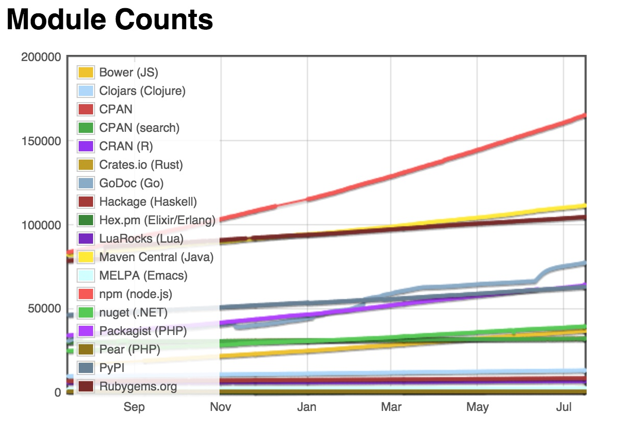
Motivations Cont.
Jokes aside, frameworks are developed and used in projects haphazardly. With so many frameworks being created and maintained it is hard to tell which frameworks will be relevant years down the road.

Slide 6
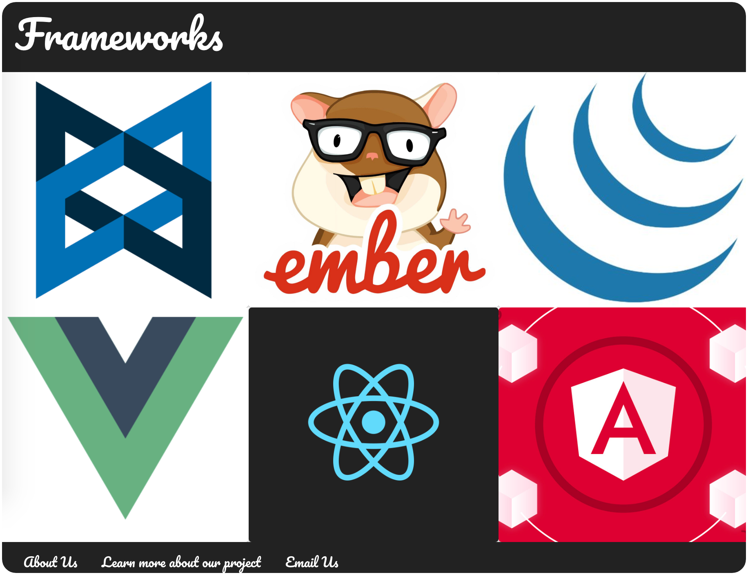
Check us out on the Web!
The data that we collected is easily accessible on the web.
If you would like to see the visuals (and amazing web design) please follow us as we go to:
https://fdac-frameworks.herokuapp.com/

Slide 7


Collecting the Data
Data attained from GitHub and StackOverflow:
GitHub Issues required stripping information from repository pages.
Stored in .json files, not kept in database.
StackOverflow had a poorly designed SQL Database, but made dumps that were .xml formatted
A python script was made to take XML data and place inside MongoDB
I should probably ask StackOverflow to pay me for my troubles.
Collection Tools:
Python was used solely.
MongoDB was our best option for Database
Most data came in incomplete.
StackOverflow was SQL, but poorly structured.

Slide 8
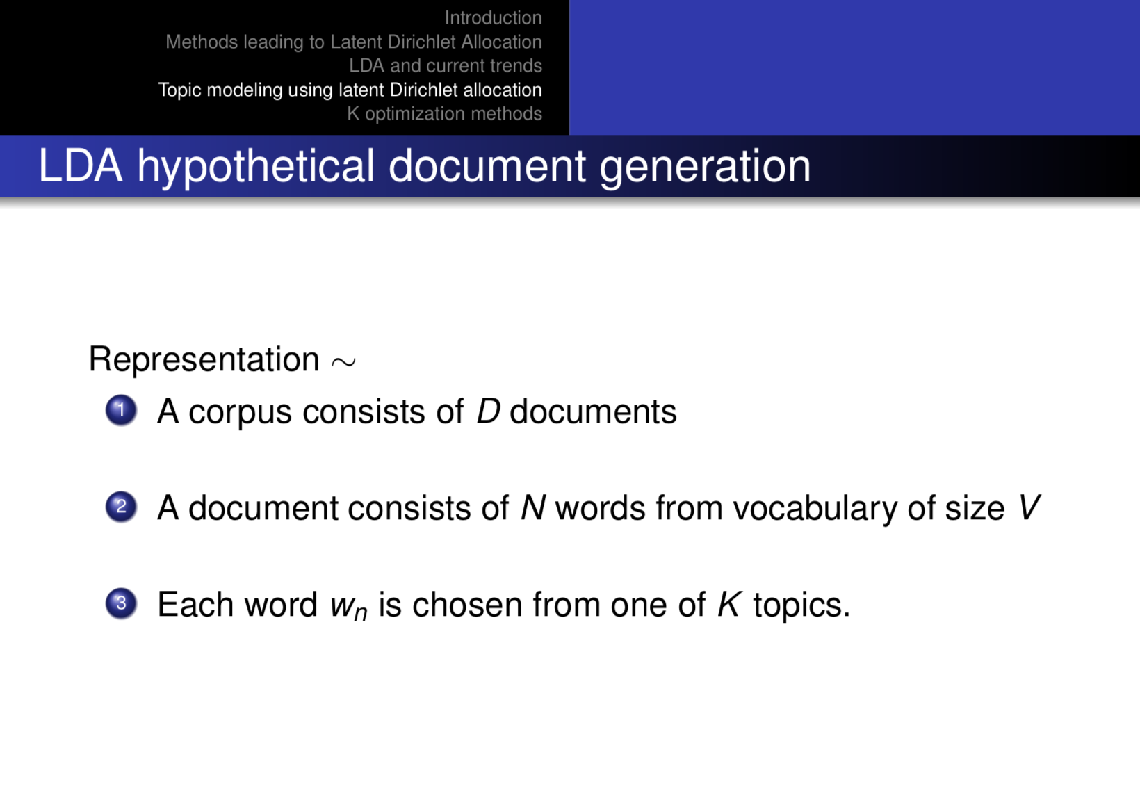

Slide 9
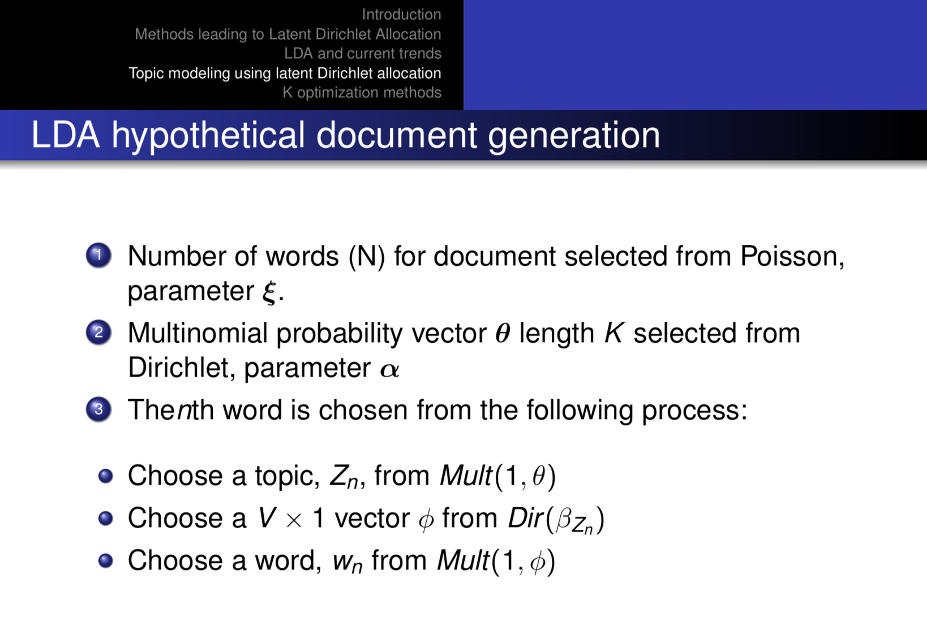

Slide 10
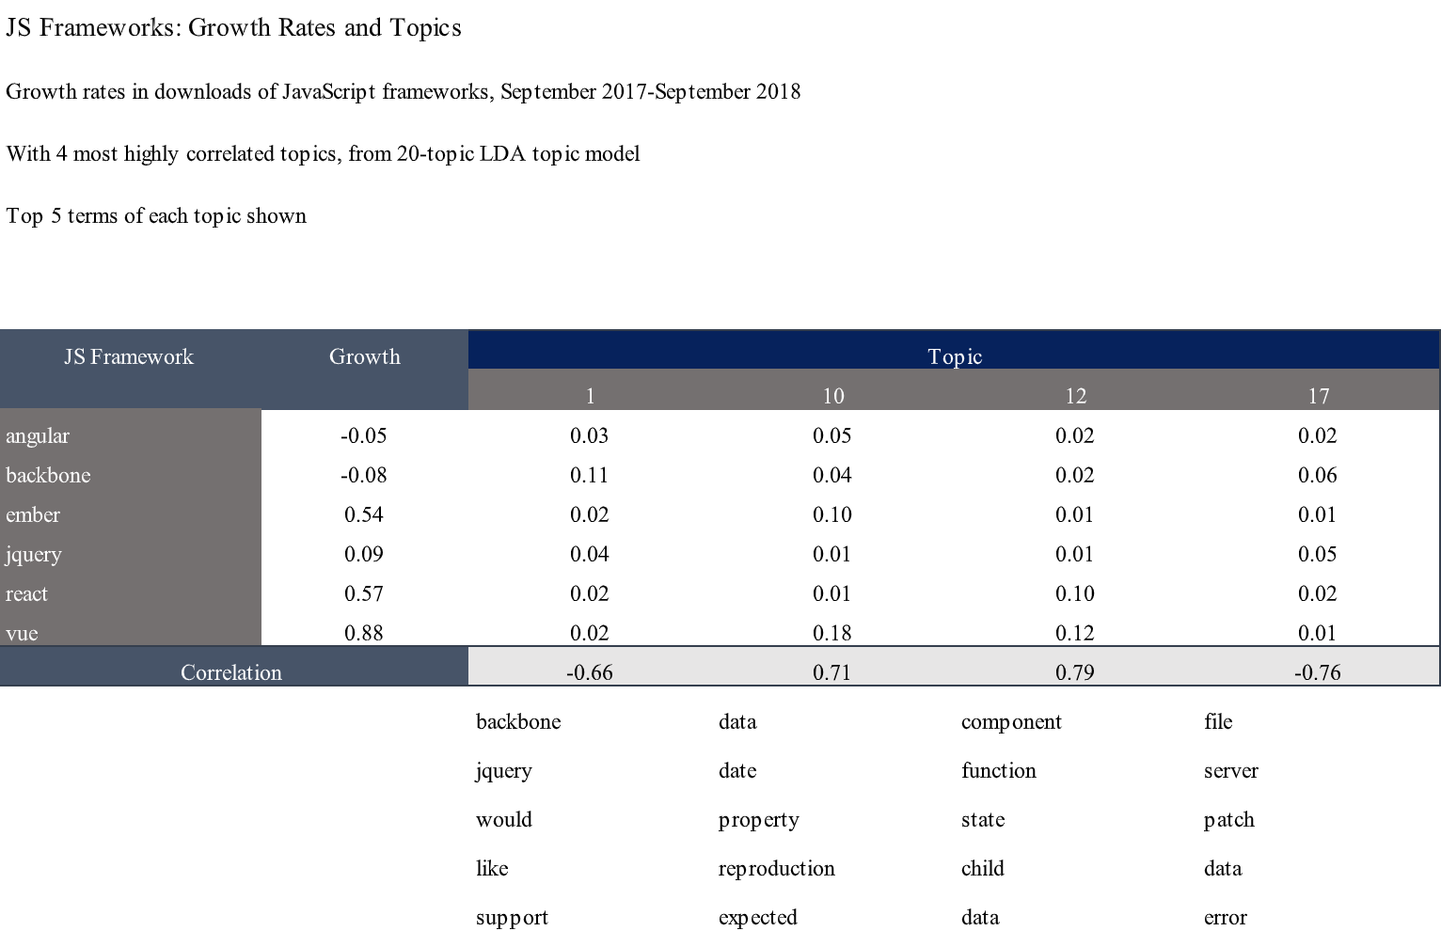
Topics are generated from GitHub Issue documents.

Slide 11
Future Work
Unfortunately, we did not have time to get to the prediction model; however, the data has all been collected and set up so that next semester in Dr. Mockus’ Evidence Engineering we can continue working on the model.
Taking this Idea to the Next Semester

Slide 12
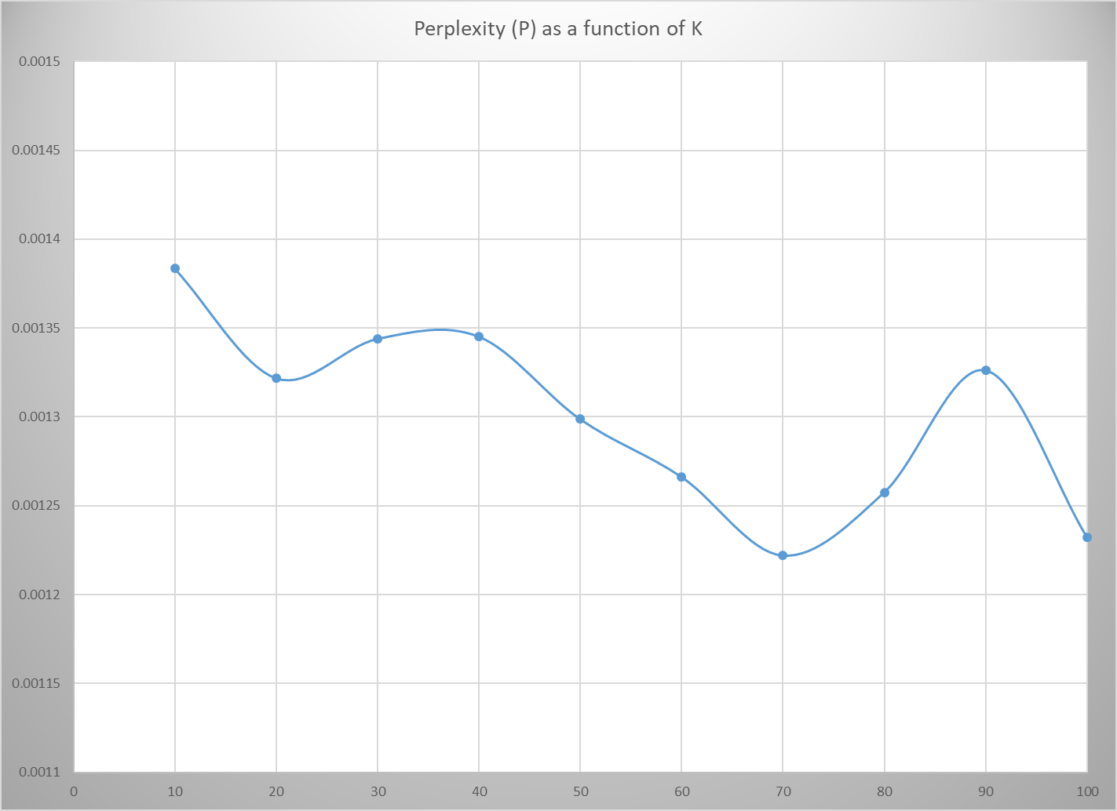
Introduction Methods leading to Latent Dirichlet Allocation
LDA and current trends Topic modeling using latent Dirichlet allocation
K optimization methods
Perplexity (P)
¹ Blei et al., 2003

Slide 13
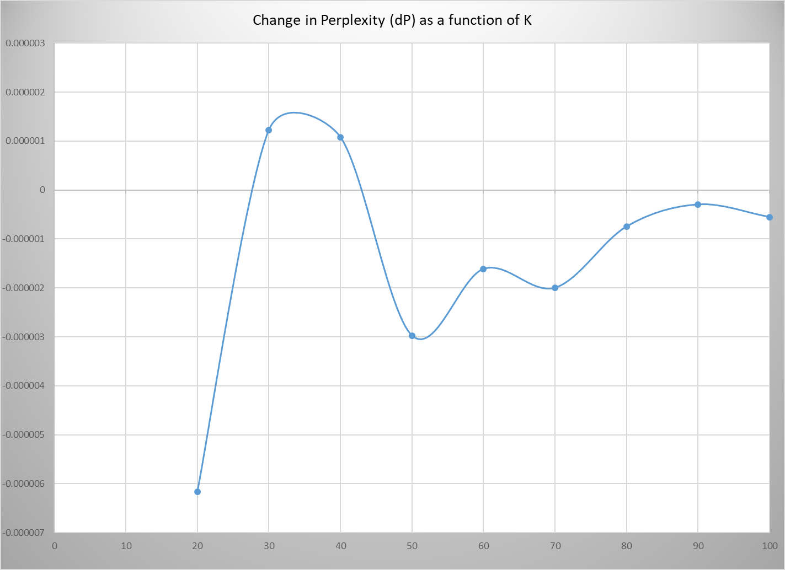
Introduction Methods leading to Latent Dirichlet Allocation
LDA and current trends Topic modeling using latent Dirichlet allocation
K optimization methods
Change in perplexity (dP)
¹ Zhao et al., 2015

Slide 14
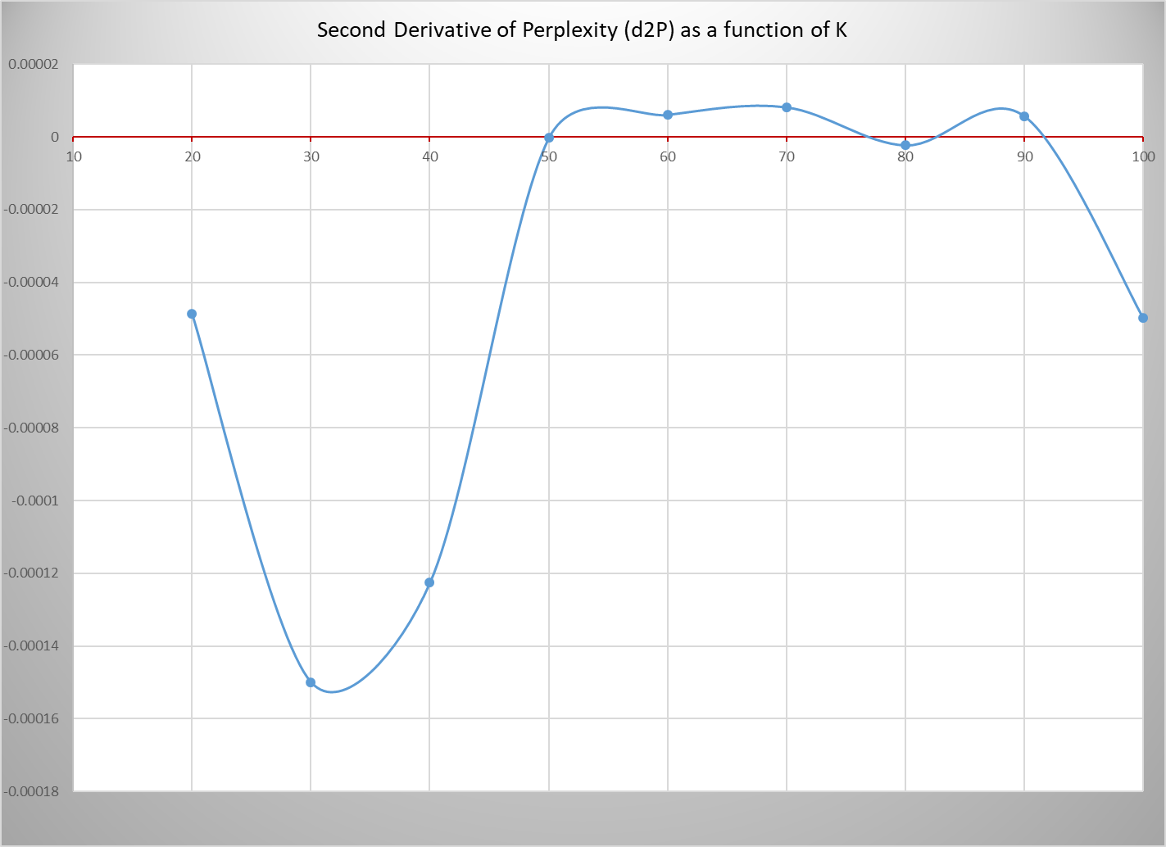
Introduction Methods leading to Latent Dirichlet Allocation
LDA and current trends Topic modeling using latent Dirichlet allocation
K optimization methods
2nd derivative of perplexity (d2P)

Slide 15
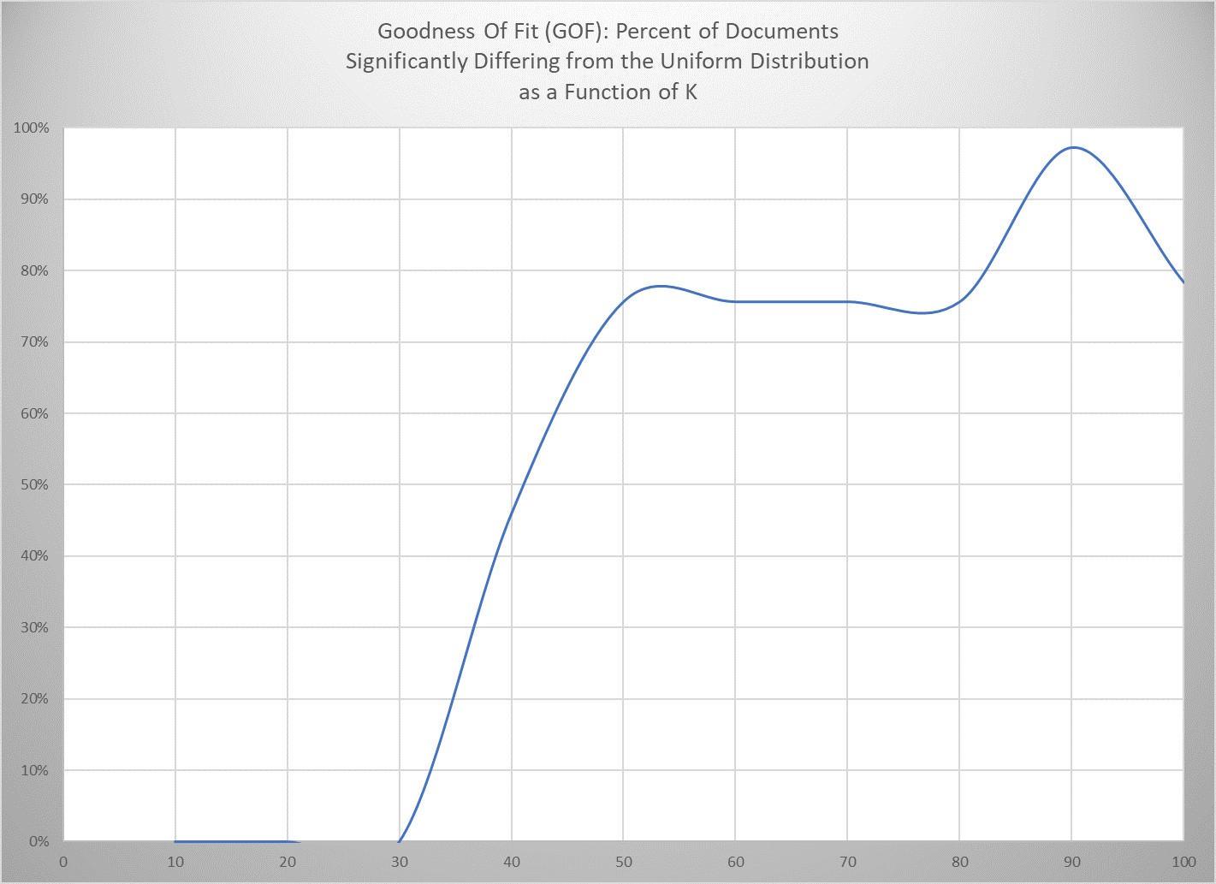
Introduction Methods leading to Latent Dirichlet Allocation
LDA and current trends Topic modeling using latent Dirichlet allocation
K optimization methods
Goodness Of Fit (GOF)
¹ Bowman, Chen and George (in press)

Slide 16
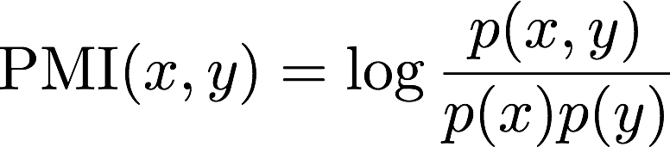
Introduction Methods leading to Latent Dirichlet Allocation
LDA and current trends Topic modeling using latent Dirichlet allocation
K optimization methods
Pointwise Mutual Information (PMI)
Newman et al. (2010) Extrinsic to modeling process
Corroborated by human judgment
¹ Image credit: http://lintool.github.io/UMD-courses.html

Slide 17
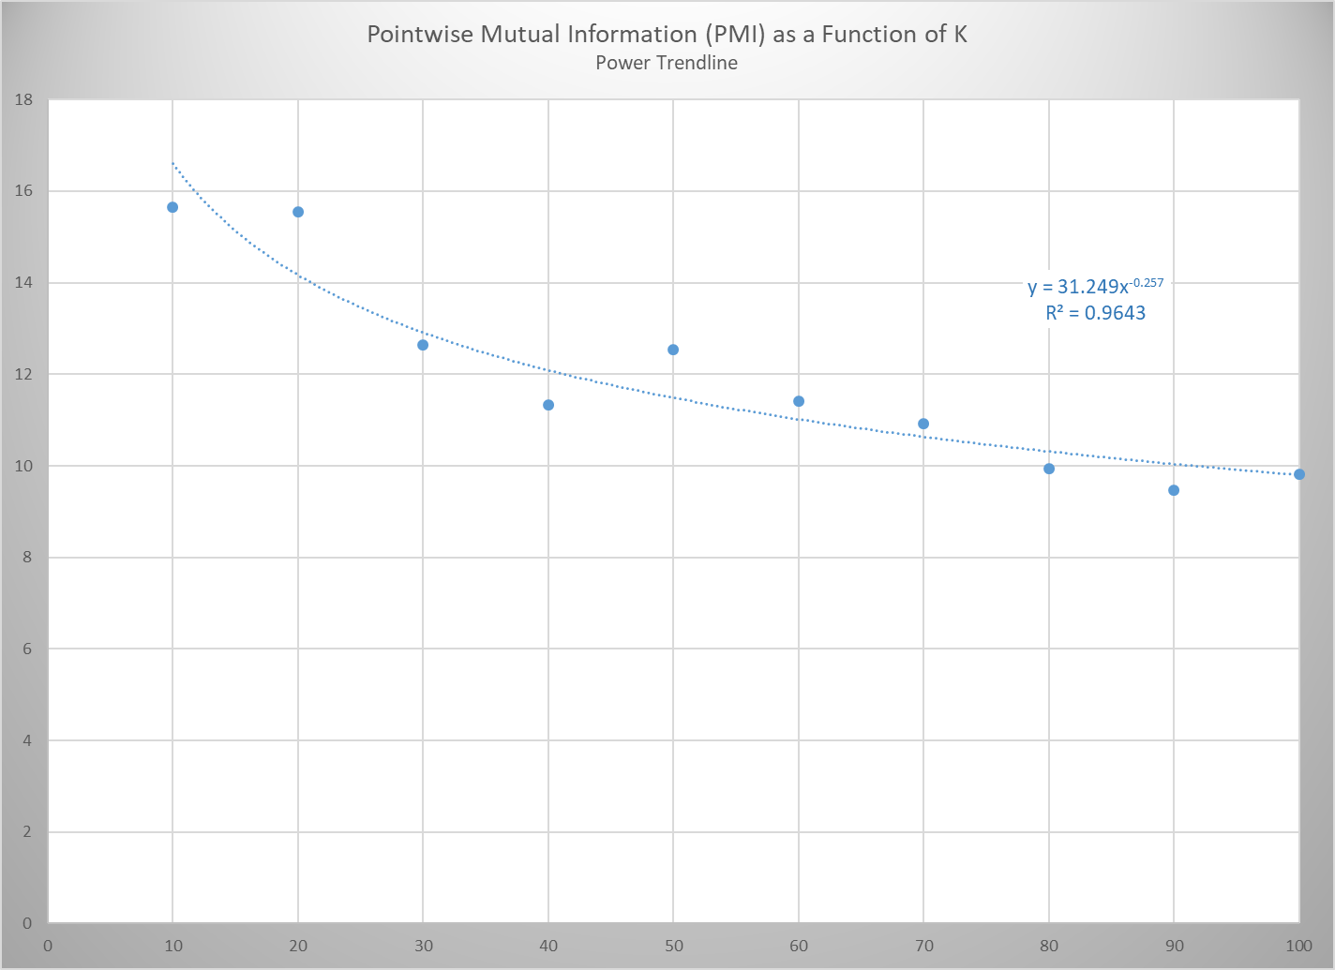
Introduction Methods leading to Latent Dirichlet Allocation
LDA and current trends Topic modeling using latent Dirichlet allocation
K optimization methods
Pointwise Mutual Information (PMI)
¹ Naraula et al., 2013

Slide 18
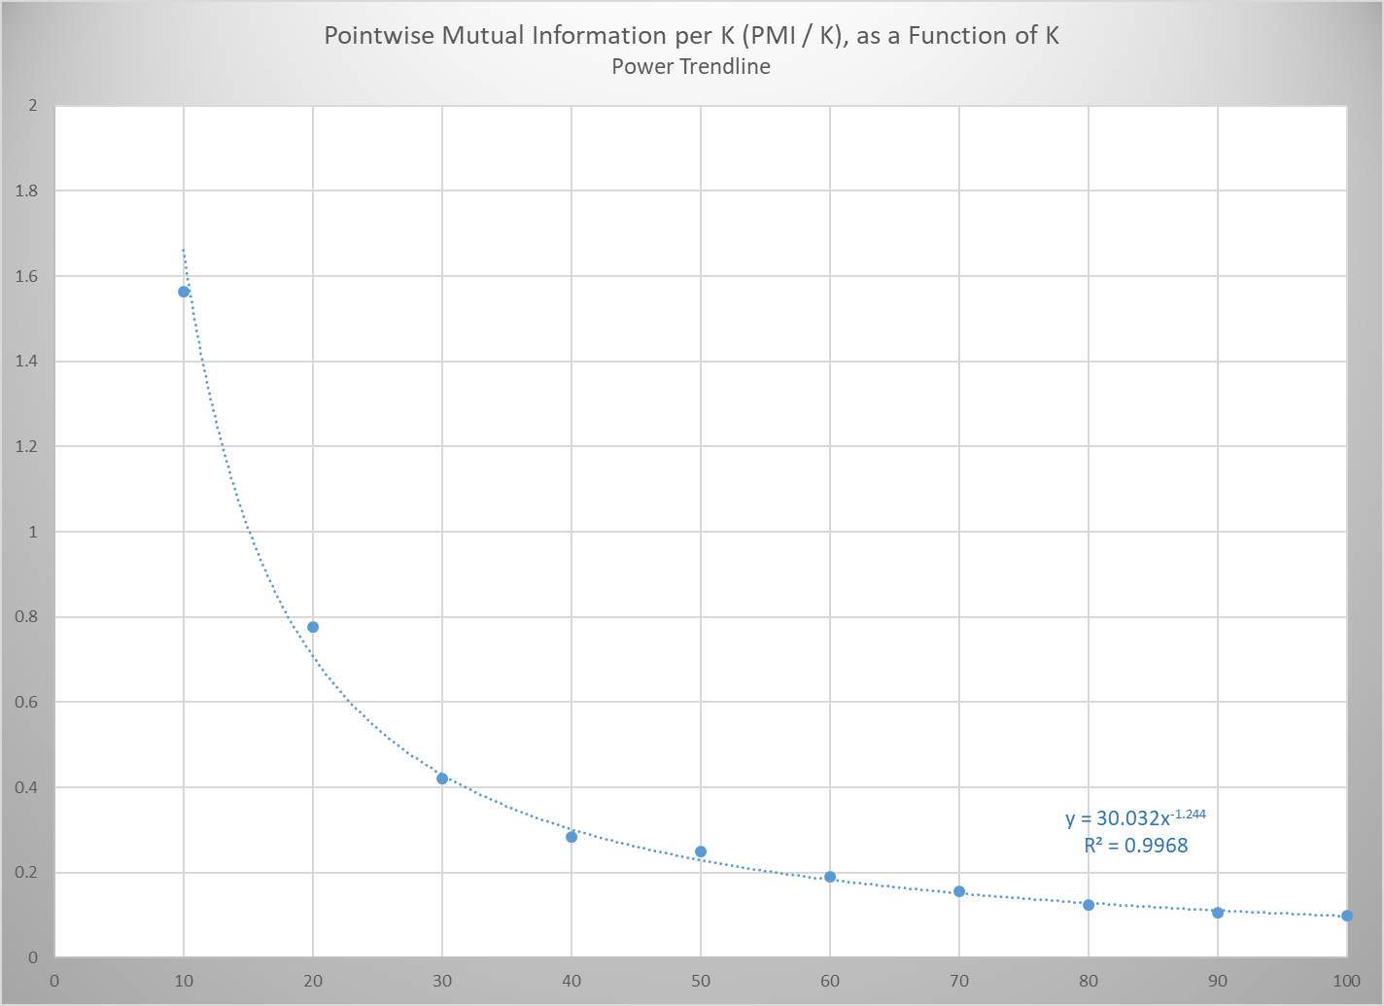
Introduction Methods leading to Latent Dirichlet Allocation
LDA and current trends Topic modeling using latent Dirichlet allocation
K optimization methods
Pointwise Mutual Information per K (PMI / K)

Slide 19

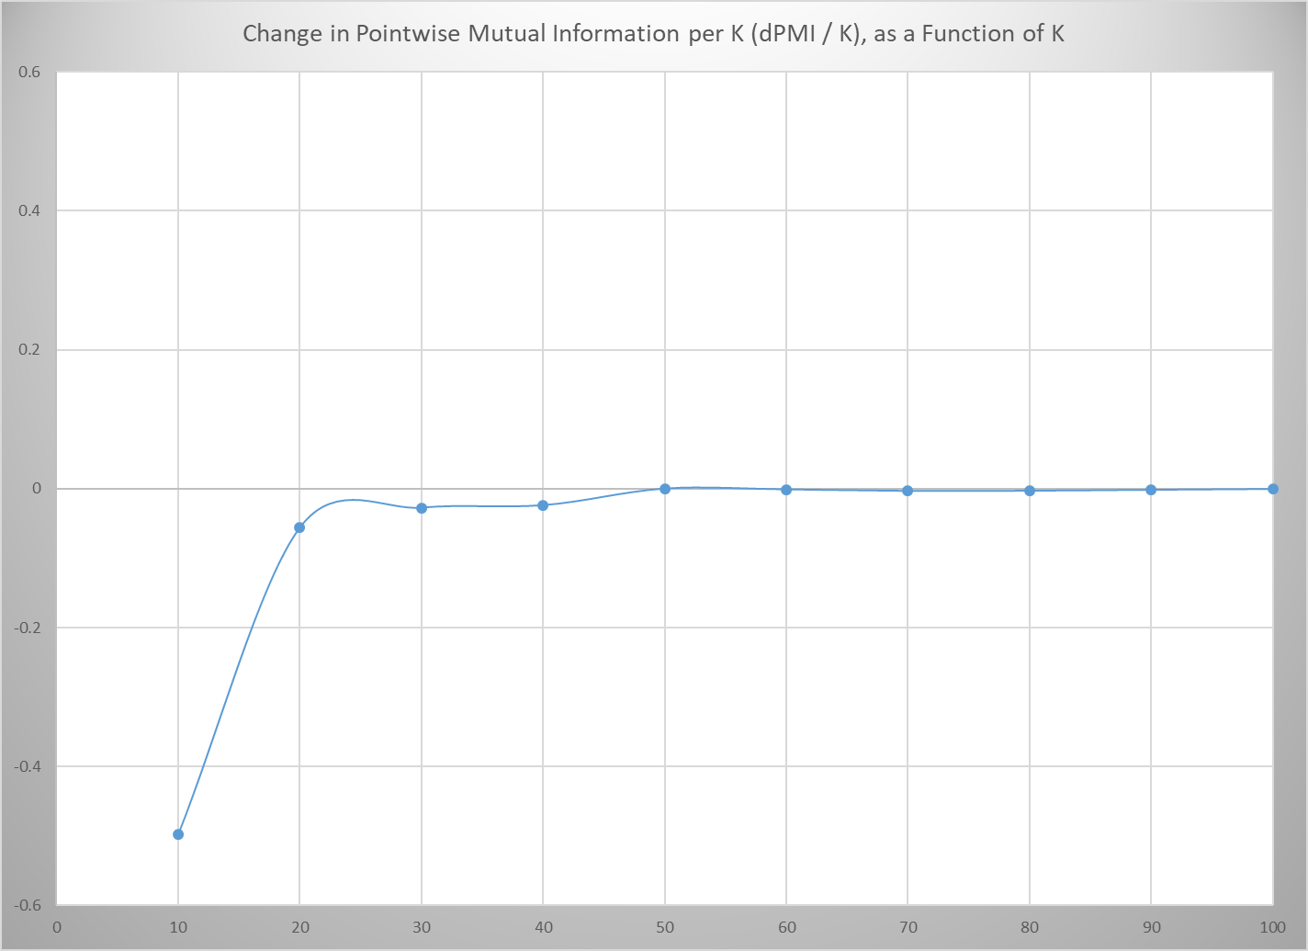
Introduction Methods leading to Latent Dirichlet Allocation
LDA and current trends Topic modeling using latent Dirichlet allocation
K optimization methods
Change in Pointwise Mutual Information per K (PMI / K)

Slide 20
Introduction Methods leading to Latent Dirichlet Allocation
LDA and current trends Topic modeling using latent Dirichlet allocation
K optimization methods
Conclusion: Optimization method comparisons
Methods of optimizing K do not converge
Different optimization methods will be appropriate for differing purposes
Judgment is called for

Slide 21
Questions?
Thank you!

