Slide 1
Digital Currency
Group members
Bohan Li, Zhekai Dong, Hyeseong Choi
Notes:
Hello, this is group 3 and we are Bohan Li and Xinlan Jia. Our final project topic is Reinforcement learning on Bitcoin trading.

Slide 2
Agenda
Introduction
Algorithm
Data
Model
Results and Analysis
Long-Term Profits
Short-Term Profits
Conclusion
Future works
Notes:
Our presentation today is going to cover following subjects. First we are going to introduce the background, challenge and motivation of our project. Then point out the team’s goal and novelty. Next, we are going to go over the design of the proposed model. Then results are posted and analysis is done. Furthermore, we explored the possibility of apply the model to other financial markets. And we will give a berif conclusion in the end.

Slide 3
Introduction
Background:
Combination of deep learning with reinforcement learning model for the stock market was first proposed in 2016
Various models available for the stock market after that
Challenge
The stock market models only rely on the price do not perform well on more unpredictable markets such as the digital currency market (ie. Bitcoin)
Motivation
Develop deep reinforcement learning model for digital currency trading
The model includes more trading indexes
Notes:
As for background, the team is inspired by the first deep reinforcement learning model for stock market which was announced several years ago in 2016. To the team’s acknowledgement, it is the first time we combined deep learning neural networks with reinforcement learning for financial market. However, we are facing the challenge that is model that suitable for the stock market, does not have the ability to predict more complexed markets such as the Bitcoin market.
This challenge has motivated the team to develop a more generalized deep reinforcement learning model that has the ability to adapt various digital currency market. Even though the team’s major focus is on the Bitcoin market, we will also further explore into other markets.

Slide 4
Algorithm
Q-learning
Deep neural network

Slide 5
Data
7 data files
5 completed daily price history of bitcoin, ltc, eth, bch, eos for long term trading
2 hours price history for bitcoin and ltc for short term high frequency trading
Training: 65% data
Validation: 10%data
Testing: 25% data

Slide 6
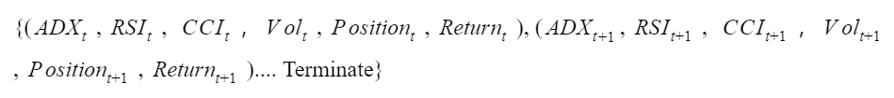
Data
Each sample will be process with indexes as a state in state space:
Action Space: Buy; Hold; Sell
Notes:
This is how we frame the MDP model.
The State-space is a list where each element is a tuple. The elements are (ADXt, RSIt, CCIt，Volt, Positiont, Returnt).
Position here contains three states, which is short, flat, and long. The action space is sell, hold, and buy.

Slide 7
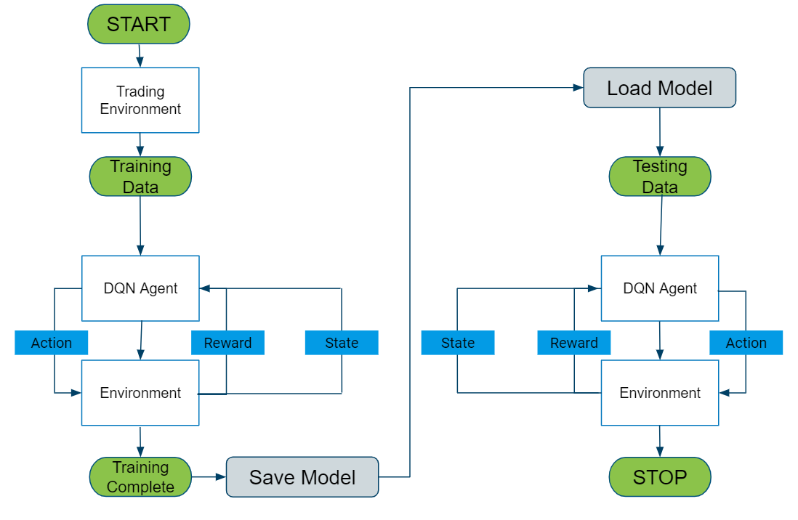
Model
Notes:
This is a overall framework of the proposed Deep Q Network model.
It is trained and tested by datasets of bitcoin’s price per day from 2010 - 2020 to see if the agent can have a positive return in both long-term and short-term trading.
We first separate the dataset into training set and testing set. The first 75% will be used as training set and the rest 25% is used for testing. We fed the training data into the model and the save the trained model. Next, the test data is being loaded in to the saved model for prediction.

Slide 8
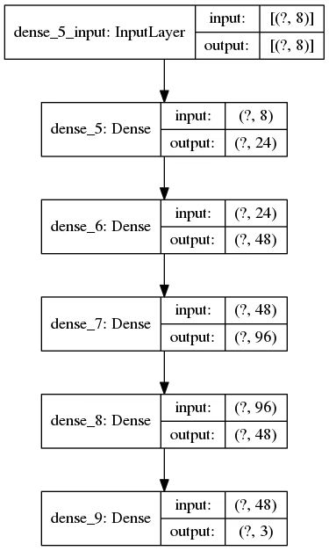


Model
Greedy approach
We define the Q(s, a) function as:
Deep Q learning:
Q function approximated by Deep Q Network (DQN) model
Notes:
The reinforcement learning method for updating Q functions is based on what we learned this semester. We define the Q(s, a) function as:
Q*(st, a) r(st, at) + maxaQ*(st+1, a)
Where Q* is the optimal Q value according to the greedy policy, is discount factor, s is state, a is action, r is reward, and t is time.
However, in order to fit real market conditions, the Q function is approximated by a deep neural network, and the gradient descent step is performed with each memory stored to stabilize the training process that can lead to final convergence. An overall flowchart of the neural network structure is shown in the right. The input layer has 8 neural since we have 6 inputs for state-space (ADXt, RSIt, CCIt，Volt, Positiont, Returnt), and one of the inputs Position actually contains three states as mention in the previous MDP slides.

Slide 9
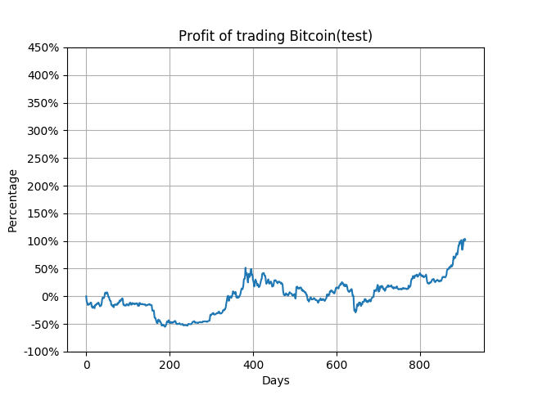
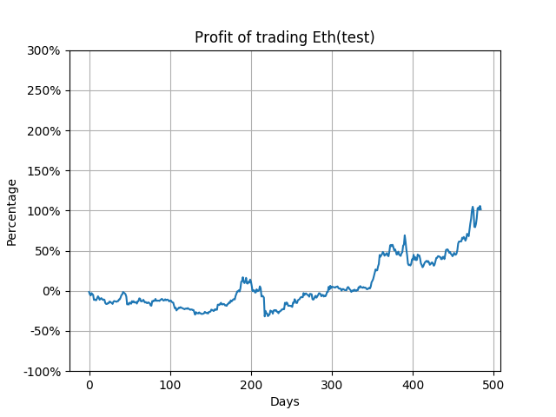
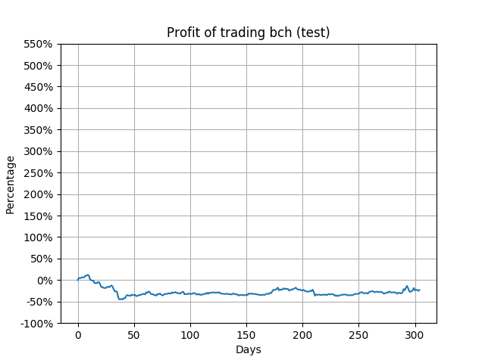
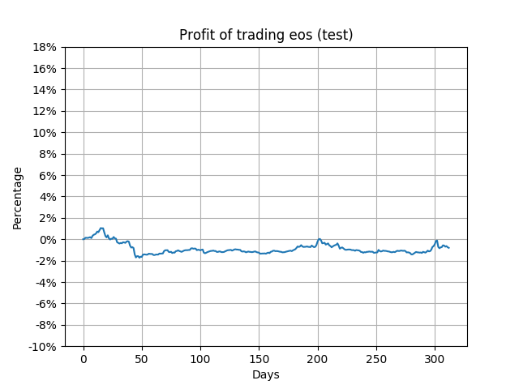
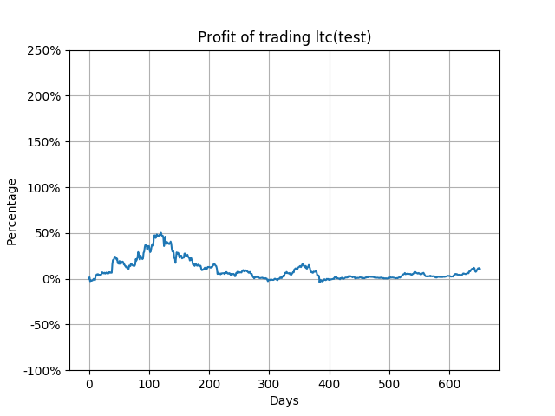
Results and Analysis - Long-Term Profits
Notes:
As for the long-term, the dataset covers all ten years of the price per day data from 2010 to 2020. The trading frequency is also everyday, and the profit of the testing set is shown on the right. As you the see, the profit increased by 100%. That means our money actually doubled. This seems incredibly well for a model, but it is actually very reasonable.

Slide 10
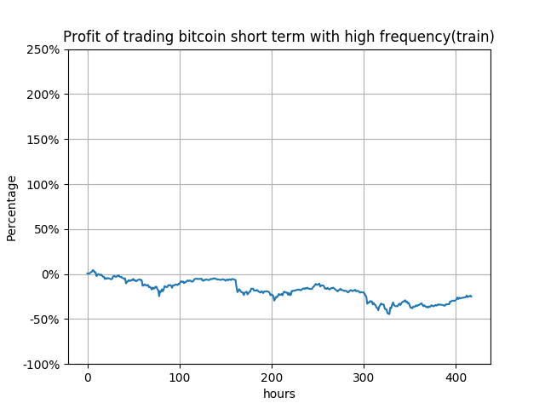
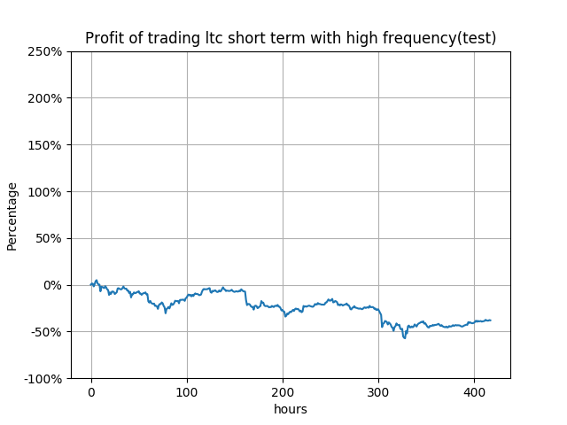
Results and Analysis - Short-Term Profits
Notes:
The results of the model are going to be analyzed under two different circumstances: short-term results and long-term results. For the short-term, the dataset is a random year selected between 2010 and 2020. Here, we are using the year 2019 as an example since it has more positive results than previous years. When trading frequency is everyday, the profit of the testing set is shown on the right.
As we can see, the profit is clearly positive.

Slide 11
Conclusion
The model is good at long term low frequency trading but not good at short term high frequency trading.(Indexes don’t help a lot in short term high frequency trading)
Notes:
Finally, for the conclusion, the team would say the proposed model has achieved the goal of be more generalized than the stock market model. This is because the additional features the model includes. Now the model at least can be used on both bitcoin and eth markets.
Also, the team would say the proposed model has a overall great performance since it can provides positive profit in the end.

Slide 12
Future works
Add some more complex layers into deep neural network like CNN and LSTM to strong our model.
Redefine our state space by using more efficient and independent trading indicators or indexes
Redefine our reward structure and make it closer to the reality.

Slide 13
Thank You!
Notes:
And that’s the end of our presentation. We are group 3. Thank you for listening.

