Slide 1
Video Game Analysis
Kishan Patel, Ryan Stewart,
William Johnson, and Luis Gonzalez

Slide 2
Outline
Motivation
Objectives
Approaches
Results & Discussion
Questions
Notes:
https://www.flaticon.com/authors/flat-icons

Slide 3


Motivation
COVID-19 has drastically affected overall human behavior and has left millions of people quarantined at home.
We want to analyze how COVID-19 has impacted video game trends and how they compare now to before the pandemic started.
Notes:
https://unsplash.com/photos/j2c7yf223Mk

Slide 4


Objective
Collect historical data – from a data set of video games from Steam
Use the Steam API to collect game IDs, game names, and monthly play counts.
Notes:
https://www.flaticon.com/authors/flat-icons

Slide 5
Tools/Methods: Steam API
Generated Steam Web API key
Read through documentation; was able to collect IDs corresponding to games/apps.
Unsuccessful at collecting historical data
Only way to obtain historical data is to persist data over a time period; too late to start now
Look for another tool or method

Slide 6

Tools/Methods: SteamSpy
Using SteamSpy, we were able to collect:
List of apps on Steam
Information on each app such as: type, name, steamId, controller support, etc.
Decided to not use SteamSpy in our analysis because it was unable to give us the usage information we needed

Slide 7

Tools/Methods: SteamDB
Using urllib and requests libraries
Scraped IDs and names from Steam page that correspond to IDs on SteamDB; SteamDB had limitations.
Using Selenium library (ChromeDriver)
Able to connect to SteamDB; however, ran into Cloudflare issue
Using Undetected ChromeDriver
Bypasses Cloudflare; however, SteamDB still blocks access
Notes:
https://www.google.com/url?sa=i&url=https%3A%2F%2Fgithub.com%2Ftopics%2Fsteamdb&psig=AOvVaw2DUZQ7lA-AhimVo18_03vw&ust=1637358787727000&source=images&cd=vfe&ved=0CAwQjhxqFwoTCMDsgfryovQCFQAAAAAdAAAAABAZ

Slide 8
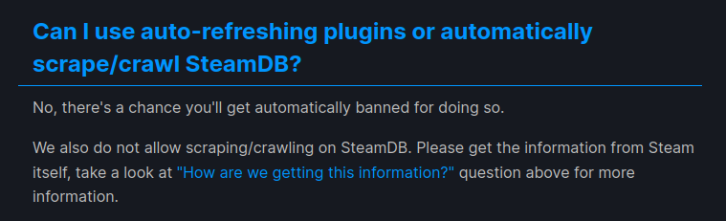
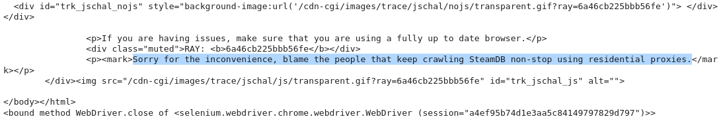
Tools/Methods: SteamDB
Policy from SteamDB’s FAQ Page
Attempting to scrape data from SteamDB using Selenium

Slide 9
Tools/Methods: Dataset Websites
Collected the following Kaggle datasets:
Twitch Data set
Steam Data set

Slide 10
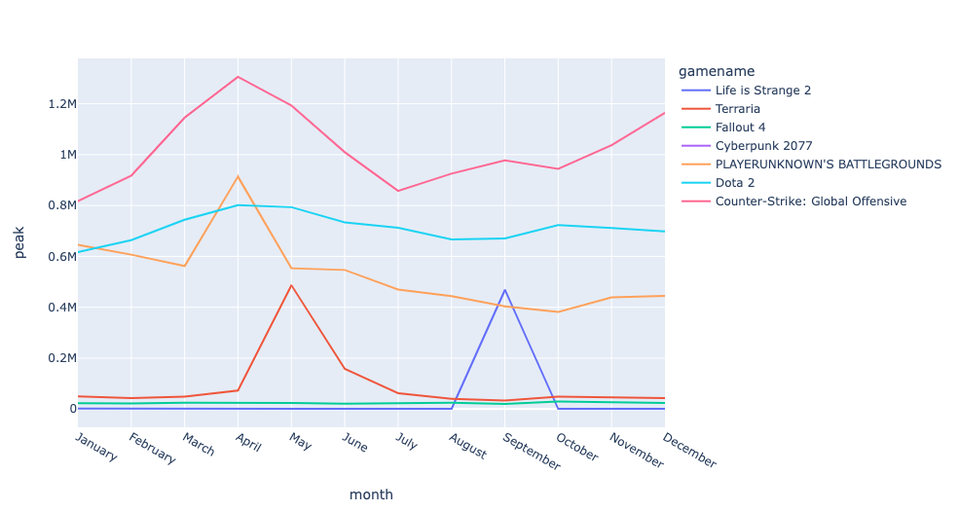
Steam Most Played Game

Slide 11
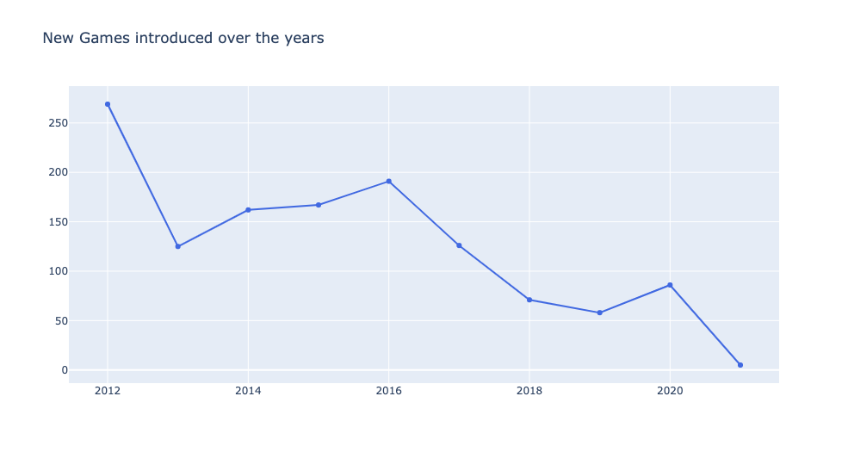
Steam Video Game Release

Slide 12

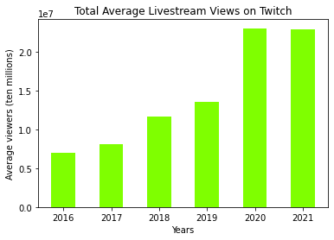
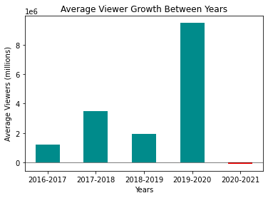
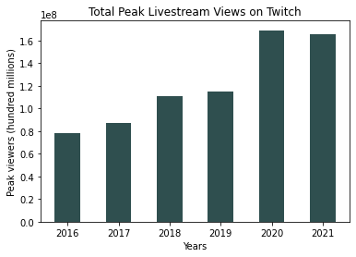
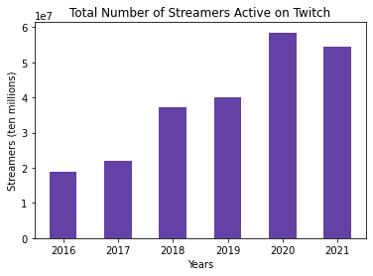
Twitch Data

Slide 13
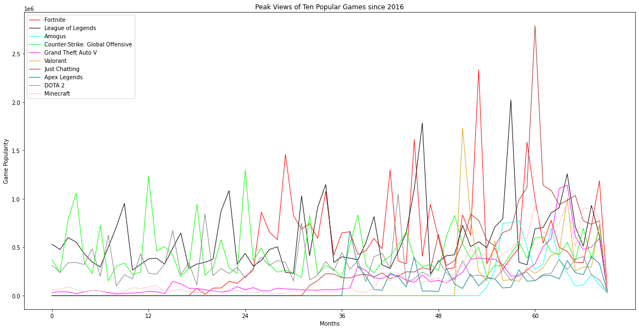
Twitch Data

Slide 14
Results & Discussion
Started off limiting ourselves to just collecting data from Steam. (Would have resulted in limited data set).
Struggled with collecting data; eventually found out about Kaggle data sets.
Opened doors to more data sets (Steam + Twitch); able to observe popular games not available on Steam platform (i.e. Fortnite, League of Legends).
Plotted data, made observations on findings and impact of games during timeline.
Yes, COVID-19 did impact the gaming industry.

Slide 15
Questions?

