Slide 1
DBaaS
Managed service
(ex mysql, postgres)

Slide 2
DBaaS - Managed services using Openshift - example PostgreSQL / MySQL
Users (via a web portal and/or API) can create databases as self service provisioning
The databases will be managed by an IT Team, not directly by the users
Openshift provides native monitoring and alerting for this databases
In this example, we provide additional tools for admin and users : pgAdmin, phpMyAdmin
Those tools bring tuning and performance troubleshooting capabilities
Snapshots are provided for easily backuping/restoring the databases
This application demo is still simple but shows how you can create a real managed service
Others operators can be looked at :
https://operatorhub.io/operator/percona-xtradb-cluster-operator

Slide 3
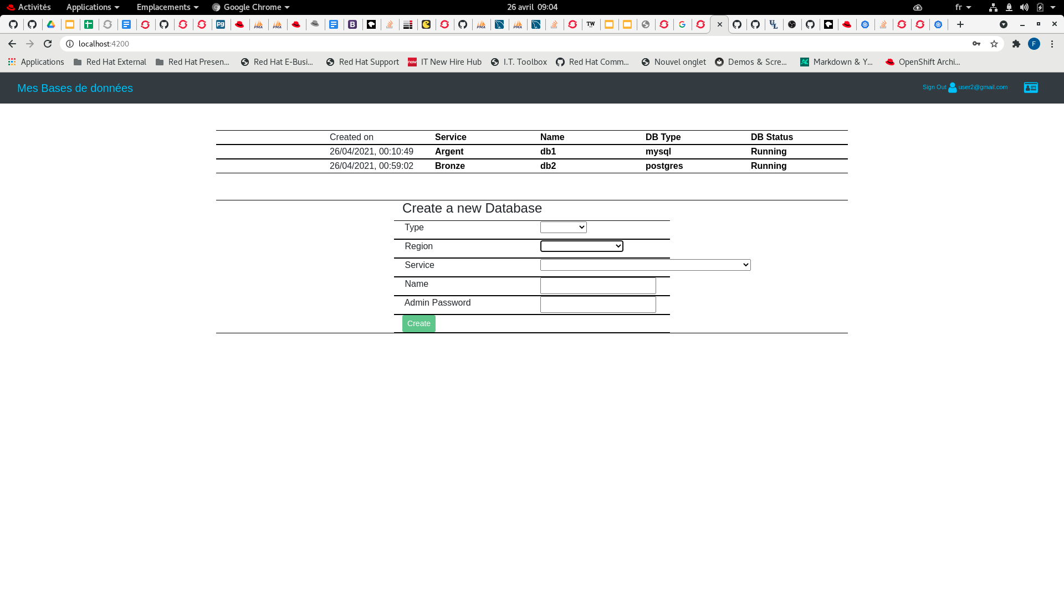
This is a simple angular self-service dbaas portal
Users can create databases and handle their content
But underlying infrastructure is managed by an IT Team
Users only configure and use their databases
The IT Team handles the service
It manages the underlying infrastructure
And the Portail/Api for users

Slide 4
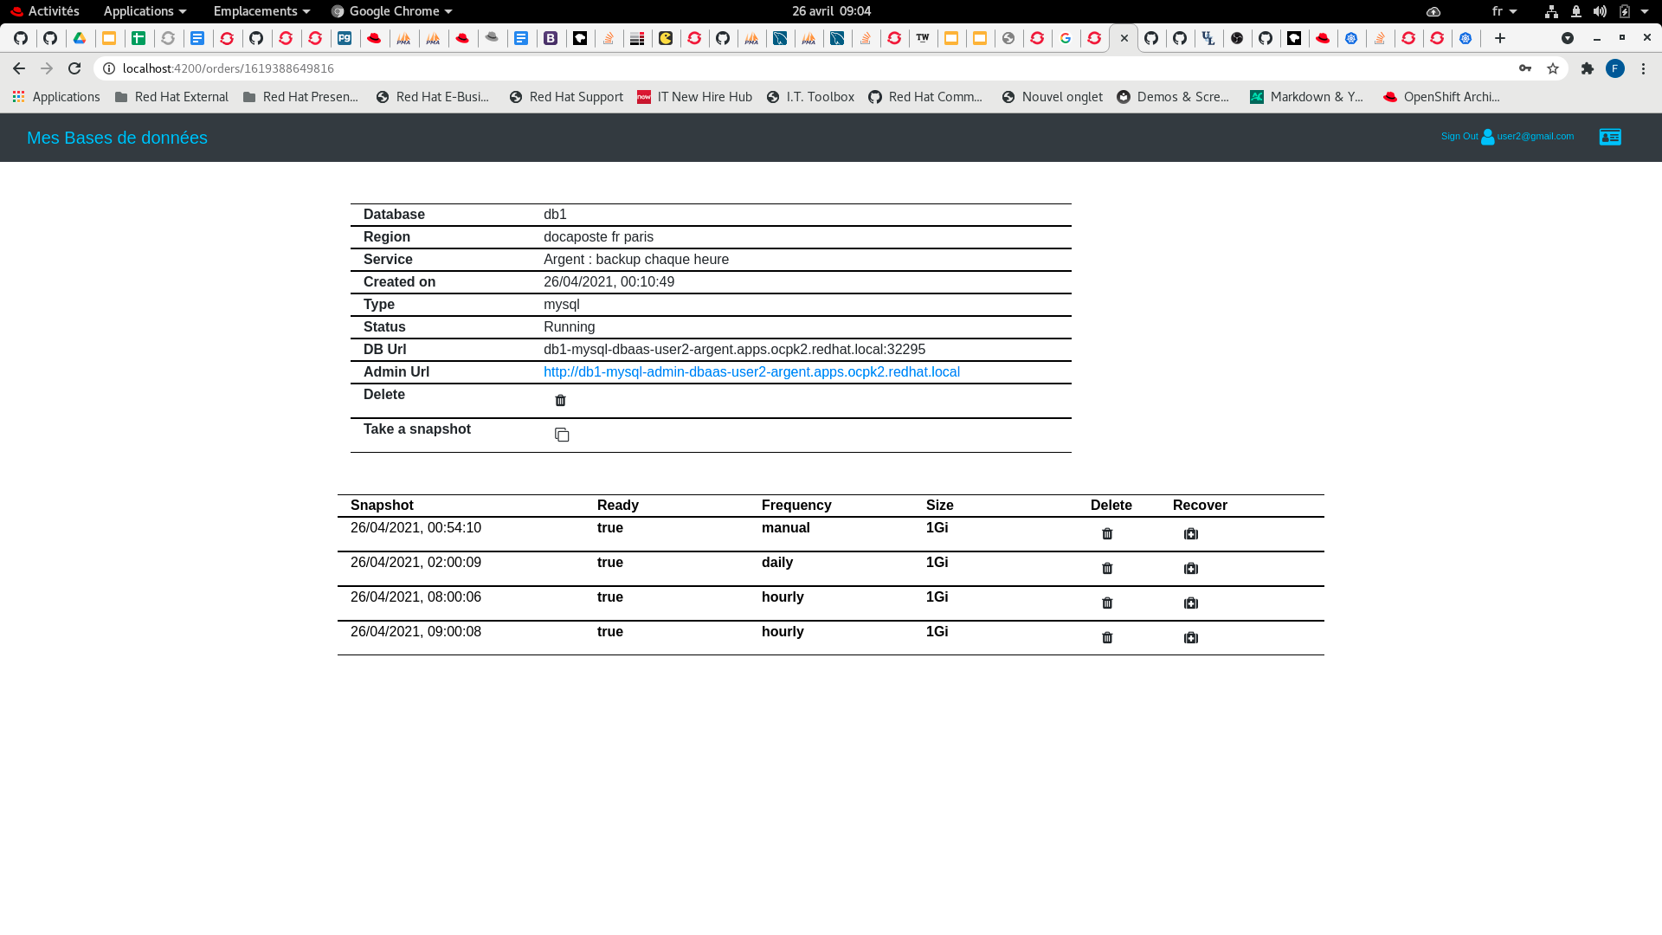
For each database instance :
The user sets the database admin password at creation
The database can be reached from outside the cluster (via node port)
An admin url is also available
Users can snapshot their database (volumesnapshot)
Users can restore a database from a snapshot (mode recover)

Slide 5
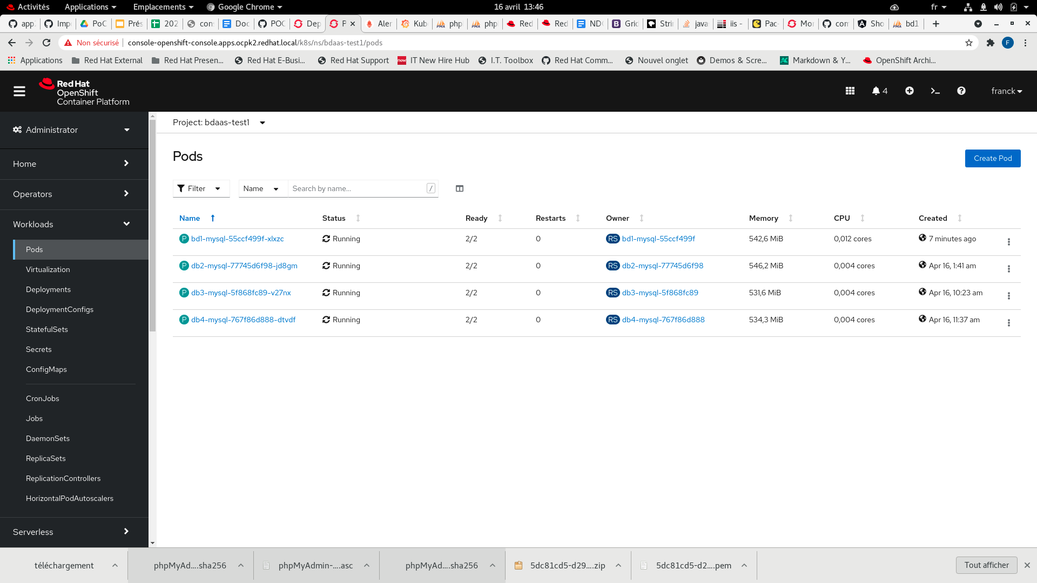
The databases are running on Openshift
The namespaces where are running the databases are created (automaticaly) and managed only by the IT Team

Slide 6
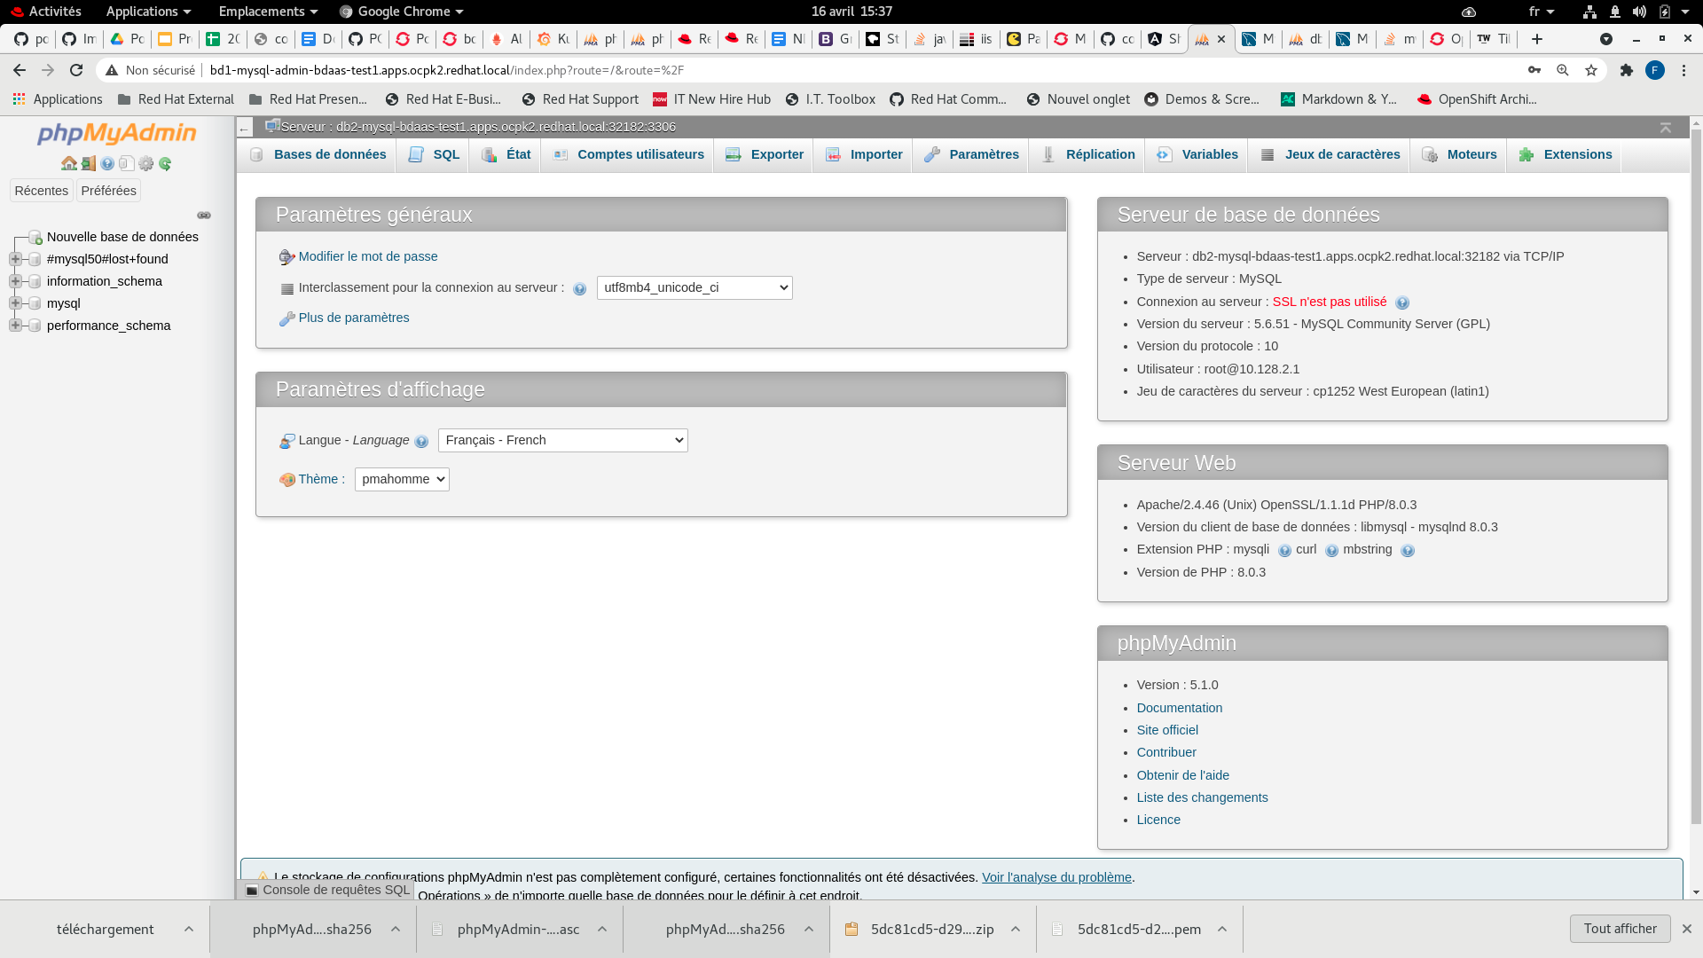
external
access
phpMyAdmin instance is created as a side container for each database instance

Slide 7
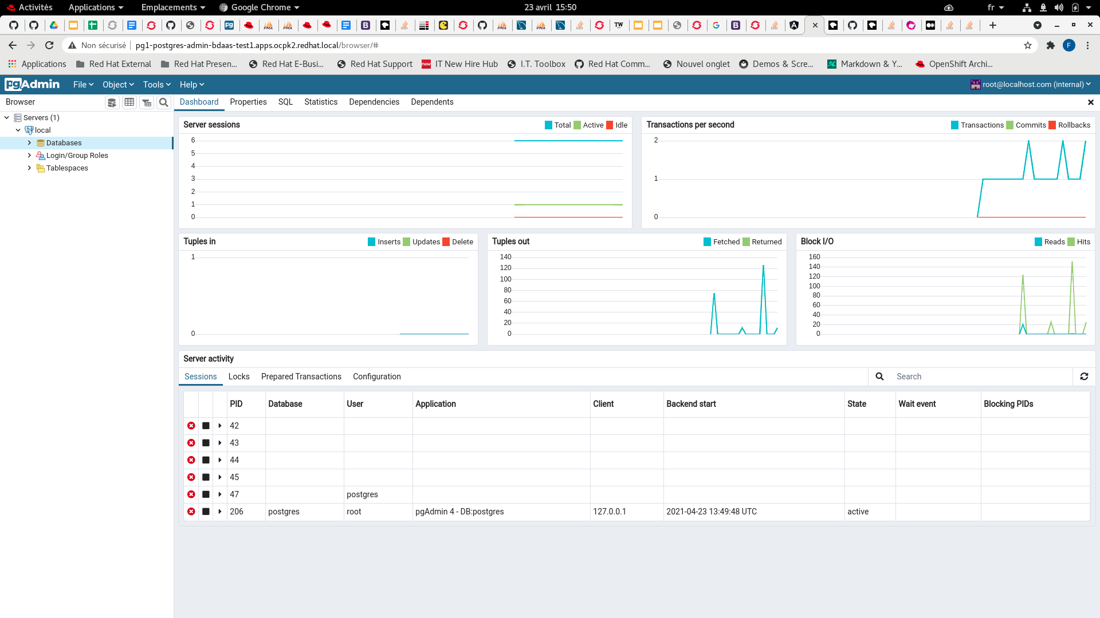
external
access
pgAdmin instance is created as a side container for each database instance

Slide 8
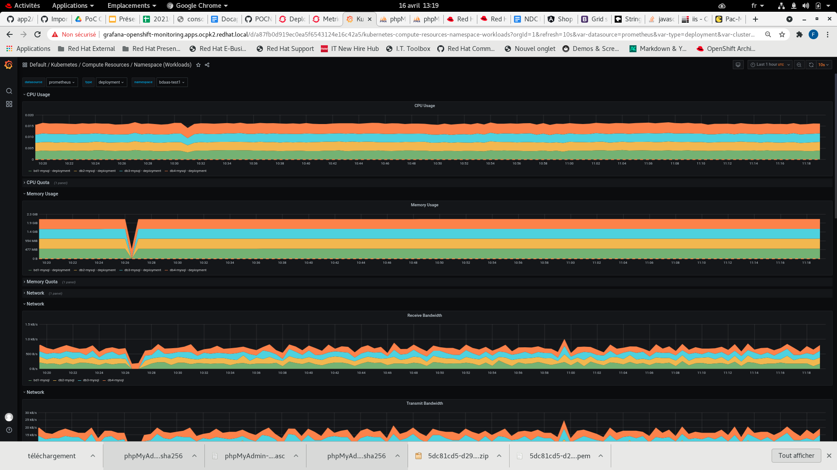
Openshift provides automatic metrology and monitoring for each create database, which makes it easy for the IT team to monitor the databases

Slide 9
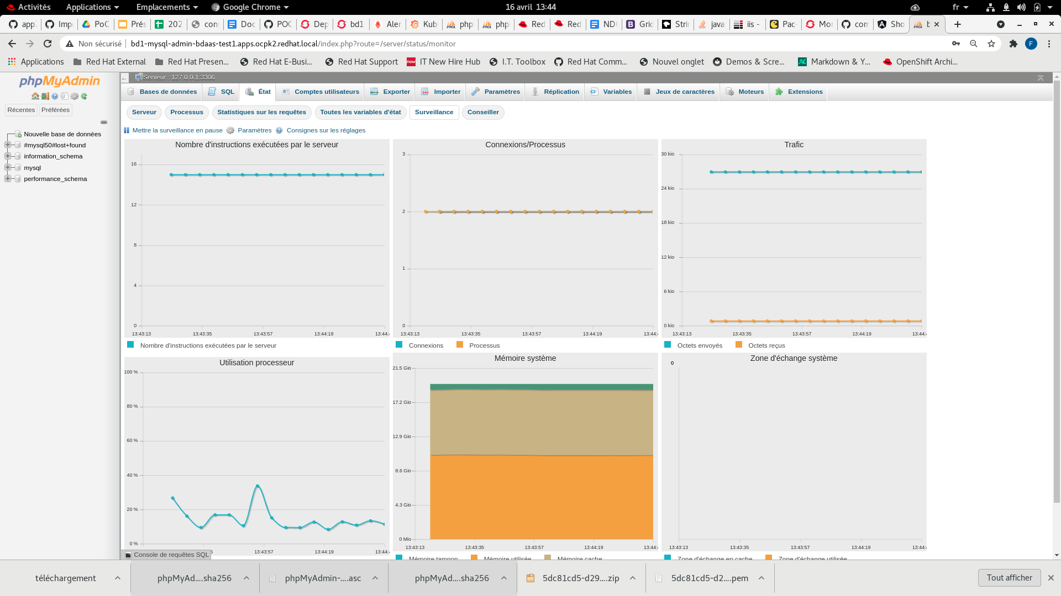
Specific tools like pgAdmin or phpMyAdmin brings more information/tooling for database users or IT admins

Slide 10
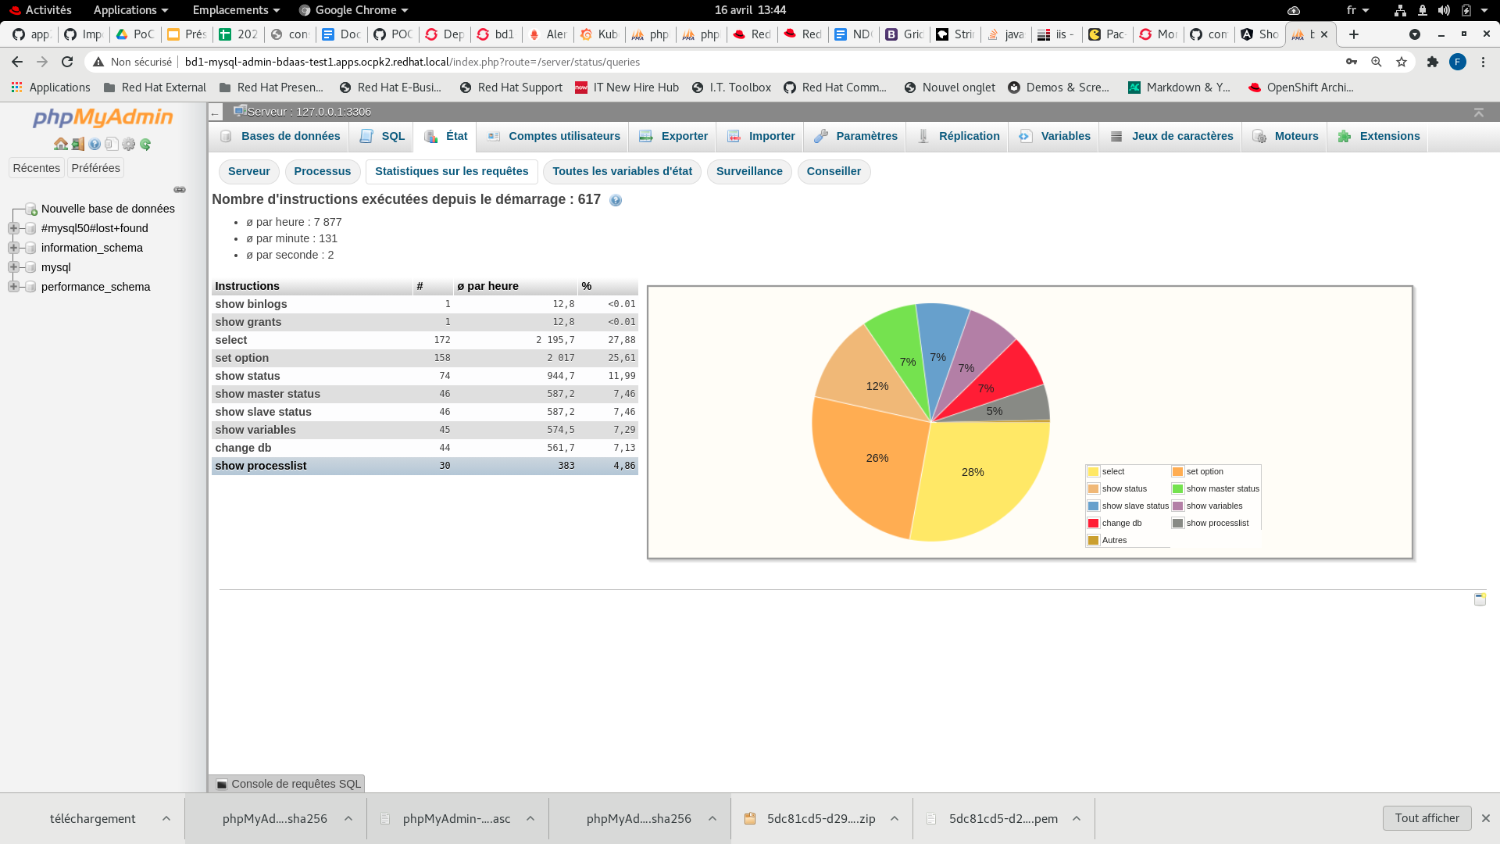
Users can troubleshoot request performance issue

Slide 11
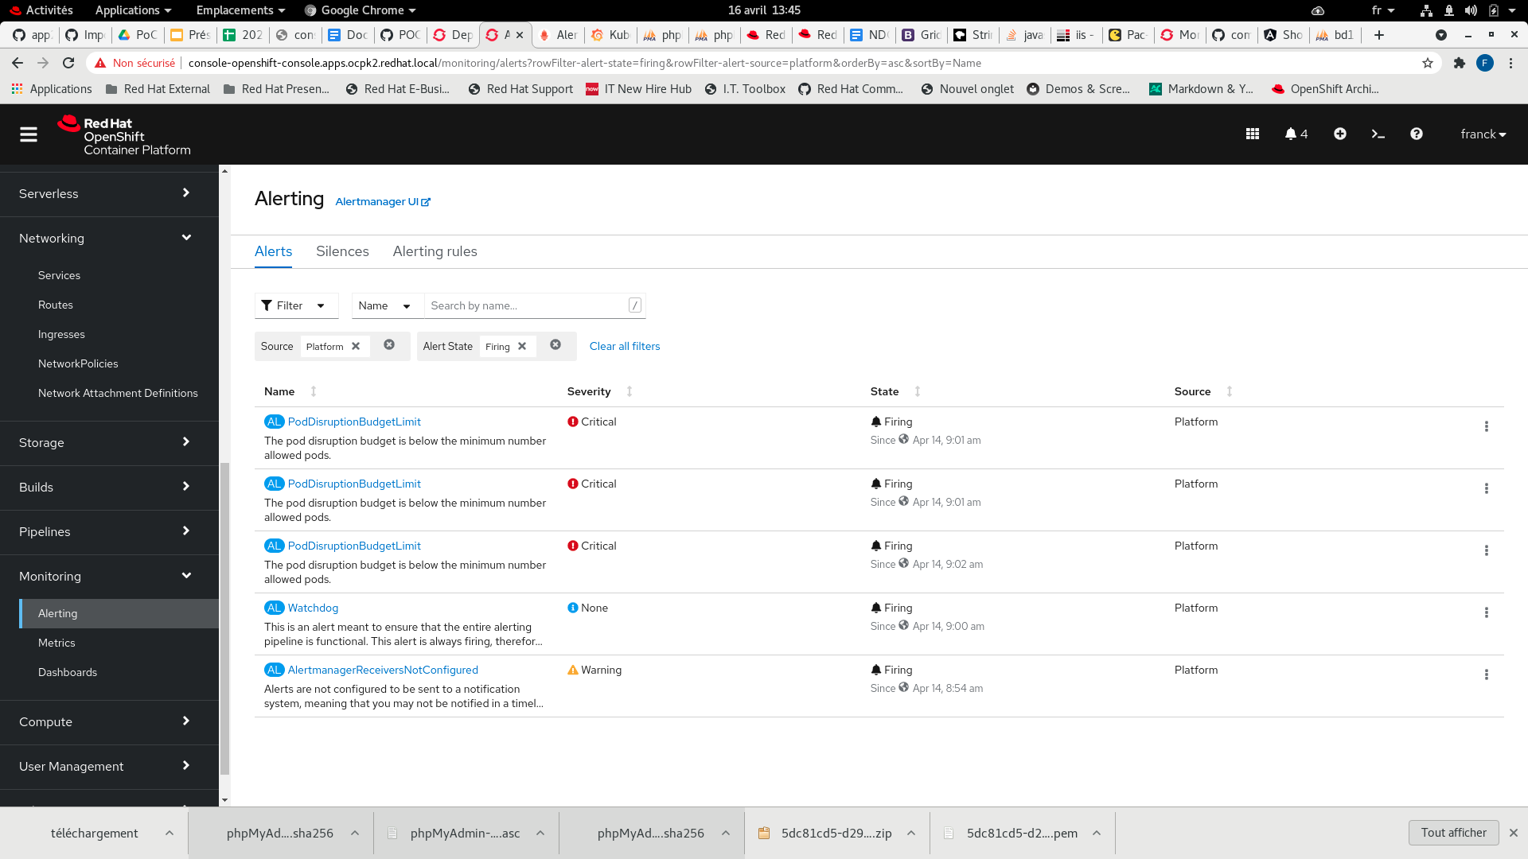
Openshift provides generic alerting rules but more can be added to provide better accuracy

