Slide 1


Towards A Polyglot Framework for Factorized ML
VLDB’21
Industry Track
David Justo, Shaoqing Yi, Lukas Stadler, Nadia Polikarpova, Arun Kumar

Slide 2





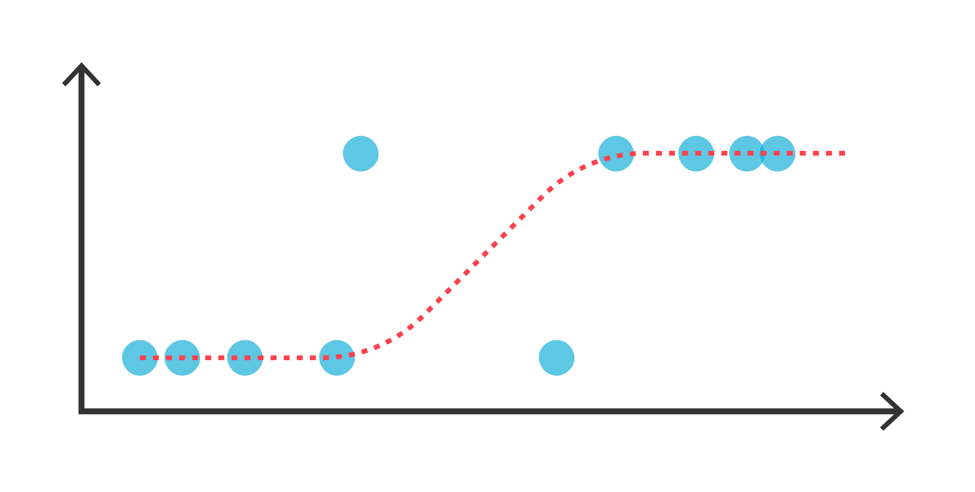
A Polyglot Data Science World

Slide 3
Challenge
Maintaining dev-tools across
multiple PLs is hard to scale

Slide 4

Morpheus

Slide 5
De-normalizing leads to redundancy
JOIN
Redundancy =
slower training times
A relational dataset
The dataset post-join

Slide 6
De-normalizing leads to redundancy
Notes:
With Morpheus, there’s a better way

Slide 7
De-normalizing leads to redundancy
Op( )
Notes:
Keyword: equivalent computation

Slide 8
De-normalizing leads to redundancy
Op( )
Op( )
Op( )
Notes:
Keyword: equivalent computation

Slide 9
De-normalizing leads to redundancy
Op( )
Op( )
Perf Gains!
Op( )

Slide 10
A development challenge
New PL
New Optimization
Opt.1
Massive burden for a research team
Opt.3
Needs PL-specific finetuning
Opt.2
…
…
Notes:
We realized we were embarking towards a massive development challenge, on 2 fronts
… on one hand
... Taking a step back, this paints the picture of tight-coupling between the design of new factorized ML optimizations, and the low-level details of its implementation per each language. The result is a kind of quadratic cost in the maintenance burden, parametrized by our number of supported PLs, and the rewrite rules we support.
… so what can we do?

Slide 11
Key Idea
We need to disentangle
the specification of rewrite rules
from target-PL domain knowledge

Slide 12
✨Trinity ✨
A framework to support and develop polyglot/
multi-language factorized ML systems

Slide 13
Contributions
To our knowledge, the first system to generalize factorized ML to multiple PLs at once
Extend GraalVM’s interoperability abstractions with Matrix support
Demonstrate perf improvements in 3 new leaner prototypes for R, JS, and Python
Notes:
Finally, using trinity we *quickly* developed 3 new implementations of Morpheus: one for R, one for JavaScript, and one for Python. They each display performance improvements compared the alternative of learning over the materialized join.

Slide 14
Agenda
Introduction
GraalVM
Architecture
Evaluation
Future Directions

Slide 15
Agenda
Introduction
GraalVM
Architecture
Evaluation
Future Directions

Slide 16

Your new PL here!
…
Shared Interpreter
Notes:
GraalVm is a language runtime that supports multiple programming languages. This means, that a shared interpreter provides implementations for various languages such as: R, Python, JavaScript, and several others.
What stands out for Graal compared to other VMs is that it has the explicit goal of supporting as many languages as possible, so its shared interpreter framework is really easy to use and the maintainers even encourage the development of new custom languages for the VM; so you could develop your own!
Furthermore, languages in graal are augmented with interoperability tools that make it easy to share code across multiple languages.
For example, in grail it is possible to have a single source code file that combines syntax from multiple languages, and the grail interpreter is able to compose different interpreters and share data among then when executing these mixed-language scripts.
These interoperability features are really powerful for code re-use, which aligned very well with out goals for Trinity. And this is the main reason why we chose it as the foundation in which to build this project.
So…with these features in mind, we’re ready to talk about the architecture of Trinity. Let’s take a look!

Slide 17
Agenda
Introduction
GraalVM
Architecture
Evaluation
Future Directions

Slide 18

MatrixLib
MorpheusDSL
Matrix is sparse in ?
Yes
No
Normalized Matrix
Call Foo()
Call Bar()
Op( )
Notes:
..a Morpheus rewrite rule wil ltrigger to perform the computation over the normalized data within.
In that takes us to the second component: the rewrite rules!
The rewrite rules, are specified in a new GraalVM language that we call MorpheusDSL.
And third, the Morpheus rewrite rules are powered by MatrixLib – an new interoperability abstraction that we developed to encapsulate all language-specific knowledge needed to port the rewrite rules to a new language.
Now let’s dive deeper into each of these components starting with MorpheusDSL.

Slide 19
MorpheusDSL
Morpheus rewrite rules as AST nodes

Slide 20
A MorpheusDSL Rewrite
*
Some PL, e.g R
5
MorpheusDSL
MorpheusDSL semantics

Slide 21
A MorpheusDSL Rewrite
Some PL, e.g R
*
*
*
MorpheusDSL
5
5
5
MorpheusDSL semantics
Notes:
At runtime, the MorpheusDSL node *expands* to several calls back to R’s own linear algebra libraries, which performs the actual computations. So MorpheusDSL is just a rewriting engine, the work is done in the same language where the data resides….R in this case.
…
In short, MorpheusDSL dynamically rewrites linear algebra operations in a language, like R, to work directly on a normalized matrix. But how is it able to do this irrespective of the language it is aiming to rewrite?

Slide 22
MatrixLib
Unified Matrix interoperability abstraction
Notes:
MatrixLib defines a unified collection of method signatures that we expect to be available for any Matrix datatype.

Slide 23
MatrixLib allows 1st class Matrix interop
You mean “%*%”?
Sure thing!
Invoke MatrixLib’s multiplication with 5
You mean “__mul__”?
Sure thing!
Notes:
Using this abstraction, MorpheusDSL is able to define its rewrite rules in terms of these generic Matrix APIs, and have them work irrespective of the language that is executing them.
MatrixLib provides the translation from these generic APIs to the concrete operators in some given language. This works using the adapter pattern, which perform the translation.

Slide 24
MatrixLib allows 1st class Matrix interop
MatrixLib
Invoke MatrixLib’s multiplication with 5
Matrix is sparse in ?
Yes
No
Call Foo()
Call Bar()
Notes:
But Matrix is more than just a translation step. MatrixLib adapters also encode language-specific optimizations that further transform our rewrites and that ensure we get good performance out of our optimizations.
For instance, an adapter may implement a Matrix multiplication operator in different ways depending on whether the target matrix is sparse, or dense. Adapters inspect various properties of the data they’re working to determine how a some operation is meant to execute.
The key though is that we’ve separated these optimizations from the rewrite rules, allowing us to benefit from them through composition of MatrixLib methods!
keyword: modular!! APPlied everytime

Slide 25

In-PL
invocation
Built-in
interop
MatrixLib interop
MatrixLib
MorpheusDSL
Op( )
PL Domain
knowledge
Op( )
Normalized Matrix
Op( )
Op( )

Slide 26
In-PL
invocation
Built-in
interop
MatrixLib interop
MatrixLib
MorpheusDSL
Op( )
PL Domain
knowledge
Op( )
Normalized Matrix
Op( )
Op( )

Slide 27
Agenda
Introduction
GraalVM
Architecture
Evaluation
Future Directions

Slide 28
Evaluation
Algorithms:
Logistic Regression
K-Means Clustering
Linear Regression
GNMF Clustering
Baselines (in R):
Morpheus
Materialized
Setting:
R language
Movies dataset
(3-table join)
Notes:
In the paper: we also show results for JavaScript and Python, and evaluate Trinity over 7 real-world datasets

Slide 29
Model Training Time (lower is better)
8.56x speed-up
8.13x speed-up
165 sec
5.05x speed-up
4.98x speed-up
358 sec

Slide 30
Model Training Time (lower is better)
7.55x speed-up
7.49x speed-up
132 sec
0.79x slow-down
0.88x slow-down
256 sec
Notes:
Now the GNMF case is interesting…..
So why do the rewrite rules perform poorly on this algorithm? The reason is that, in some cases, the rewrite overhead is larger than the speedups you obtain, so you end up with a slowdown. So factorized ML is not a silver bullet, but it does work in many cases as shown in the rest of our evaluation.
<move to next slide>
Taking a step back from GNMF, let’s summarize our evaluation results.

Slide 31
Aside: When is Factorized ML slower?
Unexpected variance in cost of LA operators
Minimal redundancy introduced by the join
Notes:
Now the GNMF case is interesting…..
So why do the rewrite rules perform poorly on this algorithm? The reason is that, in some cases, the rewrite overhead is larger than the speedups you obtain, so you end up with a slowdown. So factorized ML is not a silver bullet, but it does work in many cases as shown in the rest of our evaluation.
<move to next slide>
Taking a step back from GNMF, let’s summarize our evaluation results.

Slide 32
Model Training Time

Slide 33
Evaluation Summary
Trinity (multi-PL) achieves comparable speed-ups to Morpheus (single PL)
Trinity’s relative performance difference with Morpheus is small, no larger than 20%
Big win: performance and generality
Notes:
Trinity achieves speeds up comparable to that of a single-language Morpheus implementation
… although the single-language approach does seem to have a slight performance advantage.
However, in our experience, Trinity’s relative performance …

Slide 34
Takeaways
Trinity is a polyglot framework for Factorized ML
Solves a developability challenge for today’s polyglot Data Science landscape
Performance comparable to single-language Morpheus implementations
Notes:
In this presentation.

Slide 35
Agenda
Introduction
GraalVM
Architecture
Evaluation
Future Directions

Slide 36
Where to go next?
Remove dependency on GraalVM
Automatic PL-specific fine-tuning
User Study on debuggability and productivity
Notes:
If you find this research direction interesting, I want to leave you with some ideas of future directions for a project like Trinity.
A first proposal is to expand Trinity to work as a transpiler.
Today, Trinity more or less accepts the Morpheus rewrite rules, and source code, and applies the rewrites as appropriate at runtime. However, in doing so we’ve created a tight dependency with GraalVM.
This proposal is to remove that dependency so that Trinity can help programmers irrespective of whether they want to use GraalVM. To do this, we can convert Trinity into a compile-time optimizer that takes in source code
And produces a copy of that source where the Morpheus rewrite rules are inlined. Then you can take that code and run in anywhere, no GraalVM required.
The hope would be that we could leverage Trinity’s language agnostic architecture so that this would work easily irrespective of language. For instance, it could optimize a Python script and inline the rewrites in it as easily as
It could with JS, or R for that matter.
The second proposal relates more closely with MatrixLib. So we’ve talked about how crucial is language-specific domain knowledge in embedding the Morpheus rewrite rules in other languages. With Trinity, we’ve modularized
This domain knowledge and made it compositional, but it still takes time to acquire and discover these language optimizations. So we would be interested in exploring how to automatically discover and encode these PL domain knowledge to
Reduce the user burden even further.
…and there you have it (next slide)

Slide 37
Towards A Polyglot Framework for Factorized ML
VLDB’21
Industry Track
https://adalabucsd.github.io/morpheus.html

Slide 38
Backup Slides

Slide 39
Where to go next?
Matrix is sparse in ?
✨Trinity ✨
Yes
No
+
Call Foo()
Call Bar()
+
Automatic discovery of PL-aware perf knowledge
Trinity as a transpiler
Notes:
If you find this research direction interesting, I want to leave you with some ideas of future directions for a project like Trinity.
A first proposal is to expand Trinity to work as a transpiler.
Today, Trinity more or less accepts the Morpheus rewrite rules, and source code, and applies the rewrites as appropriate at runtime. However, in doing so we’ve created a tight dependency with GraalVM.
This proposal is to remove that dependency so that Trinity can help programmers irrespective of whether they want to use GraalVM. To do this, we can convert Trinity into a compile-time optimizer that takes in source code
And produces a copy of that source where the Morpheus rewrite rules are inlined. Then you can take that code and run in anywhere, no GraalVM required.
The hope would be that we could leverage Trinity’s language agnostic architecture so that this would work easily irrespective of language. For instance, it could optimize a Python script and inline the rewrites in it as easily as
It could with JS, or R for that matter.
The second proposal relates more closely with MatrixLib. So we’ve talked about how crucial is language-specific domain knowledge in embedding the Morpheus rewrite rules in other languages. With Trinity, we’ve modularized
This domain knowledge and made it compositional, but it still takes time to acquire and discover these language optimizations. So we would be interested in exploring how to automatically discover and encode these PL domain knowledge to
Reduce the user burden even further.
…and there you have it (next slide)

Slide 40
Where to go next?
👩‍💻
User Study: productivity and debuggability
Notes:
If you find this research direction interesting, I want to leave you with some ideas of future directions for a project like Trinity.
A first proposal is to expand Trinity to work as a transpiler.
Today, Trinity more or less accepts the Morpheus rewrite rules, and source code, and applies the rewrites as appropriate at runtime. However, in doing so we’ve created a tight dependency with GraalVM.
This proposal is to remove that dependency so that Trinity can help programmers irrespective of whether they want to use GraalVM. To do this, we can convert Trinity into a compile-time optimizer that takes in source code
And produces a copy of that source where the Morpheus rewrite rules are inlined. Then you can take that code and run in anywhere, no GraalVM required.
The hope would be that we could leverage Trinity’s language agnostic architecture so that this would work easily irrespective of language. For instance, it could optimize a Python script and inline the rewrites in it as easily as
It could with JS, or R for that matter.
The second proposal relates more closely with MatrixLib. So we’ve talked about how crucial is language-specific domain knowledge in embedding the Morpheus rewrite rules in other languages. With Trinity, we’ve modularized
This domain knowledge and made it compositional, but it still takes time to acquire and discover these language optimizations. So we would be interested in exploring how to automatically discover and encode these PL domain knowledge to
Reduce the user burden even further.
…and there you have it (next slide)

Slide 41


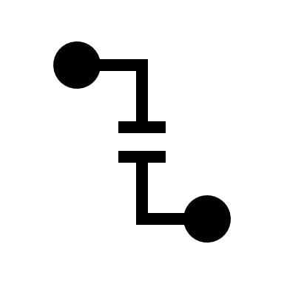
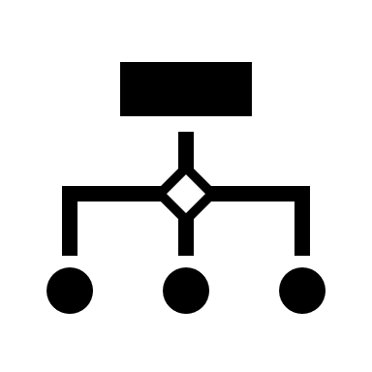
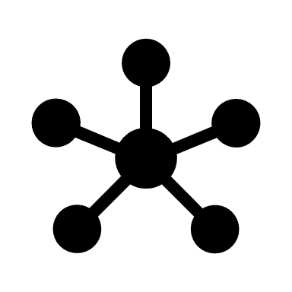
Options
FFIs
not PL-general
not efficient
Compiler
hard to extend
Shared Runtime
challenge: how many PLs are supported

Slide 42
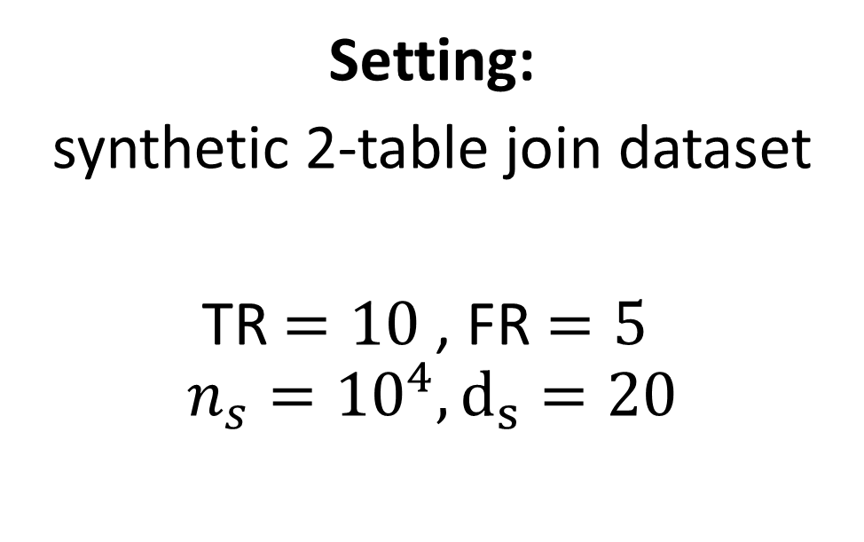
JS and polyglot (R+Python) Evaluation
Algorithm:
Linear Regression
Setting:
synthetic 2-table join dataset
TR $=10$, FR $=5$
$$n_{s}={10}^{4}, d_{s}=20$$
Baselines:
Materialized

Slide 43
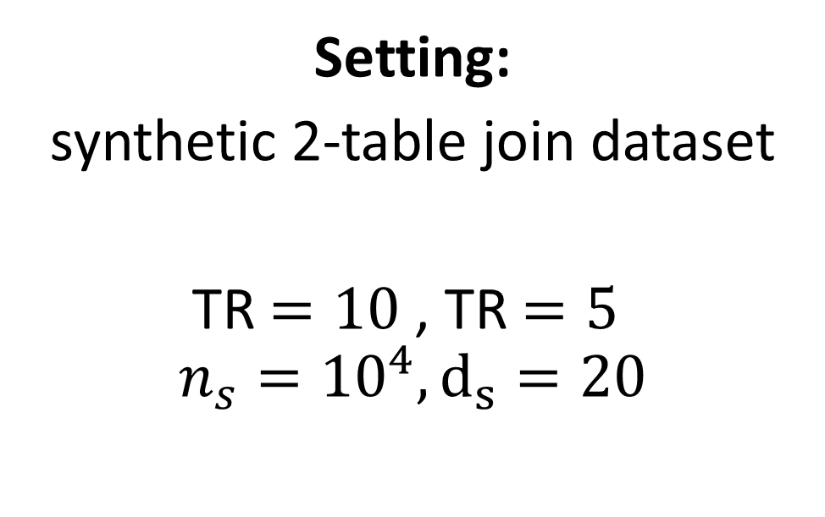
JS and polyglot (R+Python) Evaluation
Algorithm:
Linear Regression
Setting:
synthetic 2-table join dataset
TR $=10$, TR $=5$
$$n_{s}={10}^{4}, d_{s}=20$$
Baselines:
Materialized

Slide 44
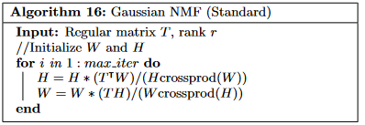
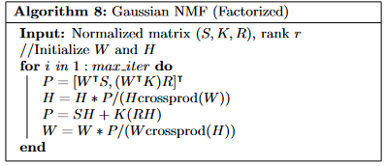
Aside: GNMF analysis
Notes:
Now the GNMF case is interesting…..
So why do the rewrite rules perform poorly on this algorithm? The reason is that, in some cases, the rewrite overhead is larger than the speedups you obtain, so you end up with a slowdown. So factorized ML is not a silver bullet, but it does work in many cases as shown in the rest of our evaluation.
<move to next slide>
Taking a step back from GNMF, let’s summarize our evaluation results.

Slide 45
Aside: GNMF analysis
Notes:
Now the GNMF case is interesting…..
So why do the rewrite rules perform poorly on this algorithm? The reason is that, in some cases, the rewrite overhead is larger than the speedups you obtain, so you end up with a slowdown. So factorized ML is not a silver bullet, but it does work in many cases as shown in the rest of our evaluation.
<move to next slide>
Taking a step back from GNMF, let’s summarize our evaluation results.

Slide 46
Aside: GNMF analysis
Notes:
Now the GNMF case is interesting…..
So why do the rewrite rules perform poorly on this algorithm? The reason is that, in some cases, the rewrite overhead is larger than the speedups you obtain, so you end up with a slowdown. So factorized ML is not a silver bullet, but it does work in many cases as shown in the rest of our evaluation.
<move to next slide>
Taking a step back from GNMF, let’s summarize our evaluation results.

Slide 47
Aside: GNMF analysis
Notes:
Now the GNMF case is interesting…..
So why do the rewrite rules perform poorly on this algorithm? The reason is that, in some cases, the rewrite overhead is larger than the speedups you obtain, so you end up with a slowdown. So factorized ML is not a silver bullet, but it does work in many cases as shown in the rest of our evaluation.
<move to next slide>
Taking a step back from GNMF, let’s summarize our evaluation results.

Slide 48
Aside: GNMF analysis
Notes:
Now the GNMF case is interesting…..
So why do the rewrite rules perform poorly on this algorithm? The reason is that, in some cases, the rewrite overhead is larger than the speedups you obtain, so you end up with a slowdown. So factorized ML is not a silver bullet, but it does work in many cases as shown in the rest of our evaluation.
<move to next slide>
Taking a step back from GNMF, let’s summarize our evaluation results.

Slide 49
Aside: GNMF analysis
Notes:
Now the GNMF case is interesting…..
So why do the rewrite rules perform poorly on this algorithm? The reason is that, in some cases, the rewrite overhead is larger than the speedups you obtain, so you end up with a slowdown. So factorized ML is not a silver bullet, but it does work in many cases as shown in the rest of our evaluation.
<move to next slide>
Taking a step back from GNMF, let’s summarize our evaluation results.

Slide 50
Aside: GNMF analysis
In GraalVM’s R:
addition operator had a higher cost than anticipated.
Notes:
Now the GNMF case is interesting…..
So why do the rewrite rules perform poorly on this algorithm? The reason is that, in some cases, the rewrite overhead is larger than the speedups you obtain, so you end up with a slowdown. So factorized ML is not a silver bullet, but it does work in many cases as shown in the rest of our evaluation.
<move to next slide>
Taking a step back from GNMF, let’s summarize our evaluation results.

Slide 51
Model Training Time (lower is better)
28.66x speed-up
2688 sec
2.02x speed-up
873 sec

Slide 52
✨DISCLAIMER ✨
The following is a merely a high-level summary of the concepts in the Morpheus rewrite system

Slide 53
Intuition of Morpheus rewrite rules
JOIN

Slide 54
Intuition of Morpheus rewrite rules
T
JOIN

Slide 55
Intuition of Morpheus rewrite rules
T
S
JOIN

Slide 56
Intuition of Morpheus rewrite rules
T
S
R
JOIN

Slide 57
Intuition of Morpheus rewrite rules
T
S
K
R
JOIN

Slide 58
Intuition of Morpheus rewrite rules
T
S
K
R
[ , ] =

Slide 59
Intuition of Morpheus rewrite rules
S
K
R
Notes:
We already have the key ingredients
Let’s look at 2 examples

Slide 60
Intuition of Morpheus rewrite rules
S
K
R
( , , )
Notes:
We already have the key ingredients
Let’s look at 2 examples

Slide 61
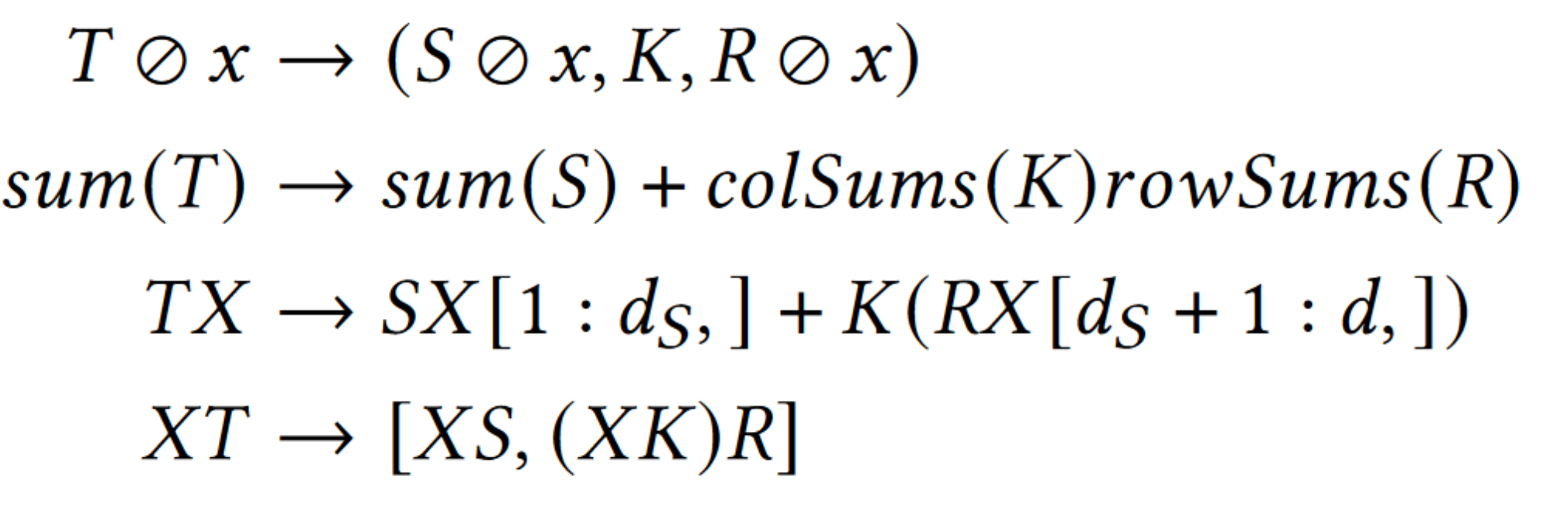
Intuition of Morpheus rewrite rules
Element-wise sum:
??

Slide 62
Intuition of Morpheus rewrite rules
Element-wise sum:
Matrix-scalar op:
??

Slide 63
Intuition of Morpheus rewrite rules
Element-wise sum:
Matrix-scalar op:

Slide 64
Summary of Morpheus
Normalized data representation: (S, K, R)
Avoids the need to materialize the redundancy of T
Rewrites may preserve normalized representation

