Slide 1
Tradeoffs between join materialization and enumeration
Paris Koutris
University of Wisconsin-Madison
joint work with Shaleen Deep

Slide 2
introduction
Data pipelines are used in many data applications
They consist of simpler tasks chained together
Join queries are ubiquitous, but are often the performance bottleneck
R
graph
processing
S
join
T
Materializing the join result can be prohibitively expensive!
ranking
visualization

Slide 3
problem statement
Can we design more efficient join materialization techniques by taking into account the downstream tasks in the data pipeline?

Slide 4
talk outline
Enumeration with Access Patterns
Ranked Enumeration
Conclusion

Slide 5
motivation
In many scenarios a pipeline repeatedly accesses the result of a join using some access pattern
Example: given a relation
we want to run a data analysis over the co-author graph, which can be expressed as the following view:
x, y are co-authors if they are authors of the same paper

Slide 6
framework
N = input size
database D
join query Q
+
access pattern
preprocessing time
data structure
space
preprocessing
enumeration
answer time
delay
= time between two consecutive outputs
access requests
Notes:
Add some motivation here about the next slides, i.e. properties of a pricing function

Slide 7
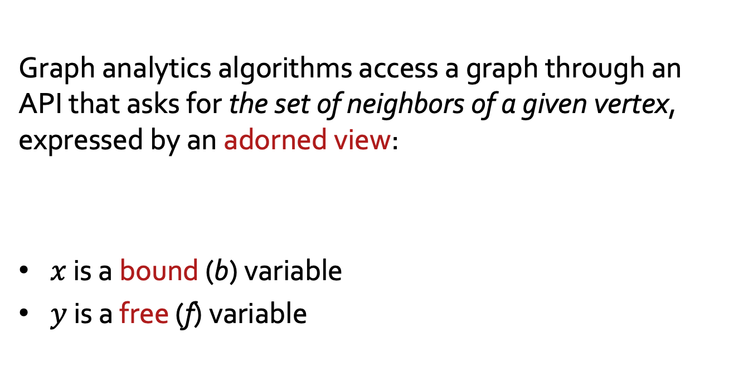
example: graph data
Graph analytics algorithms access a graph through an API that asks for the set of neighbors of a given vertex, expressed by an adorned view:
$x$ is a bound (b) variable
$y$ is a free (f) variable
[Xirogiannopoulos & Deshpande, ’17 ]

Slide 8
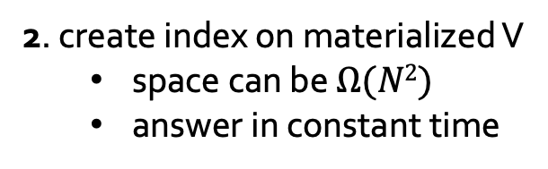
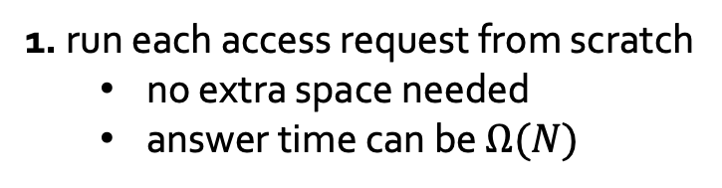
example: graph data
How can we solve this problem?
1. run each access request from scratch
no extra space needed
answer time can be $Ω(N)$
2. create index on materialized V
space can be $Ω(N2)$
answer in constant time
What exists between the two extremes?

Slide 9
adorned views
We consider the class of Conjunctive Queries (CQs):
An adorned view [Ullman ‘85] describes an access pattern where some variables are bound (b) and others free (f)
A CQ is full is every variable appears in the head

Slide 10


query as a hypergraph
It will be convenient to view a CQ as a hypergraph
x
w₁
w₃
bound variables: $V_{b}$
y
z
free variables: $V_{f}$
w₂

Slide 11
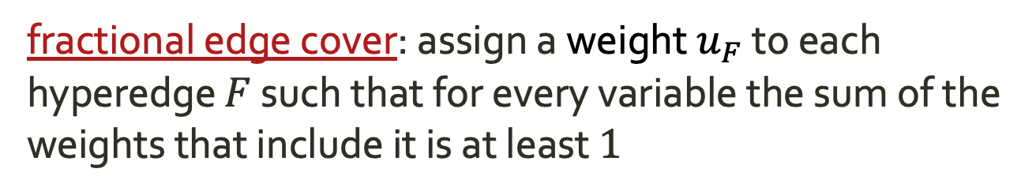
fractional edge cover
fractional edge cover: assign a weight $u_{F}$ to each hyperedge $F$ such that for every variable the sum of the weights that include it is at least $1$
1
1
x
w₁
w₃
y
z
w₂
1

Slide 12
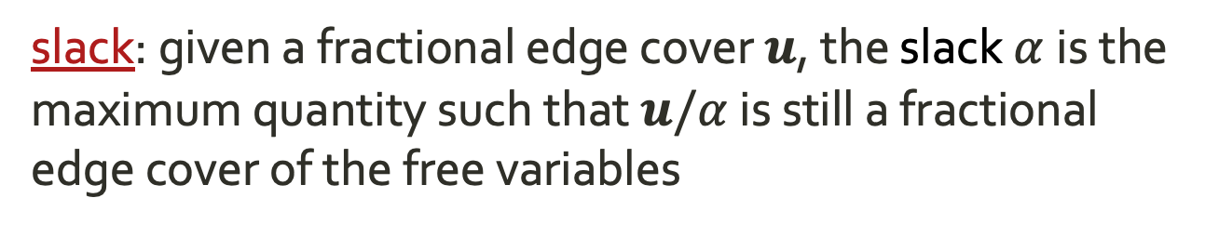
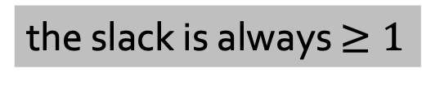
slack
slack: given a fractional edge cover $u$, the slack $α$is the maximum quantity such that $u/α$ is still a fractional edge cover of the free variables
1
1
x
w₁
w₃
y
z
w₂
the slack is always $≥1$
1

Slide 13
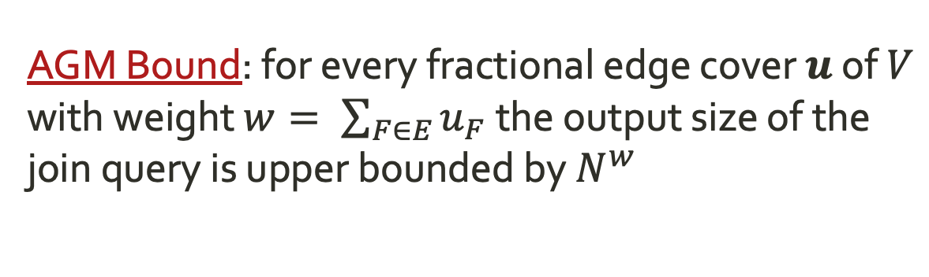
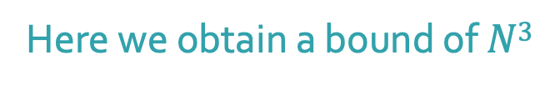
agm bound
AGM Bound: for every fractional edge cover $u$ of $V$ with weight $w= \sum_{F∈E}{u_{F}}$ the output size of the join query is upper bounded by $N^{w}$
1
1
x
w₁
w₃
Here we obtain a bound of $N3$
y
z
w₂
1

Slide 14
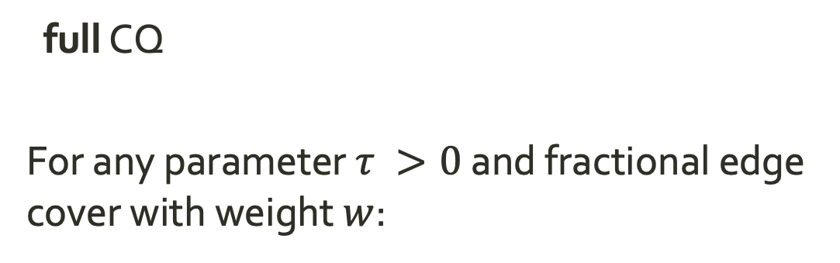
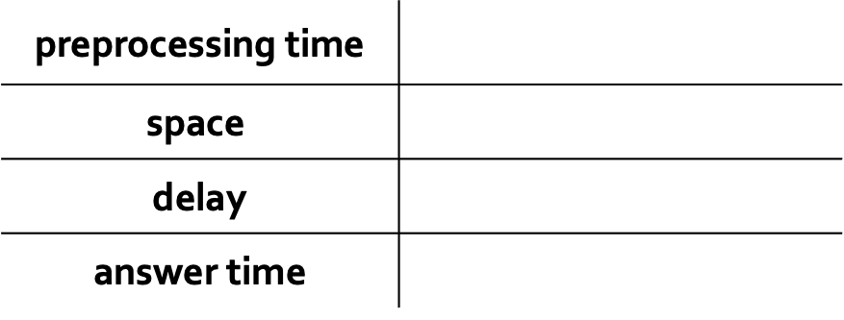
theorem #1
PODS 2018
full CQ
For any parameter $τ >0$ and fractional edge cover with weight $w$:
preprocessing time
$$\text{space}$$
delay
answer time

Slide 15
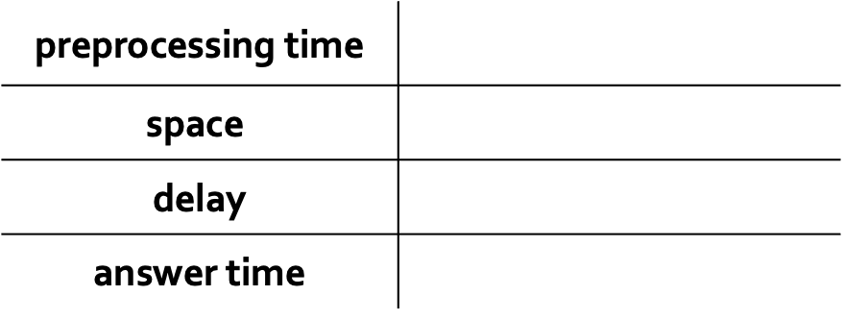
example
1
1
x
w₁
w₃
y
z
w₂
1
preprocessing time
$$\text{space}$$
delay
answer time
Notes:
say for example what happens for different values of t.

Slide 16
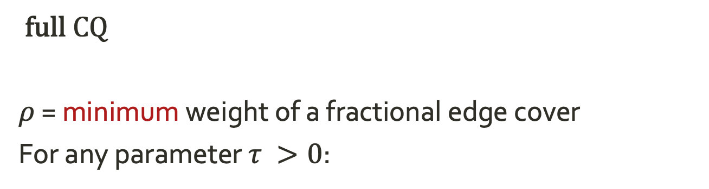

corollary of theorem #1
PODS 2018
full CQ
$ρ$ = minimum weight of a fractional edge cover
For any parameter $τ >0$:
preprocessing time
$$\text{space}$$
delay
answer time
For $τ =1$, the space matches the AGM bound!

Slide 17
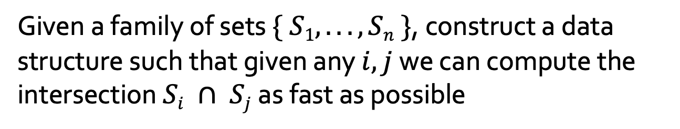
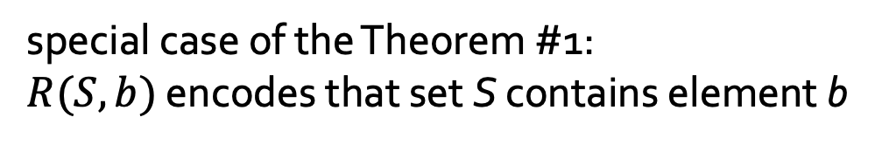
fast set intersection
Given a family of sets $\{ S1, . . . , Sn \}$, construct a data structure such that given any $i,j$we can compute the intersection $Si ∩ Sj$as fast as possible
[Cohen & Porat ‘10]
y
1
z
1
x
special case of the Theorem #1:
$R(S, b)$ encodes that set S contains element b
Notes:
application to pattern matching in documents

Slide 18
delay-space tradeoff
delay
slack =1
slack > 1
AGM bound
1
N
N^{ρ}
space

Slide 19
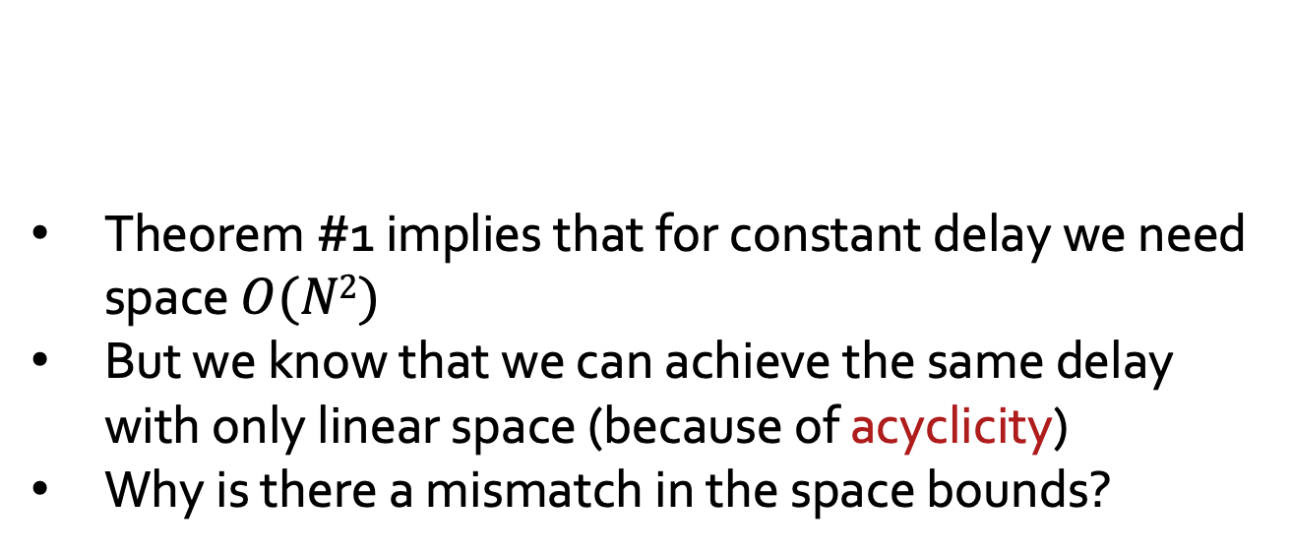
limitations of theorem #1
Theorem #1 implies that for constant delay we need space $O(N2)$
But we know that we can achieve the same delay with only linear space (because of acyclicity)
Why is there a mismatch in the space bounds?
We must take the query structure into account as well
Notes:
same reason why AGM is not enough to optimally characterize query runtime

Slide 20
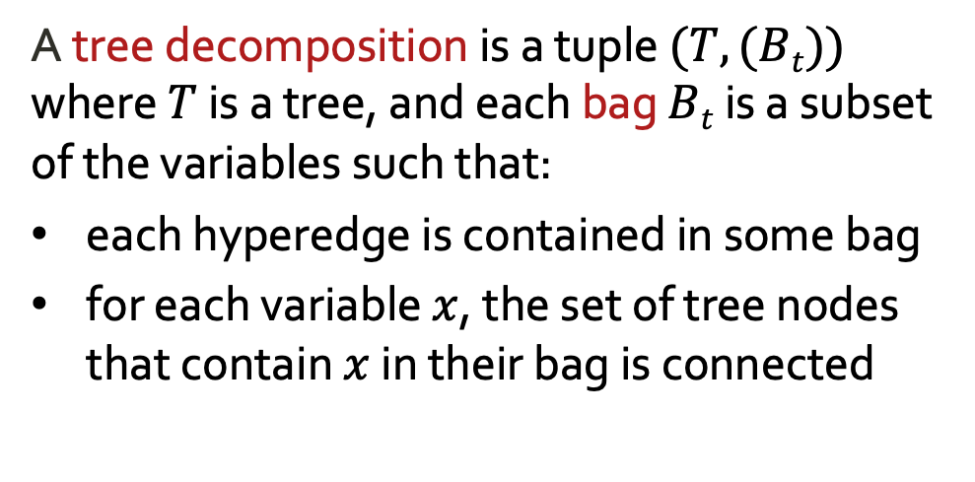
tree decomposition
x₂ x₁
A tree decomposition is a tuple $(T, (Bt))$ where $T$ is a tree, and each bag $Bt$ is a subset of the variables such that:
each hyperedge is contained in some bag
for each variable $x$, the set of tree nodes that contain $x$ in their bag is connected
x₃ x₂
x₄ x₃
x₅ x₄
fhw(decomposition) = maximum ρ over all bags
fhw(Q) = minimum fhw over all tree decompositions of Q
x₆ x₅
x₇ x₆

Slide 21
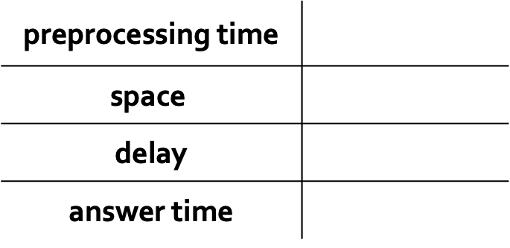
all free variables
full CQ with all free variables:
IDEA: factorized databases [Olteanu & Závodný 15]
preprocessing time
$$\text{space}$$
delay
answer time

Slide 22
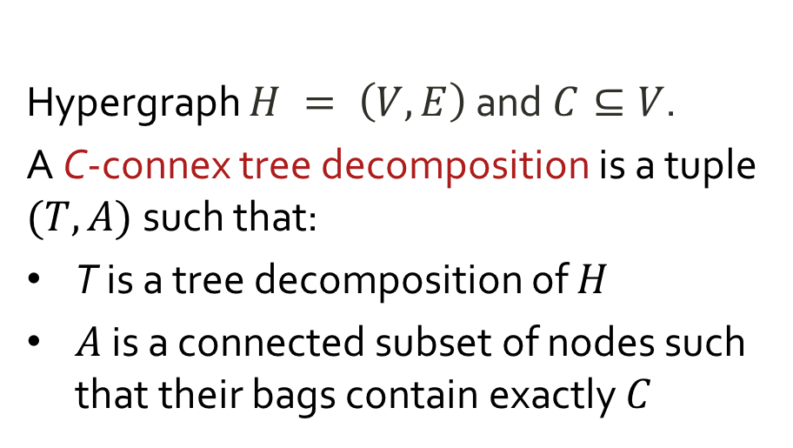
connex tree decomposition
Hypergraph $H = \left(V,E\right)$ and $C⊆V$.
A C-connex tree decomposition is a tuple $(T,A)$such that:
T is a tree decomposition of $H$
$A$ is a connected subset of nodes such that their bags contain exactly $C$
x₁ x₅ x₆
x₂ x₄ x₁ x₅
x₇ x₆
x₃ x₂ x₄

Slide 23
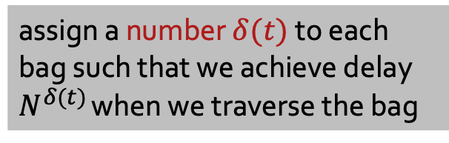
beyond constant delay
x₁ x₅ x₆
δ=0
assign a number $δ(t)$to each bag such that we achieve delay $N^{δ(t)}$ when we traverse the bag
δ=1/3
ρ=5/3
δ=0
ρ=1
x₂ x₄ x₁ x₅
x₇ x₆
δ=1/6
ρ=5/3
x₃ x₂ x₄
δ-width: maximum cover over all bags (captures space)
δ-height: maximum weight root-to-leaf path (captures delay)
Notes:
When the delay assignment is $δ=0$ everywhere, then we recover the standard notions of fractional hypertree width

Slide 24
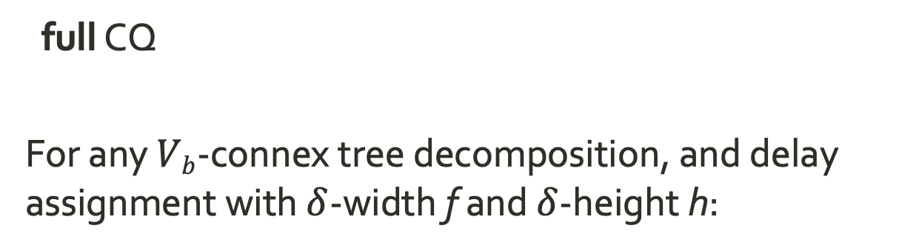
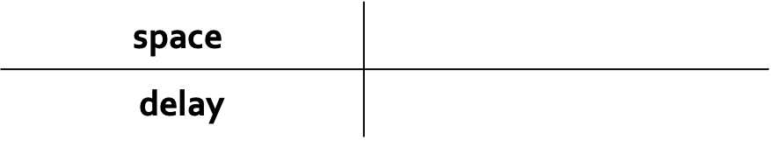
theorem #2
PODS 2018
full CQ
For any $Vb$-connex tree decomposition, and delay assignment with $δ$-width f and $δ$-height h:
$$\text{space}$$
delay

Slide 25
talk outline
Enumeration with Access Patterns
Ranked Enumeration
Conclusion

Slide 26
motivation
The output of the join is accessed in ranked order
SQL queries with ORDER BY and LIMIT
Pattern matching in graphs
What do we do when we want to view only the top-k results for a small k?
SELECT *
FROM H, M, R
WHERE M.area = R.area AND H.area = R.area
ORDER BY H.price + M.ticket + R.cost ASC
LIMIT 10;
H(hotel, area, price)
M(museum, area, ticket)
R(restaurant, area, cost)

Slide 27
framework
database D
join query Q
+
ranking function
data structure
preprocessing
enumeration
top-k request
Notes:
Add some motivation here about the next slides, i.e. properties of a pricing function

Slide 28
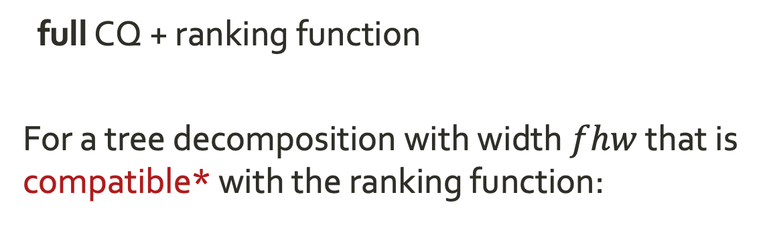
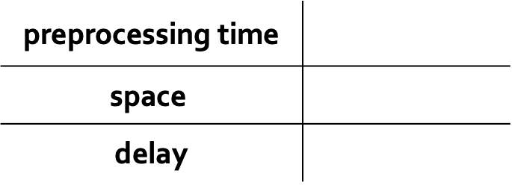
theorem #3
ICDT 2021
full CQ + ranking function
For a tree decomposition with width $fhw$ that is compatible* with the ranking function:
preprocessing time
$$\text{space}$$
delay
logarithmic additional cost of ordering
* sum/product/max/min are examples of compatible ranking functions

Slide 29
talk outline
Enumeration with Access Patterns
Ranked Enumeration
Conclusion

Slide 30
open questions
What about projections?
See Shaleen’s talk!
What are the optimal space / delay tradeoffs?
Based on conditional lower bounds
Does the theory transfer to efficient implementations?
We already have some positive evidence

Slide 31
Thank You !

