Slide 1


Indian Institute of Technology Gandhinagar
ADMINISTERED THROUGH THE COMPETENCY ADVANCEMENT ACADEMY
WEEK 2 · THURSDAY · HALF TWO
Will Monday's table rebuild itself and hold?
“Build them the table in pandas, from the warehouse, and make it refreshable in one run.”
The data platform lead, Kalpa Retail
06
Will Monday rebuild it?
07
Can you build it alone?
08
Where did the room go wrong?
09
Which tool would you sign?
10
How would you say it aloud?
11
What goes to the growth team?
Week 2, Day 4. Will Monday's table rebuild itself and hold?
1 / 35
Notes:
LIVE, one minute. The morning built the table a chapter at a time: 340 customers, the sale's 130
reached, Retail-Plus down 29.4 percent, three tools agreeing on 107 of 130, and Finance's number
given to SQL. The afternoon makes the table rebuild itself (chapter 6), then the room builds it alone
(the escalated case), then pairs answer Kavya in three tools, then the interview drill and the close.

Slide 2
Indian Institute of Technology Gandhinagar
PG DIPLOMA IN AI-ML AND AGENTIC AI ENGINEERING · COHORT 2
ADMINISTERED THROUGH THE COMPETENCY ADVANCEMENT ACADEMY
06
Will Monday rebuild it?
Can the table rebuild itself every Monday and refuse to ship when something breaks, before the growth team sends a single code?
Will Monday rebuild it?
Can you build it alone?
Where did the room go wrong?
Which tool would you sign?
How would you say it aloud?
What goes to the growth team?
Week 2, Day 4. Will Monday's table rebuild itself and hold?
2 / 35
Notes:
LIVE. Thirty minutes. Notebook C2_W02_D04_06_monday_refresh is the demonstration.

Slide 3

Indian Institute of Technology Gandhinagar
WEEK 2 · DAY 4 · KALPA GLOBAL CAPABILITY CENTRE
ADMINISTERED THROUGH THE COMPETENCY ADVANCEMENT ACADEMY
Answering it takes six smaller questions
Who needs the answer, and what has to be settled on the way?
Who needs the answer. The growth team, who act on Monday's table with no analyst watching the run; a refresh that counts from the wrong day sends win-back codes to customers who bought a few weeks ago.
1
2
3
4
5
6
Which way runs it?
What is it told?
Who is on the 19 October list?
Which guards fire?
Do two runs agree?
Does the warehouse agree?
Two inputs; the rest read from the data
By hand, a report, guards or a view
Recency, and the date it counts to
Each one made to fire on a broken copy
The same data on two Mondays
The list counted in SQL
Will Monday rebuild it?
Can you build it alone?
Where did the room go wrong?
Which tool would you sign?
How would you say it aloud?
What goes to the growth team?
S1 · 3 / 35
Notes:
LIVE, 1 minute. The morning's table had last order dates; the refresh turns them into days and
flags, and makes the whole build one call that stops when a check fails.

Slide 4

Indian Institute of Technology Gandhinagar
WEEK 2 · DAY 4 · KALPA GLOBAL CAPABILITY CENTRE
ADMINISTERED THROUGH THE COMPETENCY ADVANCEMENT ACADEMY
The win-back list goes out with nobody watching
What does the growth team send from the refresh, and what does a bad Monday cost?
60 days
every Monday
1 code each
THE WIN-BACK LINE
THE REFRESH
THE OFFER
no order in the 60 days to the as-of date
one run, no analyst at the desk
sent to every customer flagged lapsed
THE CLIENT ASKS
"Make it refreshable in one run." The growth team adds: "and we send Monday's codes from whatever it produces."
Will Monday rebuild it?
Can you build it alone?
Where did the room go wrong?
Which tool would you sign?
How would you say it aloud?
What goes to the growth team?
S2 · 4 / 35
Notes:
LIVE, 2 minutes. Recency is the days since a customer's last order; lapsed means more than 60 days
before the table's as-of date, the last date the data covers. A customer who never ordered is not
lapsed; they are on chapter 1's first-order list. A bad Monday sends a code to someone who bought last
month, or ships a broken table before anyone looks.

Slide 5

Indian Institute of Technology Gandhinagar
WEEK 2 · DAY 4 · KALPA GLOBAL CAPABILITY CENTRE
ADMINISTERED THROUGH THE COMPETENCY ADVANCEMENT ACADEMY
England's lab refresh dropped 15,841 cases
Who else ran a daily refresh that dropped rows without an error?
15,841
65,536
CSV files
CASES LEFT OUT
ROWS PER .XLS SHEET
FETCHED AUTOMATICALLY
25 September to 2 October 2020
the old format's limit
from commercial laboratories
WHAT BREAKS
A refresh that never counts rows in against rows out loses them without an error, and a week of decisions rests on the short number.
Will Monday rebuild it?
Can you build it alone?
Where did the room go wrong?
Which tool would you sign?
How would you say it aloud?
What goes to the growth team?
S3 · 5 / 35
Notes:
LIVE, 2 minutes. Sources, checked 1 Oct 2026: Public Health England's statement of 4 October 2020,
"15,841 cases between 25 September and 2 October were not included in the reported daily COVID-19
cases"; and The Register, 5 October 2020, on the cause: results "automatically fetched in CSV format"
from commercial labs were stored in the older .XLS format "that limited the number of rows to 65,536
per spreadsheet". A row count on every run would have stopped it on day one.

Slide 6
Indian Institute of Technology Gandhinagar
WEEK 2 · DAY 4 · KALPA GLOBAL CAPABILITY CENTRE
ADMINISTERED THROUGH THE COMPETENCY ADVANCEMENT ACADEMY
One function whose guards stop a bad run
Which of four ways should run the Monday refresh, and what does each catch?
Option | How it runs | When a check fails
a) Rerun the notebooks by hand | An analyst runs chapters 1 to 5 and reads the numbers | Ships if the analyst misses it
b) A function that reports | Prints PASS or FAIL for each check | Ships, with a FAIL beside it
c) A function with guards | Every failed check raises an error | Not written; the error says why
d) The table as a SQL view | The warehouse builds it when read | Nothing runs to fail
The call. c: of the four failures the day has met, a customer missing, a customer sent twice, spend off the warehouse and a repeated key, only c stops all four before the table ships. What would switch it: readers querying the table from the warehouse, such as a dashboard; then d, with the checks as the warehouse's own tests.
Will Monday rebuild it?
Can you build it alone?
Where did the room go wrong?
Which tool would you sign?
How would you say it aloud?
What goes to the growth team?
S4 · 6 / 35
Notes:
LIVE, 4 minutes. Ask which option most teams run today: a. Which option costs no analyst time and
still ships a broken table: b and d. The sizing is the count of failures each stops: 0, 0, 4, 0.

Slide 7
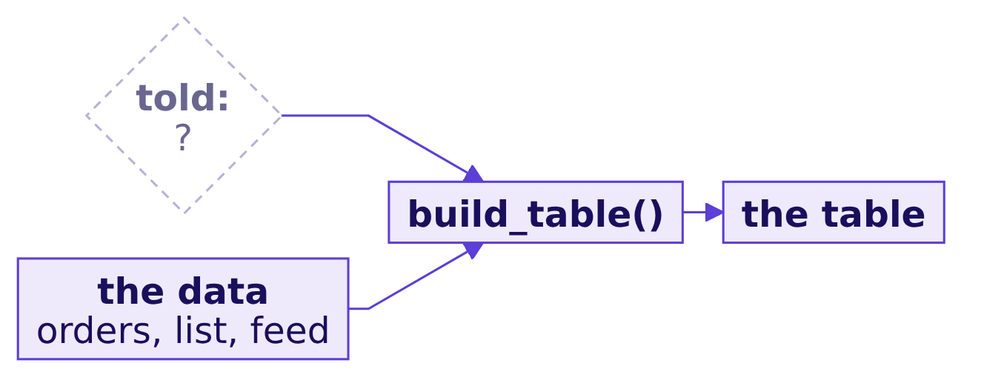
Indian Institute of Technology Gandhinagar
WEEK 2 · DAY 4 · KALPA GLOBAL CAPABILITY CENTRE
ADMINISTERED THROUGH THE COMPETENCY ADVANCEMENT ACADEMY
What must the refresh function be told?
What does the refresh need to be told, and what can it read from the data itself?
Question. As a letter? a) the day to count recency from; b) the warehouse connection and the feed's path; c) the number of customers; d) the total spend.
Will Monday rebuild it?
Can you build it alone?
Where did the room go wrong?
Which tool would you sign?
How would you say it aloud?
What goes to the growth team?
S5 · 7 / 35
Notes:
LIVE, 2 minutes. Every input is a chance to be told something wrong; the fewer, the better.

Slide 8
Indian Institute of Technology Gandhinagar
WEEK 2 · DAY 4 · KALPA GLOBAL CAPABILITY CENTRE
ADMINISTERED THROUGH THE COMPETENCY ADVANCEMENT ACADEMY
Answer: the connection and the feed's path
What does the function read for itself?
def build_table(engine, feed_path):
"""Chapters 1 and 2 in one call: the list as spine, three numbers, first touch."""
...
table, orders_read = build_table(ENG, FEED_PATH)
340
Rs 19,84,00,000
130
ROWS
SPEND
REACHED
read from the customer list
read from the orders
read from the feed, first touch
Will Monday rebuild it?
Can you build it alone?
Where did the room go wrong?
Which tool would you sign?
How would you say it aloud?
What goes to the growth team?
S6 · 8 / 35
Notes:
LIVE, 2 minutes. The answer is b. The customers, their numbers and the sale all come from the data,
so the function cannot be told a stale count. Recency is the one column still missing, and it needs a
date to count to.

Slide 9
Indian Institute of Technology Gandhinagar
WEEK 2 · DAY 4 · KALPA GLOBAL CAPABILITY CENTRE
ADMINISTERED THROUGH THE COMPETENCY ADVANCEMENT ACADEMY
How many does the 19 October refresh list?
How many customers land on the win-back list when the refresh runs on Monday 19 October?
RUN_DAY = pd.Timestamp.today() # on the first Monday refresh: 19 October 2026
recency = (RUN_DAY - table["last_order"]).dt.days
(recency > 60).sum()
Question. As a letter? a) 111; b) 166; c) 301; d) 55.
Will Monday rebuild it?
Can you build it alone?
Where did the room go wrong?
Which tool would you sign?
How would you say it aloud?
What goes to the growth team?
S7 · 9 / 35
Notes:
LIVE, 2 minutes. The hurried analyst counts to today so the refresh "stays current". The notebook
pins today to 19 October, the first Monday after this session, so the number is exactly what that
refresh would send.

Slide 10
Indian Institute of Technology Gandhinagar
WEEK 2 · DAY 4 · KALPA GLOBAL CAPABILITY CENTRE
ADMINISTERED THROUGH THE COMPETENCY ADVANCEMENT ACADEMY
Answer: 166, counted to the wall clock
What would Monday's send have looked like?
166
21 days
ON THE WIN-BACK LIST
SMALLEST RECENCY
counted to 19 October
the most recent buyer, as the table says
WHAT BREAKS
166 codes go out, and 55 of them reach customers who ordered within 60 days of the data's last date.
Will Monday rebuild it?
Can you build it alone?
Where did the room go wrong?
Which tool would you sign?
How would you say it aloud?
What goes to the growth team?
S8 · 10 / 35
Notes:
LIVE, 2 minutes. The answer is b. On the class day, 15 October, the same code counts 154; every day
the notebook is run, the list is different.

Slide 11
Indian Institute of Technology Gandhinagar
WEEK 2 · DAY 4 · KALPA GLOBAL CAPABILITY CENTRE
ADMINISTERED THROUGH THE COMPETENCY ADVANCEMENT ACADEMY
Why it is wrong: 21 days the data never saw
Why is the list too long, and which check catches it?
The check. Somebody always bought on the data's last day, so the smallest recency in an honest table is 0. Here it is 21, and the list reads 166, 180 and 187 on three Mondays with no new data.
Will Monday rebuild it?
Can you build it alone?
Where did the room go wrong?
Which tool would you sign?
How would you say it aloud?
What goes to the growth team?
S9 · 11 / 35
Notes:
LIVE, 3 minutes. The warehouse's last order is dated 28 September; nothing after it is loaded.
Counted to the run day, every customer looks 21 days staler, and the table becomes a function of the
calendar.

Slide 12
Indian Institute of Technology Gandhinagar
WEEK 2 · DAY 4 · KALPA GLOBAL CAPABILITY CENTRE
ADMINISTERED THROUGH THE COMPETENCY ADVANCEMENT ACADEMY
The fix: count to 28 September, 111 remain
What changes when recency counts to the data's own last date?
AS_OF = orders_read["order_date"].max() # 28 September 2026, carried in the table
table = table.assign(as_of=AS_OF, recency_days=(AS_OF - table["last_order"]).dt.days)
table = table.assign(lapsed=table["recency_days"] > 60)
111
55
0
ON THE WIN-BACK LIST
CAME OFF
SMALLEST RECENCY
Business 5, Core 49, Plus 47, Student 10
ordered within 60 days of 28 September
the check passes
Will Monday rebuild it?
Can you build it alone?
Where did the room go wrong?
Which tool would you sign?
How would you say it aloud?
What goes to the growth team?
S10 · 12 / 35
Notes:
LIVE, 3 minutes. Writing as_of into the table lets the growth team see what 60 days was counted
from. At 45 days the honest list is 144, at 90 days 74: the take-home asks which line to sign.

Slide 13
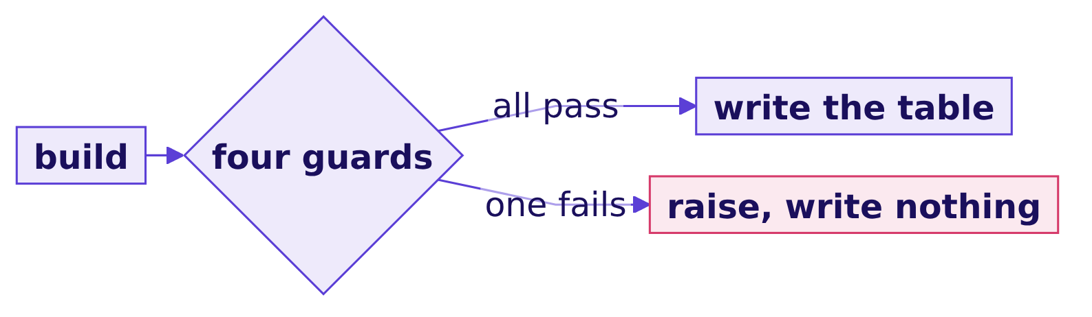
Indian Institute of Technology Gandhinagar
WEEK 2 · DAY 4 · KALPA GLOBAL CAPABILITY CENTRE
ADMINISTERED THROUGH THE COMPETENCY ADVANCEMENT ACADEMY
Four guards, each against the warehouse
Which guards stop a bad Monday?
Guard | Compared with | Stops
One row per customer | customer_id is unique | a repeated customer
Rows equal the list | 340 from customers | a customer missing
Spend equals the warehouse | Rs 19,84,00,000 from orders | spend added or lost
Smallest recency is 0 | the as-of date | a count from the wrong day
Will Monday rebuild it?
Can you build it alone?
Where did the room go wrong?
Which tool would you sign?
How would you say it aloud?
What goes to the growth team?
S11 · 13 / 35
Notes:
LIVE, 3 minutes. Each guard is compared with a number the warehouse gives on its own, so a slip in the
notebook cannot pass its own check.

Slide 14
Indian Institute of Technology Gandhinagar
WEEK 2 · DAY 4 · KALPA GLOBAL CAPABILITY CENTRE
ADMINISTERED THROUGH THE COMPETENCY ADVANCEMENT ACADEMY
A repeated row: which guards fire?
Which guards stop a bad Monday, and does each one fire when it should?
repeated = pd.concat([table, table[table["customer_id"] == "C-0152"]]) # one customer twice
guard_failures(repeated)
Question. As a letter? a) only the unique-key guard; b) the unique-key and row-count guards; c) the unique-key, row-count and spend guards; d) all four.
Will Monday rebuild it?
Can you build it alone?
Where did the room go wrong?
Which tool would you sign?
How would you say it aloud?
What goes to the growth team?
S12 · 14 / 35
Notes:
LIVE, 2 minutes. Prove each guard by making it fire on a copy broken on purpose.

Slide 15
Indian Institute of Technology Gandhinagar
WEEK 2 · DAY 4 · KALPA GLOBAL CAPABILITY CENTRE
ADMINISTERED THROUGH THE COMPETENCY ADVANCEMENT ACADEMY
Answer: three fire, and the recency guard holds
Does every broken copy trip at least one guard, and the honest table none?
The table | Guards that fire
The honest table | none
One customer's row repeated | one row per customer, rows equal the list, spend equals the warehouse
Recency counted to the run day | smallest recency is 0
Customers with no orders dropped | rows equal the list
WHAT BREAKS
Nothing ships broken: every broken copy trips a guard, and the honest table trips none.
Will Monday rebuild it?
Can you build it alone?
Where did the room go wrong?
Which tool would you sign?
How would you say it aloud?
What goes to the growth team?
S13 · 15 / 35
Notes:
LIVE, 3 minutes. The answer is c. The repeated customer's recency is the same, so the recency guard
holds. Dropping customers with no orders leaves spend unchanged, since they spend 0, so only the row
count catches it, chapter 1's lesson inside the refresh.

Slide 16
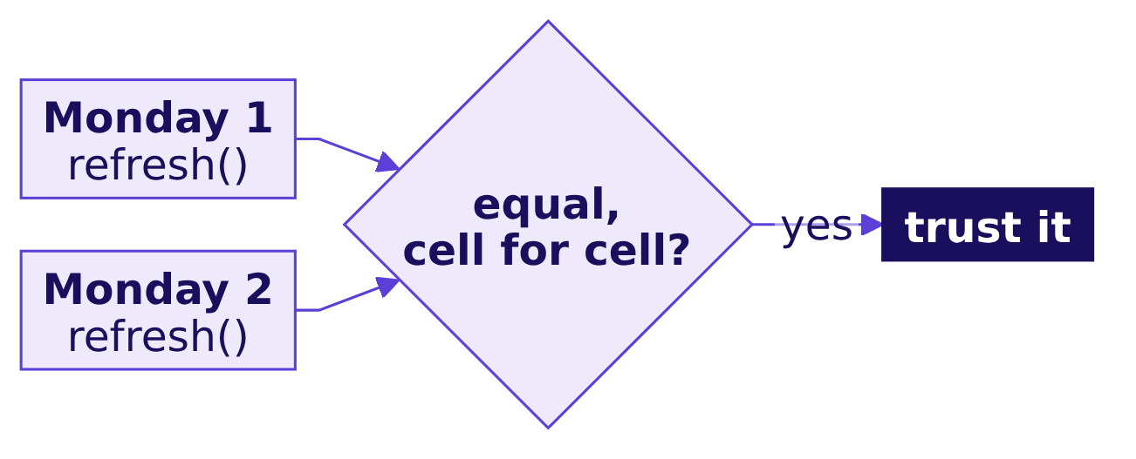
Indian Institute of Technology Gandhinagar
WEEK 2 · DAY 4 · KALPA GLOBAL CAPABILITY CENTRE
ADMINISTERED THROUGH THE COMPETENCY ADVANCEMENT ACADEMY
Two honest runs give one table
Do two runs on the same data give the same table?
0
166 then 180
111 and 111
CELLS THAT DIFFER
THE HURRIED LIST
THE HONEST LIST
two honest runs, a week apart
counted to each run day
counted to 28 September
Will Monday rebuild it?
Can you build it alone?
Where did the room go wrong?
Which tool would you sign?
How would you say it aloud?
What goes to the growth team?
S14 · 16 / 35
Notes:
LIVE, 2 minutes. Ask the room to predict first: 55, 14, 0 or 111 customers different. Nothing in the
honest refresh reads the calendar, so the answer is 0.

Slide 17
Indian Institute of Technology Gandhinagar
WEEK 2 · DAY 4 · KALPA GLOBAL CAPABILITY CENTRE
ADMINISTERED THROUGH THE COMPETENCY ADVANCEMENT ACADEMY
A second route: the warehouse counts 111
Does the warehouse, counting on its own, find the same win-back list?
WITH last AS (SELECT customer_id, max(order_date) AS last_order FROM orders GROUP BY customer_id),
as_of AS (SELECT max(order_date) AS d FROM orders)
SELECT count(*) AS win_back FROM last, as_of WHERE as_of.d - last.last_order > 60;
111 = 111
THE WIN-BACK LIST
SQL and the refresh
Will Monday rebuild it?
Can you build it alone?
Where did the room go wrong?
Which tool would you sign?
How would you say it aloud?
What goes to the growth team?
S15 · 17 / 35
Notes:
LIVE, 2 minutes. Subtracting two dates in Postgres gives whole days. The query shares no code with
the refresh. When to switch: the refresh for the table, the query to confirm the list's size before
a send.

Slide 18


Indian Institute of Technology Gandhinagar
WEEK 2 · DAY 4 · KALPA GLOBAL CAPABILITY CENTRE
ADMINISTERED THROUGH THE COMPETENCY ADVANCEMENT ACADEMY
Chapter 6: 111 on the list, and a run that stops
What did each smaller question find?
Question | The answer
Which way runs it? | One function with guards; it alone stops all four failures
What is it told? | The connection and the feed's path
Who is on the 19 October list? | 166 counted to the run day; 111 counted to 28 September
Which guards fire? | Each broken copy trips one or more; the honest table none
Do two runs agree? | Cell for cell; the hurried list went 166 then 180
Does the warehouse agree? | Yes: 111
KAVYA'S REVIEW
The table carries its as-of date, the smallest recency is 0, and a run that fails a guard writes nothing.
IN THE INTERVIEW
[F] How do you compute recency in a job that runs every week?
Will Monday rebuild it?
Can you build it alone?
Where did the room go wrong?
Which tool would you sign?
How would you say it aloud?
What goes to the growth team?
S16 · 18 / 35
Notes:
LIVE, 2 minutes. One breath: from the data's last loaded date, carried in the table, never the wall
clock; the check is that the smallest recency is 0. The depth section of notebook 06 mirrors
Wednesday's falling flag in pandas with groupby and shift and checks it against the warehouse. Then
the escalated case.

Slide 19
Indian Institute of Technology Gandhinagar
PG DIPLOMA IN AI-ML AND AGENTIC AI ENGINEERING · COHORT 2
ADMINISTERED THROUGH THE COMPETENCY ADVANCEMENT ACADEMY
07
Can you build it alone?
Can you build the growth team's whole Monday table alone, with both flags, one view and a guarded run, and post four numbers that hold?
Will Monday rebuild it?
Can you build it alone?
Where did the room go wrong?
Which tool would you sign?
How would you say it aloud?
What goes to the growth team?
Week 2, Day 4. Will Monday's table rebuild itself and hold?
19 / 35
Notes:
LIVE. Fifty minutes, unguided. The brief is exercises/unguided/C2_W02_D04_escalated_case_STUDENT.md
and the notebook notebooks/C2_W02_D04_ex1_escalated_case_STUDENT.ipynb.

Slide 20
Indian Institute of Technology Gandhinagar
WEEK 2 · DAY 4 · KALPA GLOBAL CAPABILITY CENTRE
ADMINISTERED THROUGH THE COMPETENCY ADVANCEMENT ACADEMY
Answering it alone: five parts, thirteen letters
What does the escalated case ask, part by part?
PART 1
PART 2
PART 3
PART 4
PART 5
Every customer, three numbers
The sale, one row each
The two flags
One view for a slide
One guarded run
Lapsed, and Wednesday's falling rule in pandas
Spend by month and segment
Two runs, one table, a CSV for Friday
The spine and the aggregates
The feed attached, and counted a second way
Will Monday rebuild it?
Can you build it alone?
Where did the room go wrong?
Which tool would you sign?
How would you say it aloud?
What goes to the growth team?
S17 · 20 / 35
Notes:
LIVE, 2 minutes. The notebook stops at __TODO1__ with a NameError by design: replace each
placeholder with the option chosen and run the step's checks. Post thirteen letters and the four
numbers the last cell prints.

Slide 21
Indian Institute of Technology Gandhinagar
WEEK 2 · DAY 4 · KALPA GLOBAL CAPABILITY CENTRE
ADMINISTERED THROUGH THE COMPETENCY ADVANCEMENT ACADEMY
Two definitions, and the checks to reach
Which flags does the table carry, and which numbers prove it before it ships?
Flag | Its rule
Lapsed | No order in the 60 days to the as-of date; a customer who never ordered is not lapsed
Falling | Spend lower in August than July and lower again in September, each reading the calendar month after the last, so a month with no order breaks the run
340
Rs 19,84,00,000
130
CUSTOMERS
SPEND
REACHED
one row each
ties to the warehouse
first exposure per customer
Will Monday rebuild it?
Can you build it alone?
Where did the room go wrong?
Which tool would you sign?
How would you say it aloud?
What goes to the growth team?
S18 · 21 / 35
Notes:
SELF-STUDY for anyone who missed the morning. The falling rule is Wednesday's, mirrored in pandas: the
previous reading of the same customer, never another customer's, and a skipped month is no reading.
The win-back count is the fourth number to post, and the notebook's check compares it with the
warehouse.

Slide 22
Indian Institute of Technology Gandhinagar
PG DIPLOMA IN AI-ML AND AGENTIC AI ENGINEERING · COHORT 2
ADMINISTERED THROUGH THE COMPETENCY ADVANCEMENT ACADEMY
08
Where did the room go wrong?
Which wrong numbers did the room produce in the case, and which check would have caught each one?
Will Monday rebuild it?
Can you build it alone?
Where did the room go wrong?
Which tool would you sign?
How would you say it aloud?
What goes to the growth team?
Week 2, Day 4. Will Monday's table rebuild itself and hold?
22 / 35
Notes:
LIVE. Fifteen minutes. Collect the wrong numbers during the case and put them on the board.

Slide 23
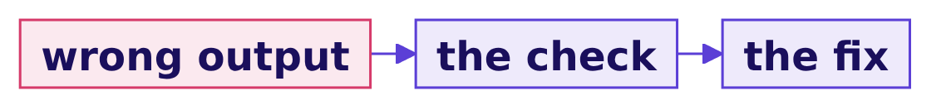
Indian Institute of Technology Gandhinagar
WEEK 2 · DAY 4 · KALPA GLOBAL CAPABILITY CENTRE
ADMINISTERED THROUGH THE COMPETENCY ADVANCEMENT ACADEMY
Answering it: six wrong outputs, six checks
Which wrong output came from which step, and which check would have caught it?
The wrong output | Where it came from | The check
301 rows | the spine taken from the orders | rows against the customer list
0 customers who never ordered | a missing count never equals 0 | fill 0 on purpose, then count
More than 340 rows after the merge | the feed's promise taken on trust | validate="one_to_one"
154 on the win-back list | recency counted to the class day | the smallest recency is 0
Falling flags on customers who never fell | the previous row read without the customer | groupby before shift
A view short of the warehouse | the pivot's default mean | the grand total against the orders
Will Monday rebuild it?
Can you build it alone?
Where did the room go wrong?
Which tool would you sign?
How would you say it aloud?
What goes to the growth team?
S19 · 23 / 35
Notes:
LIVE, 8 minutes. For each wrong number on the board, ask the room which check catches it before
naming the fix. 154 is what pd.Timestamp.today() gives on 15 October; next Monday it would be 166.
Do not read any customer ids aloud.

Slide 24
Indian Institute of Technology Gandhinagar
WEEK 2 · DAY 4 · KALPA GLOBAL CAPABILITY CENTRE
ADMINISTERED THROUGH THE COMPETENCY ADVANCEMENT ACADEMY
The miss most rooms make: the class-day date
Why is the wall-clock count the one that survives review?
154
166
111
COUNTED TO 15 OCTOBER
COUNTED TO 19 OCTOBER
COUNTED TO 28 SEPTEMBER
the class day
the first Monday refresh
the data's last date
WHAT BREAKS
Every run gives a plausible count, so nobody questions it; only the smallest-recency check or a second run on the same data exposes it.
Will Monday rebuild it?
Can you build it alone?
Where did the room go wrong?
Which tool would you sign?
How would you say it aloud?
What goes to the growth team?
S20 · 24 / 35
Notes:
LIVE, 5 minutes. Three counts for one dataset, depending on the calendar. Ask for the one sentence
to the growth team: the list is 111, counted to 28 September, and it will not grow unless new orders
arrive. Then the break, ten minutes.

Slide 25
Indian Institute of Technology Gandhinagar
PG DIPLOMA IN AI-ML AND AGENTIC AI ENGINEERING · COHORT 2
ADMINISTERED THROUGH THE COMPETENCY ADVANCEMENT ACADEMY
09
Which tool would you sign?
Did Retail-Plus members order less often in Q2, in plain Python, SQL and pandas, and which tool would you sign for each job?
Will Monday rebuild it?
Can you build it alone?
Where did the room go wrong?
Which tool would you sign?
How would you say it aloud?
What goes to the growth team?
Week 2, Day 4. Will Monday's table rebuild itself and hold?
25 / 35
Notes:
LIVE. Ten-minute break first, then forty minutes in pairs. The brief is
exercises/unguided/C2_W02_D04_second_case_STUDENT.md and the notebook
notebooks/C2_W02_D04_ex2_second_case_STUDENT.ipynb.

Slide 26
Indian Institute of Technology Gandhinagar
WEEK 2 · DAY 4 · KALPA GLOBAL CAPABILITY CENTRE
ADMINISTERED THROUGH THE COMPETENCY ADVANCEMENT ACADEMY
Answering it in pairs: three tools, one note
What does Kavya ask the pair for?
THE CLIENT ASKS
"You did the tree in plain Python in Week 1, in SQL on Monday. Do it a third way now, and tell me honestly which tool you would pick for which job."
1
2
3
4
Plain Python
SQL
pandas
The note
A set per quarter, one row at a time
In the warehouse, without Monday's integer division
The analyst's bench, members counted once
One line per tool, the rows each moved, one refusal
Will Monday rebuild it?
Can you build it alone?
Where did the room go wrong?
Which tool would you sign?
How would you say it aloud?
What goes to the growth team?
S21 · 26 / 35
Notes:
LIVE, 2 minutes. The question is Week 1's branch that moved: Retail-Plus orders per member, Q1
against Q2, where a member counts in a quarter if they ordered in it. The room writes the SQL first;
then the trainer runs it through plain Python and pandas and closes the loop.

Slide 27
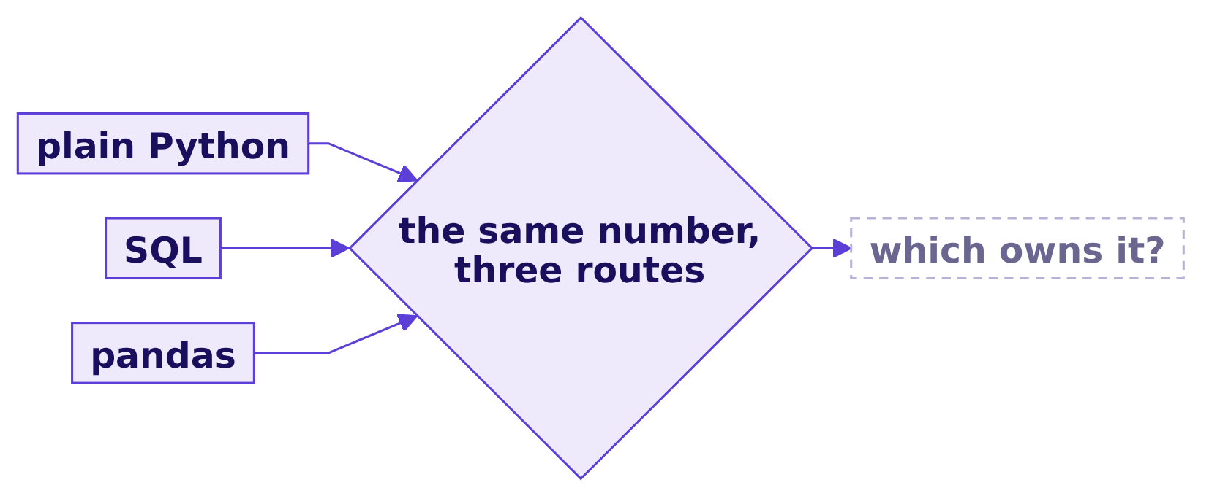
Indian Institute of Technology Gandhinagar
WEEK 2 · DAY 4 · KALPA GLOBAL CAPABILITY CENTRE
ADMINISTERED THROUGH THE COMPETENCY ADVANCEMENT ACADEMY
Which tool would you sign for Finance's number?
The three agree; which one should own a number Finance reruns every Monday?
Question. As a letter? a) a pandas notebook on the analyst's machine; b) a plain Python loop; c) a SQL query in the warehouse; d) a CSV export refreshed every Monday.
Will Monday rebuild it?
Can you build it alone?
Where did the room go wrong?
Which tool would you sign?
How would you say it aloud?
What goes to the growth team?
S22 · 27 / 35
Notes:
LIVE, 3 minutes, after the pairs have run all three routes. Letters in chat.

Slide 28
Indian Institute of Technology Gandhinagar
WEEK 2 · DAY 4 · KALPA GLOBAL CAPABILITY CENTRE
ADMINISTERED THROUGH THE COMPETENCY ADVANCEMENT ACADEMY
Answer: SQL, and pandas reads its answer
What did the three routes give, and what did each move?
2.363 to 1.842
3 of 3
355 / 2 / 1,000
ORDERS PER MEMBER
TOOLS AGREE
ROWS MOVED
Q1 215 over 91, Q2 140 over 76
to three decimal places
Python, SQL, pandas
What changed. Retail-Plus members ordered 22 percent less often in Q2, the branch Week 1 found. The note gives Finance's number to SQL, which moves only its answer, and refuses a pandas notebook for it.
Will Monday rebuild it?
Can you build it alone?
Where did the room go wrong?
Which tool would you sign?
How would you say it aloud?
What goes to the growth team?
S23 · 28 / 35
Notes:
LIVE, 5 minutes. The answer is c. Read two pairs' notes aloud and check each has the rows moved and
a reason for the refusal. A notebook runs on a copy on one machine; an export is a copy that ages
from the moment it is written.

Slide 29
Indian Institute of Technology Gandhinagar
PG DIPLOMA IN AI-ML AND AGENTIC AI ENGINEERING · COHORT 2
ADMINISTERED THROUGH THE COMPETENCY ADVANCEMENT ACADEMY
10
How would you say it aloud?
How does each of today's interview questions sound when answered aloud, the design question among them?
Will Monday rebuild it?
Can you build it alone?
Where did the room go wrong?
Which tool would you sign?
How would you say it aloud?
What goes to the growth team?
Week 2, Day 4. Will Monday's table rebuild itself and hold?
29 / 35
Notes:
LIVE. Twenty minutes. Two learners per question: one answers, one asks the follow-up.

Slide 30
Indian Institute of Technology Gandhinagar
WEEK 2 · DAY 4 · KALPA GLOBAL CAPABILITY CENTRE
ADMINISTERED THROUGH THE COMPETENCY ADVANCEMENT ACADEMY
Answering aloud: the row's five
Which questions does every screen ask about today's work?
Tag | The question
[S] | Describe groupby in the split-apply-combine sentence.
[S] | Merge against join: what is the same and what differs?
[F] | Which merge argument raises on duplicate keys, and which error?
[F] | Pivot against melt: which widens and which lengthens?
[D] | Same question, three tools: how do you choose, and defend one choice?
Will Monday rebuild it?
Can you build it alone?
Where did the room go wrong?
Which tool would you sign?
How would you say it aloud?
What goes to the growth team?
S24 · 30 / 35
Notes:
LIVE, 10 minutes. Tags: [S] staple asked everywhere, [F] frequent in GCC and product screens, [D]
differentiator. Answers in one breath are in the day sheet; push for a number in every answer.

Slide 31
Indian Institute of Technology Gandhinagar
WEEK 2 · DAY 4 · KALPA GLOBAL CAPABILITY CENTRE
ADMINISTERED THROUGH THE COMPETENCY ADVANCEMENT ACADEMY
Seven follow-ups, three of them design
Which case-style follow-ups does an interviewer add?
Tag | The follow-up
[F] | Your customer table has fewer rows than the customer list. Why, and what do you do?
[F] | Your Monday refresh stopped with a MergeError. What do you do?
[F] | Your pivot's totals look low. Where do you look first?
[F] | What does SQL's GROUP BY do with a NULL key, and pandas' groupby with a missing one?
[D] | A dashboard says 100 percent of the customers a campaign reached went on to buy. What do you check first?
[D] | Which tool would you refuse for Finance's numbers, and why?
[D] | The orders table grows to 5 crore rows. Where do you build the customer table?
Will Monday rebuild it?
Can you build it alone?
Where did the room go wrong?
Which tool would you sign?
How would you say it aloud?
What goes to the growth team?
S25 · 31 / 35
Notes:
LIVE, 10 minutes. The design follow-ups want a sizing in the answer: rows moved, who reruns it, and
the fact that would switch the choice.

Slide 32
Indian Institute of Technology Gandhinagar
PG DIPLOMA IN AI-ML AND AGENTIC AI ENGINEERING · COHORT 2
ADMINISTERED THROUGH THE COMPETENCY ADVANCEMENT ACADEMY
11
What goes to the growth team?
What does the growth team hear, which lines are worth keeping, and what does Friday ask?
Will Monday rebuild it?
Can you build it alone?
Where did the room go wrong?
Which tool would you sign?
How would you say it aloud?
What goes to the growth team?
Week 2, Day 4. Will Monday's table rebuild itself and hold?
32 / 35
Notes:
LIVE. Fifteen minutes: the Kahoot first, eight items including Wednesday's return question, then this
chapter.

Slide 33
Indian Institute of Technology Gandhinagar
WEEK 2 · DAY 4 · KALPA GLOBAL CAPABILITY CENTRE
ADMINISTERED THROUGH THE COMPETENCY ADVANCEMENT ACADEMY
Answer: the table is ready, and it holds
What does the growth team hear, and with which caveat?
"The Monday table is ready: 340 customers, one row each, with spend that ties to the warehouse at Rs 19,84,00,000, the 130 customers the monsoon sale reached, and a win-back list of 111 counted to 28 September. It rebuilds itself every Monday and will not ship if a guard fails, and Finance's revenue stays in the warehouse as a query the table reconciles with every week."
The GCC data and AI team
The caveat. The table records whom the sale reached; whether the sale changed what they spent is a separate test, and Week 1 Thursday found the reached were buying anyway.
Will Monday rebuild it?
Can you build it alone?
Where did the room go wrong?
Which tool would you sign?
How would you say it aloud?
What goes to the growth team?
S26 · 33 / 35
Notes:
LIVE, 2 minutes. Read it aloud once. Every number in it was checked twice today.

Slide 34
Indian Institute of Technology Gandhinagar
WEEK 2 · DAY 4 · KALPA GLOBAL CAPABILITY CENTRE
ADMINISTERED THROUGH THE COMPETENCY ADVANCEMENT ACADEMY
Five lines worth keeping
Which rules does the cheat sheet print word for word?
 | The line
1 | Start a customer table from the customer list, because a table built from orders leaves out everyone who never ordered: 39 of Kalpa's 340.
2 | Write how= and validate= on every merge, because one repeated key adds a customer's whole spend again and validate stops the merge before the table exists.
3 | Write aggfunc= on every pivot and check its grand total against the source, because pivot_table averages by default and turned a 29 percent fall into 18.
4 | Two tools agree only when they share one definition, so give each recurring number one owner, chosen by who reruns it and sized by the rows each route moves.
5 | Count recency to the data's own last date and let the refresh refuse a table that fails a guard, because the wall clock put 166 customers on a list that holds 111.
Will Monday rebuild it?
Can you build it alone?
Where did the room go wrong?
Which tool would you sign?
How would you say it aloud?
What goes to the growth team?
S27 · 34 / 35
Notes:
LIVE, 3 minutes. Ask a learner to read each line and give the number behind it.

Slide 35
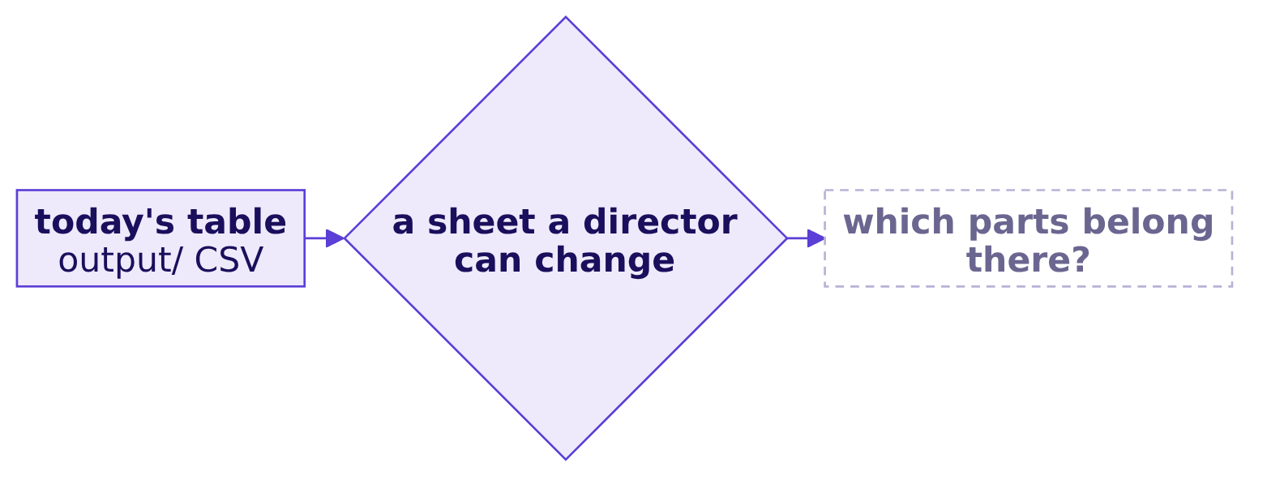
Indian Institute of Technology Gandhinagar
WEEK 2 · DAY 4 · KALPA GLOBAL CAPABILITY CENTRE
ADMINISTERED THROUGH THE COMPETENCY ADVANCEMENT ACADEMY
Tomorrow's question, left open
Which parts of this week belong in a sheet a director can change, and which must never be there?
"Monday's growth review deck needs three things I can open on my laptop without a login: the revenue tree by segment for both quarters, the top-fifty protect list with a lookup so I can find any member by id, and one number on the front page with its trend. Nothing that needs Python. If a director changes an assumption in the room, the sheet must recalculate in front of them."
Meera's chief of staff
Will Monday rebuild it?
Can you build it alone?
Where did the room go wrong?
Which tool would you sign?
How would you say it aloud?
What goes to the growth team?
S28 · 35 / 35
Notes:
LIVE, 2 minutes. Read it and leave it open; do not answer. Tonight: bring the CSV the refresh wrote
to output/, with 340 rows and Rs 19,84,00,000 of spend, and read the pre-read.

