Slide 1


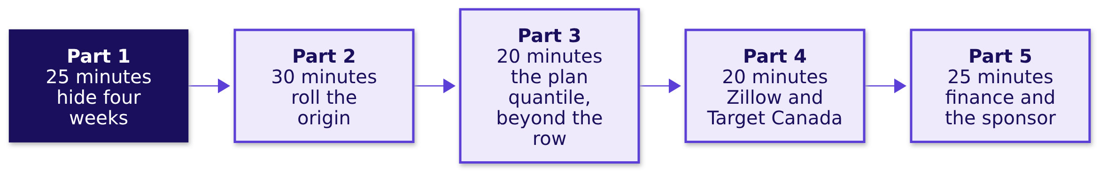
Indian Institute of Technology Gandhinagar
WEEK 4 · FRIDAY · FORECASTING BASICS · FALLBACK
ADMINISTERED THROUGH THE COMPETENCY ADVANCEMENT ACADEMY
Five parts, each testing the day's choice
What runs in the next 120 minutes, and in what order?
This hour runs only if the IITGN faculty session W4-4 (tentative) does not run. Illustrative case: the company is real, the situation and the data are synthetic, built for this class.
Week 4, Day 5. Forecasting basics: the fallback hour
S1 · 1 / 18
Notes:
LIVE, 2 minutes, on screen only if the faculty session (tentative) slips. Nothing here teaches
autocorrelation, smoothing or ARIMA: the faculty session (tentative) owns them. Read the five parts;
part 3 goes beyond the curriculum row's five subtopics, and says so on its first slide.
Each ends on one line a group writes down. Transition:
part 1.

Slide 2
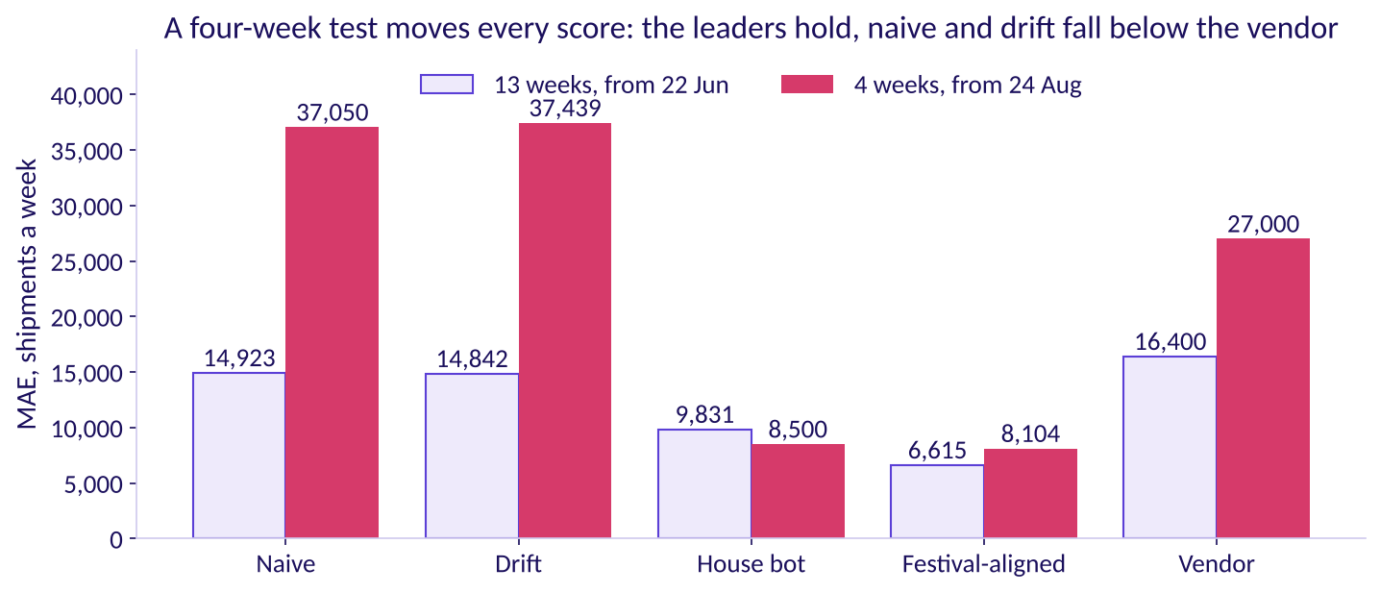
Indian Institute of Technology Gandhinagar
WEEK 4 · FRIDAY · FORECASTING BASICS · FALLBACK
ADMINISTERED THROUGH THE COMPETENCY ADVANCEMENT ACADEMY
Hide four weeks, forecast from 24 August
What do the rules score when only the last four weeks are hidden?
MAE by rule on thirteen hidden weeks and on the last four
Festival-aligned and finance's rule still lead and the house bot stays next, while naive and drift fall below the vendor; every number moves a great deal. The four-week test rests on four misses and on one origin week.
Week 4, Day 5. Forecasting basics: the fallback hour
S2 · 2 / 18
Notes:
LIVE, 8 minutes. Groups run notebook 06 with the split moved to 24 August 2026, or read this table.
The vendor's four weeks are its old forecast, made from 22 June, so they are its farthest weeks
ahead. Transition: why naive moved most.

Slide 3

Indian Institute of Technology Gandhinagar
WEEK 4 · FRIDAY · FORECASTING BASICS · FALLBACK
ADMINISTERED THROUGH THE COMPETENCY ADVANCEMENT ACADEMY
Why did naive jump from 14,923 to 37,050?
What, in the four-week test, made naive's average miss more than double?
A
B
C
D
The last four weeks are harder
The origin week was a dip
Four weeks are too few to average
Naive ignores growth
It never adds the 4 percent.
September ships more than July.
The week of 24 August shipped 196,600.
Any one miss moves the mean.
Week 4, Day 5. Forecasting basics: the fallback hour
S3 · 3 / 18
Notes:
LIVE, 5 minutes. Vote, argue for one minute, vote again. a and c are partly true; b is the cause.
Transition: the answer.

Slide 4
Indian Institute of Technology Gandhinagar
WEEK 4 · FRIDAY · FORECASTING BASICS · FALLBACK
ADMINISTERED THROUGH THE COMPETENCY ADVANCEMENT ACADEMY
Answer: the origin week was a dip, 196,600
How does one origin week set every naive miss?
196,600
41,800
37,050
THE WEEK OF 24 AUGUST 2026
ITS FIRST MISS, TOO LOW
NAIVE'S MAE ON FOUR WEEKS
the origin naive repeats four times
then 37,100, 33,700 and 35,600, all too low
against 14,923 on thirteen
A short test judges the origin as much as the rule. All four of naive's misses are too low, so its MAE is the gap between the dip and the four weeks' average, 233,650. The thirteen-week test started from 218,300, close to its hidden weeks' average of 217,746: luck in the other direction.
Week 4, Day 5. Forecasting basics: the fallback hour
S4 · 4 / 18
Notes:
LIVE, 5 minutes. Show the four misses on the board. The house bot and festival-aligned barely move
because they copy last year's weeks and ignore the origin. Transition: the rule this proves.

Slide 5



Indian Institute of Technology Gandhinagar
WEEK 4 · FRIDAY · FORECASTING BASICS · FALLBACK
ADMINISTERED THROUGH THE COMPETENCY ADVANCEMENT ACADEMY
A test shorter than the horizon judges too little
Why must the hidden weeks reach at least as far ahead as the plan does, ten weeks?
THE RULE
THE VENDOR
THE LUCK
At least as long as the horizon
Its gap grows with the weeks ahead
One origin can flatter or punish
The plan's last week is ten weeks past the data, so the test must reach ten weeks ahead; four cannot (FPP3, section 5.8, checked 13 October 2026).
148 percent worse than festival-aligned on thirteen weeks, 233 percent on its four farthest.
A rule that looked fine from 22 June looks poor from 24 August.
Week 4, Day 5. Forecasting basics: the fallback hour
S5 · 5 / 18
Notes:
LIVE, 5 minutes. Each group writes one line: what a four-week test would have let the vendor's
sponsor claim. Transition: part 2, rolling the origin.

Slide 6
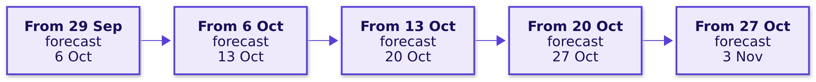
Indian Institute of Technology Gandhinagar
WEEK 4 · FRIDAY · FORECASTING BASICS · FALLBACK
ADMINISTERED THROUGH THE COMPETENCY ADVANCEMENT ACADEMY
Roll the origin: one week ahead, five times
What does a rolling origin show that one hidden block cannot?
Each forecast is made from the week before and scored, then the origin moves on one week. The twelve rows hold five such steps in 2025: from 29 September to 27 October, forecasting the week after each.
Week 4, Day 5. Forecasting basics: the fallback hour
S6 · 6 / 18
Notes:
LIVE, 5 minutes. This is the rolling-origin picture of FPP3's section 5.10 (checked 12 October
2026), on the twelve printed rows. Groups work it by hand. Transition: the five forecasts.

Slide 7
Indian Institute of Technology Gandhinagar
WEEK 4 · FRIDAY · FORECASTING BASICS · FALLBACK
ADMINISTERED THROUGH THE COMPETENCY ADVANCEMENT ACADEMY
Five one-week forecasts, worked by hand
What do naive and festival-aligned forecast one week ahead through 2025's festival?
Week forecast | Naive: the week before | Naive's miss | Festival-aligned | Its miss
6 Oct 2025 | 331,200 | 87,000 too low | 417,040 | 1,160 too low
13 Oct 2025 | 418,200 | 49,200 too high | 370,448 | 1,448 too high
20 Oct 2025 | 369,000 | 60,100 too high | 308,776 | 124 too low
27 Oct 2025 | 308,900 | 120,300 too high | 187,824 | 776 too low
3 Nov 2025 | 188,600 | 39,300 too low | 221,208 | 6,692 too low
Week 4, Day 5. Forecasting basics: the fallback hour
S7 · 7 / 18
Notes:
LIVE, 12 minutes. Each group takes one row and calls out its two misses. Festival-aligned copies
2024's week at the same distance from Diwali, plus 4 percent. Transition: the vote.

Slide 8
Indian Institute of Technology Gandhinagar
WEEK 4 · FRIDAY · FORECASTING BASICS · FALLBACK
ADMINISTERED THROUGH THE COMPETENCY ADVANCEMENT ACADEMY
Which rule swings most through the festival?
Over the five one-week forecasts, whose average miss is larger, and by how much?
A
B
C
D
Naive, by about ten times
Naive, by about thirty-five times
Festival-aligned, narrowly
A tie: one week ahead, both are close
The week before is a poor guide when weeks change fast.
Every festive week differs sharply from the last.
Copying 2024 adds 2024's own noise.
A week is short.
Week 4, Day 5. Forecasting basics: the fallback hour
S8 · 8 / 18
Notes:
LIVE, 5 minutes. Groups add their row's misses to the board first. Transition: the answer.

Slide 9
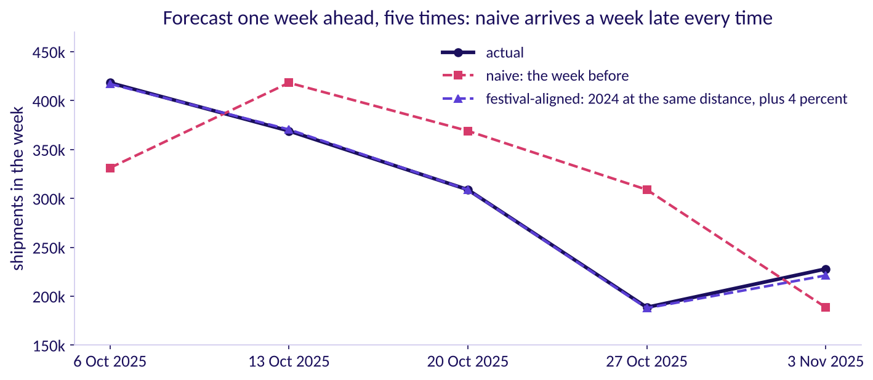
Indian Institute of Technology Gandhinagar
WEEK 4 · FRIDAY · FORECASTING BASICS · FALLBACK
ADMINISTERED THROUGH THE COMPETENCY ADVANCEMENT ACADEMY
Answer: naive, by about thirty-five times
What does the rolling origin say about naive near a festival?
Naive and festival-aligned, one week ahead from five origins
Naive's five misses average 71,180 a week and festival-aligned's 2,040. Near a festival the week before is a poor guide, because the weeks change sharply; last year's week at the same distance from Diwali is a good one.
Week 4, Day 5. Forecasting basics: the fallback hour
S9 · 9 / 18
Notes:
LIVE, 8 minutes. 71,180 over 2,040 is about thirty-five: b was the closest option. Transition:
part 3, how far above the forecast the plan should sit.

Slide 10
Indian Institute of Technology Gandhinagar
WEEK 4 · FRIDAY · FORECASTING BASICS · FALLBACK
ADMINISTERED THROUGH THE COMPETENCY ADVANCEMENT ACADEMY
Beyond the row: how far above the forecast?
The day booked the forecast itself, and a late shipment costs 4.6 times a spare one. Where should the plan sit?
A
B
C
D
At the forecast
Above the forecast
Far enough to cover every week
Below the forecast
Covering demand in about half the weeks.
Covering demand in about four weeks of five.
Since spare shipments waste money.
Since a late parcel is never acceptable.
This part goes beyond the five subtopics of Friday's curriculum row: it is the plan quantile, the spine's addition, taught only in this hour and in notebook 07's depth section.
Week 4, Day 5. Forecasting basics: the fallback hour
S10 · 10 / 18
Notes:
LIVE, 4 minutes. Vote first. The day's plan, 19,760 shifts, books festival-aligned's forecast itself
and prices the error bar both ways; this part asks how far a planner should lean. Transition: the
answer.

Slide 11
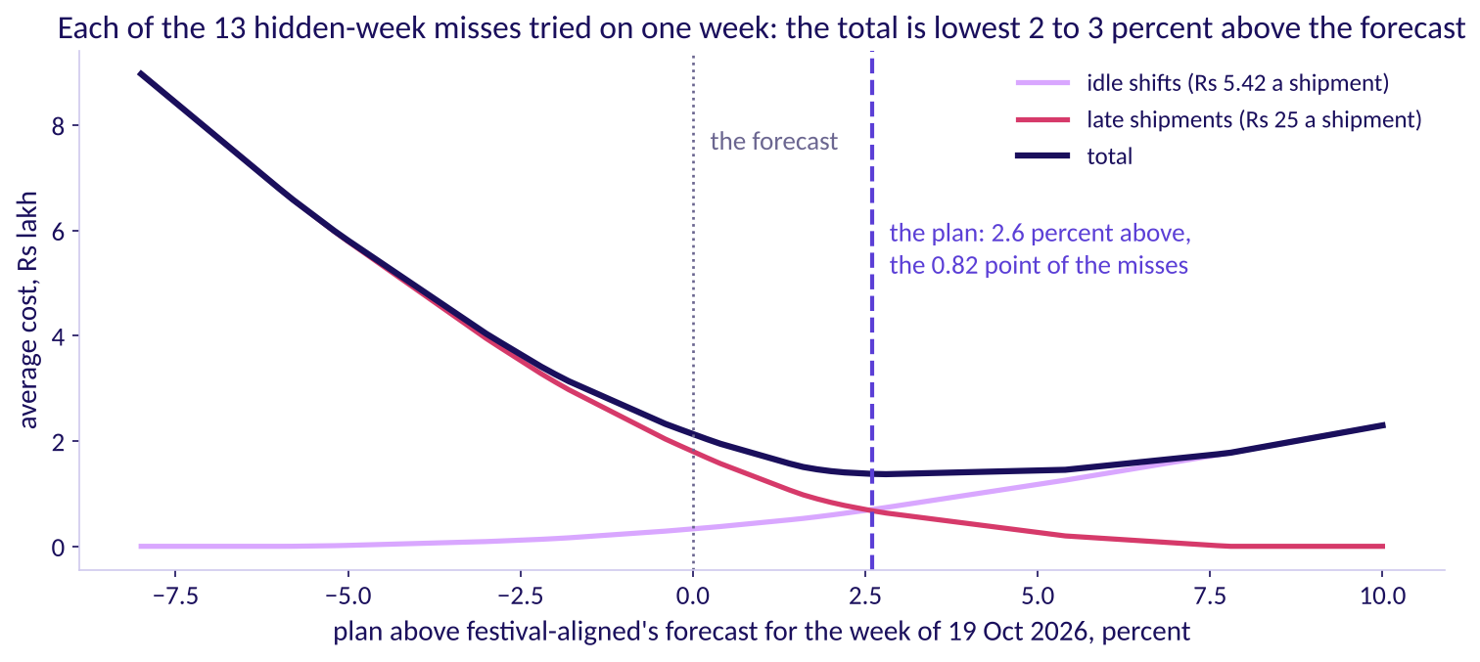
Indian Institute of Technology Gandhinagar
WEEK 4 · FRIDAY · FORECASTING BASICS · FALLBACK
ADMINISTERED THROUGH THE COMPETENCY ADVANCEMENT ACADEMY
Answer: cover 0.82 of weeks, 25 over 25 plus 5.42
Why should the plan sit above the forecast, and how far?
The average cost of a week's plan against how far it is raised
The answer is b. Raise the plan by one shipment. Over 100 weeks, if demand beats the plan in 18, that shipment saves 18 x Rs 25 = Rs 450 and wastes 82 x Rs 5.42 = Rs 444: about even. So the cheapest plan covers demand in 25 / (25 + 5.42), about 0.82, of weeks: the newsvendor rule, named after a seller deciding how many newspapers to stock.
Week 4, Day 5. Forecasting basics: the fallback hour
S11 · 11 / 18
Notes:
LIVE, 6 minutes. Work the 100 weeks on the board first, then read the curve: the average cost of the
week of 19 October with each of the thirteen hidden-week misses tried as its demand. The total is
lowest between 2 and 3 percent above the forecast. If the late cost rises toward Rs 40, the low point
moves right. Explorer: scene F4. Transition: reading the 0.82 off thirteen weeks.

Slide 12
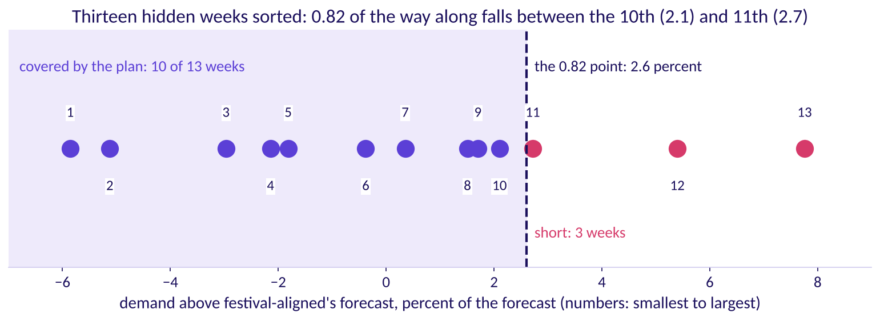
Indian Institute of Technology Gandhinagar
WEEK 4 · FRIDAY · FORECASTING BASICS · FALLBACK
ADMINISTERED THROUGH THE COMPETENCY ADVANCEMENT ACADEMY
The 2.6 percent sits 0.82 along thirteen weeks
How far above the forecast is the 0.82 point, on the weeks we hid?
Thirteen hidden weeks sorted by how far demand came above festival-aligned
Sort the thirteen hidden weeks by how far demand came above festival-aligned: from 5.9 percent below to 7.8 percent above. The 0.82 point falls between the 10th week, 2.1 percent, and the 11th, 2.7; read 0.82 of the way along, it is 2.6 percent. The raised forecast covers 10 of the 13 weeks, and the 11th sits just above it.
Week 4, Day 5. Forecasting basics: the fallback hour
S12 · 12 / 18
Notes:
LIVE, 5 minutes. Point at the 10th and 11th dots. With thirteen weeks the true point could sit
anywhere from about 2 to 3 percent, and the curve on S11 is nearly flat there. The cushion is read
from the same weeks it is scored on, so every forecast is compared at its own 0.82 point; a rolling
origin through 2025's festival would set it on weeks the test never touches. Transition: the plan,
raised.

Slide 13
Indian Institute of Technology Gandhinagar
WEEK 4 · FRIDAY · FORECASTING BASICS · FALLBACK
ADMINISTERED THROUGH THE COMPETENCY ADVANCEMENT ACADEMY
The plan, raised: 20,275 packer shifts
How many packer shifts does each week need once the plan sits 2.6 percent above the forecast?
Week of | Forecast | Plan, plus 2.6 percent | Packer shifts
12 Oct | 344,448 | 353,404 | 2,946
19 Oct | 434,928 | 446,236 | 3,719
26 Oct | 383,760 | 393,738 | 3,282
2 Nov | 321,256 | 329,609 | 2,747
9 Nov | 196,144 | 201,244 | 1,678
16 Nov | 237,016 | 243,178 | 2,027
23 Nov | 225,992 | 231,868 | 1,933
30 Nov | 227,136 | 233,042 | 1,943
Shifts are the plan over 120, rounded up: 20,275 in all, 515 more than the 19,760 the forecast alone needs. For 19 October, demand at the hidden weeks' extremes would need 3,413 to 3,906 shifts against the 3,719 booked.
Week 4, Day 5. Forecasting basics: the fallback hour
S13 · 13 / 18
Notes:
LIVE, 5 minutes. Walk the first row aloud: 344,448 times 1.026 is 353,404, over 120 and rounded up is
2,946 shifts. Each group writes one line: what the 515 extra shifts buy, and what would lower them.
Transition: part 4, two real failures.

Slide 14
Indian Institute of Technology Gandhinagar
WEEK 4 · FRIDAY · FORECASTING BASICS · FALLBACK
ADMINISTERED THROUGH THE COMPETENCY ADVANCEMENT ACADEMY
Zillow: a forecast's error outran its guardrail
What did Zillow's forecasting miss cost, and which guardrail failed?
 | Zillow Offers, 2021 (Zillow's Q3 2021 shareholder letter, checked 12 October 2026)
The forecast | Home prices three to six months ahead, to buy homes and resell them
The guardrail | Public targets of plus or minus 200 basis points, 2 percentage points, of breakeven unit economics: what Zillow made or lost on each home it resold was meant to stay near zero
The miss | Price forecasts missed in both directions by far more than Zillow had modelled, and unit economics swung about 1,200 basis points, 12 percentage points, from Q2 to an expected minus 500 to minus 700 basis points in Q4 2021; more offers were accepted than planned, and renovation capacity ran short
The cost | A write-down of about USD 304 million on homes bought above what they would now sell for; Zillow wound the business down and cut about 25 percent of its workforce
Week 4, Day 5. Forecasting basics: the fallback hour
S14 · 14 / 18
Notes:
LIVE, 7 minutes. The guardrail sat on the margin, which suggests the price forecast's error three to
six months out was wider than the whole band; Zillow did stop, by winding the business down. Groups name
the Lucknow equivalent: a cushion thinner than the forecast's error at the plan's horizon.
Transition: Target Canada.

Slide 15
Indian Institute of Technology Gandhinagar
WEEK 4 · FRIDAY · FORECASTING BASICS · FALLBACK
ADMINISTERED THROUGH THE COMPETENCY ADVANCEMENT ACADEMY
Target Canada: a forecast with no history
What did Target's buyers have to forecast with in Canada?
 | Target Canada, 2013 to 2015 (Target's release of 15 January 2015 and Canadian Business, checked 12 October 2026)
The decision | Target announced on 15 January 2015 that it would close all 133 Canadian stores, about 17,600 employees
The forecasting failure | Its forecasting and replenishment system needed years of sales history the new stores did not have, so buyers used optimistic projections from headquarters, and the item data feeding it was right about 30 percent of the time
What followed | Distribution centres overflowed while shelves sat barely stocked
Week 4, Day 5. Forecasting basics: the fallback hour
S15 · 15 / 18
Notes:
LIVE, 7 minutes. The forecasting account is Canadian Business's, through the archived copy the
research ledger cites. The Lucknow version: a vendor model with no Lucknow festival in its record.
Transition: the two side by side.

Slide 16
Indian Institute of Technology Gandhinagar
WEEK 4 · FRIDAY · FORECASTING BASICS · FALLBACK
ADMINISTERED THROUGH THE COMPETENCY ADVANCEMENT ACADEMY
Two failures, and their Lucknow versions
Which check in today's plan would have caught each failure?
The failure | The Lucknow version | The check that catches it
Zillow: a forecast's error wider than its margin guardrail | The vendor's curve, high on 12 of 13 hidden weeks and climbing | Size the forecast's miss at the plan's horizon, and compare it with the cushion before booking
Target Canada: a forecast with no history | A vendor model never scored on a Lucknow festival | Score it on 2025's festival from data to September 2025 before it books a shift; with no history at all, size from the ground up and keep capacity that can stretch
Week 4, Day 5. Forecasting basics: the fallback hour
S16 · 16 / 18
Notes:
LIVE, 6 minutes. Each group writes the check in one line. Transition: part 5, the second
transcript.

Slide 17
Indian Institute of Technology Gandhinagar
WEEK 4 · FRIDAY · FORECASTING BASICS · FALLBACK
ADMINISTERED THROUGH THE COMPETENCY ADVANCEMENT ACADEMY
[D] Finance and the sponsor each want theirs
How does a candidate choose between two stakeholders' forecasts and present the error? [D] tags a differentiator, a question that separates strong candidates.
A weak answer | A hire-grade answer
"I would go with the vendor, trimmed toward finance: plus 13 percent." | "I would score both on weeks neither saw, against a copy of last year, in shipments and in rupees."
Picks the more senior stakeholder's number | Concedes what is true in each: finance's growth, the vendor's tilt to the cheap side
Gives one number with no range | Gives the plan, its error bar in each direction, and what would change it
Week 4, Day 5. Forecasting basics: the fallback hour
S17 · 17 / 18
Notes:
LIVE, 23 minutes. Pairs play the planner and one stakeholder, then swap. The full [D] transcript is
in `extras/C2_W04_D05_interview_transcripts_STUDENT.md`. Transition: the close.

Slide 18



Indian Institute of Technology Gandhinagar
WEEK 4 · FRIDAY · FORECASTING BASICS · FALLBACK
ADMINISTERED THROUGH THE COMPETENCY ADVANCEMENT ACADEMY
Close: the rule that holds without the session
What survives this hour, whether or not the faculty session (tentative) runs?
THE TEST
THE FESTIVAL
THE PLAN
As long as the plan
Copy by distance from Diwali
Beat the bot, then price it
Hide at least as many weeks as the plan reaches ahead, from one origin.
One week ahead, naive missed by 71,180 through the festival.
Nothing books a shift until it beats a copy of last year on hidden weeks.
Week 4, Day 5. Forecasting basics: the fallback hour
S18 · 18 / 18
Notes:
LIVE, 2 minutes. The faculty session (tentative) picks up autocorrelation and smoothing from here
whenever it runs. Transition: close for the day.

